Slide 1
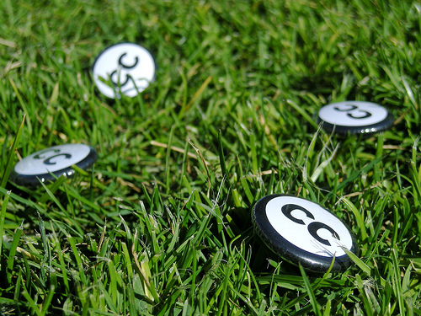

Creative Commons in the Classroom
Jessica Coates
Creative Commons - Global Network Manager
January 2013
Carpeted commons by Glutnix, http://www.flickr.com/photos/glutnix/2079709803/in/pool-ccswagcontest07 available under a Creative Commons Attribution 2.0 licence, http://creativecommons.org/licenses/by/2.0/deed.en

