Slide 1

Overview: OLI
Norman Bier @NormanBier
John Rinderle @JohnRinderle

Slide 2
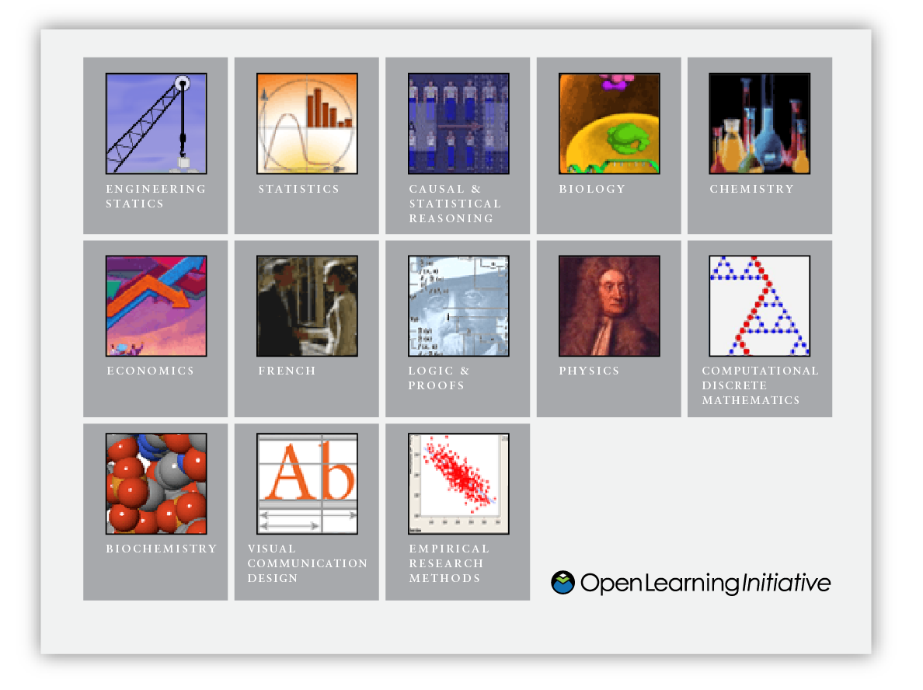
What is CMU’s Open Learning Initiative?
Scientifically-based online learning environments designed to improve both quality and productivity in higher education

Slide 3
Open Learning Initiative
Produce courses and course materials which enact instruction and support instructors
Provide open access to these courses and materials
Develop communities of use, research and development that enable evaluation and continuous improvement

Slide 4
Why a learner-centered approach?
Learning results from what the student does and thinks and only from what the student does and thinks. The teacher can advance learning only by influencing what the student does to learn.
Herbert Simon, 2001
It’s not teaching that causes learning. Attempts by the learner to perform cause learning, dependent upon the quality of feedback and opportunities to use it.
Grant Wiggins
President, Center of Learning Assessment

Slide 5
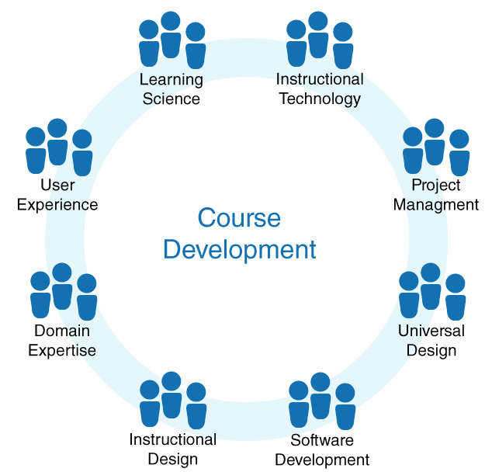
Team-based design and development

Slide 6
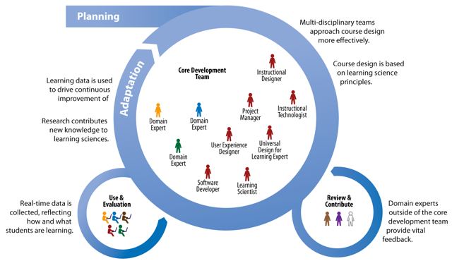
Community-based Research

Slide 7
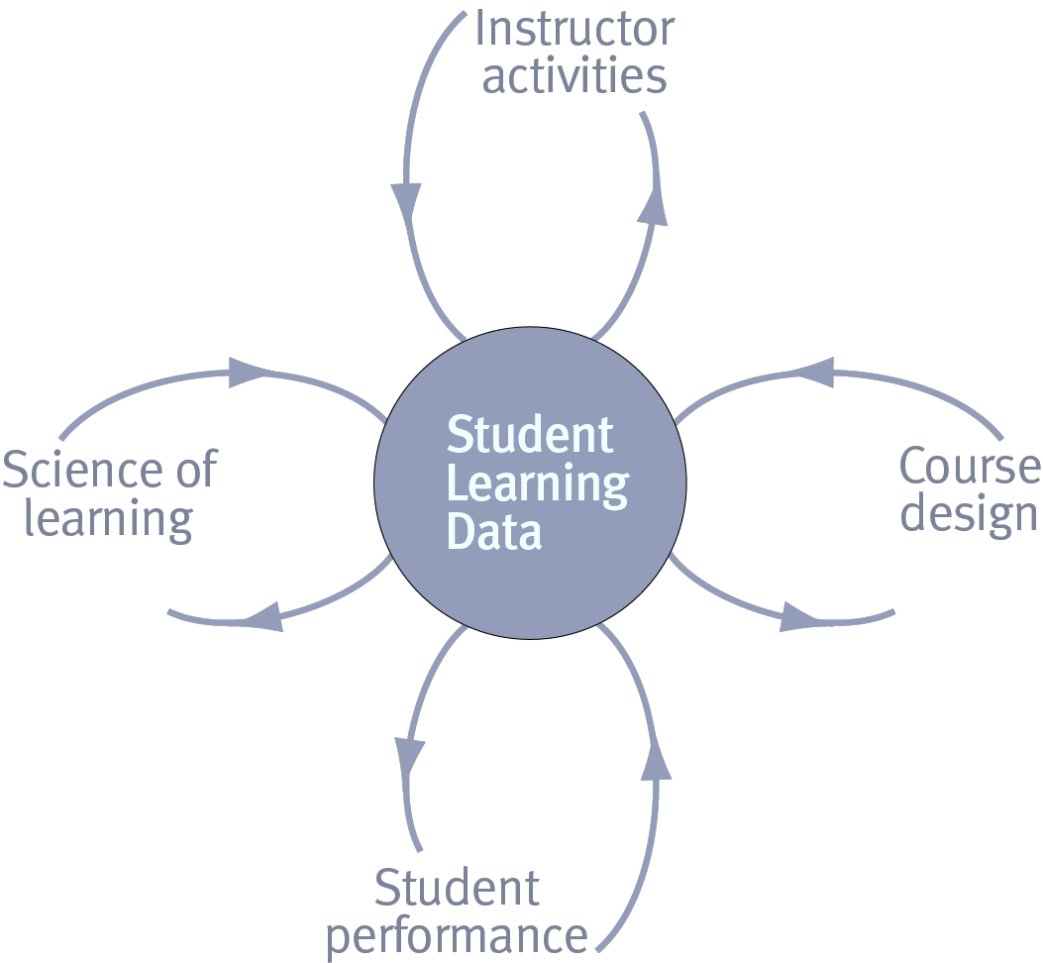
Powerful Feedback Loops
Notes:
The most powerful feature of web based instruction is the ability to collect data on student interactions
and use that data to provide timely, contextual feedback to the student and instructor.
This data can also be used to drive iterative improvement of course materials
and improve our understanding of human learning.

Slide 8
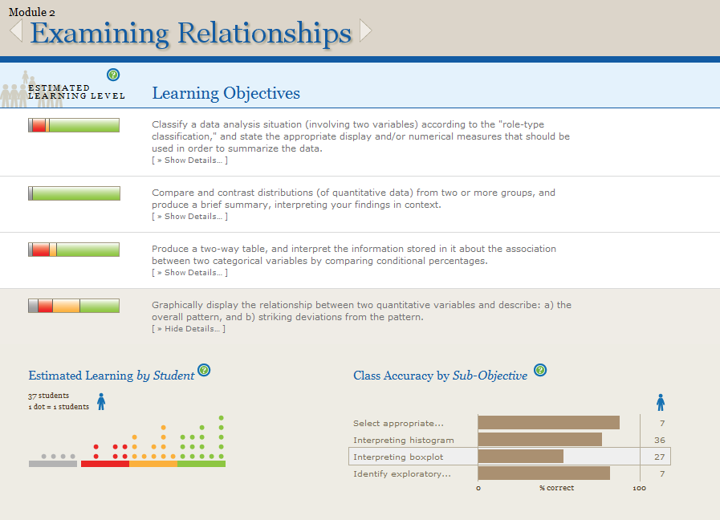
Learning Dashboard
Notes:
The instructor Learning Dashboard provides instructors with a real-time, outcomes centered view of student progress.
In a blended mode course, students complete an OLI module as homework. As they are working the system collects data about their learning. Instructors access the Learning Dashboard before class. With a few clicks, the Learning Dashboard allows instructors to see where students are succeeding and where they need support. For each learning outcome in the module, the Learning Dashboard offers an estimate level of learning for each student. Grey = students are not practicing, Red = students either need more practice or having difficulty, Orange = students are on their way, and Green = we predict students are able to demonstrate the learning outcome successfully.

Slide 9
Ensuring Success Online
Develop, use, and evaluate learning environments collaboratively. (teams of content experts and novices, learning scientists, HCI specialists, software engineers)
Feedback loops for adaptive learning and continuous improvement
Apply learning science research and scientific method to course development, implementation and evaluation
What Difference Does it Make?
Notes:
Our recommendations for ensuring success online…

Slide 10
Accelerated Learning
With the OLI Statistics course, the Accelerated students:
Completed the course in half as many weeks with half as many class meetings per week
Spent the same amount of time in a given week on coursework outside of class as traditional students
Gained much more on the CAOS test than did the traditional controls
Retained their knowledge and maintained an advantage over traditional students in retention tests given 1+ semesters later.
M. Lovett, O. Meyer, & C. Thille, C., “The Open Learning Initiative: Measuring the effectiveness of the OLI statistics course in accelerating student learning,” Journal of Interactive Media in Education (2008).
Notes:
We’ve seen some impressive results…

Slide 11
Other Class Results
Large Public University: OLI Online vs. traditional. OLI 99% completion rate vs 41% completion rate traditional.
Community College accelerated learning study in Logic: An instructor with minimal experience in logic. Students obtained high levels of performance on more advanced content (~33%) not covered in traditional instruction.
OLI stoichiometry course: The number of interactions with the virtual lab outweighed ALL other factors including gender and SAT score as the predictor of positive learning outcome.

Slide 12
Strengthen Online and Technology-Enabled Learning
“TAACCCT will support institutions that are committed to using data to continuously assess the effectiveness of their strategies in order to improve their program… and build evidence about effective practice..”
Notes:
12
We are being asked to address the seemingly impossible challenge of making higher education less expensive and more accessible while also increasing its effectiveness. The difficulty is heightened by the fact that faculty and institutions must support not only an increase in the number of students but also greater variability in the student population's background knowledge, relevant skills and future goals.
OER can be a key component of success, but only if it leverages the results and methodologies of learning science to create transformational innovations that fundamentally change the way higher education is developed, delivered and improved year-after-year.

Slide 13
OLI Supported Development
Best Practices (all projects): Apply learning science research and scientific method to OER development, implementation and evaluation.
Platform+ (25 projects): Use rich data gathered from student interactions to drive multiple feedback loops for continuous improvement.
Co-development (3 teams): Develop OER collaboratively: Teams of TAACCCT grantees with OLI learning scientists, human computer interaction experts & software engineers.
Notes:
OLI will offer three tiers of support to grantees:
Information and support on effective course design and evaluation.
Course delivery and data capture for 25 grantees via out Platform+ program.
Three teams of grantees will be selected to participate with OLI in full Co-development efforts.

Slide 14
Best Practices
Resources for effective course design and evaluation
Pointers to current findings in learning science and how to apply them to your work
Share in OLI’s best practices and lessons learned
Opportunities to engage with OLI, CAST, the OPEN team and other grantees

Slide 15
Platform+
Available to 25 projects:
Project space and hosting
Training and support
Authoring tools
Advanced Mini-Tutors, Assessments
Data capture and reporting
CC licensing and metadata
Accessibility compliance
UDL enhanced

Slide 16
Co-Development
OLI led development process: learning design, development, evaluation, and iterative improvement
Bring together projects working in same content areas committed to:
Align on desired learning outcomes
Collaborate and engage in shared process
Take a scientific, research driven approach
Incorporate outside expertise in project management, technology, learning science

Slide 17
Co-Development
Build learning environments which
Target the mutual needs of participant projects
Embed frequent opportunities for goal directed practice and targeted feedback
Capture data and deliver timely feedback to the learner, instructor, and course development team
Demonstrate effectiveness through research and evaluation
Increase adoption through goal alignment
Satisfy your TAACCCT obligations for effectiveness evaluation

Slide 18
“Improvement in Post Secondary Education will require converting teaching from a ‘solo sport’ to a community based research activity.”
—Herbert Simon

