Slide 1
Jenkins
Auto Deployment

Slide 2
Prerequisites Software's
Jenkins windows exe
Java 1.7 or 1.8
Git1.9.5 version or later versions
.NET Framework 3.5 for ASP.NET applications
MS BUILD for ASP.NET applications

Slide 3
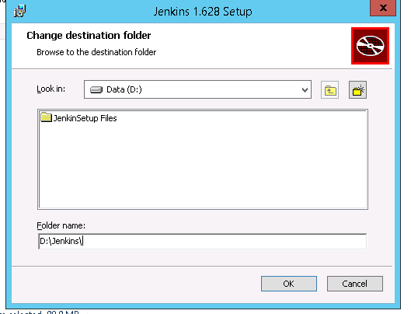
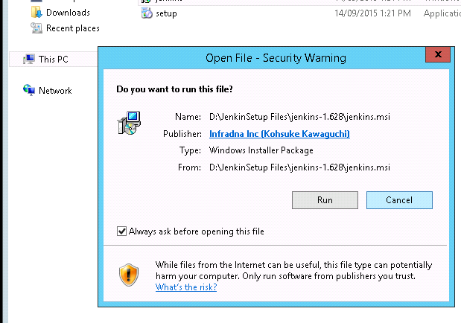
Jenkins Installation process
Double click and next
Finish the setup
Double click on setup

Slide 4
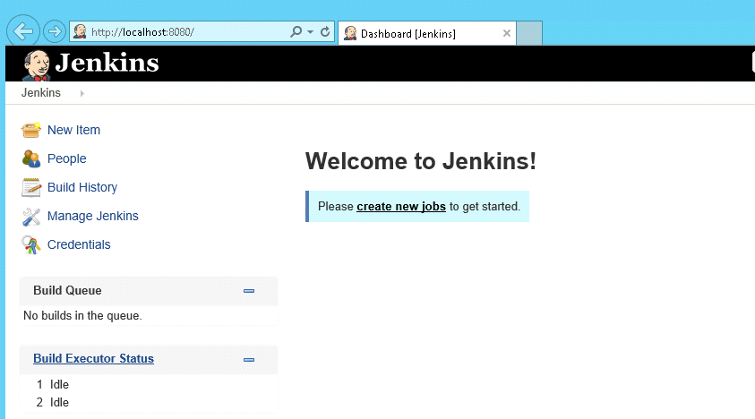
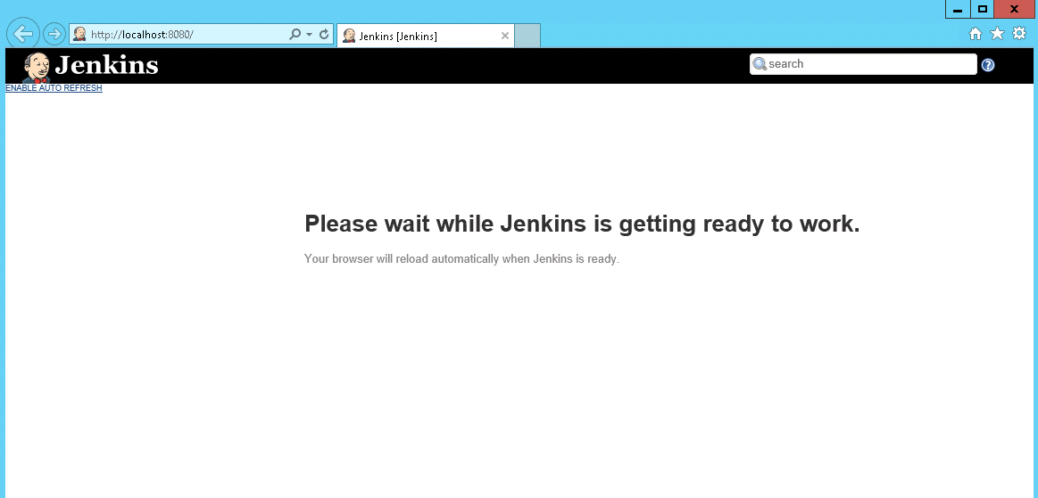
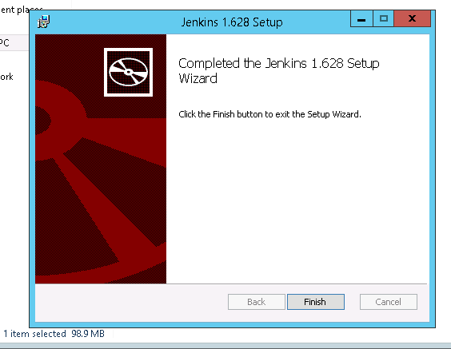
Jenkins Installed successfully

Slide 5
Install Java and Git Software's
Java is used in Jenkins To build maven projects and to configure child slaves.
Git software is used for to pull the application code.

Slide 6
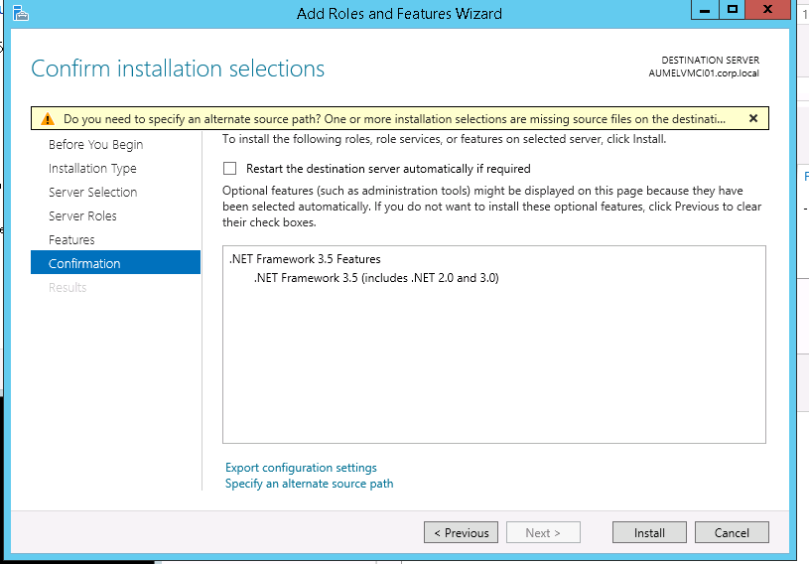
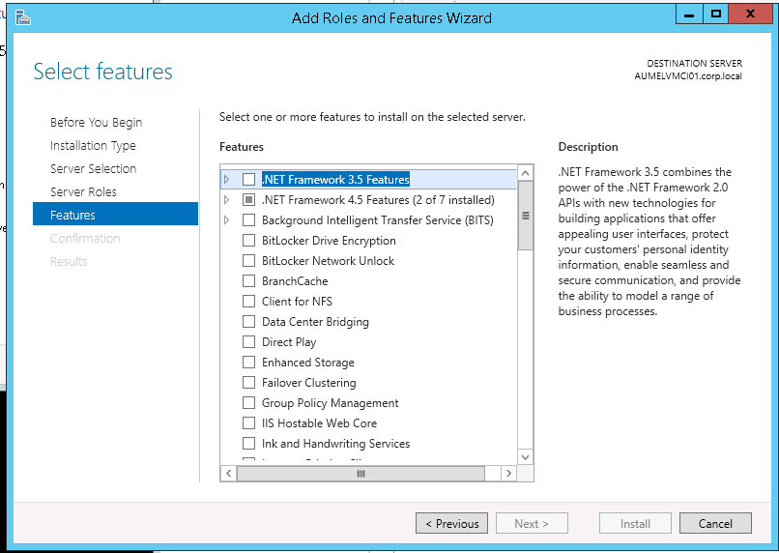
Installing .NET FRAMEWORK 3.5.0 Or Above
Go to server manager, and select role and feature, add.
Select framework and click install

Slide 7
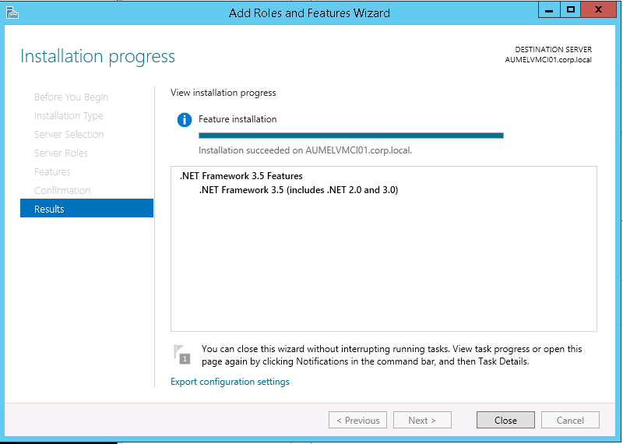
.NET Framework installation completed

Slide 8
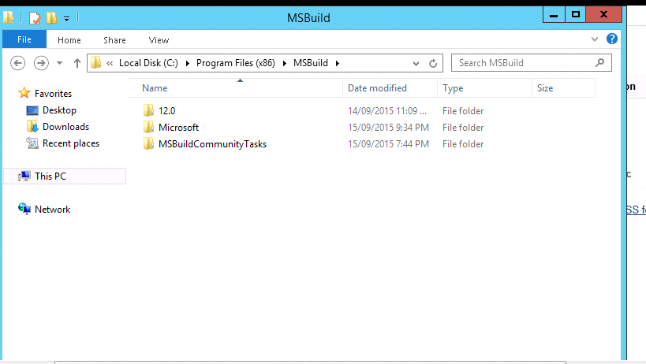
MSBUILD INSTALLATION
Once installation of Msbuildcommunity tasks completed. Copy the visual studio folder from development(or local) machine located in C:\Program Files (x86)\MS Build\Microsoft\VisualStudio into Jenkins server and slaves same location .Since we can’t install visual studio IDE for Jenkins alone

Slide 9
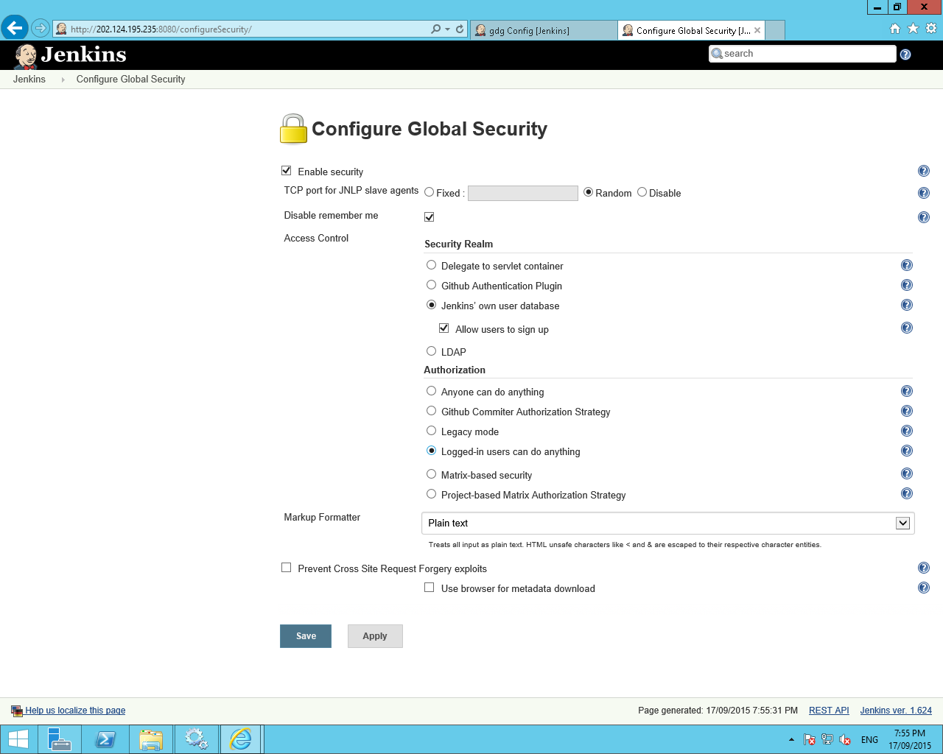
Jenkins Authorization setup
we can change security settings here
manage Jenkins->config global security
We need to check Enable security and Jenkin’s own user database.
We should check allow user’s to sign up for 1st time and then we have to uncheck this else any one can do signup and anyone can login.
We need to enable Slave → Master Access Control option for handling slaves

Slide 10
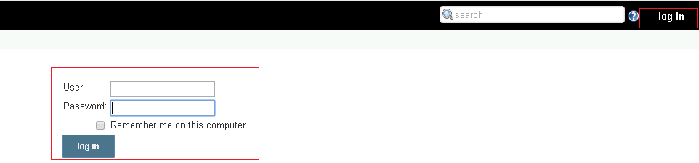
Login Credentials for Jenkins
Username: htcjai
Password: htc@123
We created this credentials using Jenkins Authorization setup

Slide 11
Plugins in Jenkins
Plugins are used in Jenkins for additional features like MS build plugin to build .NET project and Git plugin to check-in and checkout application code
Performencetest plugin to create jmeter reports and html report plugin to generate html plugin etc.

Slide 12
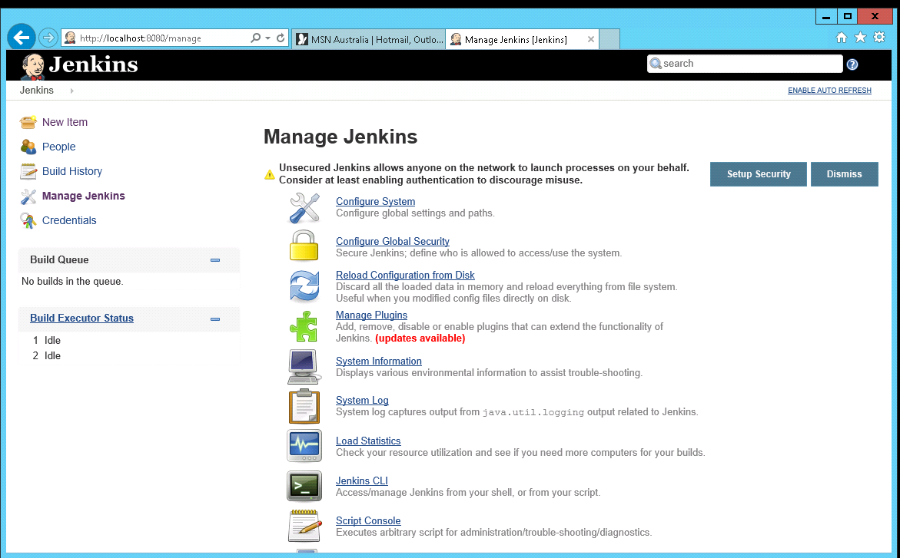
Installation of Plugins
Click on manage Jenkins
Click on manage plugins

Slide 13
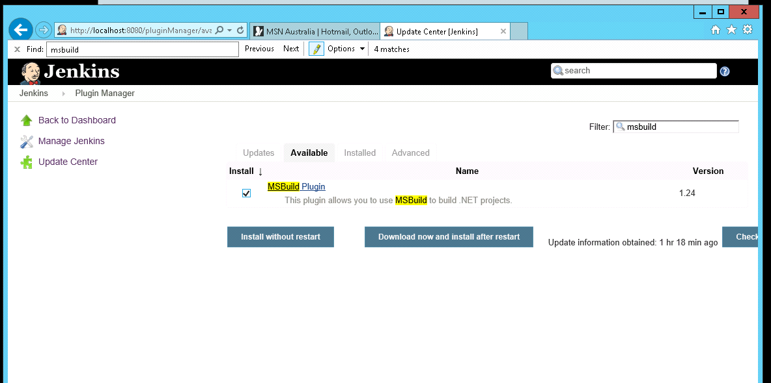
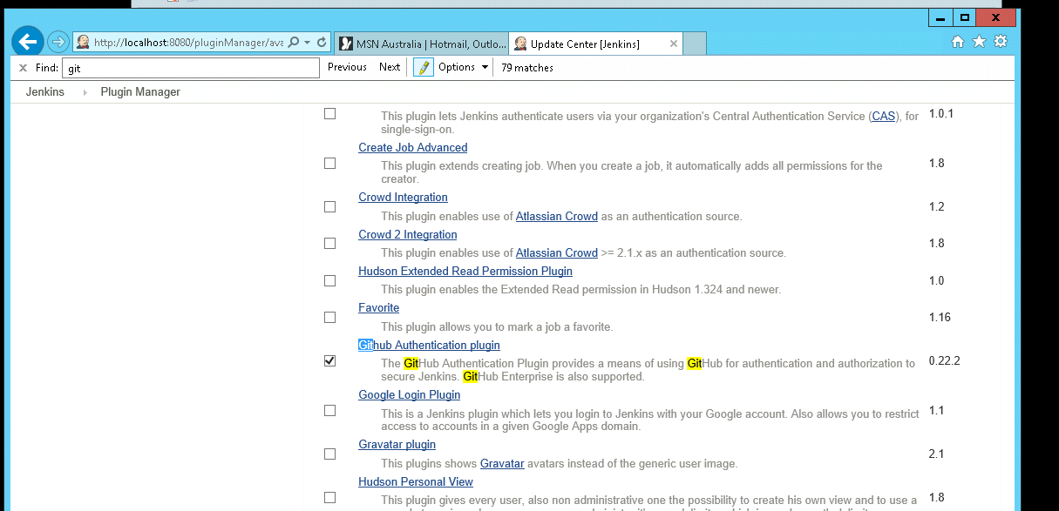
Plugin installation Process
Select Ms-build plugin for example.
Select install without restart button

Slide 14
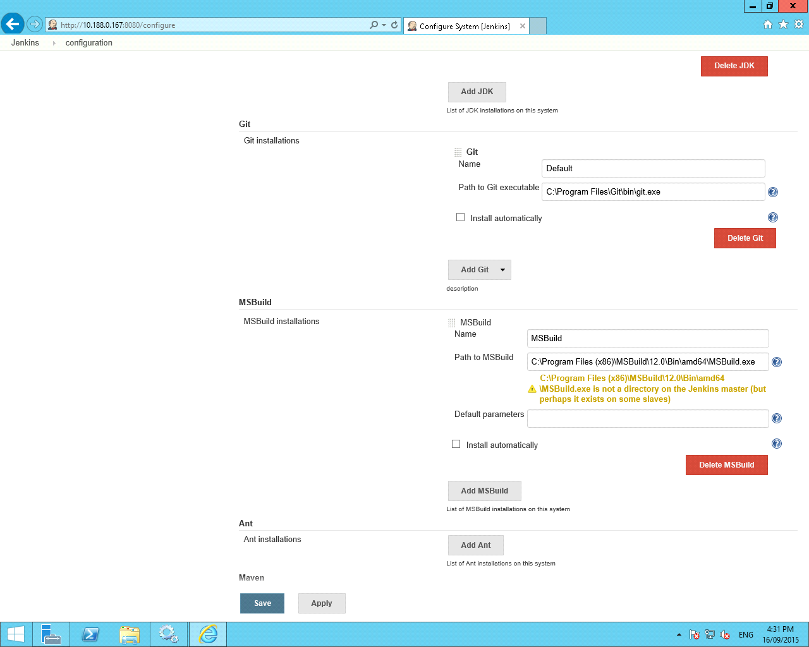
Plugin installation Process
We have to provide installation paths for some of plugins which need’s to be install software's && plugin by clicking Jenkins Home → Manage Jenkins → Configure System.
Ex: Git,MSBuild,Java.

Slide 15
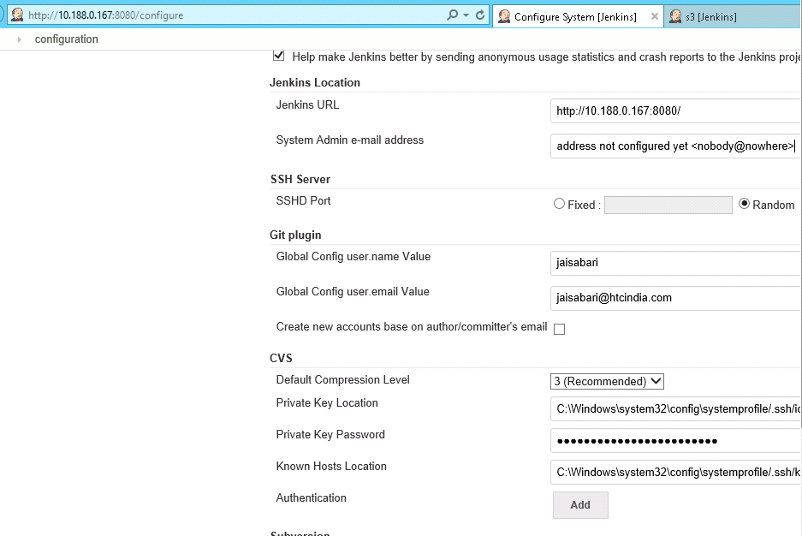
Enter Jenkins URL and Fill some basic details
In Jenkins URL Replace localhost with ip address. So that we can access in our network. Fill some basic details like git username email. And then click save. Now try to access in browser with this url.

Slide 16
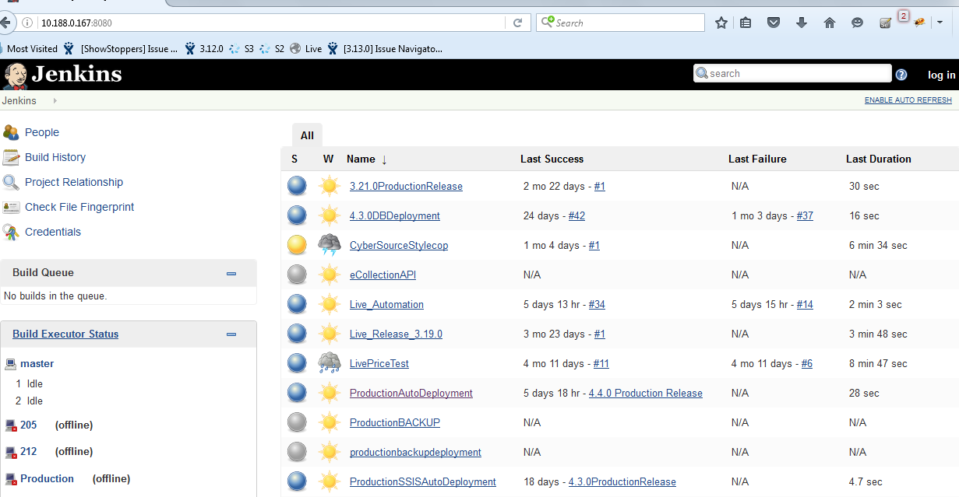
Jenkins Sample Home Page url: http://10.188.0.167:8080

Slide 17
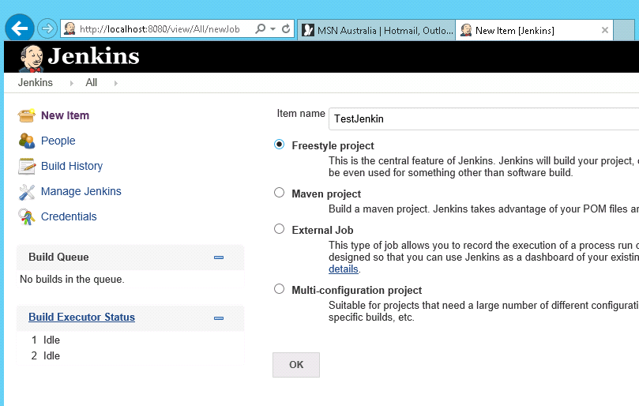
Configuring Sample Job for Deployment in Master.
Select new item in Jenkins Home page
Provide item name as ‘TestJenkin’
Select Freestyle project

Slide 18
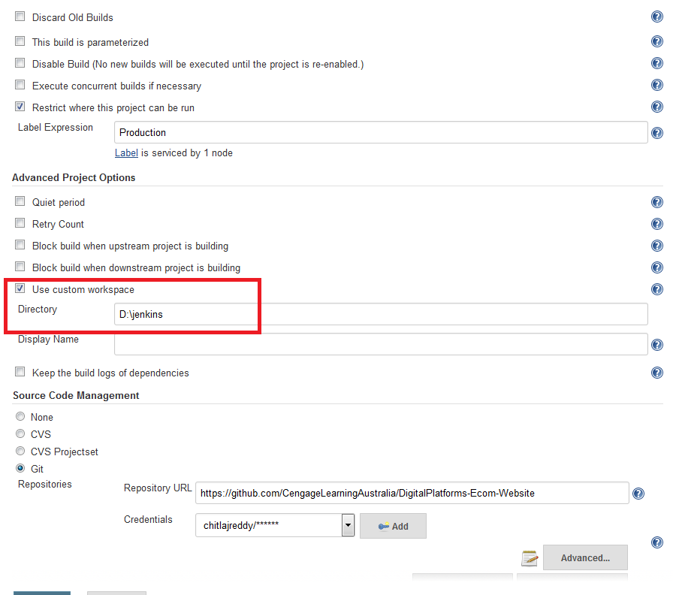
Selecting Custom work space for job
We can select custom workspace. in this location only GitHub code or any other source code(SVN,CVS) will be saved.
In this folder path the job will perform actions .

Slide 19
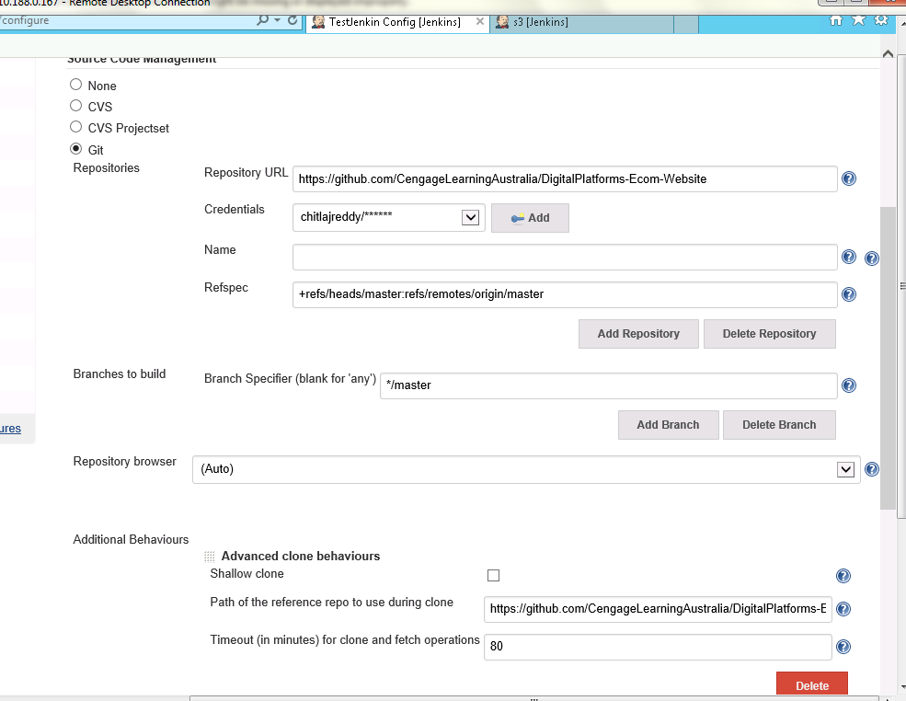
Setting Git Plugin in job to manage GitHub code
now click on Test Jenkin>configure
In source code management section select Git . And fill-up the details like Repository URL &branch Name
Credentials option we can add git credentials or we can just select the credentials if already available.
Refspec and branches to be build option is for checkout specific branch. In screenshot we can see master branch as example.
In additional behaviour add Advance clone behaviour option to set timeout. We need this option if source code is taking too long to pull the code into machine
Same as we can select other options also like CVS,SVN etc.
We can select NONE option if we are not using source code repositories like Git,SVN,CVS.

Slide 20
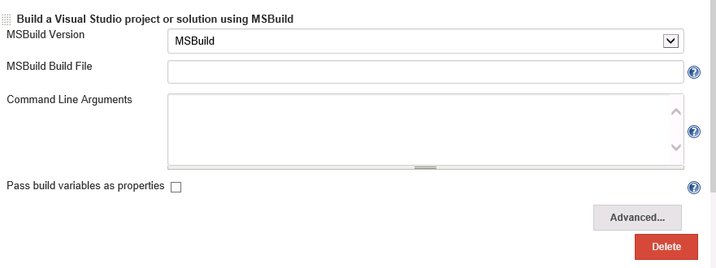
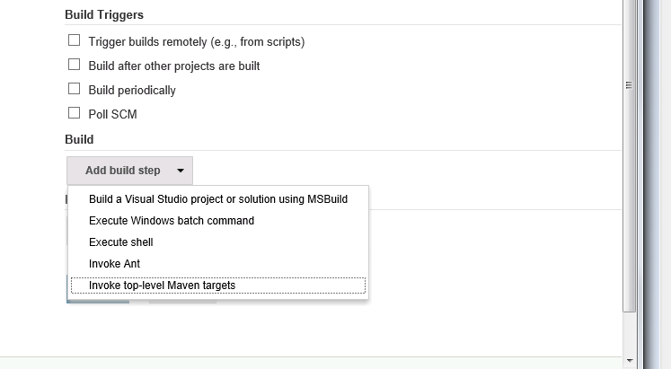
Setting MS build Plugin in job to build source code
In build click add build step we can select any one option in that either 1.Build a visual studio project or solution using MS build. Or 2.Execute windows batch command
Specify the paths of .sln files here . This is 1st option of building process by using MS build plugin
But we are not using this because if any new .sln files added to GitHub code at that time we have to specify the path manually every time here. that's why we are going for windows batch command for building and deployment.

Slide 21
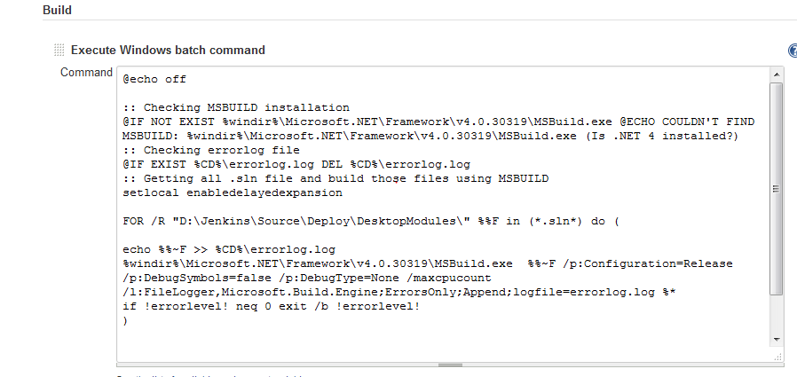
Setting Execute windows batch command in job to compile source code
By using batch command we can compile the code and deploy to application root folder.
For ex Here in the batch command we are compiling the GitHub pulled code located in D:\Jenkins\Source\Deploy\Desktopmodules folder.
In this Step we are compiling all .sln files located in Desktop modules folders

Slide 22
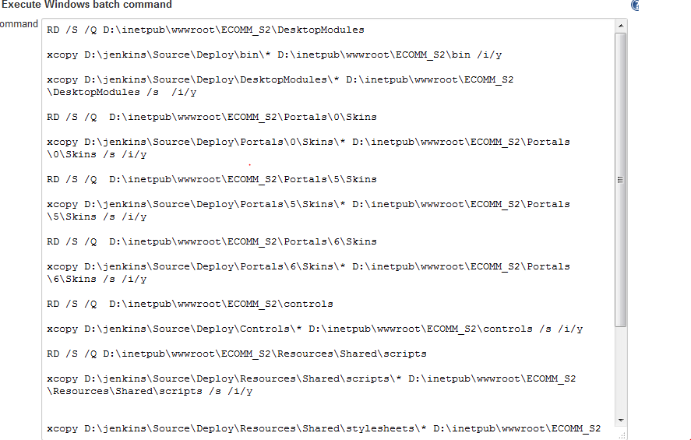
Setting Execute windows batch command in job to Deploy source code
By using batch command we can deploy the source code to application root folder.
For ex Here in the batch command the compiled code which locates in Jenkins folder we are deploying to application root folder.
Click save and Build Now.

Slide 23
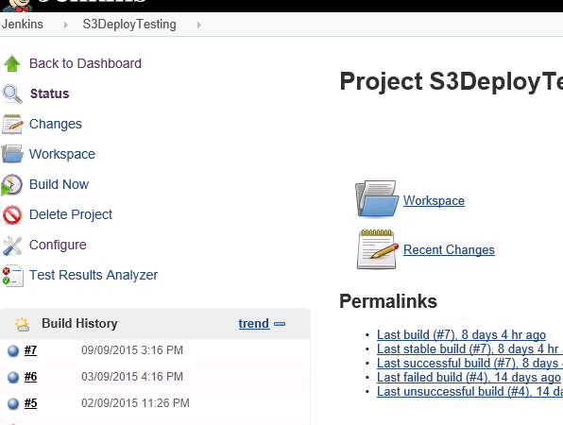
Build And Deployment completed successfully in Master
you can see the results in console output by clicking on latest build number and console output link.
if build numbers turn to blue colour it’s success symbol if it is red colour build get fails.
We are done with sample deployment process in master

Slide 24
Child Slaves for Master
Since For an any application there will be minimum 3 environments like Development, staging, production. we need to make these as slaves for master.
So that only with one installation of Jenkins service we can do Auto deployment in all three servers.
In slaves also all above software's should be installed except Jenkins installation.

Slide 25
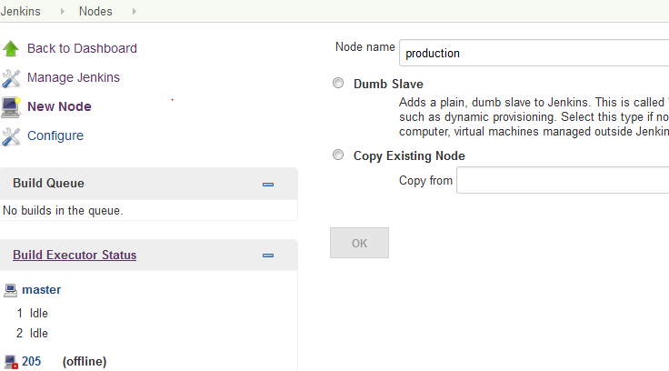
Setting child Slaves for Master
To set up slaves
click Manage Jenkins->Manage nodes->New node.
Enter Node name like (Production,development,staging etc)
Select Dumb slave .Click ok.
Now we are making production environment as a slave for master.

Slide 26
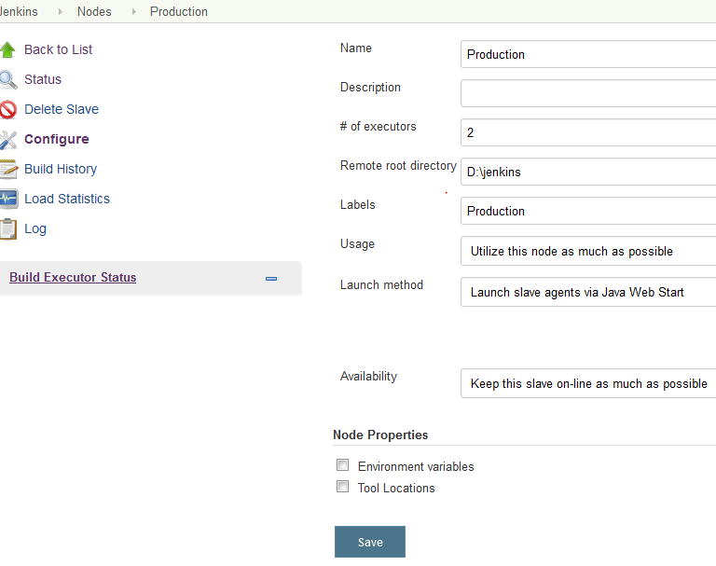
Setting child Slaves for Master
Fill the details
#of executors : 2 (No of users can build at a time)
Remote root directory: for ex D:\Jenkins(folder path to save code or execute jobs)
Labels :Production(This label will be used in job to specify that job should run in specific environment)
Launch method : Launch slave agents via java web start
Availability: keep this slave on line as much as possible
Here root directory and labels and launch methods are mandatory
Click save

Slide 27
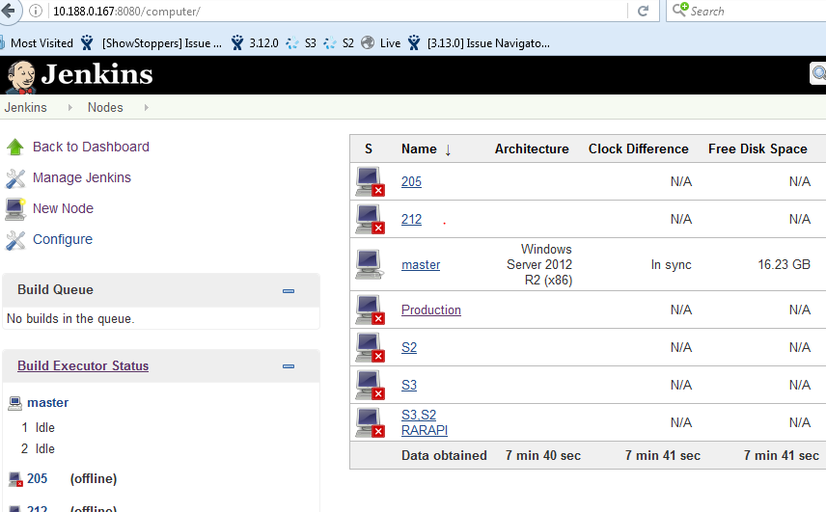
Setting child Slaves for Master
Click on Production
Initially it will be in offline mode.
We can see X mark on production.

Slide 28
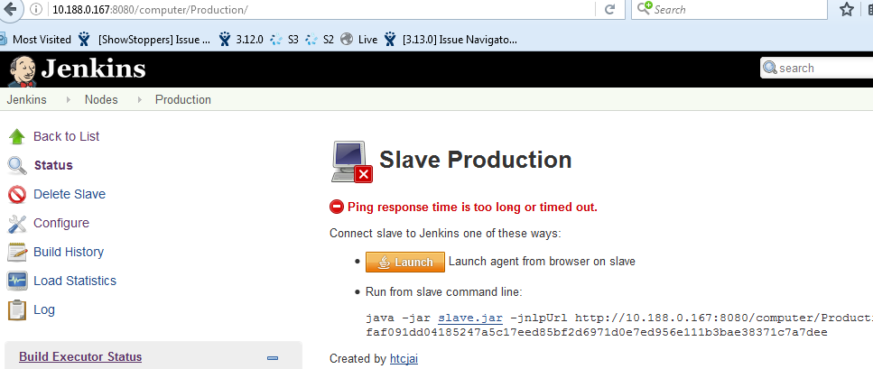
Setting child Slaves for Master
Now we wiil make this slave as online by entering same url in production server browser(chrome or any) and by clicking Launch button.

Slide 29
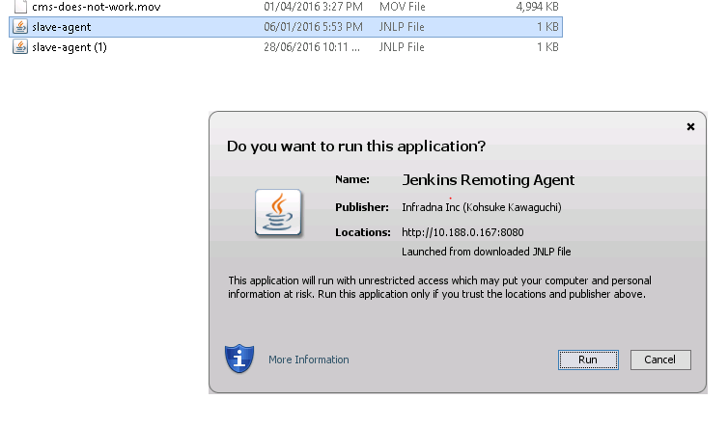
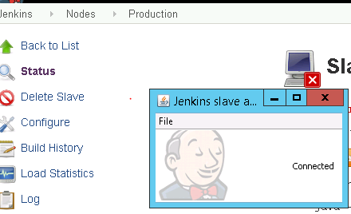
Setting child Slaves for Master
It will download one slave agent exe double click on it . Click run on that pop up.
Finally Now We successfully connected to master from production slave.
NOTE: During deployment process we have to make sure always Jenkins slave agent is connected. If slaves shows offline in master we have to launch from slave machine by using same url as we discussed above. Or in downloads slave agent exe will be there just double click it.

Slide 30
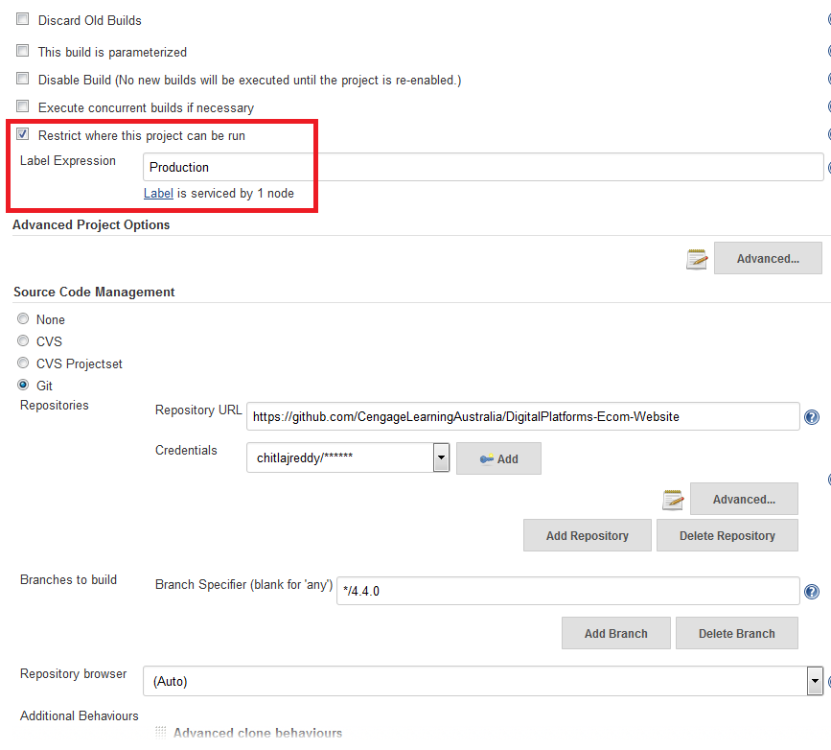
Creating a sample job in Production slave
The steps for creating a new job in slave is same as master .And additionally we have to select one option which is must and should be selected.
check restrict where this project can be run and mention the label name which we gave while creating node(production).
If we give any different label name it will start executing job in other server.
Done same process for any slaves to connect the master. Now we are done up to building and deployment and connecting to master and slaves.

Slide 31
Build and Deployment completed successfully
Both in master and slaves

Slide 32
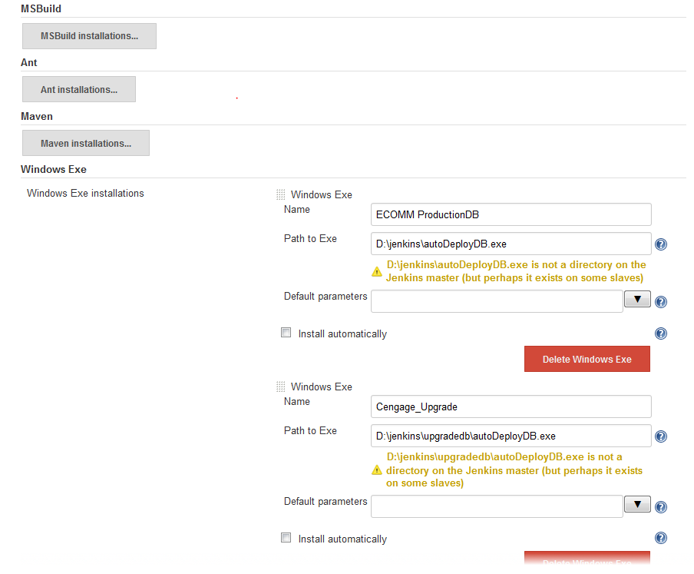
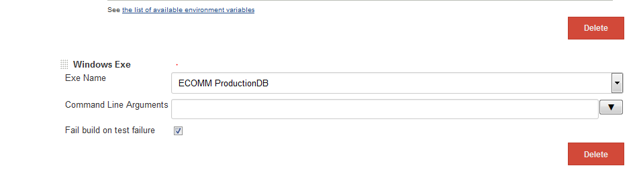
AutoDBDeployment
We can implement windows exe through .NET code to execute procedures and we can trigger this using windows plugin in Jenkins.
We need to provide the exe paths as mentioned earlier.
We need to include this exe in job.

Slide 33
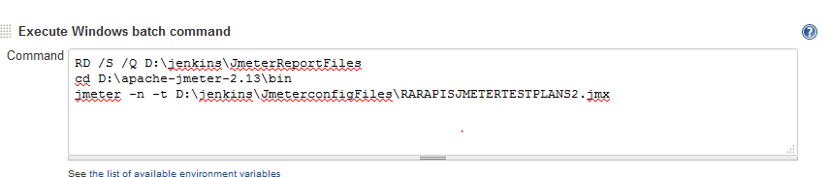
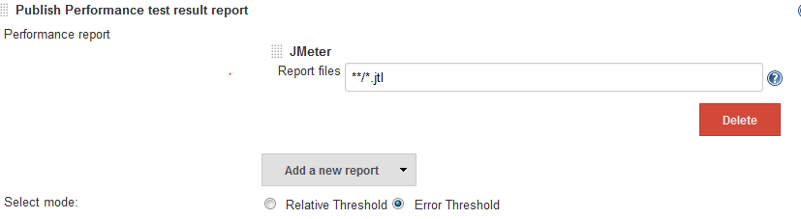
Configuring JMeter with Jenkins
We need to prepare jmeter script and we need to trigger that jmeter script using windows batch command in Jenkins.
We need to install performance report plugin and include in job .

Slide 34
Jenkins process for Every S2 and Production Release
applicable to Cengage Team only

Slide 35
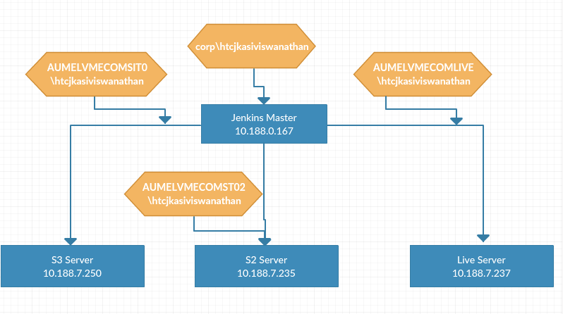
Cengage Jenkins Config setup

Slide 36
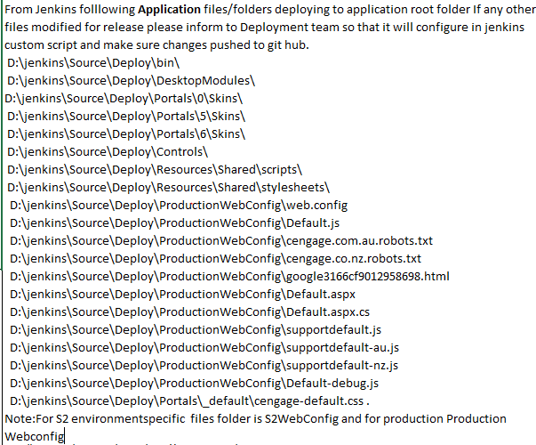
Use htcjkasiviswanathan account for deployment in any server
Check with all Developers to make sure Updated code pushed to GitHub.
Files to be compare exclusively by GitHub code and application code.
web.config
default.js
default.aspx
default.aspx.cs
supportdefault.js
supportdefaultau.js
supportdefaultnz.js
You can refer screenshot for application related files which are deploying through jenkins

Slide 37
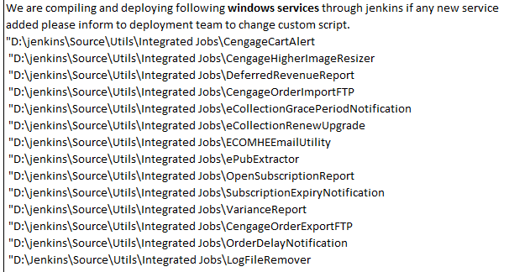
Windows service
We need to check any windows service code modified or added and make sure it is pushed to GitHub .
You can refer screenshot for windows service related files which are compiling and deploying through Jenkins.

Slide 38
DBDeployment
We need to Make sure all modified/created procedures pushed to GitHub to following folder and save it in following format
Fold path for ex :D\4.5.0Release\Source\Procedures.
Format : Procedurename.sql.

Slide 39
S2
Production
Login through RDP in S2 server(10.188.7.235).
Enter Jenkins homepage URL 10.188.0.167:8080
Click on the job S2AutoDeployment
Check whether slave is online or offline.
If it is in offline make it online by following the steps as mentioned in document.
Login through RDP in production server(10.188.7.237)
Enter Jenkins URL 10.188.0.167:8080
Click on the job ProductionAutoDeployment
Check whether slave is online or offline.
Same as S2.

Slide 40
S2
Production
Click configure and Make sure that the labels are referring in S2AutoDeployment job : S2
If the label pointed to production in S2 job it will start executing in Production server. We need to check this for every s2 deployment
Check whether correct GitHub branch mapped to job.
Click configure Make sure that the labels are referring in productionAutoDeployment job : Productio
If the label pointed to S2 in Production job it will start executing in S2 server. We need to check this for every Production deployment
Check whether correct GitHub branch mapped to job.

Slide 41
Application windows batch command.
Check each and every command mentioned in Jenkins custom script for application as well as windows service so that no files will move from wrong location to target folder .
If any file or folder missed we need to include in the Jenkins script command.
In this screen shot we mentioned only application related files.
We are maintaining 2 windows batch command in job to deploy application code as well as windows service code.

Slide 42
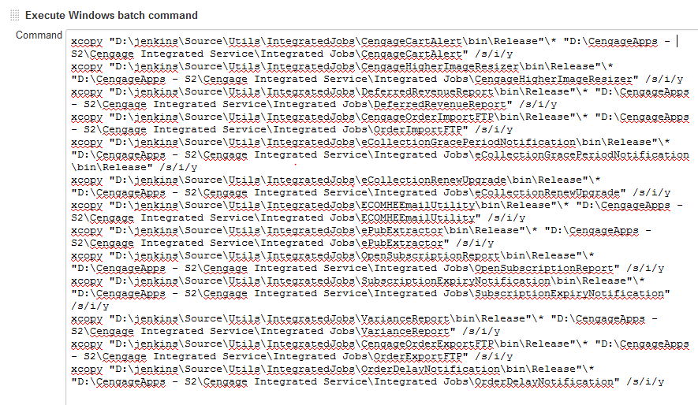
windows service batch command.
For windows service deployment we have to refer this screenshot to add/modify script command.
We need to check whether source and target folders mapped correctly

Slide 43
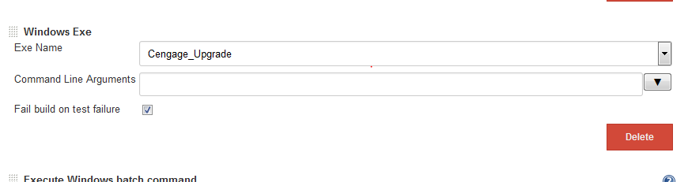
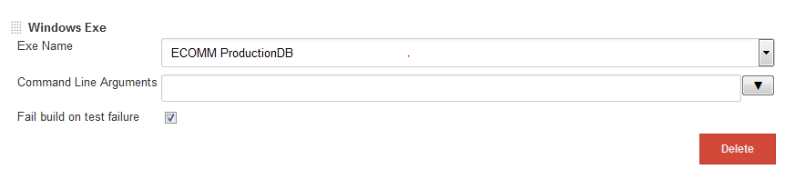
AutoDbDeployment windows exe
For S2 Deployment check Cengage_upgrade exe mapped or not.
For production Deployment check ECOMMProductionDb exe mapped or not.

Slide 44
SSIS Auto Deployment
S2
Production
Check latest packages pushed to GitHub or not.
Location in GitHub for S2Packages is:
D:\jenkins\Source\SSIS\LatestSSISPackages\S2
Check latest packages pushed to GitHub or not.
Location in GitHub for Production Packages is:
D:\jenkins\Source\SSIS\LatestSSISPackages\Production

Slide 45
SSIS Auto Deployment
S2
Production
Login through RDP in S2DBserver(10.188.0.212).
Enter Jenkins homepage URL 10.188.0.167:8080
Click on the job S2AutoSSISDeployment Check whether slave is online or offline.
If it is in offline make it online by following the steps as mentioned in document.
Check label is pointing to 212 or not.
In this job we are having one windows batch command to deploy packages to C:\Program Files (x86)\Microsoft SQL Server\100\DTS\Packages folder
Login through RDP in S2DBserver(10.188.0.205).
Enter Jenkins homepage URL 10.188.0.167:8080
Click on the job ProductionAutoSSISDeployment Check whether slave is online or offline.
If it is in offline make it online by following the steps as mentioned in document.
Check label is pointing to 205 or not
In this job we are having one windows batch command to deploy packages to C:\Program Files (x86)\Microsoft SQL Server\100\DTS\Packages folder
.

Slide 46

Cautions
Make sure all code and procedures pushed to GitHub.
Check Correct labels and GitHub branch mapped to jobs.
Check correct windows exe mapped to jobs for Db deployment.
Login into ALL servers (10.188.7.237,10.188.7.235,10.188.7.250,10.188.7.239,10.188.0.167) to make sure Deployment target folder or files doesn't open in any server. So that deployment goes smoothly.
Stop Windows services : CengageIntegratedServices and start once deployment completed.
Redirect cengage.com.au and cengage.co.nz url to http://maint.cengagelearning.com.au/down.php for production deployment
Check each and every command mentioned in Jenkins custom script for application as well as windows service so that no files will move from wrong location to target folder .
Once all these steps done click build now button and watch console output.
Do cntrl+F->Access Is Denied and cntrl+F->Being used By and cntrl+F ->file creation error in console output of a job. If we found any words mentioned above it means that deployment fails.
Revert back the redirect url to cengage.com.au and cengage.co.nz.
Check DB deployment Report to make sure all procedures executed successfully in DBReportpath:D:\BACKUP\Spreport\LatestDate.txt
Once job completed successfully check RARAPI automated results in console output for S2Release.
Check jmeter report for RAR api's by S2AutoDeployment->PerformenceTrend->Lastreport.

Slide 47
Any Queries???
Thank you
Mohammad

