Slide 1

Intro Imbalance market
31-5-2017

Slide 2
Content
Power market
Example
Imbalance market
Assignment & Data
Validator (Huib)

Slide 3
Power market
Three main markets:
Forward market
Granularity: Years, quarters, months
Base/peak
Day ahead market (APX)
Granularity: hourly
Daily auction with gate closure at 12:00 the day before delivery
Imbalance market (real time)
Granularity: 15 minutes [PTU;PTE]
Energy surplus/deficit balanced by tennet
Balancing has a price (i.e. asset that needs to ramp up)

Slide 4
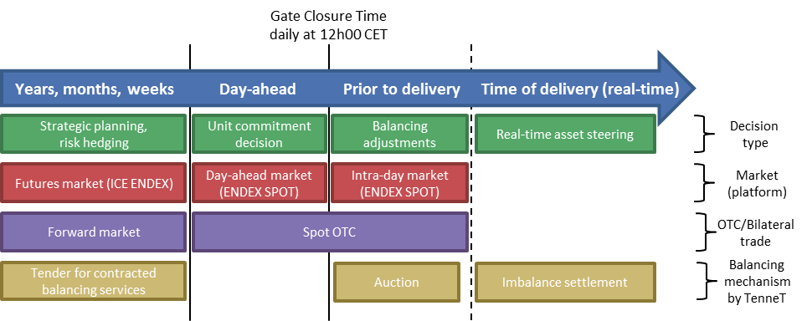
Power market

Slide 5
Power market: example 100 MW wind
Forward market: hedge 30 MW at 33 EUR/MWh for whole 2018
APX delivery 1-JAN-2018 hour 16:
hedge additional 50 MW at APX prices (we expect 80 MW wind produciton at H16)
APX for hour 16 clears at 25 EUR/MWh
Imbalance market (wind different than expected):
15:00 – 15:15: wind = 85 -> sell 5 MW against imbalance price of 15 EUR/MWh
15:15 – 15:30: wind = 80 -> no imbalance
15:30 – 15:45: wind = 70 -> buy 10 MW at imbalance price of 30 EUR/MWh
15:45 – 16:00: wind = 60 -> buy 20 MW at 35 EUR/MWh

Slide 6
Imbalance market
Why is there imbalance?
Wind/solar/demand is different than expected
Outages of power plants
Hour versus quarter
How is imbalance balanced?
Tennet measures the imbalance then steers power plants down/up
Tennet stops steering when imbalance is gone

Slide 7
Imbalance price
The imbalance price is determined by demand and supply
Demand: the need for balancing energy
Supply: flexible powerplants which can increase/reduce output very quickly
The are two prices:
[Afnemen]: this is the price you pay when you have a energy deficit
[invoeden]: this is the price you receive when you have an energy surplus. This could go negative.

Slide 8
Potential drivers of imbalance price
Demand:
Forecast error in wind/solar/demand
Outages
Hour versus quarter
Supply:
Number of power plants running (i.e. low wind could mean many power plants running → lots of ramp down capacity → imbalance price can not go very low
Cross border capacity

Slide 9
Why is this important
Eneco has relatively high share of renewables in portoflio
Therefore very exposed to imbalance prices
Current imbalance bill around 15MM
If were able to predict imbalance prices we are able to make better hedging decisions. Therefore reducing the imbalance bill.

Slide 10
Assignment
Make a model to predict imbalance prices (Afnemen and invoeden)
At 10:00 every day you have to predict the imbalance price for all 96 PTU’s of the next day. Both [Afnemen] and [invoeden] need to be forecasted.
Performance measure:
Mean absolute error on validation set (=last 100 days)

Slide 11
Data
Data set May 2014 – May 2016
Different sources:
Tennet
Reuters
APX
Eneco
Actual data versus forecasted data
Actual data. You can only use lags in your model

Slide 12
Auto regressive model
One could start with the following AR model
Y(t) = Y(t-2)+Y(t-3)+Y(t-4)+Y(t-7)+Y(t-14)+Y(t-21)+Y(t-28) + error
Lags are in days
NB: Y(t-1) cannot be used as you have to predict at 10:00 in the morning for the next day

Slide 13
Validator for python users

