Slide 1
Energy datapalooza Showcase Demo: Green Button Rate Integration Tool
Marty Burns | David Wollman | Erich Gunther
Hypertek, Inc. | NIST | EnerNex

Slide 2





An overnight success … years in the making
OpenADE (Open Automated Data Exchange)
Early requirements effort for securely sharing energy information with 3rd parties
NIST SGIP Priority Action Plans 10 & 20
Accelerates issue resolution and consensus development
OpenADE/SGIP inputs to NAESB standard REQ21
Energy Services Provider Interface (ESPI)
Privacy: REQ22 Third Party Access to Smart-Meter-based Information
Flexible file format basis for Green Button
initial implementation use a subset of ESPI and energy usage information.
Notes:
Consensus - emerges around an industry standard North American Energy Standards Board (NAESB) Energy Usage Information (PAP10) completed

Slide 3
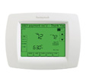
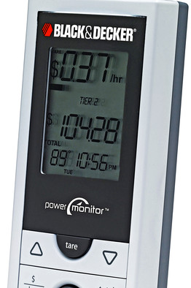
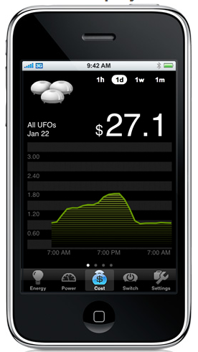
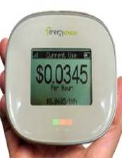
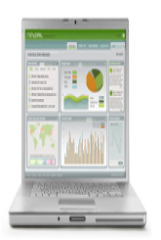
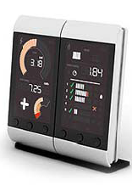
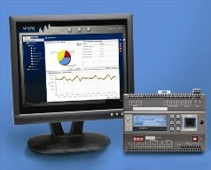
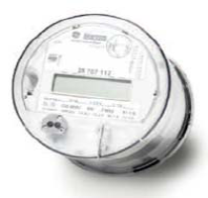
Green Button Enabling Vision
Overall Usage
History of Usage
Cost of Usage

Slide 4
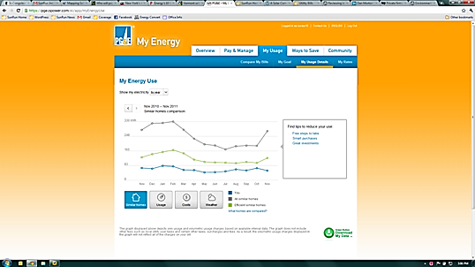

Green Button Download My Data
Common-sense idea that electricity customers should be able to download their own energy usage information in a consumer- and computer-friendly format.
Source:

Slide 5
Green Button Connect My Data
The ability to authorize a third party to automatically retrieve EUI from a utility via Web Services.

Slide 6
Green Button Connect My Data
The ability to authorize a third party to automatically retrieve EUI from a utility via Web Services.

Slide 7
Download/Connect My Data and the Utility Enterprise
Edge
Utility Enterprise
Web
Web Portal
Green Button Data W/O Cost
GUI Web Interface
MDMA
Has EUI
Green Button Download My Data
Green Button Data W/ Cost
RESTful Web Services
Billing System
Has Cost
Green Button Connect My Data
MDMA = Meter Data Management Agent
EUI = Energy Usage Information

Slide 8
Energy Data Jam → Rate Integration
This Green Button “Rate Integration” effort was launched by NIST and its partners based on an idea generated at the July Energy Data Jam (http://www.whitehouse.gov/blog/2012/07/12/open-data-clean-secure-energy-future, led by US CTO Todd Park, OSTP).
Project successful in addressing the current challenge to providing cost-attributed Energy Usage Information by encouraging third party services and apps.
Demonstration by example of concept using existing schema fragments from industry standards (ZigBee and NAESB) and sample Green Button data generated by the Green Button Software Development Kit.

Slide 9
The Tariff Demo
A tariff is created based on the tariff.xsd schema.
A sample Green Button Data file is selected which does not have cost data in it.
A simple batch file is executed that applies the XSLT (xml style sheet) to process the no-cost Green Button Data File into
one that has costs
espi. xsd
tariff.xsd
1
Block and Tier Tariff XML File
2
3
4
Green Button Data XML File – No Costs
XSLT w/jscript
Green Button Data XML File – With Costs

Slide 10
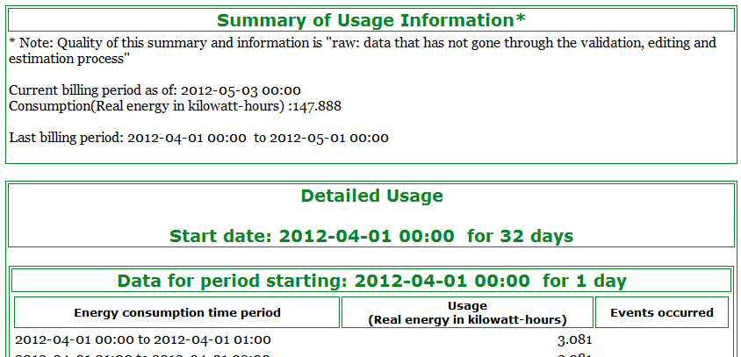
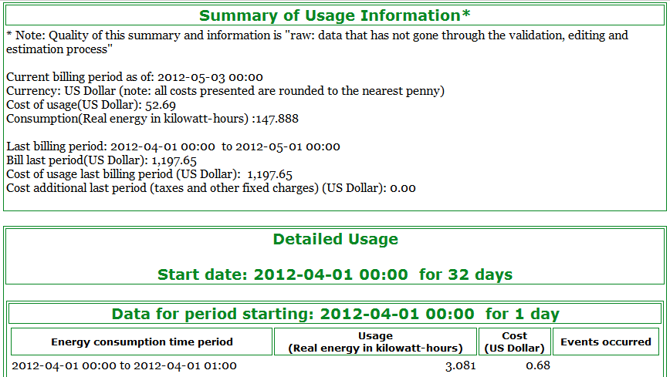
The Tariff Demo
Tariff created
Green Button file without costs selected
Batch file applies the XSLT (xml style sheet)
Producing modified Green Button file with costs
espi.xsd
tariff.xsd
1
Block and Tier Tariff XML File
2
3
4
Green Button Data XML File – No Costs
XSLT w/jscript
Green Button Data XML File – With Costs

Slide 11
Summary
A Tariff Schema was assembled
A sample Tariff.xml instance file created based on California “block and tier” concept
XSLT created to transform non-cost-containing Green Button Data to cost-containing Green Button Data
Potential future work: your input and discussions on the attractiveness of this concept may lead to the creation of a new Priority Action Plan proposal to produce a standard Tariff XML Schema

Slide 12
Additional Details

Slide 13
Sample Block and Tier Tariff
Description | Local Time | Tier | Block | start value (kWh) | Price
Off Peak | 00:00-08:00 | 1 | 1 | 0 | $ 0.22
 |  |  | 2 | 150 | $ 0.24
 |  |  | 3 | 250 | $ 0.33
 |  |  | 4 | 300 | $ 0.37
 |  |  | 5 | 350 | $ 0.40
Mid Peak | 8:00-10:00 | 2 | 1 | 0 | $ 0.32
 |  |  | 2 | 150 | $ 0.34
 |  |  | 3 | 250 | $ 0.43
 |  |  | 4 | 300 | $ 0.47
 |  |  | 5 | 350 | $ 0.50
On Peak | 10:00-18:00 | 3 | 1 | 0 | $ 0.52
 |  |  | 2 | 150 | $ 0.54
 |  |  | 3 | 250 | $ 0.73
 |  |  | 4 | 300 | $ 0.77
 |  |  | 5 | 350 | $ 0.80
Mid Peak | 18:00-24:00 | 2 | 1 | 0 | $ 0.32
 |  |  | 2 | 150 | $ 0.34
 |  |  | 3 | 250 | $ 0.43
 |  |  | 4 | 300 | $ 0.47
 |  |  | 5 | 350 | $ 0.50

Slide 14
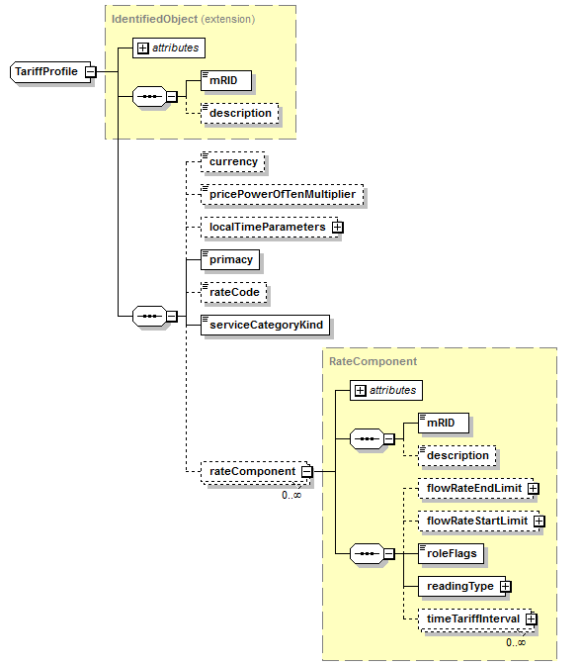
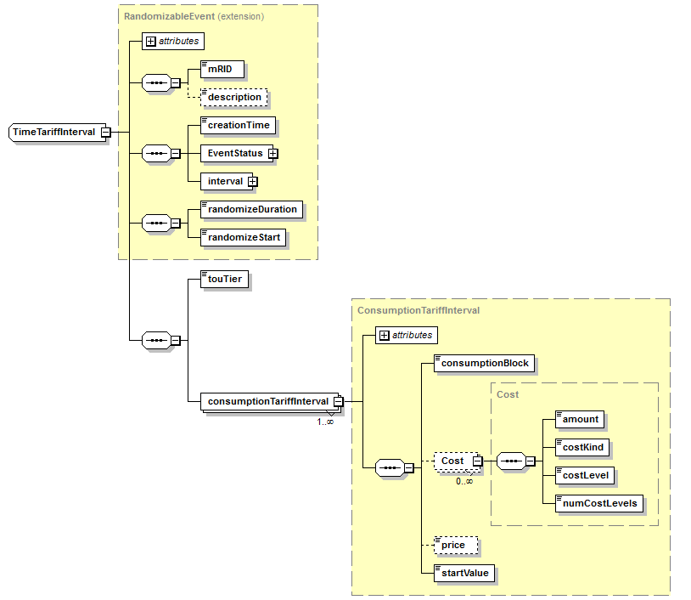
Tariff Schema

Slide 15
SGIP PAP20: Green Button ESPI Evolution Roadmap Going Forward …
SGIP PAP Activities:
Coordinates with
PAP 20
CSWG
SGTCC
SGIMC
Requirements for Green Button and ESPI Rollout
Privacy assurance recommendations
Test plan consistency
Requirements for standards and test criteria
Facilitate/Coordinate SGIP interactions
Cybersecurity recommendations for EUI exchanges
ITCA assurances
Education on implementation strategies, standards, use cases and test criteria
Specification Deliverables:
Standards (NAESB)
REQ.18/WEQ.19 Maintenance Update
ESPI Errata Update
REQ.21/REQ.22
ESPI New Reqs Update
International Version
T&C (UCAIug)
Green Button Download My Data Test Plan
Green Button Connect My Data Test Plan
UCAIug ITCA
Implementation (EnergyOS)
Green Button SDK
OpenESPI

Slide 16
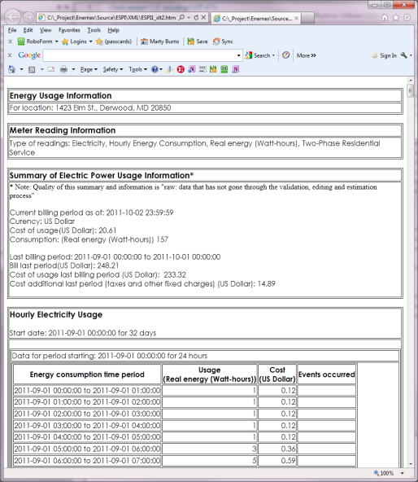
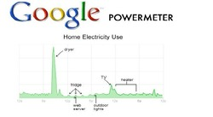
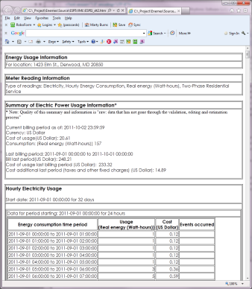
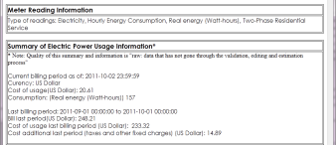

Alternate paths to EUI – single format
Sources of EUI
Single Data Format: all at once
Uses of EUI
Power Utility
Via: ESPI, SEP2, Web Portal
Single Data Format: as sequence
Acknowledgements to graphics owners

Slide 17

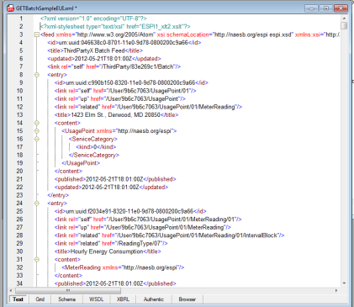
Web Technologies for Definition and Presentation of EUI File Format
X
XML Schema (XSD)
XML
XSLT
Describes the rules of file format
Contains customer EUI data in standard file format and references to XSD and XSLT
Defines how to transform for humans
Standard EUI file Format

Slide 18
Technical and Organizational Links
Smart Grid Interoperability Panel (SGIP)
SGIP PAP20 Green Button ESPI evolution: http://collaborate.nist.gov/twiki-sggrid/bin/view/SmartGrid/GreenButtonESPIEvolution
SGIP Green Button Initiative TWiki: https://collaborate.nist.gov/twiki-sggrid/bin/view/SmartGrid/GreenButtonInitiative
SGIP Green Button FAQ: https://collaborate.nist.gov/twiki-sggrid/bin/view/SmartGrid/GreenButtonFAQ
Standards:
NAESB PAP10 Task Force Project Page : http://www.naesb.org/smart_grid_pap10.asp
NAESB ESPI Task Force Project Page : http://www.naesb.org/espi_task_force.asp
NAESB ESPI and PAP10 email lists: to subscribe contact Denise Rager at NAESB - drager@naesb.org
NAESB Green Button Portal - http://www.naesb.org/ESPI_Standards.asp
Users Group:
UCAIug OpenADE Task Force Home Page: http://osgug.ucaiug.org/sgsystems/OpenADE/default.aspx
UCAIug OpenADE Mail List: http://www.smartgridlistserv.org/cgi/wa.exe?A0=OPENSG-OPENADE
UCAIug OpenADE Meetings: tuesdays at 3:00 EST - https://www2.gotomeeting.com/join/844935738, 415-363-0070 #844-935-738
UCAIug OpenADE Green Button Issues List: http://osgug.ucaiug.org/HelpDesk/Lists/servicerequests/GreenButton.aspx
Open Source Implementations and tools:
EnergyOS OpenESPI Mail List: http://groups.google.com/group/energyos_espi/subscribe?hl=en
EnergyOS OpenESPI Web Site: http://www.openespi.org/
EnergyOS OpenESPI Meetings: mondays at 12:00 EST - https://www2.gotomeeting.com/join/129392235, +1 (516) 453-0010 #129-392-235
EnergyOS OpenESPI GitHub: https://github.com/energyos/OpenESPI
EnergyOS OpenESPI GitHub Issues List: https://github.com/energyos/OpenESPI/issues
General OpenESPI information: https://github.com/energyos/OpenESPI/wiki/
Energy OS home page: http://energyos.org/
Other:
NREL OpenEnergyInfo Green Button Apps Repository: http://en.openei.org/wiki/Main_Page
Green Button Data Sample/Developmental Web Site: http://www.greenbuttondata.org

Slide 19
Questions?
Marty Burns | David Wollman | Erich Gunther
Hypertek, Inc. | NIST | EnerNex
marty@hypertek.us | david.wollman@nist.gov | erich@enernex.com

