Slide 1

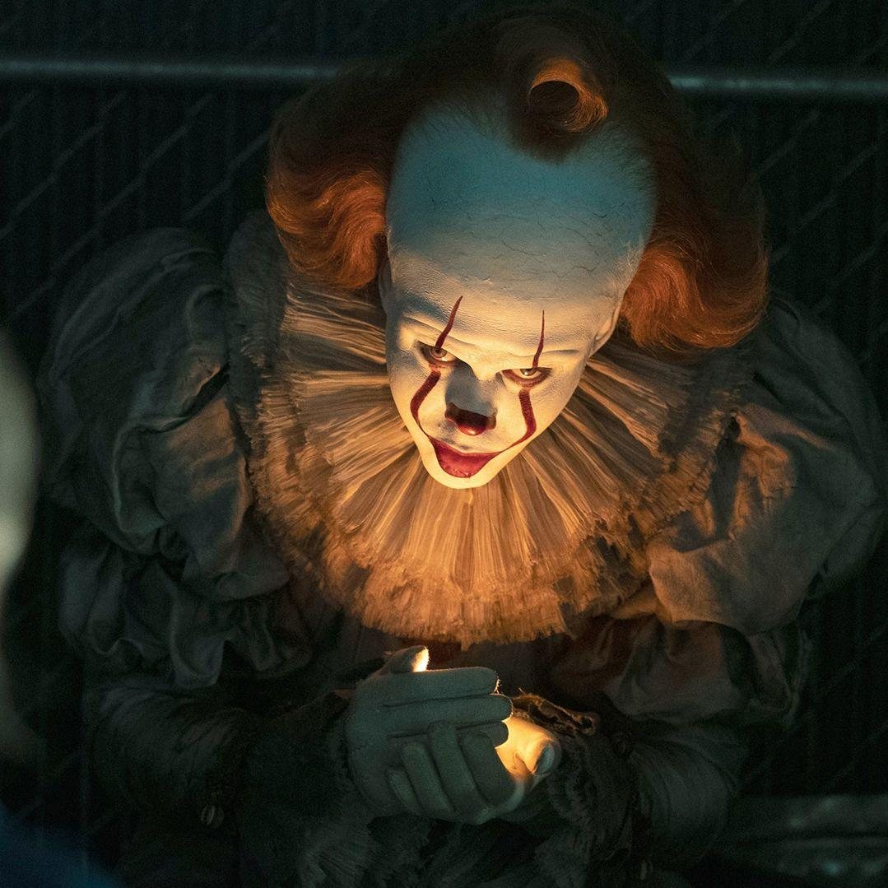

PHOTOGRAPHY 1A / LIGHTING
LIGHTING THE MONSTER
THE CINEMATOGRAPHER’S PLAYBOOK
One light, one shadow, and a hundred years of horror. How the people behind the camera built fear out of nothing but contrast.
SHADOW / NOIR / PORTRAIT
PHOTOGRAPHY 1A / MR. SILVA / PIONEER VALLEY HIGH SCHOOL

Slide 2

WHAT A DIRECTOR OF PHOTOGRAPHY DOES
THE ROLE / 01
The director decides what happens in the scene. The Director of Photography, or DP, decides what it looks like. Every shadow on an actor’s face was somebody’s decision.
Designs the lighting
Chooses the lens and exposure
Picks every light, where it sits, how hard it is, and what color it is. This is the biggest part of the job.
Decides how much of the scene is sharp, how dark the image is allowed to get, and what the camera sees.
Runs the camera and grip crew
Protects the mood
Gaffers, electricians, and grips build what the DP designs. On a big film that is dozens of people.
If the story is about dread, the DP makes sure every frame feels like dread, even the quiet ones.
PHOTOGRAPHY 1A / MR. SILVA / PIONEER VALLEY HIGH SCHOOL

Slide 3

THE ONLY FOUR THINGS A LIGHT CAN DO
TOOLS / 02
Every lighting choice in every film ever made comes down to four dials. Learn these four and you can read any image on earth.
Quality
Direction
Intensity
Color
How sharp the shadow edge is. Hard light cuts. Soft light wraps. Decided by how big the light looks from where the subject is standing.
Where the light comes from. Front, side, behind, above, below. Direction is where almost all the drama lives.
How bright it is compared to everything else. Not how bright it feels. Brightness only means something next to darkness.
What hue the light is. Your eye reads color as temperature and emotion before it reads anything else.
Change one dial and the whole mood changes. That is the entire craft, repeated a few thousand times.
PHOTOGRAPHY 1A / MR. SILVA / PIONEER VALLEY HIGH SCHOOL

Slide 4
01
WHERE THE LOOK CAME FROM
THE SHADOW TRADITION
A hundred years ago a handful of camera operators figured out that what you hide scares people more than what you show. Horror has been stealing from them ever since.
PHOTOGRAPHY 1A / MR. SILVA / PIONEER VALLEY HIGH SCHOOL

Slide 5

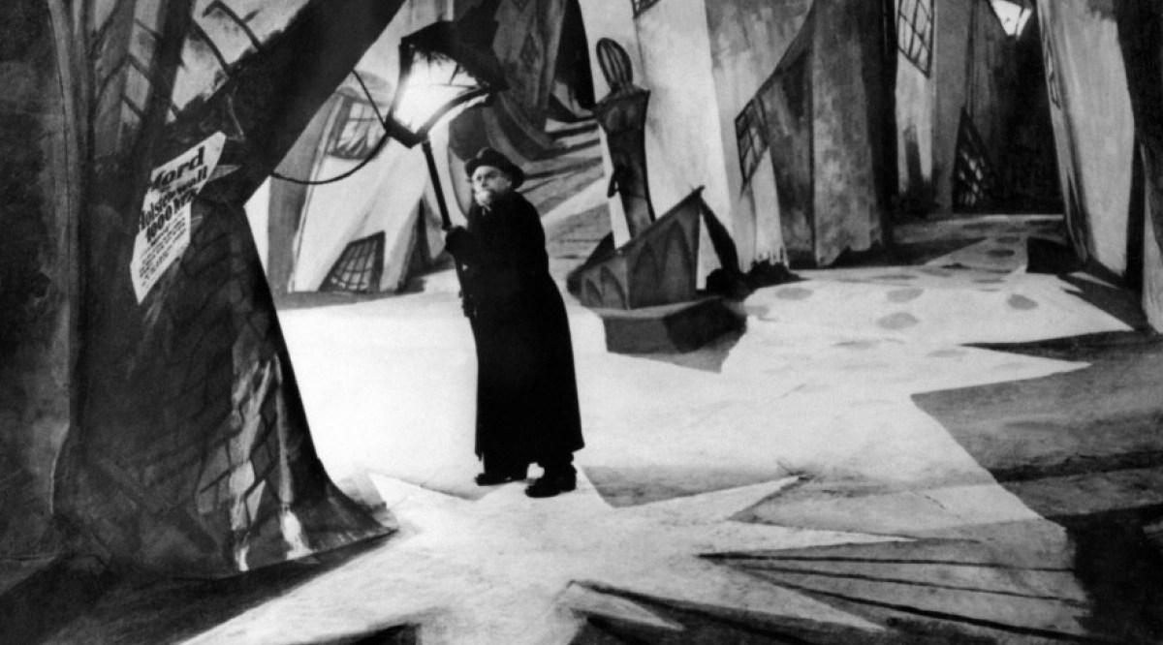
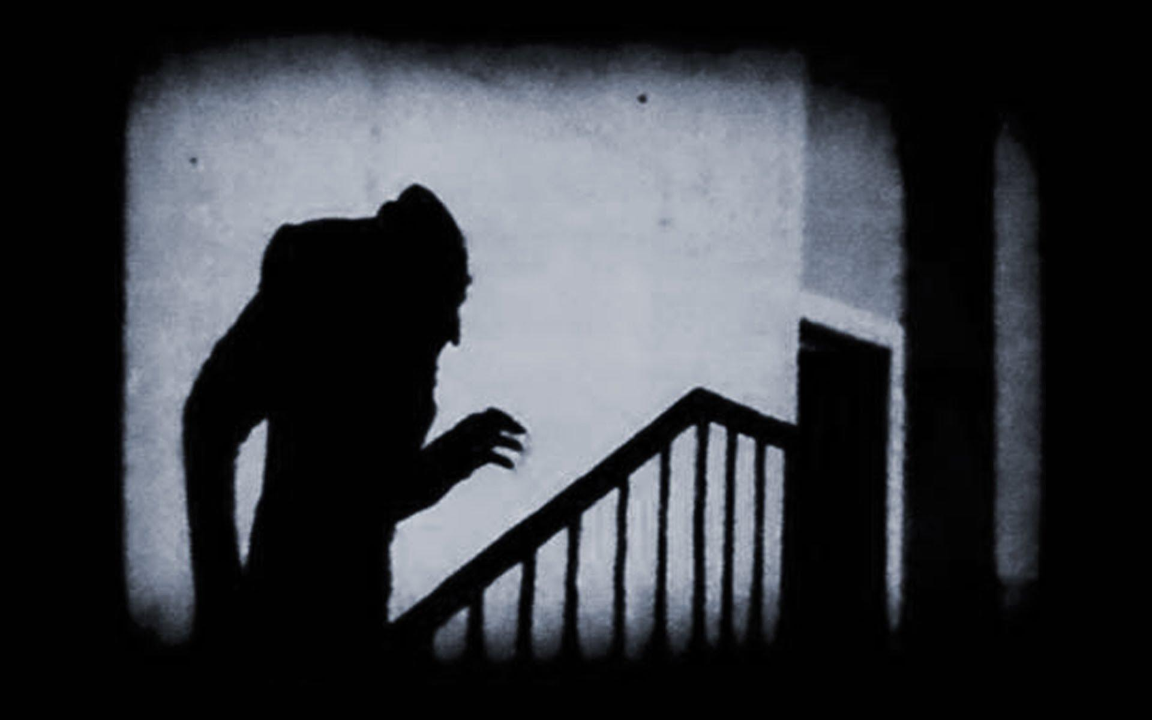
IT STARTED WITH PAINTED SHADOWS
ORIGINS / 03
In Germany in the 1920s, film studios had almost no money and almost no electricity to spare. So they painted shadows directly onto the sets, bent the walls on purpose, and lit actors with one hard lamp.
01
THE CABINET OF DR. CALIGARI, 1920
Crooked sets and painted-on shadows. Nothing in the frame is square, and that is the point.
The Cabinet of Dr. Caligari, 1920. The shadows are painted onto the set.
02
NOSFERATU, 1922
The shadow of the vampire climbing the staircase. You never see him, only what he blocks.
03
WHY IT STILL WORKS
Your brain finishes the picture. A shape you cannot fully see is always scarier than one you can.
Nosferatu, 1922. The shadow arrives before the vampire does.
PHOTOGRAPHY 1A / MR. SILVA / PIONEER VALLEY HIGH SCHOOL

Slide 6

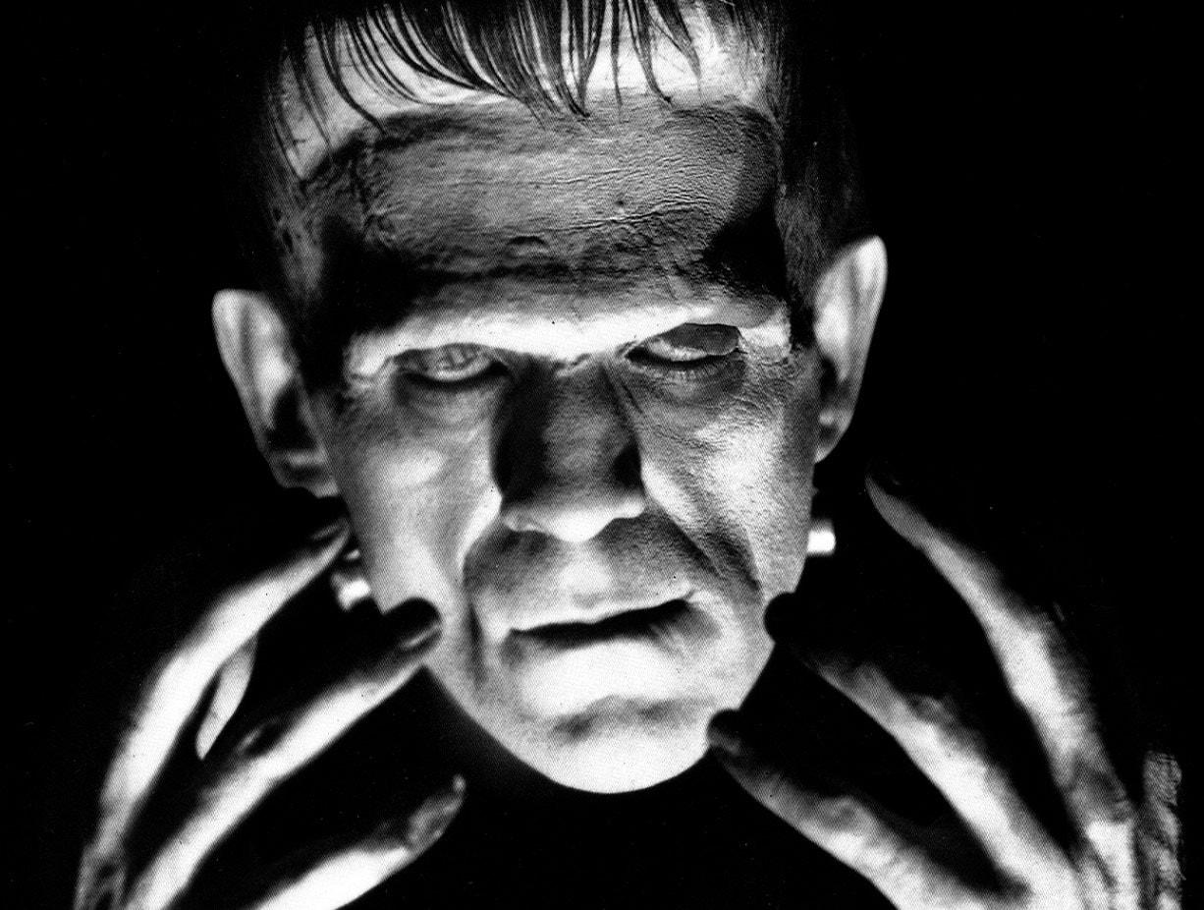
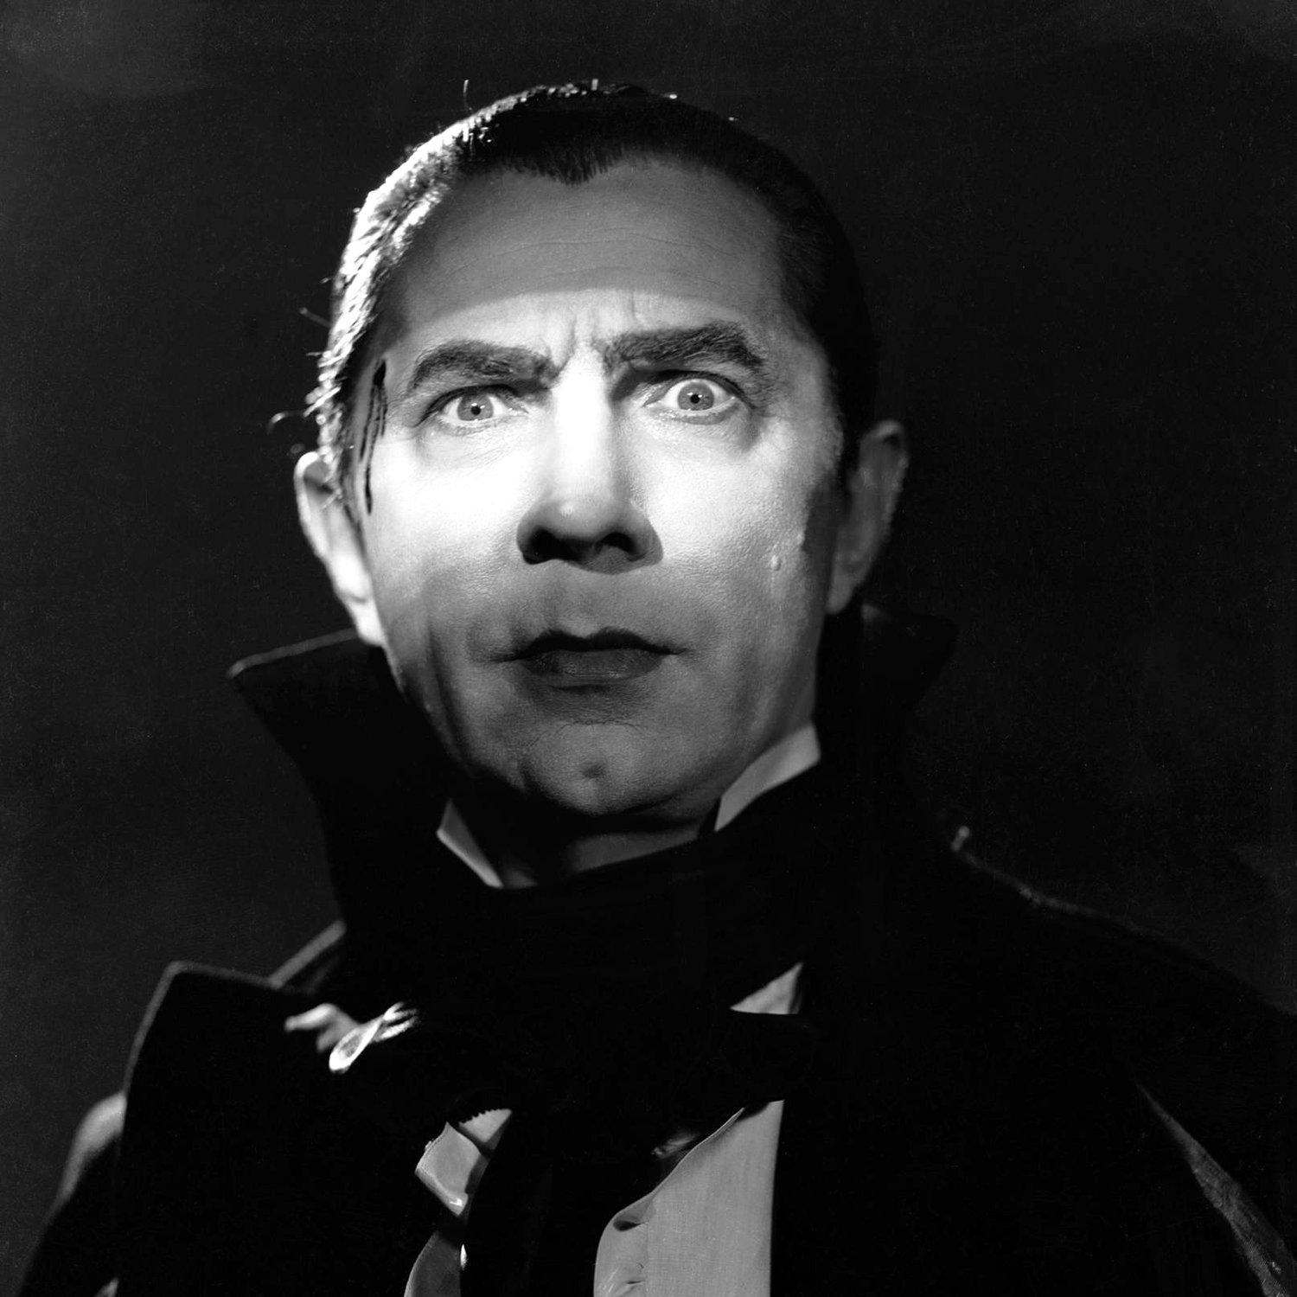
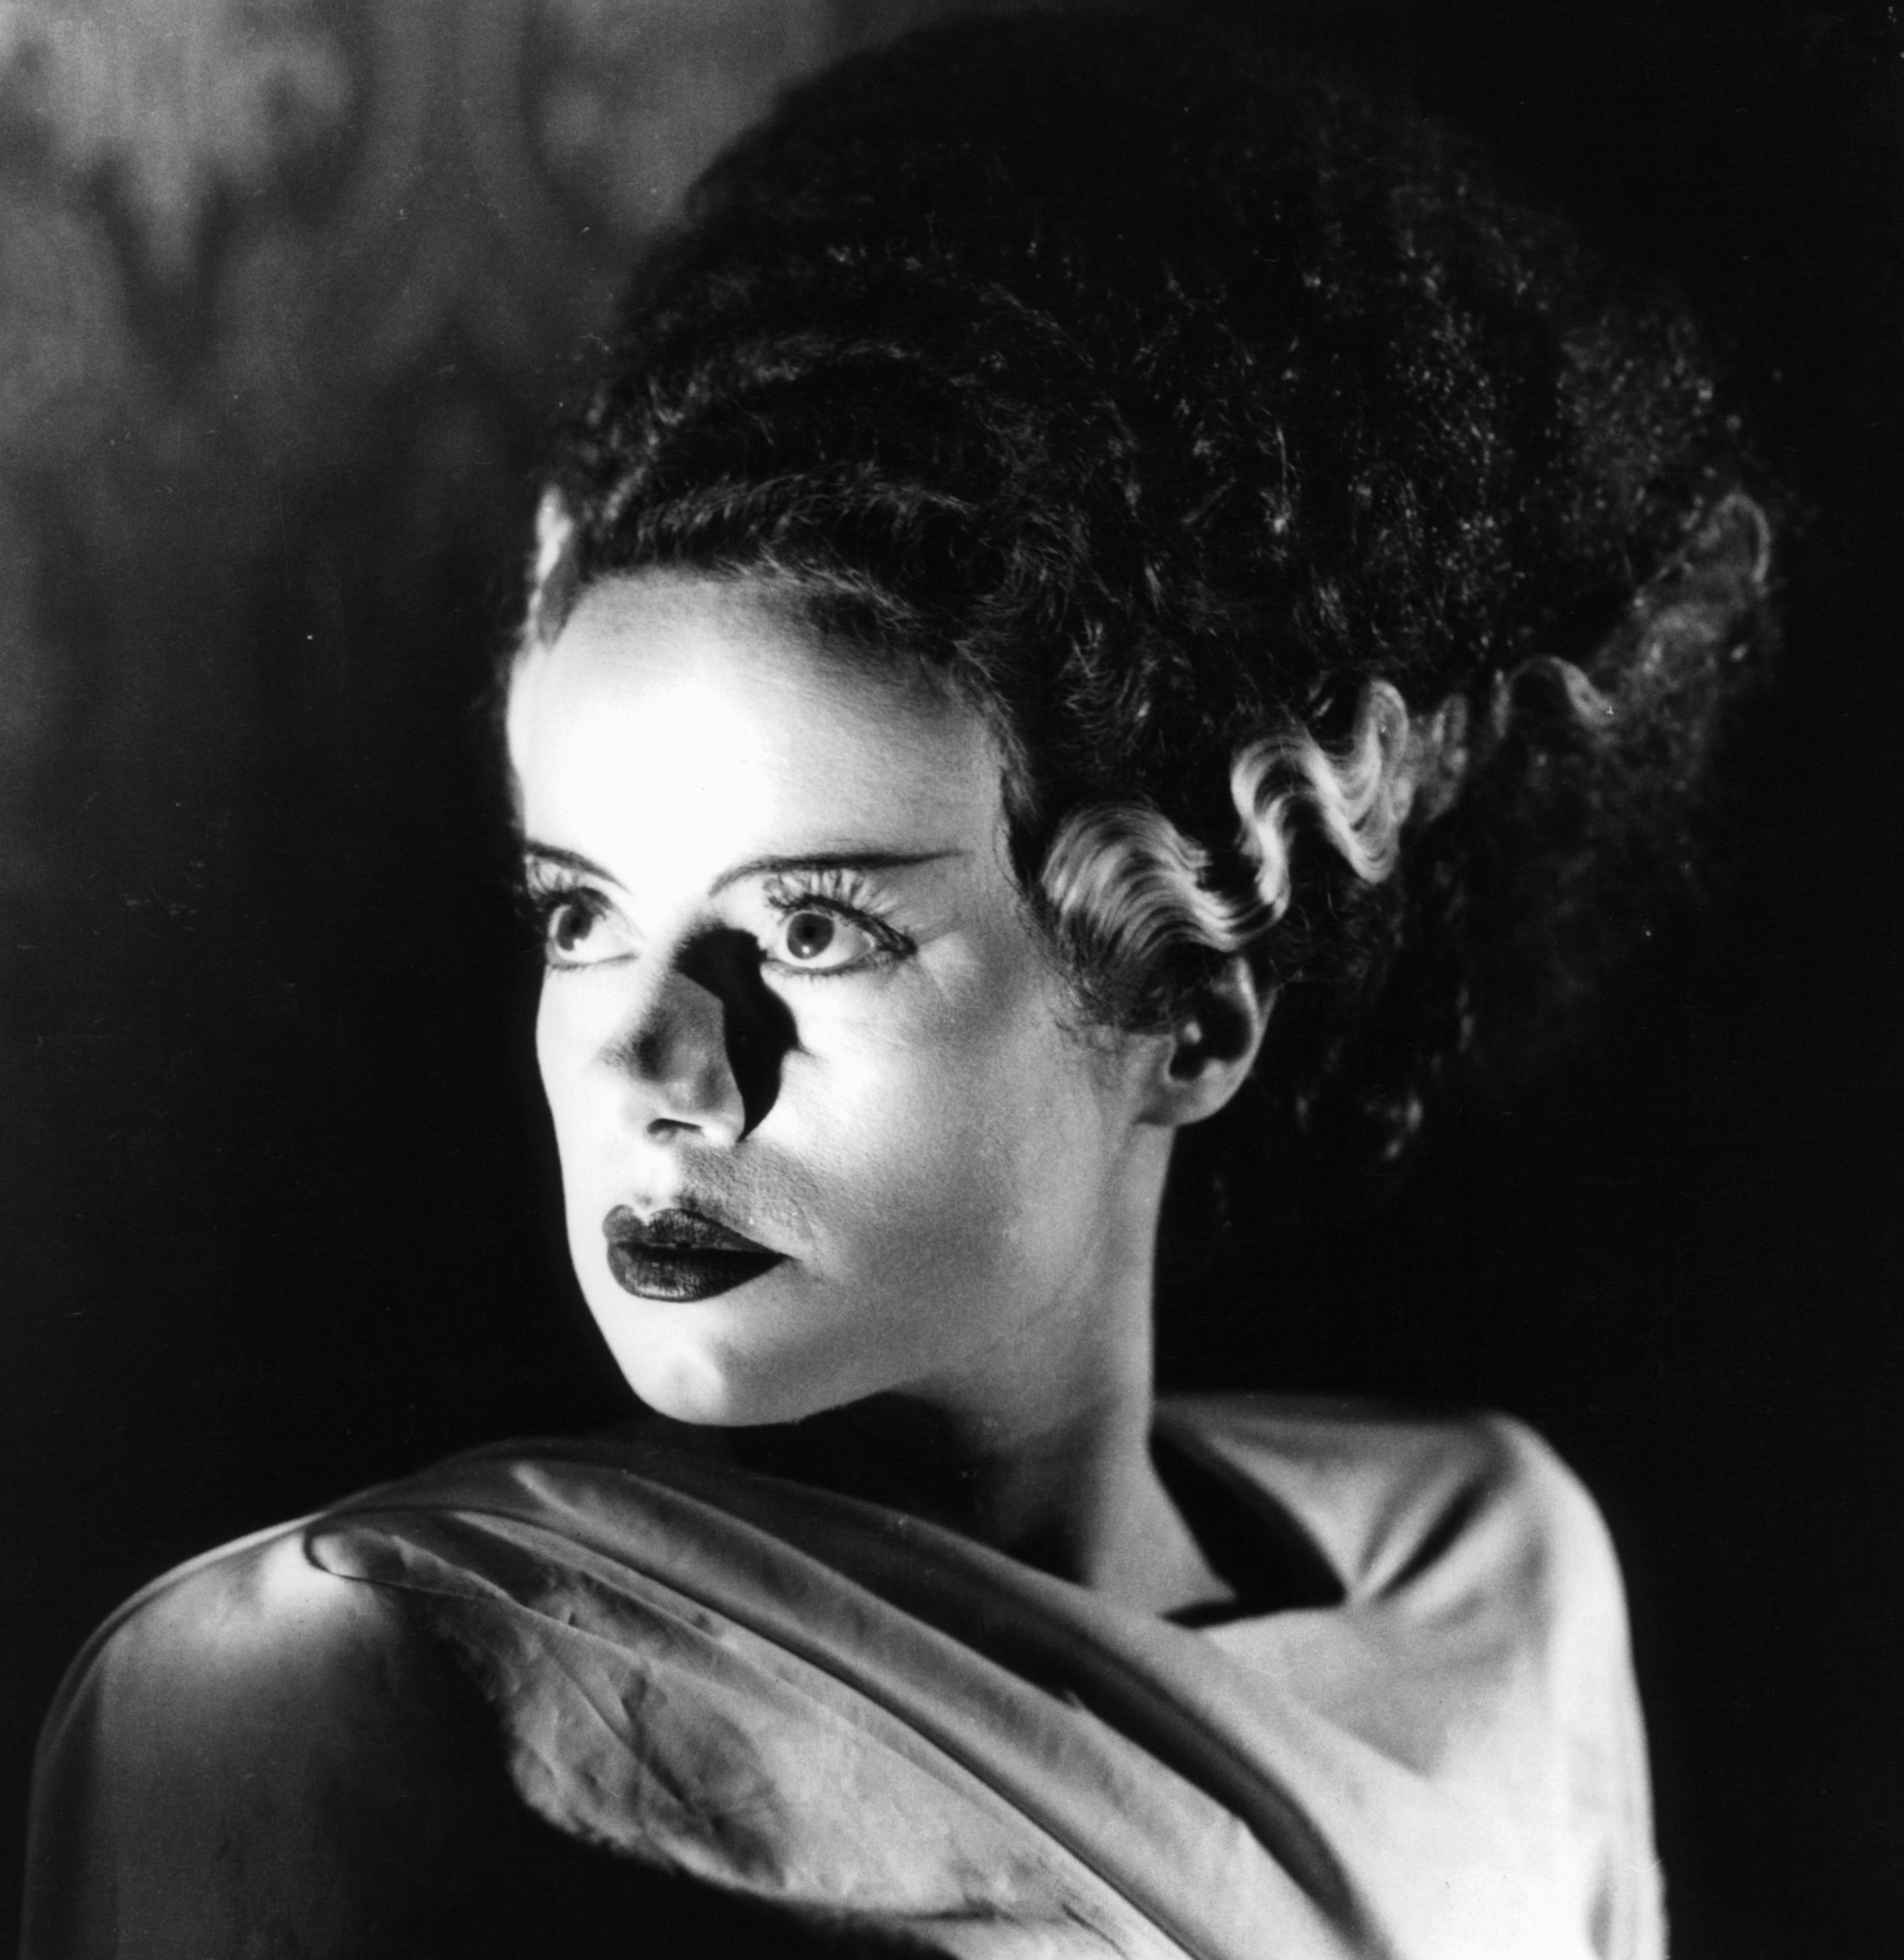
HOLLYWOOD HIRED THOSE CAMERA CREWS
MONSTERS / 04
Universal Pictures brought the German crews to California and handed them the monsters. These are the images every Halloween decoration still copies.
Frankenstein
Dracula
Bride of Frankenstein
1931
1931
1935
Photographed by Arthur Edeson. Hard light from below, and a brow that throws the eyes into pure black.
Photographed by Karl Freund, straight from Germany. Two pinpoints aimed only at Lugosi’s eyes.
Photographed by John J. Mescall. Higher contrast, the Bride rimmed in light against near black.
Frankenstein, 1931. Hard light from below. The brow erases the eyes.
Dracula, 1931. Two pinpoints of light, aimed only at the eyes.
Bride of Frankenstein, 1935. Rim light carving her off a black field.

Slide 7

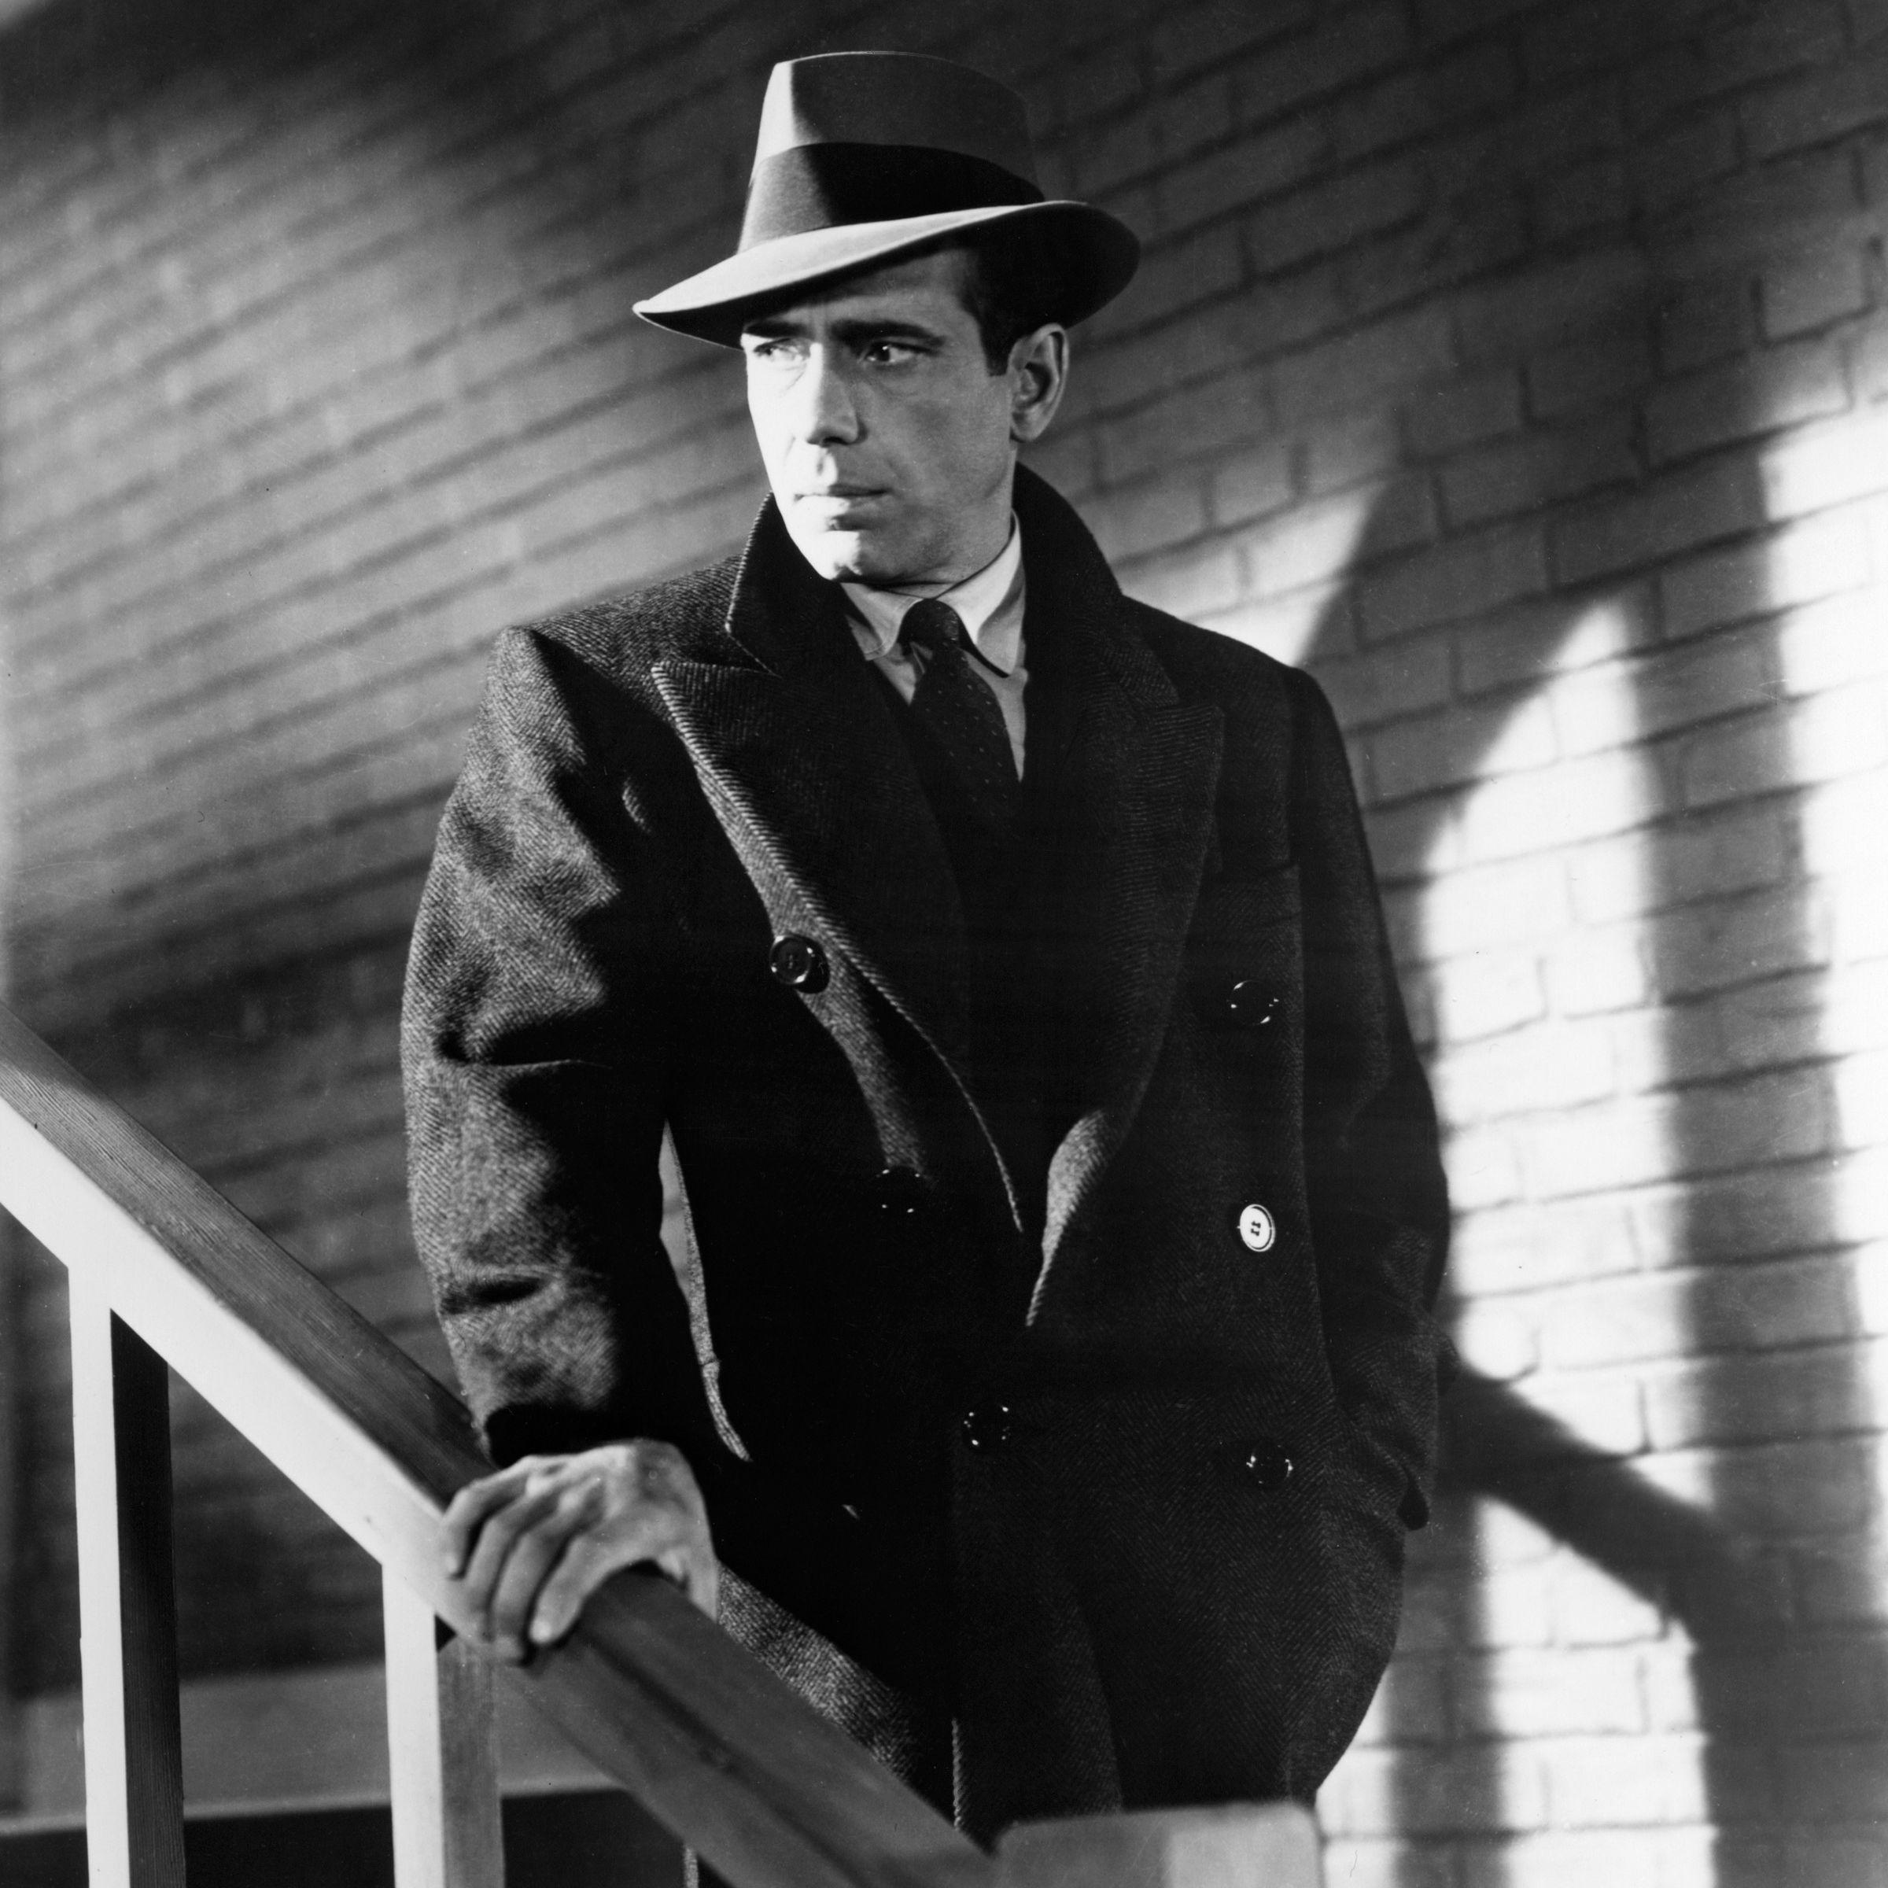
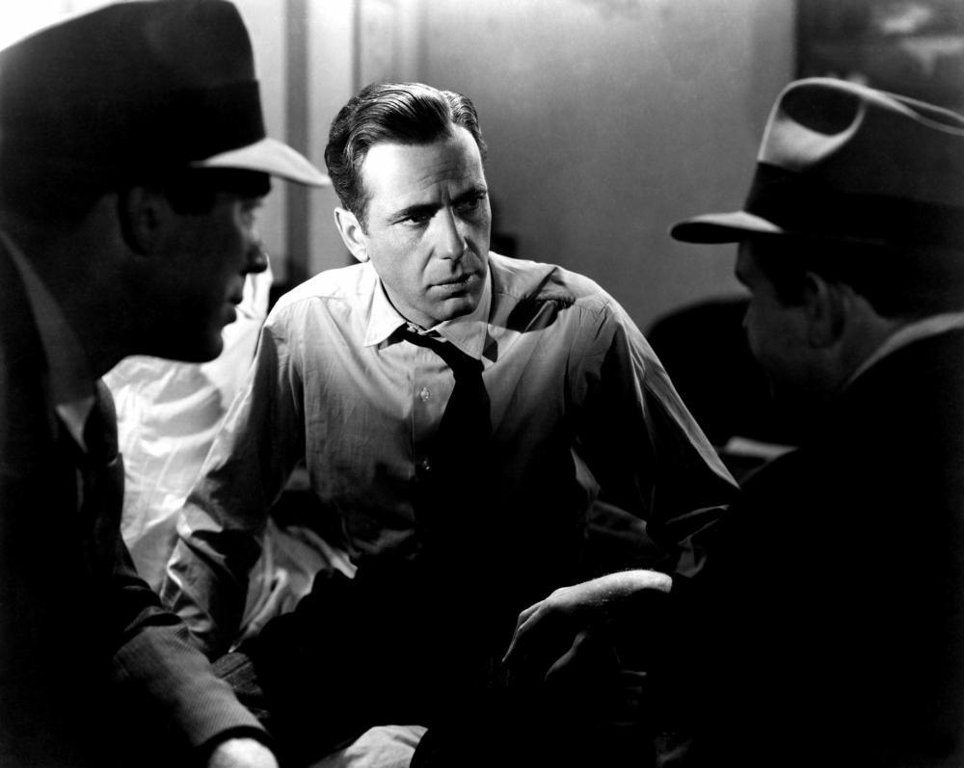
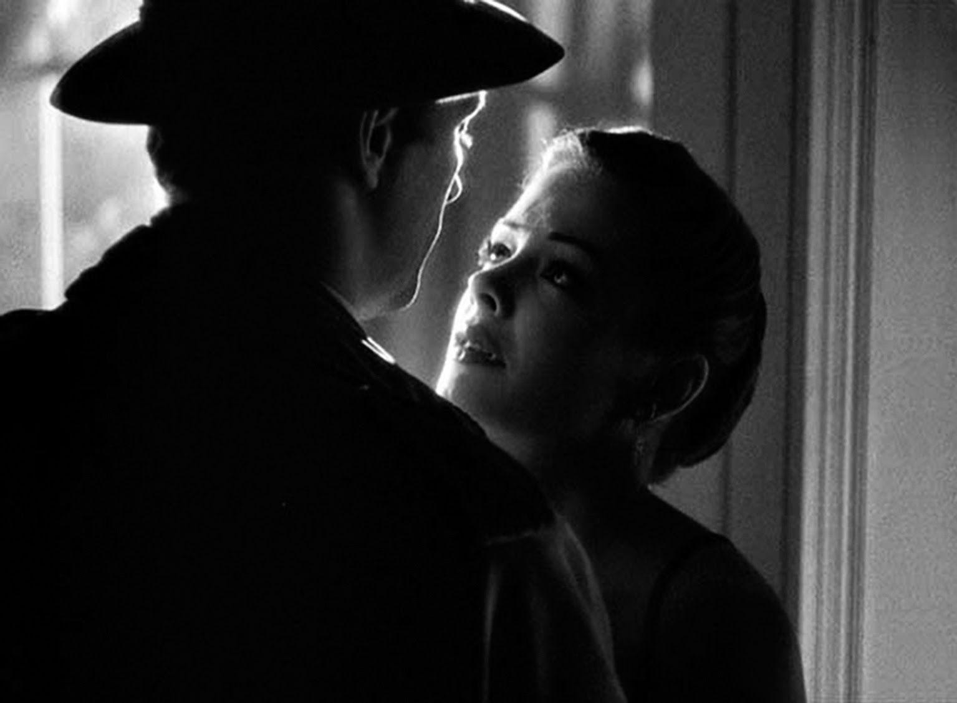
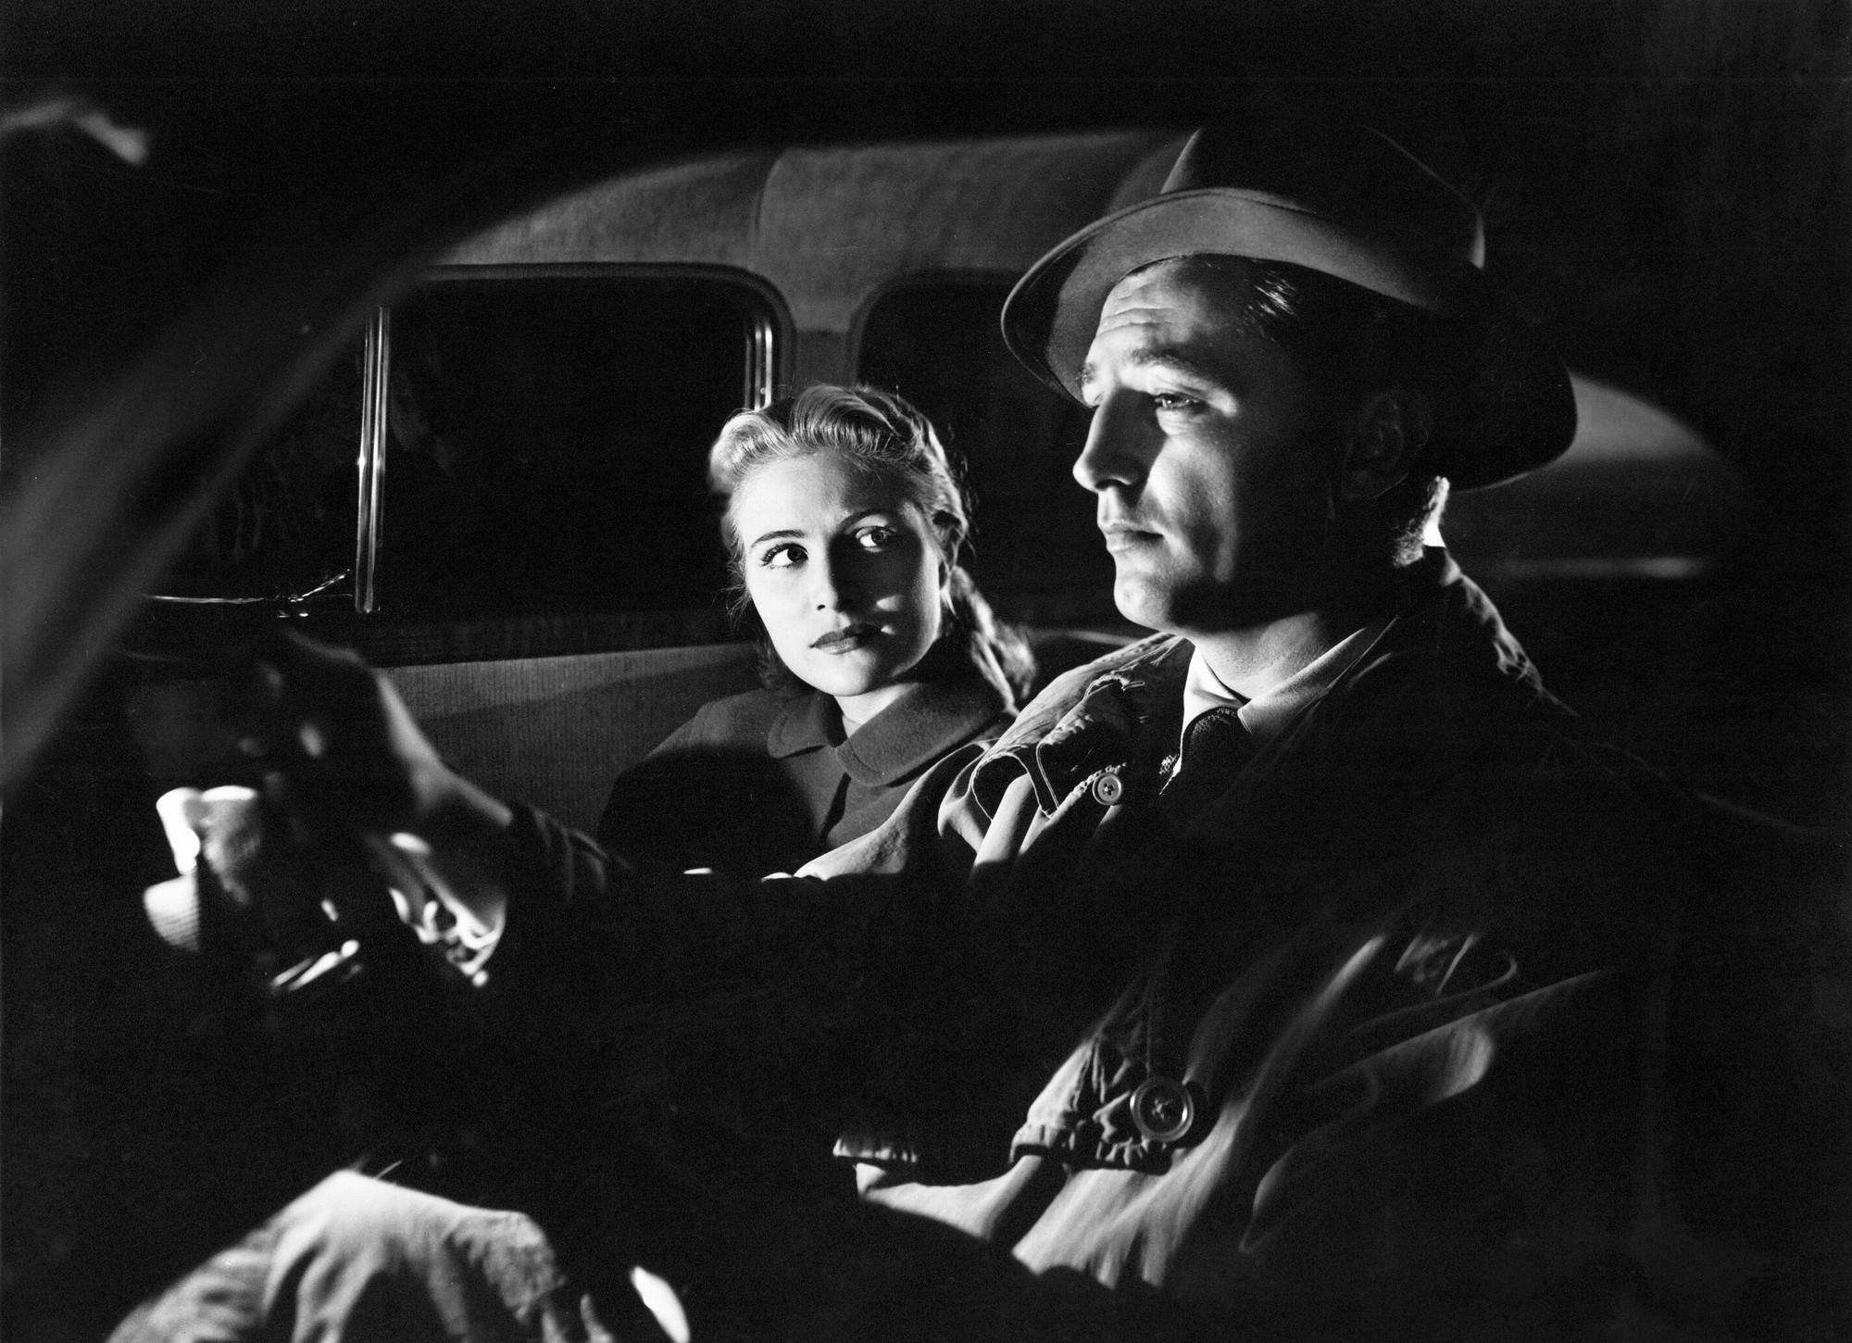
THEN THE DETECTIVES TOOK IT OVER
FILM NOIR / 05
By the 1940s the same lighting moved out of the castle and into the city. Crime, wet streets, and venetian blinds. The French called it film noir, which just means black film.
Double Indemnity, 1944
Out of the Past, 1947
John F. Seitz. Blind slats thrown across the walls and faces in long hard bars.
Nicholas Musuraca. Faces half swallowed, shadow side left completely black.
T-Men, 1947 and The Big Combo, 1955
Touch of Evil, 1958
John Alton. The most extreme of them all. Sometimes a single light in a black room.
Russell Metty. Wide lenses, low angles, and light that never once looks accidental.
Window light on brick. The pattern does the work.
One face lit, the rest of the room left in shadow.
Side light. Half a face, and a hat that is pure black shape.
No fill at all. The shadows are allowed to go completely black.

Slide 8
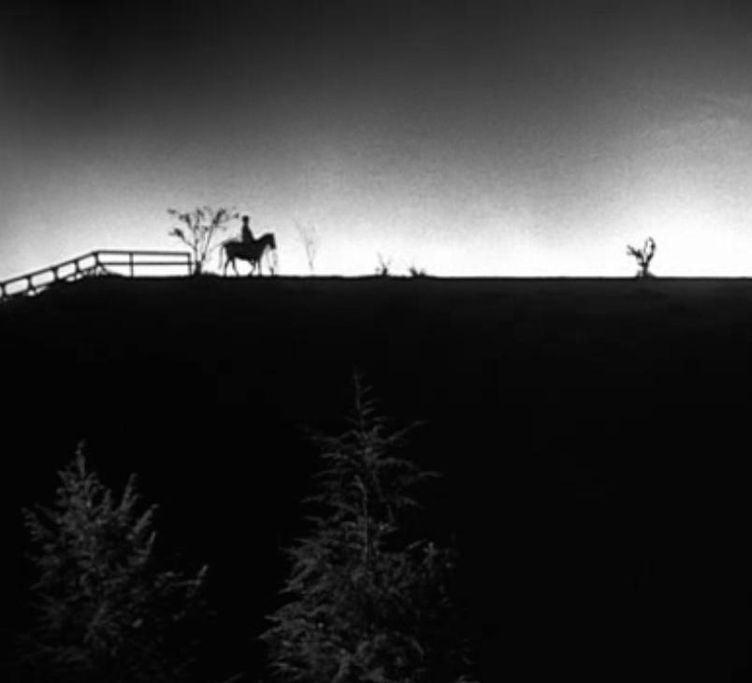
THE BRIDGE BETWEEN THEM
ONE FILM / 06
THE NIGHT OF THE HUNTER
1955 / Photographed by Stanley Cortez / Directed by Charles Laughton
A horror film lit like a nightmare and a crime film at the same time. Cortez kept almost the entire movie in near darkness and used one hard source, so the villain is often just a black cutout with a hat.
Watch what it teaches: a silhouette can act. You do not need to see a face to feel threatened by it.
Silhouette on the horizon. You read the threat without seeing a face.
PHOTOGRAPHY 1A / MR. SILVA / PIONEER VALLEY HIGH SCHOOL

Slide 9

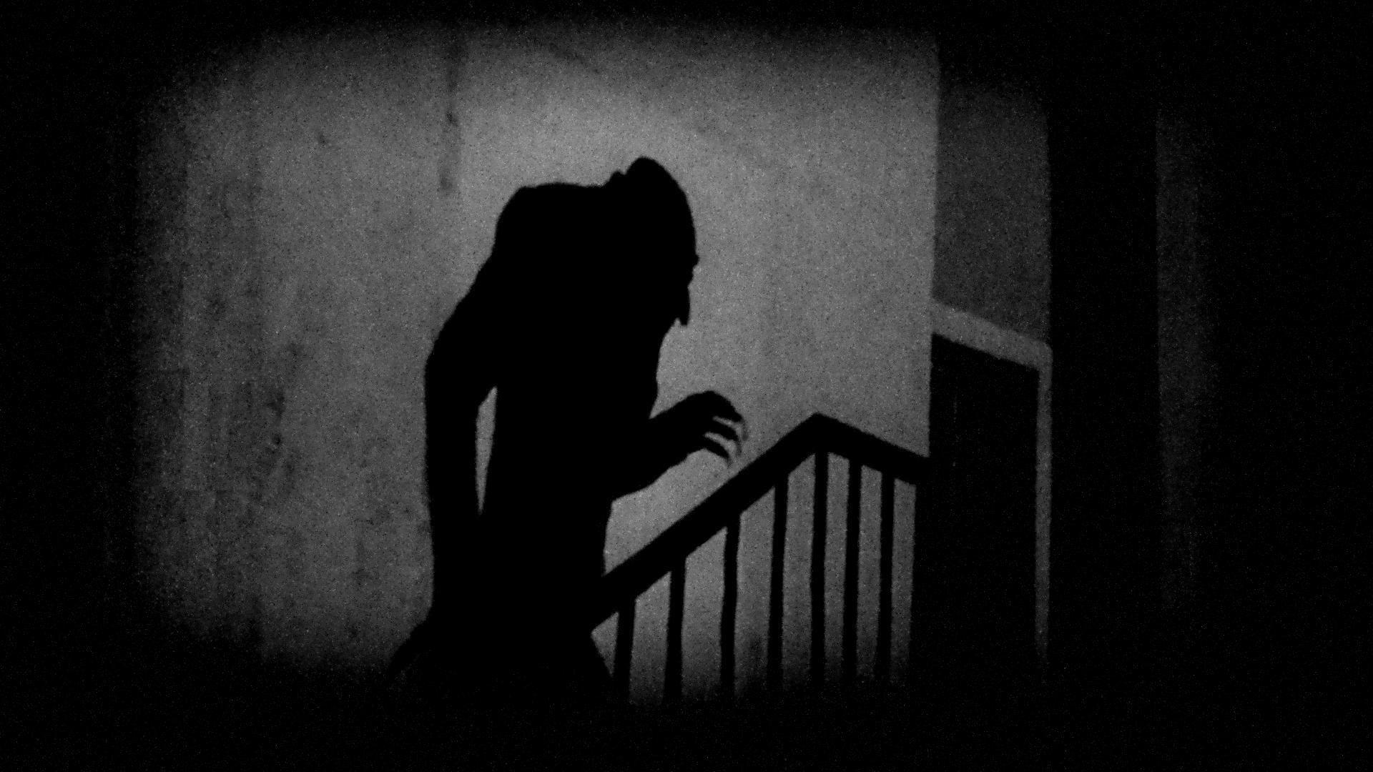
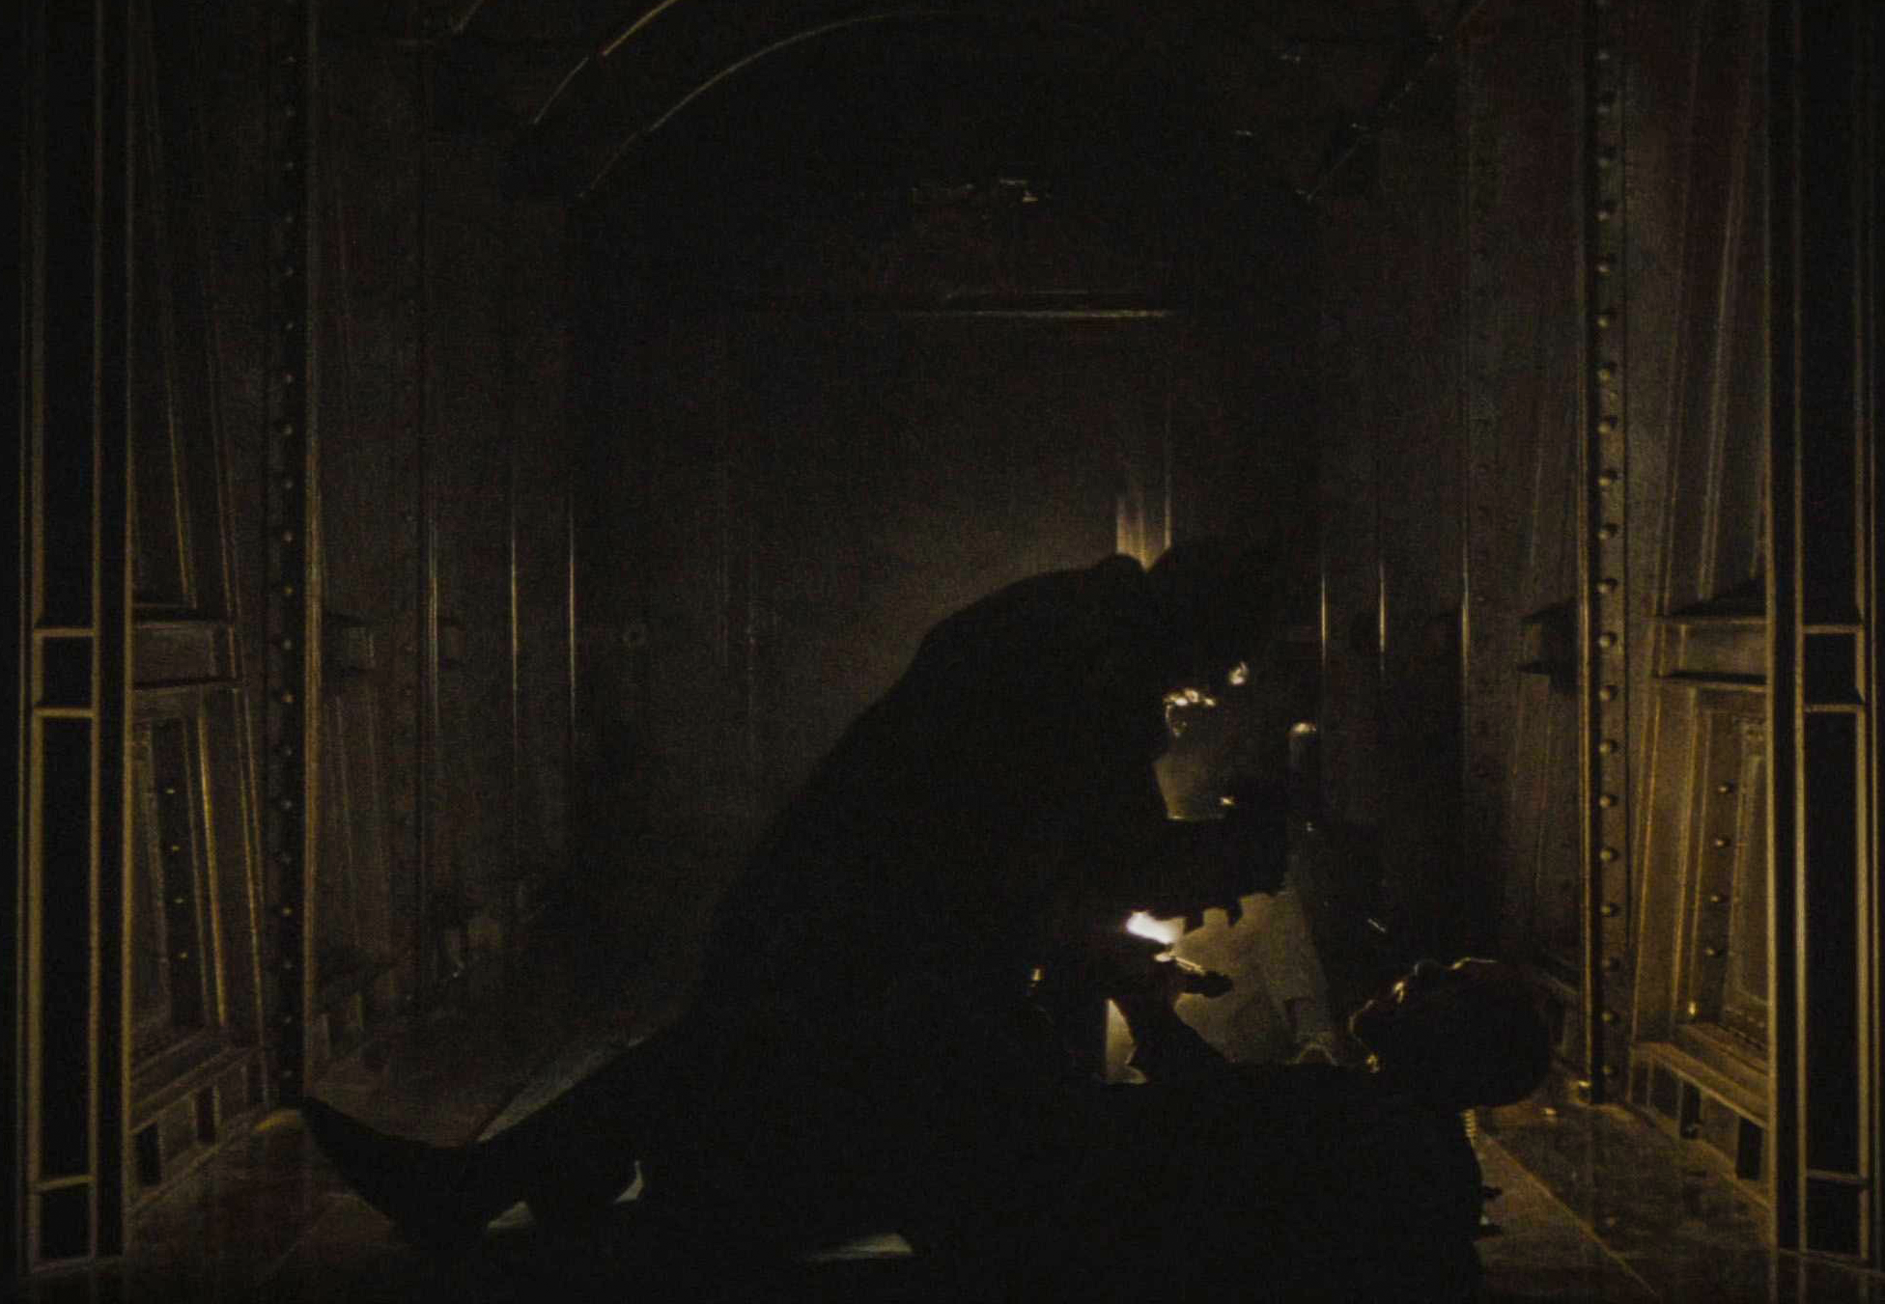
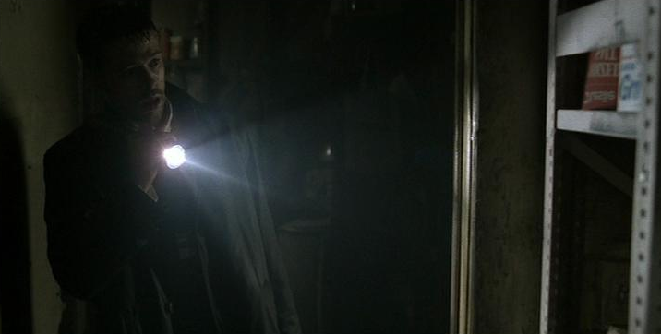
IT NEVER WENT AWAY
TODAY / 07
Every one of these is running the same playbook that was written in 1931.
Nosferatu, 2024
The Batman, 2022
Jarin Blaschke used real candle flames and bounced moonlight. Orlok stays backlit, mostly in silhouette.
Greig Fraser kept the hero in shadow and let the lights already in the room do the work.
The Lighthouse, 2019
Se7en, 1995
Blaschke again. Black and white, boxy frame, hard lantern light, and faces lit from below for most of the film.
Darius Khondji. Flashlights in black rooms. You only ever see the small circle the character is pointing at.
Nosferatu, 2024: Orlok as pure silhouette. The same move Murnau used in 1922.
The Batman, 2022: One warm source deep in the frame. Everything else stays black.
Se7en, 1995: A flashlight is the whole lighting plan. You see only what it points at.

Slide 10
02
HOW IT IS ACTUALLY DONE
THE LANGUAGE OF SHADOW
Seven ideas. Once you have them, you stop guessing where to put the light and start deciding.
PHOTOGRAPHY 1A / MR. SILVA / PIONEER VALLEY HIGH SCHOOL

Slide 11
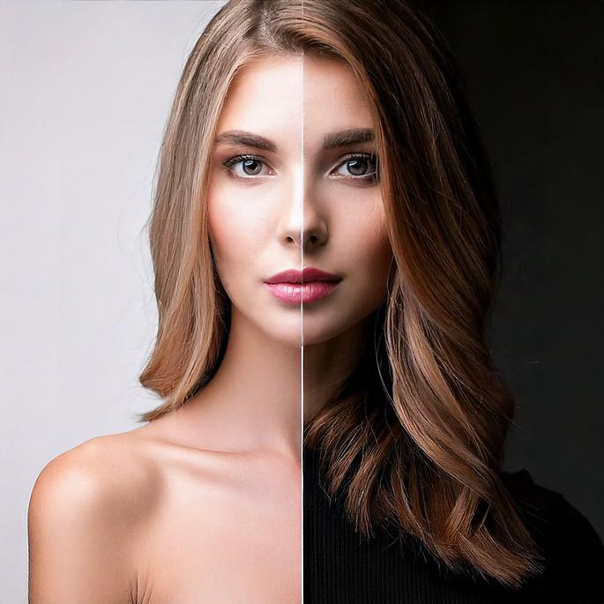
LOW KEY IS NOT THE SAME AS DARK
IDEA 01 / 08
Most of the frame sits in shadow and the lit parts are small. It does not mean underexposed. The bright parts stay bright. There are just fewer of them.
01
HIGH KEY
Light everywhere, soft shadows, nothing hidden. Sitcoms, school portraits.
02
LOW KEY
A little light, a lot of black. Horror, noir, and most music videos.
03
THE TEST
Delete the shadows. Does the picture still say anything? In low key, no. The shadow is the subject.
Same face, same person. High key on the left, low key on the right.
PHOTOGRAPHY 1A / MR. SILVA / PIONEER VALLEY HIGH SCHOOL

Slide 12

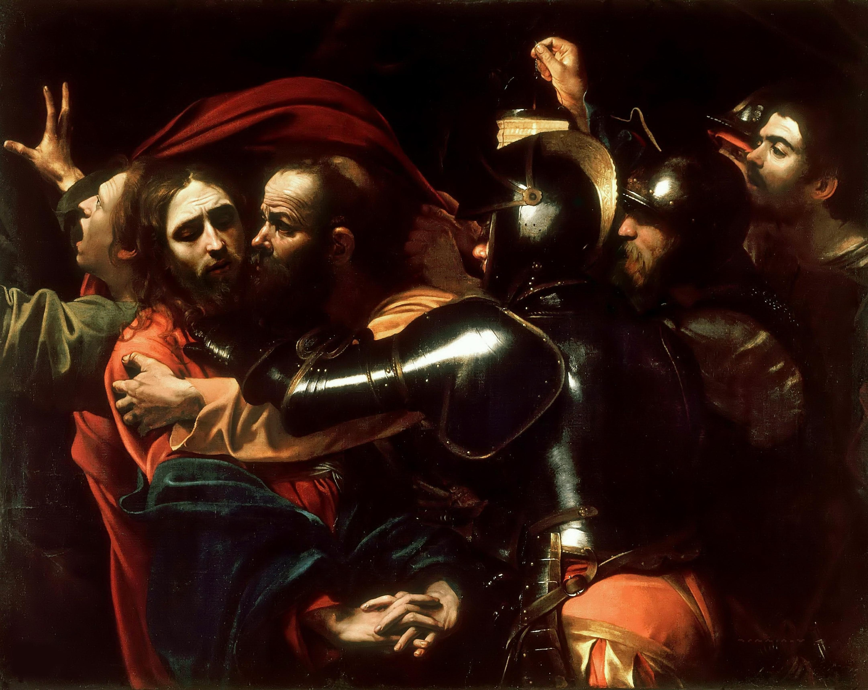
CHIAROSCURO
IDEA 02 / 09
Say it: kee-ARE-uh-SKYOOR-oh. Italian for light dark.
Painters invented this four hundred years before cameras existed. One strong light, deep black around it, and the subject half eaten by the dark. Caravaggio and Rembrandt built careers on it.
Film crews did not invent the horror look. They copied it off museum walls, and so can you. Look at a Caravaggio and you are looking at a lighting diagram.
Caravaggio. One hard light, and black doing the rest of the work.
PHOTOGRAPHY 1A / MR. SILVA / PIONEER VALLEY HIGH SCHOOL

Slide 13
HARD LIGHT AND SOFT LIGHT
IDEA 03 / 10
This is decided by one thing only: how big the light looks from where your subject is standing. Not the wattage. Not the brand. Size, as seen from the face.
Hard light
Soft light
Small source, or a source far away. Shadow edges are sharp enough to cut on. Every wrinkle and texture shows. This is your horror light. Bare bulb or a reflector on the Amaran, pulled back from the subject.
Big source, close to the subject. Shadow edges melt into the light. Skin smooths out. Flattering, calm, safe. Softbox on the Amaran, pushed in close.
Move a light closer and it gets softer and brighter at the same time. Those two things are tied together, and that trips up everybody at first.
PHOTOGRAPHY 1A / MR. SILVA / PIONEER VALLEY HIGH SCHOOL

Slide 14
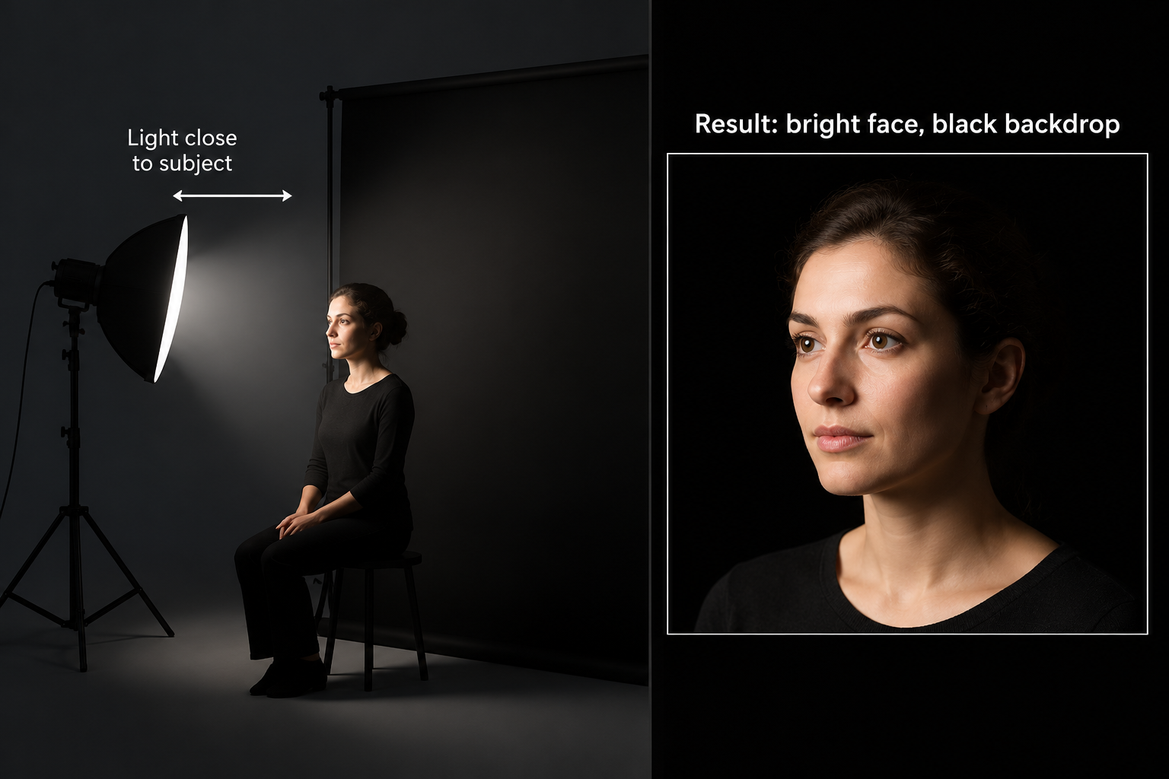
WHY YOUR BACKGROUND GOES BLACK
IDEA 04 / 11
Light does not fade evenly. Move twice as far away and you get a quarter, not a half. That steep drop is called falloff.
01
LIGHT CLOSE TO THE FACE
The face is bright and the backdrop two feet behind goes almost black on its own. Free darkness.
02
LIGHT FAR FROM THE FACE
The face and the backdrop get nearly the same amount. The black backdrop turns gray and the mood dies.
03
SO THE MOVE IS
Pull the subject off the backdrop, then bring the light in close. Do that before touching the camera.
PHOTOGRAPHY 1A / MR. SILVA / PIONEER VALLEY HIGH SCHOOL

Slide 15

LIGHTING RATIO
IDEA 05 / 12
The key is your main light. The fill is anything that lifts the shadow side. The gap between them is your ratio, and the ratio is the mood.
1 to 1
2 to 1
4 to 1
8 to 1 and past
Key and fill equal. Flat, open, friendly. Nothing is hiding.
Gentle shaping. Normal portraits. Most of what you have been doing so far.
Clearly dramatic. The shadow side is dark but you can still read it.
The shadow side goes to black. This is noir. This is the monster.
AT THE ONE LIGHT STATION YOU HAVE NO FILL AT ALL
That means your ratio is as extreme as it gets. The shadow side falls to pure black with nothing to lift it. That is a feature, not a problem. Noir photographers paid good money for that.
PHOTOGRAPHY 1A / MR. SILVA / PIONEER VALLEY HIGH SCHOOL

Slide 16
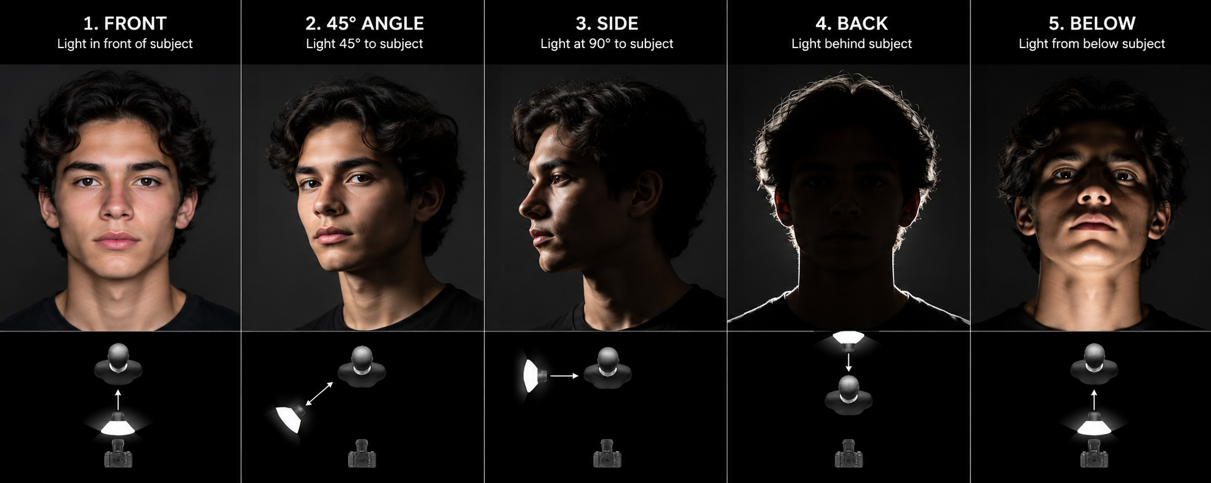
WHERE YOU PUT IT CHANGES EVERYTHING
IDEA 06 / 13
Same light, same person, same camera. Walk the light around them and you get five different photographs.
Front
45 degrees
Side, 90 degrees
Behind, 3/4
Below
Flat and open. Kills shadow. Hardest position to make scary.
The normal portrait spot. Shapes the face without hiding it.
Split lighting. Half the face lit, half gone. The noir position.
Mostly silhouette with a bright edge. The face stays a mystery.
Shadows run upward. Everything about it reads wrong.

Slide 17
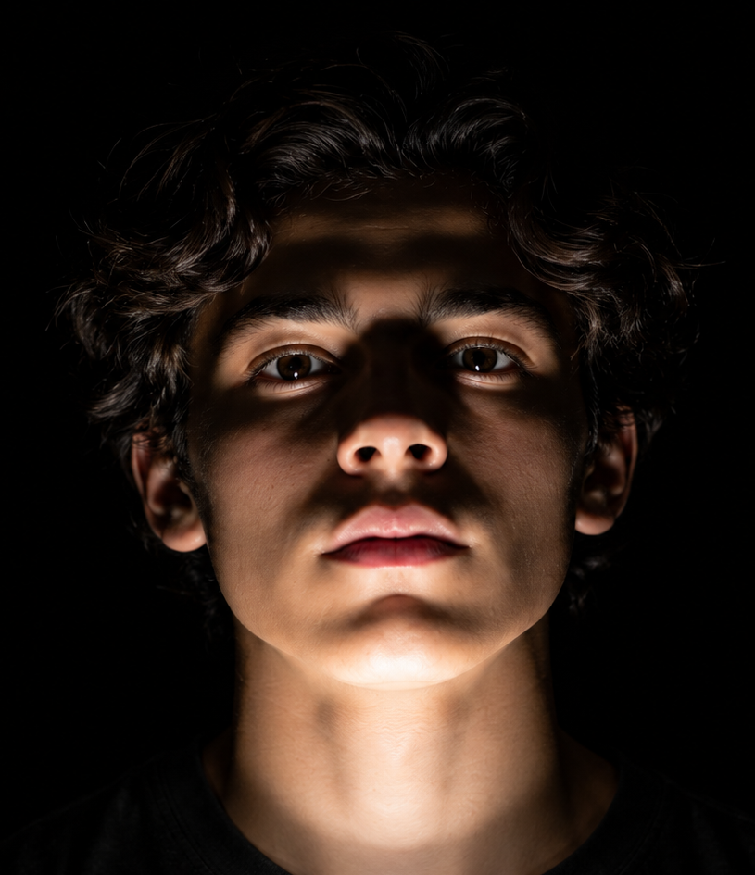
THE MONSTER LIGHT
IDEA 07 / 14
Put the light below the chin and aim it up. This one trick has been scaring people since before film existed, and here is the reason it works.
01
LIGHT HAS COME FROM ABOVE YOUR WHOLE LIFE
The sun, the ceiling, a campfire. Your brain has twenty thousand years of expecting shadows to fall downward.
02
UNDER LIGHT FLIPS IT
Now the shadows climb up. The brow casts upward. The nose shadow runs onto the forehead.
03
YOU FEEL IT BEFORE YOU CAN EXPLAIN IT
Nobody looks at that photo and thinks about shadow direction. They just think something is off.
Light below the chin. The shadows climb up instead of falling down.
PHOTOGRAPHY 1A / MR. SILVA / PIONEER VALLEY HIGH SCHOOL

Slide 18
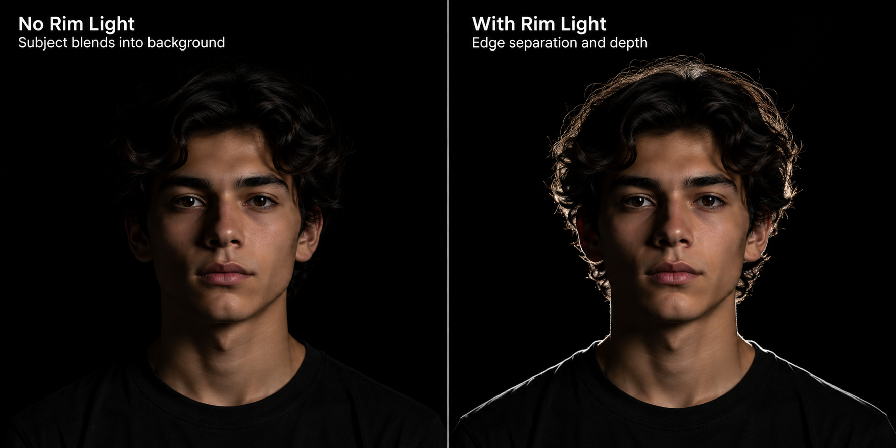
KEEPING A DARK SUBJECT OFF A DARK BACKDROP
IDEA 08 / 15
Dark hair on a black backdrop turns into one black blob. Fixing that is the whole job of a second light, and it is the single biggest upgrade from one light to two.
Rim light
Background light
Negative fill
Second light behind the subject and off to one side, aimed at the edge of the head and shoulder. A thin line carves them off the background.
Aim the second light at the backdrop instead. Now the subject is a dark shape on a glowing pool. This is the silhouette move.
Not a light at all. Hold anything black on the shadow side to soak up stray bounce. Costs nothing and deepens the dark.

Slide 19

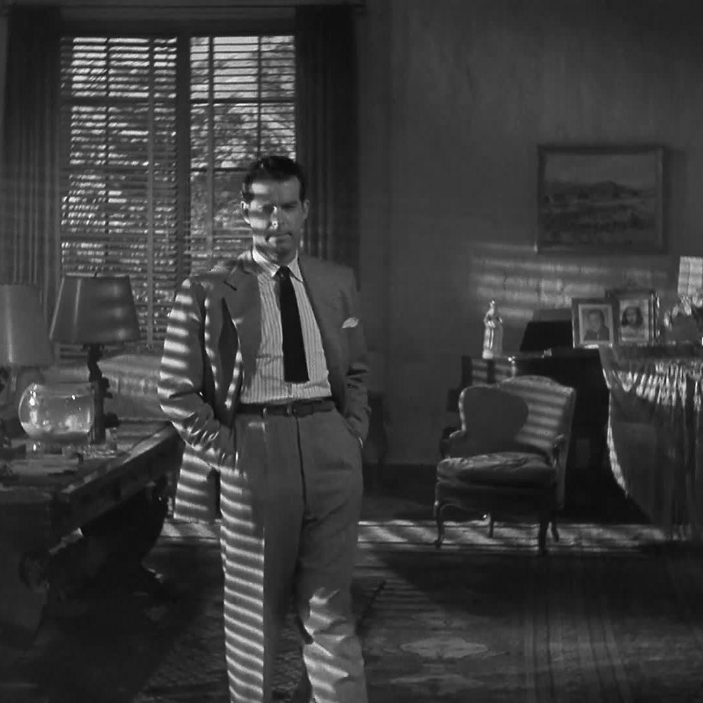
SHADOW PATTERNS
IDEA 09 / 16
Put something between the light and the wall and you get a pattern. Crews call it a gobo or a cookie.
01
IT ONLY WORKS WITH HARD LIGHT
Soft light blurs the pattern into nothing. If your shadow looks mushy, your source is too big or too close.
02
ANYTHING WILL DO
Blinds, a chair back, slatted cardboard, a houseplant, fingers, a cut up cereal box, broken lattice.
03
MOVE THE OBJECT, NOT THE LIGHT
Toward the light for a bigger, softer pattern. Toward the wall for a smaller, sharper one.
Venetian blinds used as a gobo. Only hard light holds an edge this sharp.
PHOTOGRAPHY 1A / MR. SILVA / PIONEER VALLEY HIGH SCHOOL

Slide 20
WHAT COLOR DOES TO A FACE
IDEA 10 / 17
Your Amaran lights do any color you want. Pick one for a reason, and stop at two.
Deep blue
Sickly green
Blood red
Moonlight, cold, lifeless. The default for night in film.
Wrong, infected, fluorescent basement. Very hard to look healthy under.
Alarm, danger, heat. Crushes skin detail, which can work for you.
Amber and orange
Magenta and purple
Two colors at once
Firelight. Warm from the front, but hellish when it is hard and low.
Dreamlike and supernatural. Reads as not quite real.
Blue rim against an amber key. Tension you can see.
TURN AUTO WHITE BALANCE OFF FIRST
Auto white balance exists to remove color casts. Leave it on and the camera fights you, cancels your red, and hands back a muddy gray photo. Set it to daylight and leave it.
PHOTOGRAPHY 1A / MR. SILVA / PIONEER VALLEY HIGH SCHOOL

Slide 21
03
WHAT IS ON THE FLOOR
YOUR TWO STATIONS
One light on one backdrop. Two lights on the other. Here is what each can actually do, and what it cannot.
PHOTOGRAPHY 1A / MR. SILVA / PIONEER VALLEY HIGH SCHOOL

Slide 22
STATION A: ONE LIGHT
SETUP / 18
One light sounds like a limit. It is the exact setup Karl Freund used on Dracula. The restriction is what forces the choice to be strong.
What it does well
What it cannot do
Split light and hard shadow. Full silhouette. Under light. Pure black backdrop with almost no effort, because falloff does it for you.
Lift the shadow side, and separate dark hair from a dark backdrop. If your subject disappears into the background, that is the one light limit showing.
STARTING POINT AT STATION A
Subject four to six feet off the backdrop. Light at head height or lower, close in, hard reflector, no softbox. Then walk the light around them and watch the face change. Make a frame at every stop.
PHOTOGRAPHY 1A / MR. SILVA / PIONEER VALLEY HIGH SCHOOL

Slide 23
STATION B: TWO LIGHTS
SETUP / 19
The second light is not a brighter version of the first. Give it a different job, or you have wasted it.
Job one: rim
Job two: glow
Job three: clash
Key on the face, second light behind and to the side on the edge of the head. The professional default on a black backdrop.
Key on the face, second light pointed at the backdrop. The subject sits dark on a colored pool of light.
Two different colors from two different sides. Nothing in the real world looks like this, which is the point.
STARTING POINT AT STATION B
Build it one light at a time. Turn the second one off, get the key exactly right, then bring the second up only until it does its job. If you cannot tell what the second light is for, turn it off.
PHOTOGRAPHY 1A / MR. SILVA / PIONEER VALLEY HIGH SCHOOL

Slide 24
CAMERA SETTINGS TO START FROM
SETTINGS / 20
These are a starting point, not an answer. Full manual mode, the way we always work.
Mode
Shutter
Aperture
ISO
Manual. You set aperture, shutter, and ISO yourself.
1 over 125. Never slower than 1 over 60 handheld or you will get blur.
f4 to f5.6. Enough depth that the whole face stays sharp.
Start at 400. Raise it only after the light is already where you want it.
Expose for the bright part of the face
White balance on daylight
Let the shadows go black. Do not rescue them. If the meter says the photo is too dark, the meter is wrong, because it wants everything gray.
Not auto. Auto will erase the color you just spent five minutes setting up.
PHOTOGRAPHY 1A / MR. SILVA / PIONEER VALLEY HIGH SCHOOL

Slide 25
WORDS YOU WILL HEAR ON SET
VOCABULARY / 21
Key light
Fill light
Rim or kicker
The main light. The one making the shadows you notice.
Anything that lifts the shadow side. A light, a wall, or a white card.
A light from behind that draws a bright edge around the subject.
Practical
Falloff
Gobo or cookie
A light that is visible in the photo. A lamp, a candle, a phone screen.
How fast light dies with distance. Close light falls off fast.
Anything placed in front of a light to cast a pattern.
Low key
Chiaroscuro
Negative fill
Mostly shadow, small lit areas. The horror and noir look.
Strong light against deep dark, borrowed from painting.
Black material used to take light away instead of adding it.
PHOTOGRAPHY 1A / MR. SILVA / PIONEER VALLEY HIGH SCHOOL

Slide 26
SPOOKY VERSUS CHEAP
JUDGMENT / 22
Everybody can make a dark photo with a weird face in it. Here is what separates the ones that actually work.
Works
Falls apart
One clear light source you can point to. Shadow that hides something specific. Eyes you can find, even if barely. A background that is black on purpose. Color chosen for a reason.
Light coming from everywhere, so nothing is shaped. A face so dark there is nothing to look at. Four colors fighting. A gray backdrop that was supposed to be black. A scary costume doing all the work.
The monster is never the scary part. What you cannot quite see is the scary part.
PHOTOGRAPHY 1A / MR. SILVA / PIONEER VALLEY HIGH SCHOOL

Slide 27

BEFORE YOU PRESS THE SHUTTER
WRAP UP / 23
Every DP on every one of those films asked themselves the same three questions. Ask them at your station.
Where is my light coming from?
What am I hiding?
Would this still work in black and white?
You should be able to point at it without looking. If you cannot name the direction, neither can the photo.
Shadow should be covering something on purpose. Hiding nothing in particular just reads as a dark photo.
If the answer is no, the color is carrying a picture that the lighting should be carrying.
You are about to do with two lights what a studio once needed a crew of forty to pull off. Go make something that would have scared 1931.
PHOTOGRAPHY 1A / MR. SILVA / PIONEER VALLEY HIGH SCHOOL

