Slide 1

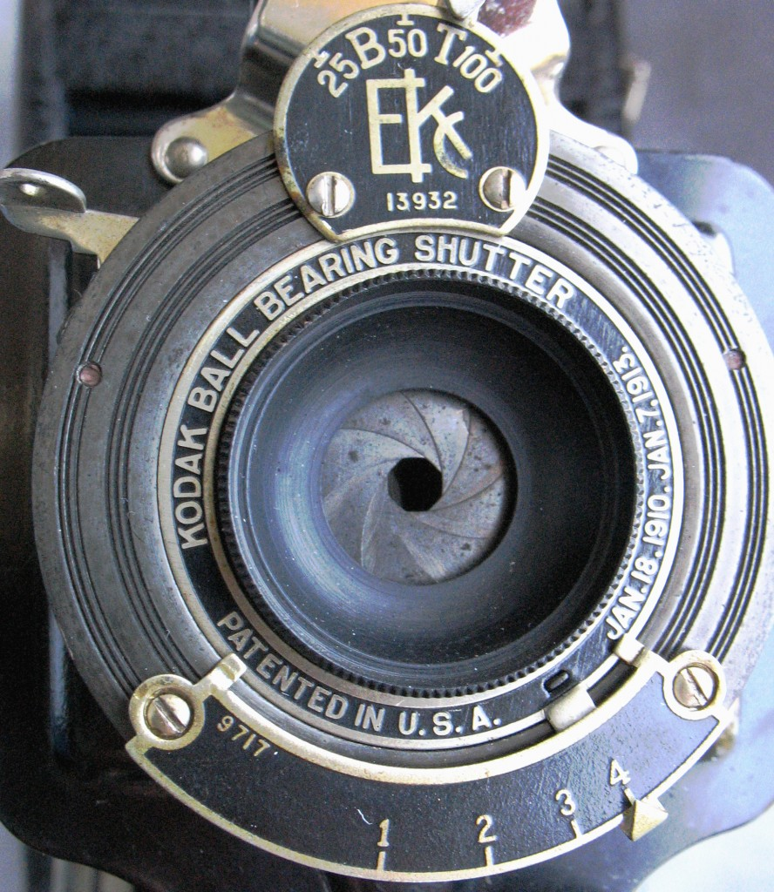

PHOTOGRAPHY 1 / CAMERA FUNDAMENTALS
APERTURE
PART 1: HOW APERTURE WORKS
The opening inside your lens, the f-stop numbers, and what they do to your photo.
CANON EOS R50 & 50MM RF 1.8
MR. SILVA / PIONEER VALLEY HIGH SCHOOL

Slide 2

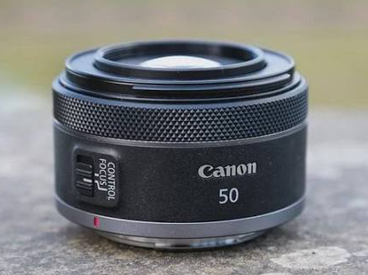
WHAT YOU WILL LEARN
OUTCOMES / 01 / 22
01
NAME THE PARTS THAT CONTROL LIGHT
You will know what the aperture is and where it sits inside your lens.
02
READ ANY F-STOP NUMBER
You will look at f/1.8 or f/11 and know right away how open the lens is.
03
USE THE BACKWARDS RULE
You will remember that a small number means a big opening, every time.
04
SET APERTURE ON THE R50
You will put the camera in Av mode and choose your own f-stop.
05
KNOW WHAT YOUR LENSES CAN DO
You will know the widest aperture on each lens in our kit.
Aperture is one of three controls that decide how a photo looks. Part 1 is about light. Part 2 is about focus.

Slide 3

INDUSTRY VOCABULARY
KEY WORDS / 02 / 22
Aperture
F-stop
The opening inside your lens that lets light through. You can make it wider or smaller.
The number that tells you how wide the aperture is open. It is written like f/4 or f/5.6.
Diaphragm
Stop
The ring of thin metal blades inside the lens. They slide open and closed to change the aperture.
One full step of light. Move one stop and you either double the light or cut it in half.
These four words show up in every camera manual, every lens review, and every job on a set. Learn them now and the rest of the unit reads easily.

Slide 4
INDUSTRY VOCABULARY
KEY WORDS / 03 / 22
Maximum aperture
Fast lens
The widest a lens can open. It is printed right on the front of the lens.
A lens with a very wide maximum aperture, like f/1.8. It lets in a lot of light.
Variable aperture
Depth of field
A zoom lens whose widest opening gets smaller as you zoom in. Most kit lenses work this way.
How much of the photo looks sharp from front to back. Part 2 covers this in full.
Maximum aperture is the number that decides what a lens can do in a dark room. It is the first thing a photographer checks before picking a lens for a job.

Slide 5

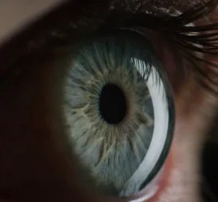
WHAT IS APERTURE?
CONTENT / 04 / 22
Think about the pupil in your eye. In a dark room it opens wide. In bright sun it shrinks. Your lens does the same thing.
01
A HOLE YOU CONTROL
The aperture is an opening inside the lens. You decide how wide it opens.
02
IT SETS HOW MUCH LIGHT GETS IN
A wider opening lets more light reach the sensor.
03
IT CHANGES WHAT LOOKS SHARP
Aperture controls depth of field too. That is all of Part 2.
Your eye and your lens solve the same problem.

Slide 6
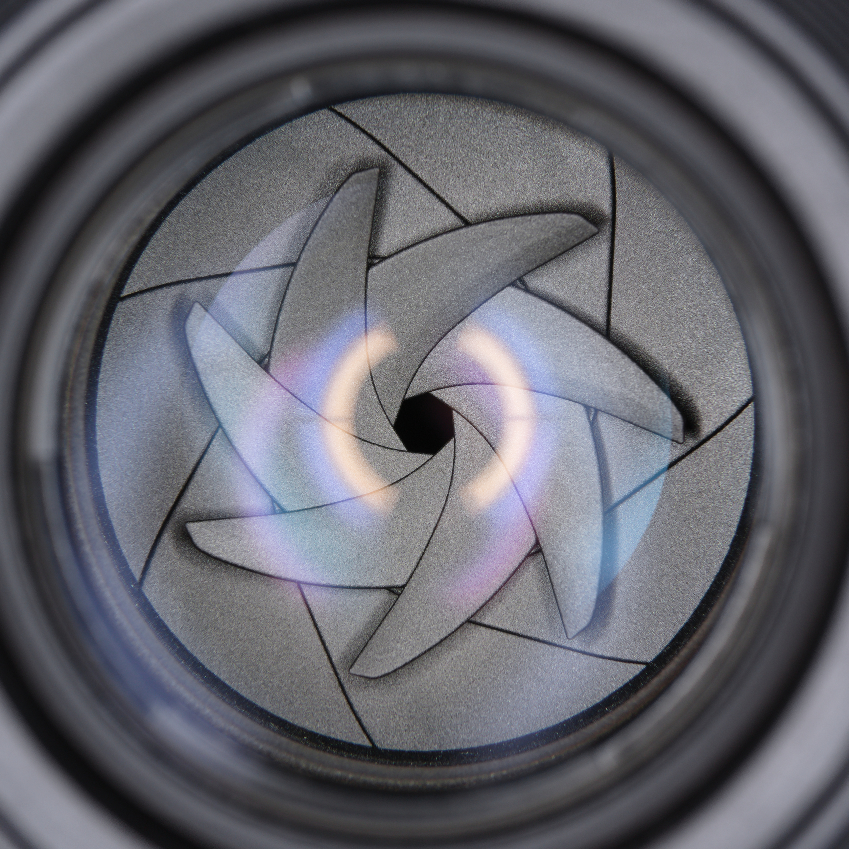
INSIDE THE LENS
CONTENT / 05 / 22
01
LOOK FOR THE BLADES
Inside every lens is a ring of thin metal blades called the diaphragm.
02
THEY SLIDE, THEY DO NOT SWAP
The blades slide across each other to open a bigger or smaller hole.
03
THE SHAPE MATTERS LATER
How many blades there are changes the look of out of focus lights. That is bokeh.
Take a lens off the camera and look through the back. You can watch the blades move.
The diaphragm, stopped down. Count the blades.

Slide 7
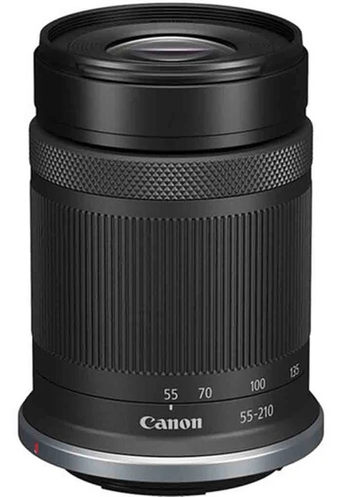
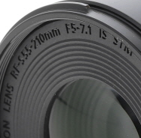
WHAT THE F-NUMBER MEANS
CONTENT / 06 / 22
01
THE SLASH IS DOING REAL WORK
f/4 is written like a fraction on purpose. The opening is about one fourth as wide as the lens is long.
02
SO F/2 IS A BIGGER SLICE
One half is bigger than one fourth. That is why f/2 is wider than f/4.
03
THAT IS THE WHOLE TRICK
Once you see it as a fraction, the numbers stop feeling backwards.
Say it out loud as a fraction. "f four" becomes "one fourth" and the size makes sense. Every lens has its focal length printed on it, and the f-number is measured against that length, which is why f/2 on a short lens and f/2 on a long lens let in the same amount of light.

Slide 8

THE BACKWARDS RULE
RULES / 07 / 22
THIS IS THE ONE THING TO MEMORIZE TODAY
Small number, big opening
Big number, small opening
f/1.8 is a wide opening. Lots of light. Good for dark rooms and blurred backgrounds.
f/16 is a tiny opening. Very little light. Good for bright sun and keeping everything sharp.
It feels backwards because the number is the bottom of a fraction. A bigger bottom number always means a smaller slice. One sixteenth is smaller than one half.
REMEMBER THIS ONE LINE
Small f-number means big opening. If you take nothing else from today, take that.

Slide 9
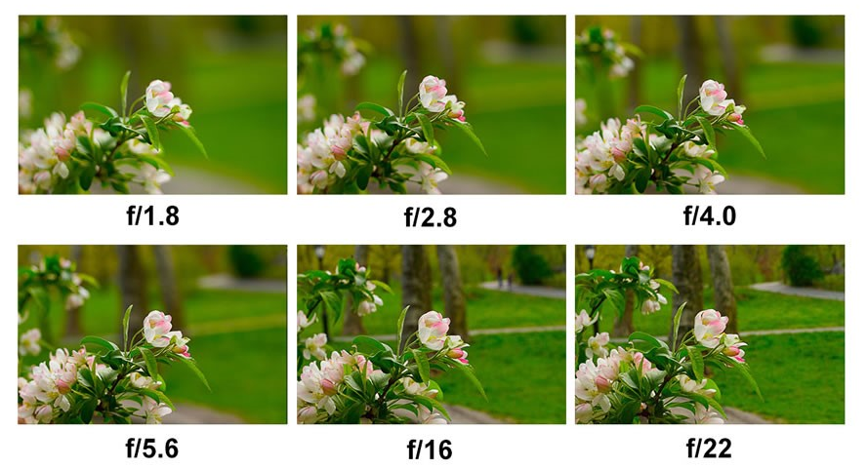
SEE THE OPENING CHANGE
CONTENT / 08 / 22
Same lens, five f-stops. Nothing changes except how much light can get through.
LEFT TO RIGHT: WIDE OPEN TO STOPPED DOWN

Slide 10
THE FULL F-STOP SCALE
REFERENCE / 09 / 22
WIDE OPEN
STOPPED DOWN
f/1.4
f/2
f/2.8
f/4
f/5.6
f/8
f/11
f/16
f/22
MORE LIGHT
LESS LIGHT
These are the full stops. Every step to the right cuts the light in half. Every step to the left doubles it.
Your camera moves in one third stops, so you will also see f/3.2 and f/4.5 in between. Those are fine. The full stops above are the ones to memorize.
COUNT IT YOURSELF
f/4 to f/8 is two full stops, so f/8 gets one quarter of the light. f/4 to f/2 is one stop wider, so f/2 gets twice as much.

Slide 11
WHAT ONE STOP DOES
CONTENT / 10 / 22
01
ONE STOP WIDER DOUBLES THE LIGHT
f/2.8 to f/2
Going from f/5.6 to f/4 lets in twice as much light.
ONE STOP SMALLER HALVES IT
One stop wider. Twice the light hits the sensor.
02
Going from f/4 to f/5.6 cuts the light in half.
03
STOPS ARE THE SHARED LANGUAGE
Aperture, shutter speed and ISO are all measured in stops.
f/2.8 to f/5.6
HALF IS A BIG CHANGE
Two stops smaller. Only one quarter of the light.
Two stops is a quarter of the light. Three stops is an eighth.
Count the steps on the scale to count the stops.
You are at f/5.6 and the photo is too dark. Open to f/4 and you have doubled the light. Open again to f/2.8 and you have four times what you started with.

Slide 12
APERTURE NEVER WORKS ALONE
CONTENT / 11 / 22
Every photo needs a certain amount of light to look right. Aperture is one of three ways to control it. Change one and you have to change another to stay balanced.
Aperture
Shutter speed
ISO
How wide the lens opens. Also controls depth of field.
How long the sensor is exposed. Also controls motion blur.
How sensitive the sensor is. Also controls picture noise.
Photographers call these three the exposure triangle. Open the aperture one stop and the camera can use a shutter speed one stop faster.

Slide 13

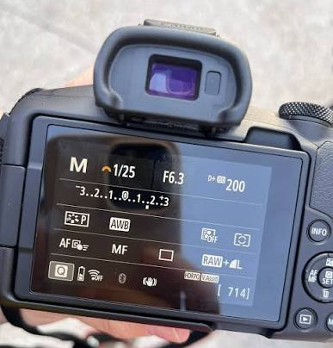
READ WHAT THE CAMERA TELLS YOU
STEP 2 / 14 / 22
04
WATCH THE SHUTTER SPEED MOVE
Open the aperture and it gets faster. Close it and it slows down.
05
CHECK THE EXPOSURE METER
It should sit at zero. If not, the scene is too bright or too dark for that f-stop.
06
TAKE THE PHOTO AND LOOK
Review it on screen. Ask if the brightness and the sharp area look the way you wanted.
Everything you need is on one screen.

Slide 14
THE TRAP IN AV MODE
WARNING / 15 / 22
AV WILL HAND YOU A SHUTTER SPEED TOO SLOW TO HOLD
Your photo comes out blurry and it is not the focus, it is camera movement.
The safe number
If it drops below
Keep your shutter speed at 1/60 or faster when the camera is in your hands.
Open the aperture wider, raise the ISO, or put the camera on a tripod.
Build the habit: glance at the shutter speed every time you change the f-stop. It takes half a second and it saves the photo.
Av mode is not being careless. You told it the aperture matters most, so shutter speed is the only setting it has left to move.

Slide 15

THE THREE LENSES IN OUR KIT
REFERENCE / 16 / 22
RF-S 18-45MM
The kit zoom. Wide to short telephoto. Your everyday lens.
f/4.5 to f/6.3
RF 50MM
The prime. Does not zoom. By far the widest opening we own.
f/1.8
RF-S 55-210MM
The long zoom. Reaches far. The smallest maximum opening of the three.
f/5 to f/7.1
THE HIGHLIGHTED NUMBER IS THE MAXIMUM APERTURE
It is the widest that lens will ever open, and it is printed on the front of the barrel.

Slide 16
WHY ZOOMS LIST TWO NUMBERS
CONTENT / 17 / 22
01
LOOK AT F/4.5 TO 6.3 AGAIN
18-45mm zoom
That is not a range you choose. It is what the widest opening becomes as you zoom.
f/4.5 at the wide end. f/6.3 at the long end.
02
ZOOMED OUT YOU GET F/4.5
At 18mm the lens can open to f/4.5, its widest.
03
ZOOMED IN YOU ONLY GET F/6.3
50mm prime
At 45mm the widest it will go is f/6.3. You just lost light by zooming.
f/1.8 at every focal length, because it has only one.
THIS ONE SURPRISES PEOPLE
Zoom in during a dark gym and the camera quietly takes light away from you.
Primes hold their maximum aperture. Zooms often do not.

Slide 17
FAST LENSES AND SLOW LENSES
CONTENT / 18 / 22
In the industry a lens is called fast or slow. It has nothing to do with focusing speed. It describes the maximum aperture.
Fast lens
Slow lens
Wide maximum aperture, around f/1.8 or f/2.8. Lets in a lot of light, so the shutter speed can be fast.
Narrow maximum aperture, around f/5.6 or f/6.3. Needs more light, so the shutter speed has to be slower.
Our RF 50mm f/1.8 is a fast lens. Our 55-210mm at f/7.1 is a slow lens. Same camera, very different results indoors. Look at the front of any lens and you will find its maximum aperture printed there.

Slide 18
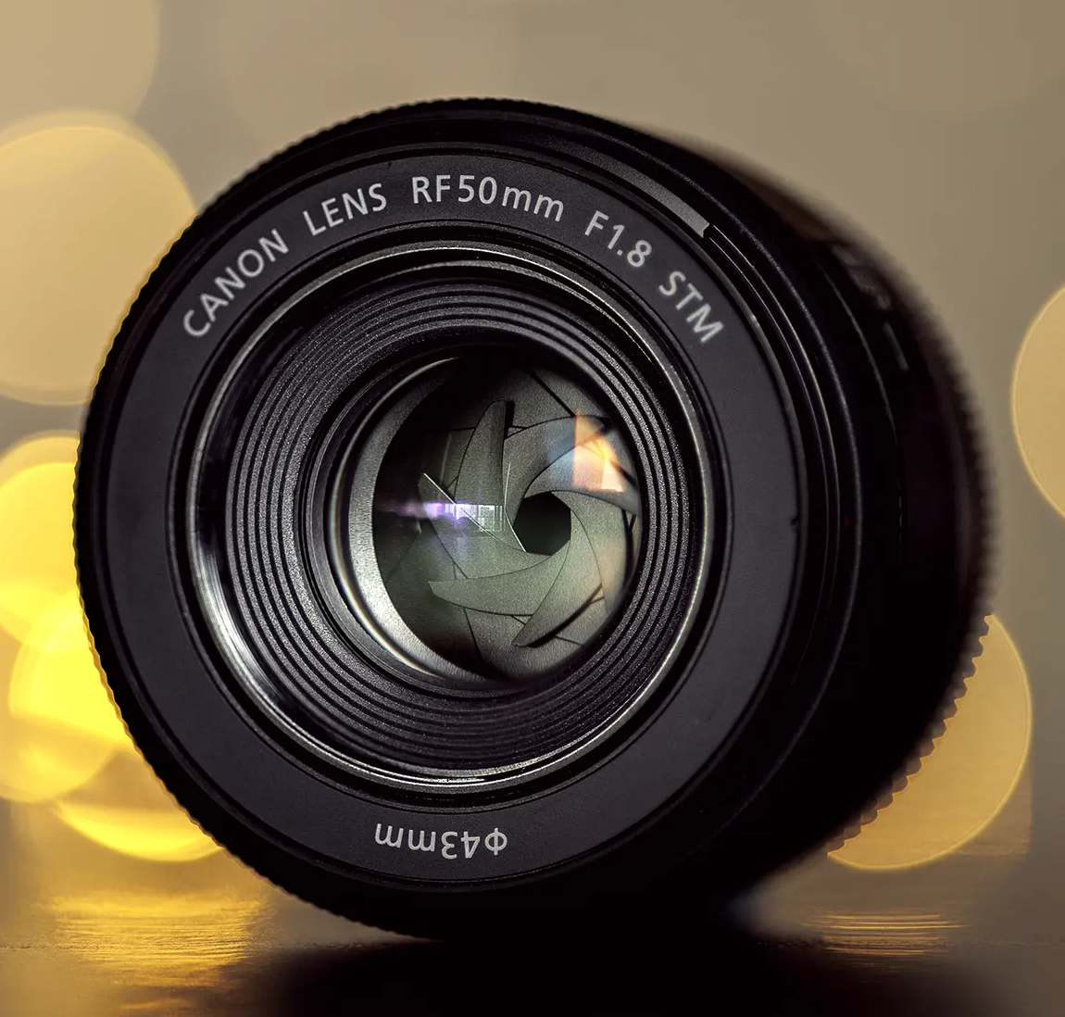
WHY THE 50MM IS WORTH GRABBING
CONTENT / 19 / 22
01
IT OPENS TO F/1.8
IMG-08
About three stops wider than the kit zoom at f/6.3. Eight times more light.
02
IT SAVES YOU INDOORS
Often the only lens in the kit that gets a clean photo without a tripod.
03
IT BLURS BACKGROUNDS BEST
A wide opening gives the shallowest depth of field in our kit.
04
YOU ZOOM WITH YOUR FEET
It does not zoom, so you walk closer or step back. That makes you frame on purpose.
RF 50mm f/1.8 STM. The fastest lens we own.

Slide 19
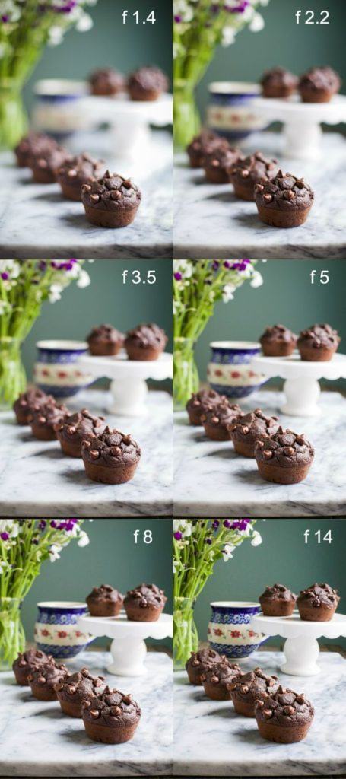
APERTURE IN LOW LIGHT
CONTENT / 20 / 22
01
OPEN UP BEFORE YOU RAISE ISO
A wider aperture adds light for free. Raising ISO adds light and also adds noise.
02
THEN CHECK YOUR SHUTTER SPEED
If it is still under 1/60, you have run out of aperture and ISO is the next move.
03
THEN THINK ABOUT SUPPORT
A tripod or a steady surface lets you use a slow shutter speed without blur.
Order of operations indoors: open the aperture, raise the ISO, add support. In that order.

Slide 20

CHECK YOURSELF
STUDY / 21 / 22
01
WHICH LETS IN MORE LIGHT, F/2.8 OR F/8?
02
YOU MOVE FROM F/4 TO F/5.6. DID THE LIGHT DOUBLE OR GET CUT IN HALF?
03
WHAT IS THE MAXIMUM APERTURE OF OUR RF 50MM PRIME?
04
YOUR KIT ZOOM READS F/4.5 TO 6.3. WHAT HAPPENS WHEN YOU ZOOM IN?
05
IN AV MODE, WHICH SETTING DO YOU CHOOSE AND WHICH DOES THE CAMERA CHOOSE?
Answer all five out loud with a partner before you pick up a camera.

Slide 21
WHAT YOU KNOW NOW
RECAP / 22 / 22
Aperture is an opening
The number is a fraction
A ring of blades inside the lens that you open and close.
Small f-number means a big opening. Big f-number means a small one.
Stops are steps of light
Av puts you in charge
One stop either doubles the light or cuts it in half.
You set the f-stop. The camera sets the shutter speed.
You also know our kit: f/4.5 to 6.3 on the 18-45mm, a fast f/1.8 on the 50mm prime, f/5 to 7.1 on the 55-210mm.

Slide 22
COMING UP IN PART 2
NEXT MODULE
Part 1 was about light. Part 2 is about focus. You will learn what depth of field is, how aperture changes it, and how focal length and your distance change it just as much.
Depth of field
Focal length
Your distance
What it is and how to see it in a photo.
Why 210mm blurs more than 18mm at the same f-stop.
Why stepping closer blurs the background too.
Bring your camera and bring questions. Part 2 is where aperture stops being a number and starts changing how your photos actually look.
PHOTOGRAPHY 1 / MR. SILVA / PIONEER VALLEY HIGH SCHOOL

