Slide 1

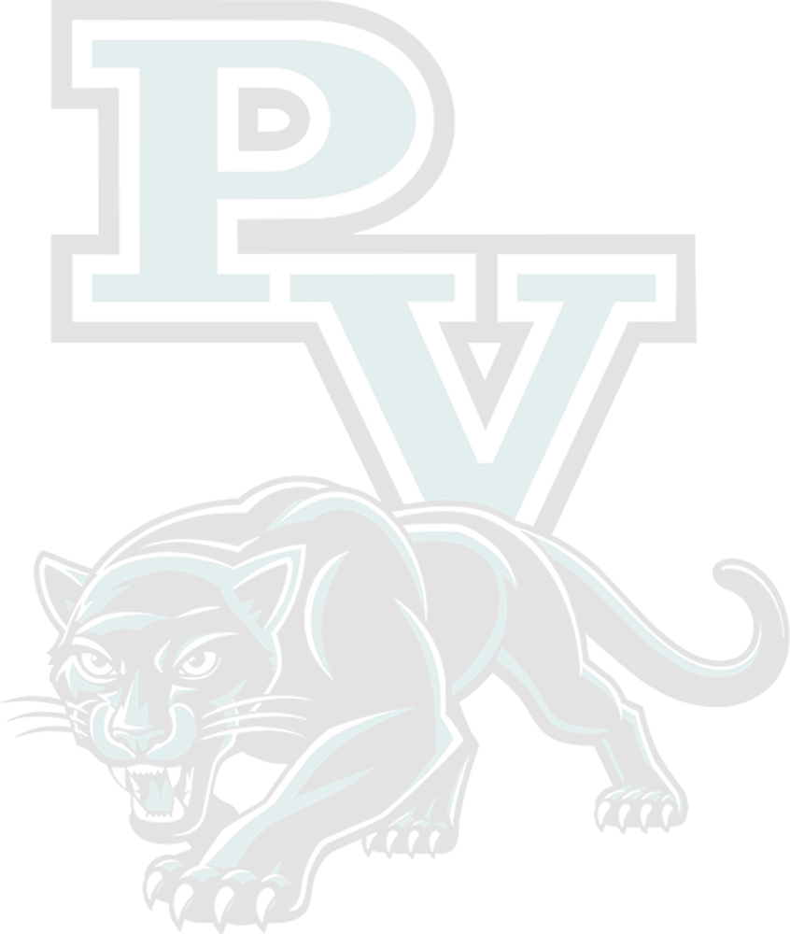
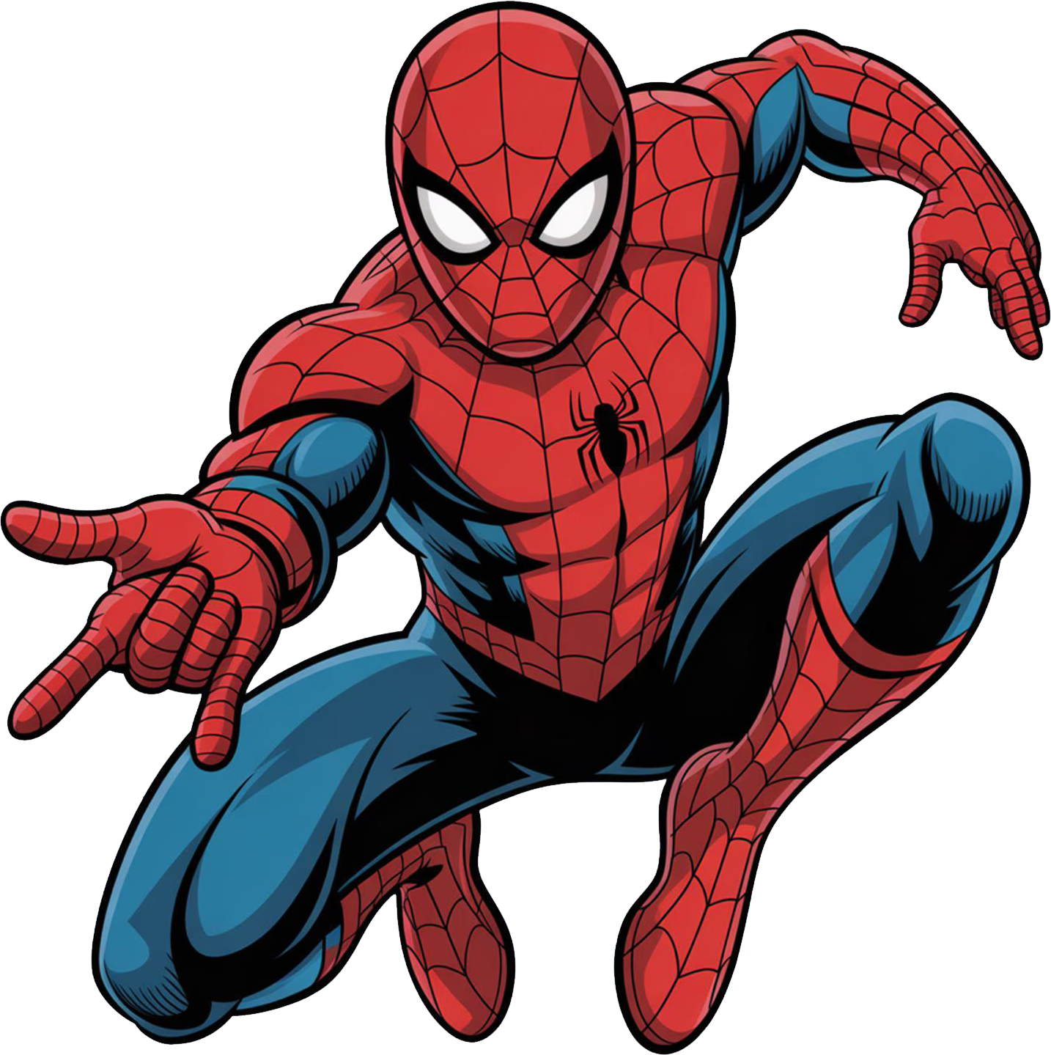
DIGITAL ARTS 1A / MR. SILVA
7 Elements of Art
in Cartoon Characters
12 Characters / 12 Breakdowns / One Framework
Mickey / SpongeBob / Pikachu / Batman / Bugs Bunny / Homer
Totoro / Finn / Spider-Man / Goku / Elsa / Invader Zim
MR. SILVA / PIONEER VALLEY HIGH SCHOOL

Slide 2
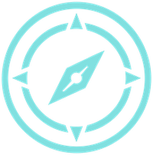
THE 7 ELEMENTS OF ART
OVERVIEW / 00 / 15
Every visual decision a character designer makes connects back to one of these seven tools.
01
LINE
05
VALUE
A mark that travels. Controls direction, energy, and edge.
Light and dark. Reveals form, creates atmosphere, and directs the eye.
02
SHAPE
06
TEXTURE
A closed area defined by an outline. The silhouette that makes recognition instant.
Surface quality, rough, smooth, soft, hard. Creates tactile presence.
03
FORM
07
SPACE
Three-dimensional volume. Makes a character feel solid and present.
The area around and between forms. Controls scale, depth, and relationships.
04
COLOR
Hue, saturation, and temperature. Communicates mood before the story does.
MR. SILVA / PIONEER VALLEY HIGH SCHOOL

Slide 3
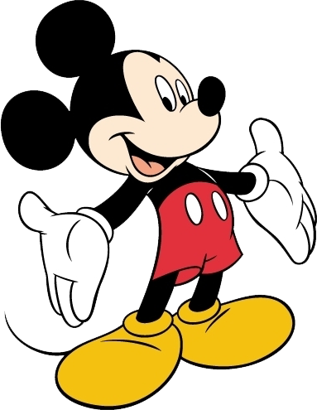
ELEMENTS OF ART IN THIS CHARACTER
01 / 12 / 15
01
Disney / 1928
SH
SHAPE
Mickey is built from three perfect circles stacked together, ears and head. This geometric shorthand made him recognizable at any size, from a postage stamp to a parade balloon.
Mickey Mouse
LN
LINE
Every outline is thick and smooth, drawn with consistent line weight and almost no variation. Those clean, confident lines made Mickey easy to animate frame after frame without losing his identity.
CL
COLOR
"The original shape formula"
The black, white, and red palette uses maximum contrast to separate Mickey from any background. There are no gradients, no shadows in early Mickey, just flat color doing the job.
KEY ELEMENTS
SHAPE
LINE
COLOR
MR. SILVA / PIONEER VALLEY HIGH SCHOOL

Slide 4
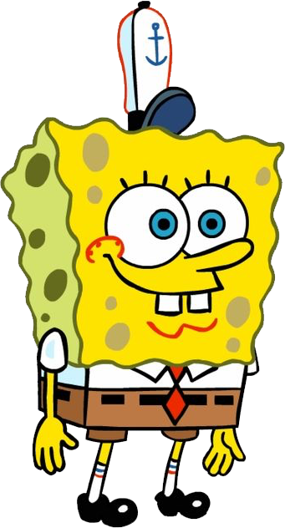
ELEMENTS OF ART IN THIS CHARACTER
02 / 12 / 15
02
Nickelodeon / 1999
SH
SHAPE
SpongeBob is literally a square sponge, the shape IS the character concept. Stephen Hillenburg made the shape match the name on purpose. Every rectangle in his design reminds you of what he is before he says a word.
SpongeBob
TX
TEXTURE
The dotted pore pattern covering his body gives SpongeBob an instantly readable surface. Texture here is not decoration, it is character information. You know what he is made of the moment you look at him.
CL
COLOR
"Texture as personality"
That saturated yellow against the blue ocean environment creates a pop that makes SpongeBob visible in any scene. The warm yellow reads as happy and energetic before he even moves.
KEY ELEMENTS
SHAPE
TEXTURE
COLOR
MR. SILVA / PIONEER VALLEY HIGH SCHOOL

Slide 5
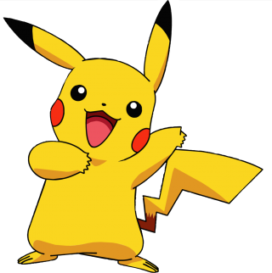
ELEMENTS OF ART IN THIS CHARACTER
03 / 12 / 15
03
Pokemon / 1996
SH
SHAPE
Pikachu's silhouette is built from simple rounded forms, oval body, pointed ears with dark tips, lightning-bolt tail. Cover the color and you still know exactly who it is from the outline alone. That is professional silhouette design.
Pikachu
CL
COLOR
Electric yellow is the central design choice, it reads as energy and speed before you know anything about the character. The red circles on the cheeks break the yellow with a warm accent that guides your eye.
VA
VALUE
"Shape designed for instant recognition"
Pikachu uses subtle value shifts on the ear tips and cheek circles to create just enough depth on an otherwise flat design. Those darks prevent the character from looking like a cut-out sticker.
KEY ELEMENTS
SHAPE
COLOR
VALUE
MR. SILVA / PIONEER VALLEY HIGH SCHOOL

Slide 6
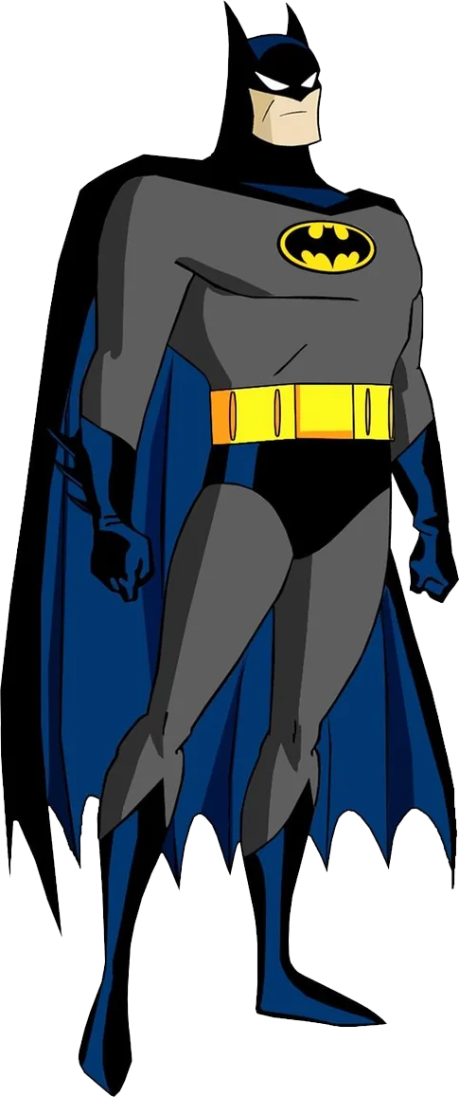
ELEMENTS OF ART IN THIS CHARACTER
04 / 12 / 15
04
DC / Warner Bros. / 1992
VA
VALUE
Batman: The Animated Series was deliberately painted on BLACK paper, an industry first. The entire series lives in dark values with light used sparingly to define form. Value creates mood, threat, and atmosphere without any extra visual noise.
Batman (BTAS)
SH
SHAPE
Batman's silhouette is designed to be intimidating, the cape spreads into an angular shadow shape, and the ears push the figure vertical and sharp. Every shape choice reads as dangerous and precise.
LN
LINE
"Value doing all the heavy lifting"
Art Deco architecture in the background uses bold, rigid vertical and diagonal lines that reinforce the city's oppressive feel. Line direction is a storytelling choice throughout. Horizontal lines signal calm; sharp diagonals signal threat.
KEY ELEMENTS
VALUE
SHAPE
LINE
MR. SILVA / PIONEER VALLEY HIGH SCHOOL

Slide 7
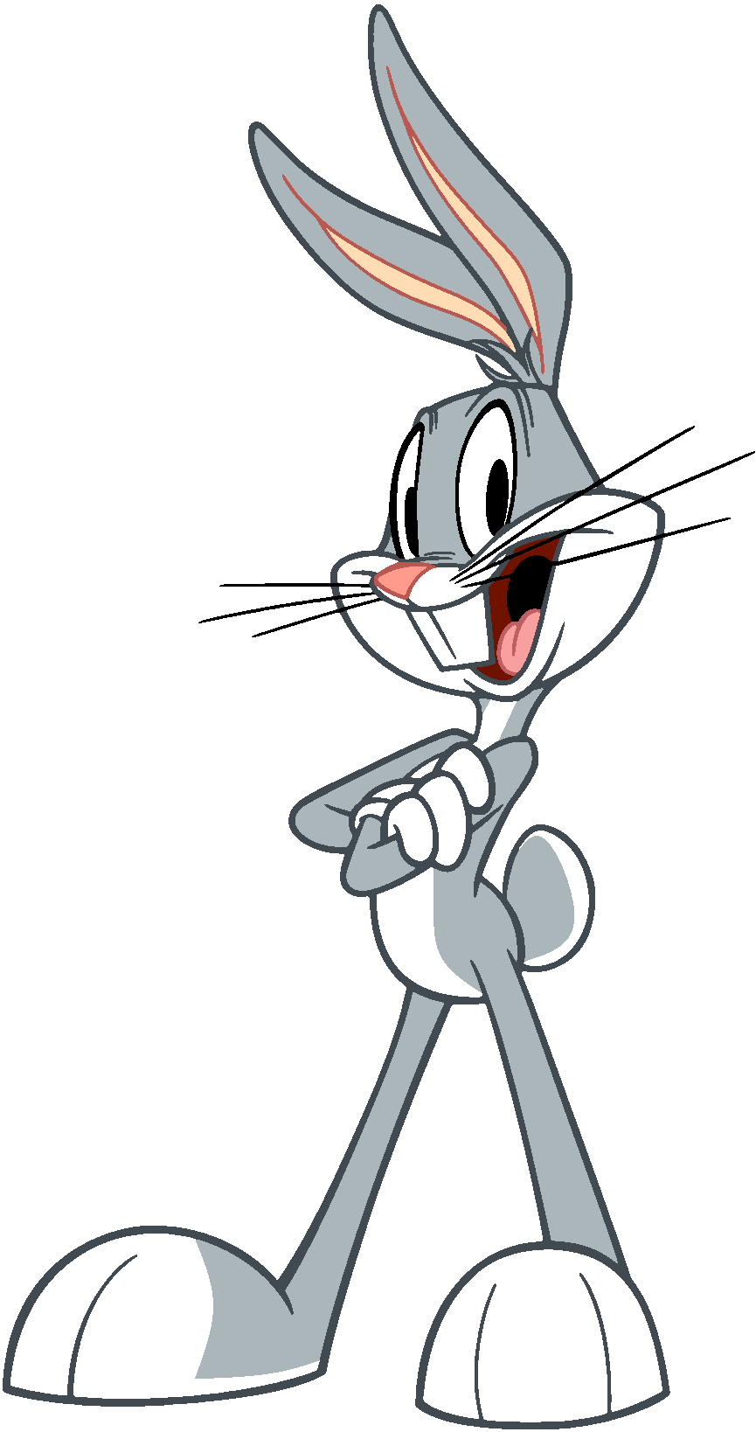
ELEMENTS OF ART IN THIS CHARACTER
05 / 12 / 15
05
Looney Tunes / 1940
LN
LINE
Bugs is drawn with curved, elastic lines that suggest constant motion and intelligence. Nothing in his design is stiff or rigid, even at rest, those lines suggest he could spring at any moment.
Bugs Bunny
FM
FORM
Chuck Jones and the team gave Bugs volume and weight through overlapping forms, the barrel chest, round belly, and thick limbs feel three-dimensional even in 2D. Form makes him feel physical and present in the scene.
SH
SHAPE
"Fluid line as character energy"
The long ears are Bugs's shape signature, they shift between relaxed, alert, and expressive depending on his mood. Shape designers use character features as visual vocabulary for emotion.
KEY ELEMENTS
LINE
FORM
SHAPE
MR. SILVA / PIONEER VALLEY HIGH SCHOOL

Slide 8
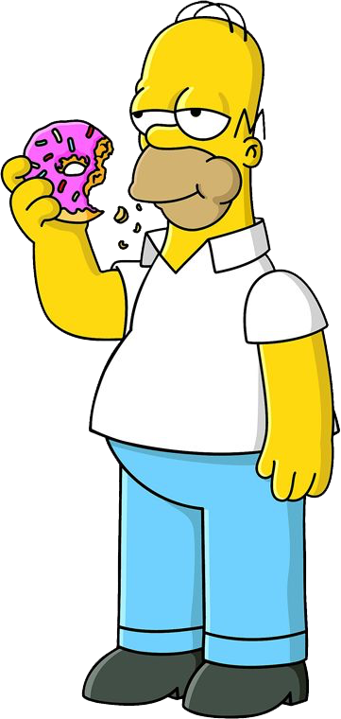
ELEMENTS OF ART IN THIS CHARACTER
06 / 12 / 15
06
The Simpsons / 1989
SH
SHAPE
Homer's D-shaped silhouette, round belly pushing forward, slumping back, communicates laziness and middle-age spread without a single line of dialogue. The rounder and more slumped, the funnier.
Homer Simpson
CL
COLOR
The Simpson yellow skin pops against any background and immediately signals this is an animated world with its own rules. That yellow was chosen to stop channel-surfing audiences mid-flip. Color creates world identity.
LN
LINE
"Shape language for instant comedy"
Five-o-clock stubble drawn as a simple broken outline ring, and the hair as just two connected spikes. The Simpsons proves that fewer lines done with intention beat complex linework every time.
KEY ELEMENTS
SHAPE
COLOR
LINE
MR. SILVA / PIONEER VALLEY HIGH SCHOOL

Slide 9
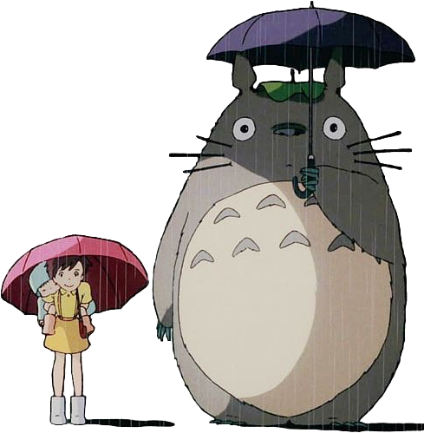
ELEMENTS OF ART IN THIS CHARACTER
07 / 12 / 15
07
Studio Ghibli / 1988
FM
FORM
Totoro's massive rounded body has undeniable volume and weight, he feels like he would be soft to the touch. Hayao Miyazaki designed him as pure round form to signal safety and gentleness. Form communicates character before the audience is told who he is.
Totoro
TX
TEXTURE
Dense fur drawn with thousands of short strokes gives Totoro tactile presence, you want to touch the screen. Texture in character design creates emotional connection. An untextured Totoro would feel empty and cold.
SH
SHAPE
"Form and texture creating warmth"
The triangular ear points contrast with Totoro's otherwise round shape, adding personality and a touch of the wild. Shape contrast, soft rounds and sharp points, creates visual interest within a single character.
KEY ELEMENTS
FORM
TEXTURE
SHAPE
MR. SILVA / PIONEER VALLEY HIGH SCHOOL

Slide 10
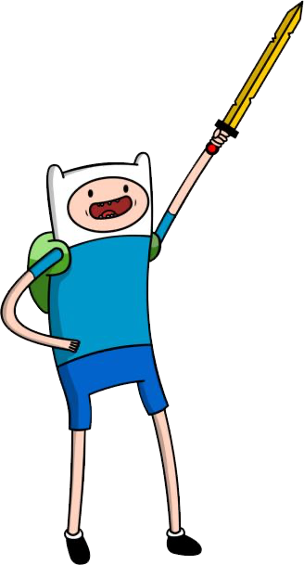
ELEMENTS OF ART IN THIS CHARACTER
08 / 12 / 15
08
Adventure Time / 2010
SH
SHAPE
Finn is drawn almost entirely from simple bean and oval shapes, small, readable, and easy to animate thousands of times. Pendleton Ward designed him to be expressive with minimal lines. Simplicity enables emotional range.
Finn the Human
CL
COLOR
Finn's white hat against the saturated fantasy landscape always makes him the focal point no matter what is happening around him. White creates a focal anchor, the eye goes there first. That is intentional hierarchy through color.
SP
SPACE
"Simple shapes for complex emotions"
Adventure Time constantly uses scale and space to show Finn as small in a huge, dangerous world. Enormous backgrounds with a tiny Finn communicates vulnerability and awe simultaneously.
KEY ELEMENTS
SHAPE
COLOR
SPACE
MR. SILVA / PIONEER VALLEY HIGH SCHOOL

Slide 11
ELEMENTS OF ART IN THIS CHARACTER
09 / 12 / 15
09
Marvel / Sony Animation / 1994
LN
LINE
Spider-Man's web pattern is an all-over line texture that creates rhythm and visual energy across every surface of the costume. Those diagonal and radial lines suggest speed even when the character is standing still.
Spider-Man
CL
COLOR
The red and blue split is a classic complementary contrast, warm and cool divided right down the center of the figure. Complementary color pairs create maximum vibration and visual energy.
FM
FORM
"Line and form built for motion"
The muscular form under the suit is exaggerated to suggest superhuman capability, wider shoulders, narrower waist, longer limbs than realistic anatomy. Form exaggeration is a character design tool, not a mistake.
KEY ELEMENTS
LINE
COLOR
FORM
MR. SILVA / PIONEER VALLEY HIGH SCHOOL

Slide 12
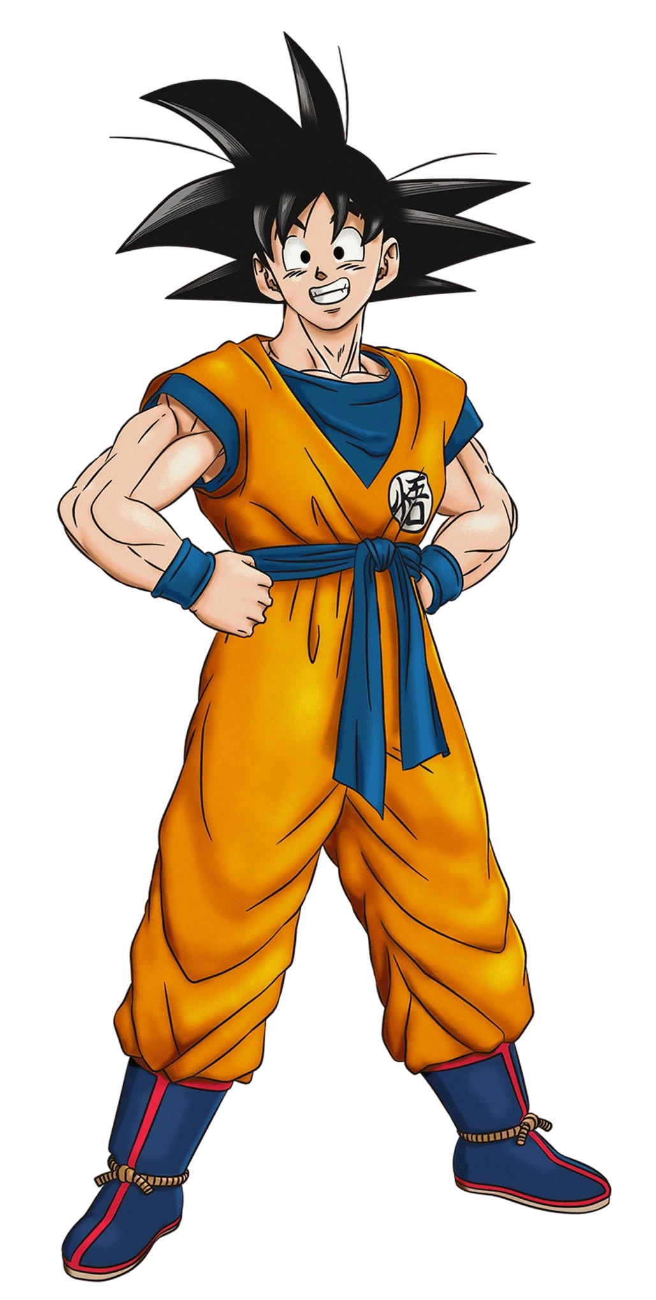
ELEMENTS OF ART IN THIS CHARACTER
10 / 12 / 15
10
Dragon Ball Z / 1989
LN
LINE
Goku's spiky hair is a series of sharp, aggressive diagonal lines that radiate outward like an explosion. Every spike is a line directing energy away from the body, even the silhouette communicates power.
Goku
FM
FORM
The power-up sequences give Goku an increasingly exaggerated muscular form, broader, harder, more geometric as strength increases. Form exaggeration is used as a visual meter for how powerful the character currently is.
VA
VALUE
"Form and line communicating power"
Super Saiyan Goku uses extreme value contrast, glowing gold hair with deep black outlines, to signal transformation from normal to extraordinary. Value shift communicates power level faster than dialogue can.
KEY ELEMENTS
LINE
FORM
VALUE
MR. SILVA / PIONEER VALLEY HIGH SCHOOL

Slide 13
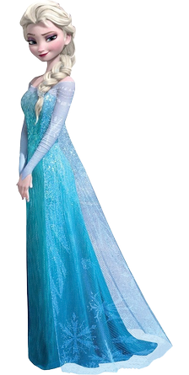
ELEMENTS OF ART IN THIS CHARACTER
11 / 12 / 15
11
Frozen, Disney / 2013
CL
COLOR
Elsa's design shifts from muted dark blues in her restricted state to luminous ice blues in her freed state. The color palette IS her character arc, told visually without exposition. The design team built the emotional story directly into the color choices.
Elsa
FM
FORM
Her ice palace and costumes use angular crystalline forms that express her precision and isolation, beautiful, sharp, and cold to the touch by design. Rounded forms feel warm; angular forms feel cool and distant.
VA
VALUE
"Color and form communicating character arc"
The ice environments use a full value range, near-white light sources and deep navy shadows, to create luminosity and depth. This value range makes the snow and ice feel like they are actually glowing.
KEY ELEMENTS
COLOR
FORM
VALUE
MR. SILVA / PIONEER VALLEY HIGH SCHOOL

Slide 14
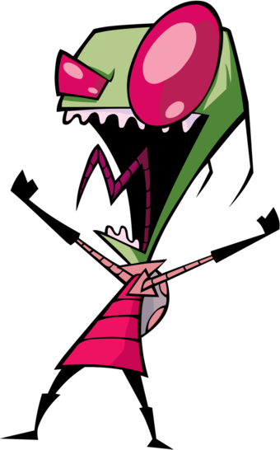
ELEMENTS OF ART IN THIS CHARACTER
12 / 12 / 15
12
Nickelodeon / 2001
SH
SHAPE
Zim is built from aggressively angular shapes, pointed head, oversized triangular eyes, rigid angular body. Jhonen Vasquez used sharp geometry to signal that this character is alien, wrong, and dangerous. Shape language can create discomfort on purpose.
Invader Zim
LN
LINE
The linework in Invader Zim is scratchy, jagged, and irregular, unlike the smooth clean lines of most Nickelodeon animation. Those aggressive lines extend the show's unsettling personality into the art itself.
SP
SPACE
"Shape and space creating unease"
Zim is always drawn just slightly too large or too small relative to the environment around him, the spatial relationships are wrong in ways that are hard to name. That subtle spatial wrongness creates a sense of threat and unreality.
KEY ELEMENTS
SHAPE
LINE
SPACE
MR. SILVA / PIONEER VALLEY HIGH SCHOOL

Slide 15
CLASS DISCUSSION
15 / 15
Which character used the elements best?
01
Name ONE element you noticed in a character that we did NOT analyze. What was it doing?
02
Which character design would work best as a LOGO? Why does its shape help?
03
Which character would fall apart if you removed ONE of its key elements? Which one and why?
04
Pick a character from this list. What ONE change would make the character design stronger?
MR. SILVA / PIONEER VALLEY HIGH SCHOOL

