Slide 1


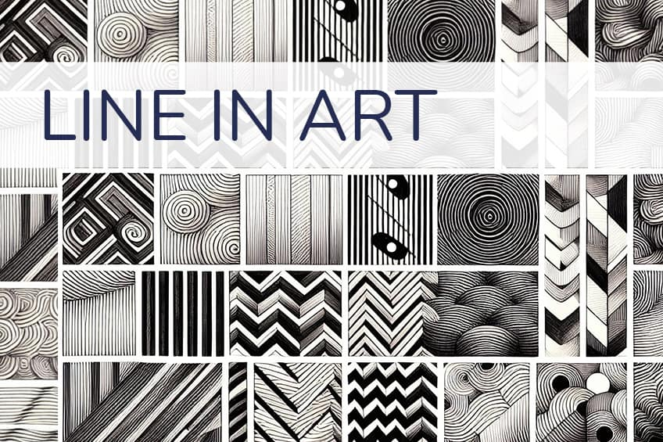
DIGITAL ARTS 1A / ART FOUNDATIONS
ELEMENTS OF ART
PART 1: LINE AND SHAPE
The two elements every character is built from. Round 1 is line and shape only.
ELEMENTS 1 AND 2 OF 7
DIGITAL ARTS 1A / MR. SILVA / PIONEER VALLEY HIGH SCHOOL

Slide 2

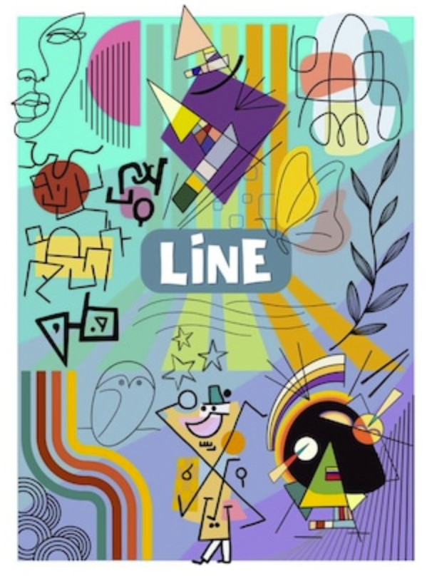
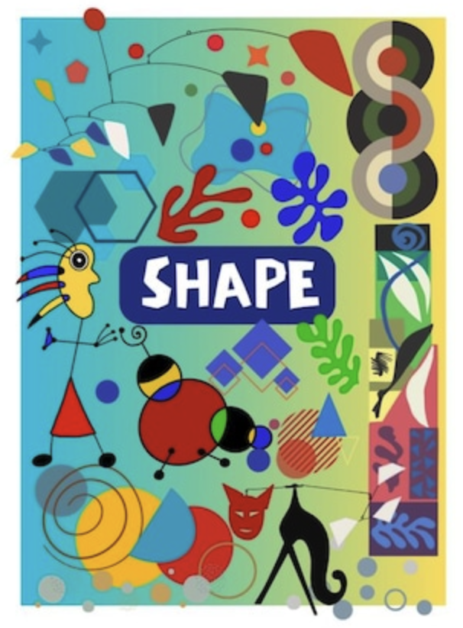
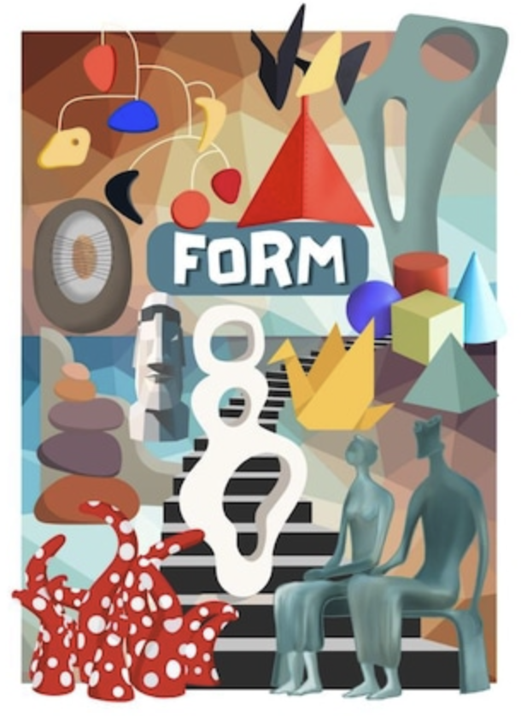
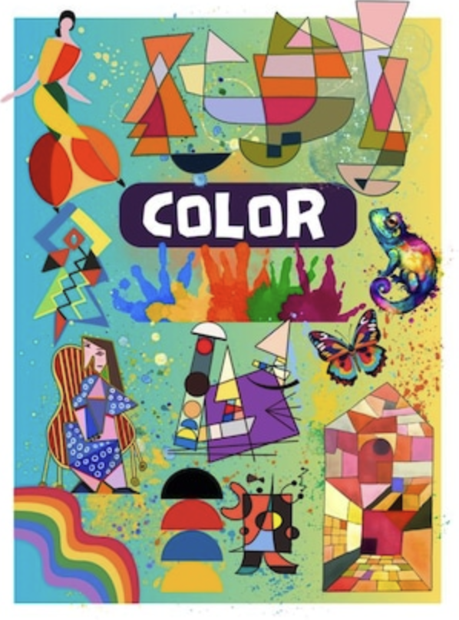
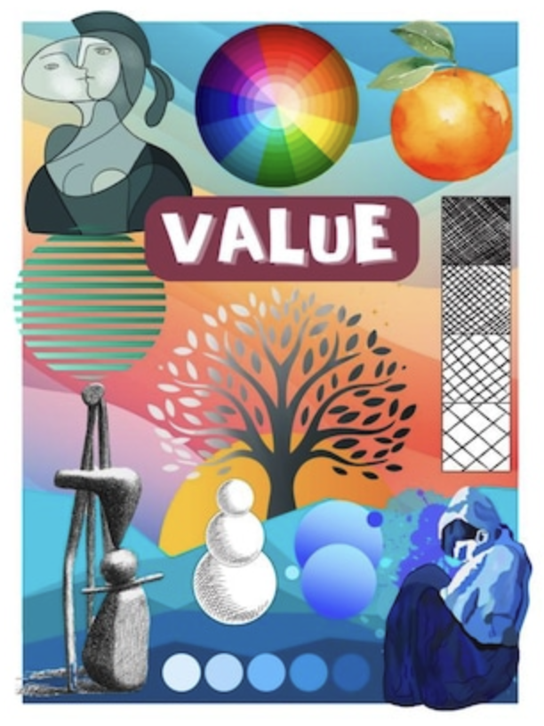
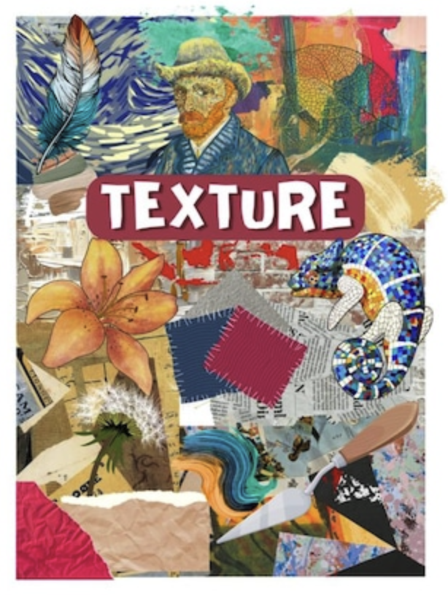

THE SEVEN ELEMENTS OF ART
OVERVIEW / 01 / 18
TODAY
LATER IN THE UNIT
01
02
03
04
05
06
07
LINE
SHAPE
The elements of art are the seven building blocks every artist and designer uses. They are not a style and they are not a rule. They are the parts every drawing is made of, including the character you will design.
We cover two at a time, and you redraw your character after each round. Round 1 is line and shape. Round 2 adds form and space. Round 3 adds value, color, and texture.

Slide 3

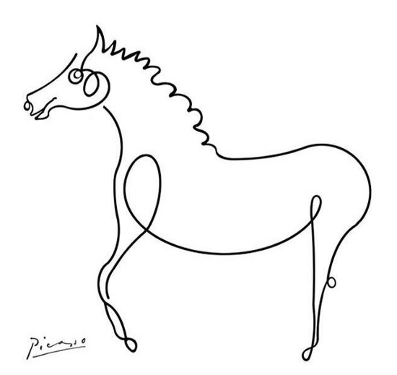
WHAT YOU WILL LEARN
OUTCOMES / 02 / 18
01
DEFINE LINE AND SHAPE
You will explain both in your own words, without looking them up.
02
NAME THE FIVE TYPES OF LINE
You will point out horizontal, vertical, diagonal, curved, and zigzag lines in real work.
03
TELL GEOMETRIC FROM ORGANIC
You will sort any shape into one group or the other.
04
FIND THE NEGATIVE SPACE
You will see the empty areas as part of the design, not as leftovers.
05
BUILD A CHARACTER FROM BOTH
You will design an original character in your sketchbook using only line and shape.
Designers use these words every day on the job. A client says "make that line heavier" or "the negative space feels tight" and you need to know exactly what they mean.

Slide 4
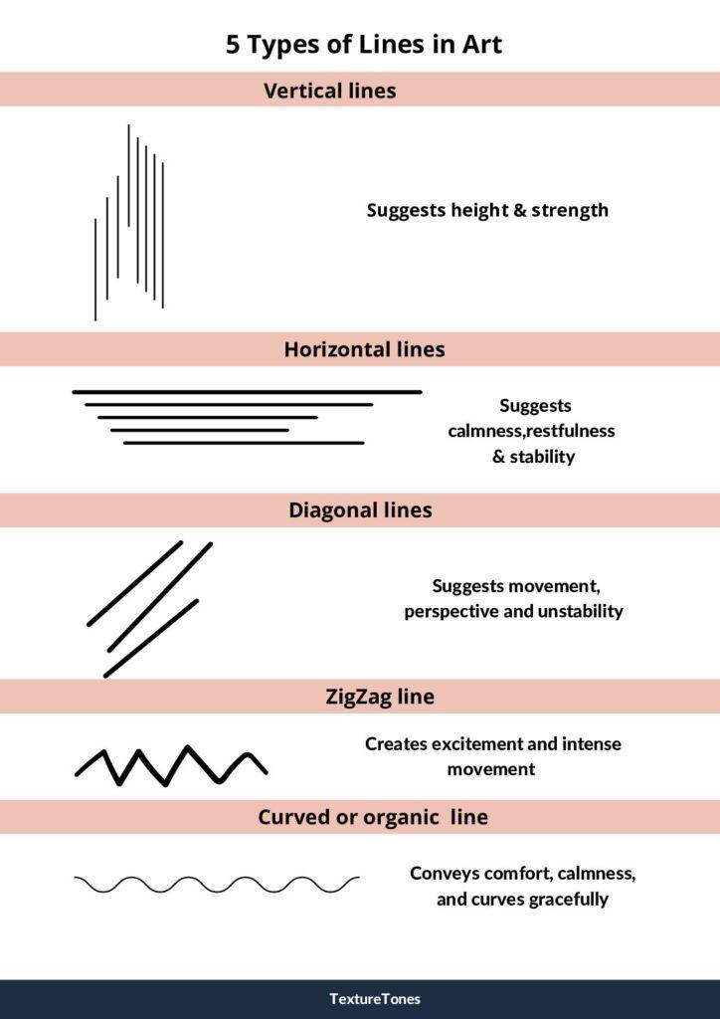
01
ELEMENT 01 OF 7
LINE
A mark that travels. The first mark any artist makes, and the one every other element is built from.
DIGITAL ARTS 1A / MR. SILVA / PIONEER VALLEY HIGH SCHOOL

Slide 5

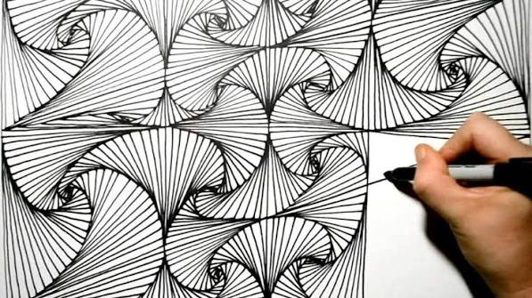
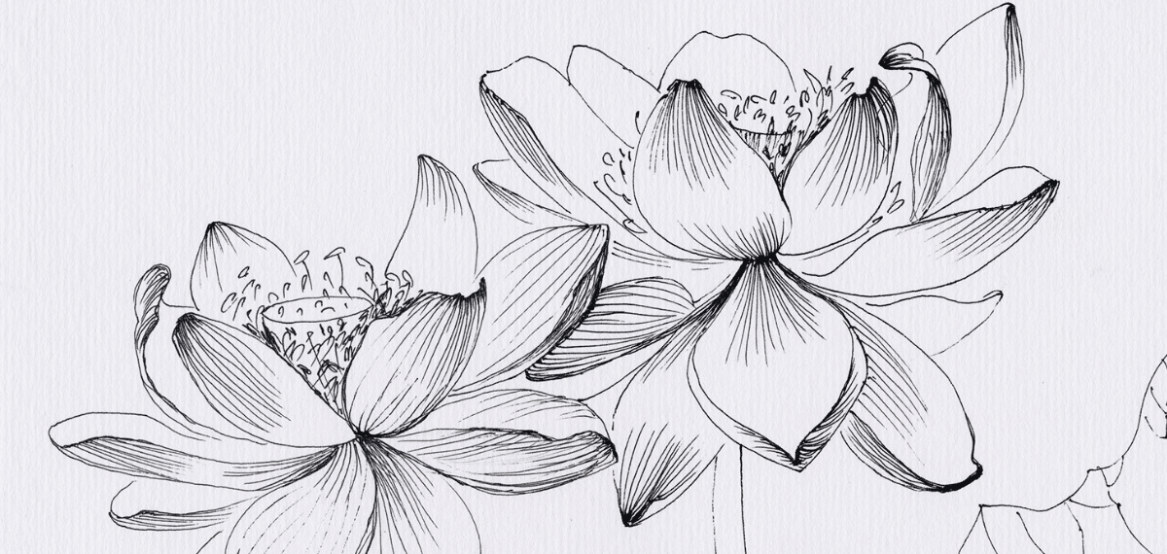
WHAT IS A LINE?
LINE / 03 / 18
A line is a mark that moves from one point to another. It has length. It has almost no width.
01
A LINE HAS DIRECTION
Every line goes somewhere. Which way it points changes how the work feels.
02
A LINE HAS WEIGHT
Weight means how thick or thin it is. A heavy line pulls your eye first.
03
A LINE CAN BE IMPLIED
Your eye connects marks that never touch. Artists use it to suggest a jaw or a cheek.

Slide 6

KEY WORDS: LINE
KEY WORDS / 04 / 18
Line
Contour line
A mark that travels from one point to another. It has length but almost no width.
A line that follows the outside edge of an object and describes its shape.
Implied line
Line weight
A line your eye finishes on its own, even though the full mark is not there.
How thick or thin a line is. Heavier weight pulls more attention to it.
These four words go on your vocabulary sheet. You will use all of them in the critique at the end of this unit.

Slide 7
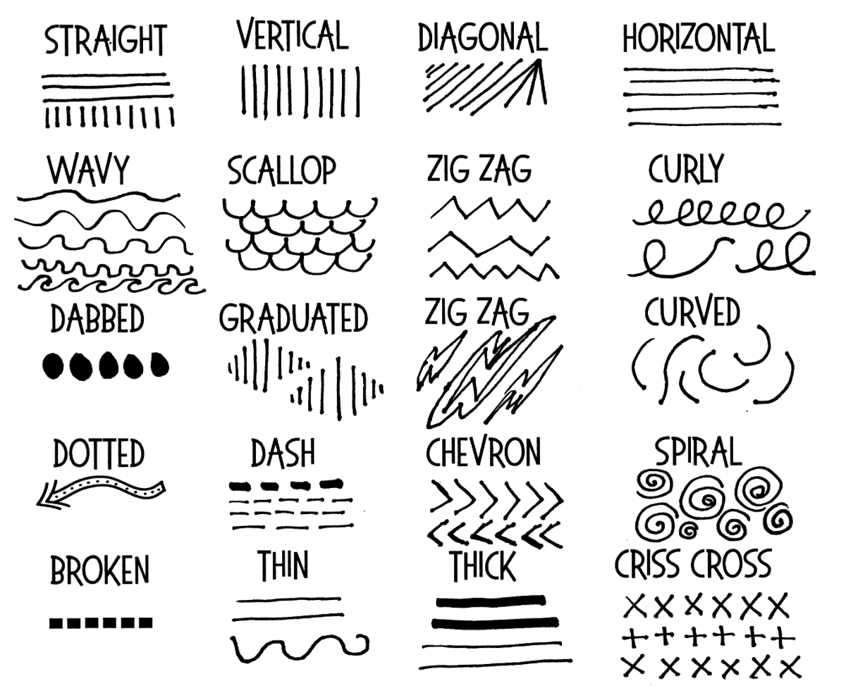
THE FIVE TYPES OF LINE
LINE / 05 / 18
01
HORIZONTAL
Lies flat, left to right. Feels calm, still, and restful.
02
VERTICAL
Stands straight up. Feels tall, strong, and formal.
03
DIAGONAL
Leans. Feels like movement, speed, or tension.
04
CURVED
Bends smoothly. Feels soft, natural, and flowing.
05
ZIGZAG
Turns sharply again and again. Feels busy, excited, or nervous.

Slide 8

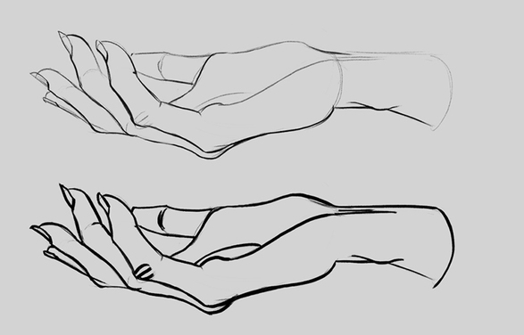
LINE WEIGHT AND LINE QUALITY
LINE / 06 / 18
01
WEIGHT IS THICKNESS
A 0.25 pt line whispers. A 12 pt line shouts. Both can be right.
02
VARY WEIGHT ON PURPOSE
Heavier on the outside edge, lighter inside, and a flat drawing starts to look solid.
03
QUALITY IS THE FEEL
Smooth, rough, broken, or shaky. Line quality is the personality of the mark.
A BEGINNER HABIT TO BREAK
Using one weight for everything makes a drawing look flat and unfinished.
Same drawing. Only the line weight changed.

Slide 9
THE FOUR JOBS A LINE DOES
LINE / 07 / 18
It leads the eye
It divides space
A line tells the viewer where to look first and where to go next.
A rule between two columns is a line doing organizing work.
It builds texture
It defines edges
Many lines close together read as rough, soft, or woven.
A closed line becomes the outline of a shape. That is the next section.
Look at any cartoon character and you will find all four jobs at once. The outline defines the edge, heavier lines pull your eye to the face, and hatching builds texture.

Slide 10

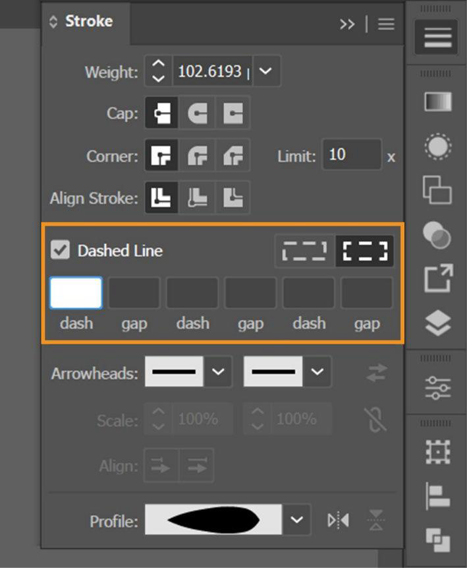
WHAT YOUR LINE SAYS ABOUT THEM
LINE / 08 / 18
01
SMOOTH CURVES READ FRIENDLY
Rounded, flowing outlines make a character feel calm, safe, and likeable.
02
SHARP ANGLES READ DANGEROUS
Jagged, pointed lines make a character feel tense, sneaky, or threatening.
03
SHAKY LINES READ NERVOUS
A broken or wobbly outline suggests the character is scared, old, or unsure.
04
HEAVY OUTLINE READS SOLID
A thick outer contour makes a character feel heavy, strong, and planted.
Pick your line style before you draw.

Slide 11

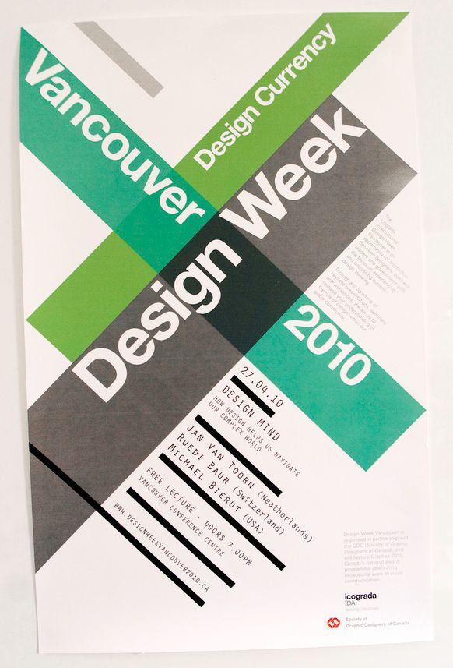
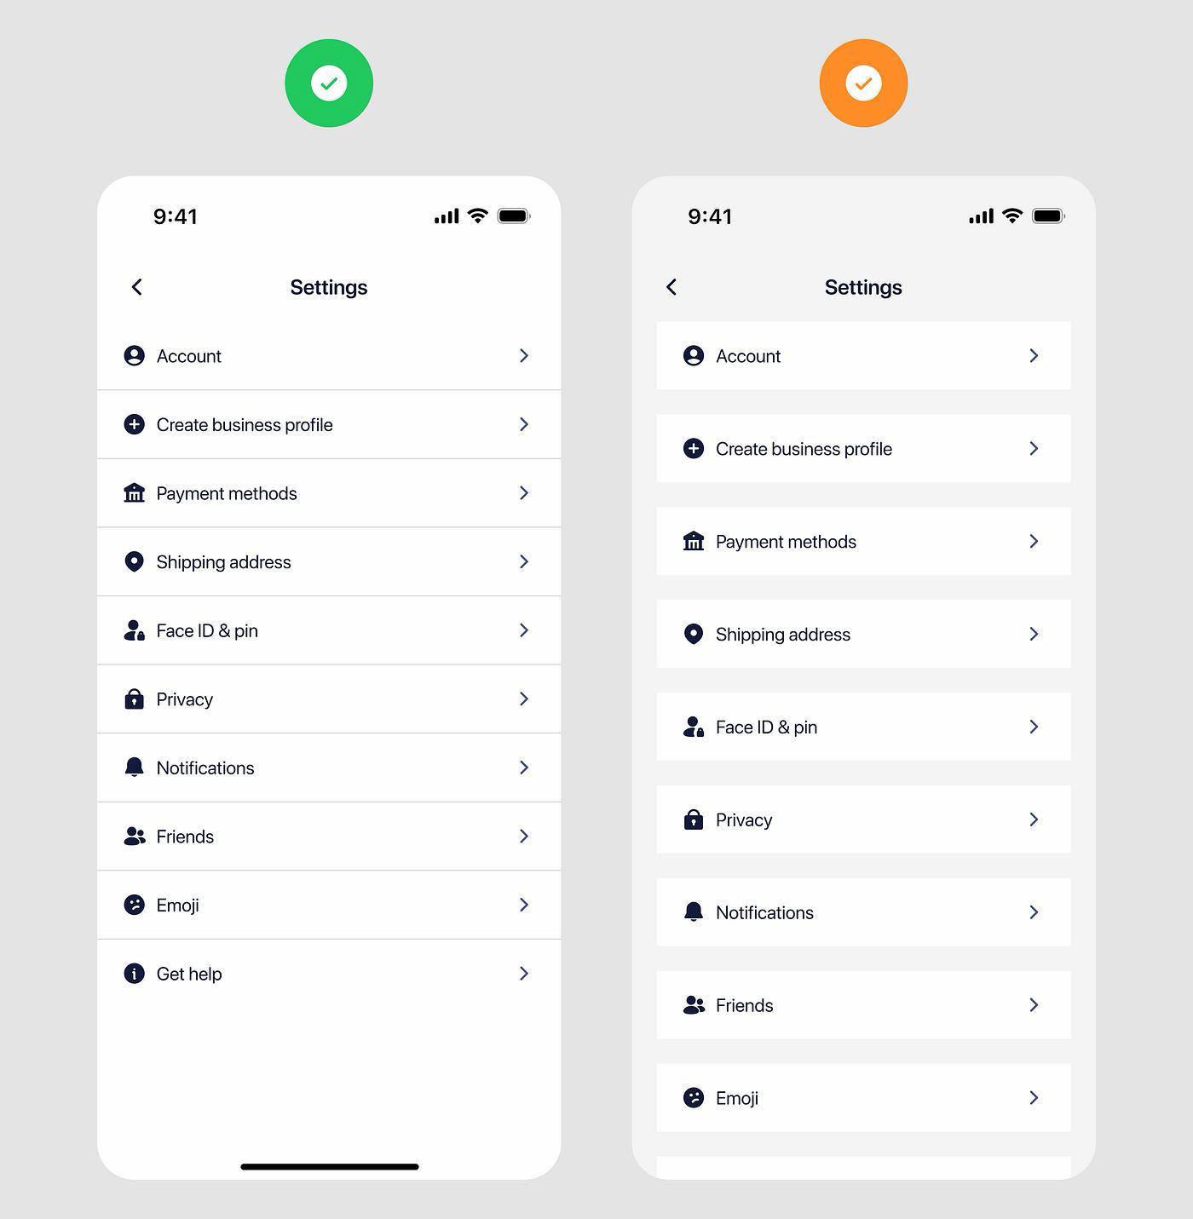
LINE IN REAL DESIGN WORK
LINE / 09 / 18
Professional work. Look at the line weight and where it changes.
ASK YOURSELF: WHERE DOES YOUR EYE GO FIRST, AND WHAT SENT IT THERE

Slide 12
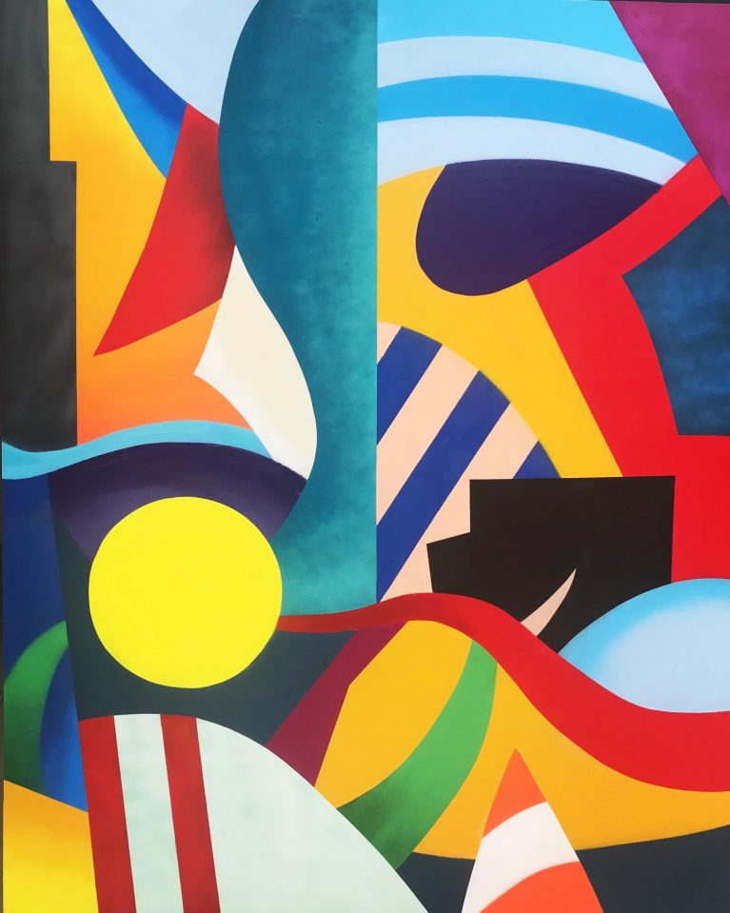
02
ELEMENT 02 OF 7
SHAPE
What happens when a line comes back around and closes. Flat, enclosed, and the base of every cartoon character you know.
DIGITAL ARTS 1A / MR. SILVA / PIONEER VALLEY HIGH SCHOOL

Slide 13
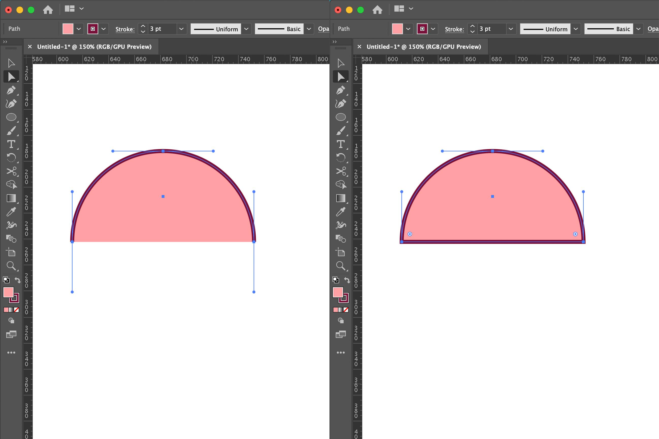
WHAT IS A SHAPE?
SHAPE / 10 / 18
A shape is a flat, enclosed area. The moment a line meets itself, the space inside becomes a shape.
01
SHAPES ARE TWO DIMENSIONAL
A shape has length and width. It does not have depth.
02
A SHAPE NEEDS A CLOSED EDGE
That edge can be a drawn line or just a change in color.
03
SHAPE IS NOT FORM
Form is the three dimensional version. Form is coming in Part 2.
Close the line and you have made a shape.

Slide 14
KEY WORDS: SHAPE
KEY WORDS / 11 / 18
Shape
Geometric shape
A flat enclosed area with length and width but no depth.
A shape with clean edges and regular measurements, like a circle, square, or triangle.
Organic shape
Negative space
A free, irregular shape. The kind you find in nature, like a leaf or a puddle.
The empty area around and between shapes. It is part of the design, not leftover room.
Negative space is the one students skip. The gap beside your character’s arm is part of the design.

Slide 15
GEOMETRIC AND ORGANIC
SHAPE / 12 / 18
Geometric
Organic
Clean edges and even measurements. Circles, squares, triangles. They feel built, ordered, and man made.
Free and irregular edges. Leaves, clouds, spills. They feel natural, relaxed, and alive.
Most characters use both. A robot leans geometric so it reads as built. A friendly animal leans organic so it reads as alive.
Neither group is better. Pick the one that matches your character. That choice is a real design decision you will defend in critique.

Slide 16

POSITIVE AND NEGATIVE SPACE
SHAPE / 13 / 18
01
POSITIVE SPACE IS THE SHAPE
It is the object itself, the part you drew on purpose.
02
NEGATIVE SPACE IS AROUND IT
It is the empty area surrounding and between your shapes.
03
BOTH ARE DESIGNED
The empty part is not leftover. A good designer shapes it as carefully as the object.
THE FAMOUS TRICK
Some of the best known logos hide a second shape inside the negative space.
Look at the white, not just the black.

Slide 17
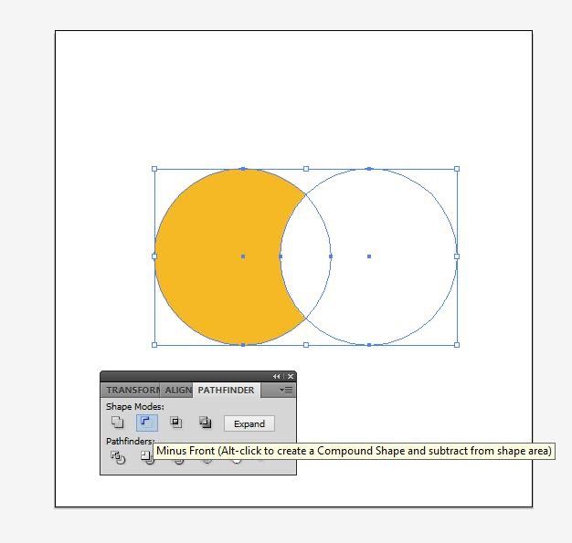
SHAPE LANGUAGE
SHAPE / 14 / 18
01
CIRCLES READ FRIENDLY
Round characters feel safe, soft, and likeable. Most heroes and sidekicks are built from circles.
02
SQUARES READ STRONG
Boxy characters feel stable, heavy, and dependable. They are the ones who hold their ground.
03
TRIANGLES READ DANGEROUS
Pointed characters feel sharp, fast, and unsafe. Most villains are built from triangles.
04
MIX THEM ON PURPOSE
Pick one shape to dominate your character, then use the other two as accents.
Choose your dominant shape before you draw.

Slide 18
HOW LINE AND SHAPE WORK TOGETHER
CONTENT / 15 / 18
Line and shape are not two separate topics. A shape is what a line becomes when it closes. Every character you know started as a shape decision.
Line makes the edge
Shape makes the mass
Together they read
The outline decides where the shape stops and the background starts.
Filled area gives the design weight and presence on the page.
Edge plus mass is how a viewer knows a character in silhouette.
Fill your character in solid black. If you can still tell who it is, your silhouette is working.

Slide 19

CHECK YOURSELF
STUDY / 16 / 18
01
NAME THE FIVE TYPES OF LINE AND THE FEELING EACH ONE GIVES.
02
WHAT IS THE DIFFERENCE BETWEEN A SHAPE AND A FORM?
03
IS A MAPLE LEAF GEOMETRIC OR ORGANIC? HOW DO YOU KNOW?
04
WHAT IS NEGATIVE SPACE, AND WHY IS IT PART OF THE DESIGN?
05
WHAT SHAPE WOULD YOU BUILD A VILLAIN FROM, AND WHY?
Say all five answers out loud with a partner before you start sketching.

Slide 20
WHAT YOU KNOW NOW
RECAP / 17 / 18
Line is a traveling mark
Five types of line
It has direction, weight, and quality. It can be implied.
Horizontal, vertical, diagonal, curved, and zigzag.
Shape is a closed area
Geometric or organic
Flat, two dimensional, and made when a line meets itself.
Clean and measured, or free and natural. Most work uses both.
You also know negative space is designed on purpose, and that shape language tells a viewer who your character is before they read a word.

Slide 21
COMING UP IN PART 2
NEXT MINI LESSON
Part 1 was flat. Part 2 adds depth. You will redraw your character with volume, then learn how the space around them works.
Element 03: Form
Element 04: Space
What happens when a shape gains depth and becomes three dimensional.
Foreground, middle ground, and background, and how depth is faked on a flat screen.
Bring your vocabulary sheet and your Round 1 character. Part 2 is Round 2.
DIGITAL ARTS 1A / MR. SILVA / PIONEER VALLEY HIGH SCHOOL

