Slide 1


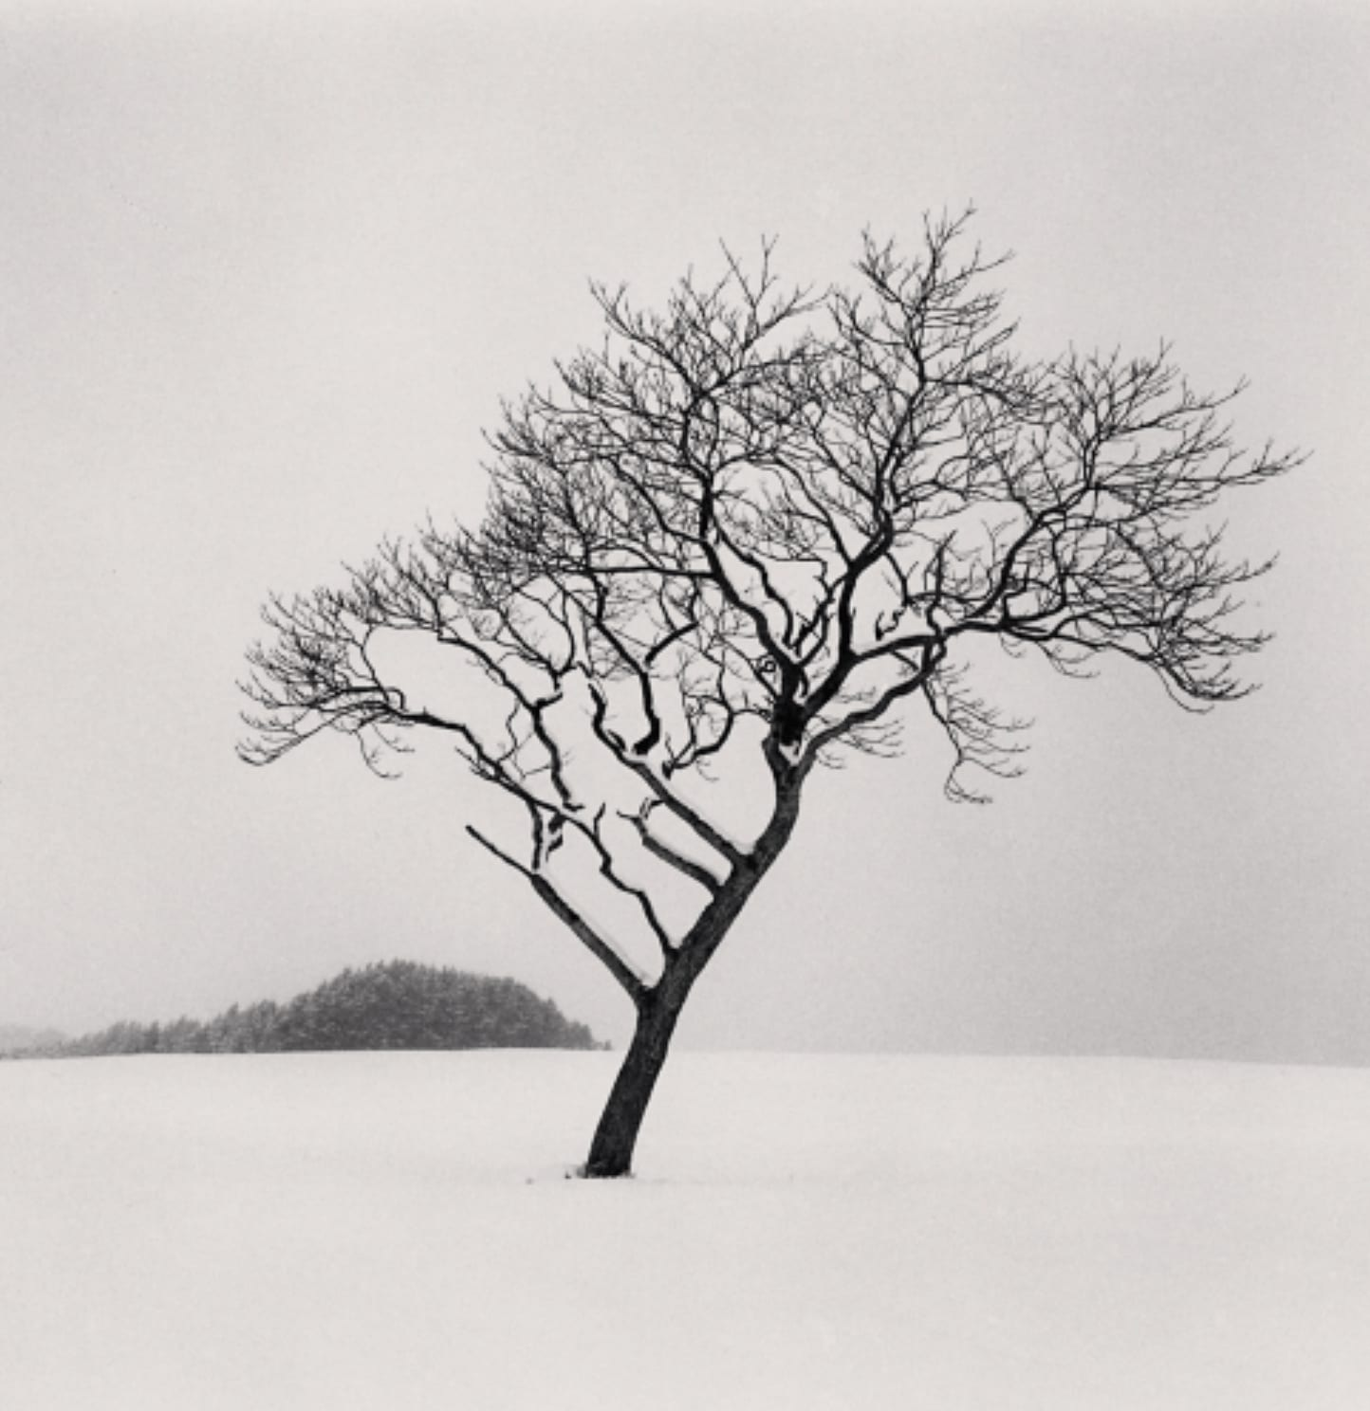
PHOTOGRAPHY 1 AND 2
SEEING IN BLACK AND WHITE
Take the color away. Find out what is really holding the photo together.
CAMPUS PHOTO WALK TODAY
Michael Kenna, Blackstone Hill Tree, 2010
PHOTOGRAPHY 1 AND 2 / MR. SILVA / PIONEER VALLEY HIGH SCHOOL

Slide 2

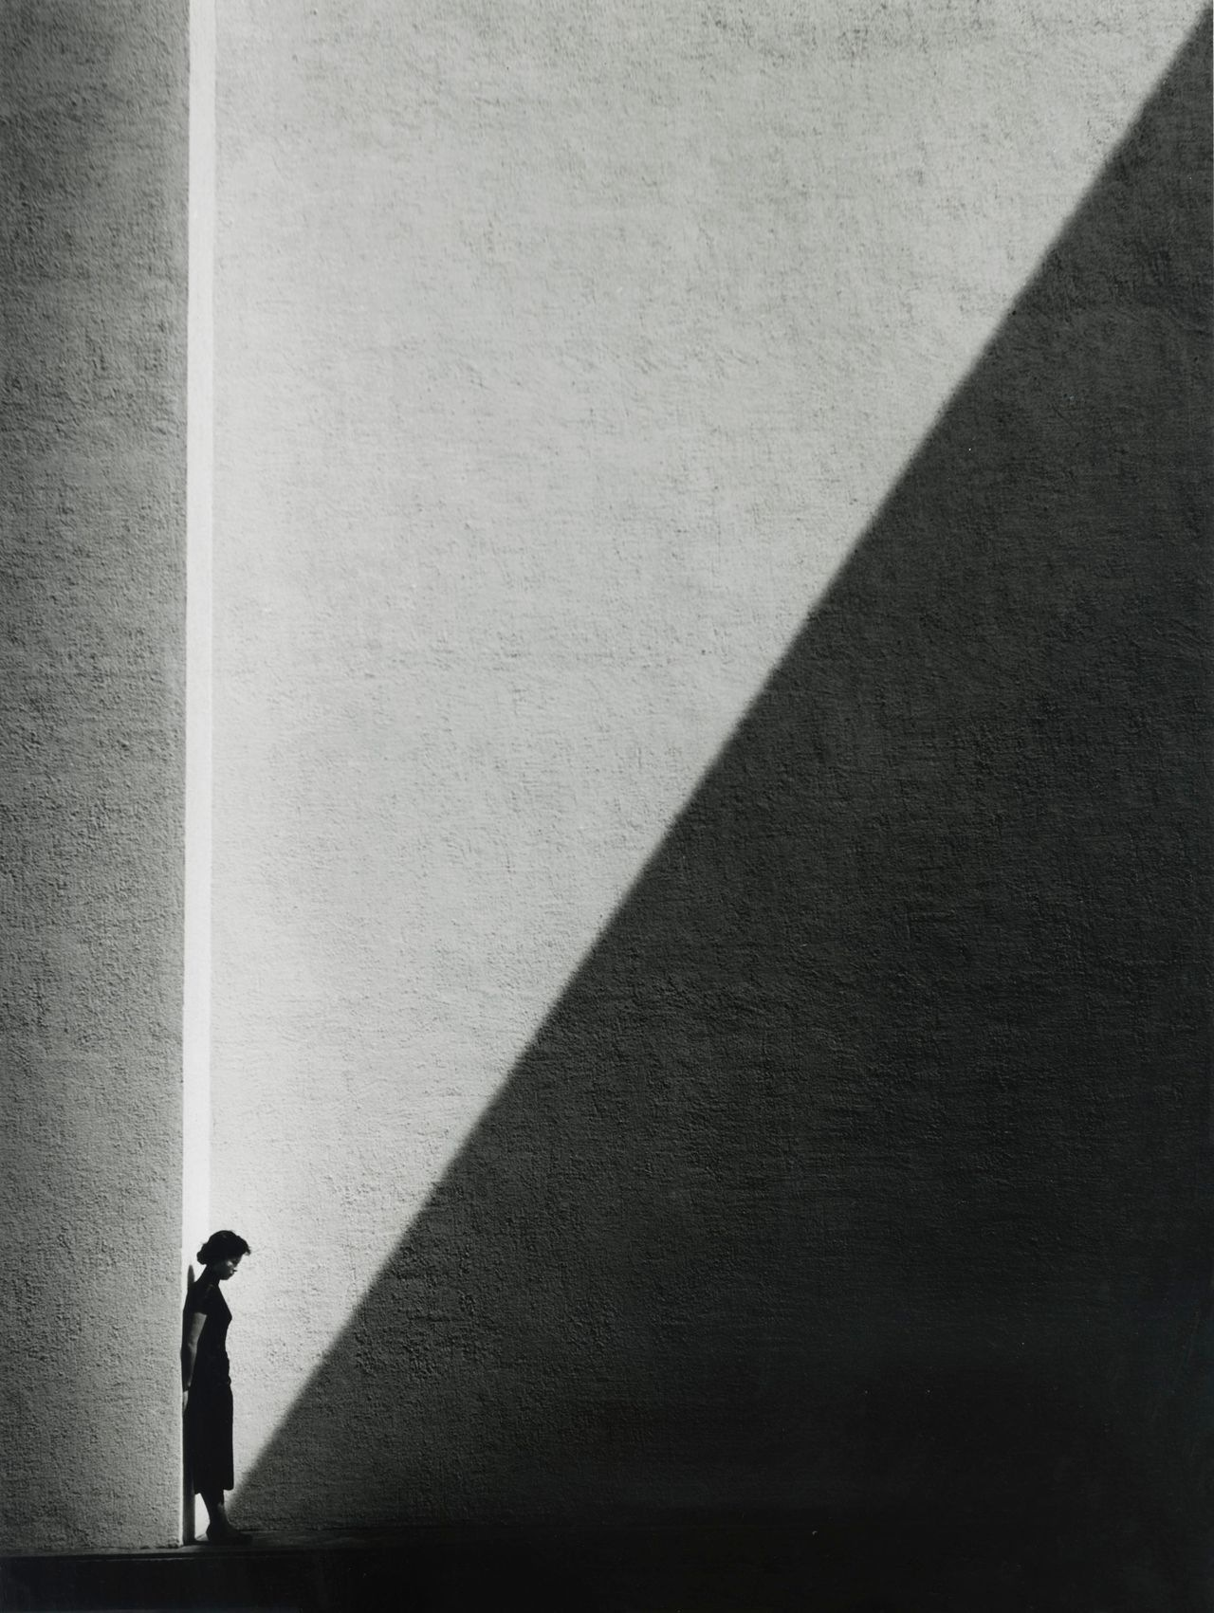
LOOK AT THIS PHOTOGRAPH
HOOK / 01
WHAT IS THE SUBJECT?
There is a person in this photo.
There is also a giant shadow.
Only one of them is the subject.
Fan Ho, Approaching Shadow, 1954
ASK
Is the subject the person, or the shadow? Say why.
PHOTOGRAPHY 1 AND 2 / MR. SILVA / PIONEER VALLEY HIGH SCHOOL

Slide 3

BLACK AND WHITE IS NOT COLOR REMOVED
THE IDEA / 02
Color grabs you
Take it away
What is left
In a color photo your eye goes straight to the brightest color.
Now there is nothing to grab. Your eye has to find something else.
Light, shadow, shape, and texture. That is the real photo.
ASK
Name a photo you love. Would it still work with no color?
PHOTOGRAPHY 1 AND 2 / MR. SILVA / PIONEER VALLEY HIGH SCHOOL

Slide 4

FIVE THINGS TO LOOK FOR
THE TOOLS / 03
Every photo you take today should use at least one of these.
01
02
03
04
05
Light and shadow
Lines
Texture
Empty space
Tones
Where sun meets shade.
Paths, rails, and edges.
Rough surfaces up close.
One subject, nothing else.
White to gray to black.
ASK
Which of these five is easiest to find on our campus?
PHOTOGRAPHY 1 AND 2 / MR. SILVA / PIONEER VALLEY HIGH SCHOOL

Slide 5

LIGHT AND SHADOW
TOOL 01 / 04
A SHADOW CAN BE THE SUBJECT
Hard sun makes a sharp edge.
That edge is a shape you can build a photo on.
ON CAMPUS
A wall with a diagonal shadow. Shade under an overhang. Leaves lit from behind.
Fan Ho, Approaching Shadow, 1954
PHOTOGRAPHY 1 AND 2 / MR. SILVA / PIONEER VALLEY HIGH SCHOOL

Slide 6
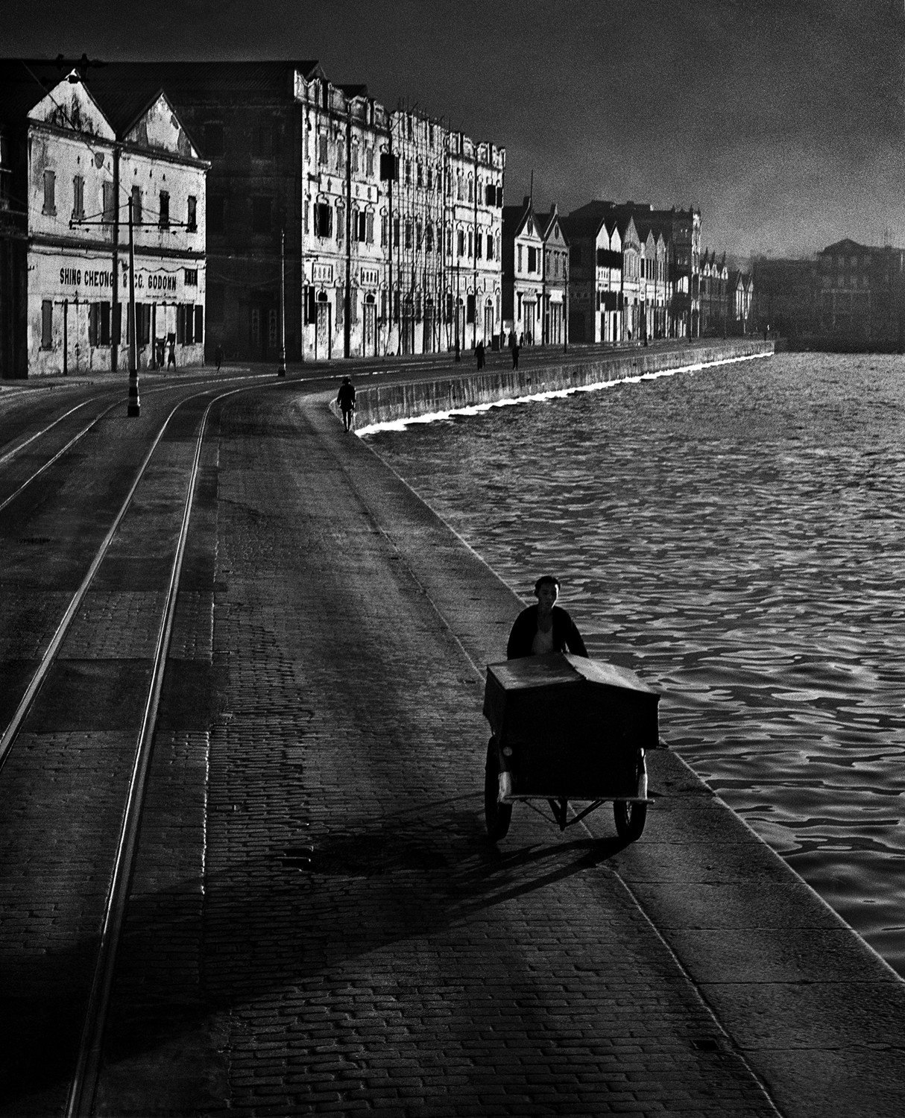
LINES PULL YOUR EYE
TOOL 02 / 05
FOLLOW THE LINE
A line leads your eye into the photo.
Put the line in a corner and let it run.
ON CAMPUS
Walkways, stairs, handrails, fences, rows of windows, curbs.
Fan Ho, As Evening Hurries By, 1955
ASK
Which line in this photo takes your eye to the person?
PHOTOGRAPHY 1 AND 2 / MR. SILVA / PIONEER VALLEY HIGH SCHOOL

Slide 7

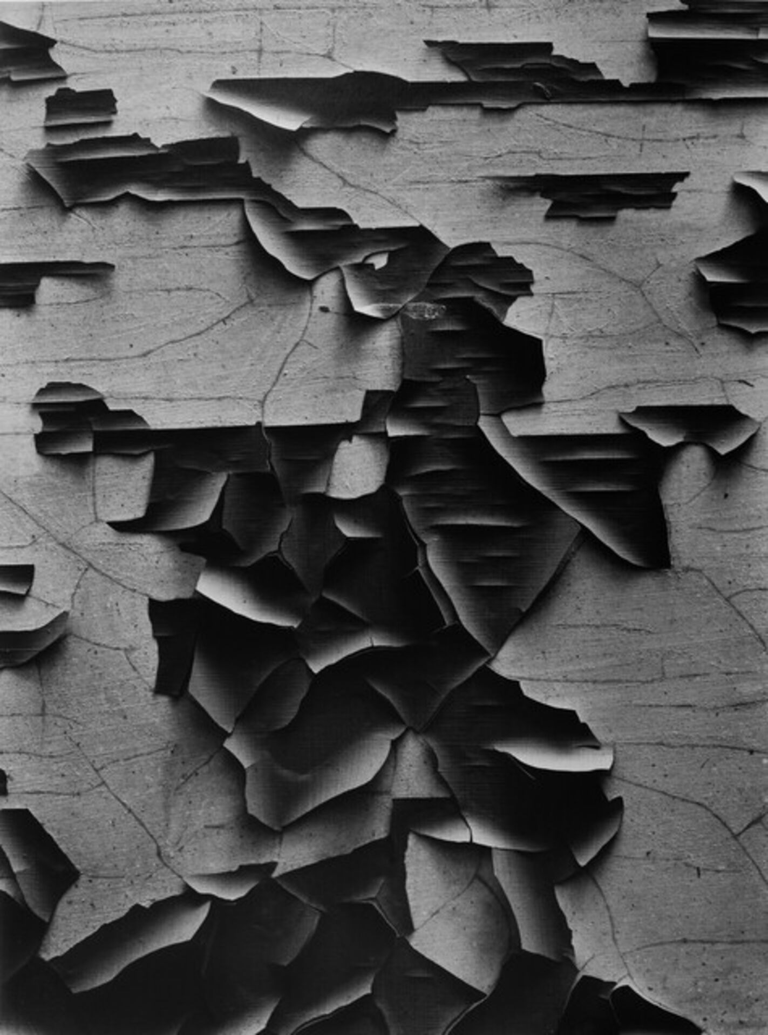
TEXTURE YOU CAN ALMOST FEEL
TOOL 03 / 06
GET CLOSE TO A SURFACE
Side light makes every bump and crack show.
Flat light makes the same wall look boring.
ON CAMPUS
Concrete, tree bark, peeling paint, cracked sidewalk, gravel, rust.
Aaron Siskind, Jerome, Arizona 21, 1949
PHOTOGRAPHY 1 AND 2 / MR. SILVA / PIONEER VALLEY HIGH SCHOOL

Slide 8

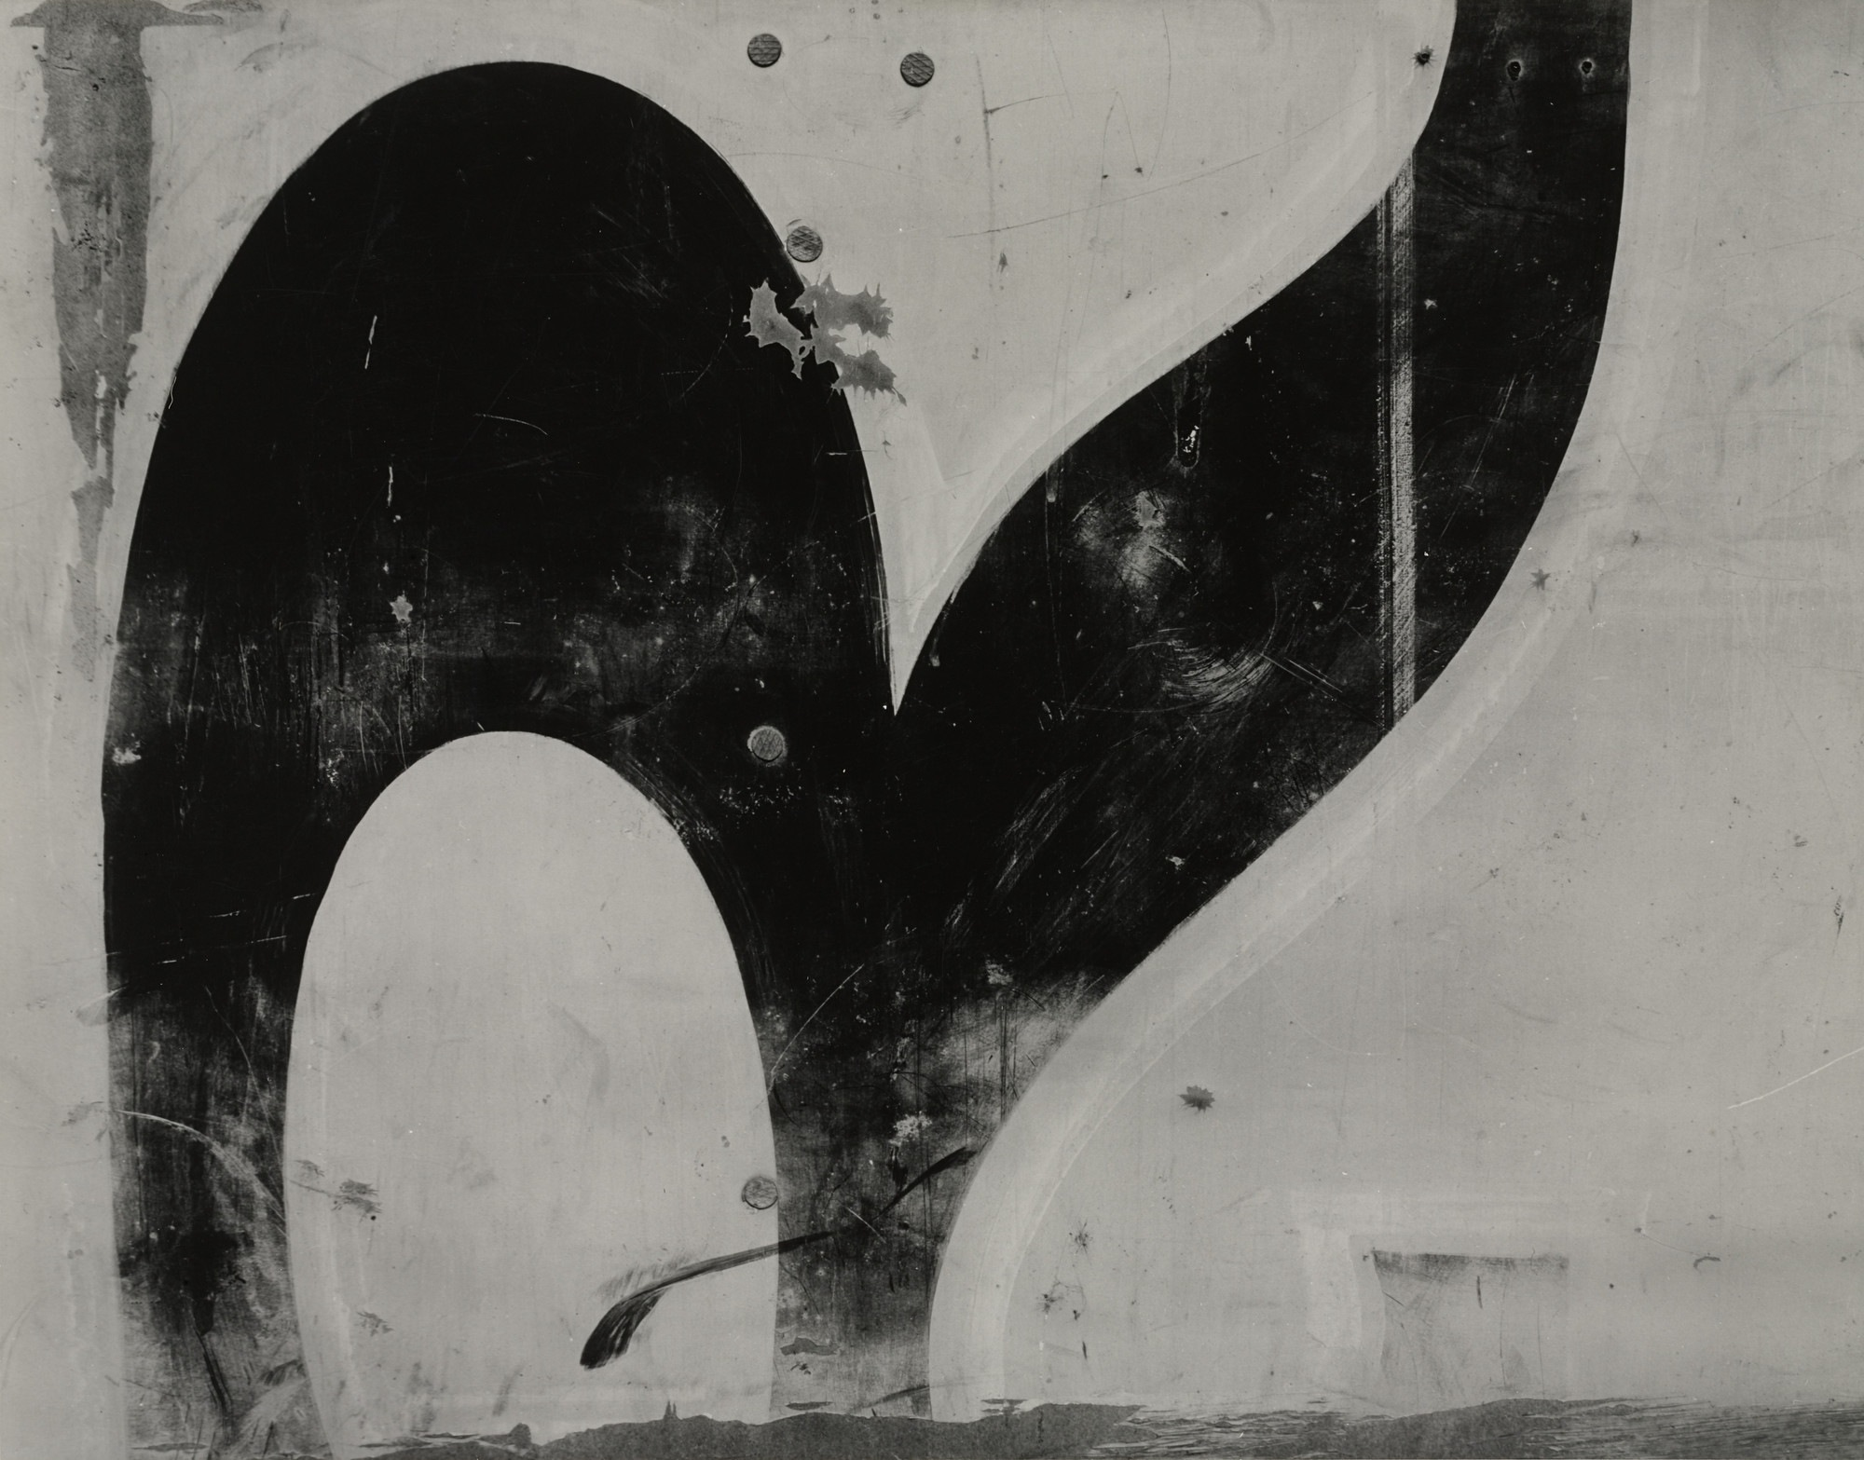
CLOSE ENOUGH TO STOP BEING A THING
TOOL 03 / 07
FILL THE WHOLE FRAME
Move in until the object is gone.
What is left is just shape and tone.
PHOTO 2
Make one frame of pure texture that nobody in class can identify.
Aaron Siskind, Chicago 30, 1949
PHOTOGRAPHY 1 AND 2 / MR. SILVA / PIONEER VALLEY HIGH SCHOOL

Slide 9
EMPTY SPACE IS NOT WASTED
TOOL 04 / 08
LEAVE MOST OF IT EMPTY
One subject. Clean background. Nothing else.
The empty part makes the subject louder.
ON CAMPUS
One branch against the sky. One leaf on pavement. A blank wall.
Michael Kenna, Blackstone Hill Tree, 2010
ASK
What would you have to leave out to make this photo work?
PHOTOGRAPHY 1 AND 2 / MR. SILVA / PIONEER VALLEY HIGH SCHOOL

Slide 10

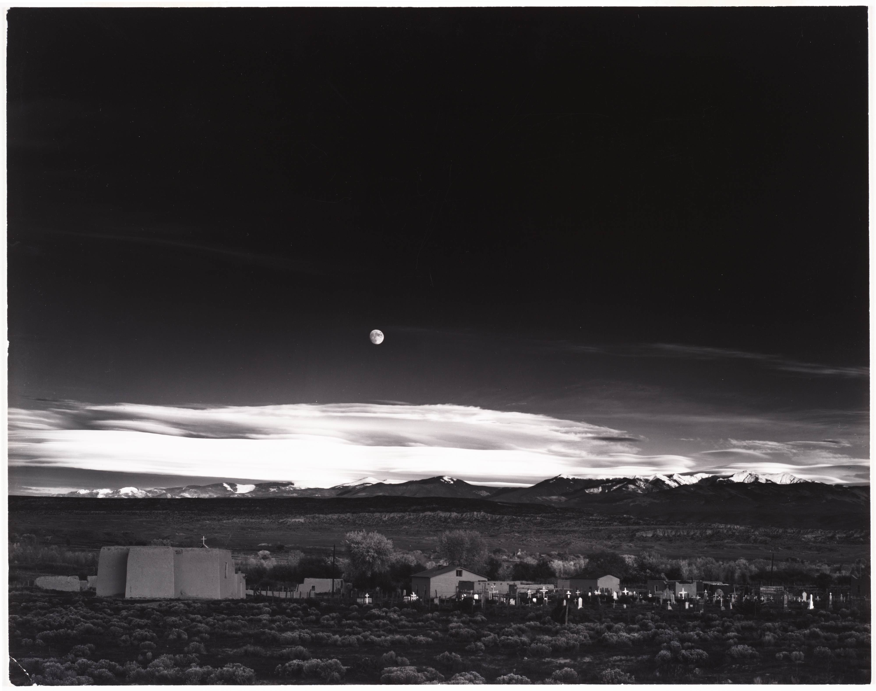
FROM BRIGHT WHITE TO DEEP BLACK
TOOL 05 / 09
USE THE WHOLE RANGE
Bright whites. Deep blacks. Grays in between.
Not every photo needs to be high contrast.
ON CAMPUS
A sunlit wall right next to a dark doorway. Both in one frame.
Ansel Adams, Moonrise, Hernandez, New Mexico, 1941
PHOTOGRAPHY 1 AND 2 / MR. SILVA / PIONEER VALLEY HIGH SCHOOL

Slide 11
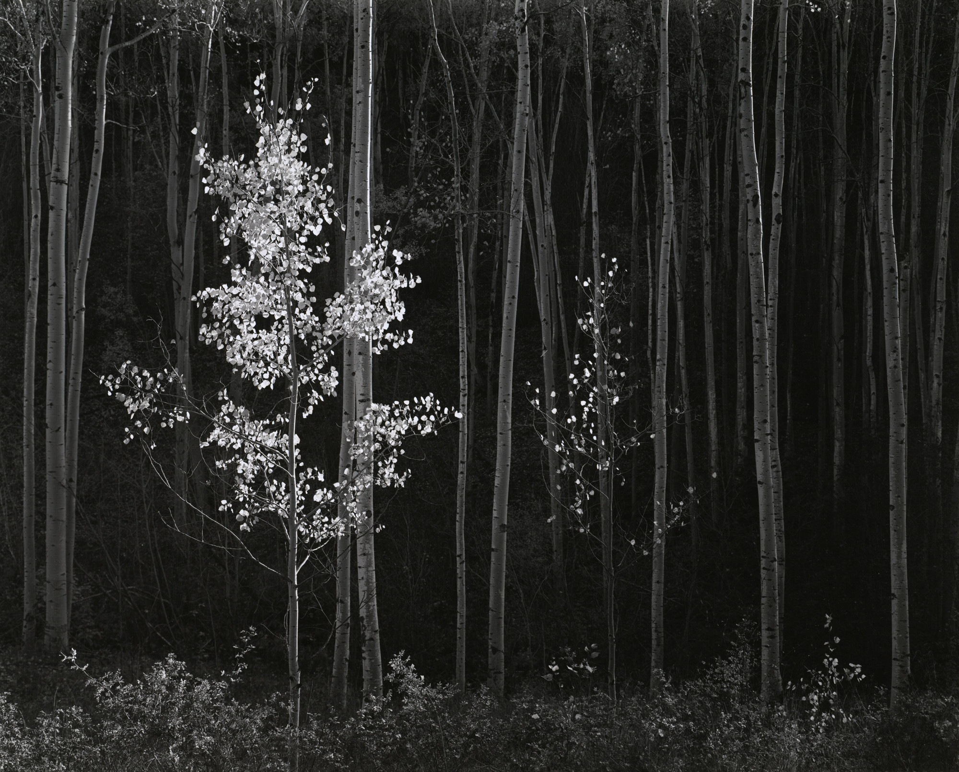
REPEATING SHAPES
BONUS / 10
THEN BREAK THE PATTERN
The same shape over and over makes a pattern.
Break it once and that break becomes your subject.
ON CAMPUS
Tree trunks, fence posts, window grids, lockers, parking lines.
Ansel Adams, Aspens, Northern New Mexico, 1958
PHOTOGRAPHY 1 AND 2 / MR. SILVA / PIONEER VALLEY HIGH SCHOOL

Slide 12
MAKE THE CAMERA SHOW YOU BLACK AND WHITE
THE CAMERA / 11
01
02
03
Press MENU
Choose Monochrome
Keep taking RAW
Find Picture Style on your Canon R50.
The screen turns black and white right away.
Do not change your file setting. Leave it on RAW.
Now you see tone instead of color while you work. That is the point.
ASK
Your screen is black and white now. What do you notice first?
PHOTOGRAPHY 1 AND 2 / MR. SILVA / PIONEER VALLEY HIGH SCHOOL

Slide 13

YOUR RAW FILE STILL HAS THE COLOR
THE CAMERA / 12
On the camera
Inside the file
In Lightroom
The screen shows black and white. That is a preview.
The RAW file keeps all of the color information.
It opens in color. Lightroom ignores the camera preview.
ASK
Lightroom opened your photo in color. Did you lose anything?
PHOTOGRAPHY 1 AND 2 / MR. SILVA / PIONEER VALLEY HIGH SCHOOL

Slide 14
SETTINGS TO START FROM
SETTINGS / 13
Mode
Shutter
Aperture
ISO
Picture Style
Manual
1/250
f8
200
Monochrome
KEEP THE SHUTTER AT 1 OVER 60 OR FASTER
You are hand holding outside. Slower than 1 over 60 and camera shake blurs the frame.
PHOTOGRAPHY 1 AND 2 / MR. SILVA / PIONEER VALLEY HIGH SCHOOL

Slide 15
WHAT TO HUNT FOR OUTSIDE
THE WALK / 14
Campus is quiet right now. That is good. Quiet is easier to compose.
A wall cut by a shadow
Stairs and handrails
Bark and concrete
Hard sun, sharp edge.
Lines and repeating shapes.
Rough texture up close.
One leaf on pavement
A bright wall, a dark door
Fences and window grids
One subject, clean background.
Full range in one frame.
Pattern you can break.
ASK
Name one spot on campus for the first one. Be specific.
PHOTOGRAPHY 1 AND 2 / MR. SILVA / PIONEER VALLEY HIGH SCHOOL

Slide 16

WHEN THE PHOTO IS BORING
THE WALK / 15
Do not walk away. Try these four, in order.
01
02
03
04
Get closer
Change your height
Check your edges
Take something out
Then get closer again.
Kneel down. Hold it up high.
Look at all four before you press.
Move so the clutter leaves the frame.
ASK
Your frame is boring. Which one do you try first, and why?
PHOTOGRAPHY 1 AND 2 / MR. SILVA / PIONEER VALLEY HIGH SCHOOL

Slide 17

PHOTOGRAPHY 2 GOES FURTHER
PHOTO 2 / 16
Photo 1 is hunting for single frames. You are building a set.
Make them a group
One pure abstract
One almost empty
Bring back three frames that belong together. Same light, same idea, or same surface.
One frame so close that nobody can name what it is.
One frame where most of the picture is nothing at all.
ASK
What would make your three frames look like one set?
PHOTOGRAPHY 1 AND 2 / MR. SILVA / PIONEER VALLEY HIGH SCHOOL

Slide 18

BEFORE YOU WALK OUT
THE CHALLENGE / 17
STOP LOOKING FOR INTERESTING THINGS
START MAKING INTERESTING PHOTOGRAPHS OUT OF ORDINARY THINGS
A concrete wall
A staircase
It is up to you
can be a great photo.
can be a great photo.
not to what is out there.
ASK
Tell me the first thing you are going to photograph. Go.
PHOTOGRAPHY 1 AND 2 / MR. SILVA / PIONEER VALLEY HIGH SCHOOL

