Slide 1


PHOTOGRAPHY 1 | LIGHTROOM CLASSIC | LESSON 03
Lightroom Classic:
Learn the Essentials
Lesson 03: Developing Basics
In this lesson you will learn how to use the Develop module to correct and enhance your photos: from cropping and white balance to exposure, contrast, and presence.
Before / After view in the Develop module
MODULE RESOURCE | Mr. Silva | Pioneer Valley High School

Slide 2
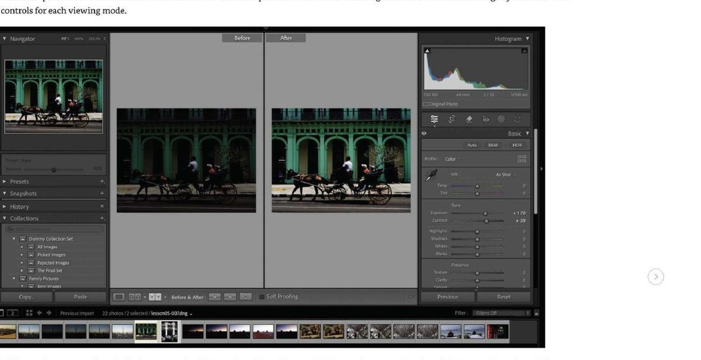
By the End of This Lesson You Will Know How To...
01
Navigate the Develop module workspace
04
Set white balance
Find the Histogram, Basic panel, and tools toolbar, and know what each section does.
Correct color casts using the WB dropdown or the White Balance Selector tool.
02
Crop and straighten your photos
05
Adjust exposure, contrast, highlights and shadows
Use the Crop Overlay tool to improve composition and fix a tilted horizon.
Use the Tone sliders in the Basic panel to correct brightness and bring out detail.
03
Apply a camera profile
06
Use Presence sliders
Choose the right color profile for your image as the starting point for editing.
Add texture, clarity, and color vibrance to finish your image.

Slide 3
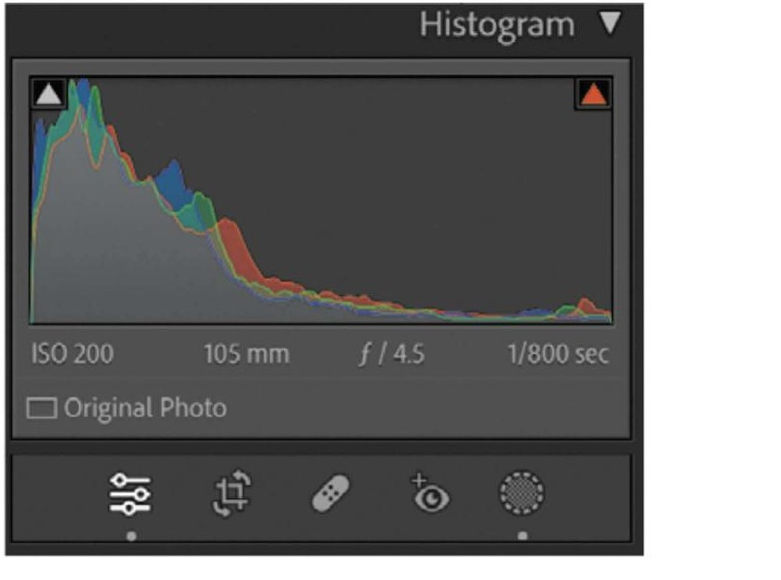
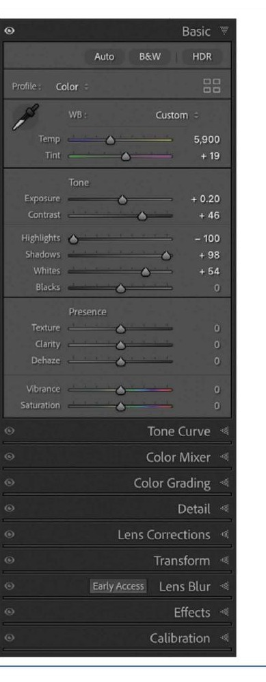
RESOURCE
The Develop Module Workspace
The Develop module is where you correct and enhance your photos. It is non-destructive, your original photo file is never changed.
Histogram (top right)
Shows the tonal range of your photo. Triangles in the corners are clipping warnings.
Basic panel (right)
Histogram panel, shows tonal range and camera metadata
Your main editing panel. Profile, white balance, tone, and presence sliders are all here.
Tools toolbar (below Histogram)
Crop, Remove, Masking, Red Eye, and Graduated Filter tools. Press R for Crop.
Left panel
Navigator, Presets, Snapshots, History, and Collections. Use Presets to apply looks quickly.
Basic panel, Profile, WB, Tone, and Presence sliders
Notes:
GROUPING: Shift+click circle + number, right-click > Group.

Slide 4
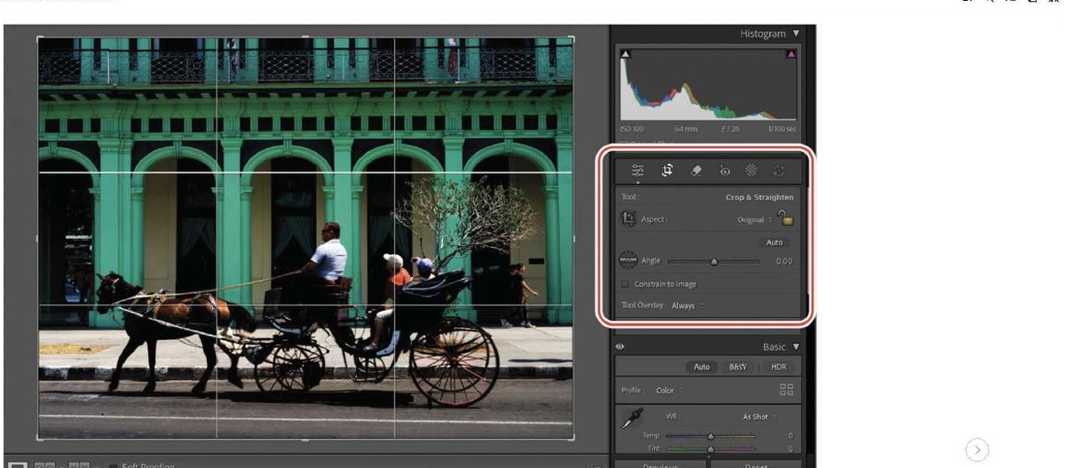
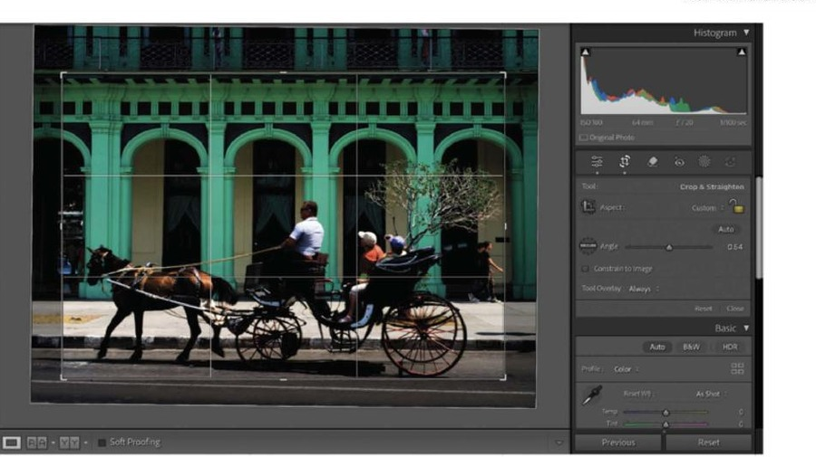
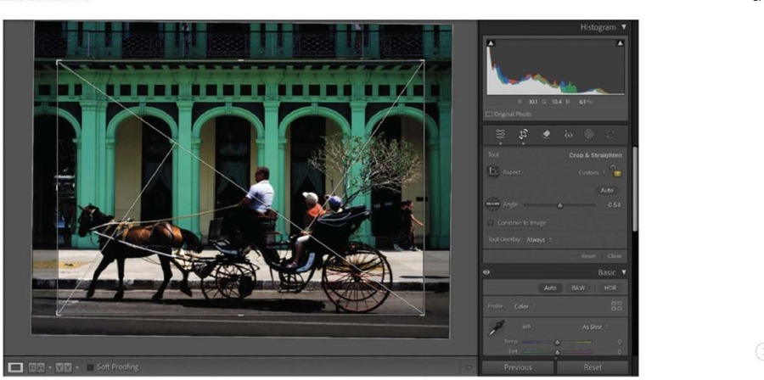
STEP 01
Crop and Straighten Your Photo
1
Press D to go to the Develop module
Make sure you are in Loupe view. Press D on your keyboard from the Library module.
Press R to open the Crop Overlay tool
2
A crop rectangle appears around your photo. The Crop & Straighten options panel opens above the Basic panel.
3
Drag the corner handles to adjust the crop
Crop Overlay active, Rule of Thirds grid visible
Drag any corner or edge of the crop box. The area outside the crop darkens so you can preview the result.
4
Press O to cycle through crop overlays
Rule of Thirds, Diagonal, Golden Ratio, and more. Use them as guides for composition.
5
Press Return or Enter to confirm the crop
The crop is applied. Press R again at any time to go back and adjust it.
Left: Rule of Thirds | Right: Diagonal overlay
Notes:
GROUPING: Shift+click circle + number, right-click > Group.

Slide 5
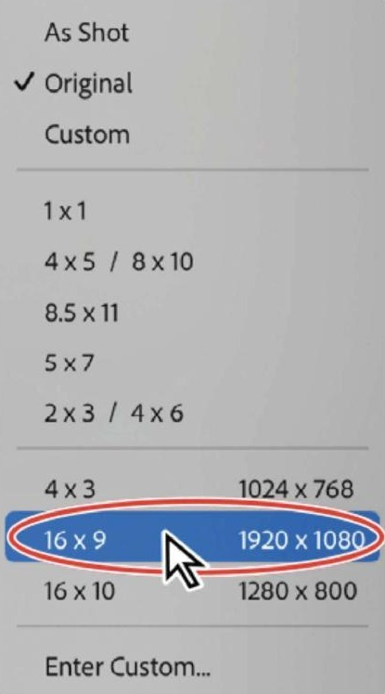
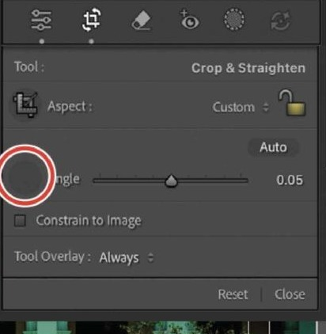
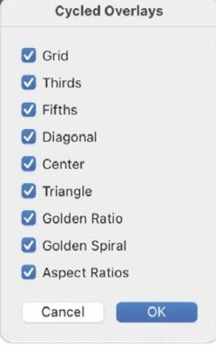
RESOURCE
Crop Overlays and Straightening
Crop overlays are guides, not rules. Use them to help you make stronger compositions. Press O to cycle between them.
Rule of Thirds
Divides the frame into thirds. Place your subject on the lines or intersections.
Diagonal
A line from corner to corner. Great for leading lines and dynamic compositions.
Crop panel
Golden Ratio
A curved composition guide used by classical painters and photographers.
Aspect Ratios
Shows common print and screen crop proportions side by side.
All 9 available crop overlays
Straighten: In the Crop & Straighten panel, drag the Angle slider left or right to level a tilted horizon. Or drag along a line in the photo that should be horizontal.
Aspect ratio options, 16x9 is 1920x1080
Notes:
GROUPING: Shift+click circle + number, right-click > Group.

Slide 6
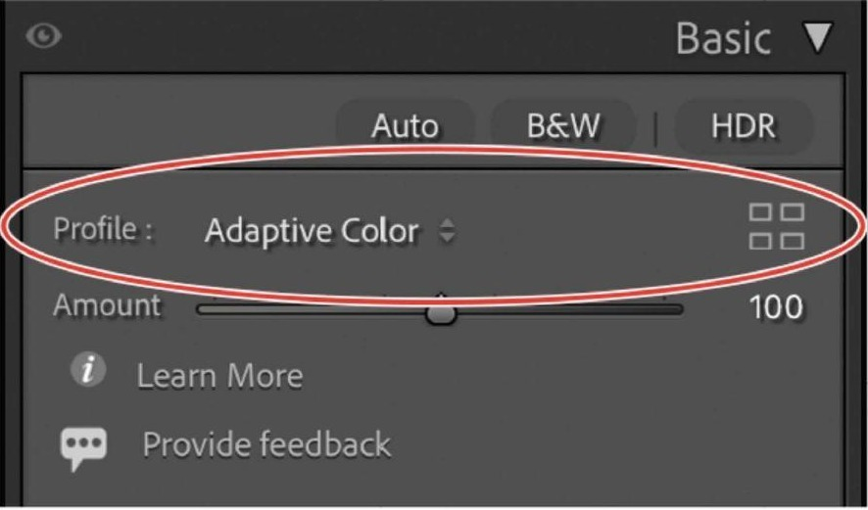
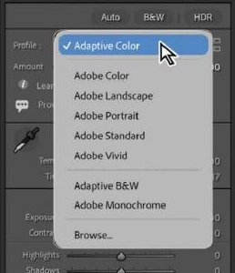
STEP 02
Apply a Camera Profile
A camera profile sets the starting color interpretation for your photo. Think of it as the color mood Lightroom begins with before you make any adjustments.
1
Go to the Basic panel in the Develop module
Look at the very top of the Basic panel, just below the Auto, B&W, and HDR buttons.
2
Click the Profile dropdown
It may show Adobe Color, Adaptive Color, or As Shot. Click on it to open the menu.
Basic panel, Profile set to Adaptive Color
3
Choose Adaptive Color as your starting point
Adaptive Color uses AI to analyze each photo individually and apply the best starting color. It is the recommended setting for class work.
4
Click the grid icon to open the Profile Browser
The Profile Browser shows all available profiles with thumbnails so you can preview them on your photo.
Profile dropdown showing all Adobe Raw profiles and Adaptive options
Notes:
GROUPING: Shift+click circle + number, right-click > Group.

Slide 7
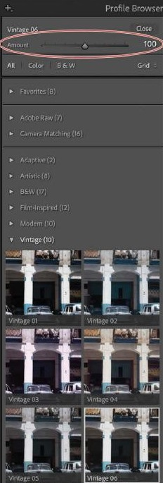
RESOURCE
Camera Profiles: What They Are
Adobe Raw profiles
Camera-independent. Give any image a unified, neutral starting look. Adobe Color is the standard baseline.
Adaptive Color
AI-enhanced. Analyzes each photo individually to apply the best starting color. Recommended for class work.
Camera Matching profiles
Mimic the picture styles built into your specific camera. The number available depends on your camera make.
Creative profiles
Artistic effects using LUTs (color lookup tables). They have an Amount slider so you can dial in the strength.
Profiles do not change the Tone or Presence sliders, you still have full control after choosing a profile.
Notes:
GROUPING: Shift+click circle + number, right-click > Group.

Slide 8
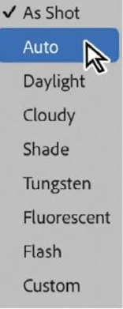
STEP 03
Set Your White Balance
White balance corrects color casts caused by different light sources. Fluorescent light turns photos green. Tungsten light turns them orange. WB fixes that.
1
Find WB at the top of the Basic panel
WB stands for White Balance. Click the dropdown next to it to see your options.
2
Choose the option that matches your lighting
Daylight, Cloudy, Shade, Tungsten, Fluorescent, Flash. For RAW photos, try Auto first and adjust from there.
3
Use the Temp and Tint sliders to fine-tune
Temp moves blue to yellow (cool to warm). Tint moves green to magenta. Drag until colors look natural.
4
Use the White Balance Selector for precision
Press W or click the eyedropper icon in the Basic panel. Click on something in your photo that should be a neutral gray. Lightroom sets WB automatically.
WB dropdown, choose the option that matches your light source
Notes:
GROUPING: Shift+click circle + number, right-click > Group.

Slide 9
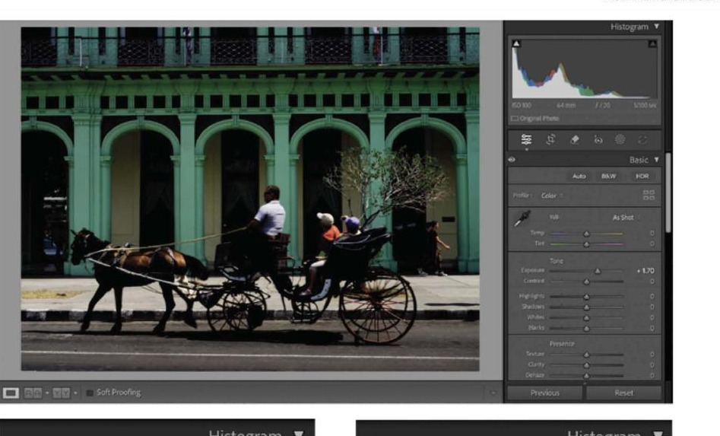
STEP 04
Adjust Exposure and Contrast
1
Find the Tone section in the Basic panel
Below White Balance you will see Tone with six sliders: Exposure, Contrast, Highlights, Shadows, Whites, and Blacks.
2
Drag Exposure to set overall brightness
Exposure affects the midtones most. Drag right to brighten, left to darken. Think of it as adjusting the base brightness of the whole photo.
3
Add Contrast to separate tones
Contrast pushes brights brighter and darks darker, increasing the difference between them. Start with +20 to +50 on most photos.
Develop workspace, Exposure +1.70 applied to the Havana street photo
Tip: Hold Shift and double-click any slider label to have Lightroom auto-set that single slider. Useful when you want Lightroom to make a quick guess.
Do not max out Exposure or Contrast. Subtle adjustments give better results. A photo that is +2.0 exposure will lose highlight detail and look washed out. Start small and work up.
Notes:
GROUPING: Shift+click circle + number, right-click > Group.

Slide 10
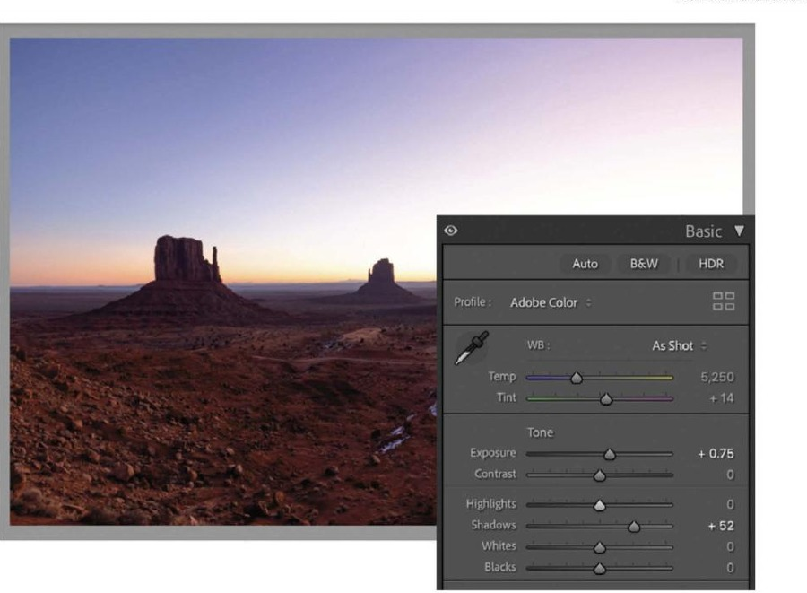
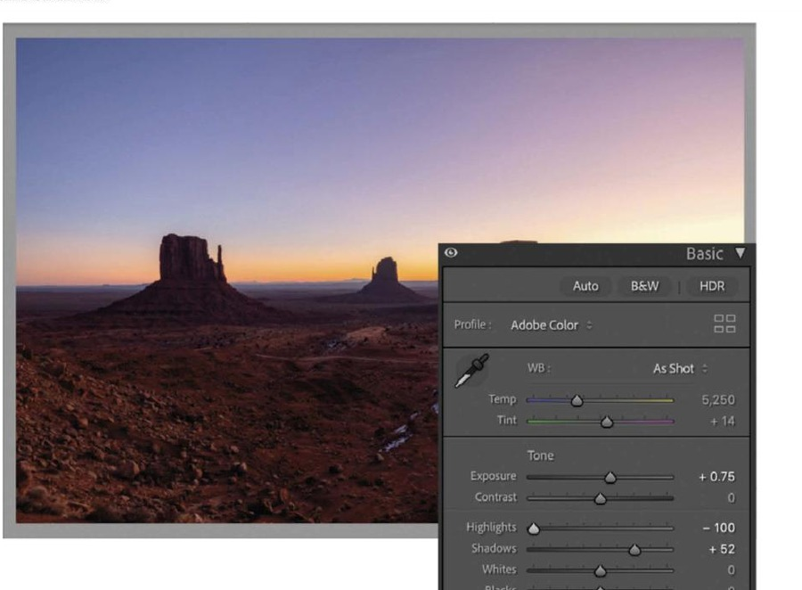
STEP 05
Recover Highlights and Lift Shadows
Highlights and Shadows are targeted sliders. Highlights only affects the bright areas. Shadows only affects the dark areas. They do not interfere with each other.
1
Drag Highlights left to recover a bright sky
Pulling Highlights down (toward -100) brings back detail in overexposed areas like clouds or a bright sky. It does not darken the shadows.
2
Drag Shadows right to open up dark areas
Pushing Shadows up (toward +100) reveals detail in dark areas like faces in shade or a dark foreground. It does not affect the bright areas.
3
Press J to see clipping warnings
Blue areas are losing shadow detail. Red areas are losing highlight detail. Use this to judge how far to push your sliders before detail is lost.
Shadows +52 applied, detail opens in the dark foreground
Highlights -100, sky detail fully recovered
Notes:
GROUPING: Shift+click circle + number, right-click > Group.

Slide 11
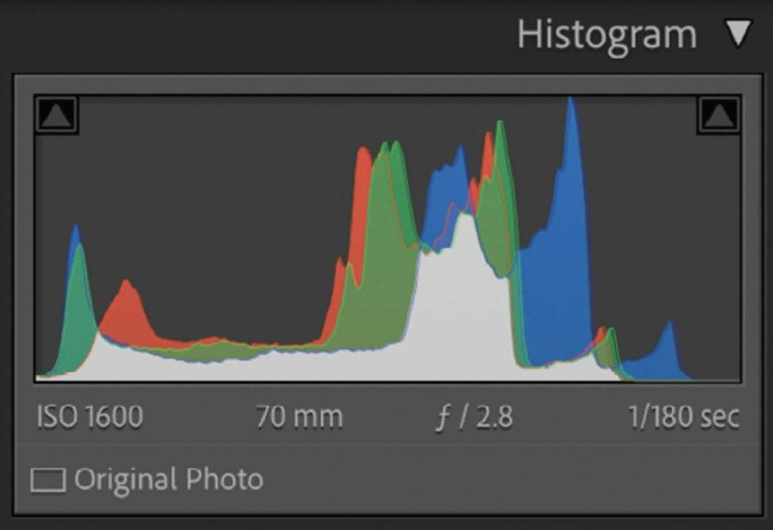
STEP 06
Set Whites and Blacks
Whites sets the brightest point in your photo. Blacks sets the darkest point. Setting these correctly spreads all your tonal information across the full range from black to white.
1
Hold Option and drag the Whites slider
The screen turns black. Drag right until you see the first small white or colored areas appear. That is your clipping point, back off slightly.
2
Hold Option and drag the Blacks slider
The screen turns white. Drag left until you see the first small black areas appear. That is your black point, back off slightly.
Histogram showing a well-spread tonal range, ISO 1600, 70mm, f/2.8
3
Check the histogram after adjusting
A well-adjusted photo has data spread across most of the histogram with no large piles against the left or right edges.
Professional workflow order: Set Exposure first. Then Highlights and Shadows to recover detail. Then Whites and Blacks to set the endpoints. Then Contrast last to taste.
Notes:
GROUPING: Shift+click circle + number, right-click > Group.

Slide 12
RESOURCE
Reading the Histogram
Left side = dark tones
Shadow and black detail. A pile against the left wall means clipped blacks, pure black with no detail.
Right side = bright tones
Highlight and white detail. A pile against the right wall means clipped highlights, blown-out whites with no detail.
Center = midtones
The bulk of most photos. Where skin tones, foliage, and middle grays live.
Colors = RGB channels
Red, green, and blue each have their own channel. Overlaps appear as mixed colors. A color-casted photo will show one channel pushed far from the others.
Histogram panel, color channels overlapping, camera metadata below
Triangles at corners
Clipping warning indicators. Click them to turn on the clipping overlay on your photo (or press J).

Slide 13
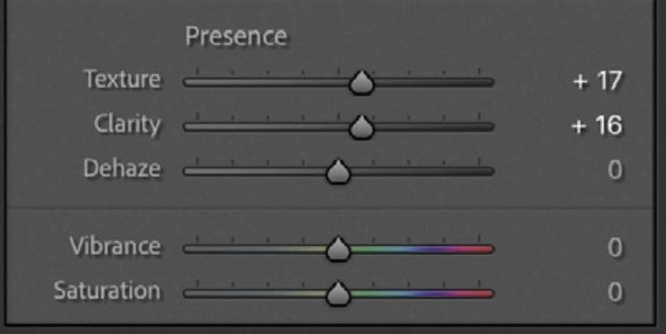
STEP 07
Add Presence, Texture, Clarity, Vibrance
Presence sliders are the finishing touches. Apply them after you have set tone and white balance.
1
Add Texture to bring out surface detail
Texture enhances fine detail like skin, fabric, bark, and feathers without affecting out-of-focus areas. Start between +15 and +30.
2
Add Clarity to increase midtone contrast
Clarity adds punch to edges and structure in the midtones. Too much makes photos look gritty and over-processed. Use sparingly, between +10 and +30.
Presence section, Texture, Clarity, Dehaze, Vibrance, Saturation
3
Add Vibrance to boost color without oversaturating
Vibrance is a smart color boost, it protects skin tones and already-saturated colors while lifting duller colors. It is almost always safer than Saturation.
4
Use Saturation with care
Saturation boosts all colors equally and can quickly make a photo look unnatural. Rarely go above +20.
Notes:
GROUPING: Shift+click circle + number, right-click > Group.

Slide 14
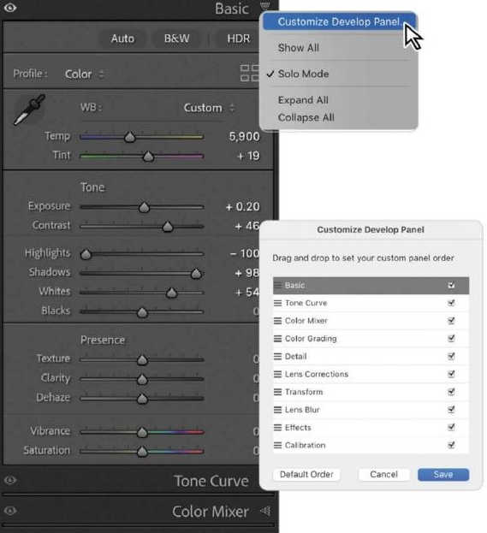
RESOURCE
Customizing the Develop Panel Order
You can rearrange the panels in the Develop module's right panel group to match the way you like to work.
1
Control-click any panel header in the right panel
A menu appears. Choose Customize Develop Panel.
2
Drag panel names to reorder them
Drag any panel name up or down to change its position. Checkboxes toggle visibility.
3
Click Save and restart Lightroom
Your custom order is saved. Lightroom restarts and your panels appear in the new order.
To go back to the default order, open Customize Develop Panel again and click Default Order at the bottom left.
For class work, leave panels in the default order so your screen matches the lesson instructions. Only customize your own personal catalog.
Customize Develop Panel dialog, drag to reorder, checkboxes toggle visibility
Notes:
GROUPING: Shift+click circle + number, right-click > Group.

Slide 15
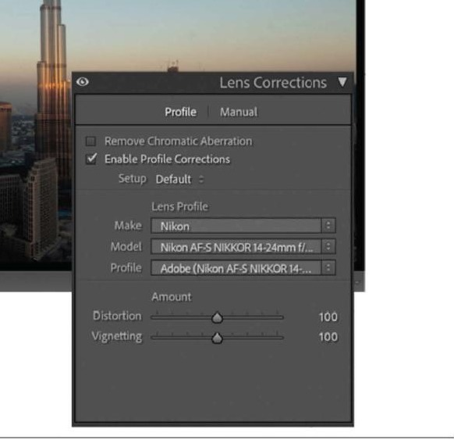
RESOURCE
Lens Corrections, Fix Distortion and Vignetting
Every lens has its own flaws, barrel distortion (bowing outward), pincushion distortion (bowing inward), and dark edges (vignetting). Lightroom can fix all of these automatically.
1
Scroll down the right panel to Lens Corrections
It is below Detail, Transform, and Lens Blur in the default panel order.
2
Click Enable Profile Corrections
Lightroom reads the EXIF data in your photo to identify your lens and automatically applies the correct distortion and vignetting fix.
3
If Lightroom cannot find your lens, choose it manually
Use the Make and Model dropdowns under Lens Profile. Choose the closest match if your exact lens is not listed.
For the Canon EOS R50 with the kit lens: Lightroom will usually find it automatically. If not, select Canon as the Make and look for RF-S 18-45mm or RF-S 18-150mm depending on which kit lens you have.
Lens Corrections panel, Enable Profile Corrections checked, Make and Model auto-detected
Notes:
GROUPING: Shift+click circle + number, right-click > Group.

Slide 16
RESOURCE
Key Vocabulary
These words will appear on quizzes and in class. Learn them now.
Develop module
The editing environment in Lightroom Classic where you correct and enhance photos.
Exposure
The overall brightness of a photo, controlled by the Exposure slider in the Tone section.
Non-destructive
Editing that never changes the original photo file. All edits are saved in the Catalog.
Highlights
The bright areas of a photo. The Highlights slider targets only the bright tones without affecting shadows.
Histogram
A graph showing the distribution of tones in your photo from pure black (left) to pure white (right).
Shadows
The dark areas of a photo. The Shadows slider opens up dark tones without affecting highlights.
Camera Profile
A color interpretation applied at the start of editing. Adaptive Color uses AI to optimize each photo.
Presence
A group of sliders, Texture, Clarity, Dehaze, Vibrance, and Saturation, that add detail and color depth.
White Balance
The color temperature and tint correction that removes color casts from different light sources.
Clipping
When bright areas blow out to pure white or dark areas crush to pure black, losing all detail.

Slide 17
Quick Reference: Your Develop Module Workflow
01
Press D
06
Highlights
Go to the Develop module from the Library module.
Drag left to recover blown-out bright areas.
02
Press R
07
Shadows
Open the Crop Overlay tool. Press Return to confirm.
Drag right to open up dark areas and reveal detail.
03
Profile
08
Whites / Blacks
Set to Adaptive Color at the top of the Basic panel.
Hold Option and drag to set the bright and dark endpoints.
04
WB
09
Contrast
Choose the WB preset that matches your light source. Fine-tune with Temp and Tint.
Add after setting tone. Shift+double-click for auto.
05
Exposure
10
Texture + Vibrance
Set overall brightness first. Press Auto to let Lightroom guess.
Add Presence last. Start with Texture +20, Vibrance +20.

Slide 18

STEP 08
Rate, Cull, and Export Your Best Photos
Rating is how you cull in this class. After editing a photo in the Develop module, press 5 on your keyboard to give it a 5-star rating. Only rate photos you are proud of and want to keep.
5-STAR RATING: YOUR BEST WORK
1
Press D to go to the Develop module
Open the photo you just edited. Make sure you are in the Develop module.
Key Shortcuts for Rating
2
Press 5 on your keyboard to rate it 5 stars
5
You will see five gold stars appear at the bottom of the image. This marks it as one of your best photos.
Rate selected photo 5 stars
0
Remove rating from a photo
3
Repeat for each photo you want to keep
Go through your edited photos. Press 5 for your best work. Press G to return to Grid view and move to the next photo.
G
Return to Grid view in Library
\
Show / hide Library Filter Bar
4
Press backslash (\) to open the Library Filter Bar
In Grid view, press the backslash key to show the Library Filter Bar at the top of the grid.
Cmd+A
Select all visible photos
5
Click Attribute, then click the 5th star to show only 5-star photos
Only your best photos are now visible. Press Cmd+A to select all of them.
To export: Filter to 5-star photos. Press Cmd+A to select all. Go to File > Export and choose JPEG as the format.

Slide 19
Your Develop Edit is Complete.
✓
Your photo is corrected. Your edits are saved in the Catalog. Your original file is untouched.
YOUR NEXT STEP
Lesson 04, AI Assisted Editing →
Press D for Develop | Press G for Grid | Press E for Loupe | Press L for Library
Pioneer Valley High School | Photography 1 | Mr. Silva

