Slide 1

DIGITAL ARTS 1
Color Theory
Understanding the Language of Color
Why do some colors feel exciting?
Why do others feel calm?
Why does a brand choose green over red?
Pioneer Valley High School | Mr. Silva

Slide 2
SECTION 01
Color theory is a set of rules that helps artists and designers use color on purpose.
What is
Color
Theory?
Instead of just picking colors you like, color theory gives you a system. It helps you choose colors that work together, send a message, and make people feel something.
🎨
💻
📱
"Color is the first thing people notice about a design."
Art
Design
Marketing
Painters have used color rules for centuries.
Designers pick colors that match a brand's message.
Brands use color to make you feel and buy.

Slide 3
SECTION 02
The Color Wheel
Every color you will ever use starts here.
Primary Colors
Secondary Colors
Tertiary Colors
These are the three starting colors. You cannot mix other colors to make them.
Mix two primary colors together and you get a secondary color.
Mix a primary and a secondary color to get a tertiary color. There are six of them.
Red Yellow Blue
Orange Green Purple
Red-Orange Yellow-Green Blue-Green

Slide 4
SECTION 03 | Color Relationships
Complementary Colors
Complementary colors sit directly across from each other on the color wheel. Together they create strong contrast and make each other look brighter.
Red + Green
Blue + Orange
Purple + Yellow-Green
Used in: Stop signs & holiday decorations
Used in: Sports teams, bold posters
Used in: Grape packaging, energy drinks

Slide 5
SECTION 03 | Color Relationships
Analogous Colors
Sunset Palette
What are they?
Analogous colors are colors that sit next to each other on the color wheel. They always look good together because they are related.
Think of a sunset. Orange, red, and yellow are all next to each other. That is why it looks so beautiful.
Use analogous colors when you want a design to feel calm, natural, and peaceful.
Ocean Palette
Forest Palette

Slide 6
SECTION 03 | Color Relationships
Triadic Colors
Three colors spaced equally around the color wheel. Bold, balanced, and energetic.
When to use triadic colors:
• When you want your design to feel exciting and bold
• For posters, logos, or social media graphics
Red
Blue
• When you need all three colors to stand out equally
• Great for kids brands, sports, and games
Yellow
▲ Primary Triad

Slide 7
SECTION 04
Color Palettes
A color palette is a small set of colors a designer picks and uses everywhere in a project.
Monochromatic
One color in many shades. Very clean and professional.
Complementary
Two opposite colors. High energy and contrast.
Neutral + Accent
Simple background colors with one bold pop of color.
Key Rule: Pick 3 to 5 colors and stick to them. Using too many colors makes a design look messy.

Slide 8
SECTION 05
Color Psychology
Colors make you feel things. Smart designers use this on purpose.
RED
ORANGE
YELLOW
Energy | Urgency | Power
Fun | Warmth | Creativity
Happiness | Attention | Caution
Brands: YouTube, Target, Coca-Cola
Brands: Amazon, Fanta, Nickelodeon
Brands: McDonald's, IKEA, Snapchat
GREEN
BLUE
PURPLE
Nature | Health | Growth
Trust | Calm | Intelligence
Luxury | Mystery | Creativity
Brands: Starbucks, Whole Foods, John Deere
Brands: Facebook, Samsung, Ford
Brands: Cadbury, Hallmark, Twitch

Slide 9
SECTION 05 | Color Psychology
How Brands Use Color
McDonald's
Coca-Cola
Apple
Red creates hunger and urgency. Yellow creates happiness and energy. Together they make you want to eat fast and feel good about it.
Red is bold, exciting, and energetic. White keeps it clean and classic. This combo has not changed in over 100 years.
Black, white, and silver say: simple, premium, and modern. No color = no distraction. The product speaks for itself.

Slide 10
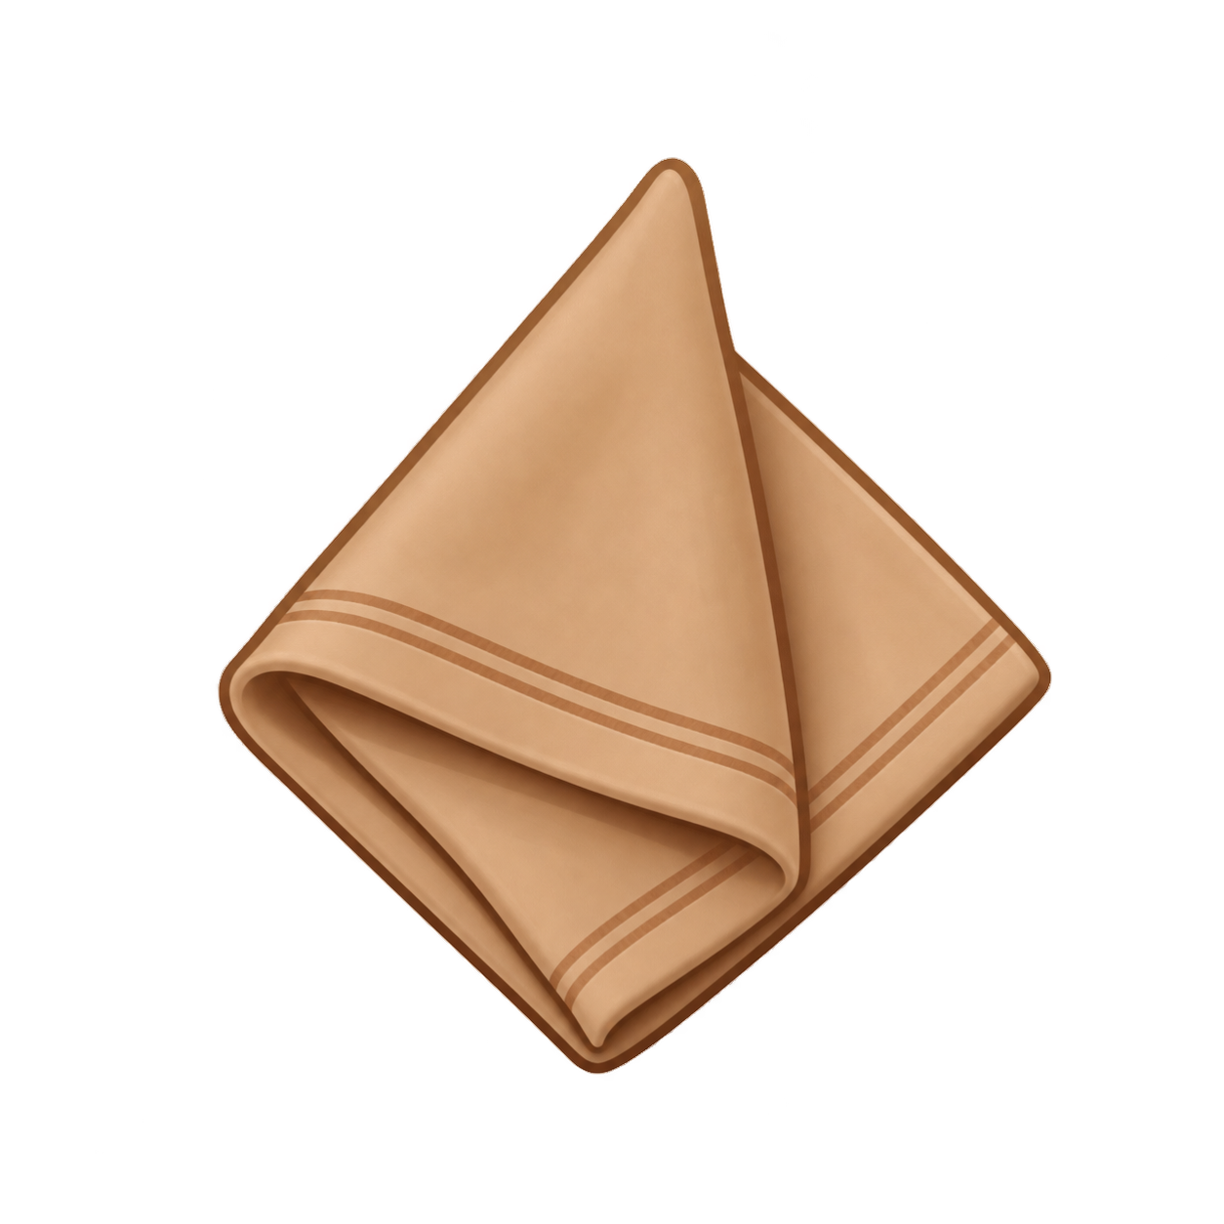
COMING UP NEXT | Section 06
Customer Touchpoints
Where does a customer actually see a brand's colors?
A touchpoint is any moment when a customer sees or interacts with a brand. Every single touchpoint uses the same colors. That is what makes a brand feel familiar.
Think About Starbucks:
☕
The Cup
📱
The App
Green and white, every time, every location.
Same green, same fonts, same icons as the store.
🏪
The Storefront
The Napkins
Green sign, warm wood tones inside.
Even the napkins match the brand.

Slide 11
YOUR
ASSIGNMENT
Choose a brand you know. Here is what you will look for:
01
Name the colors
What 2 to 4 colors does this brand use most?
02
Identify the type
Are the colors complementary, analogous, or something else?
Coming up next session, you will pick a real brand and analyze it.
03
Analyze the psychology
What do those colors make people feel? Why do you think the brand chose them?
04
Spot the touchpoints
Where do you see the colors? App, building, packaging, website?

Slide 12
What You Learned Today
Color theory gives designers a system for choosing colors on purpose.
The color wheel shows primary, secondary, and tertiary colors.
Complementary, analogous, and triadic colors are the main relationships.
A color palette is a small set of colors used consistently across a design.
Colors create feelings. Designers use this to influence how people react.
Brands use color at every touch-point so customers always recognize them.
Pioneer Valley High School | Digital Arts 1 | Mr. Silva

