Slide 1

PHOTOGRAPHY 1
Importing Photos
into Lightroom Classic
From OneDrive to your Catalog, step by step.
1. Check OneDrive
2. Open Lightroom
3. Click Import
4. Find Your Folder
5. Confirm Import
6. Create Collection
Pioneer Valley High School | Mr. Silva

Slide 2
BEFORE YOU START
Lightroom Does Not Move Your Photos
Lightroom Classic uses a Catalog. The catalog remembers where your photos are and tracks your edits. Your actual photo files stay exactly where you put them on OneDrive.
🗂️ The Catalog
📁 Your Photo Files
A database file inside Lightroom
Live inside OneDrive.
Tracks where your photos live
Path: OneDrive-SantaMariaJUHSD
Remembers every edit you make
> Photography
Does not contain your actual photo files
> Your Project Folder

Slide 3

STEP 01
Check OneDrive First
Do this before opening Lightroom. If your photos are not fully synced, Lightroom cannot find them.
1
Find the OneDrive icon
Look in the bottom-right corner of your screen in the System Tray.
2
It should show a green checkmark
White or blue cloud icon with a checkmark = you are good to go.
Red X or yellow triangle = there is an error. Fix it before continuing.
3
Wait if it is still syncing
A spinning icon means OneDrive is still working. Wait until it stops and shows a green checkmark.
4
Confirm your folder in File Explorer
Open File Explorer. Go to OneDrive-SantaMariaJUHSD > Photography > your project folder. Make sure your image files are there.

Slide 4

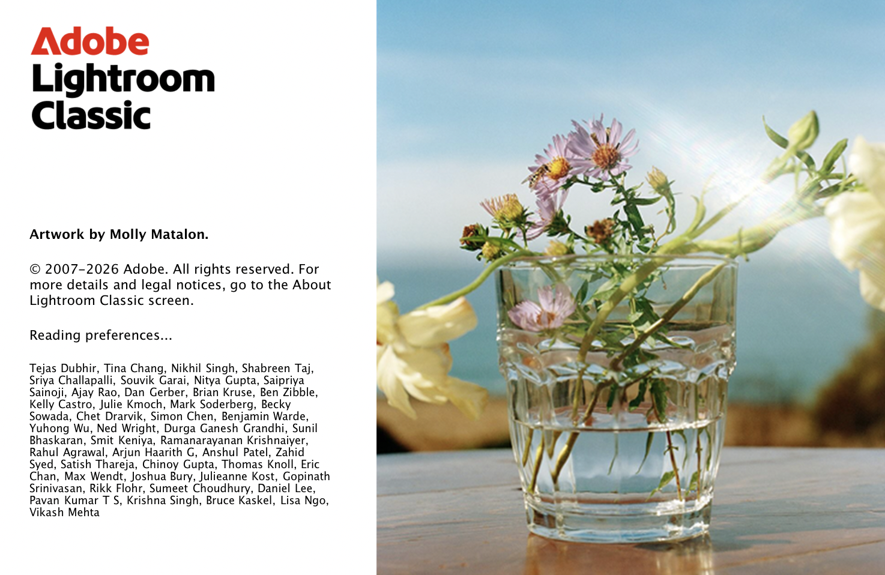

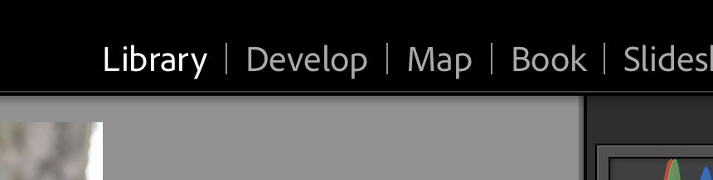
STEP 02
Open Lightroom Classic
⚠️ Open Lightroom Classic, not the regular Lightroom app. The correct icon LrC not just LR.
1
Click the Windows Start button
Press the Windows key and type Lightroom Classic in the search bar.
2
Click to open it
Click the icon that says Classic underneath. It may take 15 to 30 seconds to fully load.
3
Make sure you are in the Library module
At the top right of Lightroom, confirm Library is highlighted in the module picker. If not, click it.

Slide 5
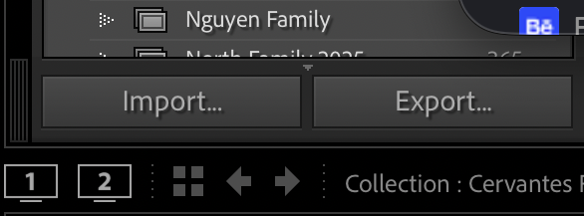
STEP 03
Click the Import Button
The Import Dialog is the window where you tell Lightroom which photos to bring into your catalog.
Click the Import button at the bottom-left of the Library module.
It is always visible in the bottom-left corner. This opens the Import Dialog.
The Import Dialog has three sections:
LEFT
CENTER
RIGHT
Source
Preview
Options
Browse to find your photo files.
Preview the photos before importing.
File handling and metadata options.

Slide 6
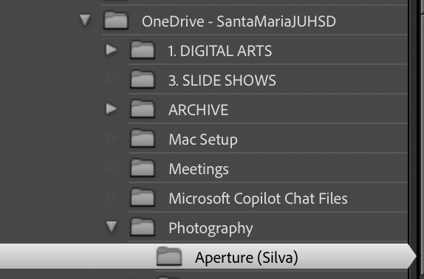
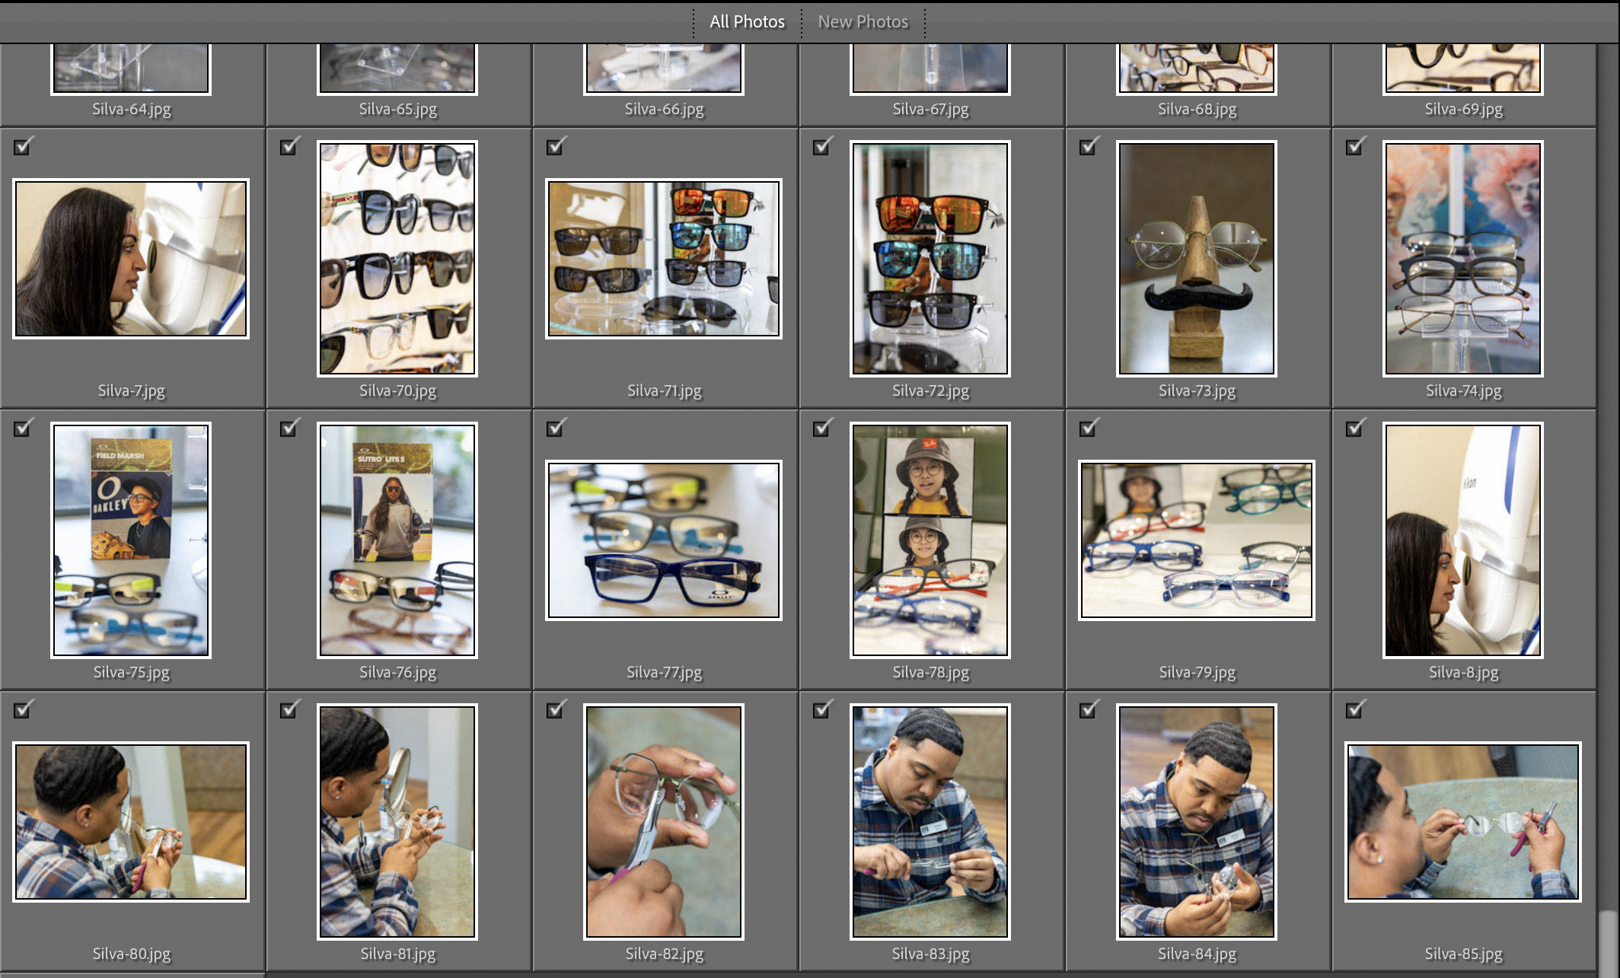
STEP 04
Find Your Project Folder
Use the Source panel on the LEFT side of the Import Dialog. Follow this path exactly:
1
📁 OneDrive - SantaMariaJUHSD
Scroll down in the Source panel until you see this folder. Click the arrow ▶ to expand it.
2
📁 Photography
Click the arrow ▶ next to Photography to expand it. Your project folders will appear inside.
3
📁 Your Project Folder
Click on your project folder once to SELECT it. Do not just expand it with the arrow.
✅ Thumbnails will appear in the center of the Import Dialog once you have selected the correct folder.

Slide 7
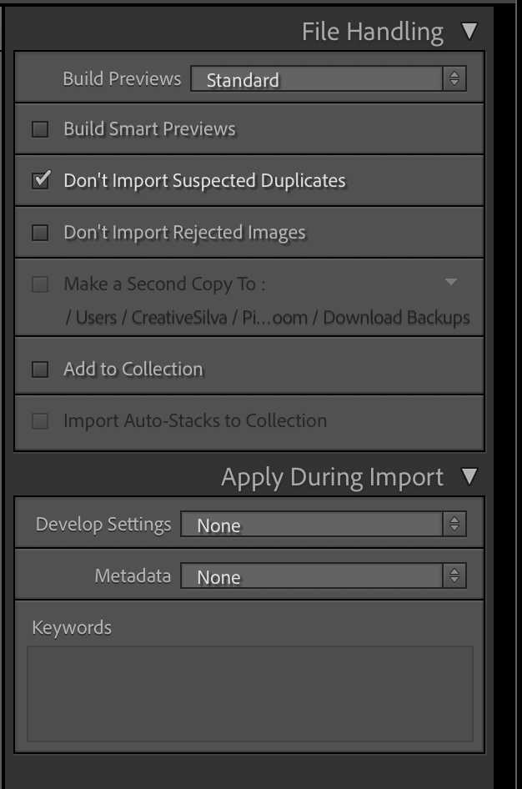
STEP 05
Import All Your Photos
Import everything. You will review and select your best images later during the culling process.
ADD is already selected at the top of the Import Dialog.
This tells Lightroom where your photos are without moving or copying them. Leave it set to ADD.
Before clicking Import, confirm these three settings in the RIGHT panel:
✅
Build Previews: Standard
Lightroom builds good quality previews. Standard is the right choice for class work.
Don't Import Suspected Duplicates: Checked ON
✅
Prevents the same photo from being imported twice if you import this folder again.
❌
Add to Collection: Leave unchecked
You will create the Collection manually after import. Leave this unchecked.

Slide 8
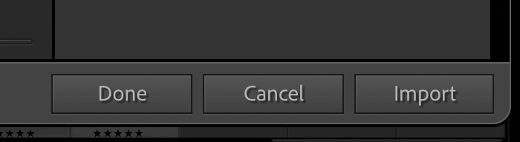
STEP 06
Click Import and Confirm It Worked
Click Import at the bottom-right of the dialog. Then take 30 seconds to confirm it worked.
How to confirm it worked:
✅ Import Successful
Look at the bottom-left corner
Folder in Library shows
the correct image count.
Grid view shows thumbnails.
Numbers match File Explorer.
1
Look at the Folders panel on the left side of the Library module. You will see a number next to your project folder. That is your imported image count.
2
Cross-reference with File Explorer
Open File Explorer and check how many files are in your project folder. That number should match the count in Lightroom exactly.
⚠️ Photos Not Showing?
A question mark on a photo means Lightroom cannot find the file.
Make sure you didn’t move or rename the source folder. Check that OneDrive finished syncing before you imported.
3
Press G for Grid view, then E for Loupe View (toggle back and forth)
You will see all your imported photos as thumbnails. Scan through quickly to confirm they all look right. Then press E to go to single image “Loupe View” and then press G to go back to grid view.

Slide 9
STEP 07 | Create a Collection
What is a Collection and What to Name It
A Collection is a virtual album inside Lightroom. It groups your photos for easy access without moving the actual files. Name it clearly so you can find it months from now.
✅ Good Names
❌ Avoid These
Natural Light Portraits
"photos"
Too vague.
Sauce Baby Product Photos
"final"
Final of what?
Campus Architecture Project
"new folder 1"
No information.
Street Photography 2026
"asdfgh"
Can't find it later.
Black and White Textures
"stuff"
Not professional.

Slide 10
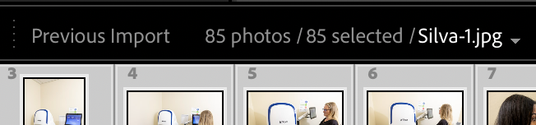
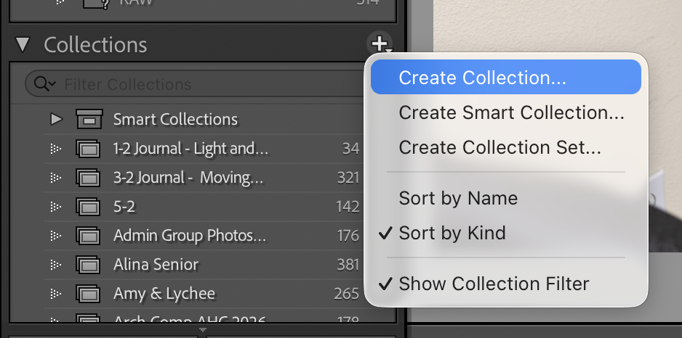
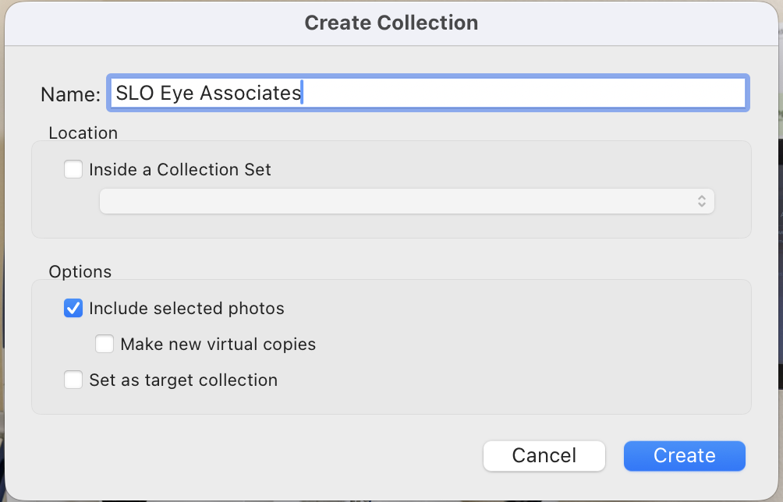
STEP 07 | Create a Collection
Create Your Collection
You are now back in the Library module. Your imported images are showing in Grid view.
Press Ctrl + A (Win) or Command + A (Mac)
This selects ALL of the images you just imported. You should see every thumbnail highlighted. Check the count at the bottom of the screen, for example, 43 selected. This should match the number you imported.
1
2
Find the Collections panel on the left
Scroll down the left panel in the Library module until you see the Collections panel with a small + icon next to it.
3
Click + and choose Create Collection
A small dropdown will appear. Choose Create Collection.
Name your Collection in the dialog
4
Type the name you decided on, for example: Natural Light Portraits.
Make sure Include Selected Photos is checked.
Click Create
5
Your new Collection appears in the Collections panel on the left. Click it to confirm all your project images are inside.

Slide 11
Your Complete Workflow
Follow this every time you start a new project.
Check OneDrive
Open Lightroom Classic
01
02
Green checkmark in taskbar. No errors.
Look for Classic under the icon. Not the regular Lightroom app.
03
Click Import
04
Navigate to your folder
Bottom-left of the Library module.
OneDrive-SantaMariaJUHSD > Photography > project folder.
Click Import
Confirm the count
05
06
Import everything. You will cull and select your best images later.
Folder count in Library must match your source folder count in File Explorer.
07
Ctrl/Cmd + A, then Create Collection
08
Name your Collection
Select all > Collections panel > + > Create Collection.
Clear, descriptive name. Example: Natural Light Portraits.

Slide 12
✓
Your Import is Complete.
Your photos are in your catalog. Your Collection is created. You are now ready to edit.
YOUR NEXT STEP
→
Head to the Develop Module to Start Editing
Click Develop in the module picker at the top right. Open your Collection and start working through your images.
Remember: Press D to go to Develop | Press G for Grid view | Press E for Loope View | Press L to go to Library
Pioneer Valley High School | Photography 1 | Mr. Silva

