Slide 1

CTE PHOTOGRAPHY 2A
Composition
Review
15 Rules Every Photographer Must Know
Welcome back! Let's sharpen your eye before we start capturing images.
Pioneer Valley High School

Slide 2
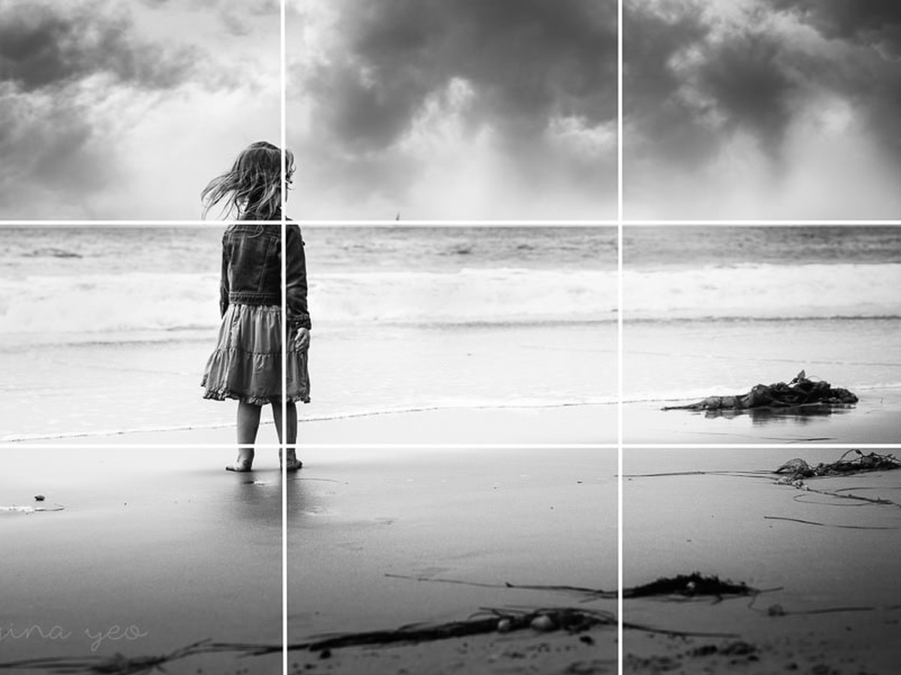
CTE Photography 2A - Composition Review
1
Rule of Thirds
Split your frame into a 3x3 grid using two horizontal and two vertical lines. Place your subject, horizon, or key detail along one of those lines or at a corner where they cross. This gives your photo a natural sense of balance that feels more interesting than placing things in the center.
KEY TIPS
Turn on your camera's grid overlay in the settings menu
Place a portrait subject's eyes on the top horizontal line
Put the horizon on the top or bottom third line, not the middle
The four intersection points are called power points. Use them.
Pioneer Valley High School - Photography 2A

Slide 3
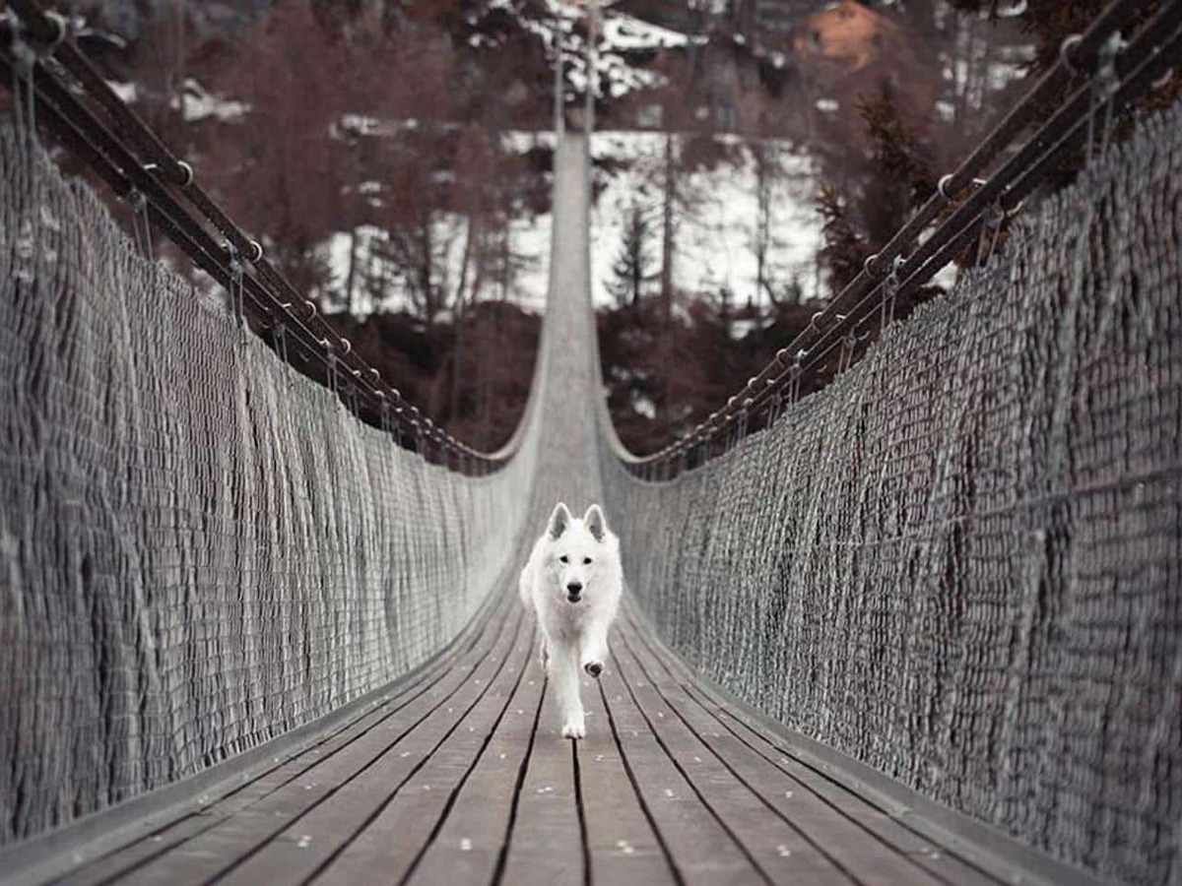
CTE Photography 2A - Composition Review
2
Leading Lines
Leading lines are lines in your scene that pull the viewer's eye toward your subject. Roads, fences, rivers, hallways, and shadows all work as leading lines. They add depth and give your image a clear path for the eye to follow.
KEY TIPS
Find lines that point toward your subject, not away from it
Diagonal leading lines feel more energetic than straight ones
Converging lines create a strong sense of depth and perspective
You can layer two or more leading lines for a stronger effect
Pioneer Valley High School - Photography 2A

Slide 4
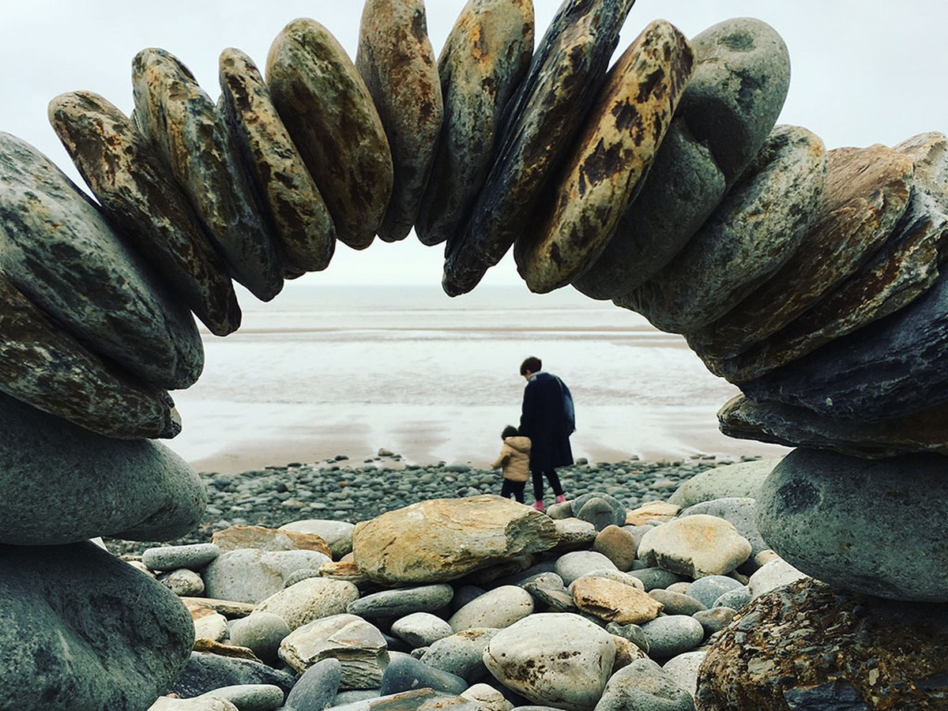
CTE Photography 2A - Composition Review
3
Framing
Use objects in your scene to build a natural frame around your subject. Doorways, arches, windows, and tree branches all create a frame within the frame. This technique pulls the viewer's attention to your subject and adds a sense of depth and place.
KEY TIPS
Your foreground frame does not need to be in sharp focus
Dark frames around a bright subject create strong contrast
Look up, down, and around you. Frames are everywhere.
Tunnel shots are a classic and powerful example of framing
Pioneer Valley High School - Photography 2A

Slide 5

CTE Photography 2A - Composition Review
4
Negative Space
Negative space is the empty area around your subject. Leaving open space in your frame gives your subject room to breathe. It also creates a feeling of calm, loneliness, or scale. The subject becomes more powerful, not less, when it has space around it.
KEY TIPS
Sky, open water, and blank walls make great negative space
Leave space in the direction your subject faces or moves
High-contrast negative space works best (dark subject, light sky)
Fight the urge to fill every corner of your frame
Pioneer Valley High School - Photography 2A

Slide 6
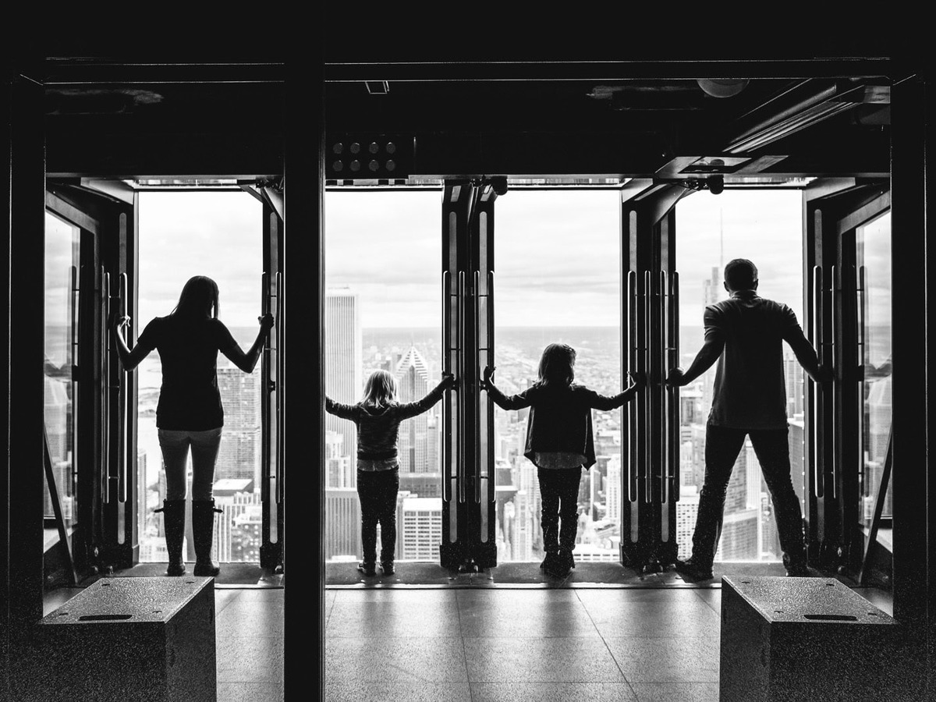
CTE Photography 2A - Composition Review
5
Symmetry
Symmetry happens when both sides of a frame mirror each other. It creates a feeling of order and calm. Perfect symmetry is very bold. You can also break symmetry on purpose by adding one small element that disrupts the pattern. That one break becomes the focal point.
KEY TIPS
Photograph straight on for true symmetry, not at an angle
Reflections in water, glass, and mirrors are natural symmetry
Breaking symmetry with one odd element creates a strong focal point
Architecture is one of the best places to find symmetry
Pioneer Valley High School - Photography 2A

Slide 7

CTE Photography 2A - Composition Review
6
Patterns and Repetition
Patterns are any repeated shapes, colors, lines, or textures in a scene. Our eyes love repetition because it feels satisfying and organized. A strong pattern image fills the frame with the repeating element. Breaking the pattern with one different object instantly grabs attention.
KEY TIPS
Fill the entire frame with the pattern for maximum impact
Look for patterns in everyday objects: bricks, tiles, windows
One element that breaks the pattern becomes the focal point
Photograph from directly above to flatten and strengthen patterns
Pioneer Valley High School - Photography 2A

Slide 8

CTE Photography 2A - Composition Review
7
Depth and Layers
A great photo feels three-dimensional. You can create depth by including a foreground, a midground, and a background. Each layer gives the viewer's eye a new place to look. This makes a flat image feel like you can step right into it.
KEY TIPS
Get low or move close to add a strong foreground element
Shallow depth of field separates layers with selective focus
Wide-angle lenses exaggerate depth between near and far objects
Slightly overlapping elements help reinforce spatial depth
Pioneer Valley High School - Photography 2A

Slide 9
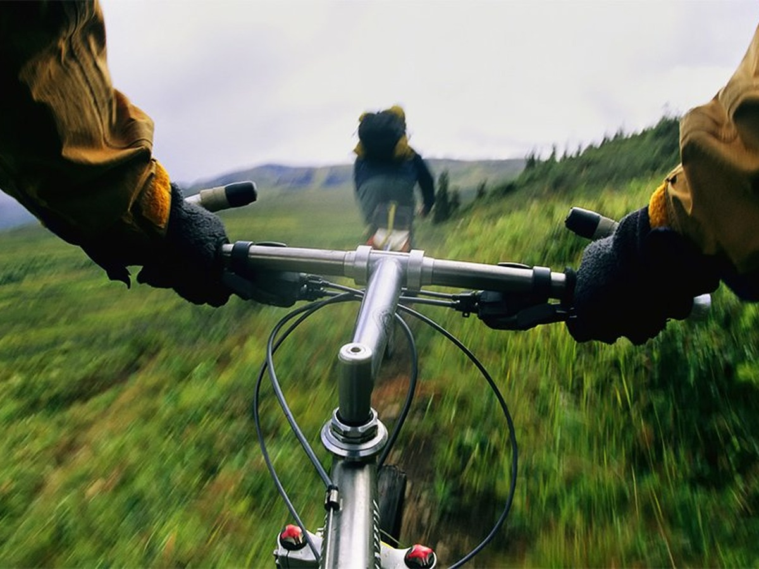
CTE Photography 2A - Composition Review
8
Point of View
Point of view is where you physically place the camera before you capture an image. Eye level is safe but neutral. Getting low makes your subject look powerful. Positioning above creates a feeling of vulnerability or gives context to the scene. Your angle is a creative choice.
KEY TIPS
Try at least two or three angles before you commit to a shot
Low angles make subjects look dominant and strong
A bird's eye view (camera pointing straight down) shows shape and pattern
Positioning through objects at ground level creates unexpected foregrounds
Pioneer Valley High School - Photography 2A

Slide 10
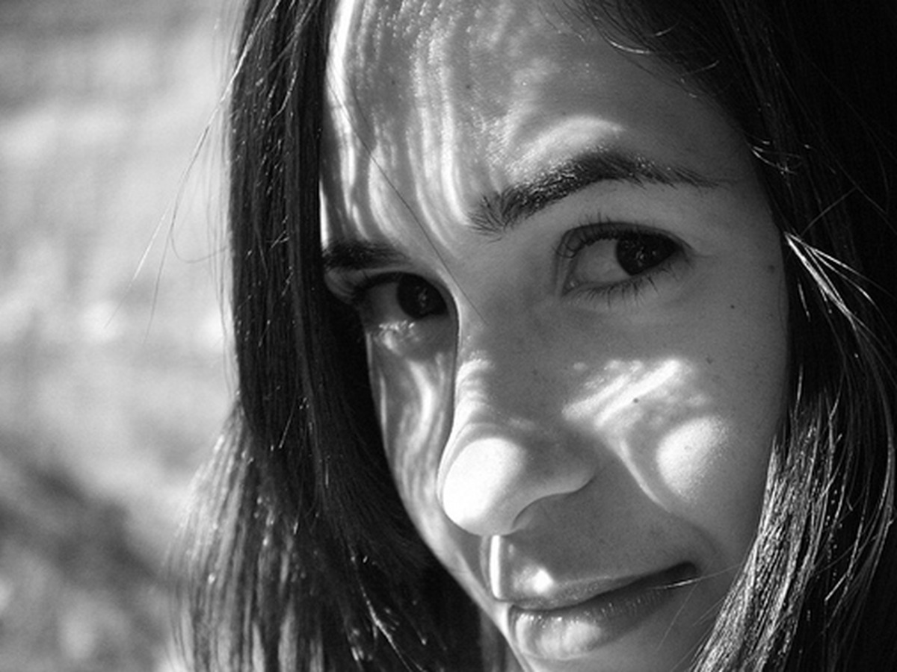
CTE Photography 2A - Composition Review
9
Fill the Frame
Move in close until your subject fills most of the frame. This removes distracting backgrounds and forces the viewer to focus on your subject. It works especially well for portraits, textures, and close-up detail images. Getting physically closer is always better than cropping in post.
KEY TIPS
Move your feet first. Then zoom if you need to.
Leave just a little breathing room so the subject does not feel trapped
Works best when the subject has strong texture or fine detail
Great for cutting out messy or busy backgrounds fast
Pioneer Valley High School - Photography 2A

Slide 11
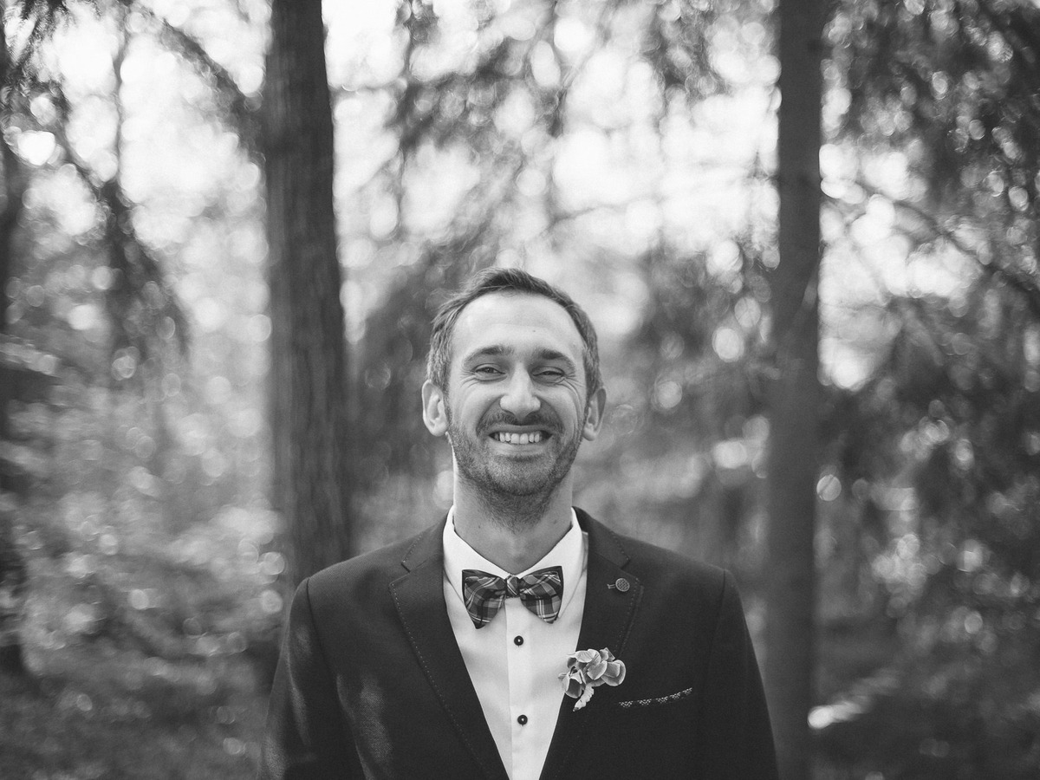
CTE Photography 2A - Composition Review
10
Centered Composition
Placing your subject directly in the center of the frame is bold and direct. It works best with symmetrical subjects like faces, tunnels, and buildings. Centered composition tells the viewer exactly where to look. It reads as confident when done on purpose.
KEY TIPS
Works best with subjects that are symmetrical by nature
Pair centering with a simple, clean background
Combine with a perfectly level horizon for a clean, powerful look
Intentional centering looks confident. Accidental centering looks lazy.
Pioneer Valley High School - Photography 2A

Slide 12
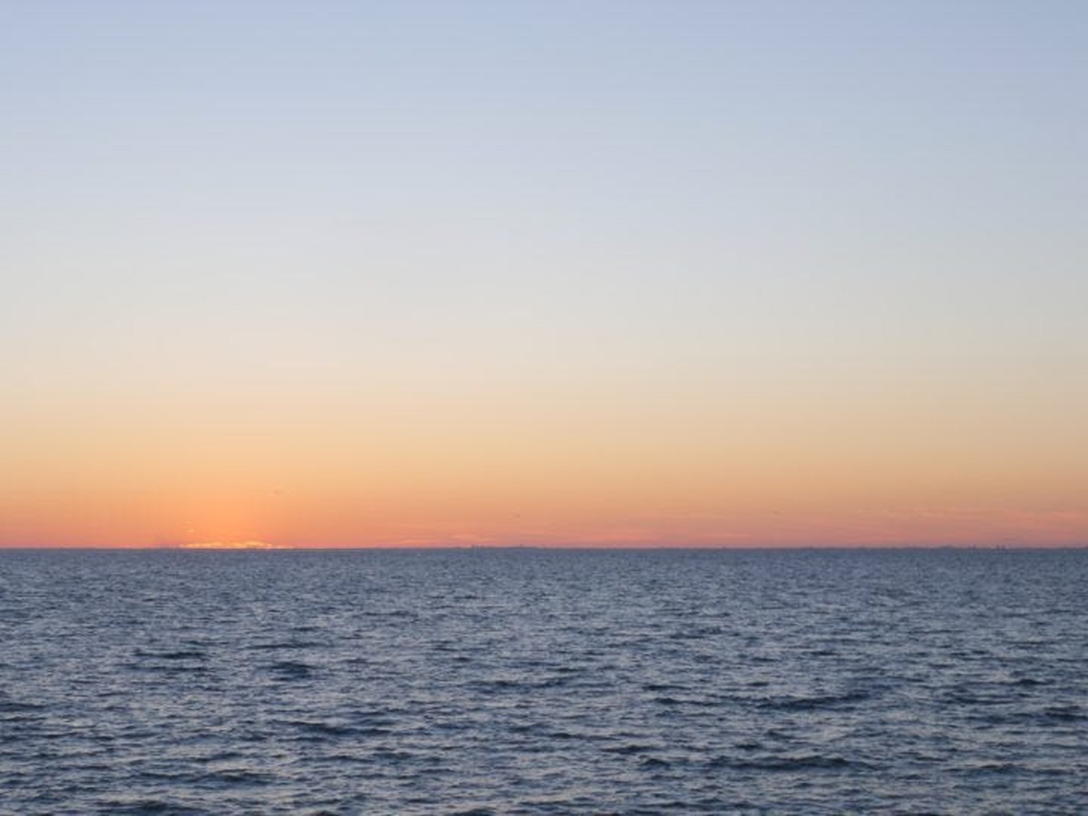
CTE Photography 2A - Composition Review
11
Horizon Line
The horizon line is where the sky meets the ground. A level horizon looks clean and in control. A tilted or crooked horizon is one of the most common and distracting composition mistakes. Always decide on purpose whether your horizon is level or intentionally tilted.
KEY TIPS
Use your camera's electronic level or grid to check alignment
Place the horizon on the upper or lower third, not the center
A Dutch angle (intentional tilt) creates tension but must be obvious
Fix a slightly tilted horizon quickly in Lightroom with the Crop tool
Pioneer Valley High School - Photography 2A

Slide 13

CTE Photography 2A - Composition Review
12
Texture and Detail
Getting close enough to show surface texture makes a photo feel tactile. The viewer can almost feel what they are seeing. Raking light (light coming in from a low side angle) is the best way to reveal texture in stone, wood, fabric, skin, and food.
KEY TIPS
Side lighting at a low angle is the best light for texture images
Use a prime lens or macro lens to get the sharpest detail
Focus precisely on the part of the texture that matters most
High contrast between light and shadow makes texture pop
Pioneer Valley High School - Photography 2A

Slide 14

CTE Photography 2A - Composition Review
13
Color and Contrast
Color contrast between your subject and background controls where the eye goes first. Complementary colors (colors opposite each other on the color wheel) create strong visual tension. A single bold color against a neutral background is one of the easiest ways to isolate a subject.
KEY TIPS
Look for bold color contrast between subject and background
Complementary pairs: orange and blue, red and green, yellow and purple
A desaturated background makes a colorful subject pop harder
Golden hour adds warm color naturally to any outdoor session
Pioneer Valley High School - Photography 2A

Slide 15
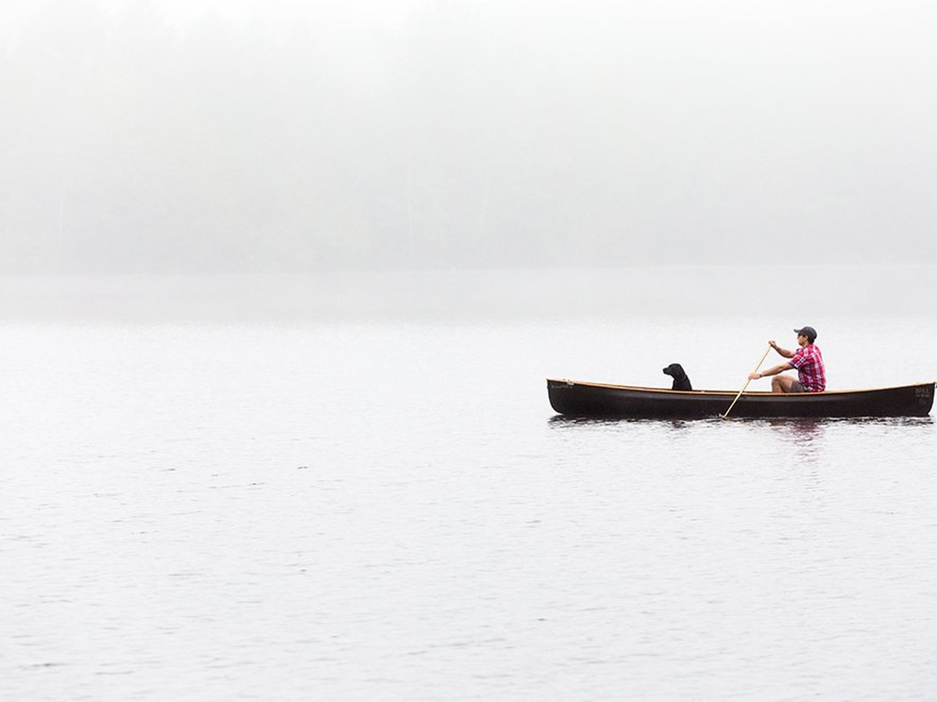
CTE Photography 2A - Composition Review
14
Rule of Space
When your subject is moving or looking in a direction, leave space in front of them in the frame. This is called the rule of space. It gives the subject somewhere to go. Without it, the subject looks like it is about to run into the edge of the frame, which feels uncomfortable.
KEY TIPS
Leave more space in front of a moving subject than behind it
Works for any subject with a clear direction: runners, cars, birds
The same idea applies to a subject that is simply looking off frame
Breaking this rule intentionally can create a feeling of tension
Pioneer Valley High School - Photography 2A

Slide 16

CTE Photography 2A - Composition Review
15
Visual Weight and Balance
Visual weight is how much attention a part of your frame pulls. Large, bright, sharp, or colorful things carry more visual weight than small, dark, or blurry things. A well-balanced photo distributes that weight so no single area feels too heavy. Balance does not have to mean symmetry.
KEY TIPS
A small bright object can balance a large dark one
Sharp subjects carry more weight than blurry backgrounds
Warm colors feel heavier than cool colors of the same size
Step back and look at your whole frame before you capture the image
Pioneer Valley High School - Photography 2A

Slide 17
Now go capture.
Rules are tools. The best photographers know when to use them and when to break them.
Pioneer Valley High School - Photography 2A - Composition Review

