Slide 1

Human Activity Recognition
Classification of mobile sensor data
Siva Prasad Jonnalagadda
Student International School of Engineering, Hyderabad.

Slide 2
Agenda
Overview
State of the art
Data
Method
Results
Analysis

Slide 3
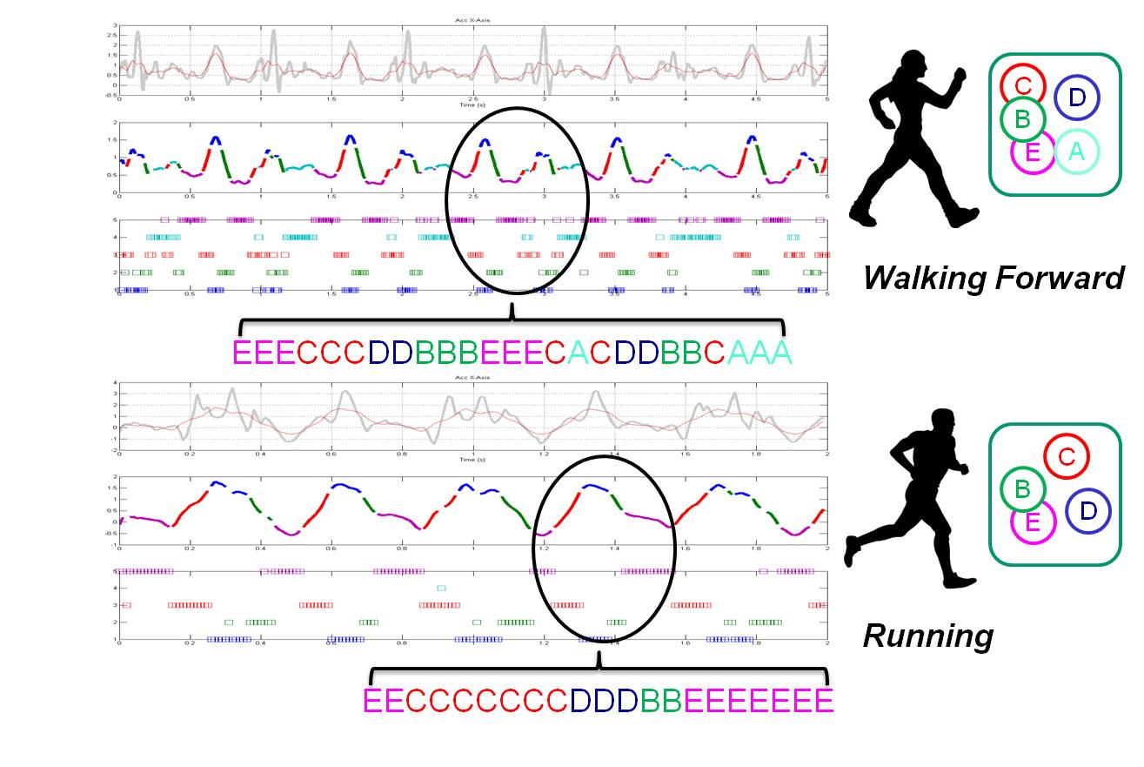
Overview
Human activity recognition has seen a tremendous growth in the last decade playing a major role in the field of health care and research. This emerging popularity can be attributed to its many of real-life applications primarily dealing with human-centric problems like healthcare and eldercare. Many research attempts with data mining and machine learning techniques have been undergoing to accurately detect human activities for e-health systems.

Slide 4
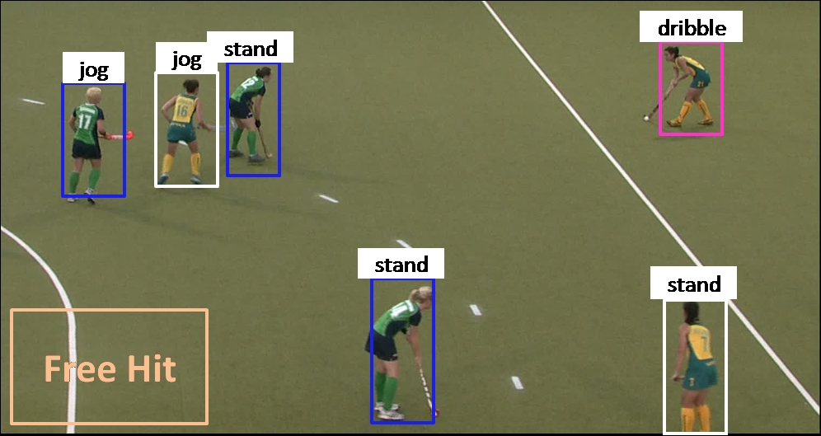
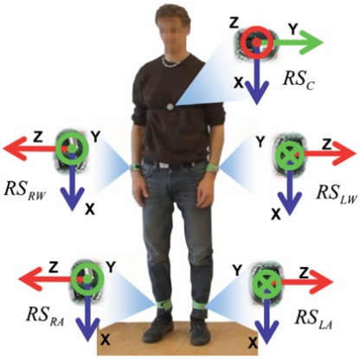
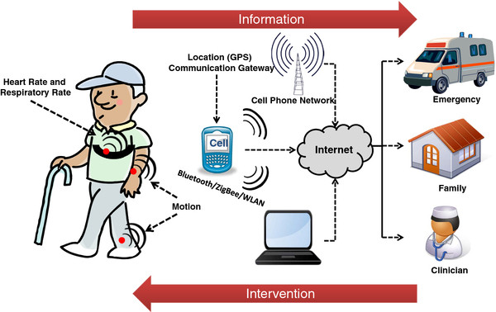
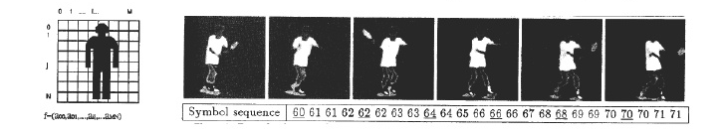
State of the art
Sensor based user activity recognition
Activity recognition through logic and reasoning
Data mining based approach to activity recognition
Vision-based activity recognition

Slide 5

Data
The Human Activity Recognition database was built from the recordings of 30 study participants performing activities of daily living (ADL) while carrying a waist-mounted smartphone with embedded inertial sensors. The objective is to classify activities into one of the six activities performed.
The experiments have been carried out with a group of 30 volunteers within an age bracket of 19-48 years. Each person performed six activities (WALKING, WALKING_UPSTAIRS, WALKING_DOWNSTAIRS, SITTING, STANDING, LAYING) wearing a smartphone (Samsung Galaxy S II) on the waist. Using its embedded accelerometer and gyroscope, we captured 3-axial linear acceleration and 3-axial angular velocity at a constant rate of 50Hz. The

Slide 6
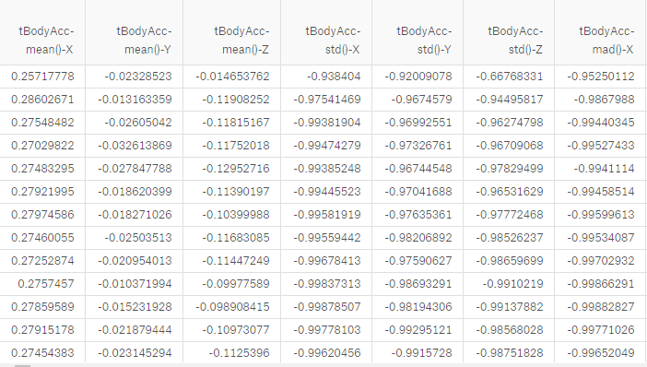
Data
Data | #Rows | #Columns
Train | 7352 | 563
Test | 2947 | 563

Slide 7
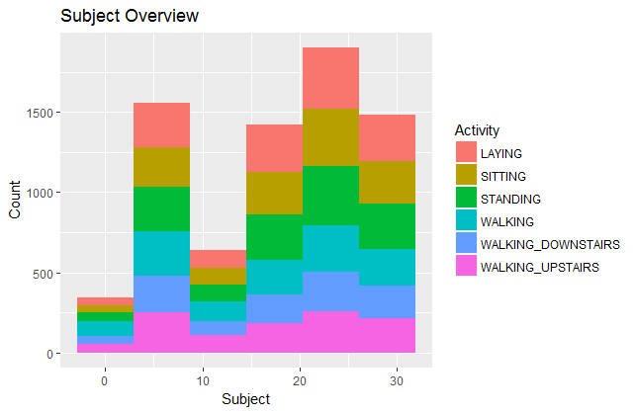
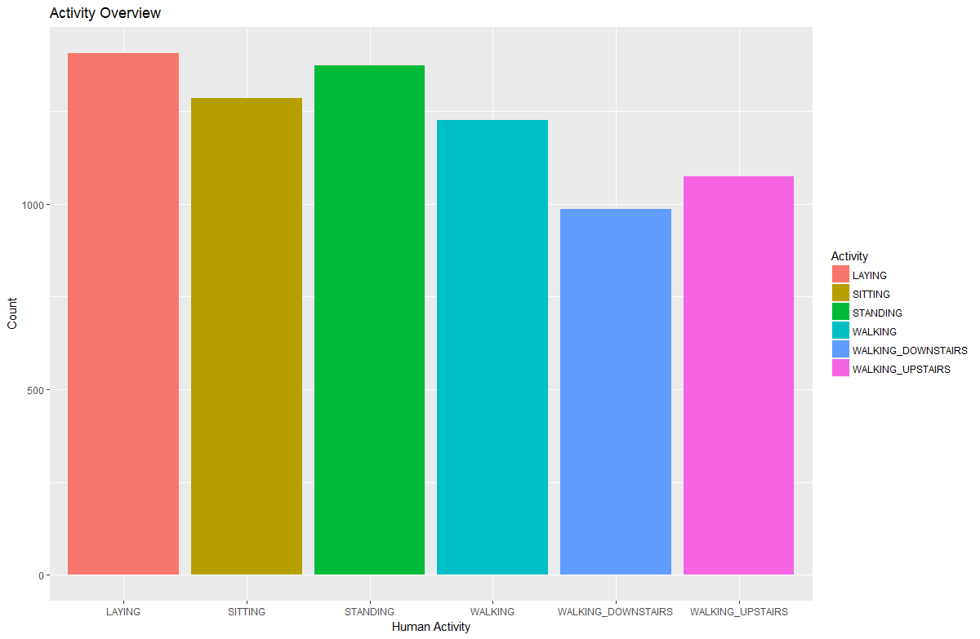
Data

Slide 8
Method
Supervised machine learning approach
Principal Component Analysis
Decision Tree
SVM
kNN
Random Forest
Ensemble

Slide 9
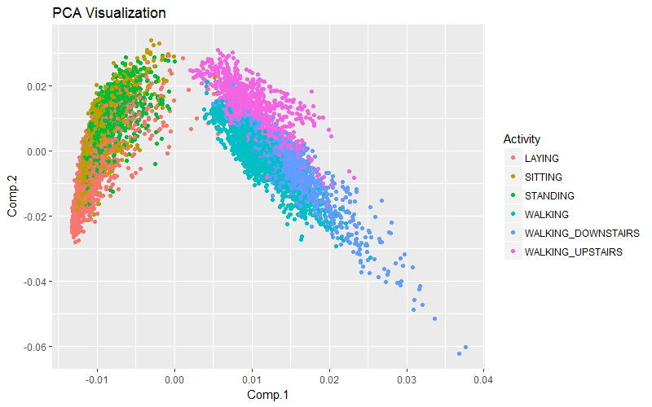
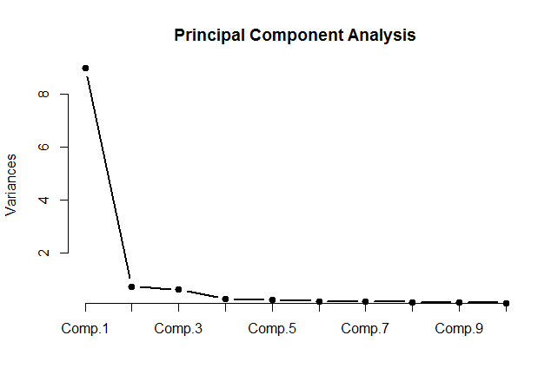
PCA

Slide 10
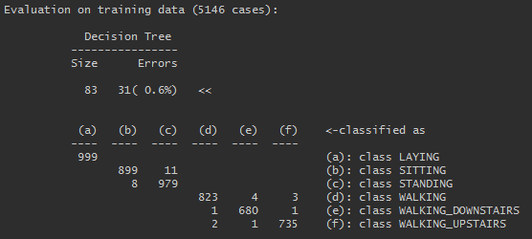
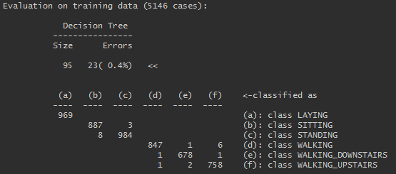
Decision tree
PCA Data
Actual Data
Accuracy on Train data - 96.73533
Accuracy on validate data - 96.37353
Accuracy on test data - 73.80387
Accuracy on train data - 99.55305
Accuracy on validate data - 95.10426
Accuracy on test data - 86.29114

Slide 11
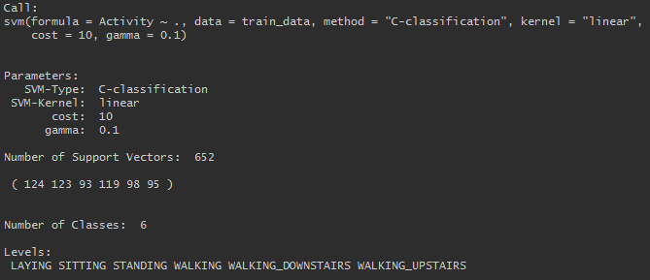
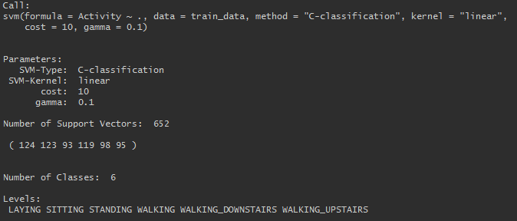
SVM
PCA Data
Actual Data
Accuracy on Train data - 94.73
Accuracy on validate data - 93.65
Accuracy on test data - 75.77
Accuracy on train data - 99.37816
Accuracy on validate data - 99.59202
Accuracy on test data - 95.453

Slide 12
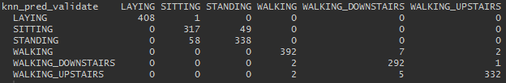
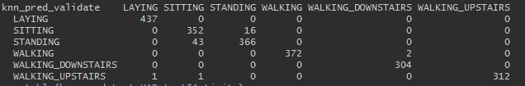
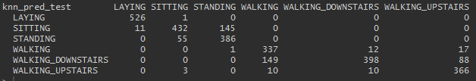
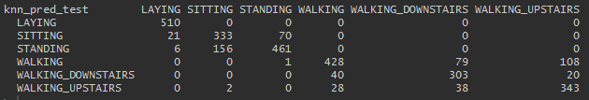
kNN
PCA Data
Actual Data
Accuracy on validate data - 94.24297
Accuracy on test data - 82.96573
Accuracy on validate data - 97.14415
Accuracy on test data - 80.69223

Slide 13
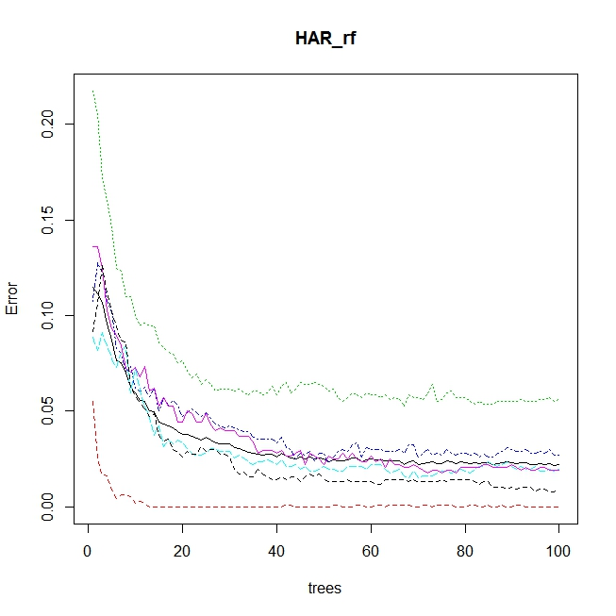
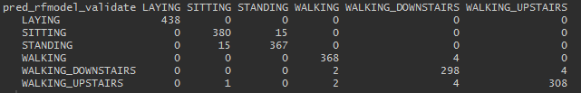
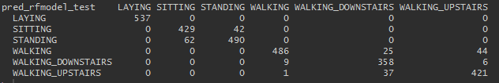
Random Forest
On Actual Data
Accuracy on validate data - 97.86945
Accuracy on test data - 92.33118

Slide 14
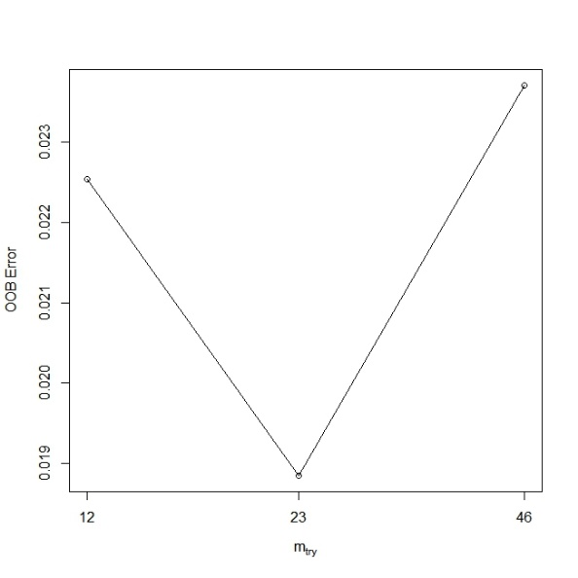
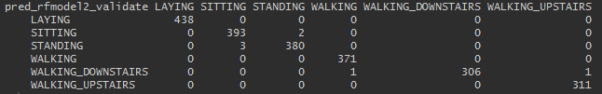
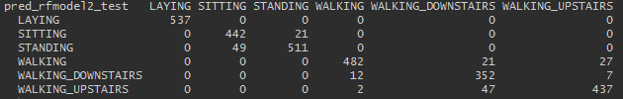

Random Forest
Model tuned
Accuracy on validate data - 99.68268
Accuracy on test data - 93.6885

Slide 15
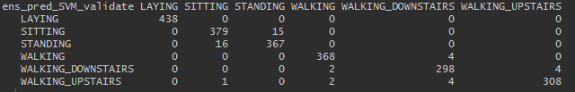

Ensemble
Accuracy on validate data - 97.82412
Accuracy on test data - 92.33118

Slide 16
Analysis
Observed that, the actual data is giving best result on SVM model than the PCA data models and ensemble.
Getting an intuition that, the SVM performs better on the IOT sensor data.

Slide 17
Analysis

Slide 18
Analysis

Slide 19
Analysis

Slide 20
Thank You

