Slide 1
Lab 1: Container & Iterator 容器和迭代器
Sep/Oct, 2024

Slide 2
Outline
Containers （容器）
Template Containers （模板容器）
Iterators（迭代器）
Friend class（友元类）
Generic Algorithms（泛型算法）

Slide 3
Review of Best Paid Employee
Try to improve the implementation
Store all the entered employee in the company
Storage
Linked（链式）
Contiguous（连续）
Problem
Implementation details of the storage

Slide 4
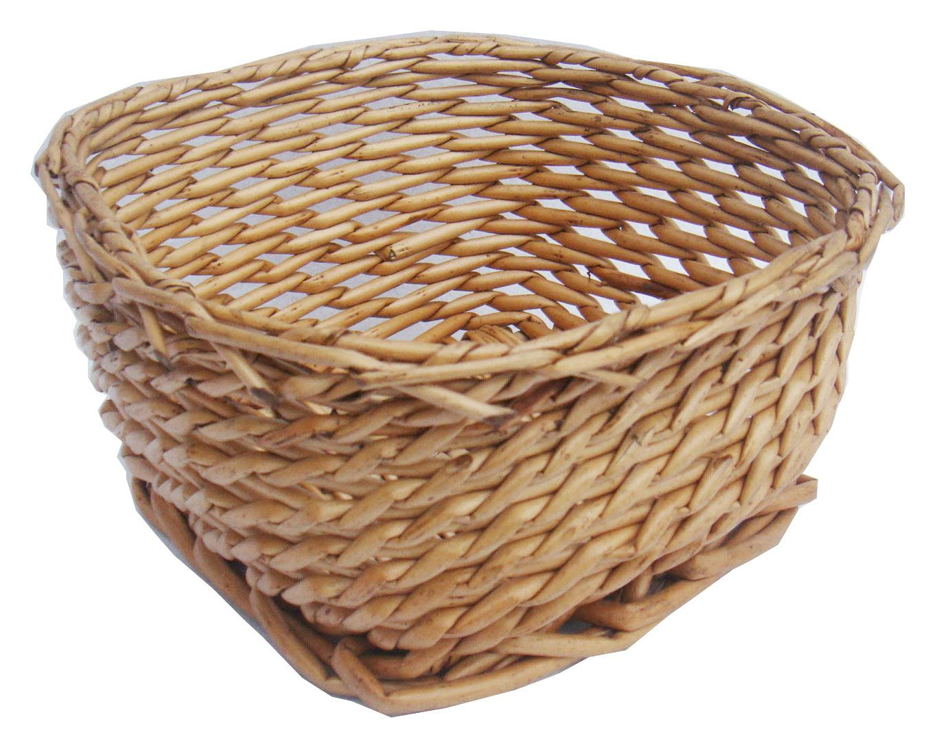
Use a container （容器）
A container is a variable that consists of a collection of items
Hold items (of a certain type)
Construct
Destruct
Add an item
Remove an item
Get size
Check empty
Access
Traverse

Slide 5
Container class（容器类）
A container class is a class whose objects are containers
Encapsulate an array (or other storage structures, e.g. linked)
Provide a list of method interfaces

Slide 6

Class Template（模板类）
A container is a variable that consists of a collection of items
Hold items (of any type)

Slide 7
Demo
Continuous Storage

Slide 8
Demo
Linked storage
A head pointer
head
NULL
元素1
元素2
…

Slide 9
Attention!
For template classes, keep the interface definition and its implementation in a single .h file!
Notes:
Why? Cannot compile the .cpp with parametric class if seperated from the .h file [无法判断类型存储空间大小，不能生成exe文件]

Slide 10
Task 1
Implement the add() and input() method

Slide 11
Traverse A Container（遍历）
Define a class
Encapsulate the position of a container
Provide public method for manipulating the position
Retrieve the value stored at the position
Move to the next position
Test whether two positions are the same
Two special positions:
The head position and the tail position

Slide 12
For the Linked List Template
class Position
{
private:
Node *curr;
public:
operator*; //retrieve value
operator++; //the next
operator==; //equivalence
}

Slide 13
For the Linked List Template
Two special positions
Position(head)
Position(NULL)

Slide 14
Nested Class（嵌入类，内部类）
Container Class A --- Position Class PA
The class PA is not used anywhere else except for in the class A
Define class PA inside class A so that it is only visible within class A
Notes:
虽然内部类在外部类内部定义，但它是一个独立的类，基本上与外部类不相关。它的成员不属于外部类，同样，外部类的成员也不属于该内部类。内部类的出现只是告诉外部类有一个这样的类型成员供外部类使用。并且，外部类对内部类成员的访问没有任何特权，内部类对外部类成员的访问也同样如此，它们都遵循普通类所具有的标号访问控制。

Slide 15
The Iterator Inner Class
Demo

Slide 16
Task 2
Implement the findBestPaid() method

Slide 17
Task 3
Bidirectional linked storage container and associated iterator
head
next
pre
NULL
node₁
node₂
…

Slide 18
Summary
A data structure is a container as viewed by a user
Almost all container classes are templated and have an associated iterator class
A generic algorithm is a template function that applies to container objects through iterators
These are included in the Standard Template Library

Slide 19
Thank you!
Questions?

Slide 20
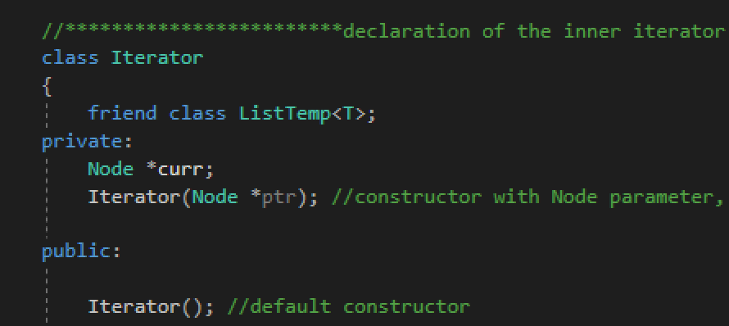
Friend Class（友元类）

Slide 21
Appendix
copy constructor vs. assignment operator???
void operator= (const Employee& otherEmployee)
return type???
typename
nested dependent name is not a type
Notes:
调用的是拷贝构造函数还是赋值运算符，主要是看是否有新的对象实例产生。如果产生了新的对象实例，那调用的就是拷贝构造函数；如果没有，那就是对已有的对象赋值，调用的是赋值运算符
声明template参数时，前缀关键字class与typename可以互换
请使用关键字typename标识嵌套从属类型名称；但不得在base class lists或者member initialization list内使用typename

