Slide 1
Lab 5: Queue & Simulation （队列与仿真）
Nov, 2024

Slide 2
Outline
Container Adaptor（容器适配器）
queue
Simulation（仿真）
Exponential distribution（指数分布）
Sampling（采样）
Queueing theory（排队论）

Slide 3
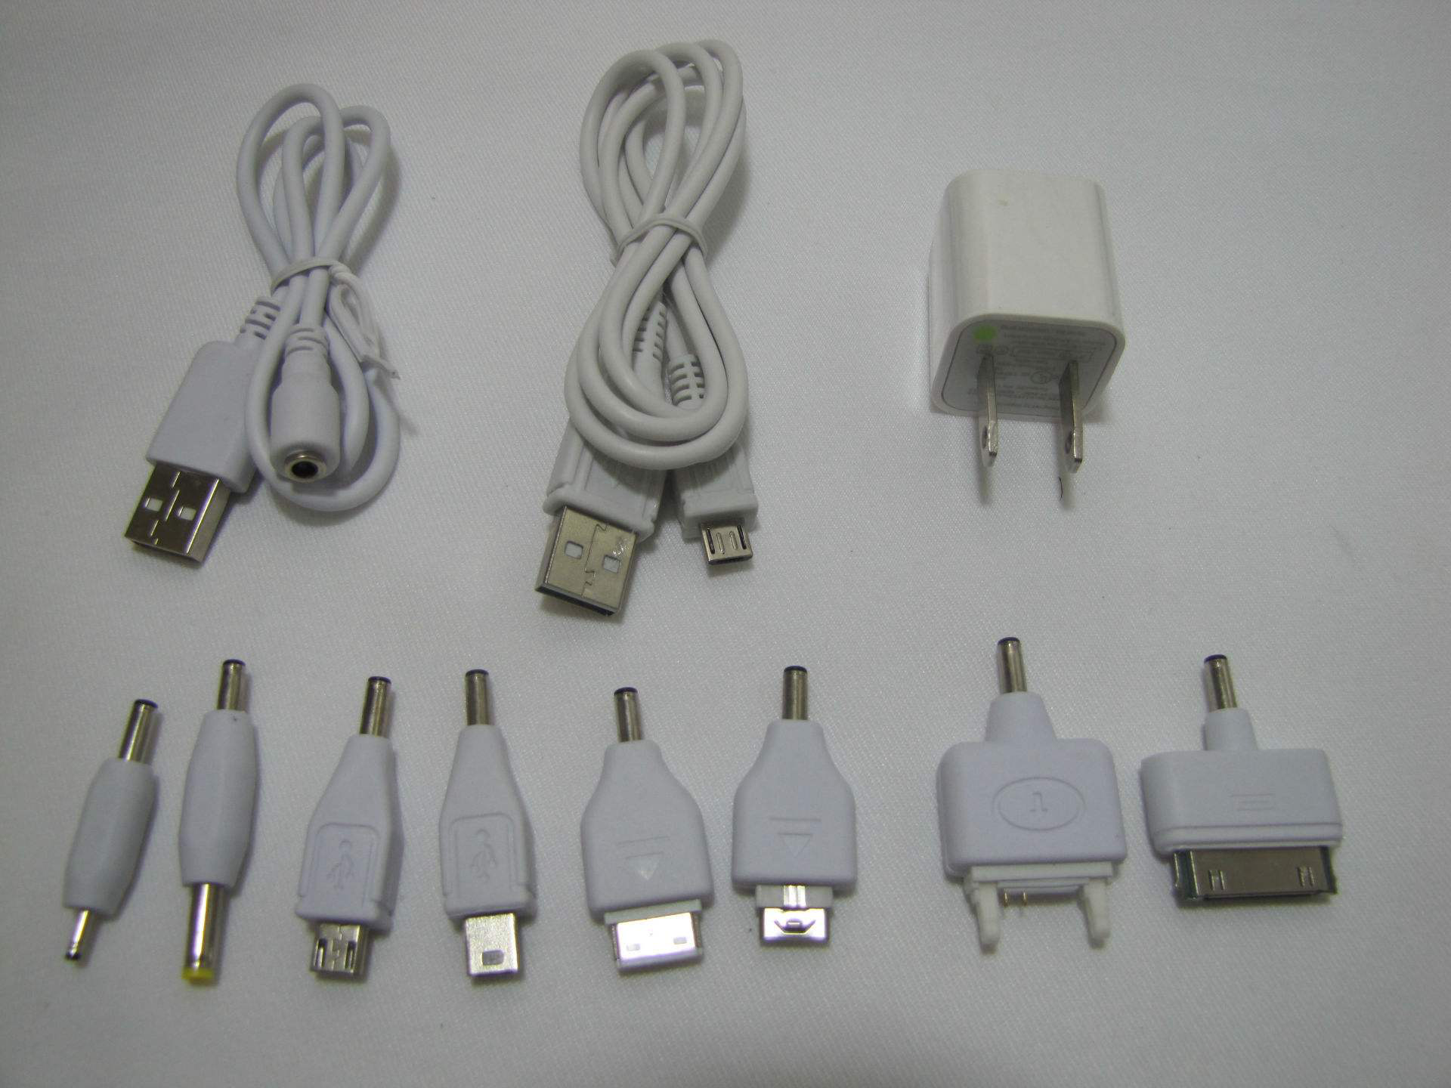
Adaptor（适配器）

Slide 4
Deque and Lists
https://cplusplus.com/reference/deque/deque/
https://cplusplus.com/reference/list/list/
empty
size
front
back
push_back
push_front
pop_back
pop_front

Slide 5
Container Adaptor（容器适配器）
A container adaptor C uses some underlying container object to define C’s methods

Slide 6
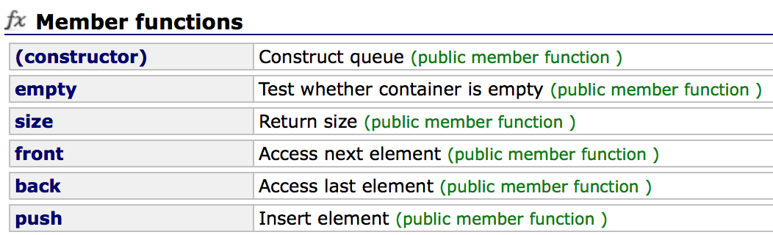
Queue（队列）
First-in-first-out (FIFO)
#include<queue>
queue<T> queueName
https://cplusplus.com/reference/queue/queue/

Slide 7
Queue（队列）
First-in-first-out (FIFO)
#include<queue>
queue<T> queueName

Slide 8
Queue（队列）
First-in-first-out (FIFO)
#include<queue>
queue<T> queueName
empty
size
front
back
push_back → push
push_front
pop_back
pop_front → pop

Slide 9
Queuing Theory（排队论）
Arrival time（到达时刻）
Departure time（离开时刻）
Service time（服务时长）
Waiting time（等待时长）
Sojourn time（逗留时长）
t
A
S
D

Slide 10
Queuing Theory
Inter-arrival time: 到达时间间隔
Arrival rate
1 / mean inter-arrival time
（单位时间平均到达的顾客数）
Service rate
1 / mean service time
（单位时间平均服务的顾客数）
Service intensity（服务强度）
arrival rate / service rate （要求 < 1）
Queue length（队列长度）

Slide 11
Car Wash（洗车）
One server
10 minutes service time
At most five car waiting (overflow)
Arrival time input from command line
999 is the sentinel
Simulate and calculate the average waiting time

Slide 12

Analysis: Event Driven（事件驱动）
arrival
departure
入队
出队
等待
等待
等待
清洗

Slide 13
Demo
Car-washing simulation（洗车仿真）

Slide 14
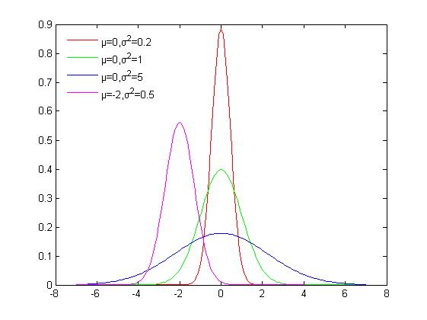
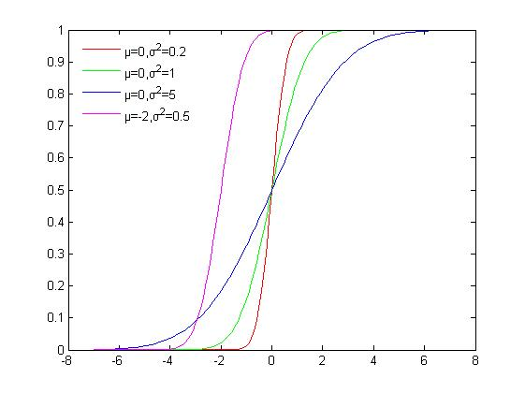
A Little Probability
probability density function
概率密度函数，PDF
cumulative distribution function
累积分布函数，CDF
Gaussian Distribution（高斯分布）
Normal Distribution（正态分布）
PDF
CDF

Slide 15
Exponential Distribution（指数分布）
In Probability theory and statistics, the exponential distribution is a continuous probability distribution that often concerns the amount of time until some specific event happens
It is a process in which events happen continuously and independently at a constant average rate

Slide 16
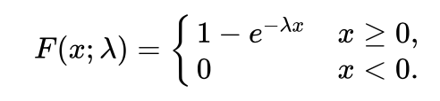
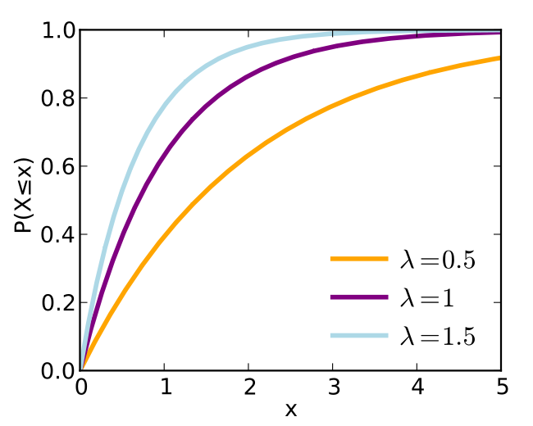
Exponential Distribution（指数分布）
Rate parameter
CDF
汽车到达时间间隔

Slide 17
Sampling（采样）
Exponential distribution
Rate parameter

Slide 18

Sampling of Exponential Distribution
Exponential distribution
Rate parameter
= p in [0, 1)

Slide 19
Task（拓展）
Extended car-washing simulation

Slide 20
Task: Improved Car Washing
No restriction on CAPACITY
The inter-arrival time and service time of each car follow exponential distributions
Output: the average waiting time and the maximal queue length
t
c1
c2
c3
t
A
S
D

Slide 21
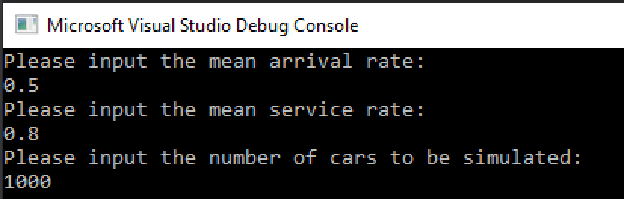
User’s input
或者平均到达时间间隔
或者平均服务时长

Slide 22
Thank you!
Questions?

