Slide 1
Lab 7: Graph---Shortest Path
（图上的最短路径）
Dec, 2024

Slide 2
Outline
Graphs
Shortest path

Slide 3
Definition
Vertex (vertices)（顶点）
Edges (arcs)（边）
G=(V,E)
Vertices interconnected by edges

Slide 4
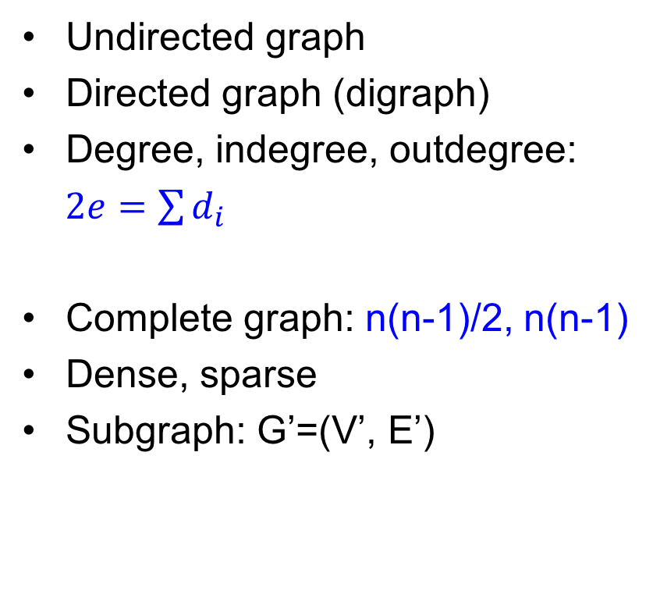
Terminology
无向图
有向图
度、入度、出度

Slide 5
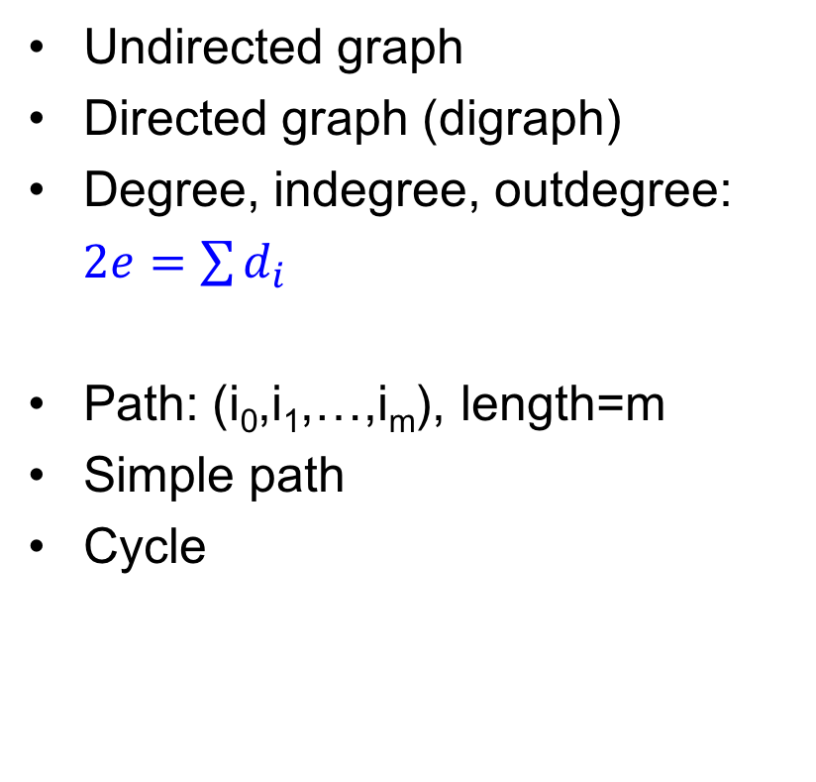
Terminology
路径、路径长度

Slide 6
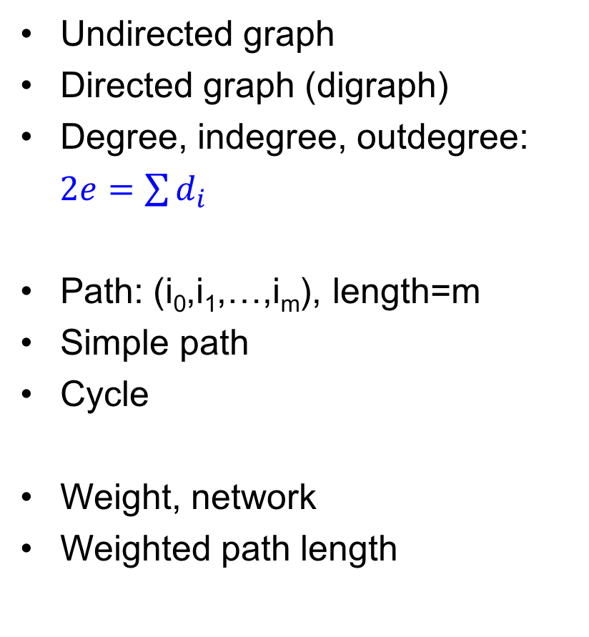
Terminology
1
4
3
赋权图
带权路径长度
2
5

Slide 7
Adjacency matrix（邻接矩阵）
0
 | 0 | 1 | 2 | 3
0 | 0 | 1 | 1 | 1
1 | 1 | 0 | 0 | 1
2 | 1 | 0 | 0 | 1
3 | 1 | 1 | 1 | 0
Adjacency
1
2
0 | V0
1 | V1
2 | V2
3 | V3
3
0
 | 0 | 1 | 2 | 3
0 | 0 | 1 | 0 | 0
1 | 0 | 0 | 0 | 1
2 | 1 | 0 | 0 | 1
3 | 1 | 0 | 0 | 0
1
2
3

Slide 8
Adjacency matrix（赋权图）
0
Adjacency
 | 0 | 1 | 2 | 3
0 | 0 | 1 | 4 | 3
1 | 1 | 0 | ∞ | 2
2 | 4 | ∞ | 0 | 5
3 | 3 | 2 | 5 | 0
1
4
1
3
2
2
0 | V0
1 | V1
2 | V2
3 | V3
5
3
0
 | 0 | 1 | 2 | 3
0 | 0 | 1 | ∞ | ∞
1 | ∞ | 0 | ∞ | 2
2 | 4 | ∞ | 0 | 5
3 | 3 | ∞ | ∞ | 0
1
4
1
3
2
2
5
3

Slide 9
Adjacency list（邻接表）
Vertex node
（顶点）
Arc node
（边）
0 | V0
1 | V1
2 | V2
3 | V3
1 | 1
0
1
4
3 | 2
1
3
2
0 | 4
3 | 5
2
5
0 | 3
3

Slide 10
Shortest Path
（最短路）

Slide 11
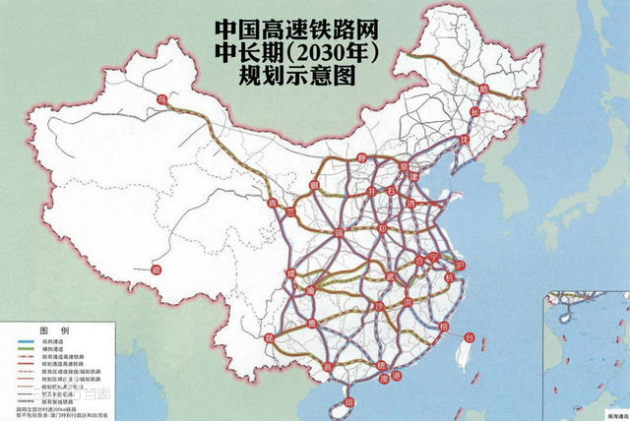
High-speed railway（高速铁路）

Slide 12
Example（例：赋权有向图）
1
10
50
0
2
90
20
30
10
3
4
50

Slide 13
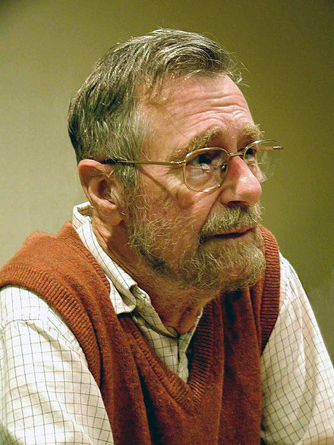
Dijkstra’s algorithm（迪杰斯特拉）
Edsger W. Dijkstra (1930-2002)
Dutch computer scientist
Turing award (1972)
Known for Dijkstra’s algorithm (1956)
For graphs without negative weight edges, find the shortest path between a given source node and every other node
https://en.wikipedia.org/wiki/Edsger_W._Dijkstra

Slide 14
Example
∞
1
1
10
50
0
∞
0
2
0
2
90
20
30
10
3
4
3
4
∞
50
∞

Slide 15
Example
10
1
1
10
50
0
∞
0
2
0
2
90
20
30
10
3
4
3
4
90
50
30
The shortest path from 0 to others passing through only 0

Slide 16
Example
10
1
1
10
50
0
∞
0
2
0
2
90
20
30
10
3
4
3
4
90
50
30
Choose the minimum from 10,30,90

Slide 17
Example
10
1
1
10
50
0
∞
0
2
0
2
90
20
30
10
3
4
3
4
90
50
30

Slide 18
Example
10
1
1
10
50
0
∞
0
2
0
2
90
20
30
10
3
4
3
4
90
50
30

Slide 19
Example
10
1
1
10
50
0
60
0
2
0
2
90
20
30
10
3
4
3
4
90
50
30
Update the shortest path from 0 to others passing through only 0,1

Slide 20
Example
10
1
1
10
50
0
60
0
2
0
2
90
20
30
10
3
4
3
4
90
50
30
Choose the minimum from 30,60,90

Slide 21
Example
10
1
1
10
50
0
60
0
2
0
2
90
20
30
10
3
4
3
4
90
50
30

Slide 22
Example
10
1
1
10
50
0
60
0
2
0
2
90
20
30
10
3
4
3
4
90
50
30

Slide 23
Example
10
1
1
10
50
0
50
0
2
0
2
90
20
30
10
3
4
3
4
90
50
30
Update the shortest path from 0 to others passing through only 0,1,3

Slide 24
Example
10
1
1
10
50
0
50
0
2
0
2
90
20
30
10
3
4
3
4
90
50
30

Slide 25
Example
10
1
1
10
50
0
50
0
2
0
2
90
20
30
10
3
4
3
4
80
50
30
Update the shortest path from 0 to others passing through only 0,1,3

Slide 26
Example
10
1
1
10
50
0
50
0
2
0
2
90
20
30
10
3
4
3
4
80
50
30
Choose the minimum from 50,80

Slide 27
Example
10
1
1
10
50
0
50
0
2
0
2
90
20
30
10
3
4
3
4
80
50
30

Slide 28
Example
10
1
1
10
50
0
50
0
2
0
2
90
20
30
10
3
4
3
4
80
50
30

Slide 29
Example
10
1
1
10
50
0
50
0
2
0
2
90
20
30
10
3
4
3
4
60
50
30
Update the shortest path from 0 to others passing through only 0,1,3,2

Slide 30
Example
10
1
1
10
50
0
50
0
2
0
2
90
20
30
10
3
4
3
4
60
50
30
Choose the minimum from 60

Slide 31
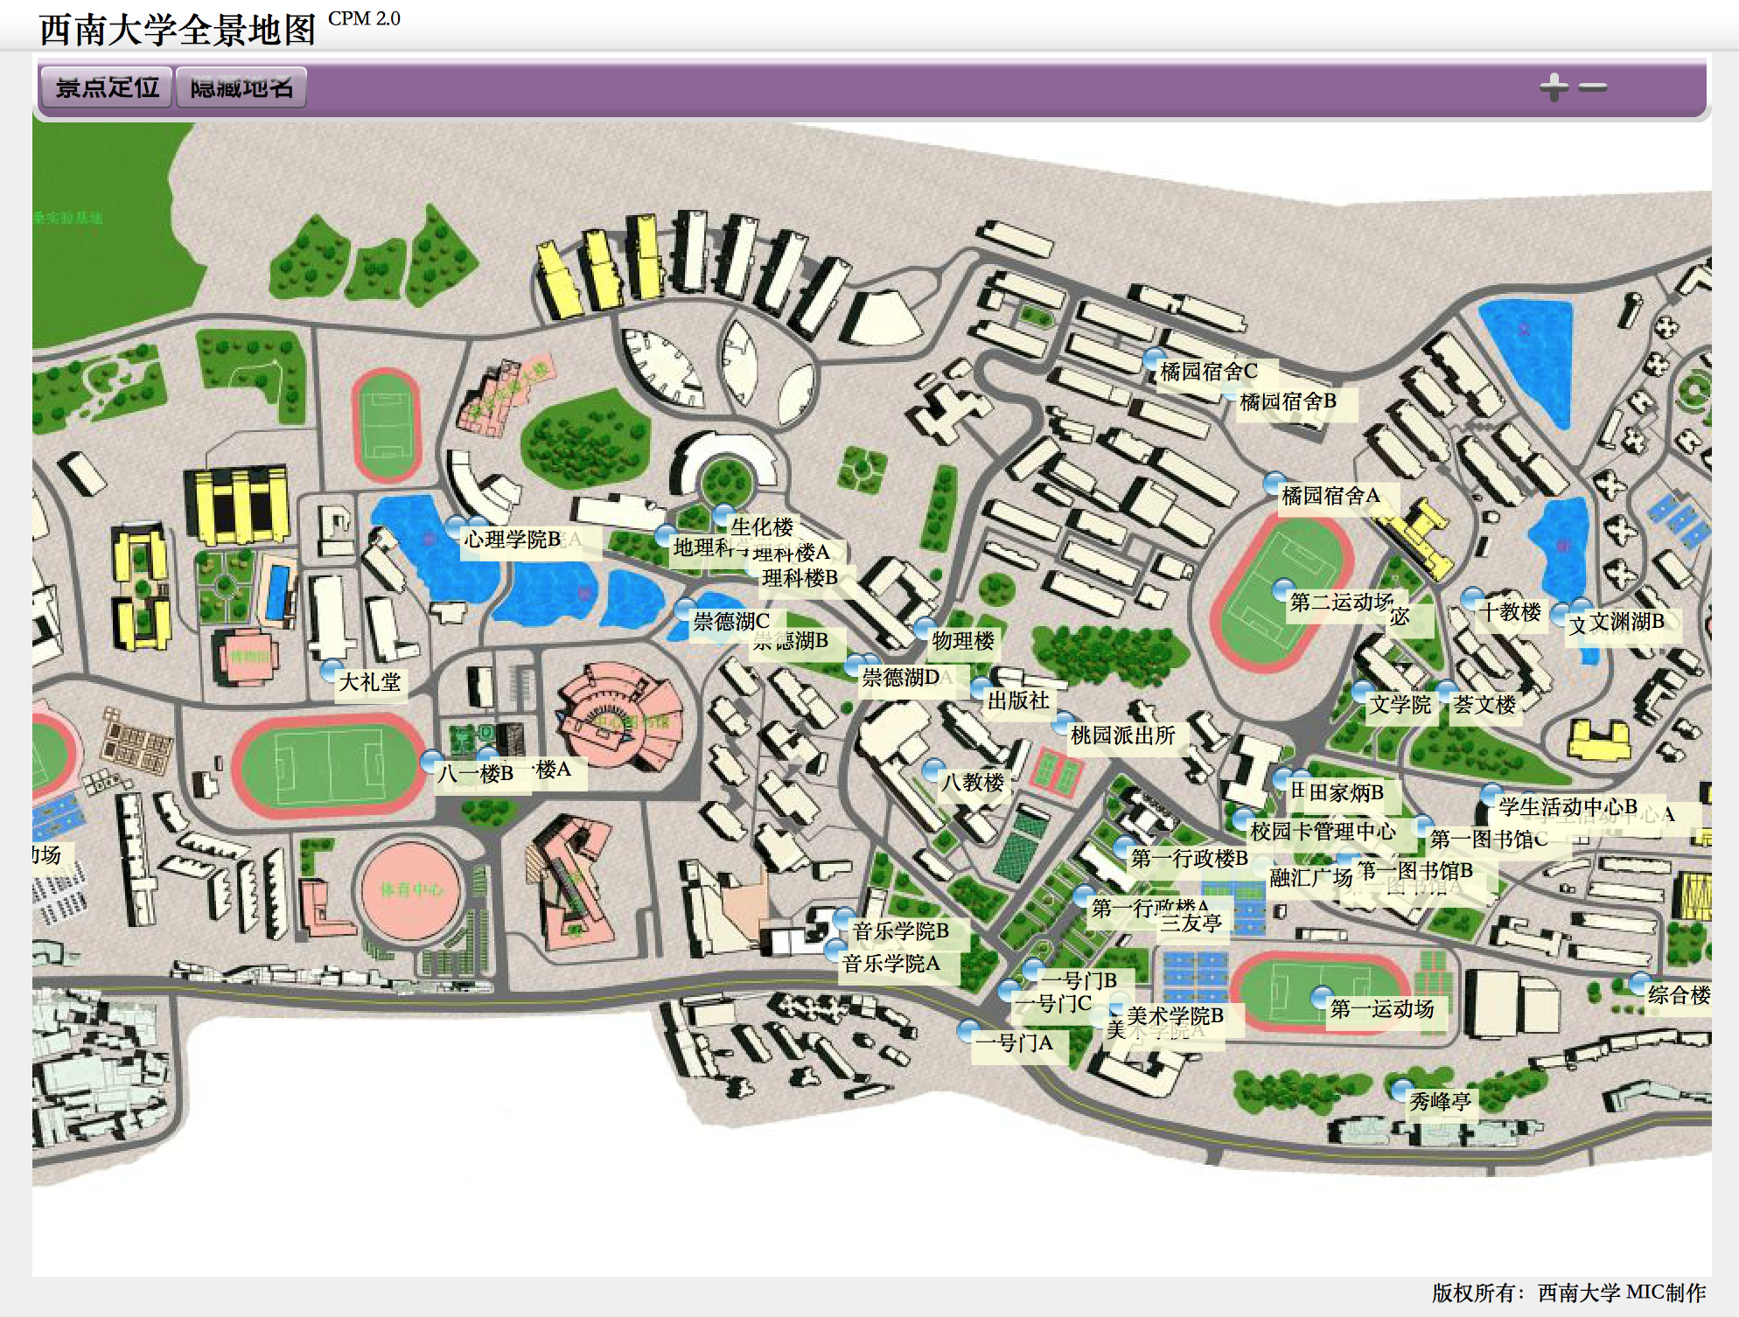
Task

Slide 32
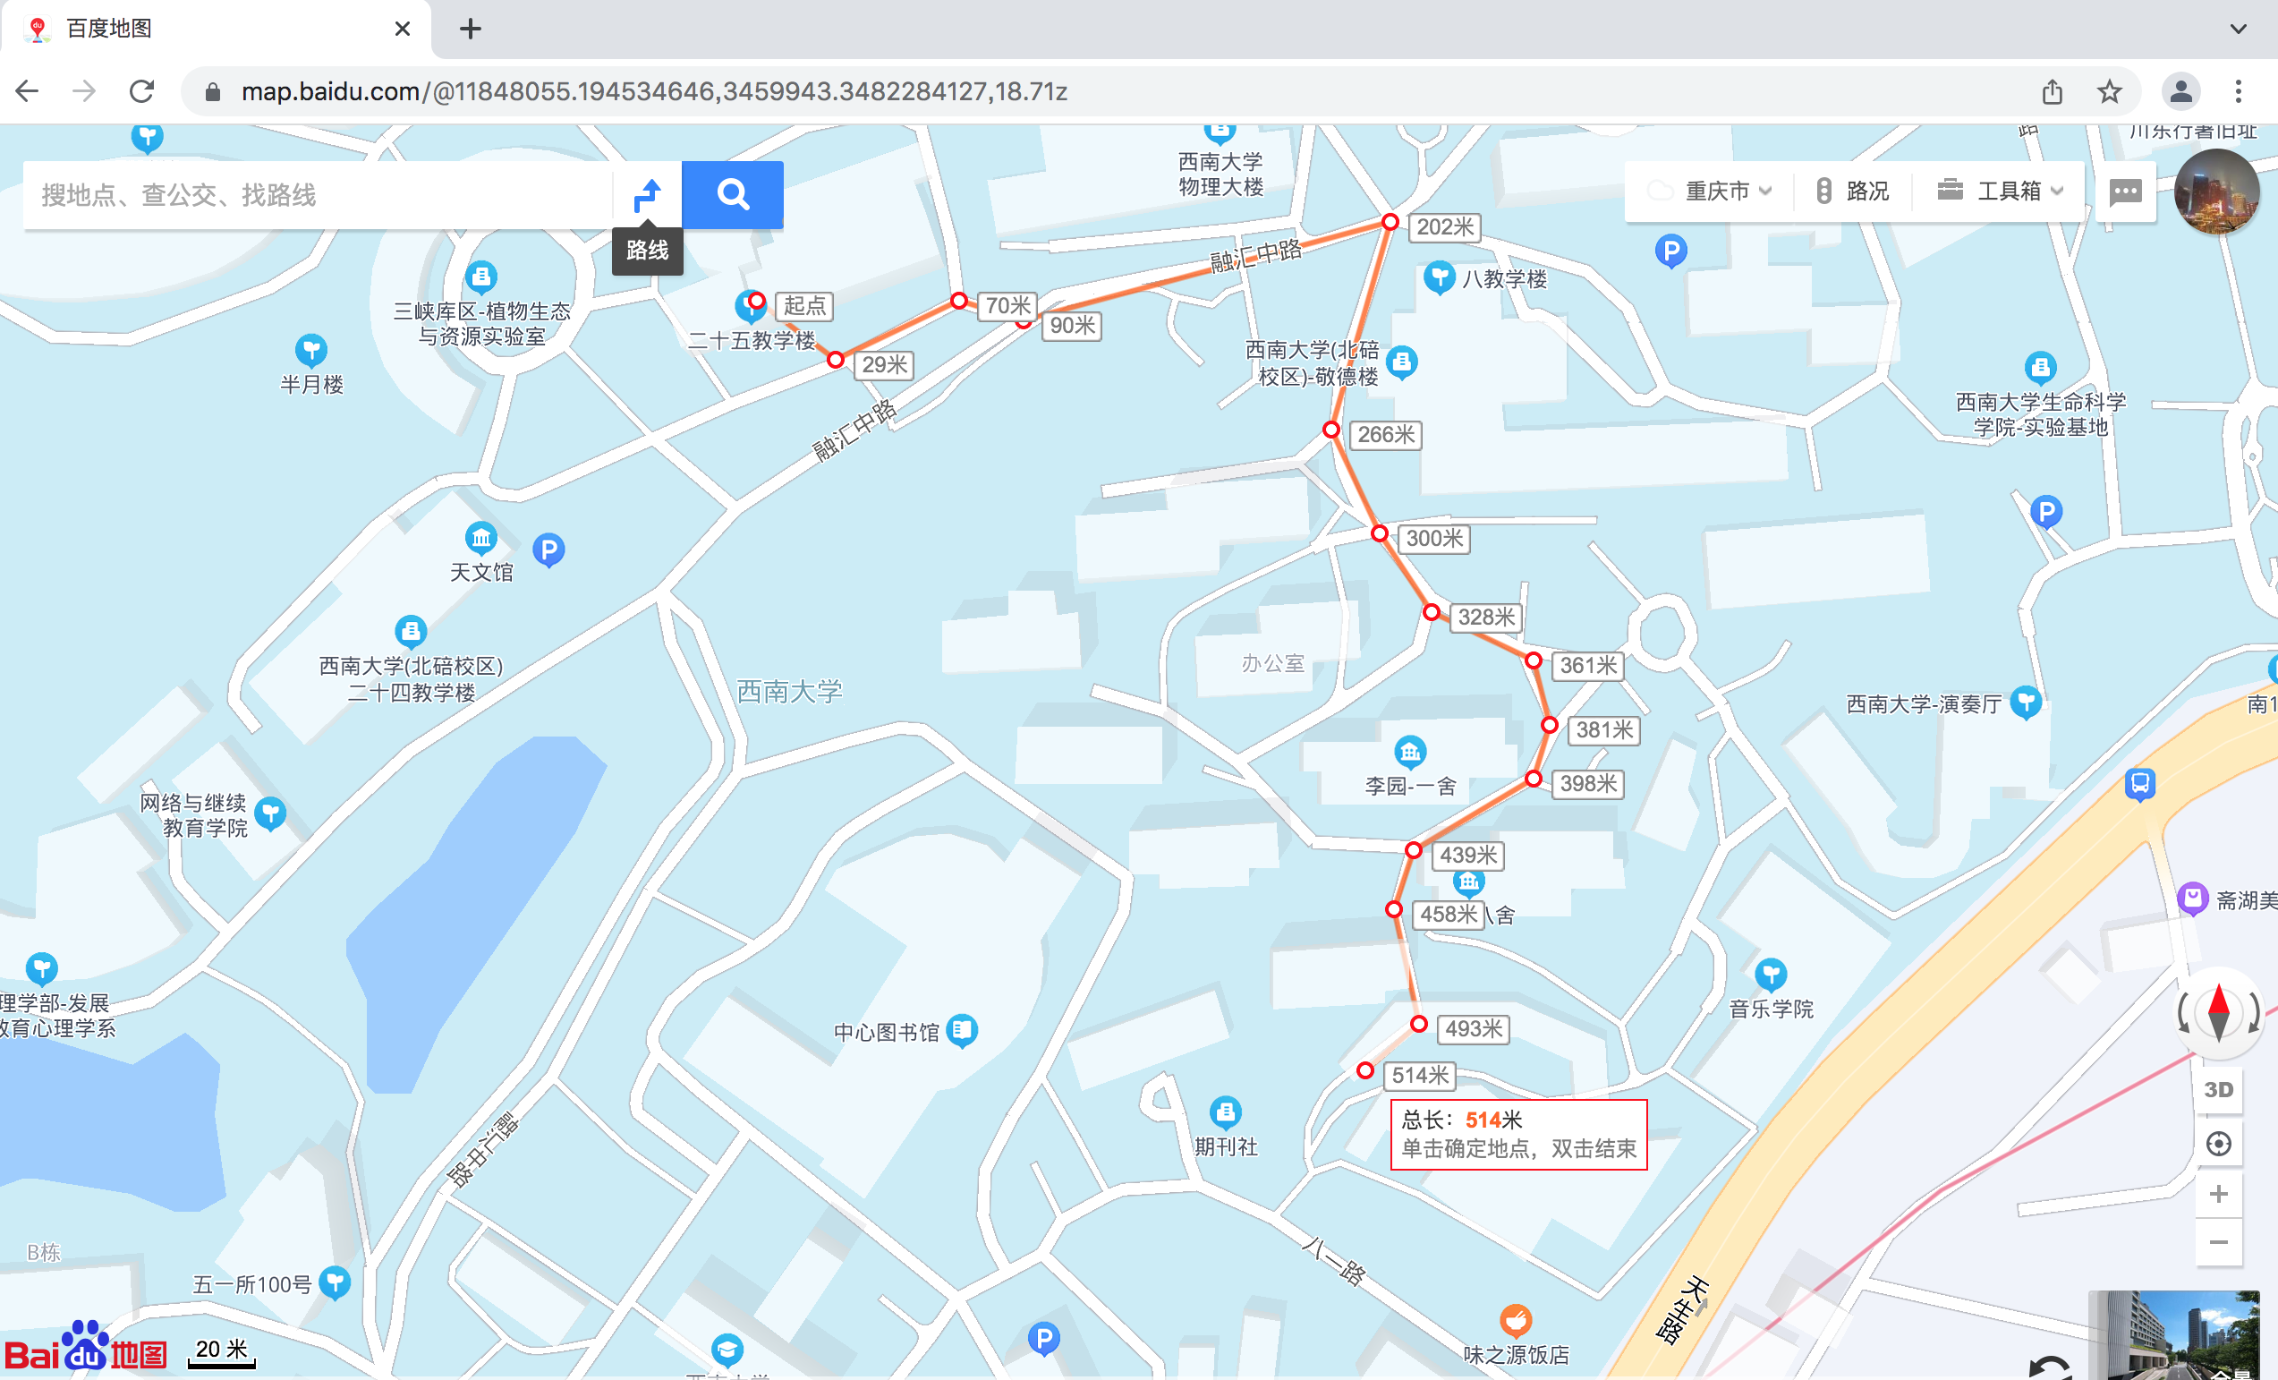
Task

Slide 33
重要通知
所有实验报告补交的截止时间为
2024年12月22日晚

Slide 34
Thank you!
Questions?

