Slide 1
Detection of COVID-19 by X-rays
Submitted By:
Achyut Krishna (41011502818)
Yash Varshney (41611502818)
Piyush Anand (42011512818)
Supervised By :
Dr. Rachna Jain
Department of Electronics and Communications Engineering
Bharati Vidyapeeth’s College of Engineering, New Delhi

Slide 2
Table of Contents
Abstract
Introduction
Proposed Framework
Dataset
Methodology
Results and Discussion
Comparison with other state of Art
Conclusion and Future Scope

Slide 3
ABSTRACT
This paper is concerned with the problem of COVID-19 detection using Chest X-rays from open image data collection.
This document describes how we can detect COVID-19 by using X-rays by using Deep learning models for image processing like CNN(Convolutional Neural Network) with very high accuracy.
This paper also describes the initial COVID-19 open image data collection.
It was created by assembling medical images from websites and publications.
The accuracy for our model comes out to be 97.52%(for validation).

Slide 4
INTRODUCTION
This paper proposes a novel method for the detection of COVID-19 from chest X-ray using CNN(Convolutional Neural Network).
Uses of X-ray method:
Blood Tests are Costly and Takes Time To conduct ~ 6-7 hours per patient.
Rapid testing is required.
Extent of Spread can be detected.
Image segmentation can be applied to find impact.
X-rays and scans are easier and cost-efficient also the spread for COVID-19 virus in the body can also be detected.

Slide 5
PROBLEM STATEMENT
Training a Convolutional Neural Network in Deep Learning for Detecting COVID-19 from X-Ray
Comparing two models and datasets one from KAGGLE and another form IEEE and comparing their accuracy(validation).

Slide 6
DATASET
ieee8023/covid-chestxray-dataset : A public open dataset of chest X-ray and CT images of patients which are positive or suspected of COVID-19 or other viral and bacterial pneumonias (MERS, SARS, and ARDS.). Data will be collected from public sources as well as through indirect collection from hospitals and physicians. All images and data will be released publicly in this GitHub repository.
Chest X-Ray Images (Pneumonia) : The dataset is organized into 3 folders (train, test, val) and contains subfolders for each image category (Pneumonia/Normal). There are 5,863 X-Ray images (JPEG) and 2 categories (Pneumonia/Normal).

Slide 7




EVALUATION MEASURE
Accuracy: It is defined by the following formula:
Confusion Matrix: It is defined by the following formula:

Slide 8
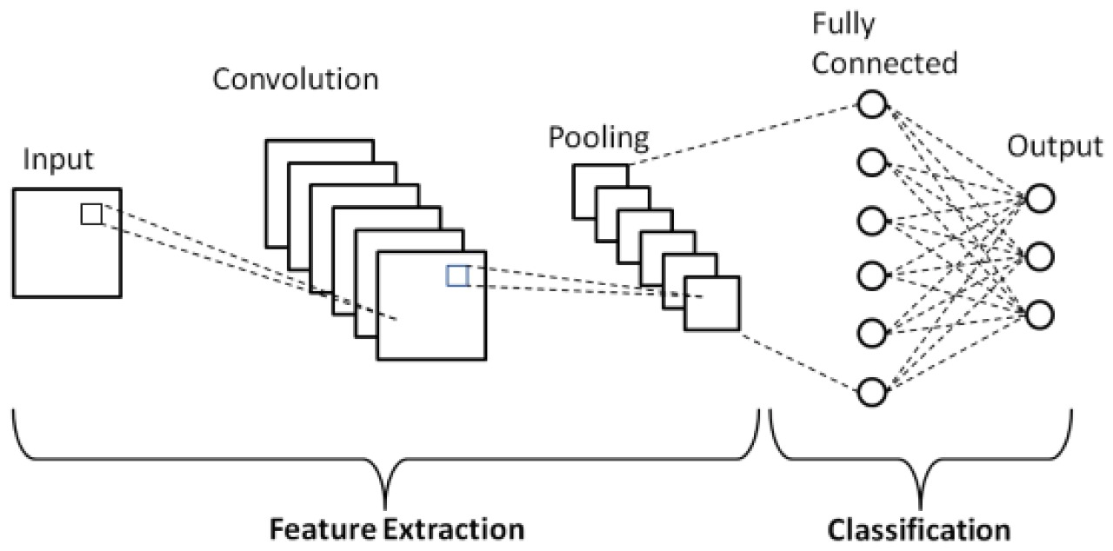
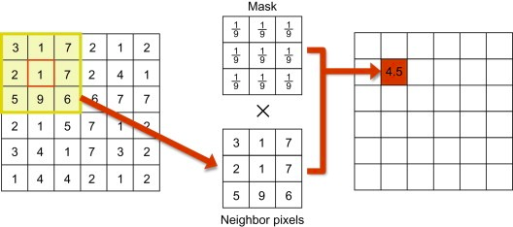
METHODOLOGY

Slide 9
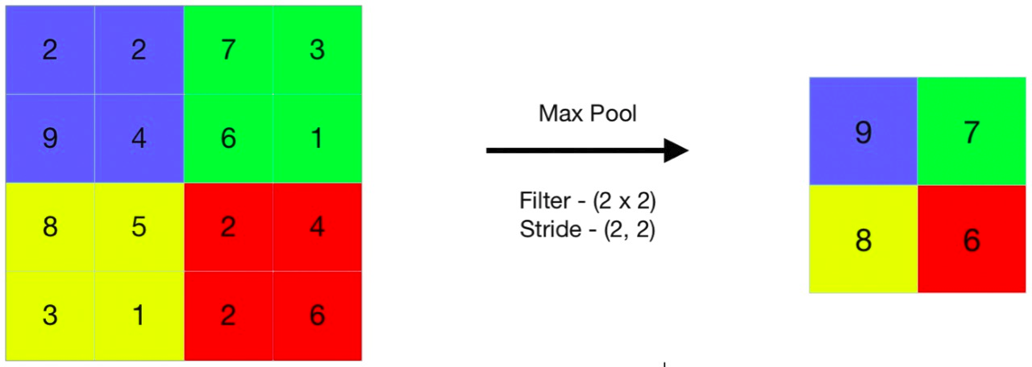
METHODOLOGY

Slide 10
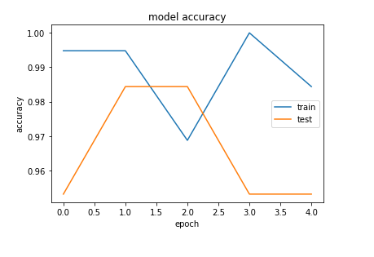
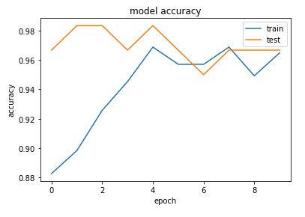
RESULT AND ANALYSIS
Plots Based on Model Accuracy
The pyplot is a collection of command style functions that make matplotlib work like MATLAB. Each pyplot function makes some change to a figure: e.g., creates a figure, creates a plotting area in a figure, plots some lines in a plotting area, decorates the plot with labels, etc.
Fig. IEEE model with accuracy 97.52%.
Fig. Kaggle model with accuracy 96.66%

Slide 11
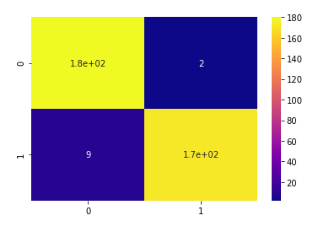
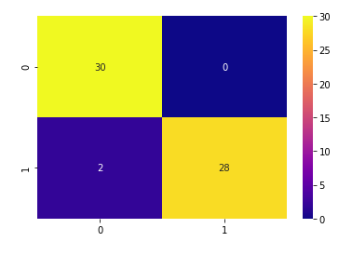
Heatmap Representing Confusion Matrix
The heatmap is the representation of matrix data in a graphical form. It is used to represent the confusion matrix or any two-dimensional data in form of color.
It has successfully able to identify
180 true positives, 9 false positives, 173 true negatives and 2 false negatives in IEEE.
30 true positives, 2 false positives, 28 true negatives and 0 false negatives in KAGGLE.
ACTUAL
ACTUAL
PREDICTIONS
PREDICTIONS
Fig. IEEE-HEATMAP
Fig. KAGGLE-HEATMAP
0 => Covid 1 => Normal

Slide 12
COMPARISION WITH OTHER STATE-OF-ART METHODS
Method | Month-Year | Accuracy (%)
DeTraC | March-2020 | 95.12
ResNetV2 | April-2020 | 97
COVID-Net | April-2020 | 96.78
VGG-19 | March-2020 | 86.7
Adam(our model) | 2020 | 97.52

Slide 13
CONCLUSION
The Validation accuracy for Kaggle model is 96.66% and IEEE model is 97.52%.
We can conclude that our Model for IEEE and KAGGLE Dataset is much better than other models.

Slide 14
REFERENCES
[1] Wang, W.et al.Detection of SARS-CoV-2 in different types of clinical specimens.JAMA(2020). IEEE.
[2] Fang, Y.et al.Sensitivity of chest CT for covid-19: Comparison to RT-PCR.Radiology200432 (2020).
[3] X. Du, Y. Cai, S. Wang and L. Zhang, "Overview of deep learning," 2016 31st Youth Academic Annual Conference of Chinese Association of Automation (YAC), Wuhan, 2016, pp. 159-164, doi: 10.1109/YAC.2016.7804882.
[4] A. Shrestha and A. Mahmood, "Review of Deep Learning Algorithms and Architectures," in IEEE Access, vol. 7, pp. 53040-53065, 2019, doi: 10.1109/ACCESS.2019.2912200.
[5] X. Zhou, W. Gong, W. Fu and F. Du, "Application of deep learning in object detection," 2017 IEEE/ACIS 16th International Conference on Computer and Information Science (ICIS), Wuhan, 2017, pp. 631-634, doi: 10.1109/ICIS.2017.7960069.

Slide 15
REFERENCES
[6] S. Albawi, T. A. Mohammed and S. Al-Zawi, "Understanding of a convolutional neural network," 2017 International Conference on Engineering and Technology (ICET), Antalya, 2017, pp. 1-6, doi: 10.1109/ICEngTechnol.2017.8308186.
[7] R. Chauhan, K. K. Ghanshala and R. C. Joshi, "Convolutional Neural Network (CNN) for Image Detection and Recognition," 2018 First International Conference on Secure Cyber Computing and Communication (ICSCCC), Jalandhar, India, 2018, pp. 278-282, doi: 10.1109/ICSCCC.2018.8703316.
[8] G. Zhu, B. Li, S. Hong and B. Mao, "Texture Recognition and Classification Based on Deep Learning," 2018 Sixth International Conference on Advanced Cloud and Big Data (CBD), Lanzhou, 2018, pp. 344-348, doi: 10.1109/CBD.2018.00068.
[9] Z. Chen and Y. Zhou, "Research on Automatic Essay Scoring of Composition Based on CNN and OR," 2019 2nd International Conference on Artificial Intelligence and Big Data (ICAIBD), Chengdu, China, 2019, pp. 13-18, doi: 10.1109/ICAIBD.2019.8837007.
[10] A. Imran, I. Posokhova, H. N. Qureshi, U. Masood, S. Riaz, K. Ali,C. N. John, M. Nabeel, and I. Hussain, ‘‘AI4COVID-19: AI enabled pre-liminary diagnosis for COVID-19 from cough samples via an app,’’ 2020,arXiv:2004.01275.
[11] IEEE Covid Chest X-Ray Dataset. Accessed: Mar. 7, 2020. [Online].Available: https://github.com/ieee8023/covid-chestxray-dataset .

Slide 16
REFERENCES
[12] L. Wang and A. Wong, ‘‘COVID-Net: A tailored deep convolutional neuralnetwork design for detection of COVID-19 cases from chest radiographyimages,’’ 2020,arXiv:2003.09871. https://arxiv.org/abs/2003.09871.
[13] L. Zhong, L. Mu, J. Li, J. Wang, Z. Yin, and D. Liu, ‘‘Early predictionof the 2019 novel coronavirus outbreak in the mainland China basedon simple mathematical model,’’IEEE Access, vol. 8, pp. 51761–51769,2020.
[14] A. Beers, J. Brown, K. Chang, J. P. Campbell, S. Ostmo, M. F. Chiang,and J. Kalpathy-Cramer, ‘‘High-resolution medical image synthesisusing progressively grown generative adversarial networks,’’ 2018,arXiv:1805.03144. [Online]. Available: http://arxiv.org/abs/1805.03144.
[15] W. Dai, J. Doyle, X. Liang, H. Zhang, N. Dong, Y. Li, and E. P. Xing,‘‘SCAN: Structure correcting adversarial network for chest X-raysorgan segmentation,’’ 2017,arXiv:1703.08770. [Online]. Available: https://arxiv.org/abs/1703.08770 .
[16] S. Mondal, K. Agarwal and M. Rashid, "Deep Learning Approach for Automatic Classification of X-Ray Images using Convolutional Neural Network," 2019 Fifth International Conference on Image Information Processing (ICIIP), Shimla, India, 2019, pp. 326-331, doi: 10.1109/ICIIP47207.2019.8985687 .
[17] E. Ayan and H. M. Ünver, "Diagnosis of Pneumonia from Chest X-Ray Images Using Deep Learning," 2019 Scientific Meeting on Electrical-Electronics & Biomedical Engineering and Computer Science (EBBT), Istanbul, Turkey, 2019, pp. 1-5, doi: 10.1109/EBBT.2019.8741582.

Slide 17
REFERENCES
[18] M. Bouchahma, S. Ben Hammouda, S. Kouki, M. Alshemaili and K. Samara, "An Automatic Dental Decay Treatment Prediction using a Deep Convolutional Neural Network on X-Ray Images," 2019 IEEE/ACS 16th International Conference on Computer Systems and Applications (AICCSA), Abu Dhabi, United Arab Emirates, 2019, pp. 1-4, doi: 10.1109/AICCSA47632.2019.9035278 .
[19] A. Wibisono, J. Adibah, F. S. Priatmadji, N. Z. Viderisa, A. Husna and P. Mursanto, "Segmentation-based Knowledge Extraction from Chest X-ray Images," 2019 4th Asia-Pacific Conference on Intelligent Robot Systems (ACIRS), Nagoya, Japan, 2019, pp. 225-230, doi: 10.1109/ACIRS.2019.8935951.
[20] X. Ren et al., "Regression Convolutional Neural Network for Automated Pediatric Bone Age Assessment From Hand Radiograph," in IEEE Journal of Biomedical and Health Informatics, vol. 23, no. 5, pp. 2030-2038, Sept. 2019, doi: 10.1109/JBHI.2018.2876916.
[21] N. Bonettini, M. Paracchini, P. Bestagini, M. Marcon and S. Tubaro, "Hyperspectral X-ray Denoising: Model-Based and Data-Driven Solutions," 2019 27th European Signal Processing Conference (EUSIPCO), A Coruna, Spain, 2019, pp. 1-5, doi: 10.23919/EUSIPCO.2019.8903151.

Slide 18
Thank You

