Slide 1
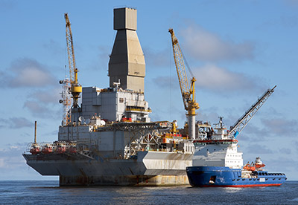
RIG SHEDULING

Slide 2
Introduction :
Rigs are critical capital-intensive resources for oil and gas exploration and production operations, such as drilling, completion, and workover. The Rig Scheduling Problem (RSP) comprises deciding which rigs will serve each of the wells and when the operations must be performed.

Slide 3
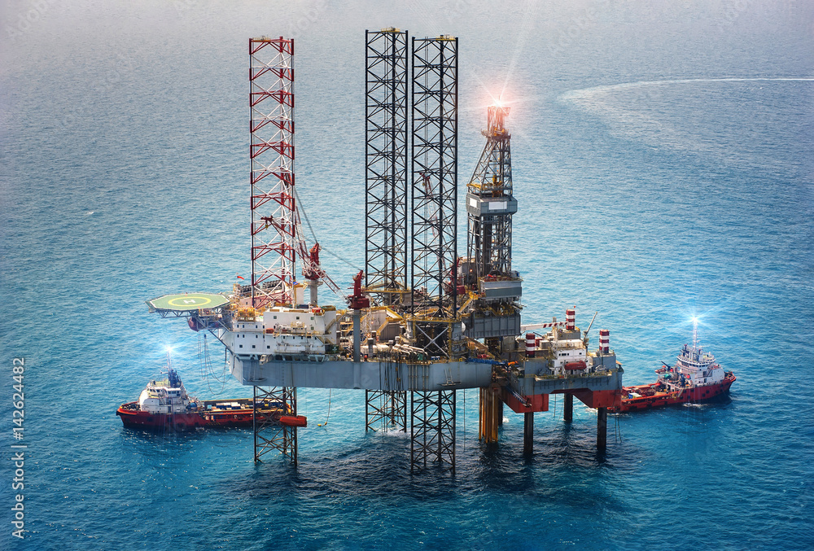
PURPOSE OF RIG :
A rig is a large machine that’s used for drilling deep holes in the earth so that oil can be extracted.
A drilling rig is the equipment used to drill a wellbore.

Slide 4
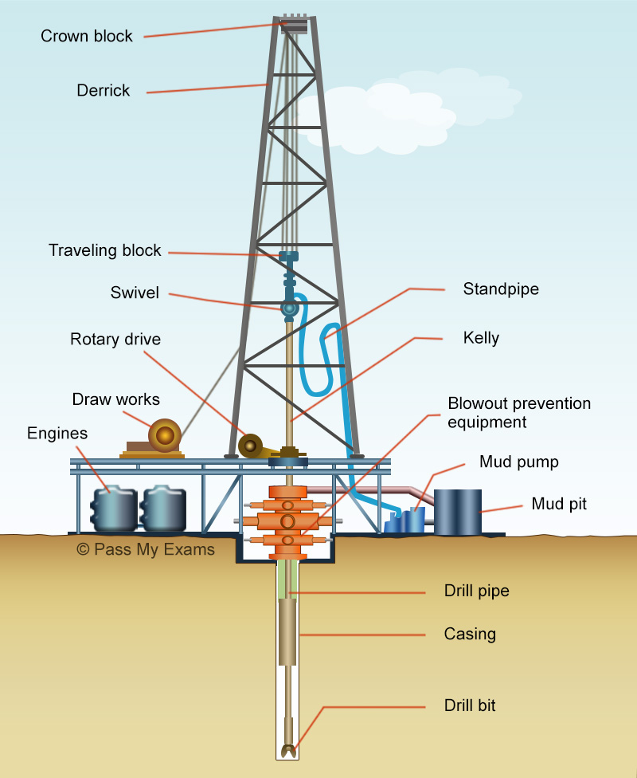
Purpose of well
An oil well is a hole dug in the Earth that serves the purpose of bringing oil or other resources like hydrocarbons and natural gas.
There are different types of wells like
Water wells
Oil wells
Gas wells

Slide 5
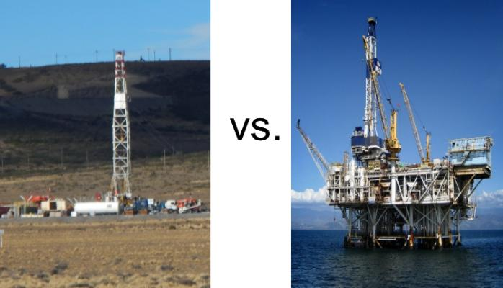
Types of rigs :
There are two types of rigs
Onshore rigs
Offshore rigs
Onshore rigs : onshore drilling is done on land.
Offshore rigs : An offshore rig is a large structure on water

Slide 6
Scheduling :
The purpose of rig scheduling is to meet with expected production and delivery dates, wells must be scheduled and allocated to rigs.
We have to allot wells to rigs based on shortest distance and duration of well production.
The main aim of project is to avoid delays and optimize the use of resources , and minimize the time and cost for the scheduling.

Slide 7
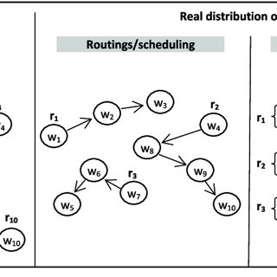
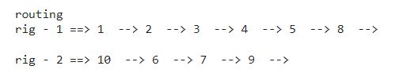
OUR WORK :
example
The rigs and wells are in different location. We assigned wells to rigs based on shortest distance.
We have taken the data of two rig locations and 10 well locations and we allotted wells to rigs.
Actually we have used haversine technique to find the shortest distance between two locations.
output

Slide 8
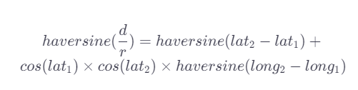
Haversine formula
The haversine formula calculates the shortest distance between two points, whose latitudes and longitudes are known, in a sphere.
lat_2 and lat_1​ are the latitudes of the two points.
long_2​ and long_1​ are the longitudes of the two points.
d is the distance between the two coordinates.
r is the radius of the earth, that is, 6,371 kilometers.

Slide 9
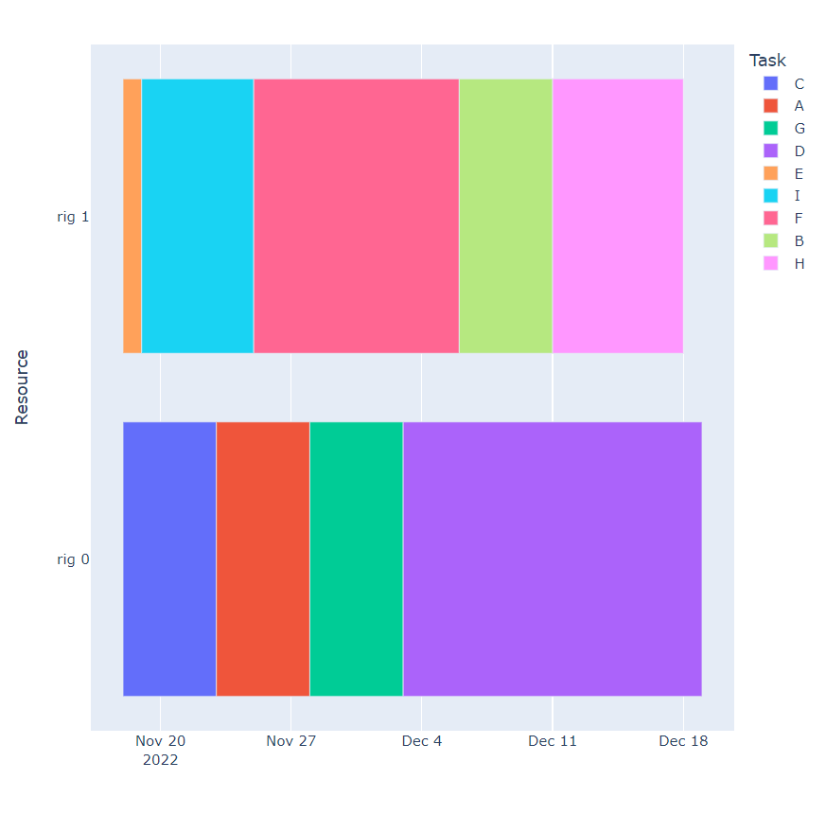
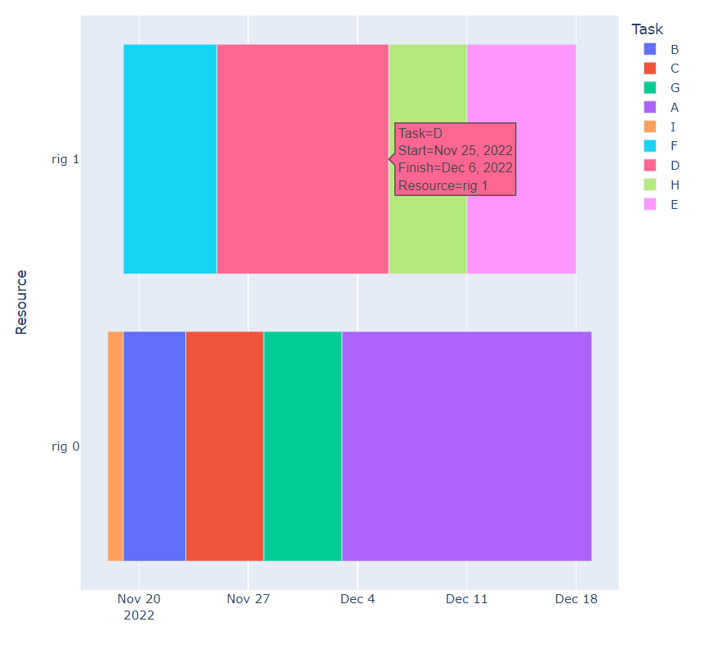
Different techniques used :
We assigned rigs based on well service time and productivity in barrel per day.
We have used two normal and two approximation techniques for scheduling the jobs.

Slide 10
THANK YOU

