Slide 1
Automation of Examination Allotment

Slide 2
Abstract:
This application presents a new automatic process for invigilation system.
Admin can add all the details of the faculty and details of students and details of the rooms, allocated to the faculty and details of the rooms allocated to students from anywhere and at any time Faculty and students can view the details of their allocated rooms at any time without any confusion.
This application gives the accurate information about the allocated room numbers to the respective faculty or student which saves a lot of time an effort
This application is mainly developed based on the principle of job shop scheduling algorithm.

Slide 3
Job shop scheduling Problem

Slide 4
Introduction:
Job Shop Scheduling problem is an optimization problem in computer science and operations research.
In this problem we are given jobs J1,J2, ………,Jn of varying processing time , which needs to be scheduled on m machines with varying processing power.
Each job consists of a set of operations O₁, O₂, ..., O_{n} which need to be processed in a specific order (known as precedence constraints). Each operation has a specific machine that it needs to be processed on and only one operation in a job can be processed at a given time.

Slide 5
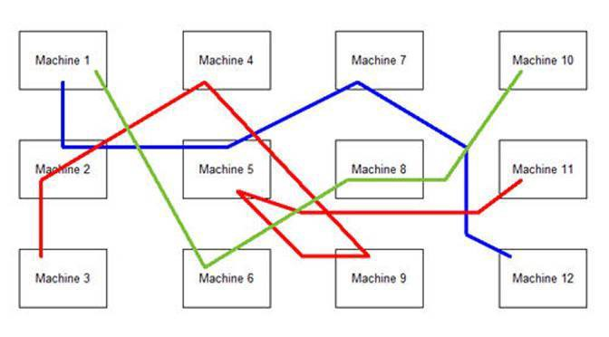
Scheduling of jobs for machines:

Slide 6
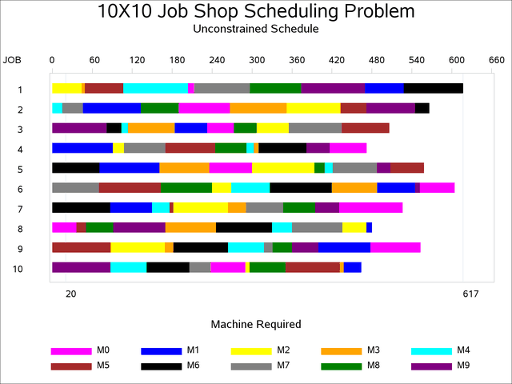
Gantt chart:

Slide 7
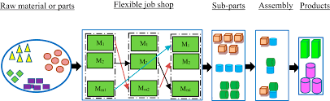
Job shop scheduling in factories:

Slide 8
Automation of Examination allotment

Slide 9
Introduction:
Staff Duty allocation is a term which is basically concerned with the allocation of the class rooms. Class room scheduling based on the number of students appearing for and appointing the faculties for invigilation duty happens to be a tedious job for the exam coordinator.
The proposed scheme aims to automate the process of assigning the duties to achieve efficient coordination of examination management process in an educational organization..
This system sends information to staff and students for their registered mail id and phone numbers.

Slide 10
Objectives:
Offers the solution for exam invigilator and classroom arrangement problems that can be achieved through the proposed system.
The proposed system gathers data and methods from a university those are being used for their exam class arrangement.
Proper utilization of the available resources and maintaining all sort of information for future references.
The monitoring of the selecting activity and the overall work becomes easy and includes the least of paperwork..

Slide 11
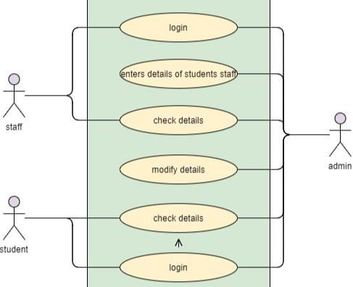
Use case diagram:

Slide 12
Roles:
Admin Role:
Initially, admin has to login using user id and password. Admin has to upload the timetable ,details of students and accordingly set the slots for faculty and students. Admin can allot the classes for the examination to be held on respective date and time The admin can delete the faculty information by entering his/her user id. Admin can also view the details of all the staff members and students, the admin should be able to do the analysis and produce the detailed report.
Faculty Role:
Initially, faculty has to login using employee id and password. If the account is not available then the admin has to register. After faculty logs in he/she can view the dates and rooms allotted.
Student Role:
The student has to login by using the registration or roll number and password to check which room is allotted for him/her.

Slide 13
Advantages:
Time-saving
Increased efficiency
Allows neat handling of data
Decreases overhead
Accurate
Data safety because of two factor authentication

Slide 14
THANK YOU

