Slide 1
CREDIFY
The Complete Operating System
for Behavioral Health
One platform for the full client journey, from first referral to final payment.
PRACTICE PARTNER OVERVIEW · 2026
Notes:
Credify: the complete operating system for behavioral health, walked through the operational arc every practice runs.

Slide 2
Behavioral health practices are stitched
together with disconnected tools.
4 to 7 Tools
5-10% of net revenue
The average behavioral health practice runs four or more disconnected platforms: EHR, billing, scheduling, CRM, email, and reporting.
Unchallenged denials, aging claims, and unbilled sessions quietly drain collections every year.
No Unified Record
Outcomes Are Invisible
Client data fragments across multiple systems. Every handoff opens a gap in care, compliance, and billing.
Accreditation reporting, payer audits, and leadership dashboards get assembled from spreadsheets instead of live systems.
Notes:
Each tool is useful in isolation but creates manual reconciliation and revenue leakage at every handoff between systems.

Slide 3
THE CREDIFY CLIENT JOURNEY
Credify’s platform supports agencies through every touchpoint.
1
2
3
4
5
6
ACQUIRE
INTAKE
SCHEDULE
TREAT
GET PAID
OPERATE
›
›
›
›
›
CRM +
Email / SMS Outreach
Client Portal +
Therapist Match
Calendar +
Reminders
EHR + Tasks +
Treatment Plan
Revenue Cycle
Mgmt
Alerts Hub +
Reports
Pipeline intelligence
for practice growth
Inquiry to onboarded
client on day one
Every session booked,
confirmed & attended
Compliant documentation
purpose-built for BH
Every dollar billed,
tracked & collected
Full visibility and custom KPIs
✦ CREDIFY AI runs through every stage: Session Assist, notes, navigation, and revenue cycle
Notes:
Every Credify module maps to a distinct operational stage, showing product completeness and workflow logic in one view. AI runs underneath all six.

Slide 4
CREDIFY AI
AI across the whole journey
Credify owns the clinical, scheduling, and billing data model, so its AI sees the whole client rather than a fragment.
Session Assist
Notes
Navigation
Revenue Cycle
Live transcription surfaces the questions a clinician should ask, in real time
Dictate after the session and AI structures it into a customizable note format
Ask for anything in plain language and get routed to the right place
Scrub, predict, code, and appeal before a claim ever leaves the building
IN DEVELOPMENT · DESIGN PREVIEW
Notes:
AI is a layer across the platform, not a feature in one module. It is currently in development, so these screens are design previews rather than shipped functionality.

Slide 5
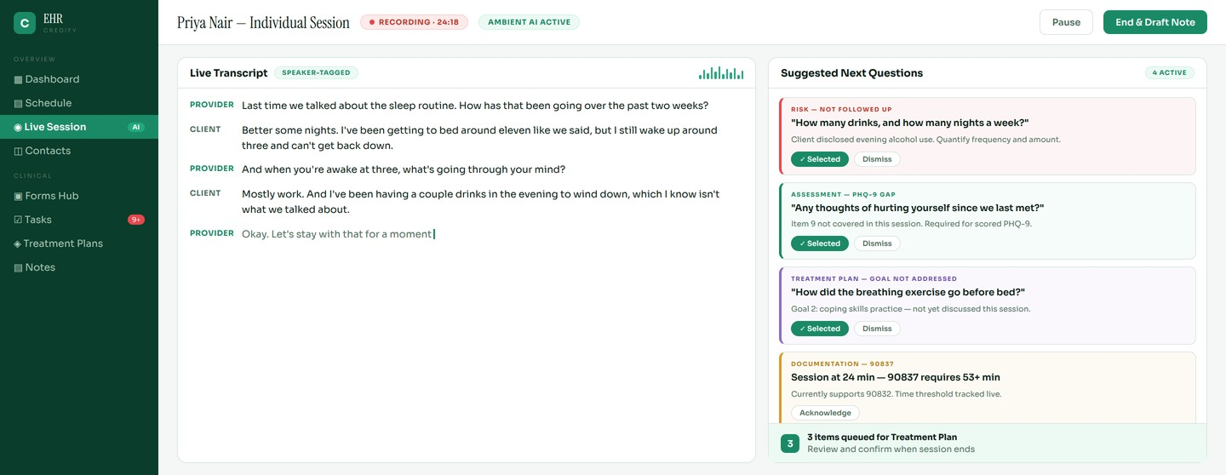
✦
CREDIFY AI · IN DEVELOPMENT
The AI listens so the clinician can stay present.
Session Assist
01
Live Question Hints
02
Code Support Tracking
03
Clinician Selects
Surfaces unasked assessment items, unaddressed goals, and risk disclosures as they happen
Watches session time against the billed code so documentation matches the claim
Nothing is auto-filed. The provider chooses what carries into the record
Notes:
Session Assist is the headline. Unlike a generic scribe, it knows the treatment plan, the assessment instruments, and the billing requirements, so its prompts are clinically specific.

Slide 6
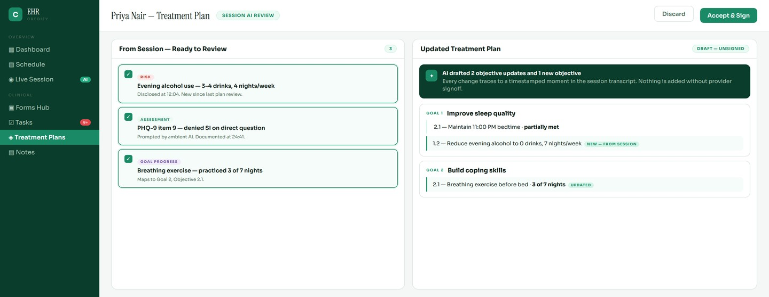
✦
CREDIFY AI · IN DEVELOPMENT
What surfaced in session flows into the plan for review, never automatically.
Session to Treatment Plan
01
Traceable Every Time
02
Drafts, Never Files
03
Closes the Loop
Each drafted change links to a timestamped moment in the session transcript
AI proposes objective updates and the plan stays unsigned until the clinician signs
Goals discussed in session update instead of waiting for chart review
Notes:
This is the compliance story: AI accelerates plan maintenance without ever removing the clinician from the decision. Traceability to transcript is the audit defense.

Slide 7
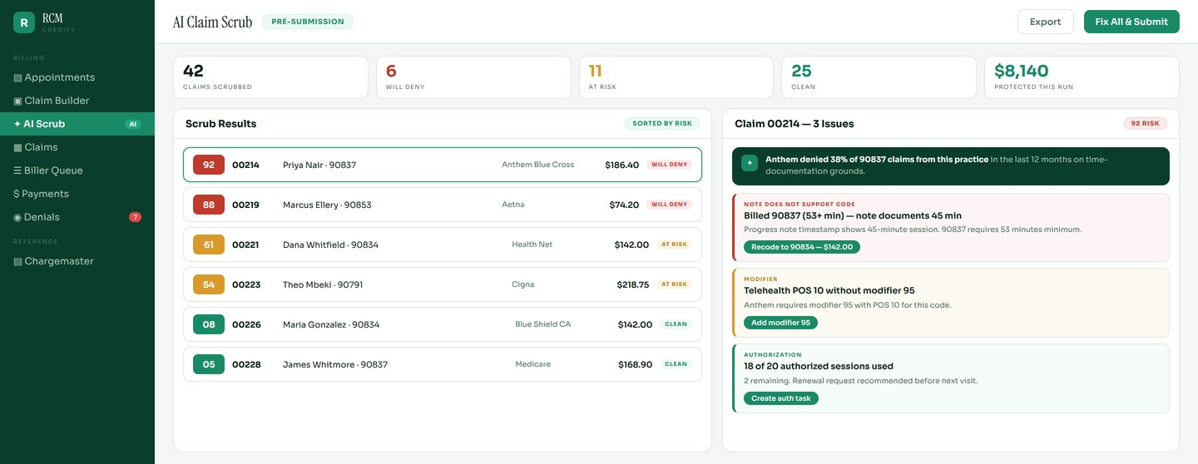
✦
CREDIFY AI · IN DEVELOPMENT
Catch the denial before the claim leaves the building.
AI Claim Scrub
01
Note-to-Claim Check
02
Learned Payer Patterns
03
Coding & Appeals
Reads the progress note and verifies it supports the billed code and time. No clearinghouse can do this
Denial risk scored from your own history with a given payer, code, and diagnosis pair
Suggests CPT and modifier corrections, then drafts the appeal when one is needed
Notes:
Rules engine handles the known rules; AI handles what rules cannot see. The note-to-claim verification is the single biggest audit-exposure reducer in the platform.

Slide 8
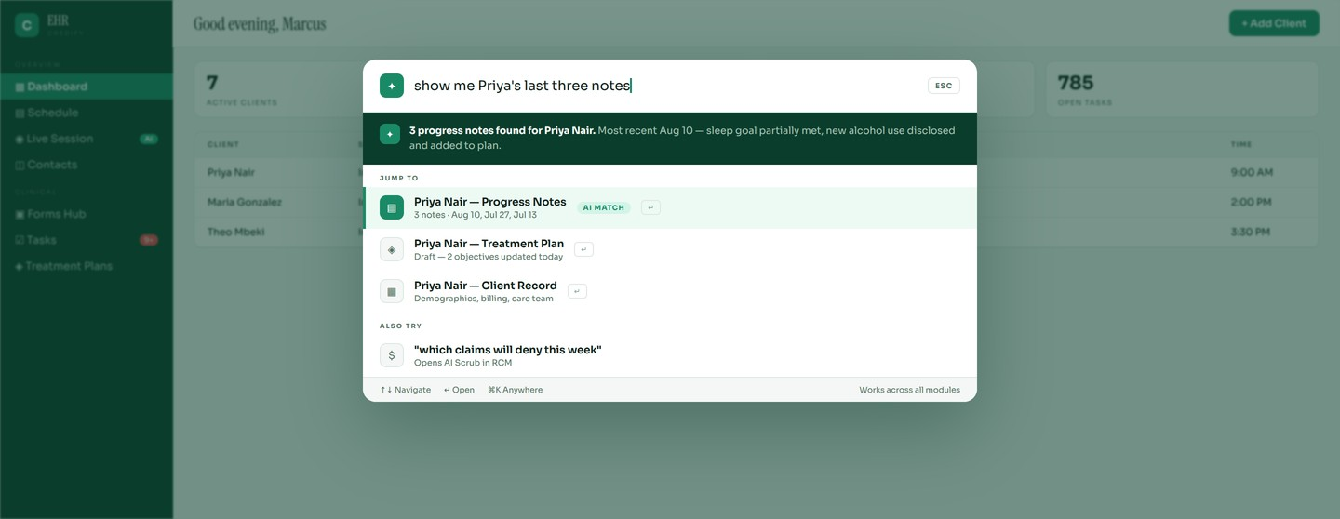
✦
CREDIFY AI · IN DEVELOPMENT
Ask for anything and land on it, in any module.
Natural-Language Navigation
01
Plain Language
02
Answers, Then Routes
03
Crosses Every Module
Ask in your own words instead of clicking through four menus
Summarizes what it found before sending you where you were going
One search bar spans clinical, scheduling, and billing because a single data model makes it possible
Notes:
Navigation seems minor but it is the clearest demonstration of the unified data model. No point solution can answer a question that spans clinical and billing.

Slide 9
STAGE 1
Acquire
Build your referral network. Turn inquiries into active clients.
CRM
Email / SMS Outreach

Slide 10
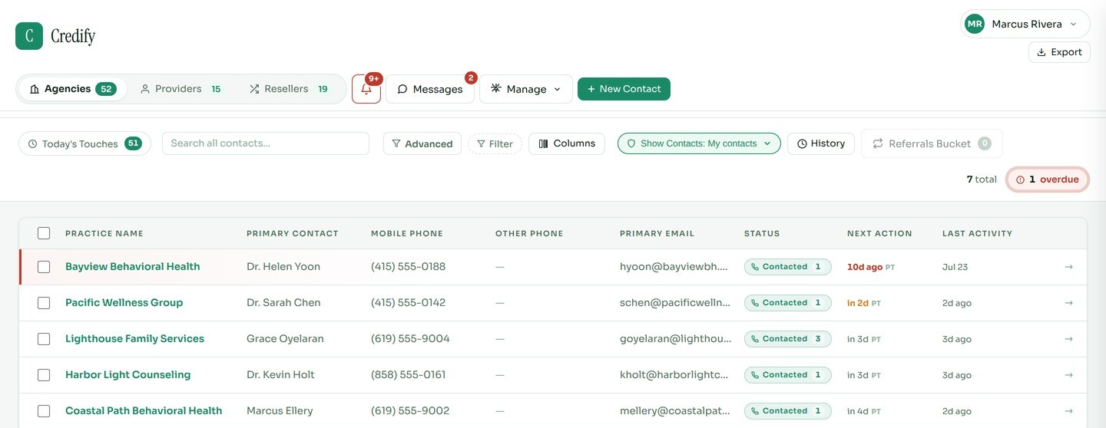
1
STAGE 1 · ACQUIRE
Your entire referral network, organized and moving.
CRM
01
Unified Pipeline
02
Full Relationship Record
03
Automated Outreach Cadence
Agencies, therapists, and referral sources with per-source status and custom contact types
Per-contact activity log, notes, documents, and complete touch history
Touch Rules fire messages and follow-ups by pipeline stage, source type, and days since contact
Notes:
Built specifically for behavioral health growth. It knows the difference between an agency referral source, an insurance case manager, and a direct-to-client lead.

Slide 11
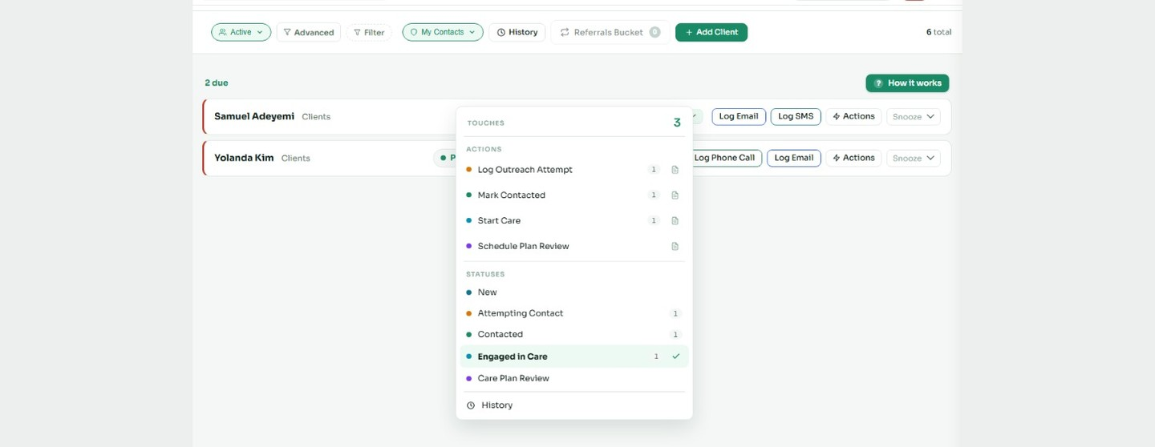
1
STAGE 1 · ACQUIRE
A structured daily queue so no referral opportunity falls through.
CRM · Touches
01
Daily Action Queue
02
One-Click Logging
03
Prospective Client Outreach
Every contact due for outreach appears automatically, with no manual list-building
Log calls, emails, and visits with instant status updates from the queue
Customize outreach cadences and track progress
Notes:
Touch Rules replace "who do I call today?" with a prioritized daily action queue. Consistent cadence drives predictable referral flow.

Slide 12
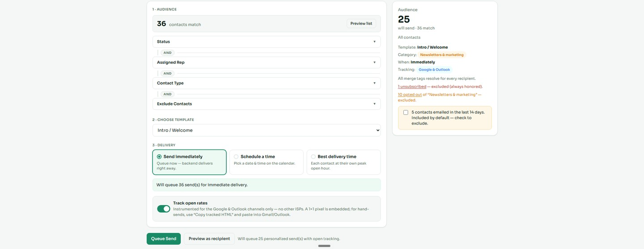
1
STAGE 1 · ACQUIRE
Segmented outreach at scale, built for practice growth.
Email / SMS Outreach
01
CRM-Native Segments
02
Compliance Built In
03
No Third-Party Vendor
Filter audiences by source type, pipeline stage, and last touch date
Open tracking, unsubscribe handling, and a full send audit log
Scheduled send, live preview, and send simulation inside the platform
Notes:
Replaces Mailchimp and Constant Contact for referral source outreach, scoped for practice growth rather than generic marketing.

Slide 13
STAGE 2
Intake
A branded front door that converts inquiries into active clients.
Client Portal
Therapist Match

Slide 14
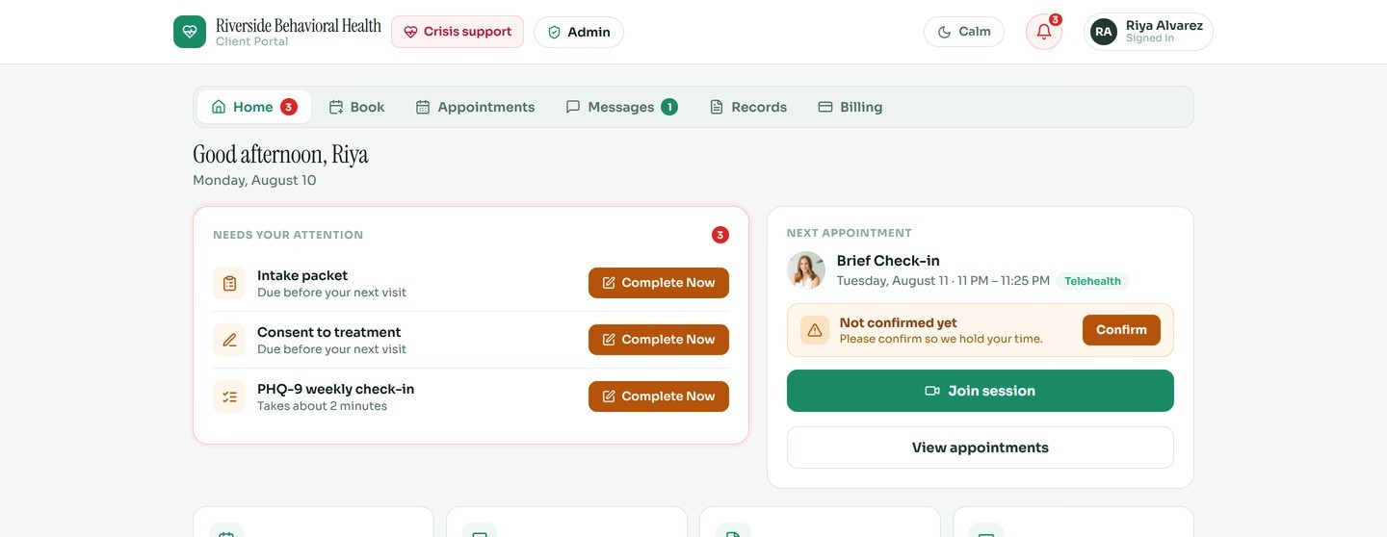
2
STAGE 2 · INTAKE
Intake is completed before session one, every time.
Client Portal
01
Pre-Visit Intake
02
Pending Items Dashboard
03
Full Client Experience
Clients complete packets, sign consents, and confirm appointments before arriving
Each client sees what needs attention while staff see what is still outstanding
Secure messaging, appointment history, records, and billing in one login
Notes:
Replaces paper intake packets and email-based consent collection. Every new client arrives pre-documented.

Slide 15
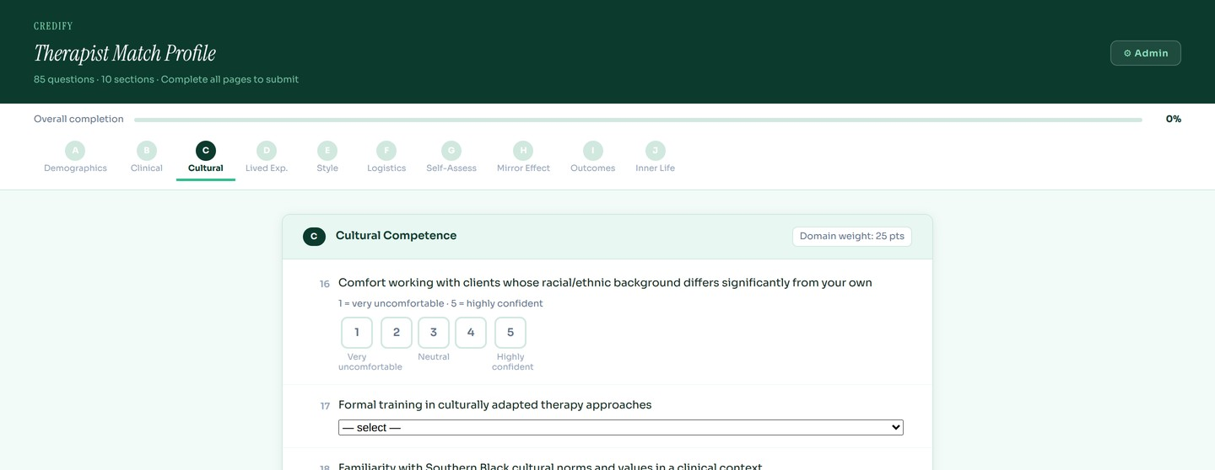
2
STAGE 2 · INTAKE
Match each client to the right clinician, not just an available one.
Therapist Match
01
85 Questions, 10 Domains
02
Weighted Scoring
03
Beyond Credentials
Demographics, clinical, cultural, lived experience, style, logistics, and philosophy
Every domain carries a point weight, so match strength is measured rather than guessed
Cultural competence and therapeutic philosophy that a directory listing cannot capture

Slide 16
STAGE 3
Schedule
Every provider, location, and session in one view.
Calendar
Appointment Reminders

Slide 17
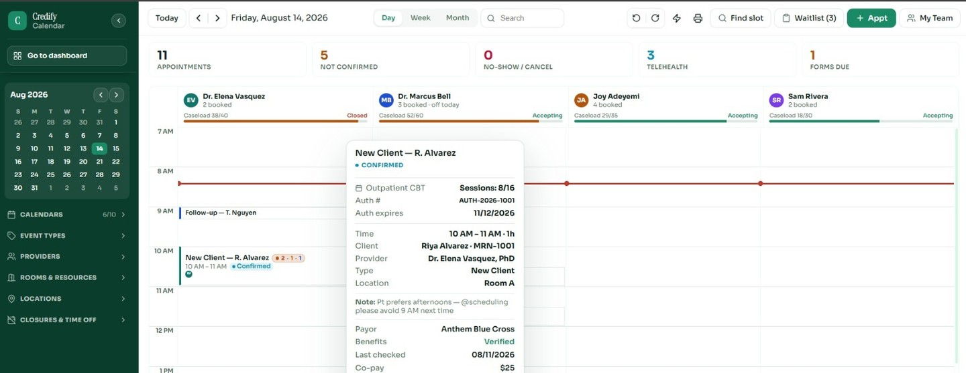
3
STAGE 3 · SCHEDULE
Every provider, every location, and every session in one view.
Calendar
01
Billing & Patient Details
02
Smart Scheduling
03
Mobile-First
Automatically pulls CPT, session count, and payer details
Find Slot automation, drag-to-reschedule, group sessions, and ICS sync
Providers check and manage their schedules from anywhere
Notes:
Built for group practices with multiple providers, multiple locations, and different service types.

Slide 18
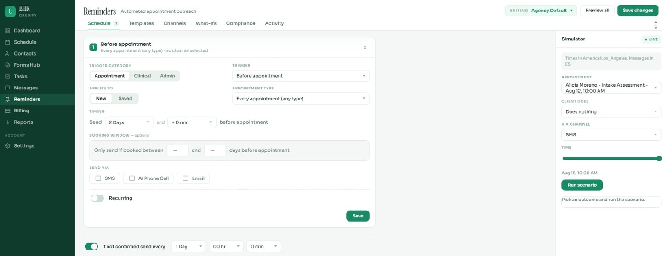
3
STAGE 3 · SCHEDULE
Reduce no-shows without lifting a finger.
Appointment Reminders
01
Multi-Channel
02
Conditional Triggers
03
Ready to Activate
SMS, email, and voice reminders with bilingual English/Spanish support built in
Customize trigger and field conditions per appointment and provider type
Prebuilt templates cut setup time from hours to minutes
Notes:
No-show reduction is one of the fastest revenue recovery levers in behavioral health.

Slide 19
STAGE 4
Treat
A full behavioral health EHR, purpose-built rather than bolted on.
EHR + Tasks
Treatment Plan

Slide 20
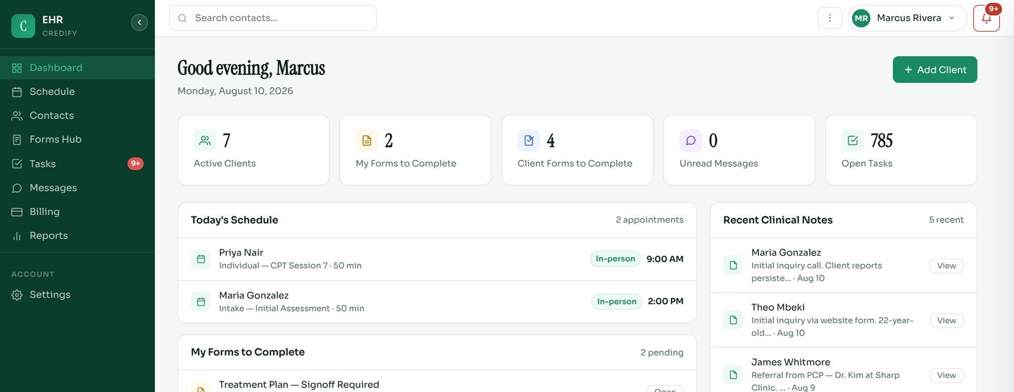
4
STAGE 4 · TREAT
A full behavioral health EHR, built native rather than adapted from primary care.
EHR
01
Clinical Dashboard
02
One Client Record
03
Purpose-Built
KPIs, upcoming sessions, recent notes, and form responses at a glance
Progress notes, demographics, and treatment history unified in one place
Documentation workflows built for behavioral health and nothing else
Notes:
Built from scratch for behavioral health. Workflows, terminology, and data model reflect real outpatient and IOP documentation requirements.

Slide 21
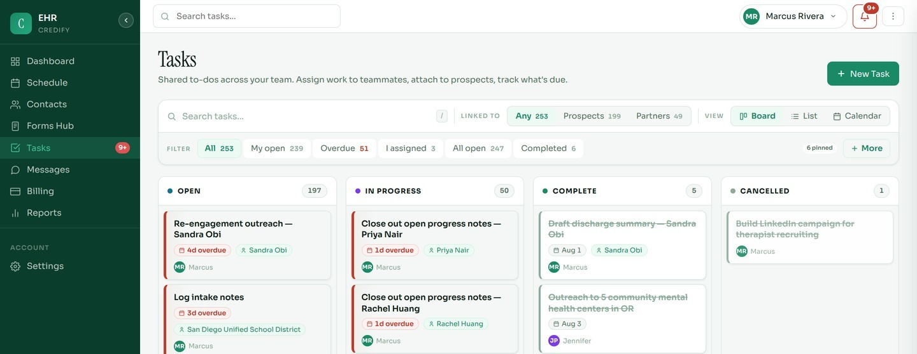
4
STAGE 4 · TREAT
Every clinical to-do tracked, assigned, and resolved for each client.
EHR · Tasks
01
Per-Client Task Board
02
Date Enforcement
03
Team Visibility
Checklists and subtasks for complex multi-provider care coordination
Mandatory due dates and recurring tasks for compliance-critical workflows
Assignee tracking, attachment panels, and full status audit trail
Notes:
Solves the coordination problem in multi-provider practices. Every outstanding clinical action lives in the system, attached to the client record.

Slide 22
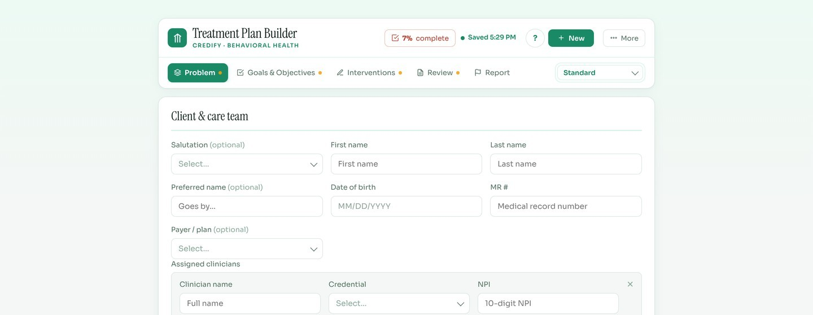
4
STAGE 4 · TREAT
Compliant treatment plans, built faster and audited easier.
Treatment Plan Builder
01
Co-Authored Plans
02
Level-of-Care Modes
03
Audit-Ready
Client and care team collaborate on goals, objectives, and GAS scale
Documentation modes for outpatient, IOP, and residential programs
Version history, clinician signoff, and export that satisfies payer review
Notes:
This is one of the highest-compliance-risk areas in behavioral health documentation. It encodes the structure needed to pass payer audits and accreditation reviews.

Slide 23
STAGE 5
Get Paid
Revenue that doesn’t leak, from first claim to final payment.
Revenue Cycle Mgmt

Slide 24
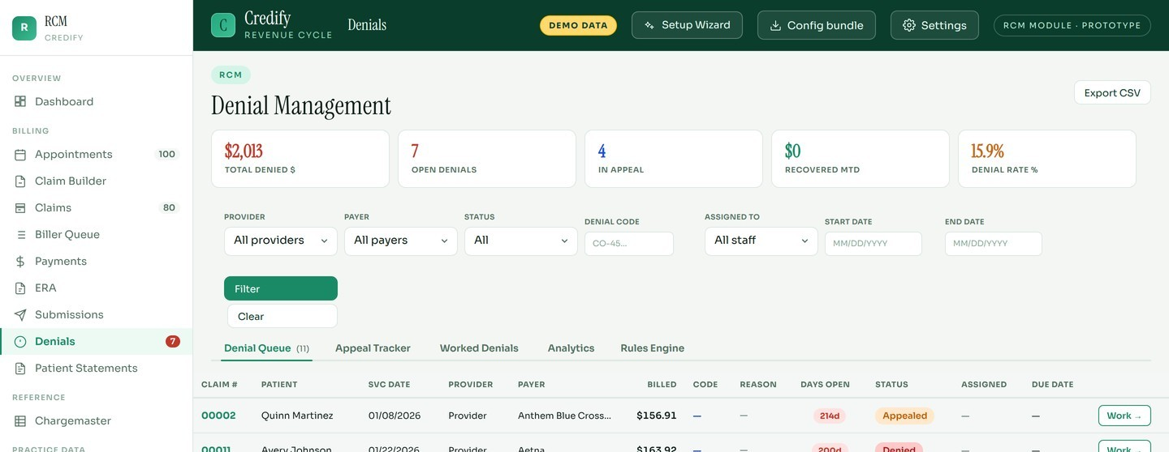
5
STAGE 5 · GET PAID
Revenue that doesn’t leak, from first claim to final payment.
Revenue Cycle Management
01
Denial Management
02
Native EDI
03
Appeal Tracker
Underpayments and rejections surfaced before write-off, with payer and reason code
835 parsing, ERA reconciliation, corrected claims, and COB, with no clearinghouse workaround
Every appealed claim tracked from filing through payer decision, so nothing ages out of the window
Notes:
Most practices write off 3 to 8 percent of billed charges to denials, not because the claims were wrong but for lack of a system to track and rework them.

Slide 25
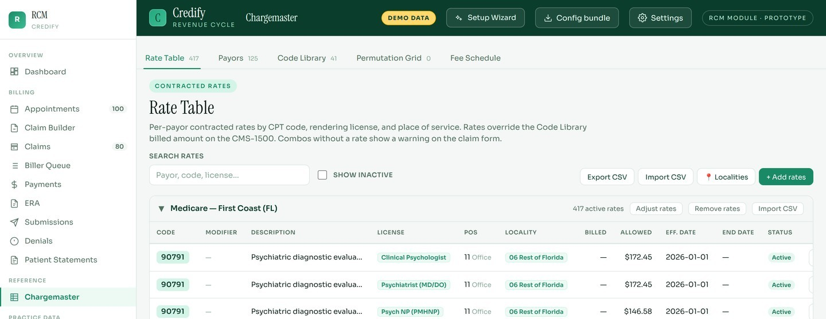
5
STAGE 5 · GET PAID
Billing infrastructure behavioral health practices actually need.
Chargemaster & Claims
01
Super Chargemaster
02
Live Claims Board
03
End-to-End Cycle
100+ CPT codes with contracted payer rates, modifiers, and locality fee schedules
Real-time payer status, billed amount, and unposted balance per claim
Patient Statements, Biller Queue, 277CA, and clearinghouse wizard
Notes:
The Chargemaster is the pricing backbone. Contracted rates by payer, code, and locality feed directly into claim generation.

Slide 26
STAGE 6
Operate
Visibility across every module, so you know before it becomes a problem.
Alerts Hub
Reports

Slide 27
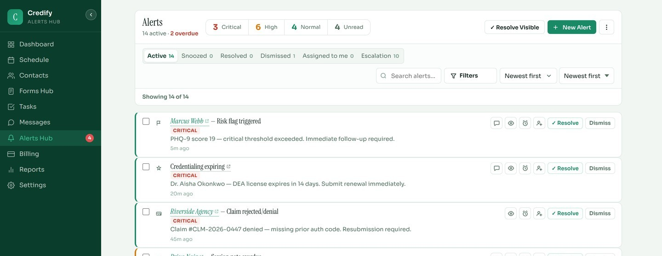
6
STAGE 6 · OPERATE
Know before it becomes a problem.
Alerts Hub
01
Cross-Module Feed
02
Escalation Routing
03
Nothing Slips
No-shows, denials, document gaps, and credential expirations in one stream
Per-user channel preferences across desktop, email, and in-app delivery
Read, snooze, and dismiss tracking ensures no critical alert is missed
Notes:
The operational nervous system. Because Credify owns every module, it fires cross-module alerts no point solution could generate.

Slide 28
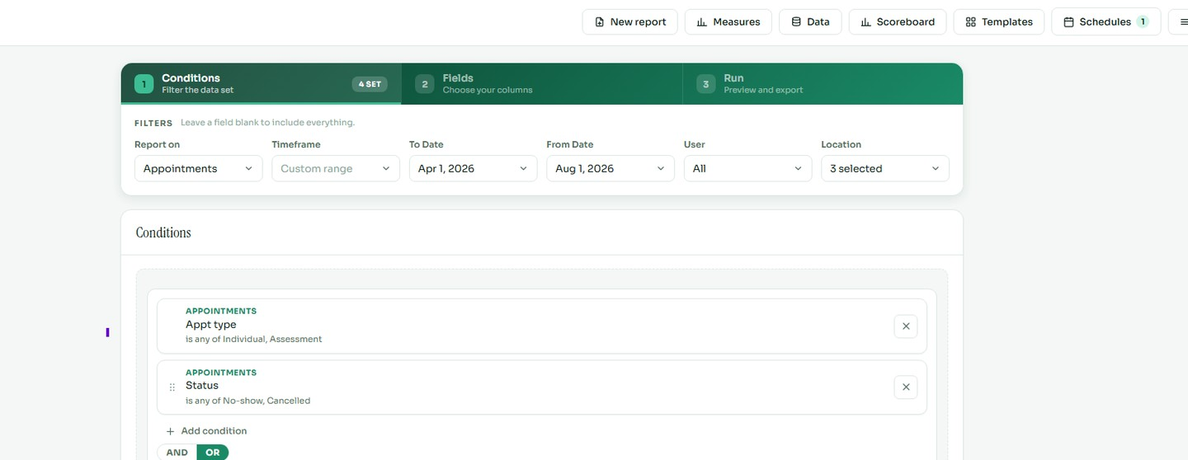
6
STAGE 6 · OPERATE
Reporting that satisfies payers, leadership, and accreditation.
Reports
01
BH KPI Library
02
Configurable Templates
03
Filter Any Dimension
Clinical, operational, and financial measures built in and ready to run
Monthly leadership reviews, payer reports, and accreditation docs
Date range, provider, location, and service type, all export-ready
Notes:
The intelligence layer. Credify owns the clinical, operational, and billing data model, producing integrated reports no point solution can generate.

Slide 29
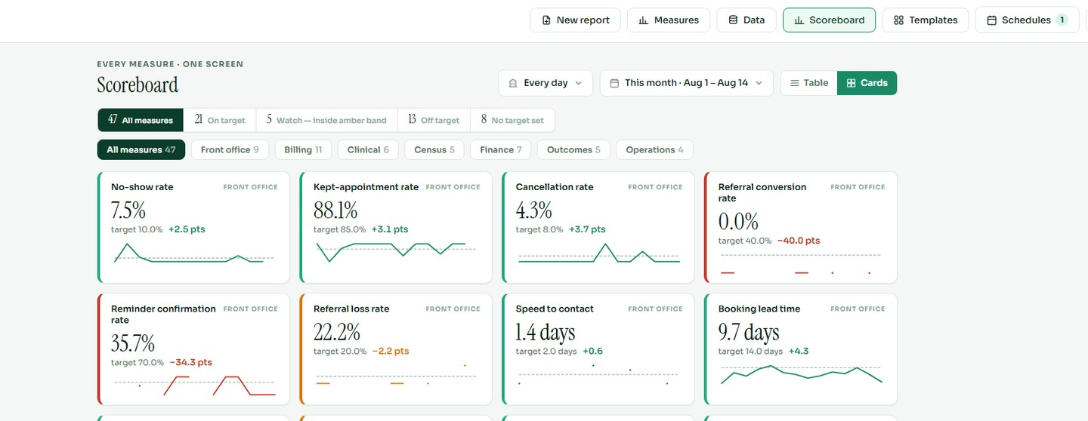
6
STAGE 6 · OPERATE
Drill into any metric, in any dimension and any time frame.
Reports · Measures
01
Any Permutation
02
Not a Ceiling
03
Comparative Analysis
Measurement over time, percentage-of-goal, weighted scoring, composite indices
Standard measures are a starting point, so you can build custom KPIs from any data point
Cohort comparison, provider benchmarks, and payer performance
Notes:
Reporting depth is the differentiator. Any permutation is buildable from the same unified data set, whether that is trend, percentage, weighting, scoring, or cohort.

Slide 30
6
STAGE 6 · OPERATE
A data analyst’s dream, on a unified data model.
Reports · Build Anything
01
Measurement Over Time
02
Percentage & Ratio
03
Weighted Scoring
Trend any metric across weeks, months, or quarters with visual comparison
Goal attainment, no-show rate, denial rate, and collection percentage
Apply custom weights to composite outcome indices from any measures
04
Cohort Analysis
05
Provider Benchmarks
06
Payer Comparison
Compare client groups by diagnosis, payer, provider, or program
Side-by-side performance metrics across every member of the care team
Reimbursement rates, denial patterns, and collection performance by payer
07
Program Outcomes
08
Accreditation Reports
09
Custom KPIs
IOP, outpatient, and residential KPIs, clinical and operational together
Pre-formatted for CARF, TJC, and NCQA requirements, ready to export
Build from any data point captured across the entire Credify platform
Notes:
Any permutation a practice, payer, or accreditation body could ask for, including measurement over time, percentage, weighting, and scoring.

Slide 31
One unified platform replaces the stack.
01 Acquire
04 Treat
CRM + Email / SMS Outreach
EHR · Tasks · Treatment Plan
02 Intake
05 Get Paid
Client Portal + Therapist Match
Revenue Cycle Management
03 Schedule
06 Operate
Calendar + Reminders
Alerts Hub + Reports
credifyfast.com
Notes:
Credify is the only platform built to own every stage of the behavioral health client journey, all under one login.

