Slide 1
Project Proposal
Han Li
Beichen Yu

Slide 2
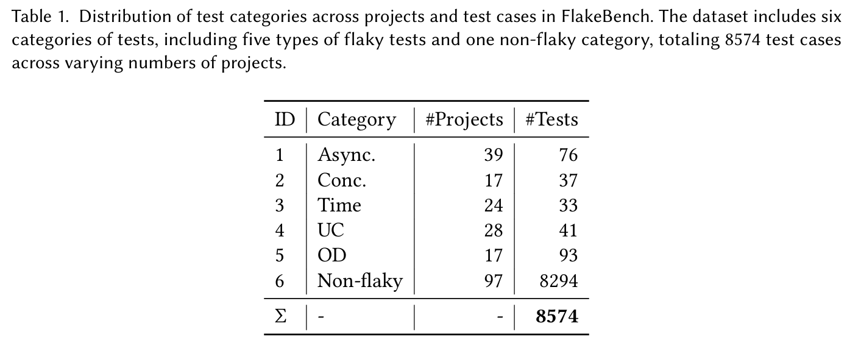
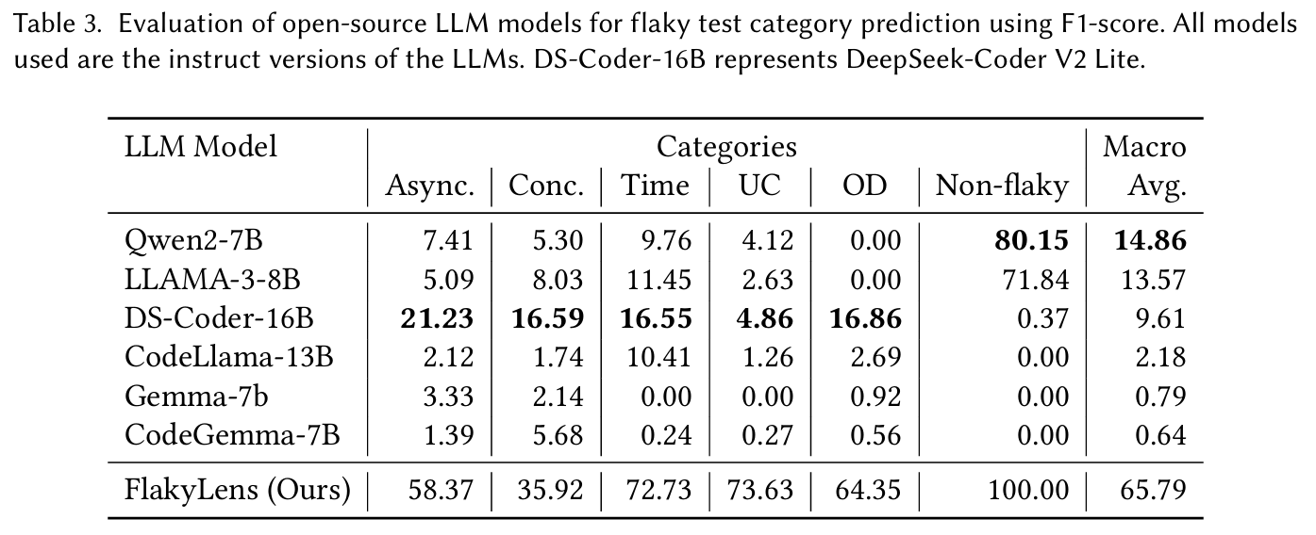
Research Inspiration
FlakeBench: a realistically distributed dataset with 8,574 tests, designed for fair evaluation of flaky test detection methods.
FlakyLens: an improved classifier built on FlakeBench, fixing design flaws and using weighted, robust training to achieve a macro-F1 of 65.79%, reach a SOTA compared with GPT models.
Problem: Existing work (FlakyLens) still relies heavily on shallow token patterns rather than deep semantic understanding, limiting its accuracy and robustness in complex scenarios!
Understanding and Improving Flaky Test Classification

Slide 3
What we will do…
Dataset
Distillation
Focal Loss
Finetuning
LoRA
Alpaca Format
Model Architecture
Mixture Experts
Majority Voting
Prompt Engineering
Markdown Format
Chain of Thought
Train a GPT-based large language model!

Slide 4
Dataset
Challenge: severe class imbalance! Number of non-flaky tests is much larger than flaky!
Solution:
1. apply Focal loss to improve the weight of rare categories. E.g. when using LLaMA-Factory, directly modify comput loss
2. (might) Synthesize additional small class samples through powerful LLM.
Biased toward predicting!
Understanding and Improving Flaky Test Classification
Notes:
causes the model to be toward predicting the majority class.

Slide 5
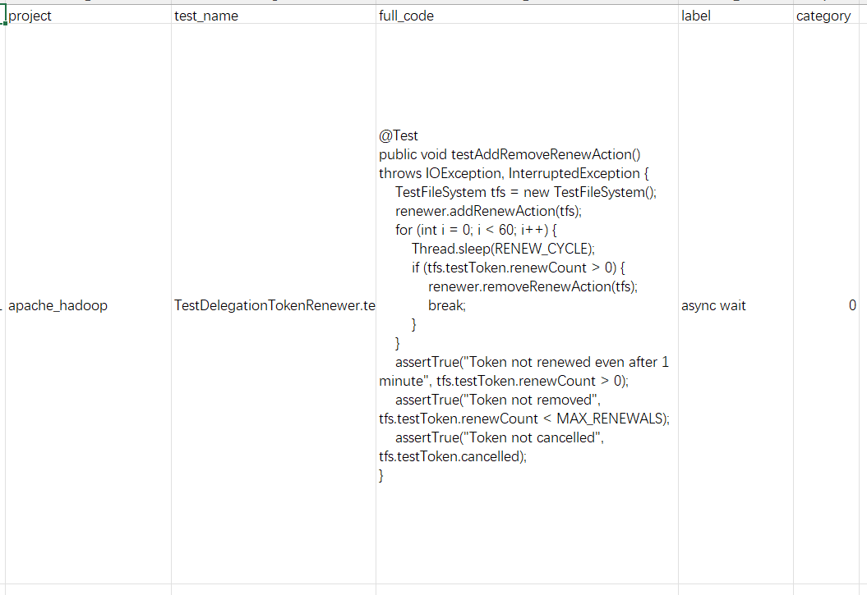
Dataset
Challenge: only provides code tag pairs without inference process.
Solution: enhance through distillation.
1. provide a powerful LLM with the original test code and its label, ask to generate a complete reasoning chain.
2. combine them with the original input to form an instruction–input–output triplets.
Example of FlakyBench dataset
Alpaca format

Slide 6

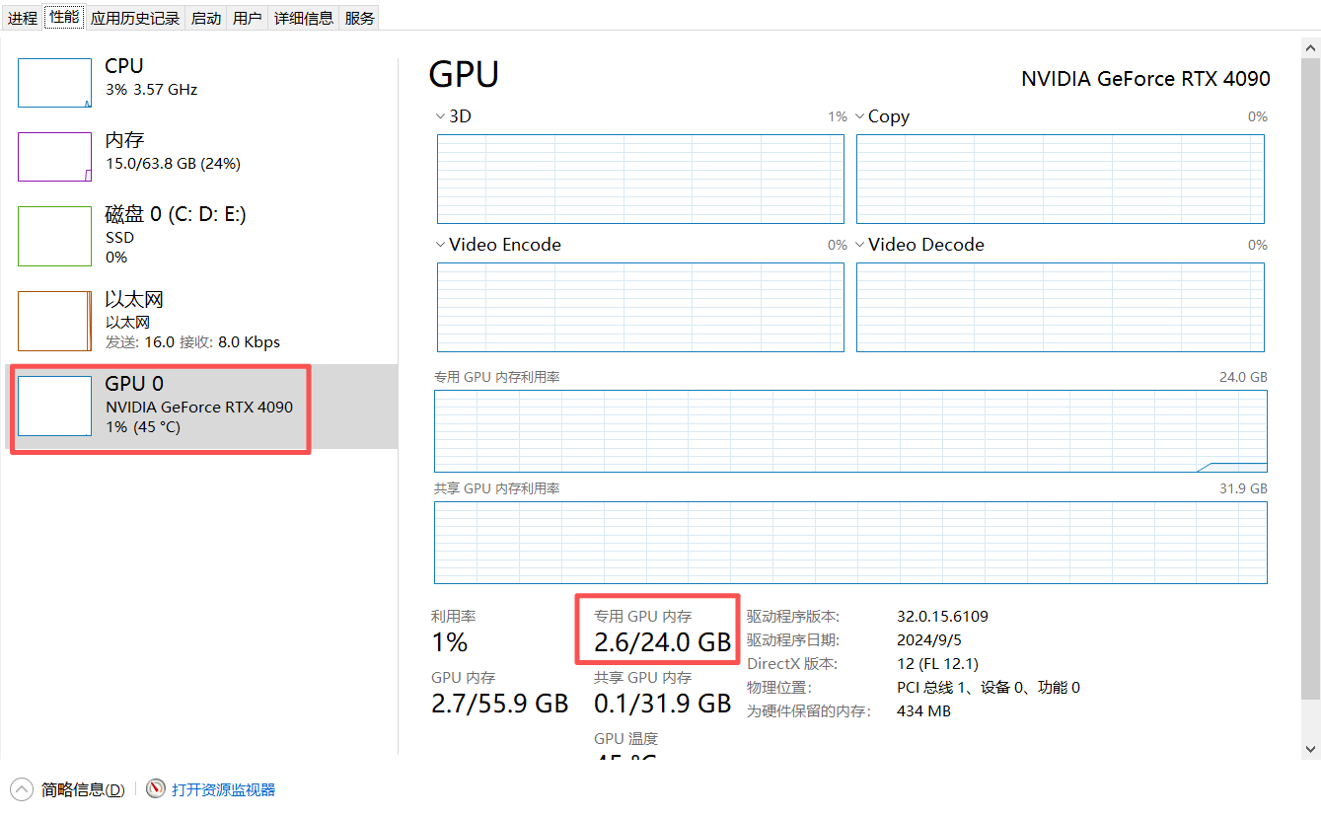
Finetuning
LoRA: Low rank adaption of LLM
1. Low GPU usage: 7B ~16 GB
2. Effective:
Updates <1% of parameters
Comparable or better performance than full fine-tuning
Easy to store & reuse adapters for multiple tasks
3. Ecosystem support: LLaMA-Factory (No need to build training pipeline!)
Already have that resource, so GPU won’t be a problem xd

Slide 7
Model Architecture
Agents
Break complex tasks into smaller subtasks
Assign to different sub-agents (finetuned for specific task types)
Agents work independently without cross-communication
Majority Vote
Aggregate outputs from multiple agents
Use voting to improve accuracy and robustness
Efficient Code Embedding
Employ task-specific models (e.g., CodeBERT)
Boost efficiency and representation quality
Inspired by this paper:
RubikSQL: Lifelong Learning Agentic Knowledge Base as an Industrial NL2SQL System

Slide 8
Prompt Engineering
Markdown Formatting
Prompts written in structured, clear Markdown style
Chain-of-Thought Guidance
Explicitly guide the model step by step in reasoning
Curated Few-Shot Examples
Carefully selected and human-reviewed demonstrations
Ensure representativeness and reliability for reference

Slide 9
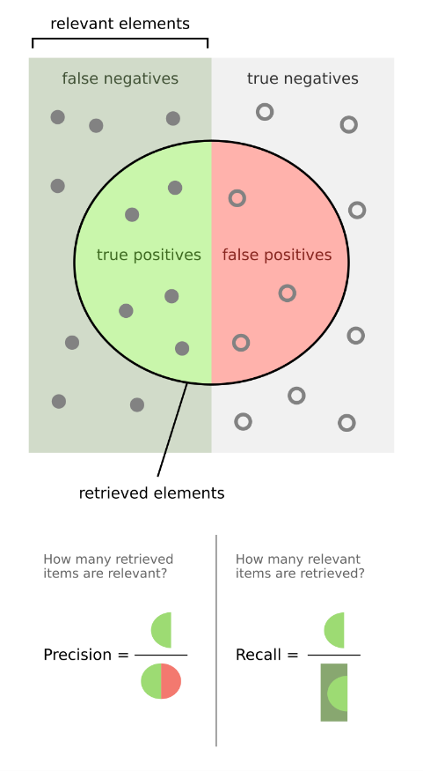
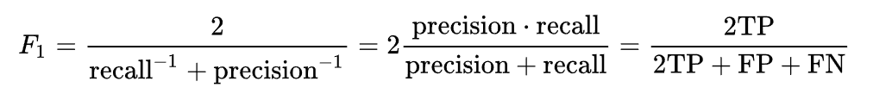
Evaluation
Baselines
Compare against popular methods in this area (e.g. close-source LLM, flakyLens)
Metrics
Macro-averaged F1 across 6 classes
Overall accuracy
Per-class F1
Confusion matrix
F-score - Wikipedia

