Slide 1
Symphony – an Open Source Framework for Lab Information and Data Management
Mark A. Miller
Principal Investigator, Biology
San Diego Supercomputer Center

Slide 2
SDSC Mission:
To serve as a premiere resource for design, development, and deployment of cyberinfrastructure for the national scientific community.

Slide 3
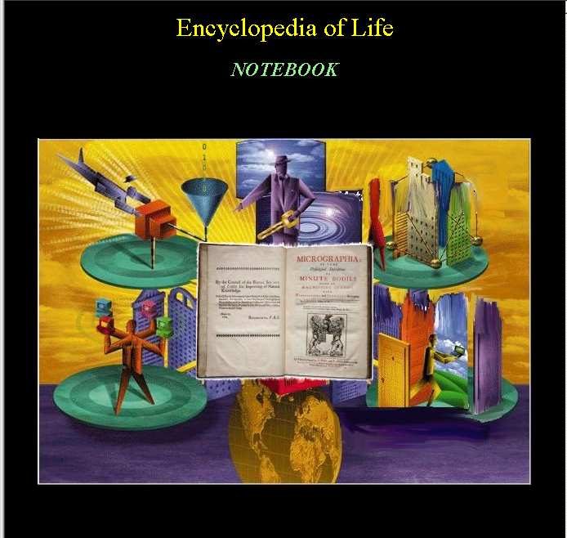

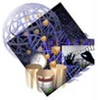

Cyberinfrastructure (We Think) Life (and Other) Scientists Need
Wet Labs
Clinical Labs
Grid
Resources
Global Data
Providers
Data
Capture
Portals
Workflow
Grid
Services
D.L.
Discovery
Portal
IntegrationSoftware
DataBases
Personal
Electronic
Notebook
Web
Services
Compute
Resources
Structure
Tools
Sequence
Tools
Data
Deposition
Portals
Wet Labs
Clinical Labs
Microarray
Tools

Slide 4
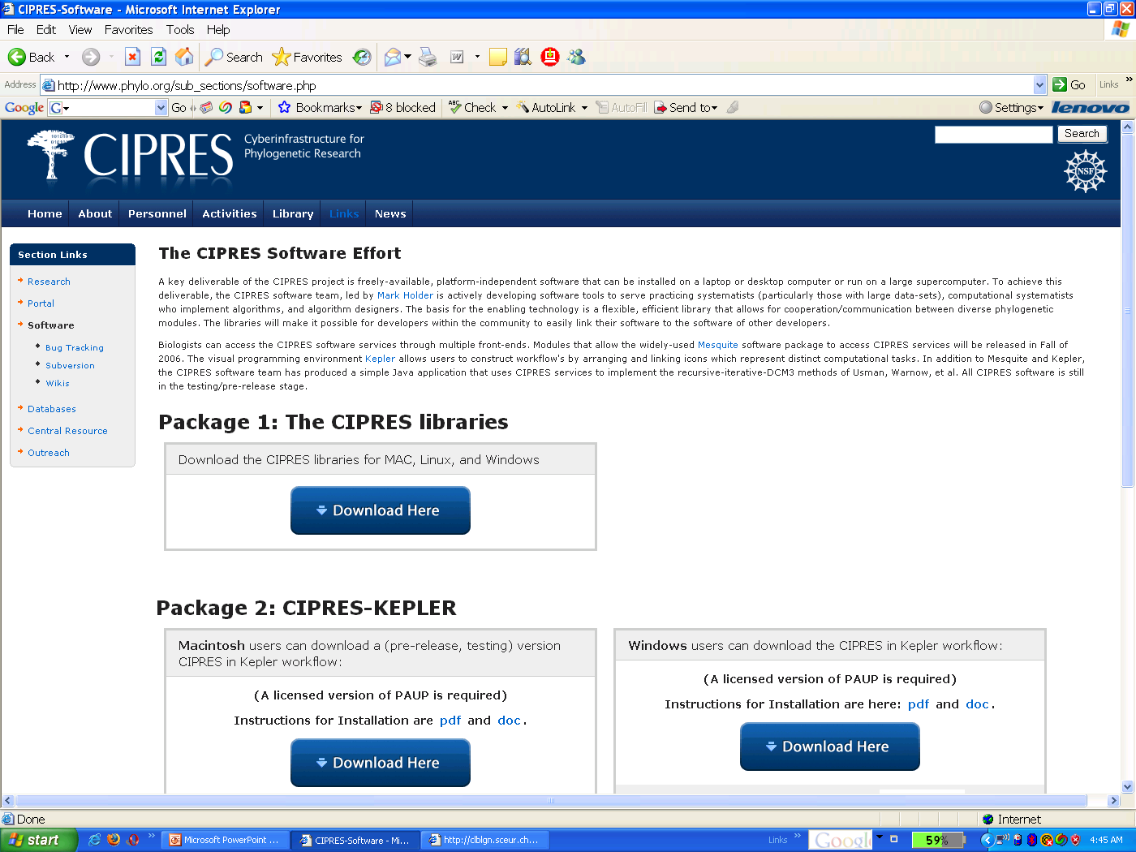
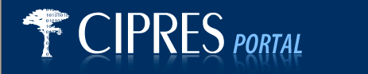


Next Generation Tools for Biology
Current Products:
CIPRES middleware
for developers
CIPRES portal
for users on our resources
CIPRES/Kepler workflow
for users on local resources
Biology Workbench
for users on our resources

Slide 5
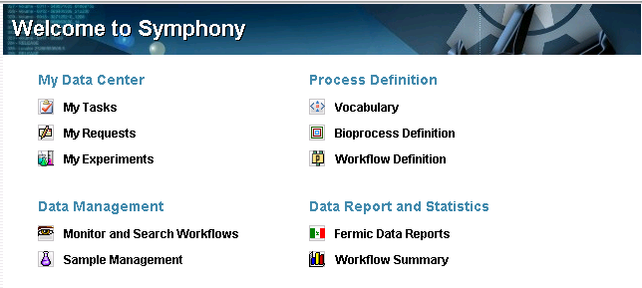
Next Generation Tools for Biology
\Introducing:

Slide 6
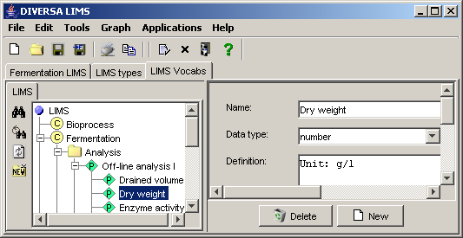
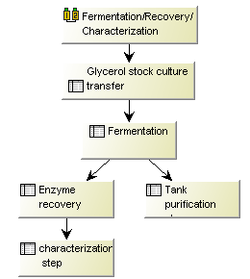
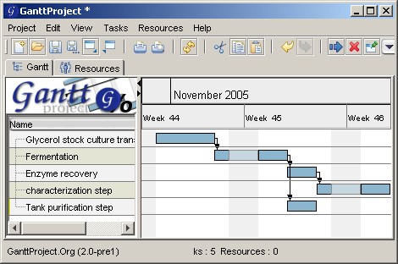
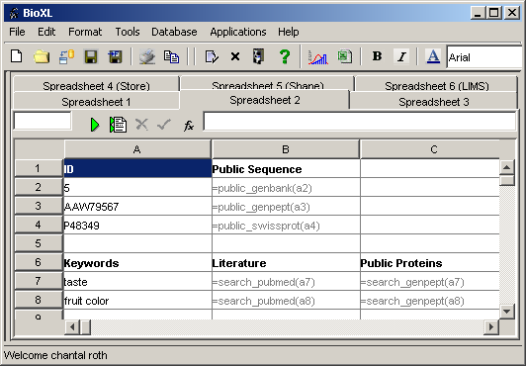
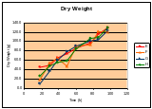
Symphony Overview
Controlled Vocabularies
Knowledge representation
Workflow/Experiment
Design
Reiteration of Variables
Identifying relevant
variables
Reports/Charts
- coupling of variables
Data Capturing
-Batch/Interactive
Data Analysis
Time Series

Slide 7
Its intent is to integrate distributed laboratory activities:
Symphony Overview
Symphony is built on a classic client:server EJB
architecture.
to coordinate laboratory workflow activities
to provide a LIMS
to integrate local and public data resources
to facilitate data management and manipulation
with enterprise stability, flexibility to incorporate new
data types, and with generic ontology capabilities

Slide 8
Symphony Overview
The use case for Symphony is support of data assembly,
integration, and exchange across a project with multiple research facilities.

Slide 9
Symphony Server Architecture
Application Server
Business Logic
Save
Service
Data Storage
Retrieve
Service
Communication
Persistence
EJB
Request
Handler
Chromosome
Retriever
Persist.
Factory
Database
Manager
DB I
RMI
Contig
Assembler
XML
creates
creates
SER
Servlet
Request
Handler
Request
Handler
Request
API
Schema
Service
Data
Loader
Database
Handler
DB II
API
Feature
Service
XML
Response
….
MC
Direct
Request
Handler
Pathway
Service
DAL
Objects
DAL
Objects
Analysis
Service
DAL
Objects
DAL
Objects
DB n
Email
Service
User
Service

Slide 10
Lucene Indexing
Lucene Indexing
Oracle
DB2
MySQL
SQL
Server
Postgre
SQL
Flat
Files
Ontology and
Management Data
Persistence
(Query Execution, Data Retrieval)
Persistence
(Data Retrieval/Loading)
Application Logic
(Query formulation, splitting, data merging etc)
Application Logic
(Ontology Queries etc)
Server
Server
Client/Server communic.
Client/Server communic.
DiscoverySearch GUI
Ontology GUI
Client Application

Slide 11
Symphony Client Architecture
Client PC
Applications
Utilities/Frameworks
X
M
L
Discovery
Search
Graphics
Framework
Threading
Framework
Object
Pool
XML
Framework
Graph
Framework
X
M
L
Feature
Viewer
X
M
L
BioXL
Server Services
Request
Handler
Communication
Control
EJB
Service
RMI
X
M
L
Chrom.
Viewer
Application
Registry
Save
Service
X
M
L
Analysis
Server
Events
Events
Communic
Service
Servlet
Service
SER
Event
Manager
Login
Component
XML
X
M
L
Pathways
Direct
Request
Service
MC
Logging
Manager
X
M
L
Discovery
Lab
Events
X
M
L
Ontologies
Gui Services
Print
Service
Export
Service
Undo
Manager
Preferences
Manager
Import
Service
X
M
L
Statistics
GUI
GUI
GUI
GUI
GUI

Slide 12
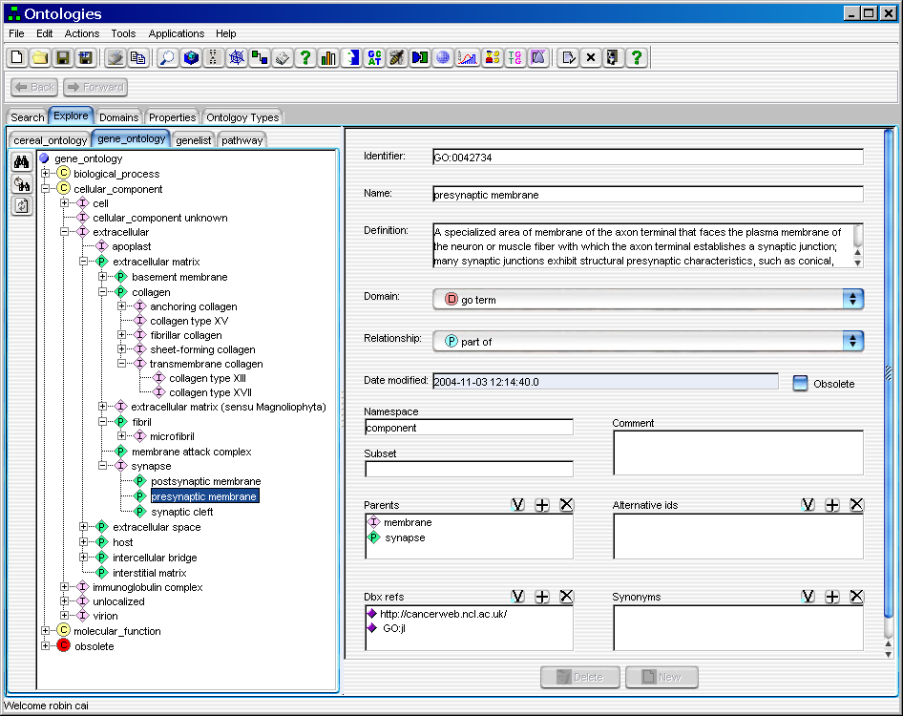
Knowledge Representation and Ontologies

Slide 13
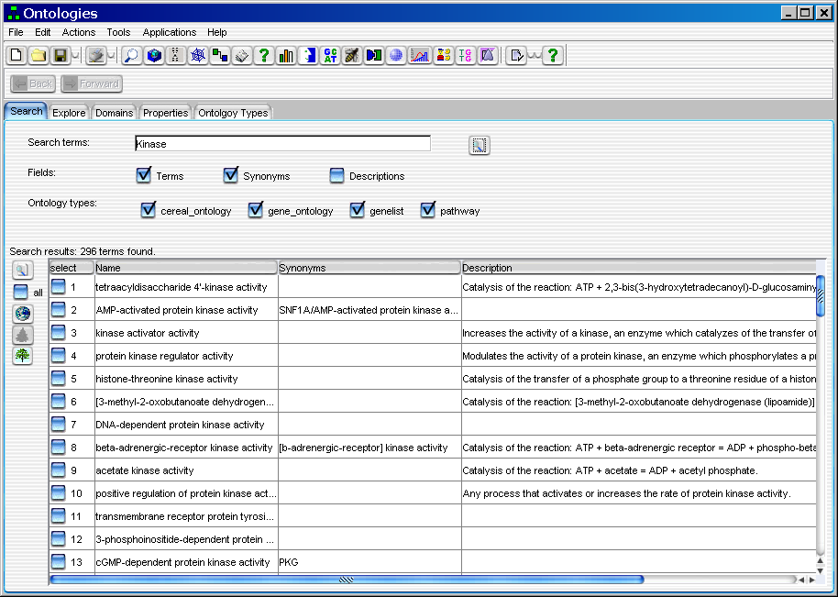
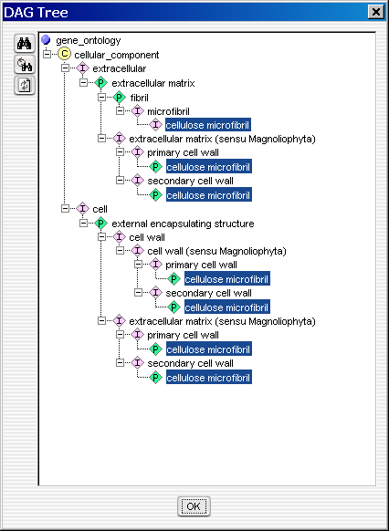
Ontologies UI
Search ontologies for terms, synonyms and / or description (definition) for any key word(s). Users select which ontologies to search. Search results will be displayed in a table. Users can enable the green tree icon to view DAG tree of the selected term.

Slide 14
Ontologies UI
Ontology Admin Tool allows admin to view, edit, browse, define and search ontologies.

Slide 15
Symphony Client Architecture
Client PC
Applications
Utilities/Frameworks
X
M
L
Discovery
Search
Graphics
Framework
Threading
Framework
Object
Pool
XML
Framework
Graph
Framework
X
M
L
Feature
Viewer
X
M
L
BioXL
Server Services
Request
Handler
Communication
Control
EJB
Service
RMI
X
M
L
Chrom.
Viewer
Application
Registry
Save
Service
X
M
L
Analysis
Server
Events
Events
Communic.
Service
Servlet
Service
SER
Event
Manager
Login
Component
XML
X
M
L
Pathways
Direct
Request
Service
MC
Logging
Manager
X
M
L
Discovery
Lab
Events
X
M
L
Ontologies
Gui Services
Print
Service
Export
Service
Undo
Manager
Preferences
Manager
Import
Service
X
M
L
Statistics
GUI
GUI
GUI
GUI
GUI

Slide 16
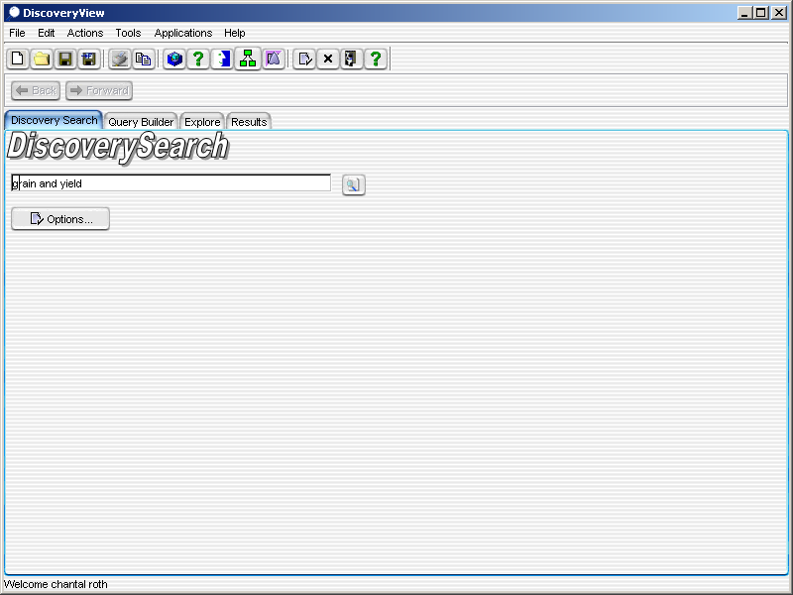
Discovery Search UI
Default search screen:
Users can enter keywords and expressions similar to Google.
Booleans are allowed: and, or, not and parenthesis.

Slide 17
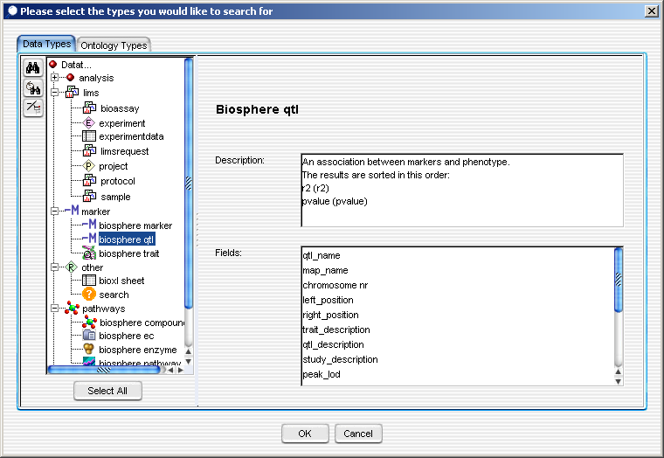
Discovery Search UI
Users can select subsets of datatypes to search.
New data types (for any database) can be added simply by editing an XML file.

Slide 18
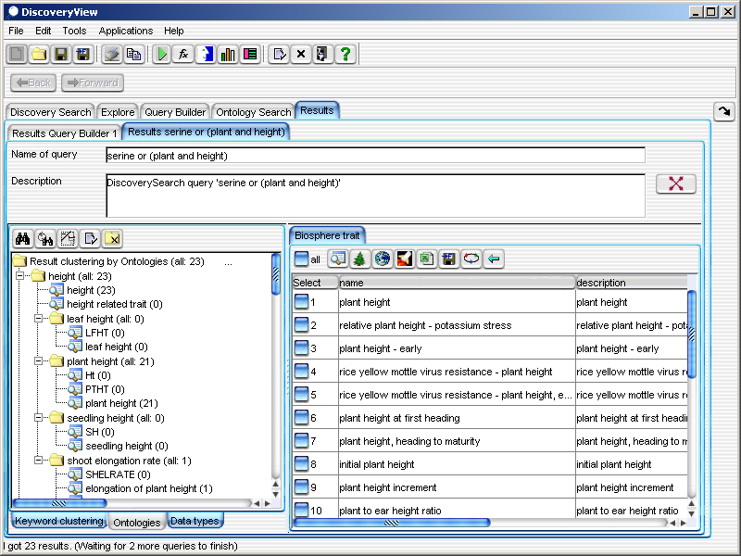
Discovery Search UI
A user can turn off the ontologies or select particular ontologies to use. In addition, a user can select which data types to include in the searches.
The options button allows a user to change the default settings. By default:
- all possible data types are searched
- ontologies are used
Search results can be organized via ontologies. The user can see the results for “plant and height”, in addition to results for expanded terms.

Slide 19
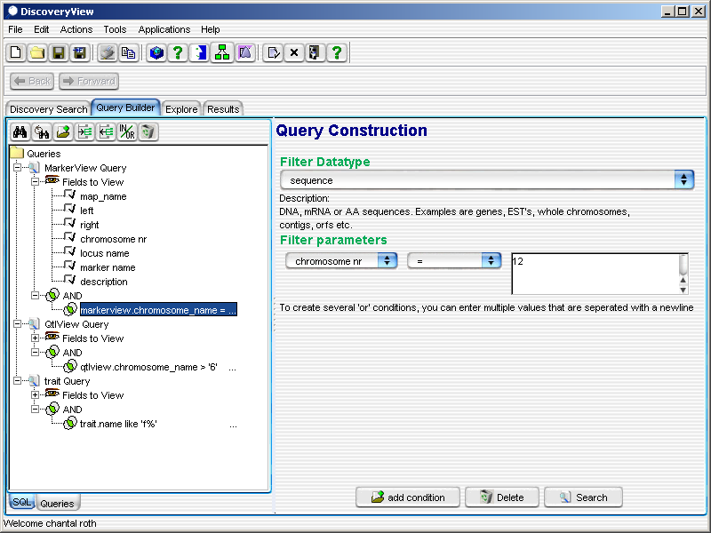
Discovery Search UI
The query that is being constructed is shown on the left as a tree.
When a user selects a node, the screen on the right is updated accordingly and shows the information about that node.
In the example below, a condition is selected (chromosome nr = 12).
QueryBuilder:
The query builder is a more advanced search utility where more complex queries can be created.

Slide 20
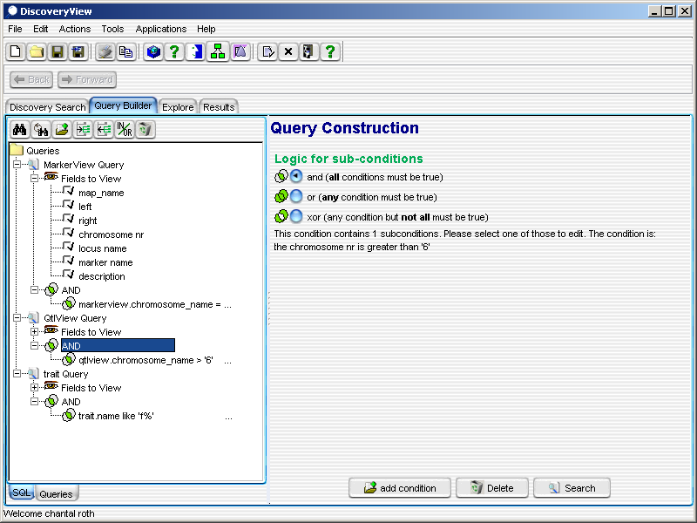
Discovery Search UI

Slide 21
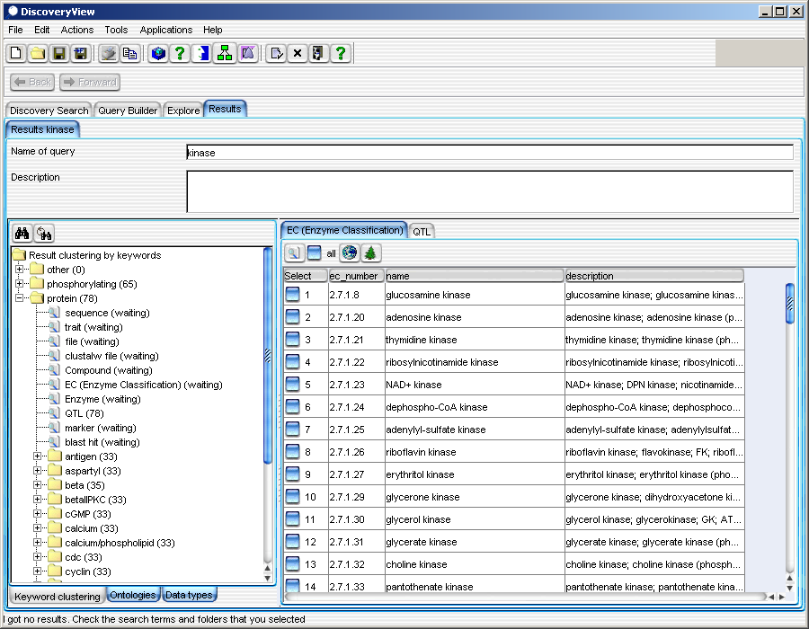
Discovery Search UI
Keyword Clustering.
The query was “kinase.” On the left side of the screen, results are clustered by keywords on the fly (without ontologies). Any result can be clustered that way, no matter what the query was or what the target database/tables were.

Slide 22
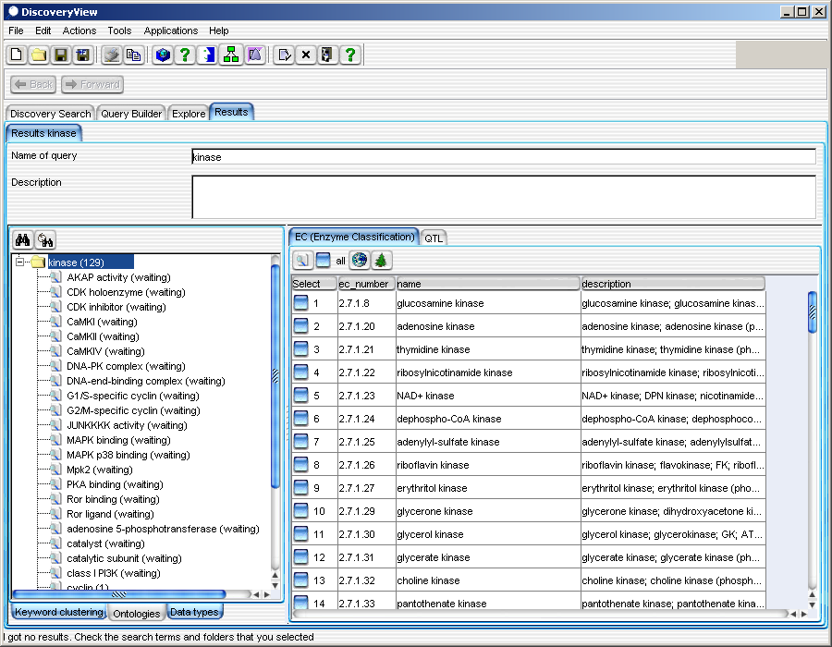
Discovery Search UI
Clustering via Ontologies. The second way to group results is via ontologies:
In this case, the query was simply “kinase”. The application automatically expanded the term kinase into a list of terms (such as “G2M-specific cyclin”).

Slide 23
Symphony Client Architecture
Client PC
Applications
Utilities/Frameworks
X
M
L
Discovery
Search
Graphics
Framework
Threading
Framework
Object
Pool
XML
Framework
Graph
Framework
X
M
L
Feature
Viewer
X
M
L
BioXL
Server Services
Request
Handler
Communication
Control
EJB
Service
RMI
X
M
L
Chrom.
Viewer
Application
Registry
Save
Service
X
M
L
Analysis
Server
Events
Events
Communic.
Service
Servlet
Service
SER
Event
Manager
Login
Component
XML
X
M
L
Pathways
Direct
Request
Service
MC
Logging
Manager
X
M
L
Discovery
Lab
Events
X
M
L
Ontologies
Gui Services
Print
Service
Export
Service
Undo
Manager
Preferences
Manager
Import
Service
X
M
L
Statistics
GUI
GUI
GUI
GUI

Slide 24
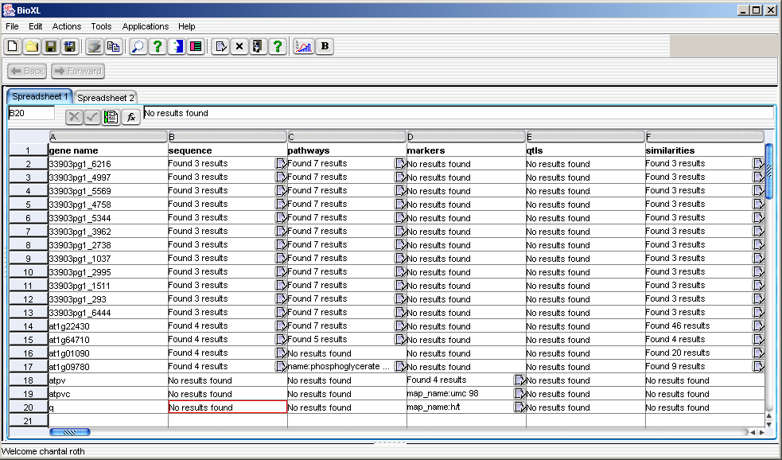
BioXL UI
BioXL integrates data types and results of complex searches in one single spreadsheet. It can update itself automatically as the data in the cells changes.

Slide 25
BioXL UI
Summary of Functionality
Excel like user-interface that allows the manipulation of data using formulas
Formulas can contain references to other cells (as in Excel)
Example: =abs(c3)
Formulas can contain formulas as arguments
Example: =translate(complement(a5))
Supports not only scalars but also lists within cells:
Example: a query may return many results
Whenever lists are returned, the user can select subsets
Example: user selects a subset of blast results to be used in further processing
Spreadsheet can be stored in the database where it can be shared with other users
Data can be exported to .csv files and used in Excel or other applications
Function wizards (as in Excel) allows users to easily pick functions and arguments

Slide 26
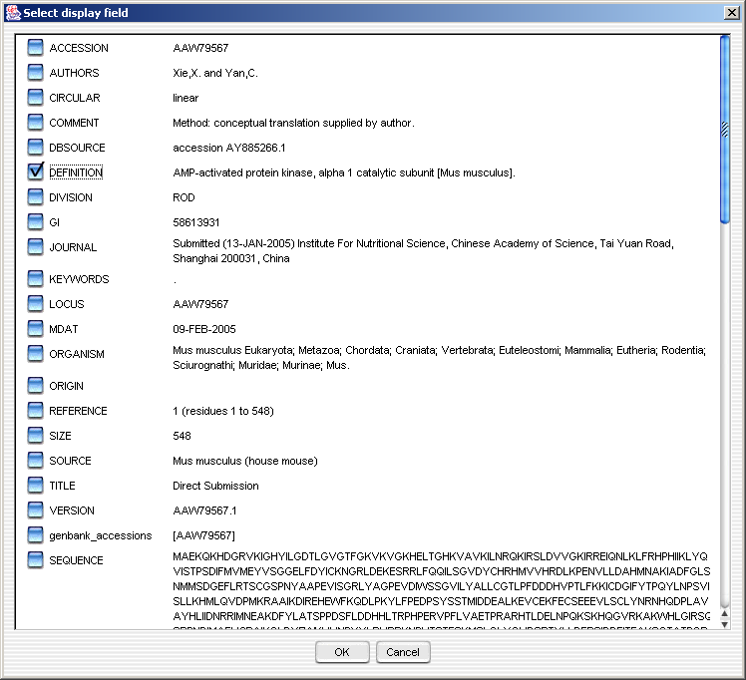
BioXL UI
View the components in a public DB, select the ones to display in BioXL

Slide 27
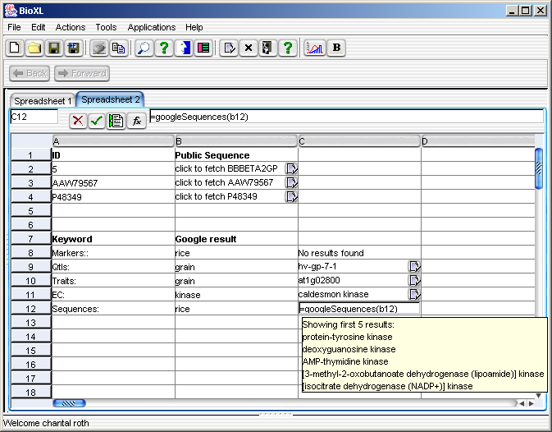
BioXL UI

Slide 28
Symphony Client Architecture
Client PC
Applications
Utilities/Frameworks
X
M
L
Discovery
Search
Graphics
Framework
Threading
Framework
Object
Pool
XML
Framework
Graph
Framework
X
M
L
Feature
Viewer
X
M
L
BioXL
Server Services
Request
Handler
Communication
Control
EJB
Service
RMI
X
M
L
Chrom.
Viewer
Application
Registry
Save
Service
X
M
L
Analysis
Server
Events
Events
Communic.
Service
Servlet
Service
SER
Event
Manager
Login
Component
XML
X
M
L
Pathways
Direct
Request
Service
MC
Logging
Manager
X
M
L
Discovery
Lab
Events
X
M
L
Ontologies
Gui Services
Print
Service
Export
Service
Undo
Manager
Preferences
Manager
Import
Service
X
M
L
Statistics
GUI
GUI
GUI
GUI

Slide 29
What real problems are distributed research groups facing
Communication:
  Different requirements/forms
  Different terms and units,
  no controlled vocabulary
Monitoring/Tracking
  No process and workflow monitoring
  No access to real-time data
  Sample tracking difficult

Slide 30

What problems are distributed research groups facing
Paper forms:
  Not all data is electronic -> inefficient, forms can get lost
  Writing reports is a lot of work
Excel Data Entry errors:
  Unit mix-up: mg/g/kg (small scale/ large scale fermentation)
  Values out of range (pH 144 because of typing error)
  Missing values
Data Analysis is difficult:
  Data is in excel sheets
  Different groups enter different types of data
  Different users/groups use different terms
  Paper forms must be found and entered into the computer

Slide 31
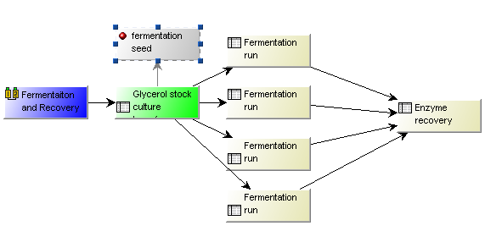
Real workflows and processes
Example: Fermentation and Recovery

Slide 32
How can DiscoveryLab help with these problems?
Tracking/Monitoring
  All data is electronic and can be tracked
  Workflow and process monitoring
Handover
  System allows different forms and unit scales (mg->kg)
  Language support:fields and user interface can be in Spanish, French, German, English or any other language
Real-time Data Access

Slide 33
How can DiscoveryLab help with current problems?
Reducing Data Entry errors:
  Values can have units, ranges (pH 0 -14) or predefined values
  Fields can be required
  Roles/Security: only certain users can enter/change data
  Formulas compute values automatically
Enabling Data Analysis while allowing group individuality:
  Different groups may use different fields and units
  Different users/groups can use different terms (synonyms/languages)
  Supports multiple languages at the same time
Improving Work Environment Efficiency:
  Workflows are well defined (who is supposed to do what, when, how)
  Notification when a step is completed
  Report generation

Slide 34
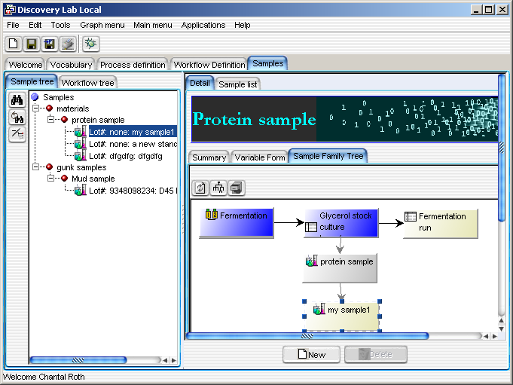
How can DiscoveryLab help with these problems?
Sample Tracking:
  Define any sample (protein sample, gunk sample)
  Track provenance: Who created it? How? When? Where is the sample?
  View a “family tree” of sample

Slide 35
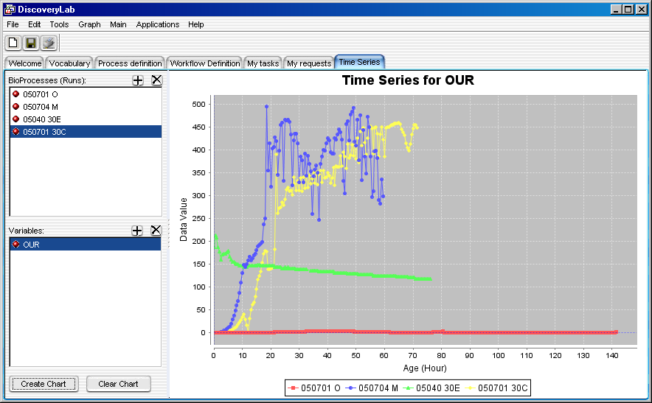
Real-time data analysis from different experiments

Slide 36
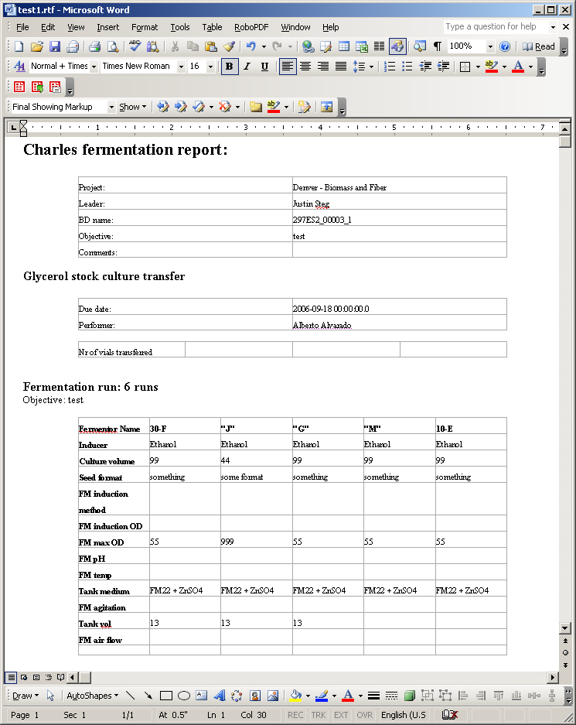
Report generation

Slide 37


Additional features that help with efficiency
Forms can be filled out automatically based on other similar forms
Steps can be repeated – supports multiple graph types:
Users can choose their preferred and most efficient way to enter data
(form or tabular view)
Any forms can be exported to Excel and Word
Formulas allow the automatic computation of fields. Example:
[1,2-DAG] + [2,3-DAG]

Slide 38

How can you define a new process/workflow?
1. What processes/assays/forms do you use?
      Examples: fermentation run, oil analysis,
      shipping a sample, cooking lasagna

Slide 39
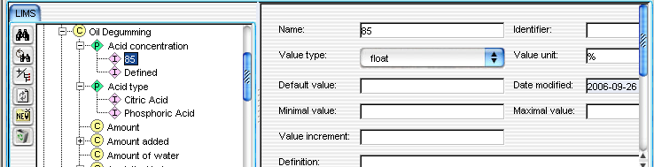
2. What terms/fields do you use to describe this process?
Examples: fermentation speed, OD, temperature, Ca content, FedEx number, oven temperature, cooking time etc
How can you define a new process/workflow?

Slide 40

How can you define a new process/workflow?
  3. Create a workflow with these processes
  Examples: fermentation/recovery workflow, oil processing workflow, shipping workflow, lasagna cooking workflow

Slide 41
Going Forward
Our Goal: Create a small group of dedicated users
Who will provide the critical mass necessary to give this platform legs in the open source community.
The more people and groups use it, the more useful the system becomes
Questions?

Slide 42
We Need YOU!
Suggest features you need at customerservice@ngbw.org
Let us know is you are interested in open source Symphony software at customerservice@ngbw.org

Slide 43
Who Did the Work?
Symphony Developers: Chantal Roth Mick Noordewier

