Slide 1
PBL Presentation
Cancer Cell Nuclei Segmentation Using openCV
Presented By
Under the guidance of
----------------------
Prof. CHANDRASHEKHAR KT
Mr. AKASH NIRAJ USN:1BY19IS016
Mr. DEEPAK SINGH USN:1BY19IS048
Mr. AMIT SHARMA USN:1BY19IS023
Ms. DIKSHA PUJAN SINGH USN:1BY19IS053
30-10-2019

Slide 2
CONTENTS
Introduction
Motivation
Literature Survey (if any)
Existing System
Proposed System
Problem Statement
Relevance to Society/Industry
Project Schedule and Budget
Tools Used (Software/Hardware)
Methodology (Use case/DFD/Flow Diagram)
Results(Screenshots)
Conclusion
Any certified course done provide certificate
References

Slide 3
INTRODUCTION
The segmentation of images plays a key role in practical applications of MRI.
Image segmentation is a process that partitions an image into its constituent regions or objects.
Various image segmentation algorithms have been proposed to achieve efficient and accurate results.
Among these algorithms, watershed segmentation is a particularly useful method. Watersheds are a classic technique in the field of topography and have long been considered a useful tool in image segmentation.

Slide 4
MOTIVATION
Early detection of a tumour at an early stage is the key to improved chances of successful treatment.
It also improves patient survival rates significantly.
In most hospitals, radiologists perform the diagnosis of a breast tumour manually on mammographic or other radiological images, which is a time consuming and error prone process due to the small sizes and various shapes of lesions.
And these manual images are affected by the presence of low contrast and unclear boundaries between surrounding normal tissues. It has been observed that even experienced radiologists miss 10–30% of cancers during routine screening in manual diagnosis.
Automated segmentation of the the tumor from the root is thus very much necessary in order to the calculate the area affected by the tumor.

Slide 5
Literature Survey:
AUTOMATIC SEGMENTATION IN BREAST CANCER USING WATERSHED ALGORITHM Hanan Alshanbari1 , Saad Amain1 , James Shuttelworth1 ,Khaled Slman2 and Shadi Muslam2 1 Faculty of Engineering and Computing, Coventry University 2King Abdullah Medical City (KAMC), Saudi Arabia
An Improved Approach for Breast Cancer Detection in Mammogram based on Watershed Segmentation BY RESEARCHGATE JOURNAL.

Slide 6
EXISTING SYSTEMS
The existing method used in segmenting cancer cells is granulometry.
It gives us information about different size distribution corresponding to the different cells present in the image.
After granulometry, there is manual segmentation of the image by the radiologists.
However, the accuracy rate of granulometry is highly dependent on cell overlapping.
For objects containing highly overlapped cells, the method fails to accurately measure the size of the components and even the accuraccy of the radiologists is 70-80% and it consumes more time.

Slide 7
PROPOSED SYSTEM
We will be using the Watershed Segmentation algorithm which has many applications and is quite useful for segmenting overlapping objects.
The project uses both OTSU binarization and Watershed to threshold and segment the cell nuclei from the tissues.
The system will be used in order to eliminate non tumor cells distinguished by their small size and irregular shape compared to tumor cells.
The markers are then extracted using the maximum on the distance function of the resulted image. Finally, we apply the watershed algorithm.
The proposed method is simple and efficient.

Slide 8
PROBLEM DESCRIPTION
The algorithm was separated into three major sections: pre-processing, watershed and post processing.
During pre-processing, the MRI is subjected to median filtering for meaningful segmentation and applied with dyes so that the cells can be diiferentiated with the nuclei.
This is followed by image rotation for the orientation and identification of the affected muscles.
The image shows that the cell wall is green and the nuclei is blue as they have been dyed with DAPI to make segmentation easier as one only needs to extract the Blue Channel from RGB(THRESOLDING

Slide 9
After this we have to dialate the image to 10 times to make a clear difference between the black background and the cell margins.
In the watershed section, a filter is applied to approximate a gradient map of the image.
Post-processing section means after applying the watershed
algorithm we need to mask the original image with the constraints and recombine the image.

Slide 10
RELEVANCE TO SOCIETY/INDUSTRY
With respect to the manual segmentation of the tumor cells, the system we are making will be a more accurate and automated one and will reduce time to catch the affected cells.
It will also be a more efficient system with respect to granulometry.
The segmented image classification will give a wide overview of the affected cells so that the tumor can be cured from the root.

Slide 11
Cost estimation:
As the project is based on software, mostly the cost is used in testing and the hardware required to run the proposed system.

Slide 12
PROJECT SCHEDULE
At first, we had no knowledge about PYTHON language so we learnt python first.
Then we learnt about OPENCV and its various real world applications.
Then we learnt how OPENCV can be used in image segmentation process.
Then we got to know how NumPy library can be used with python
language to perform operations on array matrices and combining
it with OPENCV.

Slide 13
TOOLS USED
HARDWARE
System : core i5. (Recommended)
Hard Disk : 10 GB
Mouse : In-built
Ram : : 8 GB
SOFTWARE
Operating system : Linux (Distro: Ubuntu)
Software Tool : VSCODE
Coding Language : Python3
Toolbox : OPENCV,NUMPY,MATPLOTLIB

Slide 14
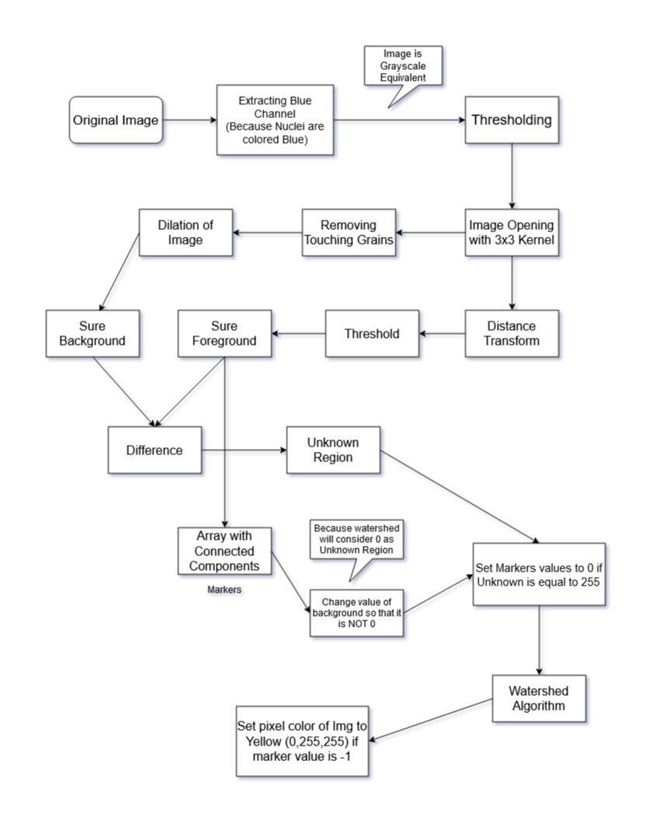
METHODOLOGY
30-10-2019

Slide 15
IMPLEMENTATION
import cv2
import numpy as np
from matplotlib import pyplot as plt
from scipy import ndimage
from skimage import measure, color, io
img = cv2.imread("Osteosarcoma_01.tif")
cv2.imshow('REAL',img)
cells=img[:,:,0] #Blue channel. Image equivalent to grey image.
#The entire background pixels is given value 0.
#This means watershed considers this region as unknown.
#So let us add 10 to all labels so that sure background is not 0, but 10
markers = markers+10
#Marked the region of unknown with zero
markers[unknown==255] = 0
plt.imshow(markers, cmap='jet') the 3 distinct regions.
plt.imsave('Markers.jpg',markers)
#Now we are ready for watershed filling.
markers = cv2.watershed(img,markers)
30-10-2019

Slide 16
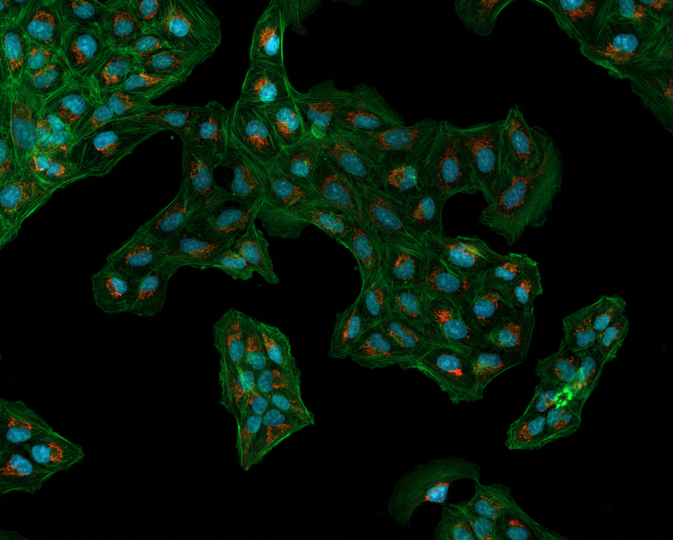
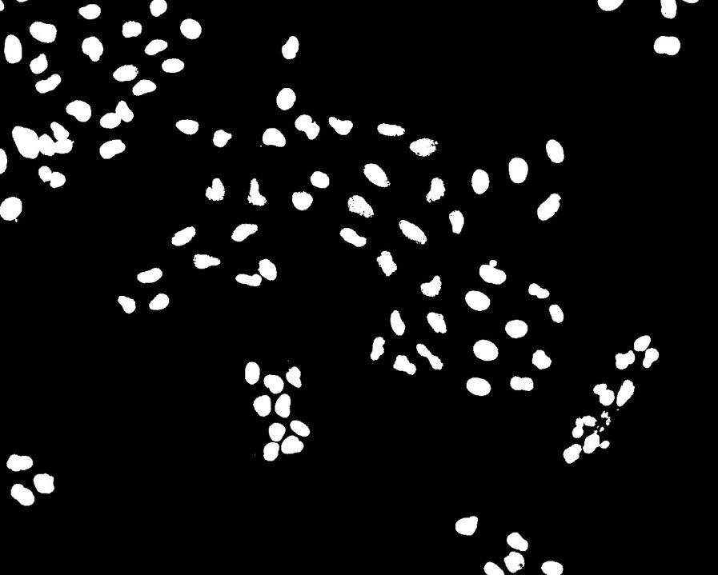
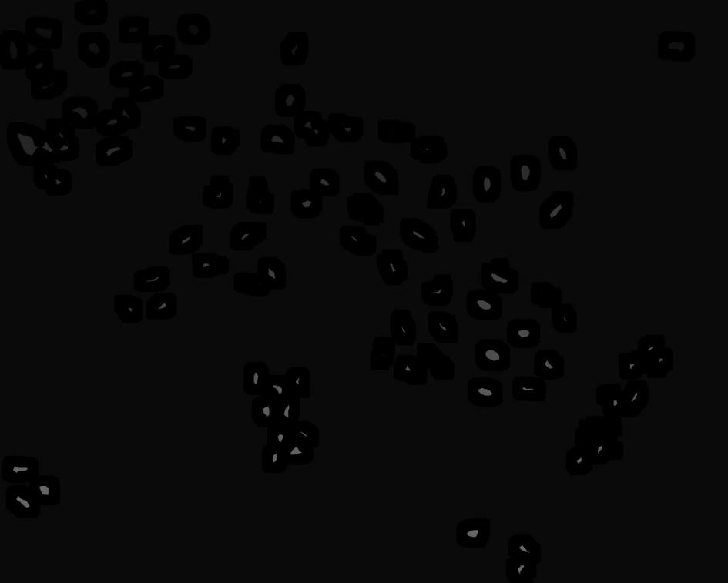
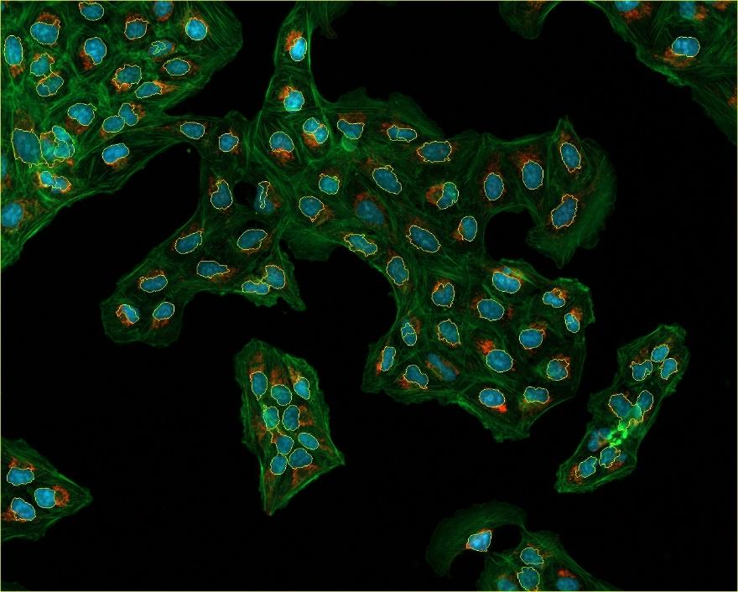
RESULTS
a
.
ORIGINAL IMAGE THRESOLDING IMAGE AND APPLYING WATERSHED
REMOVING BLUE CHANNEL ALGORITHM
RESULTING IMAGE AFTER GETTING BACK THE CHANNELS
30-10-2019

Slide 17
CONCLUSION
The results of MRI segmentation using the watershed algorithm are satisfactory and this can be a beneficial tool for the early detection of cancer.
The study showed that the automatic results correctly agree with the manual detection.
The system is also beneficial as compared to the granulometry as overlapped images are 99% taken care of.
This automated image segmentation of cancer cells are highly efficient and less time consuming as compared to manual segmentation by the radiologists.
.
30-10-2019

Slide 18
FUTURE ENHANCEMENT
In future we will segment images of not only the cancer cells and tumor but different cell behaviours and changes due to different diseases and will change algorithms according to the same.
Like what changes and behaviours happen during cell inflammation we will see and will decide algorithm for it.
We will be using MACHINE LEARNING later through which we get a better algorithm so that we can separate the cells with great ease.
.
30-10-2019

Slide 19
REFERENCES
AUTOMATIC SEGMENTATION IN BREAST CANCER USING WATERSHED ALGORITHM Hanan Alshanbari1 , Saad Amain1 , James Shuttelworth1 ,Khaled Slman2 and Shadi Muslam2 1 Faculty of Engineering and Computing, Coventry University 2King Abdullah Medical City (KAMC), Saudi Arabia
https://ieeexplore.ieee.org/document/8217793/
An Improved Approach for Breast Cancer Detection in Mammogram based on Watershed Segmentation BY RESEARCHGATE JOURNAL.
.
30-10-2019

Slide 20
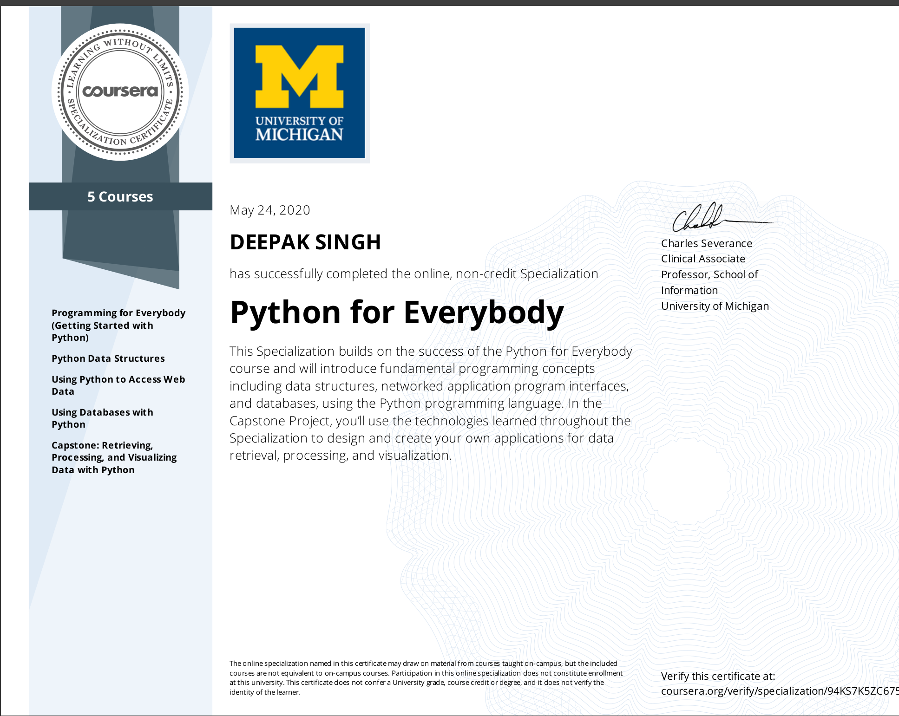
Certificates:

