Slide 1




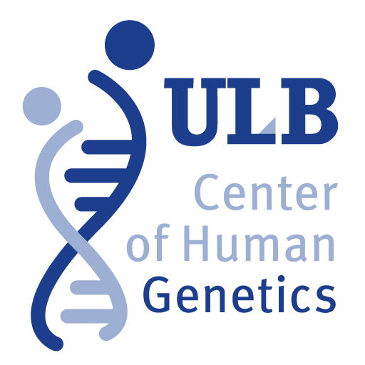

Novel promoters and coding first exons in DLG2 linked to developmental disorders and intellectual disability
Claudio Reggiani
Université Libre de Bruxelles, Bruxelles, Belgium
Interuniversity Institute of Bioinformatics in Brussels, Bruxelles, Belgium
Online Journal Club
September 22, 2017
1

Slide 3
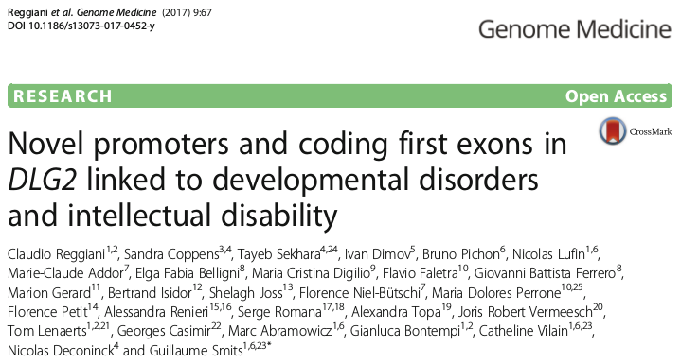

Slide 4
Biology

Slide 5
Computer
science
Biology

Slide 6
Computer
science
Biology
Clinics

Slide 7
Computer
science
Biology
Clinics

Slide 8
Computer
science
Biology
Clinics

Slide 9
Computer
science
Biology
Clinics

Slide 10
Background
(biology)

Slide 11

Gene model and isoforms
gene

Slide 12
Gene model and isoforms
gene
Introns
Exons
DNA
1
2
3
4
5
Transcription
RNA
1
2
3
4
5
Translation
Protein

Slide 13
Gene model and isoforms
gene
TSS
Introns
Exons
DNA
1
2
3
4
5
Transcription
RNA
1
2
3
4
5
Translation
Protein

Slide 14
Gene model and isoforms
gene
TSS
Introns
Exons
DNA
1
2
3
4
5
Transcription
RNA
1
2
3
4
5
Translation
3
4
5
Protein
Isoform 1
Isoform 2

Slide 15
Gene model and isoforms
gene
TSS
Introns
Exons
DNA
1
2
3
4
5
Transcription
RNA
1
2
3
4
5
Translation
3
4
5
Protein
Isoform 1
Isoform 2

Slide 16
Gene model and isoforms
gene
TSS
Introns
Exons
DNA
1
2
3
4
5
Transcription
RNA
1
2
3
4
5
Translation
3
4
5
Protein
Isoform 1
Isoform 2

Slide 17
Gene model and isoforms
Protein
Isoform 1
Isoform 2

Slide 18
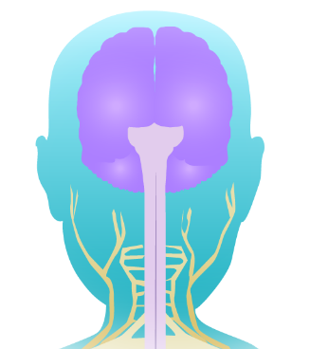
Gene model and isoforms
Protein
Isoform 1
Isoform 2

Slide 19
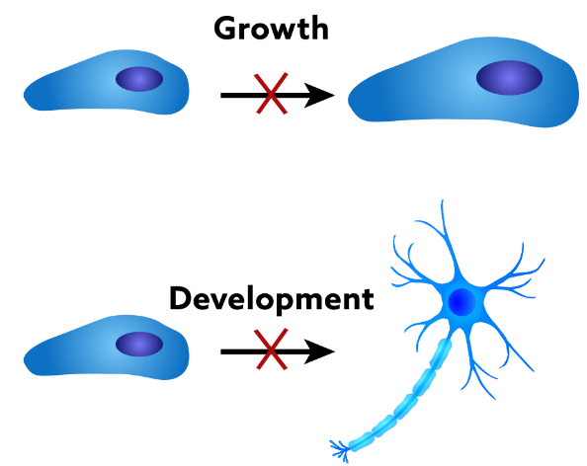
Gene model and isoforms
Protein
Isoform 1
Isoform 2

Slide 20
Promoter regions
TSS
Introns
Exons
DNA
1
2
3
4
5

Slide 21
Promoter regions
TSS
Introns
Exons
DNA
1
2
3
4
5

Slide 22
Promoter regions
TSS
Introns
Exons
DNA
1
2
3
4
5
TSS
1
Promoter region

Slide 23
Promoter regions
TSS
Introns
Exons
DNA
1
2
3
4
5
Transcription
factors (TFs)
TSS
1
Promoter region

Slide 24
Promoter regions
TSS
Introns
Exons
DNA
1
2
3
4
5
RNA Pol
(RNAP)
Transcription
factors (TFs)
TSS
1
Promoter region

Slide 25
Epigenetic mechanisms

Slide 26
Epigenetic mechanisms
Closed chromatin

Slide 27
Epigenetic mechanisms
Histone tail
Histone
Closed chromatin

Slide 28
Epigenetic mechanisms
Epigenetic factor
(H3K4me3)
Histone tail
Histone
Closed chromatin
Open chromatin

Slide 29
Epigenetic mechanisms
Epigenetic factor
(H3K4me3)
Histone tail
Histone
Closed chromatin
Open chromatin

Slide 30
Background
(clinics)

Slide 31
Copy Number Variation

Slide 32
Copy Number Variation
Reference
A
B
C
D
E
F

Slide 33
Copy Number Variation
Deletion of
‘D’ region
Reference
A
A
B
B
C
C
E
D
F
E
F

Slide 34
Copy Number Variation
Deletion of
‘D’ region
Reference
Duplication of
‘D’ region
A
A
A
B
B
B
C
C
C
E
D
D
F
E
D
F
E
F

Slide 35
Copy Number Variation
Deletion of
‘D’ region
Reference
Duplication of
‘D’ region
A
A
A
B
B
B
C
C
C
E
D
D
F
E
D
F
E
F

Slide 36
DLG2 gene

Slide 37
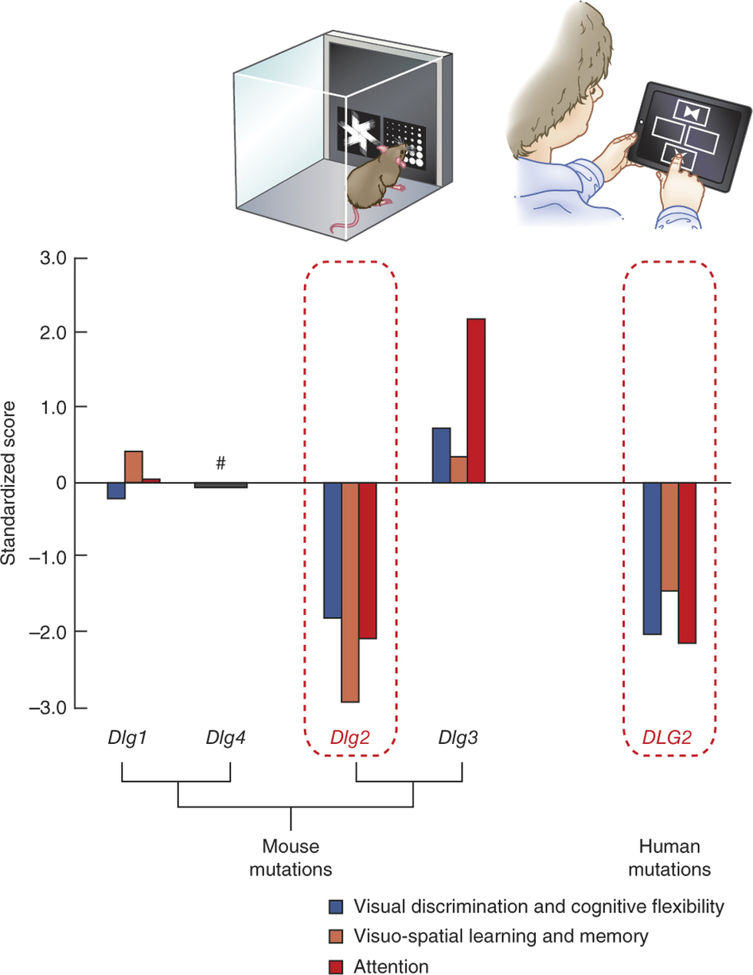
DLG2 gene
Location: 11q14.1 (2.1Mb)
Role
  complex learning
  cognitive flexibility
  attention
Nithianantharajah et al. (2013) Nature Neuroscience

Slide 38
How the investigation began

Slide 39
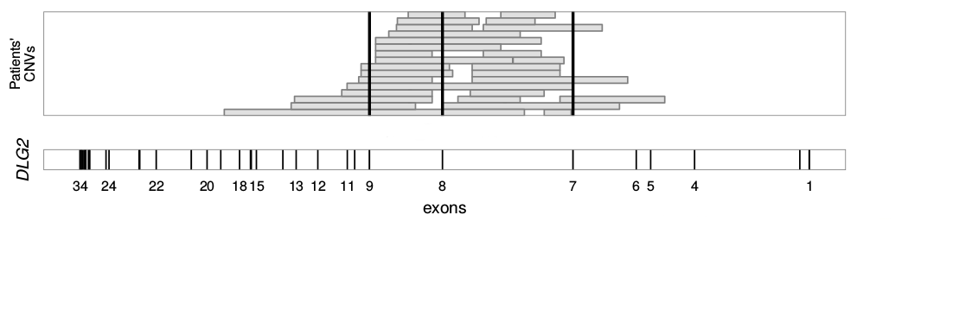
DLG2 patients

Slide 40
DLG2 patients

Slide 41



DLG2 patients

Slide 42
DLG2 patients
- 29 patients in the DLG2 7-9 region from DECIPHER, ULB, Literature

Slide 43
DLG2 patients
- 29 patients in the DLG2 7-9 region from DECIPHER, ULB, Literature
- 24 with NDD phenotypes

Slide 44
DLG2 patients
- 29 patients in the DLG2 7-9 region from DECIPHER, ULB, Literature
- 24 with NDD phenotypes
- 17/24 affect exons 7, 8 and/or 9

Slide 45
DLG2 patients
- 29 patients in the DLG2 7-9 region from DECIPHER, ULB, Literature
- 24 with NDD phenotypes
- 17/24 affect exons 7, 8 and/or 9
- 7/24 (~30%) are purely intronic deletions

Slide 46
DLG2 patients
- 29 patients in the DLG2 7-9 region from DECIPHER, ULB, Literature
- 24 with NDD phenotypes
- 17/24 affect exons 7, 8 and/or 9
- 7/24 (~30%) are purely intronic deletions
- 3/24 (12.5%) are purely intronic deletions and no other CNVs

Slide 47
DLG2 patients
- 29 patients in the DLG2 7-9 region from DECIPHER, ULB, Literature
- 24 with NDD phenotypes
- 17/24 affect exons 7, 8 and/or 9
- 7/24 (~30%) are purely intronic deletions
- 3/24 (12.5%) are purely intronic deletions and no other CNVs

Slide 48
Integrative analysis of multi-omics data

Slide 49
Integrative analysis of multi-omics data
Novel promoters and coding first exons in DLG2 linked to
developmental disorders and intellectual disability

Slide 50
Integrative analysis of multi-omics data
Novel promoters and coding first exons in DLG2 linked to
developmental disorders and intellectual disability

Slide 52


Histone Modification H3K4me3
Epigenetic factor
(H3K4me3)

Slide 53
Histone Modification H3K4me3
Transcription, RNA
Epigenetic factor
(H3K4me3)
DNA
1
2
3
4
5
RNA
1
2
3
4
5
Protein

Slide 54
Histone Modification H3K4me3
Transcription, RNA
Epigenetic factor
(H3K4me3)
DNA
1
2
3
4
5
RNA
1
2
3
4
5
Protein
Transcription Factor Binding Sites
Transcription
factors (TFs)
1

Slide 55

Histone Modification H3K4me3
Transcription, RNA
Epigenetic factor
(H3K4me3)
DNA
1
2
3
4
5
RNA
1
2
3
4
5
Protein
Transcription Factor Binding Sites
Identification of TSS (CAGE)
TSS
Transcription
factors (TFs)
DNA
1
2
3
4
5
1
RNA
1
2
3
4
5
Protein

Slide 56
Histone Modification H3K4me3
Transcription, RNA
Epigenetic factor
(H3K4me3)
DNA
1
2
3
4
5
RNA
1
2
3
4
5
Protein
Transcription Factor Binding Sites
Identification of TSS (CAGE)
TSS
Transcription
factors (TFs)
DNA
1
2
3
4
5
1
RNA
1
2
3
4
5
Protein

Slide 57
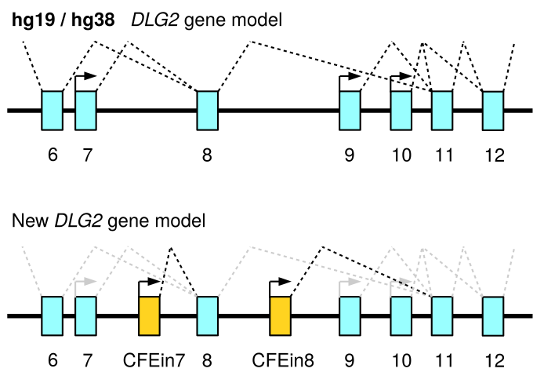
Histone Modification H3K4me3
Transcription, RNA
Epigenetic factor
(H3K4me3)
DNA
1
2
3
4
5
RNA
1
2
3
4
5
Protein
Transcription Factor Binding Sites
Identification of TSS (CAGE)
TSS
Transcription
factors (TFs)
DNA
1
2
3
4
5
1
RNA
1
2
3
4
5
Protein

Slide 58
Histone Modification H3K4me3
Transcription, RNA
Epigenetic factor
(H3K4me3)
DNA
1
2
3
4
5
RNA
1
2
3
4
5
Protein
Transcription Factor Binding Sites
Identification of TSS (CAGE)
TSS
Transcription
factors (TFs)
DNA
1
2
3
4
5
1
RNA
1
2
3
4
5
Protein

Slide 59

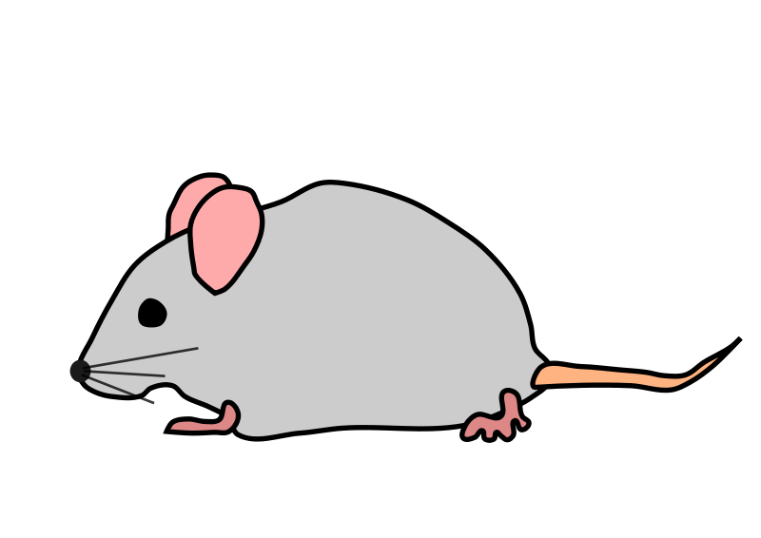
Histone Modification H3K4me3
Transcription, RNA
Epigenetic factor
(H3K4me3)
DNA
1
2
3
4
5
RNA
1
2
3
4
5
Protein
Transcription Factor Binding Sites
Identification of TSS (CAGE)
TSS
Transcription
factors (TFs)
DNA
1
2
3
4
5
1
RNA
1
2
3
4
5
Protein

Slide 60
Integrative analysis of multi-omics data
(part II)
Novel promoters and coding first exons in DLG2 linked to
developmental disorders and intellectual disability

Slide 61
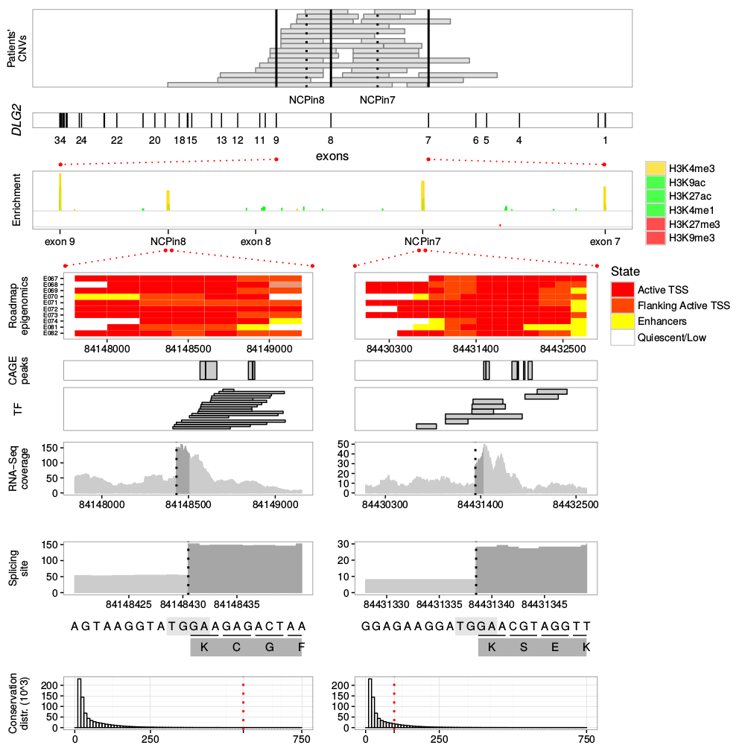
HPin8
HPin7

Slide 62

HPin8
HPin7

Slide 63
HPin8
HPin7

Slide 64
HPin8
HPin7

Slide 65
HPin8
HPin7
HPin7

Slide 66
HPin8
HPin7

Slide 67
HPin8
HPin7

Slide 68
DECIPHER
ULB
Literature
HPin8
HPin7
Roadmap
Epigenomics
FANTOM5
ENCODE
(fetal brain)

Slide 69
DECIPHER
ULB
Literature
HPin8
HPin7
Roadmap
Epigenomics
FANTOM5
ENCODE
(fetal brain)

Slide 70
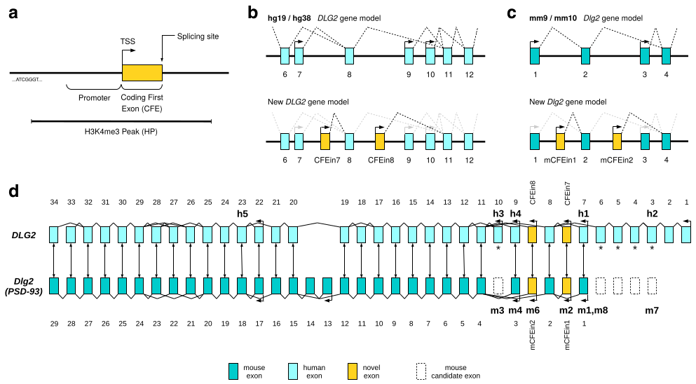

Slide 71
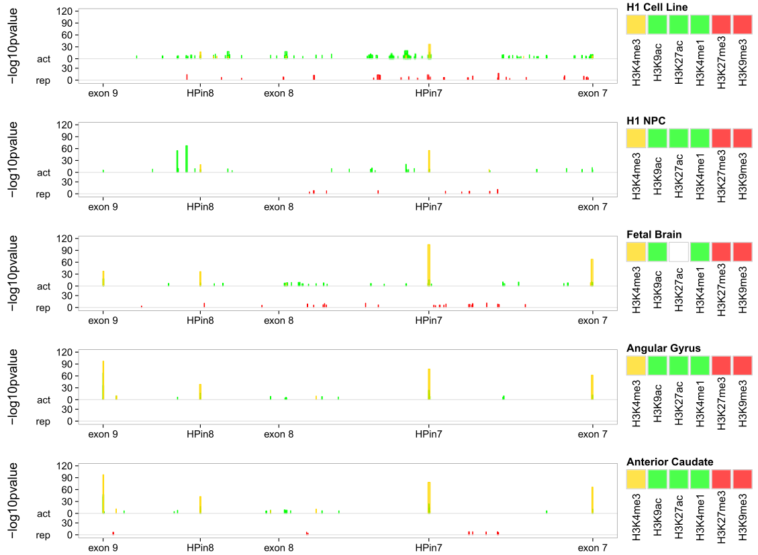

Slide 75
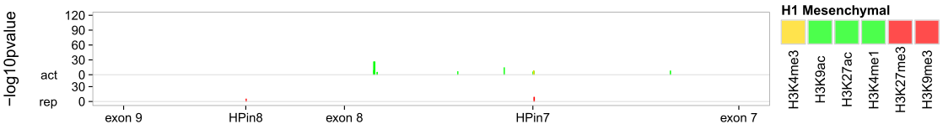

Slide 76
Statistical analysis

Slide 77
Statistical analysis
Novel promoters and coding first exons in DLG2 linked to
developmental disorders and intellectual disability

Slide 78
Statistical analysis
Novel promoters and coding first exons in DLG2 linked to
developmental disorders and intellectual disability

Slide 79
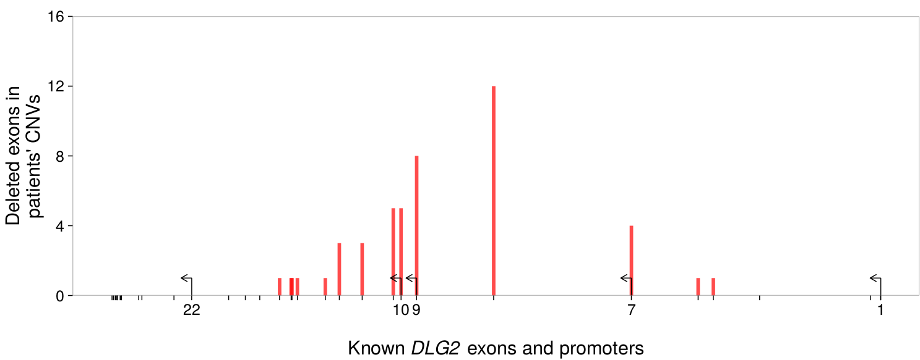
Old DLG2 gene model

Slide 80
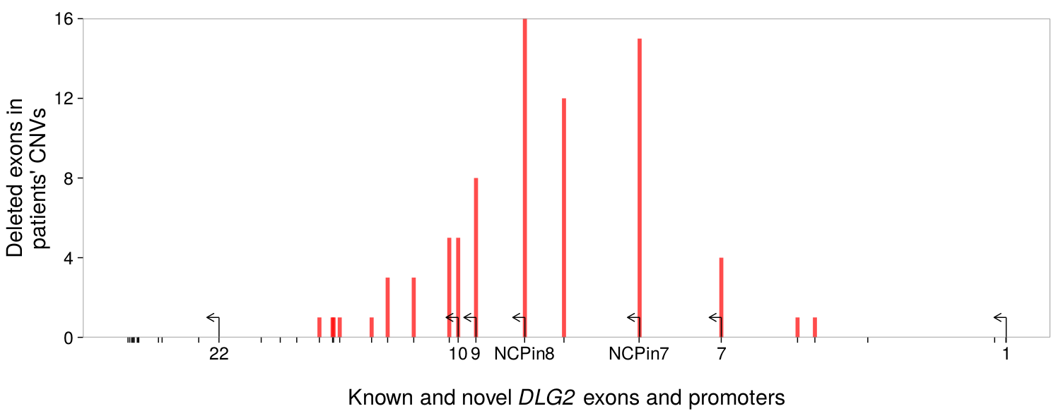
New DLG2 gene model

Slide 81
Statistical analysis
DECIPHER (cases) vs DGV (control)
  on exons 7,8,9: enrichment of cases pv. 6x10⁻⁰⁴
  on HPs: enrichment of cases, pv. 8x10⁻⁰⁷
GDD/ID cases vs GDD/ID control
  on exons 7,8,9: enrichment of cases pv. 0.38
  on NCPs: enrichment of cases, pv. 4x10⁻⁰⁴
WG analysis (DECIPHER + DGV + GDD/ID)
  11 novel promoters detected in introns
  NCPin7 and NCPin8 resulted statistical significant

Slide 82
Statistical analysis
DECIPHER (cases) vs DGV (control)
  on exons 7,8,9: enrichment of cases pv. 6x10⁻⁰⁴
  on HPs: enrichment of cases, pv. 8x10⁻⁰⁷
GDD/ID cases vs GDD/ID control
  on exons 7,8,9: enrichment of cases pv. 0.38
  on HPs: enrichment of cases, pv. 4x10⁻⁰⁴
WG analysis (DECIPHER + DGV + GDD/ID)
  11 novel promoters detected in introns
  NCPin7 and NCPin8 resulted statistical significant

Slide 83
Statistical analysis
DECIPHER (cases) vs DGV (control)
  on exons 7,8,9: enrichment of cases pv. 6x10⁻⁰⁴
  on HPs: enrichment of cases, pv. 8x10⁻⁰⁷
GDD/ID cases vs GDD/ID control
  on exons 7,8,9: enrichment of cases pv. 0.38
  on HPs: enrichment of cases, pv. 4x10⁻⁰⁴
WG analysis (DECIPHER + DGV + GDD/ID)
  11 novel promoters detected in introns
  HPin7 and HPin8 resulted statistical significant

Slide 84
Clinical considerations

Slide 85
17%
other
83% NDD
phenotypes

Slide 86
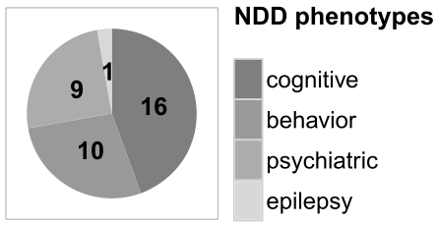
Cognitive
Behavioral
17%
other
Psychiatric
Epilepsy
83% NDD
phenotypes

Slide 87

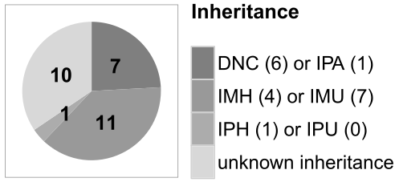
Cognitive
Behavioral
17%
other
Psychiatric
Epilepsy
Male / Female ratio = 3.7
(11 to 3, 10 unknown)
83% NDD
phenotypes

Slide 88
Cognitive
Behavioral
17%
other
Psychiatric
Epilepsy
Male / Female ratio = 3.7
(11 to 3, 10 unknown)
83% NDD
phenotypes
DLG2 HP deletion as NDD risk factor

Slide 89
Conclusions

Slide 90
Epigenetic factor
(H3K4me3)
DNA
1
2
3
4
RNA
1
2
3
4
5
Protein
Transcription
factors (TFs)
1
TSS
DNA
1
2
3
4
RNA
1
2
3
4
5
Protein

Slide 91
Epigenetic factor
(H3K4me3)
DNA
1
2
3
4
RNA
1
2
3
4
5
Protein
Transcription
factors (TFs)
1
TSS
DNA
1
2
3
4
RNA
1
2
3
4
5
Protein

Slide 92
Epigenetic factor
(H3K4me3)
DNA
1
2
3
4
RNA
1
2
3
4
5
Protein
Transcription
factors (TFs)
1
TSS
DNA
1
2
3
4
RNA
1
2
3
4
5
Protein

Slide 93
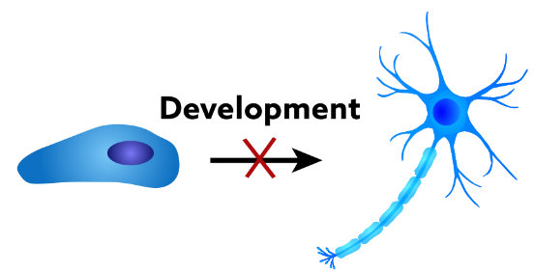
Epigenetic factor
(H3K4me3)
DNA
1
2
3
4
RNA
1
2
3
4
5
Protein
Transcription
factors (TFs)
1
TSS
DNA
1
2
3
4
RNA
1
2
3
4
5
Protein

Slide 94
Epigenetic factor
(H3K4me3)
DNA
1
2
3
4
RNA
1
2
3
4
5
Protein
Transcription
factors (TFs)
1
TSS
DNA
1
2
3
4
RNA
1
2
3
4
5
Protein

Slide 95
Epigenetic factor
(H3K4me3)
DNA
1
2
3
4
RNA
1
2
3
4
5
Protein
Transcription
factors (TFs)
1
TSS
DNA
1
2
3
4
RNA
1
2
3
4
5
DLG2 HP/CFE deletion as NDD risk factor
Protein

Slide 96

Acknowledgements
1

Slide 97
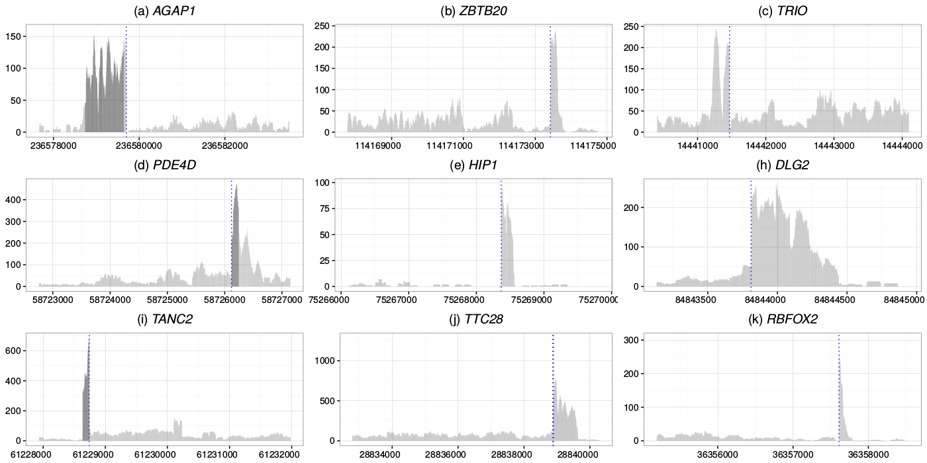
9 other candidate promoters

Slide 98
Conclusion and Future Works
Conclusions
  Identification of two novel coding promoters, NCPin7 and NCPin8, and their link to NDDs.
  NCPs isoforms are active only in fetal brain
Future Works
  Whole genome analysis

Slide 99
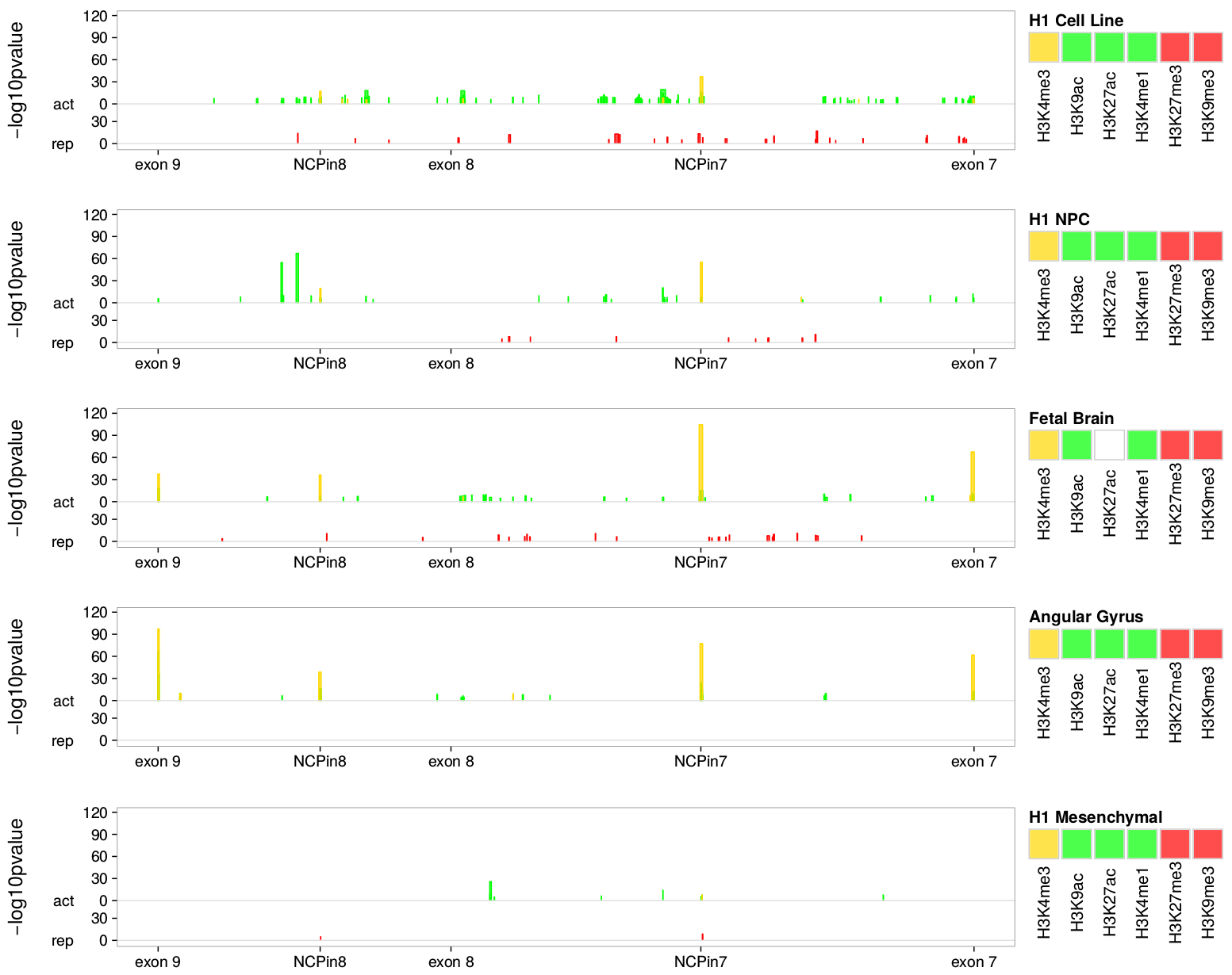
DLG2 7-9 region across “time”

Slide 100
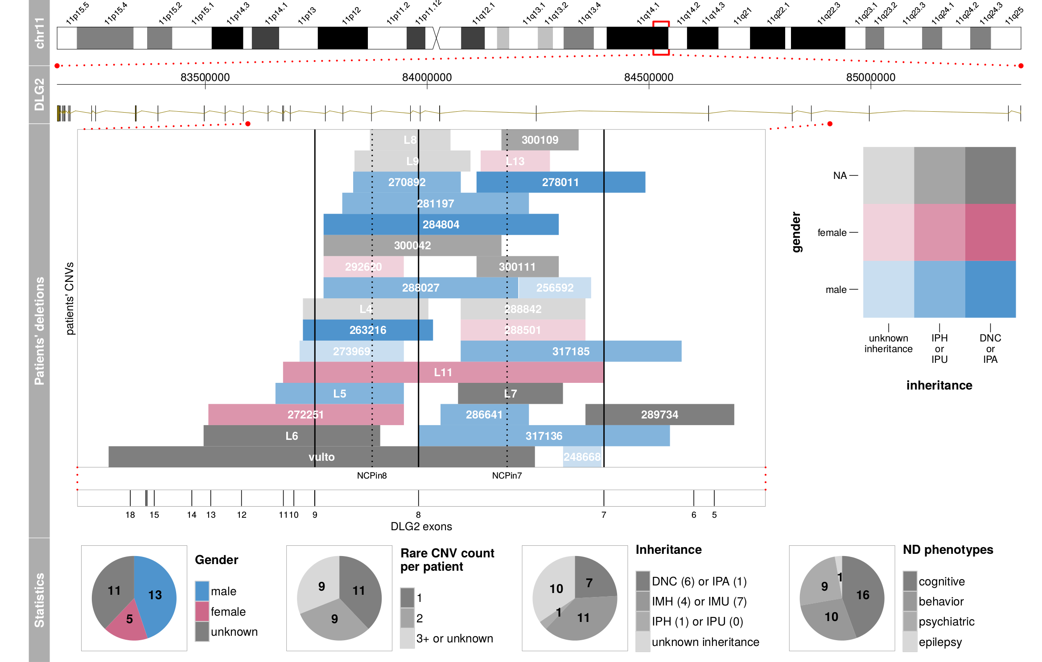
Clinical data of the 29 NDD patients

