Slide 1

Feature selection in high-dimensional
dataset using MapReduce
Claudio Reggiani
Yann-Aël Le Borgne
Gianluca Bontempi
BNAIC 2017 – November 8, 2017

Slide 2
mRMR

Slide 3
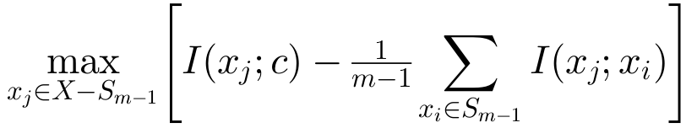
mRMR
candidate
feature j

Slide 4
mRMR
candidate
feature j
set of all
features

Slide 5
mRMR
candidate
feature j
set of selected
features
set of all
features

Slide 6
mRMR
maximal
relevance
minimal redundancy
candidate
feature j
set of selected
features
set of all
features

Slide 7
mRMR
maximal
relevance
minimal redundancy
candidate
feature j
set of selected
features
set of all
features

Slide 8
mRMR
maximal
relevance
minimal redundancy
candidate
feature j
set of selected
features
set of all
features

Slide 9
mRMR
maximal
relevance
minimal redundancy
candidate
feature j
set of selected
features
mutual
information
(descrete values)
set of all
features

Slide 10
mRMR
maximal
relevance
minimal redundancy
candidate
feature j
set of selected
features
mutual
information
(descrete values)
set of all
features

Slide 11
mRMR
maximal
relevance
minimal redundancy
candidate
feature j
set of selected
features
cardinality
of selected
features set
mutual
information
(descrete values)
set of all
features

Slide 12
How do we cope with high-dimensional datasets?

Slide 13
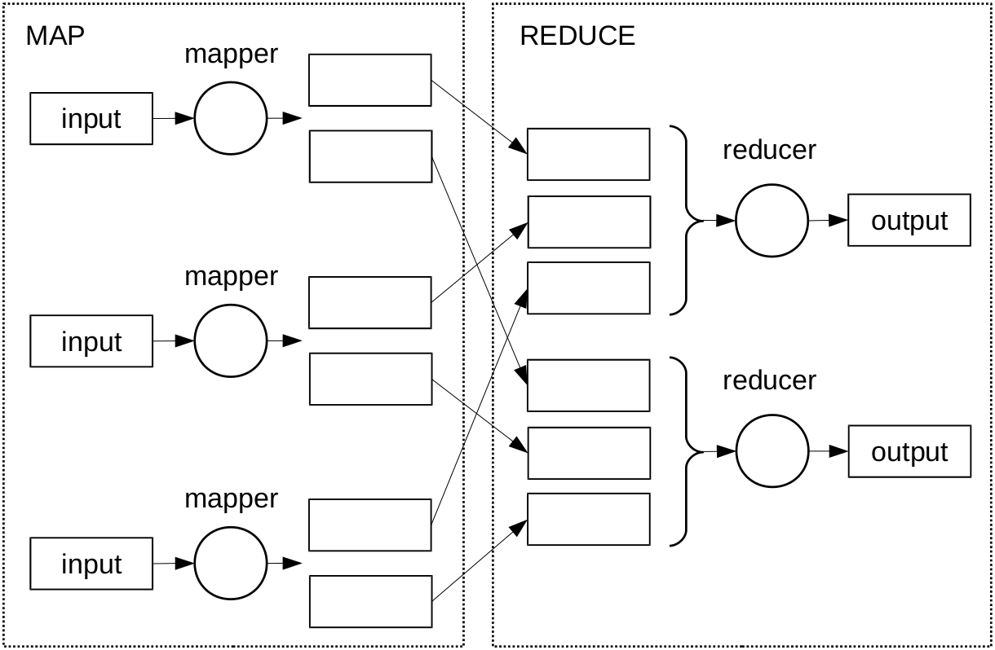
Brief introduction to MapReduce

Slide 14
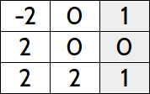
Brief introduction to MapReduce
1
2

Slide 15
Brief introduction to MapReduce
1
2

Slide 16
Brief introduction to MapReduce
1, (-2, 1)
1
2

Slide 17
Brief introduction to MapReduce
1, (-2, 1)
2, (0, 1)
1
2

Slide 18
Brief introduction to MapReduce
1, (-2, 1)
2, (0, 1)
1
2
1, (2, 0)

Slide 19
Brief introduction to MapReduce
1, (-2, 1)
2, (0, 1)
1
2
1, (2, 0)
2, (0, 0)

Slide 20
Brief introduction to MapReduce
1, (-2, 1)
2, (0, 1)
1
2
1, (2, 0)
2, (0, 0)
1, (2, 1)

Slide 21
Brief introduction to MapReduce
1, (-2, 1)
2, (0, 1)
1
2
1, (2, 0)
2, (0, 0)
1, (2, 1)
2, (2, 1)

Slide 22
Brief introduction to MapReduce
1, (-2, 1)
2, (0, 1)
1, (-2, 1)
1
2
1, (2, 0)
1, (2, 0)
1, (2, 1)
2, (0, 0)
2, (0, 1)
2, (0, 0)
1, (2, 1)
2, (2, 1)
2, (2, 1)

Slide 23
Brief introduction to MapReduce
1, (-2, 1)
2, (0, 1)
1, (-2, 1)
1
2
1, (2, 0)
1, MI₁
1, (2, 0)
1, (2, 1)
2, (0, 0)
2, (0, 1)
2, (0, 0)
2, MI₂
1, (2, 1)
2, (2, 1)
2, (2, 1)

Slide 24

Brief introduction to MapReduce
1, (-2, 1)
2, (0, 1)
1, (-2, 1)
1
2
1, (2, 0)
1, MI₁
1, (2, 0)
1, (2, 1)
2, (0, 0)
2, (0, 1)
2, (0, 0)
2, MI₂
1, (2, 1)
2, (2, 1)
2, (2, 1)

Slide 25
Brief introduction to MapReduce
...
Notes:
- combiner is a good solution, but
- this data structure is not designed to be cumulative

Slide 26
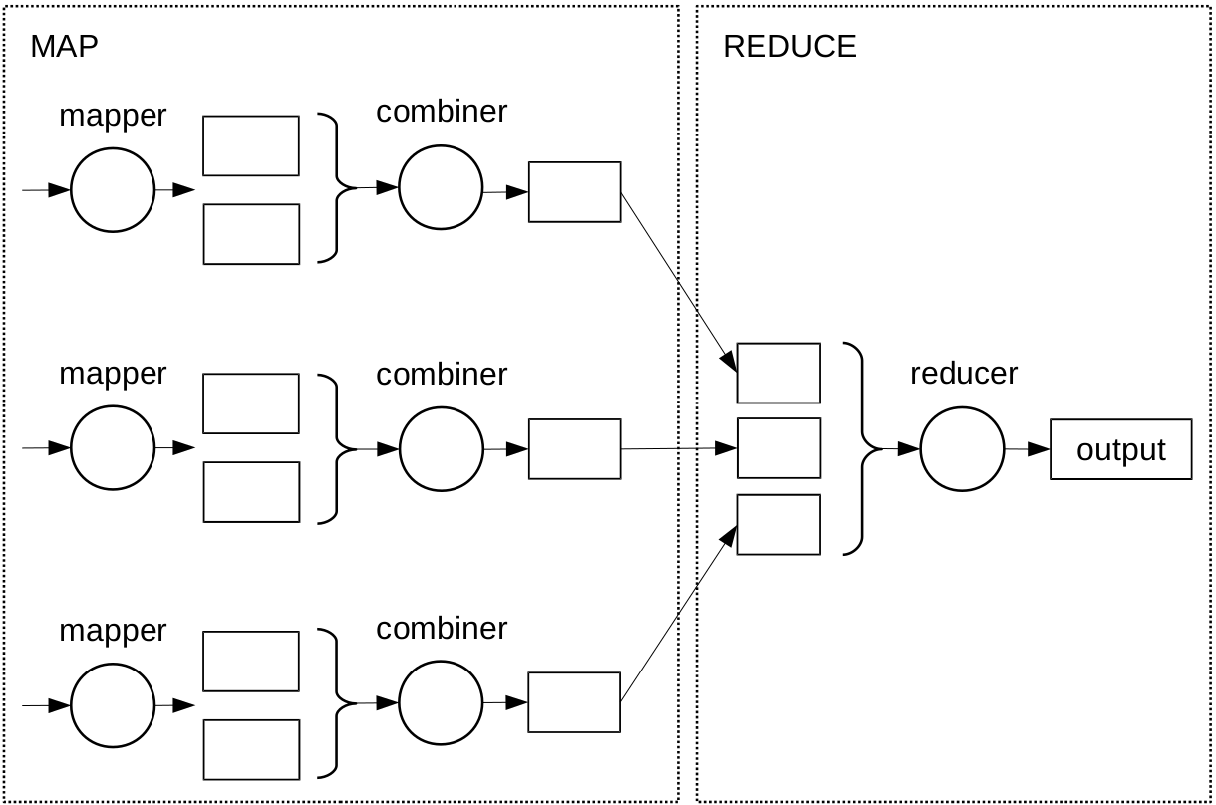
Brief introduction to MapReduce
...
Notes:
- combiner is a good solution, but
- this data structure is not designed to be cumulative

Slide 27
Brief introduction to MapReduce
...
Notes:
- combiner is a good solution, but
- this data structure is not designed to be cumulative

Slide 28
Brief introduction to MapReduce
1, (-2, 1)
1, (-2, 1)
1, (-2, 1)
1, (-2, 1)
...
Notes:
- combiner is a good solution, but
- this data structure is not designed to be cumulative

Slide 29

Brief introduction to MapReduce
1, (-2, 1)
1, (-2, 1)
1, (-2, 1)
1, (-2, 1)
...
Notes:
- combiner is a good solution, but
- this data structure is not designed to be cumulative

Slide 30
Data structure with cumulative property

Slide 31

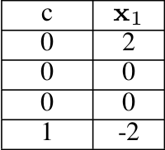
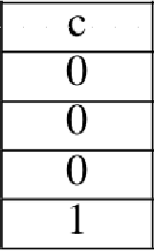
Data structure with cumulative property

Slide 32
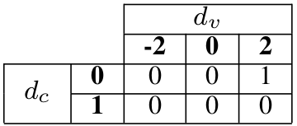
Data structure with cumulative property
categories
of the feature
categories
of the class

Slide 33
Data structure with cumulative property

Slide 34
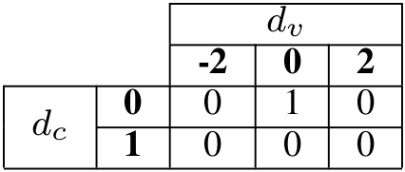
Data structure with cumulative property

Slide 35
Data structure with cumulative property

Slide 36
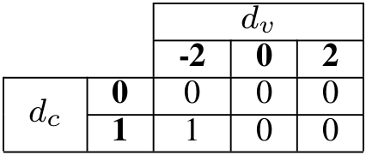
Data structure with cumulative property

Slide 37
Data structure with cumulative property

Slide 38
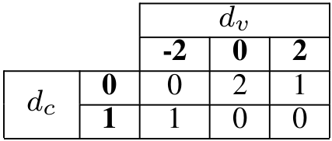
Data structure with cumulative property

Slide 39
Data structure with cumulative property
Notes:
- further optimization is the encoding and decoding of sparse data.

Slide 40
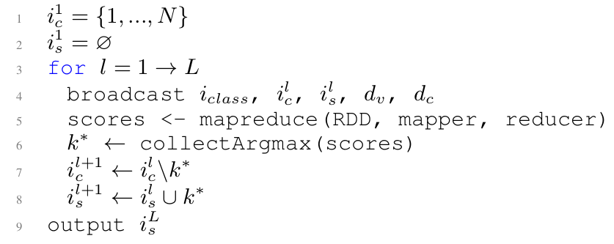
mRMR in MapReduce

Slide 41
mRMR in MapReduce

Slide 42
mRMR in MapReduce

Slide 43
mRMR in MapReduce

Slide 44
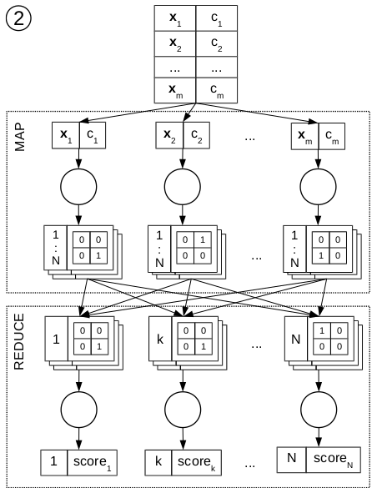
mRMR in MapReduce

Slide 45
mRMR in MapReduce

Slide 46
mRMR in MapReduce

Slide 47
mRMR in MapReduce

Slide 48
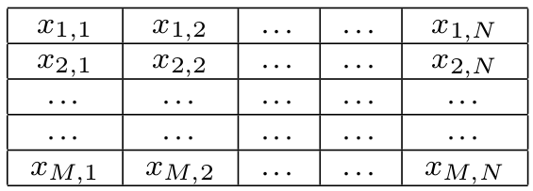
mRMR in MapReduce, alternative layout

Slide 49
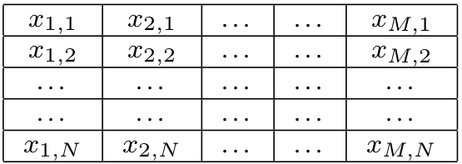
mRMR in MapReduce, alternative layout

Slide 50
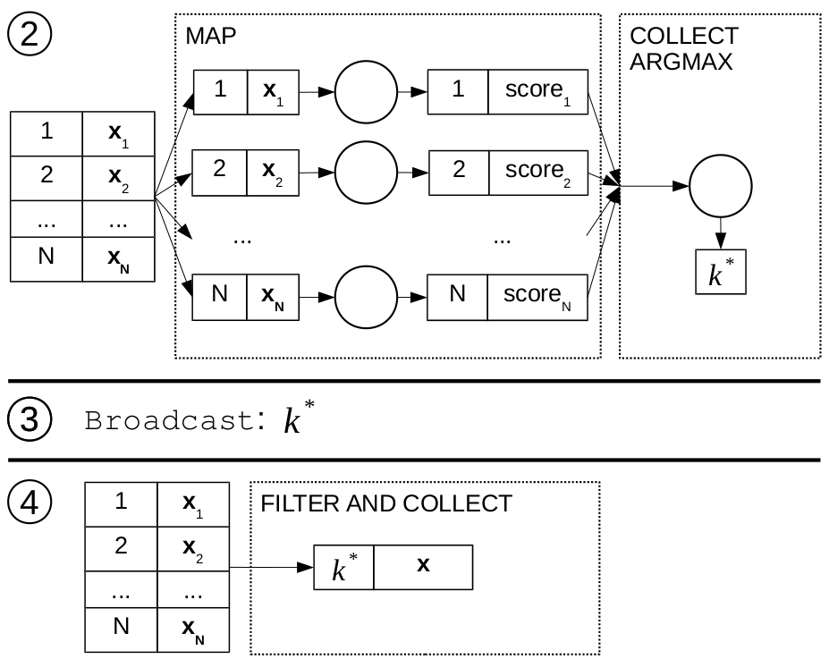
mRMR in MapReduce, alternative layout

Slide 51
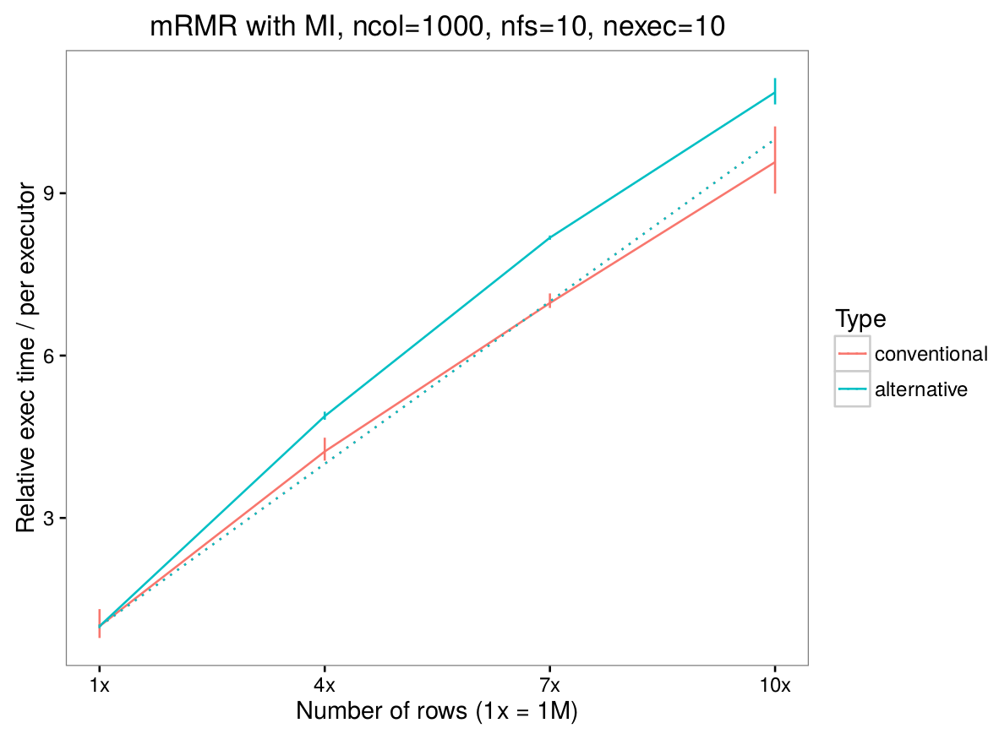
Scalability: #rows

Slide 52
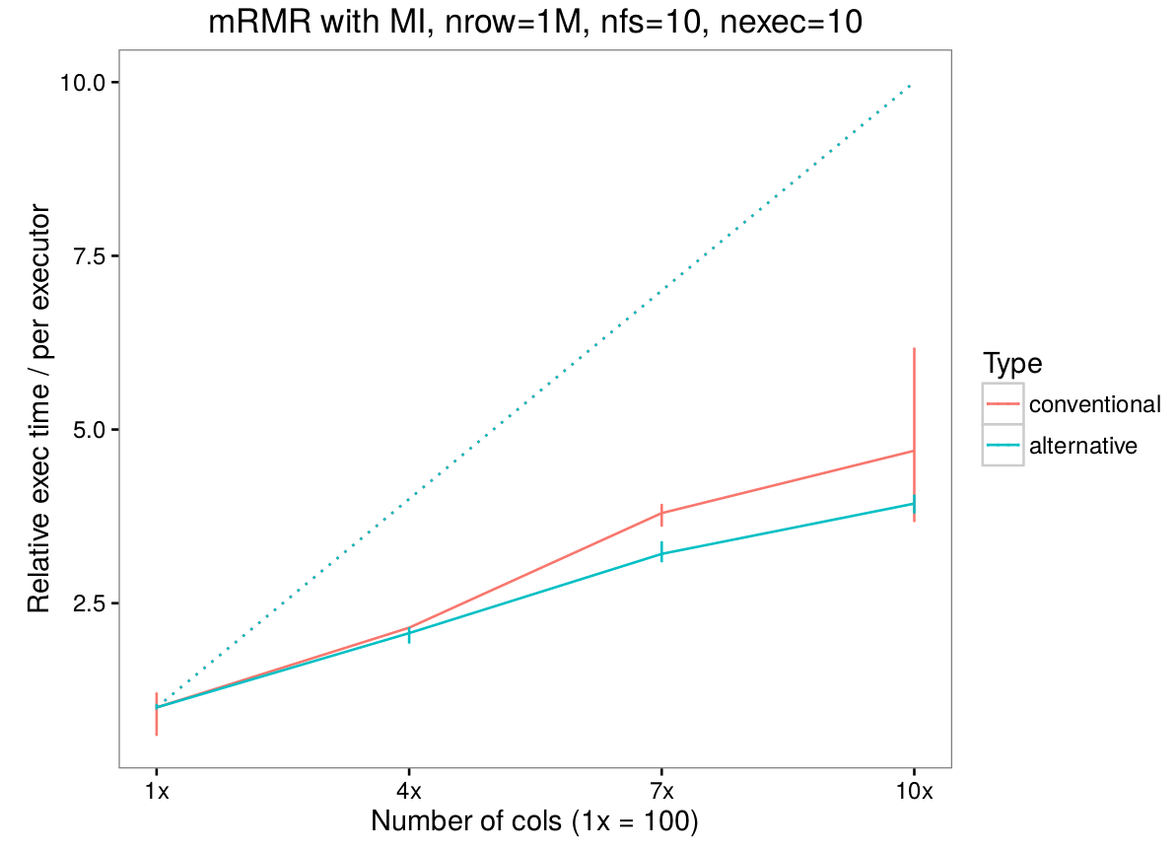
Scalability: #columns

Slide 53
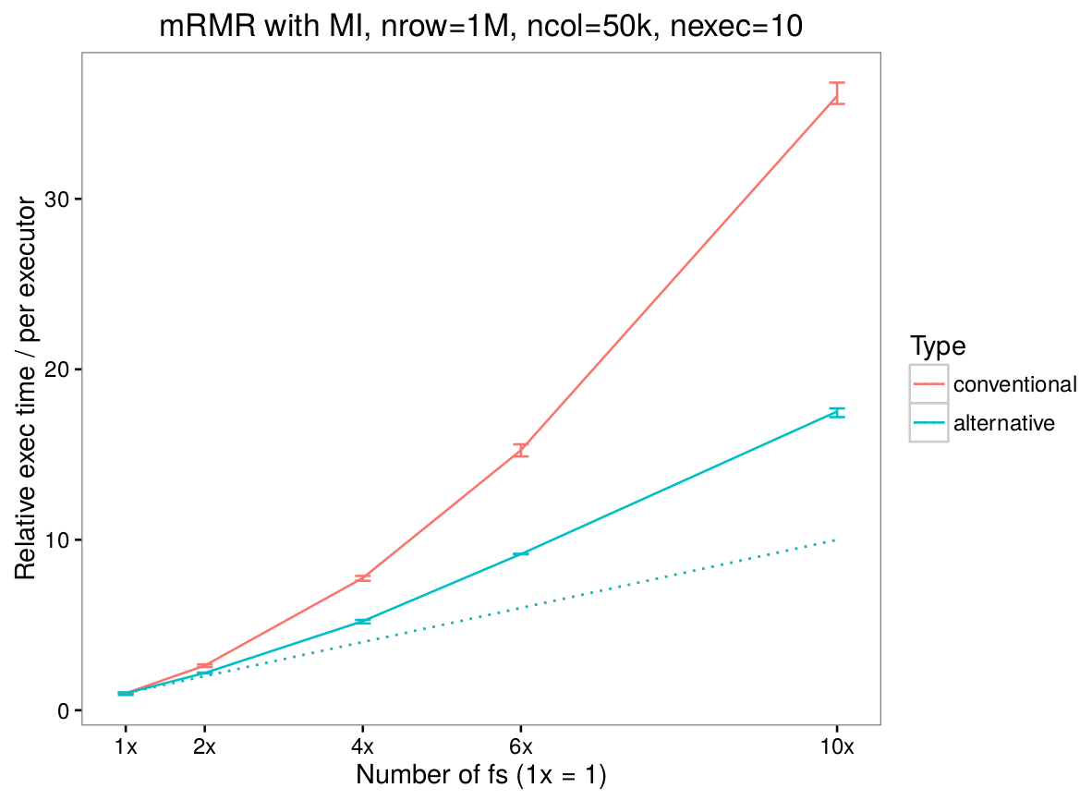
Scalability: #selected features

Slide 54
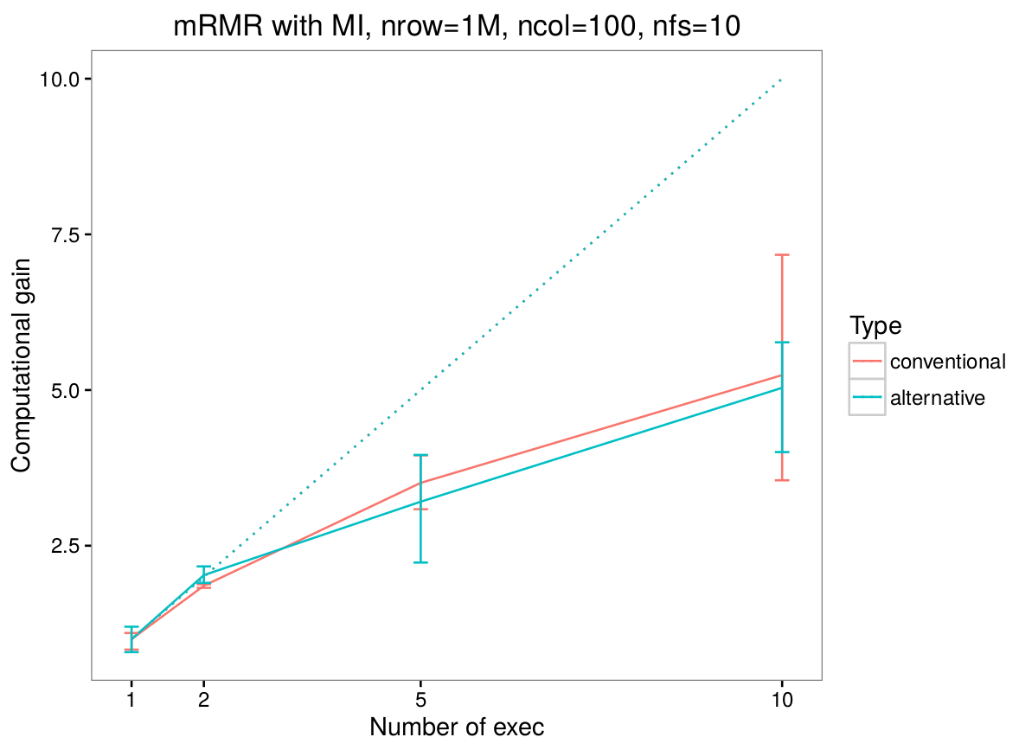
Scalability: #nodes

Slide 55
Customization

Slide 56
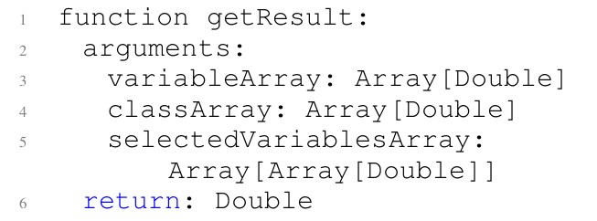
Customization

Slide 57




github.com/creggian/spark-ifs
Yann-Aël
Le Borgne
Gianluca
Bontempi
github.com/creggian/slides
claudioreggiani.com

Slide 58
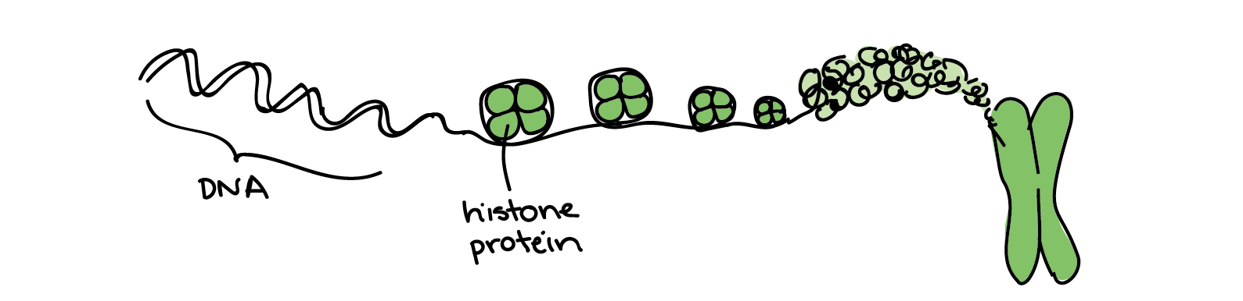
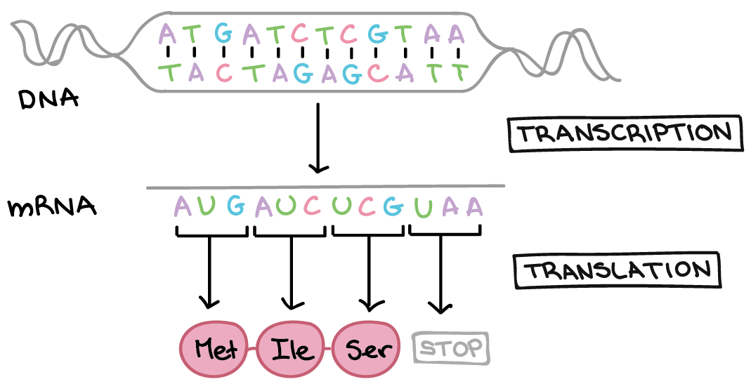
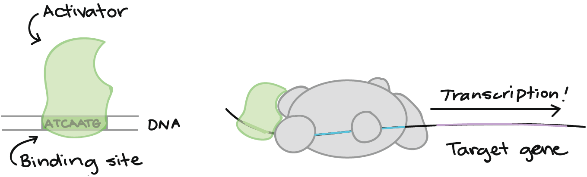
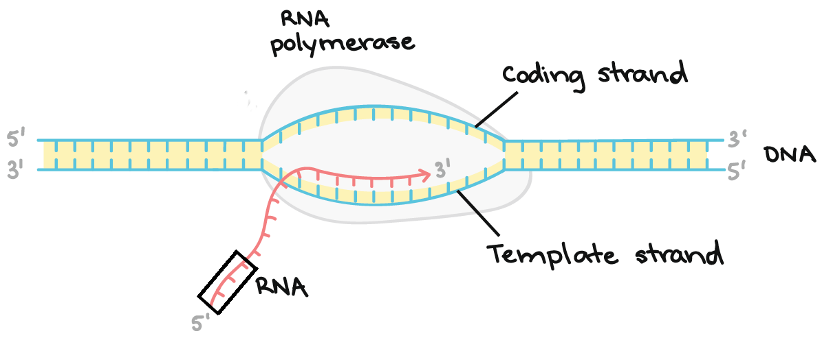
Histone Modification H3K4me3
Transcription, RNA
H
S
Transcription Factor Binding Sites
Identification of TSS (CAGE)
T
F

