Slide 1






3-Tier Web service example
Web server tier
Database tier
Storage tier
MSSQL Server failover cluster
(two-way game logic DB instance)
Web server cluster
(online gameplay)
Asynchronous online gameplay requests
Primary DB
VM (IIS7 )
IP Filter + Ticketing
VM (IIS7 )
IP Filter + Ticketing
ESX Server
MSSQL Server
Virtual host
VM (IIS7 )
IP Filter
Ticketing
SAN storage
Hot standby DB
...
MSSQL Server (inbound-only stat gathering DB instance)
MSMQ
stat gathering
MSSQL Server
Web server cluster
(read-only data)
Replicated DB
Non-realtime
read-only data requests
MSSQL Server
VM(IIS7 )
IP Filter + DataCache
MSSQL Server
Replicated DB
MSSQL Server
Replicated DB
VM(IIS7 )
IP Filter + DataCache
ESX Server
VM(IIS7 )
IP Filter
Reverse Proxy servers
DataCache
(memcached)
...

Slide 2
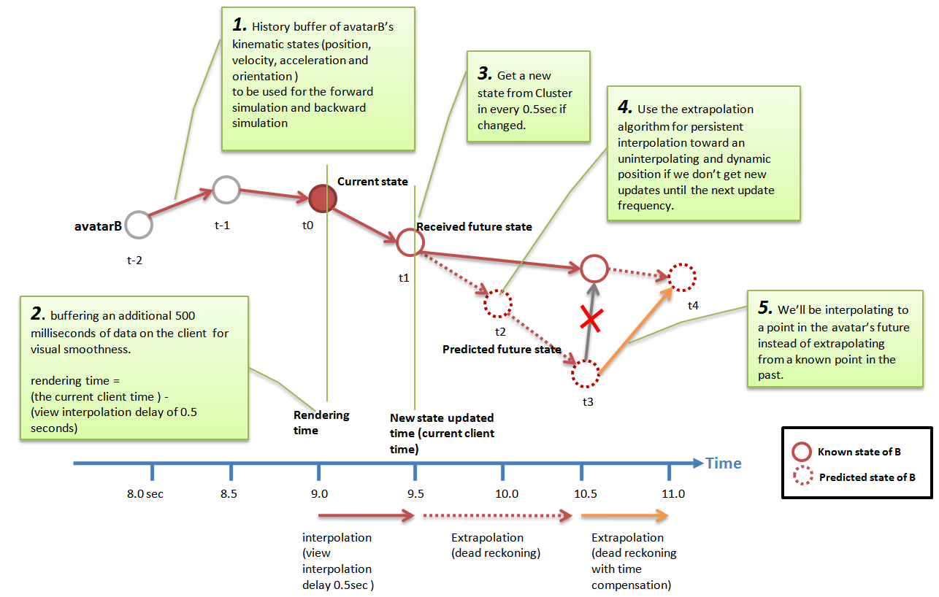
Client position synchronization algorithm design and implementation This describes how to replicate a player and non-player’s kinematic state (information that describes the current kinematic state of the entity, including position, velocity, acceleration and orientation; and other information) across multiple machines in the lag-prone internet environment. Forward simulation To render its kinematic state in a consistent and smooth way using dead reckoning algorithms.

Slide 3

Mobile Backend service architecture design/implementation – synchronous model with lobby system
Public domain
Private domain
①
Patch servers
③
②
Account DB server
④
L4 switch
Login servers
⑤
Game DB server
⑪
iPad
Log DB server
iPhone
Relay servers
Game client
SAN storage
Statistics DB server
⑧
DB servers
Lobby 1
Lobby 2
Lobby 3
⑥
Lobby 4
⑩
3rd party Billing server
Lobby servers
3rd party servers
⑦
Lobby Controller server
Lobby cluster
⑨
Game server administrator PC
Admin console

Slide 4
Single sign-on ticketing mechanism design and implementation
iPad/iPhone game client
Account server
Game server
Log into game online service by ID/Password
Authenticated and get UUID (unique user identifier) and session ticket to single sign-on to other online service.
UUID
HTTPS
Session ticket
Game client log-in to game server with UUID and session ticket
Verify the session ticket through Kando
MD5 hash the ticket
Hashed session ticket
Authenticate game client’s log-in to game server, and reply with MD5 hashed ticket data
Store the hashed ticket to DB/memcached
UUID
Hashed session ticket
Game client appends the hashed ticket payload for every game messages
Compare the hashed ticket with the stored one in DB/memcached
game data
Only accept the game message packet if the hashed ticket data is matched.

Slide 5
Network packet security implementation
1) Inbound packet
2) IP and account filtering
3) Decryption
(AES 128-bit)
7) Binary sanitization
Verify that binary format is authentic to guarantee the DB integrity.
Security filters
4) Replay blocker
6) Thumbprint check
5) Platform-specific ticketing authentication
Passed
Failed
8) Outbound packet
7) Processed in DB procedures
9) Penalized and Recorded in the blacklist
11) recorded in DB log or local system’s log file
10) Send back error code to client in some packets to redirect users to customer help desk just in case it’s from authentic source

Slide 6
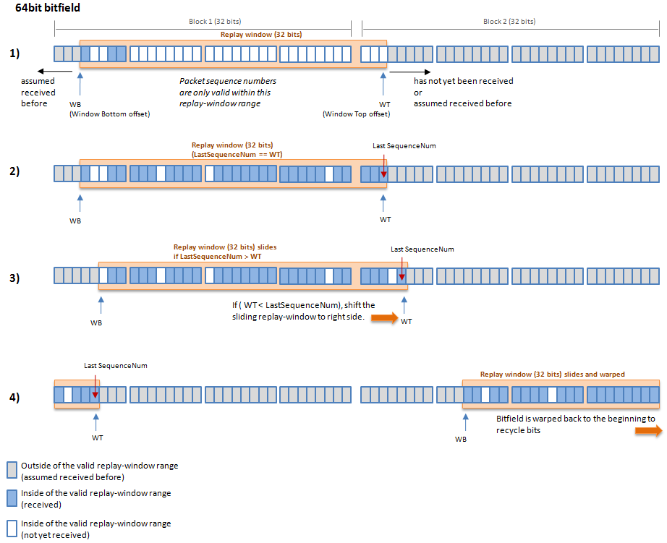
Anti packet replay algorithm implementation
This is a diagram I made to explain how sliding window algorithm is used to prevent packet replay attack in typical stateless HTTP communication between client and web host.
I use two 32-bits bit fields to store session sequence index and slide it through in circular fashion.
The referenced algorithm is ‘An Anti-Replay Window Protocol with Controlled Shift’. It’s not perfect defence against packet replay attack, but it was a reasonably efficient solution.

Slide 7
Avoid Quest AI logic implementation
Pattern B
(No destination point
+ Time Limit)
- Player work or run randomly to flee away from spawned NPCs.
Quest complete condition:
player should keep distance from NPCs for certain time limit.
Target point A
Pattern A
(Destination point
+ Time Limit)
- Player should escape from chasing NPCs before reaching the target point A.
- Quest complete condition:
player should keep distance from NPCs before he reaches the target point A.
If chasing NPC threaten the player, player can defend itself by attacking NPC.
Enemy mob
Killed
attack
Player(escaper)
3.
Within the escaping limit distance, NPC chase the target player with normal speed.
But if the HP gets lower than 30%, it runs faster than normal speed.(“Berserker speed”)
1.
NPC choose whether it fights the player back or run away based on configuration.
If NPC get killed, it’s regenerated after certain duration.
Fight (or)
Run away
chase
Enemy mob
(chaser)
Escaping limitation radius
Escaping radius:
For certain time duration, player should keep distance from chasers to succeed the quest.
2.
If NPCs are outside the escaping radius for certain time limit, mission will succeed.
NPC use “boost-up” speed to catch up the player if it gets too far away from.
Enemy mob
Enemy mob

Slide 8

Dynamic Programming Trip Planning algorithms
test in all stations
i
i+1
...
n
No fill-up
S
T
Di
Optional fill-up
X km
gas
min{1 + f(i+1, X - ∆Di), f(i+1, j - ∆Di ) }
j km
gas
remaining
∆D km
Di+1
fill-up
( left-over remaining at i + 1 station)
∆D = (Di+1 – Di)
Binary choices
X km
gas
X km
gas
j km
gas remaining
fill-up
X km
gas
j km
gas
remaining
∆D km
1 + f(i+1), X - ∆Di)
f(i,j) with i,j∈N means the minimum number of stops when we are in station i and we have j kilometres available in our tank

Slide 9
Solution for minimum coin change problem
Given a set of denominations and an amount, how do we minimize the number of coins to make up the given amount?
amount j
denominations {v₁,v₂,...v_{n}}
Base cases
M[j] = 0
Formulate sub-problems
M[j] = min { M[j-v1], M[j-v2], ..., M[j-vn] } + 1
= min 1<=i<=j { M[j-vi] } + 1
C[p]: the minimum number of coins needed to make change for p cents
x: the value of the first coin used in the optimal solution
C[p] = 1 + C[p − x]
We don’t know x. try all possible x and take the minimum
C[p] = min(i:di≤p){ C[p − di ] + 1} if p > 0
0 if p = 0
v₁
v₂
v₃
1 | 2 | 3
M[j]
0 | = 0
1 | min{M[1-v1]} + 1 = min{M[0]} + 1 = 1
2 | min{M[2-v1], M[2-v2]} + 1 = min{M[1], M[0]} + 1 = 1
3 | min{M[3-v1], M[3-v2], M[3-v3]} + 1 = min{M[2], M[1], M[0]} + 1 = 1
4 | min{M[4-v1], M[4-v2], M[4-v3]} + 1 = min{M[3], M[2], M[1]} + 1 = 2
5 | min{M[5-v1], M[5-v2], M[5-v3]} + 1 = min{M[4], M[3], M[2]} + 1 = 2
d1 = 1 d2 = 4 d3 = 5 d4 = 10
Change(p)
if (p < 0)
then return ∞
else if (p = 0)
then return 0
else
return 1 + min{Change(p − 1), Change(p − 5), Change(p − 10)}

