Slide 1






3-Tier Web service example
Web server tier
Database tier
Storage tier
MSSQL Server failover cluster
(two-way game logic DB instance)
Web server cluster
(online gameplay)
Asynchronous online gameplay requests
Primary DB
VM (IIS7 )
IP Filter + Ticketing
VM (IIS7 )
IP Filter + Ticketing
ESX Server
MSSQL Server
Virtual host
VM (IIS7 )
IP Filter
Ticketing
SAN storage
Hot standby DB
...
MSSQL Server (inbound-only stat gathering DB instance)
MSMQ
stat gathering
MSSQL Server
Web server cluster
(read-only data)
Replicated DB
Non-realtime
read-only data requests
MSSQL Server
VM(IIS7 )
IP Filter + DataCache
MSSQL Server
Replicated DB
MSSQL Server
Replicated DB
VM(IIS7 )
IP Filter + DataCache
ESX Server
VM(IIS7 )
IP Filter
Reverse Proxy servers
DataCache
(memcached)
...

Slide 2
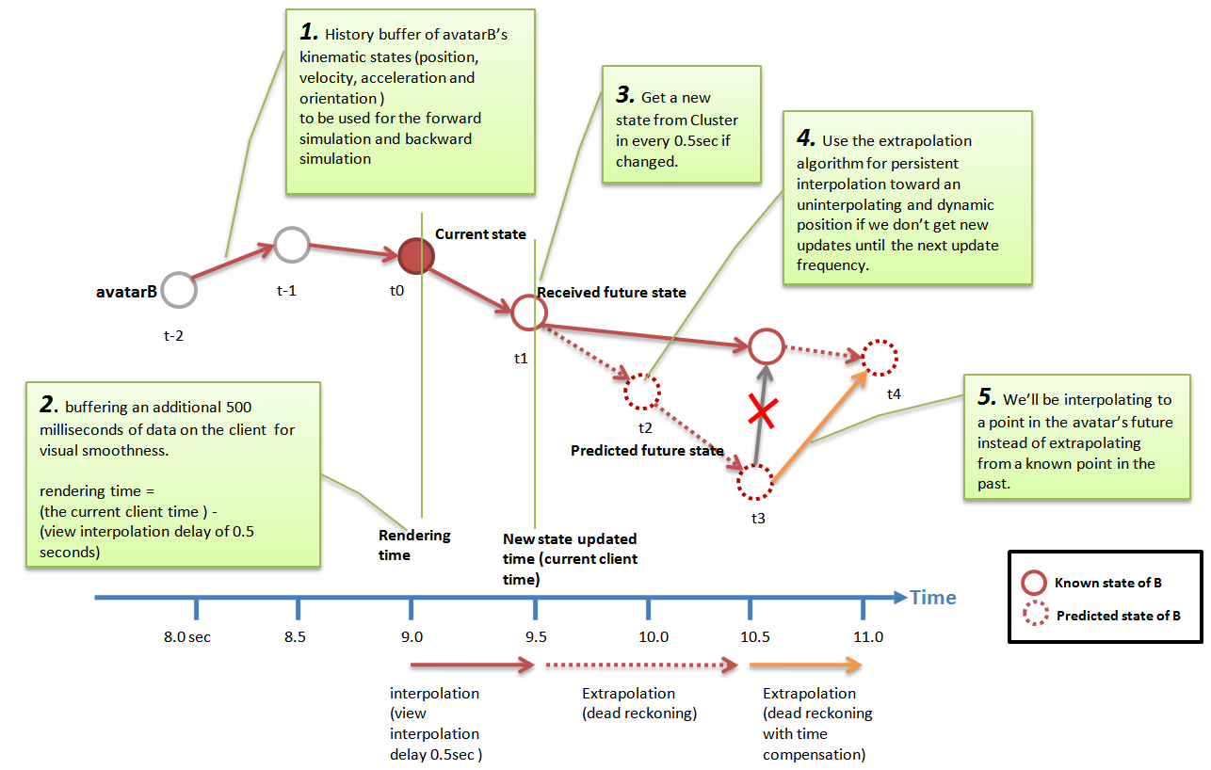
Client position synchronization algorithm design and implementation This describes how to replicate a player and non-player’s kinematic state (information that describes the current kinematic state of the entity, including position, velocity, acceleration and orientation; and other information) across multiple machines in the lag-prone internet environment. Forward simulation To render its kinematic state in a consistent and smooth way using dead reckoning algorithms.

Slide 3

Mobile Backend service architecture design/implementation – synchronous model with lobby system
Public domain
Private domain
①
Patch servers
③
②
Account DB server
④
L4 switch
Login servers
⑤
Game DB server
⑪
iPad
Log DB server
iPhone
Relay servers
Game client
SAN storage
Statistics DB server
⑧
DB servers
Lobby 1
Lobby 2
Lobby 3
⑥
Lobby 4
⑩
3rd party Billing server
Lobby servers
3rd party servers
⑦
Lobby Controller server
Lobby cluster
⑨
Game server administrator PC
Admin console

Slide 4
Single sign-on ticketing mechanism design and implementation example
iPad/iPhone game client
Account server
Game server
Log into game online service by ID/Password
Authenticated and get UUID (unique user identifier) and session ticket to single sign-on to other online service.
UUID
HTTPS
Session ticket
Game client log-in to game server with UUID and session ticket
Verify the session ticket
MD5 hash the ticket
Hashed session ticket
Authenticate game client’s log-in to game server, and reply with MD5 hashed ticket data
Store the hashed ticket to DB/memcached
UUID
Hashed session ticket
Game client appends the hashed ticket payload for every game messages
Compare the hashed ticket with the stored one in DB/memcached
game data
Only accept the game message packet if the hashed ticket data is matched.

Slide 5
Network packet security implementation example for custom binary protocol communication
1) Inbound packet
2) IP and account filtering
3) Decryption
(AES 128-bit)
7) Binary sanitization
Verify that binary format is authentic to guarantee the DB integrity.
Security filters
4) Replay blocker
6) Thumbprint check
5) Platform-specific ticketing authentication
Passed
Failed
8) Outbound packet
7) Processed in DB procedures
9) Penalized and Recorded in the blacklist
11) recorded in DB log or local system’s log file
10) Send back error code to client in some packets to redirect users to customer help desk just in case it’s from authentic source

Slide 6
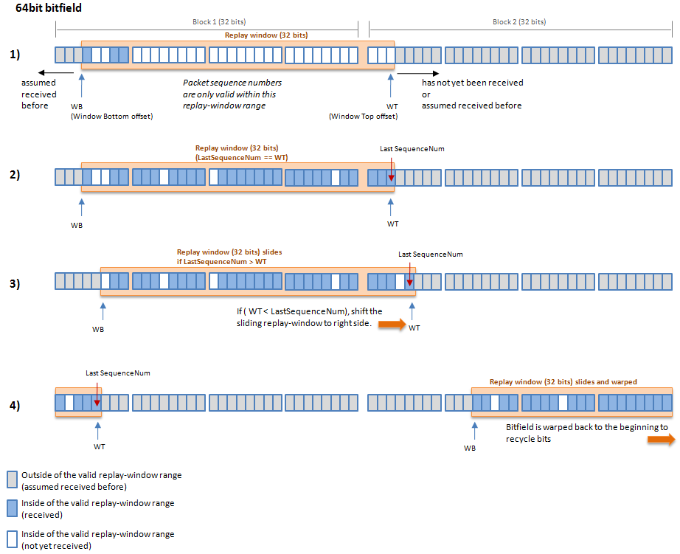
Anti packet replay algorithm implementation
This is a diagram to explain how sliding window algorithm is used to prevent packet replay attack in typical stateless HTTP communication between client and web host.
I use two 32-bits bit fields to store session sequence index and slide it through in circular fashion.
The referenced algorithm is ‘An Anti-Replay Window Protocol with Controlled Shift’. It’s not perfect defence against packet replay attack, but it was a reasonably efficient solution.

Slide 7
Redis Pros:
Stores data in a variety of formats: list, array, sets and sorted sets
Pipelining! Multiple commands at once
Blocking reads -- will sit and wait until another process writes data to the cache
Mass insertion of data to prime a cache
Does pub/sub... if you want to do pub/sub through your cache
Partitions data across multiple redis instances
Can back data to disk
Redis Cons:
Super complex to configure -- requires consideration of data size to configure well
SENTINEL, the automated failover which promotes a slave to master, is perpetually on the redis unstable branch
Master-slave architecture means if the master wipes out, and SENTINEL doesn't work, the system is sad
Lots o' server administration for monitoring and partitioning and balancing...
My advice: if you need to cache database queries or REST round trips or numbers or page fragments, use memcached. Most cached data types and caching needs are simple and straight forward. This is 80% of all caching needs.
Leaderboards
Redis can manage sets in memory, which gives it an advantage here over memcached. Leaderbaords are sets of items ordered just in time and served from in memory to a page. A database is too slow -- and it's all disposable data. Here both the pipelining and the key/values to sorted sets are powerful features.
piping to multiple items and ordering sets in memory where a system reads them out and streams results -- websockets! -- in real time makes implementing this feature simpler and streamlined.
Page Clicks and Analytics
redis is really good at counting lists and sets of things
Of all of redis's features, its ability to do key/value to sorted sets is where it exceeds memcached -- and counting something like page clicks per sets of pages and then summing those numbers together into analytics which can be pumped via a worker into a bigger analytics engine is one place where the redis choice is the right one.
Redis Sentinel
Monitoring. Sentinel constantly checks if your master and slave instances are working as expected.
Notification. Sentinel can notify the system administrator, or another computer program, via an API, that something is wrong with one of the monitored Redis instances.
Automatic failover. If a master is not working as expected, Sentinel can start a failover process where a slave is promoted to master, the other additional slaves are reconfigured to use the new master, and the applications using the Redis server informed about the new address to use when connecting.
Configuration provider. Sentinel acts as a source of authority for clients service discovery: clients connect to Sentinels in order to ask for the address of the current Redis master responsible for a given service. If a failover occurs, Sentinels will report the new address.

Slide 8
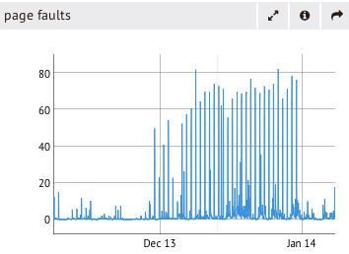
Lots of MongoDB users succeed with a single replica set.
Sharding too early may be a premature optimization. Not every MongoDB deployment requires sharding. Sharding addresses very specific needs and it's not automatically the best solution to "my database is slow." When you have very poorly tuned schema, or incorrect indexes, sharding won't solve your problem, instead you will end up with several poorly tuned and poorly performing shards! Sharding is appropriate when a specific resource becomes a bottleneck on a single machine or replica set, and you can't add more of that resource at a reasonable cost.

Slide 9
Infrastructure (Scaling)
SQL server DB replication (Database redundancy)
Primary DB
(gameplay)
Realtime requests
(Gameplay)
Read/Write
Secondary DB
(game stats)
Replicate (1)
Non-realtime writes
(Gameplay)
Write
Replicated DBs
Non-realtime reads
(Gameplay)
Read
Replicate (2)
Non-realtime reads
(Public website)
Read
Non-realtime reads
(Internal data-mining)
Read

Slide 10
Apache JMeter load-testing concept
Script the test plan.
You can define how many threads to use, request types , order and randomization
Thread Group
Target
Test thread
Apache JMeter
Test thread
Test thread
Test thread
Online Community Web service
Protocol sampler
JMeter plug-in codes
Apache Jmeter
(Slave)
Thread Group
Target
Test thread
Test thread
Apache Jmeter
(Slave)
Thread Group
Online Community Web service
Test thread
Test thread
Apache Jmeter
(master)
Apache Jmeter
(Slave)
Thread Group
Test thread
Test thread
Apache Jmeter
(Slave)
Thread Group
Test thread
Test thread

Slide 11
Avoid Quest AI logic implementation
Pattern B
(No destination point
+ Time Limit)
- Player work or run randomly to flee away from spawned NPCs.
Quest complete condition:
player should keep distance from NPCs for certain time limit.
Target point A
Pattern A
(Destination point
+ Time Limit)
- Player should escape from chasing NPCs before reaching the target point A.
- Quest complete condition:
player should keep distance from NPCs before he reaches the target point A.
If chasing NPC threaten the player, player can defend itself by attacking NPC.
Enemy mob
Killed
attack
Player(escaper)
3.
Within the escaping limit distance, NPC chase the target player with normal speed.
But if the HP gets lower than 30%, it runs faster than normal speed.(“Berserker speed”)
1.
NPC choose whether it fights the player back or run away based on configuration.
If NPC get killed, it’s regenerated after certain duration.
Fight (or)
Run away
chase
Enemy mob
(chaser)
Escaping limitation radius
Escaping radius:
For certain time duration, player should keep distance from chasers to succeed the quest.
2.
If NPCs are outside the escaping radius for certain time limit, mission will succeed.
NPC use “boost-up” speed to catch up the player if it gets too far away from.
Enemy mob
Enemy mob

Slide 12

Dynamic Programming Trip Planning algorithms
test in all stations
i
i+1
...
n
No fill-up
S
T
Di
Optional fill-up
X km
gas
min{1 + f(i+1, X - ∆Di), f(i+1, j - ∆Di ) }
j km
gas
remaining
∆D km
Di+1
fill-up
( left-over remaining at i + 1 station)
∆D = (Di+1 – Di)
Binary choices
X km
gas
X km
gas
j km
gas remaining
fill-up
X km
gas
j km
gas
remaining
∆D km
1 + f(i+1), X - ∆Di)
f(i,j) with i,j∈N means the minimum number of stops when we are in station i and we have j kilometres available in our tank

Slide 13
Solution for minimum coin change problem
Given a set of denominations and an amount, how do we minimize the number of coins to make up the given amount?
amount j
denominations {v₁,v₂,...v_{n}}
Base cases
M[j] = 0
Formulate sub-problems
M[j] = min { M[j-v1], M[j-v2], ..., M[j-vn] } + 1
= min 1<=i<=j { M[j-vi] } + 1
C[p]: the minimum number of coins needed to make change for p cents
x: the value of the first coin used in the optimal solution
C[p] = 1 + C[p − x]
We don’t know x. try all possible x and take the minimum
C[p] = min(i:di≤p){ C[p − di ] + 1} if p > 0
0 if p = 0
v₁
v₂
v₃
1 | 2 | 3
M[j]
0 | = 0
1 | min{M[1-v1]} + 1 = min{M[0]} + 1 = 1
2 | min{M[2-v1], M[2-v2]} + 1 = min{M[1], M[0]} + 1 = 1
3 | min{M[3-v1], M[3-v2], M[3-v3]} + 1 = min{M[2], M[1], M[0]} + 1 = 1
4 | min{M[4-v1], M[4-v2], M[4-v3]} + 1 = min{M[3], M[2], M[1]} + 1 = 2
5 | min{M[5-v1], M[5-v2], M[5-v3]} + 1 = min{M[4], M[3], M[2]} + 1 = 2
d1 = 1 d2 = 4 d3 = 5 d4 = 10
Change(p)
if (p < 0)
then return ∞
else if (p = 0)
then return 0
else
return 1 + min{Change(p − 1), Change(p − 5), Change(p − 10)}

