Slide 1


Deep Learning Essentials
www.creoleap.com

Slide 2

Overview
Deep learning uses multi-layered neural networks to automatically learn complex patterns from data. Neural networks mimic the brain through interconnected neurons that transform inputs into higher-level features. Convolutional Neural Networks (CNNs) specialize in image tasks by extracting spatial features through filters and pooling. Overall, deep learning enables machines to perform vision, speech, and language tasks with high accuracy through hierarchical feature learning.
www.creoleap.com

Slide 3
Learning Outcomes
Define deep learning and explain how it differs from traditional machine learning.
Describe the structure and components of an artificial neural network.
Explain key concepts such as activation functions, loss functions, and optimization algorithms.
Understand the process of training a neural network using forward and backward propagation.
Identify and differentiate between major deep learning architectures such as CNNs, RNNs, and Autoencoders.
www.creoleap.com

Slide 4
What is Deep Learning?
Deep learning is a type of machine learning that uses multi-layered neural networks to automatically learn patterns and make decisions from large amounts of data.
Example:
Deep learning is used in image recognition, such as how Google Photos automatically identifies faces or objects (like “dog” or “car”) in pictures using Convolutional Neural Networks (CNNs).
www.creoleap.com

Slide 5
What are neural networks?
Neural networks are computer systems designed to mimic how the human brain works. They consist of layers of connected nodes (called neurons) that process data, each neuron receives input, applies weights and an activation function, and passes the result to the next layer to make predictions or decisions.
www.creoleap.com

Slide 6
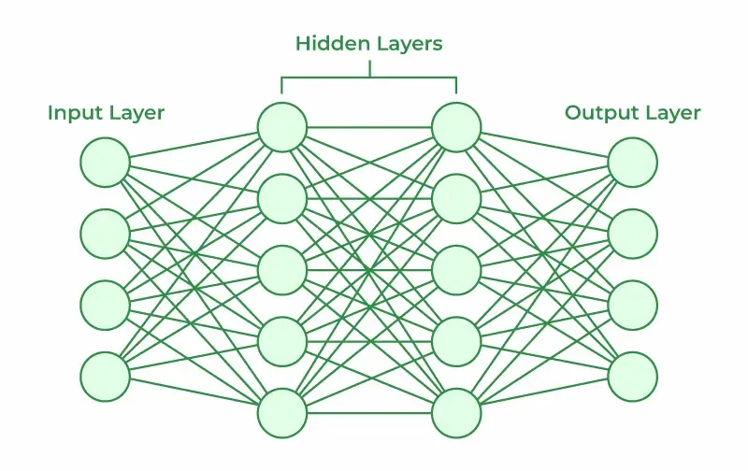
Structure of a Neural Network
A neural network is made up of layers of neurons:
Input Layer: Receives the data.
Hidden Layers: Process and learn features.
Output Layer: Produces the final result.
Each connection has weights that determine importance.
Activation functions introduce non-linearity to help the model learn complex patterns.
www.creoleap.com

Slide 7

Mathematics behind a neuron
Mathematical Formula:
Where:
x₁, x₂, … = input features
w₁, w₂, … = weights
b = bias (shifts the output)
f = activation function
y = neuron output
www.creoleap.com

Slide 8
What is an Activation function?
An activation function decides whether a neuron should activate or not. It determines the output of a neuron based on its input and helps the network learn complex patterns. It adds non-linearity to the model so it can understand more than just straight-line relationships.
In short: Activation Function = the part of a neuron that decides how signals pass.
www.creoleap.com

Slide 9
What are the common types of activation functions?
Sigmoid: outputs between 0 and 1
Tanh: outputs between -1 and 1
ReLU (Rectified Linear Unit): outputs positive values only
Softmax: converts outputs into probabilities for classification
www.creoleap.com

Slide 10
What is a loss function?
A loss function tells the neural network how wrong its predictions are. It compares the predicted output with the actual (true) value and gives a number showing the error.
www.creoleap.com

Slide 11
What is forward propagation?
Forward propagation is the process of passing input data through the neural network to get an output.
Each layer processes the input by applying weights, biases, and activation functions.
The final layer produces the predicted output.
The output is then compared with the actual value to calculate loss.
www.creoleap.com

Slide 12
What is backward propagation?
Back propagation is the process of learning by adjusting the network’s weights to reduce the loss.
It works backward from the output layer to the input layer.
Uses the gradient of the loss function to update each weight based on its contribution to the error.
It applies the Chain Rule of calculus to compute gradients efficiently.
www.creoleap.com

Slide 13
What are vanishing gradients?
The vanishing gradient problem happens when the gradients (error signals) used to update the weights during training become very small as they move backward through the layers of a deep neural network.
Because of this, the earlier layers in the network learn very slowly or stop learning completely, while the later layers continue to update.
In short:
When gradients get too small → weights stop updating → learning almost stops.
www.creoleap.com

Slide 14
THANK
YOU
www.creoleap.com

