Slide 1


ESP32-C3 DEVELOPMENT BOARD
www.creoleap.com

Slide 2

Objectives
To understand the ESP32-C3 Development Board.
To learn the architecture and features of the ESP32-C3.
To study the GPIO pins and communication interfaces.
To understand Wi-Fi and Bluetooth capabilities.
To explore programming using the Arduino IDE.
To learn real-world applications of the ESP32.
www.creoleap.com

Slide 3
What is ESP32?
ESP32 is a powerful 32-bit microcontroller developed by Espressif Systems. It integrates Wi-Fi and Bluetooth connectivity.
It is designed for IoT (Internet of Things) applications.
ESP32 offers higher processing speed and more memory than Arduino UNO.
It supports multiple communication protocols and peripherals.
www.creoleap.com

Slide 4
ESP32-C3 Specifications
Technical Specifications
Feature | Specification
Processor | 32-bit RISC-V
Clock Speed | Up to 160 MHz
SRAM | 400 KB
Flash Memory | 4 MB (Typical)
Wi-Fi | IEEE 802.11 b/g/n
Bluetooth | Bluetooth 5 LE
GPIO Pins | Up to 22
Operating Voltage | 3.3V
ADC Channels | 6
PWM | Supported
UART | 2
SPI | 2
I²C | Supported
www.creoleap.com

Slide 5
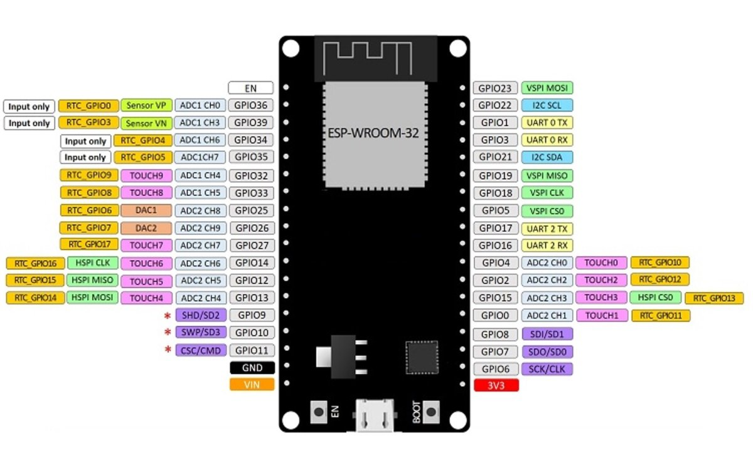
ESP32 pin diagram
GPIO
ADC
PWM
UART
SPI
I²C
Power Pins
www.creoleap.com

Slide 6
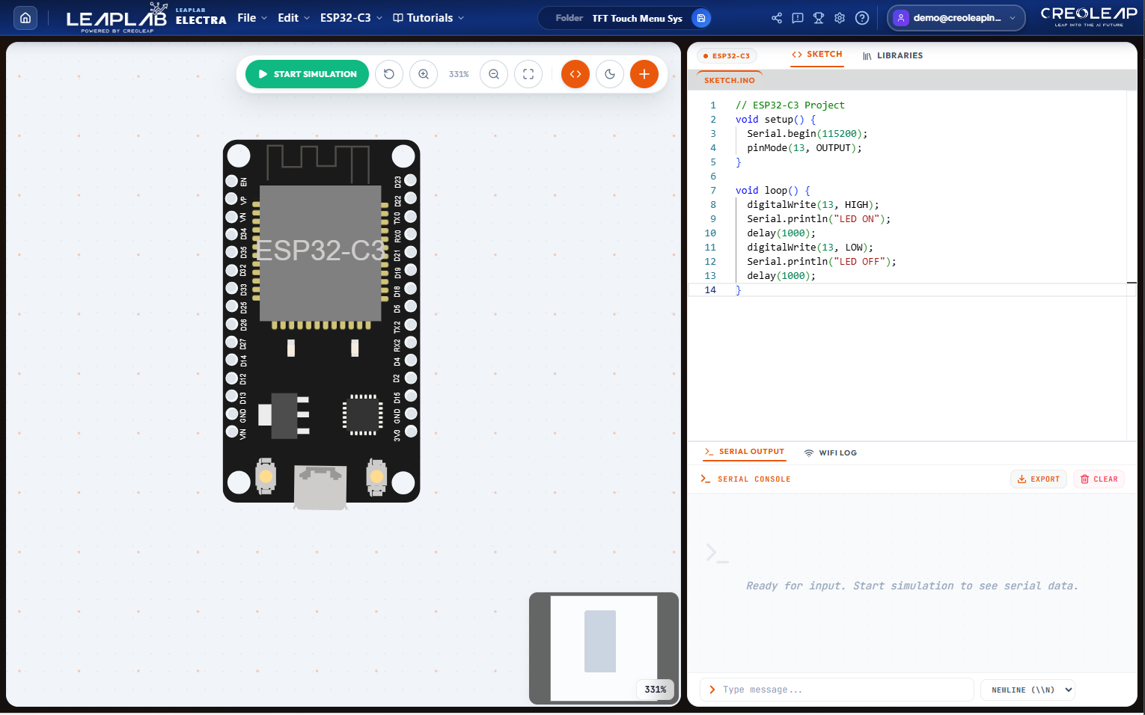
Setting up your circuit
Drag to the components form the component library
www.creoleap.com
www.creoleap.com
www.creoleap.com

Slide 7
Features in ESP32
Built-in Wi-Fi
Bluetooth Low Energy (BLE)
High-Speed Processor
Multiple GPIO Pins
Analog Inputs PWM Outputs
SPI Communication
I²C Communication
UART Communication
Deep Sleep Mode
Low Power Consumption
OTA (Over-the-Air Updates)
www.creoleap.com

Slide 8
Communication protocols
UART
SPI
I²C
PWM
ADC
Wi-Fi
Bluetooth LE
www.creoleap.com

Slide 9
Esp32 vs Arduino uno
Feature | Arduino UNO | ESP32-C3
Processor | ATmega328P | RISC-V
Clock | 16 MHz | 160 MHz
Wi-Fi | No | Yes
Bluetooth | No | Yes
RAM | 2 KB | 400 KB
Flash | 32 KB | 4 MB
GPIO | 14 | 22
ADC | 6 | 6
PWM | 6 | Multiple
www.creoleap.com

Slide 10
ESP32 programming
Arduino IDE
PlatformIO
ESP-IDF
MicroPython
Visual Studio Code
www.creoleap.com

Slide 11
Installing ESP32 Board
Arduino IDE Setup
Install Arduino IDE.
Open Preferences.
Add ESP32 Board URL.
Open Boards Manager.
Install ESP32 by Espressif.
Select ESP32-C3 Board.
Connect the board. Upload the program.
www.creoleap.com

Slide 12
First ESP32 Program
LED Blink Example
void setup()
{
pinMode(2, OUTPUT);
}
void loop()
{
digitalWrite(2, HIGH);
delay(1000);
digitalWrite(2, LOW);
delay(1000);
}
www.creoleap.com

Slide 13
ESP32 Applications
Internet of Things (IoT)
Smart Home Automation
Weather Monitoring
Industrial Automation
Smart Agriculture
Robotics
Medical Devices
Wearable Electronics
Security Systems
Wireless Sensor Networks
www.creoleap.com

Slide 14
Advantages
Built-in Wi-Fi
Bluetooth LE
High Processing Speed
Low Power Consumption
Rich Peripheral Support Large Memory
Free Development Tools
Ideal for IoT Projects
www.creoleap.com

Slide 15
Advantages
Built-in Wi-Fi
Bluetooth LE
High Processing Speed
Low Power Consumption
Rich Peripheral Support
Large Memory
Free Development Tools
Ideal for IoT Projects
www.creoleap.com

Slide 16
Limitations
Operates at 3.3V only
Limited ADC accuracy compared to dedicated ADCs
More complex than Arduino UNO for beginners
Some GPIO pins have boot configuration functions
Higher power consumption during Wi-Fi operation
www.creoleap.com

Slide 17
T H A N K
YOU
www.creoleap.com

