Slide 1


House of fragrance and beauty · Havana, Cuba
BRAND GUIDELINES
Version 1.0 · August 2026
A VELUM HOUSE

Slide 2

BRAND GUIDELINES
Contents
01
The House
Origin, purpose, values and territory
02
Identity
Logotype, lockups, clear space and usage
03
Colour
Palette, proportion and pairing
04
Typography
The three families and the scale
05
Application
Packaging, photography, symbol and endorsement
AnaLopez · Brand Guidelines
02

Slide 3
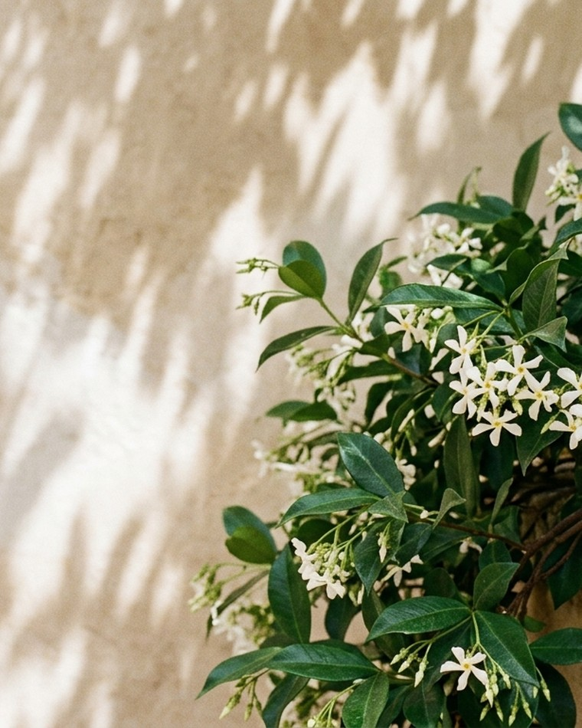
01
The House
Origin, purpose, values and territory

Slide 4
BRAND GUIDELINES
The origin
“Every morning it smelled of jasmine.”
In Havana, beside the room where our founder slept as a child, a jasmine plant grew. Every morning, before the day began, its scent filled the garden.
Years later he discovered the plant had not started with him: it had belonged to his grandmother, Ana, who carried it from the house where she lived as a girl with her father.
One plant accompanied several generations of a family, until one day it was gone. But its scent had stayed in memory.
That memory is the origin of AnaLopez.
AnaLopez · Brand Guidelines
04

Slide 5
THE HOUSE
Purpose, vision and mission
01
02
03
Purpose
Vision
Mission
To preserve emotions and memories through the universal language of perfume.
To be a reference perfume house born in Cuba, known for its olfactory identity and its emotional narrative.
To create fragrances that join memory, science, culture, craft and contemporary design.
AnaLopez · Brand Guidelines
05

Slide 6
THE HOUSE
Values
What governs every decision
01
02
03
04
Memory
Heritage
Cuba
Science
Personal stories are the raw material.
We honour what is passed between generations.
Origin, context and sensibility. Not decoration.
Biochemistry and molecular biology as a real foundation.
05
06
07
08
Craft
Elegance
Authenticity
Evolution
The formula and the execution matter as much as the story.
Refined without being ostentatious.
The founding story stays true.
Born of the past, but not trapped in it.
AnaLopez · Brand Guidelines
06

Slide 7
THE HOUSE
Positioning
A contemporary perfume house born in Cuba, turning family and cultural memory into fragrances with an identity of their own.
DOES NOT COMPETE ON
COMPETES ON
Being “Cuban”
Story
Being cheap
Identity
Being artisanal
Olfaction
Exotic ingredients
Design
Looking like a souvenir
Experience
AnaLopez · Brand Guidelines
07

Slide 8
THE HOUSE
Personality
IT IS
IT IS NOT
Elegant
Cheap
Intimate
Touristic
Cultural
Folkloric
Contemporary
Overloaded
Sensual
Datedly nostalgic
Intellectual
Too feminine
Refined
Too masculine
Warm
Generic
Assured
Artificially “luxury”
Mysterious
AnaLopez · Brand Guidelines
08

Slide 9
THE HOUSE
The brand territory
Five worlds that make it hard to copy
Cuba
Memory
Botany
Science
Perfumery
Havana, gardens, architecture, coffee, tobacco, music, memory.
Grandparents, childhood, houses, gardens, objects, rituals.
Jasmine, flowers, leaves, roots, natural matter.
Molecules, olfactory perception, formulation, biology.
Composition, raw materials, skin, evolution.
AnaLopez · Brand Guidelines
09

Slide 10

MANIFESTO
Things change.
Houses change.
People grow.
Gardens disappear.
Generations pass.
But some memories remain.
Sometimes they arrive in a photograph.
Sometimes in a voice.
And sometimes, in a scent.
AnaLopez was born from one of them.
A jasmine.
A garden in Havana.
A grandmother named Ana.
The plant disappeared.
The memory remained.
AnaLopez · Brand Guidelines
10

Slide 11
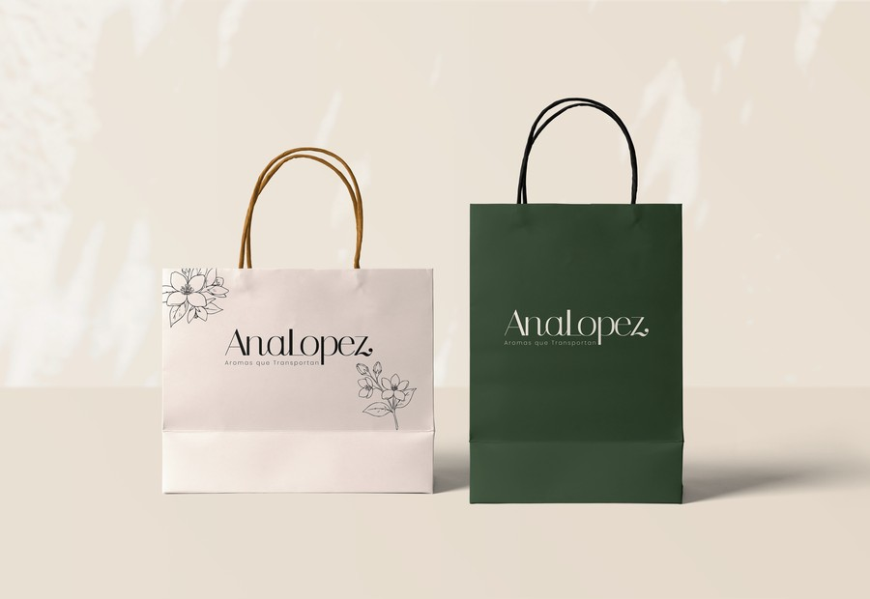
02
Identity
Logotype, lockups, clear space and usage

Slide 12

IDENTITY
The logotype
Construction
01
02
03
Italiana Regular
Structure, proportion, vertical axis
Bodoni Moda Italic
The swash z
AnaLopez logotype
Locked artwork
The logotype is a custom drawing, not a font setting. It starts from Italiana letterforms and replaces the terminal z with the swash z of Bodoni Moda Italic. The two are merged and redrawn so the swash resolves into the baseline.
Never reproduce it by typing “AnaLopez” in Italiana: the swash would be missing and the fit would be wrong. Always place the supplied vector.
AnaLopez · Brand Guidelines
12

Slide 13



IDENTITY
The four lockups
Primary
Wordmark
Horizontal. The default. Web, stationery, advertising, headers.
No descriptor. Where the brand is already known or space is tight.
Stacked
Monogram
Monogram with descriptor. Vertical formats, labels, seals, social.
A/L only. Bottle cap, favicon, engraving, avatar, marking.
AnaLopez · Brand Guidelines
13

Slide 14
IDENTITY
Clear space and minimum size
MINIMUM SIZES
1x
Primary
Print 32 mm wide · Digital 180 px
1x
1x
Wordmark
Print 26 mm wide · Digital 150 px
1x
Stacked
Print 18 mm wide · Digital 96 px
Clear space equals the height of the logotype's A (1x) on all sides. No other element, text or edge enters that zone.
Monogram
Print 8 mm wide · Digital 32 px
AnaLopez · Brand Guidelines
14

Slide 15




IDENTITY
Colour versions
Which version on which ground
Limewash
Jasmine
Sand
Deep Green
Black
Cacao
Olive
Black
Deep Green
Cacao
Jasmine
Sand
Sand
Jasmine
Seven monochrome versions. The logotype never carries more than one colour, never a gradient and never an outline. Over photography use Jasmine, always on a quiet area.
On Limewash or Jasmine
Black, Deep Green or Cacao
On Deep Green or Black
Jasmine or Sand
On Sand or kraft
Cacao or Deep Green
On photography
Jasmine on a dark, quiet area
Foil, emboss or engrave
Amber (metal) or blind deboss
AnaLopez · Brand Guidelines
15

Slide 16
IDENTITY
Misuse
NEVER
×
×
×
×
Re-typing the logotype in a font
Stretching, condensing or slanting
Rotating the logotype
Adding shadow, glow or outline
×
×
×
×
Using more than one colour
Moving or resizing the descriptor
Placing it over a busy photograph
Enclosing it in a box or pill
AnaLopez · Brand Guidelines
16

Slide 17





IDENTITY
The monogram
The A and the L share the swash. It is the smallest asset in the system and the only one that works below 32 px. Used on bottle cap, seal, favicon, avatar and engraving.
FAVICON AND APP
48
32
64
180
512
16, 32, 48, 64, 180 and 512 px, in Black and Jasmine. Multi-resolution favicon.ico included.
AnaLopez · Brand Guidelines
17

Slide 18
03
Colour
Palette, proportion and pairing

Slide 19
COLOUR
The palette
Eight colours. Not one more
Black
Deep Green
Olive
Cacao
Amber
Sand
Jasmine
Limewash
#0D0D0C
#1C2417
#585C41
#492B17
#B8762A
#D6BD9A
#EDE5DA
#F5F0EA
CMYK 0 0 8 95
CMYK 22 0 36 86
CMYK 4 0 29 64
CMYK 0 41 68 71
CMYK 0 36 77 28
CMYK 0 12 28 16
CMYK 0 3 8 7
CMYK 0 2 4 4
RGB 13 13 12
RGB 28 36 23
RGB 88 92 65
RGB 73 43 23
RGB 184 118 42
RGB 214 189 154
RGB 237 229 218
RGB 245 240 234
Primary ink. Body text and default logotype.
Brand colour. Packaging, cartons, dark grounds.
Secondary. Garden, botanical, mid surfaces.
Secondary. Roasted matter: coffee, tobacco, cacao.
Single accent. Metal, foil, detail. Never dominant.
Warm neutral. Kraft, paper, wall shadow.
Light base. Labels and reversed logotype.
Surface. Page and photography ground.
AnaLopez · Brand Guidelines
19

Slide 20
COLOUR
Proportion and pairing
The system is restrained by construction. A light surface dominates, a dark anchors, and Amber appears once per piece.
60%
Limewash or Jasmine
Surface. Paper, ground, white space.
25%
Deep Green or Black
Anchor. Cartons, type, dark blocks.
10%
Olive, Cacao or Sand
Support. Matter, texture, secondaries.
5%
Amber
Single accent. Foil, detail, once only.
NEVER
× Amber as the ground of a whole piece
× Cacao and Deep Green together at large scale
× More than three palette colours in one piece
× Gradients between brand colours
AnaLopez · Brand Guidelines
20

Slide 21
04
Typography
The three families and the scale

Slide 22
TYPOGRAPHY
Typography
Three families
Aa
Aa
Aa
Italiana
Bodoni Moda
Poppins
RESERVED
DISPLAY AND EDITORIAL
SUPPORT
ABCDEFGHIJKLM abcdefghijklm 0123456789
ABCDEFGHIJKLM abcdefghijklm 0123456789
ABCDEFGHIJKLM abcdefghijklm 0123456789
The base of the logotype. Outside it, only for very large numerals or a collection title, at 40 px and up. Never for text.
Headlines, collection names, quotes and campaign lines. It supplies the logotype's swash z. Below 18 px its hairlines break up.
The descriptor, in ExtraLight at 0.30 em tracking. Also labels, navigation, ingredient lists, back-of-pack and body copy.
All three are SIL Open Font License: free for print, web, packaging and embedding.
AnaLopez · Brand Guidelines
22

Slide 23
TYPOGRAPHY
Type scale
ROLE
FAMILY
SIZE
TRACKING
Campaign line
Bodoni Moda 400
48-96 px
-2%
Heading 1
Bodoni Moda 400
36-48 px
-1%
Heading 2
Bodoni Moda 500
24-32 px
0
Label
Poppins ExtraLight
11-13 px
+0.30 em, caps
Body
Poppins Regular
15-17 px / 1.7
0
Caption and legal
Poppins Light
11-12 px / 1.5
+0.02 em
AnaLopez · Brand Guidelines
23

Slide 24
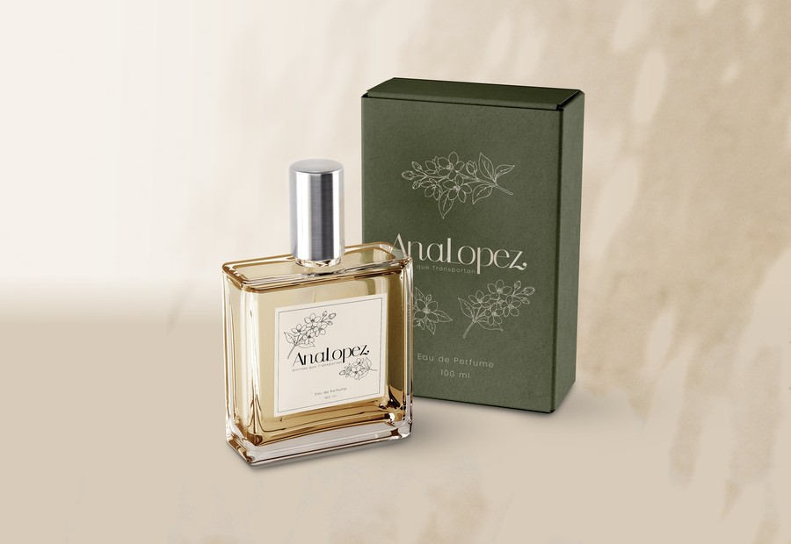
05
Application
Packaging, photography, symbol and endorsement

Slide 25
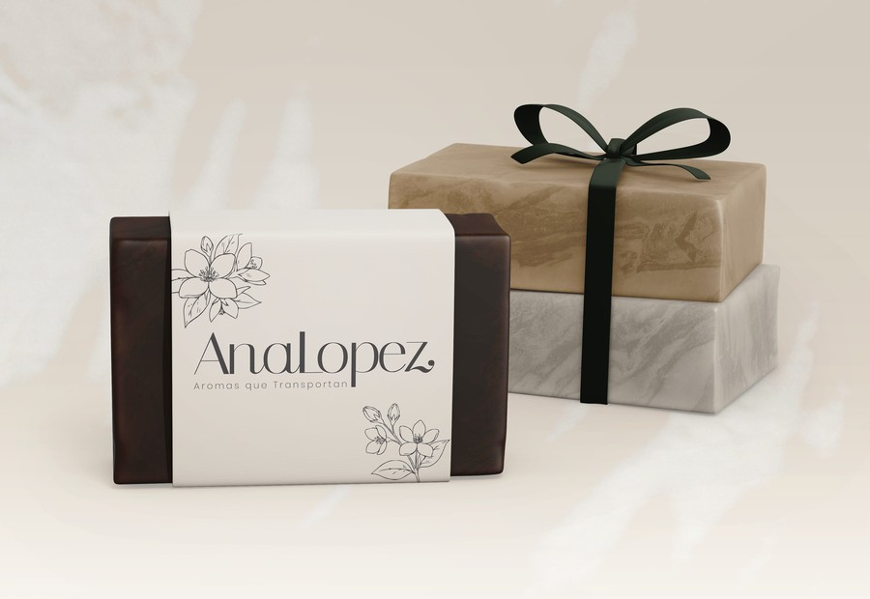
APPLICATION
Packaging
The ritual of the experience
01
02
03
04
05
06
Box
Texture
Message
Bottle
Scent
Story
Carton in Deep Green, label in Jasmine, ribbon in Green or Amber, kraft for shipping. The drawn jasmine appears once per piece, never twice.
“This perfume began with a jasmine.”
AnaLopez · Brand Guidelines
25

Slide 26






APPLICATION
Textures and patterns
Material, not ornament
Limewash
Sand plaster
Green board
Olive board
Cacao board
Kraft
Page ground, label, photography wall.
Warm surface, still life, product ground.
Carton, rigid box, bag, lid.
Secondary, box interior, dividers.
Roasted matter: coffee, tobacco, cacao.
Shipping, filler, tissue, belly band.
The brand rests on real matter: limewash, plaster, paper and matte board. Texture is seen, not announced. One texture per piece.
OVERLAY ASSETS
Leaf shadow
Cast over wall or product at 40-60% opacity. Never over the logotype.
NEVER
Jasmine pattern
Very sparse, single colour, 10-15% opacity. Box lining, tissue, reverse.
× Two textures on the same surface
× Texture behind the logotype
× A dense or obviously repeating pattern
× Marble, gradient or fake metallic effect
AnaLopez · Brand Guidelines
26

Slide 27

APPLICATION
Image guide
What we photograph
Real jasmine, natural light, limewash wall
Vegetation shadow on a warm wall
Product forward, quiet ground
Raw matter: coffee, cacao, tobacco, wood
SPECIFICATION
Light
Colour
Framing
Grain
People
Natural and hard. Defined shadow of leaf or louvre.
Warm and contained. Real green, sand, cacao. Never saturated.
Generous. The air around the object is part of the picture.
Fine and visible. No plastic smoothing.
Hands, skin, gesture. Never looking at camera.
AnaLopez · Brand Guidelines
27

Slide 28
APPLICATION
Art direction
DO
DON'T
•
Hard natural light, with leaf shadow
×
Flat studio light with no shadow
•
Limewash, plaster, stone walls
×
High saturation or colour filters
•
Real green: jasmine, palm, foliage
×
Cuba cliches: cars, flags, cigars
•
Product forward, quiet ground
×
Models looking at camera
•
Fine grain, warm and contained colour
×
Busy grounds behind the logotype
AnaLopez · Brand Guidelines
28

Slide 29

APPLICATION
The jasmine
Secondary symbol
The jasmine flower is the house's secondary symbol: Ana's jasmine. It is drawn as line art, in a single colour, and appears on bottle, cap, seal, label and favicon.
It does not refer to “Havana”, but directly to her.
RULES
— One palette colour only, never filled
— One appearance per piece
— Never combined with the monogram on the same plane
— Never used as a dense or repeating pattern
AnaLopez · Brand Guidelines
29

Slide 30





APPLICATION
The illustrations
Six jasmine drawings
Bloom
Branch wide
Branch diagonal
Single
Spray
Stem
Six vector jasmine drawings, in all seven colour versions. This is the complete repertoire: no new flowers are drawn and these are not modified.
USE
Single
Favicon, seal, small marking.
Spray and Stem
Label, band, card corner.
Branches
Carton, bag, header, full page.
Bloom
Single large-format piece.
AnaLopez · Brand Guidelines
30

Slide 31
APPLICATION
Applications
How it should look in the real world
Eau de Parfum
Bag and stationery
Soap and body care
Clear bottle, label in Jasmine, carton in Deep Green. The jasmine embossed on the box, once only.
Two versions: Jasmine with Amber handle, Deep Green with black handle. Logotype small and centred.
Paper band in Jasmine over a Cacao block. Kraft and Green ribbon for shipping.
These pieces are the house's visual reference. Any question of proportion, colour or logotype placement is settled by looking at these three.
AnaLopez · Brand Guidelines
31

Slide 32
APPLICATION
Iconography
A system, not a collection
01
02
03
04
05
06
Flower
Nature
Science
Tobacco
Coffee
Cacao
Jasmine. Memory and origin.
Leaf. Garden and botany.
Flask. Formulation and biology.
Tobacco leaf. Ritual and earth.
Bean. Morning and home.
Pod. Warmth and pleasure.
Six subjects cover the whole universe of the house. Drawn as line art, at the same weight as the jasmine, on a 24 px grid.
SPECIFICATION
— 24 px grid, 1.5 px stroke
— Round caps, no fill
— One palette colour only
— Same visual weight as the drawn jasmine
Outstanding: draw the six icons. Only the specification exists today.
AnaLopez · Brand Guidelines
32

Slide 33

APPLICATION
VELUM
Discreet endorsement
AnaLopez operates as an independent house. VELUM appears discreetly, never inside the primary lockup, and never on the front face of a pack.
WHERE IT GOES
WHERE IT DOES NOT
• Back of pack and carton
× Inside the AnaLopez lockup
• Website footer
× Front face of pack or label
• Corporate stationery and decks
× Campaign, social or advertising
A VELUM HOUSE
• Press releases and legal copy
× With VELUM's navy and gold palette
Poppins ExtraLight, caps, 0.30 em tracking, at no more than 40% of the logotype width, in Olive or Sand.
AnaLopez · Brand Guidelines
33

Slide 34
APPLICATION
Voice and tagline
Poetic, but precise. Emotional, but sophisticated. Cultural, but contemporary. Personal, but never sentimental.
BETTER
THAN
“Every morning it smelled of jasmine.”
“A fragrance inspired by the magic of Cuba.”
DESCRIPTOR
TAGLINE
Aromas que Transportan
The scent of what remains.
The descriptor lives in the lockup. The tagline lives in campaign, never inside the logotype. Neither is translated.
AnaLopez · Brand Guidelines
34

Slide 35
BRAND GUIDELINES
Summary
BRAND
AnaLopez
CATEGORY
House of fragrance and beauty
ORIGIN
Cuba / Havana
MEANING
Homage to Ana Lopez, the founding grandmother
DNA
Jasmine + memory + Cuba
DIFFERENTIATOR
Real story + science + culture
POSITIONING
Contemporary niche perfumery
AUDIENCE
Premium 25-45
HERO PRODUCT
Eau de Parfum
DESCRIPTOR
Aromas que Transportan
TAGLINE
The scent of what remains.
PARENT
VELUM, discreet endorsement
AnaLopez · Brand Guidelines
35

Slide 36
And we decided to turn it into perfume.
The scent of what remains.
A VELUM HOUSE

