Slide 1
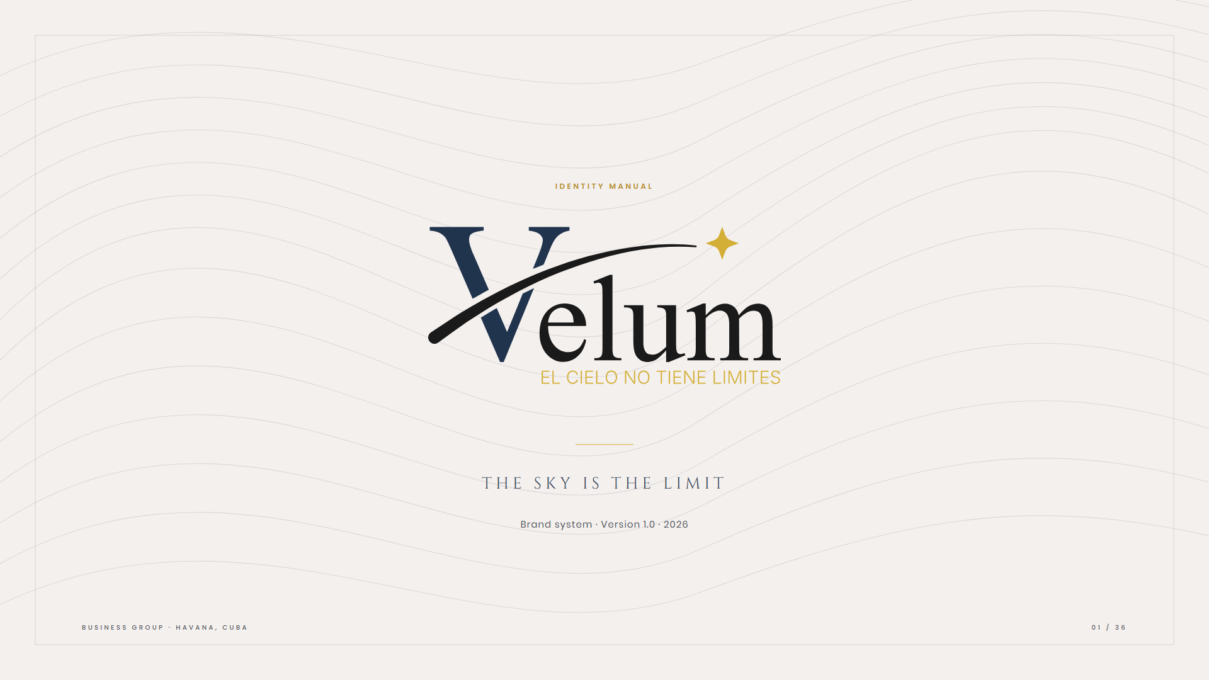
Notes:
01 — Cover

Slide 2
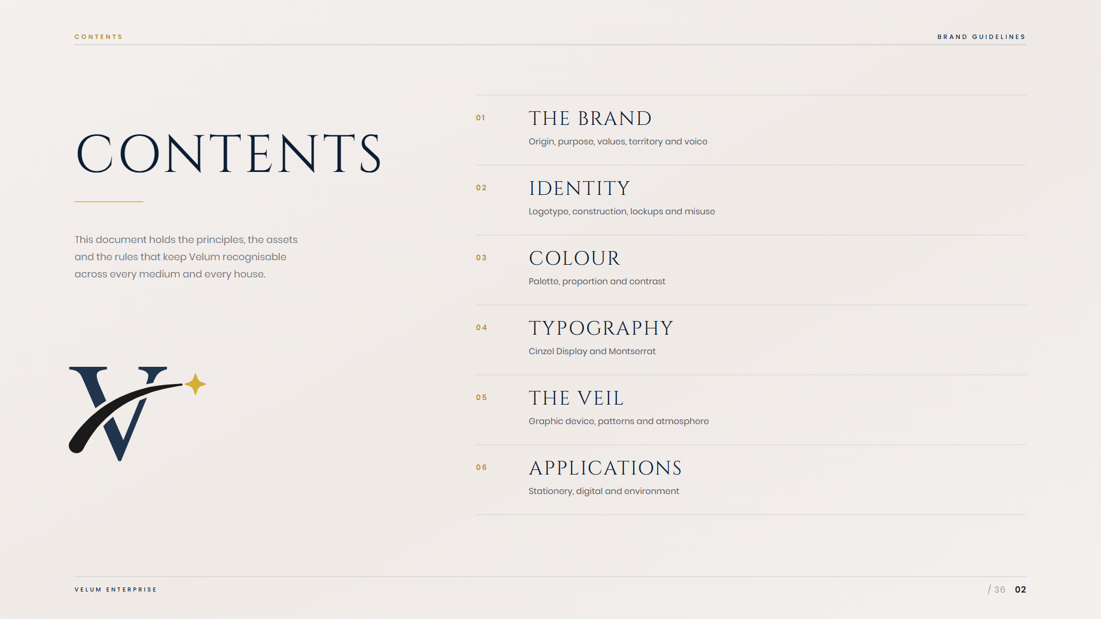
Notes:
02 — Contents

Slide 3

Notes:
03 — 01 · The brand

Slide 4
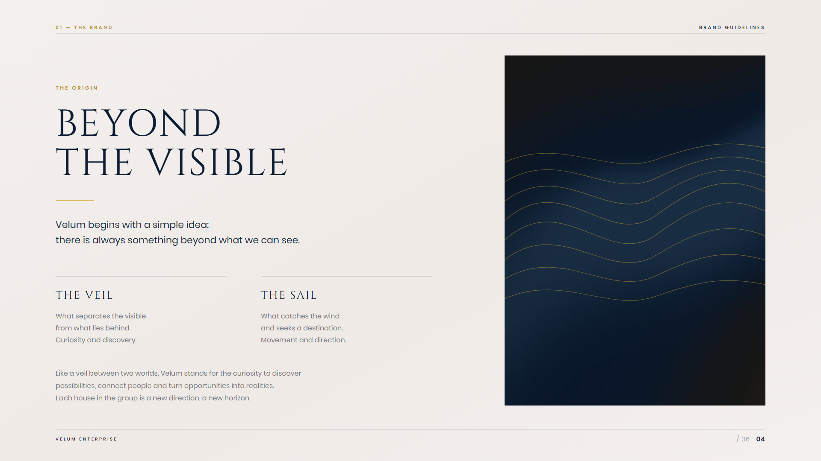
Notes:
04 — The origin

Slide 5
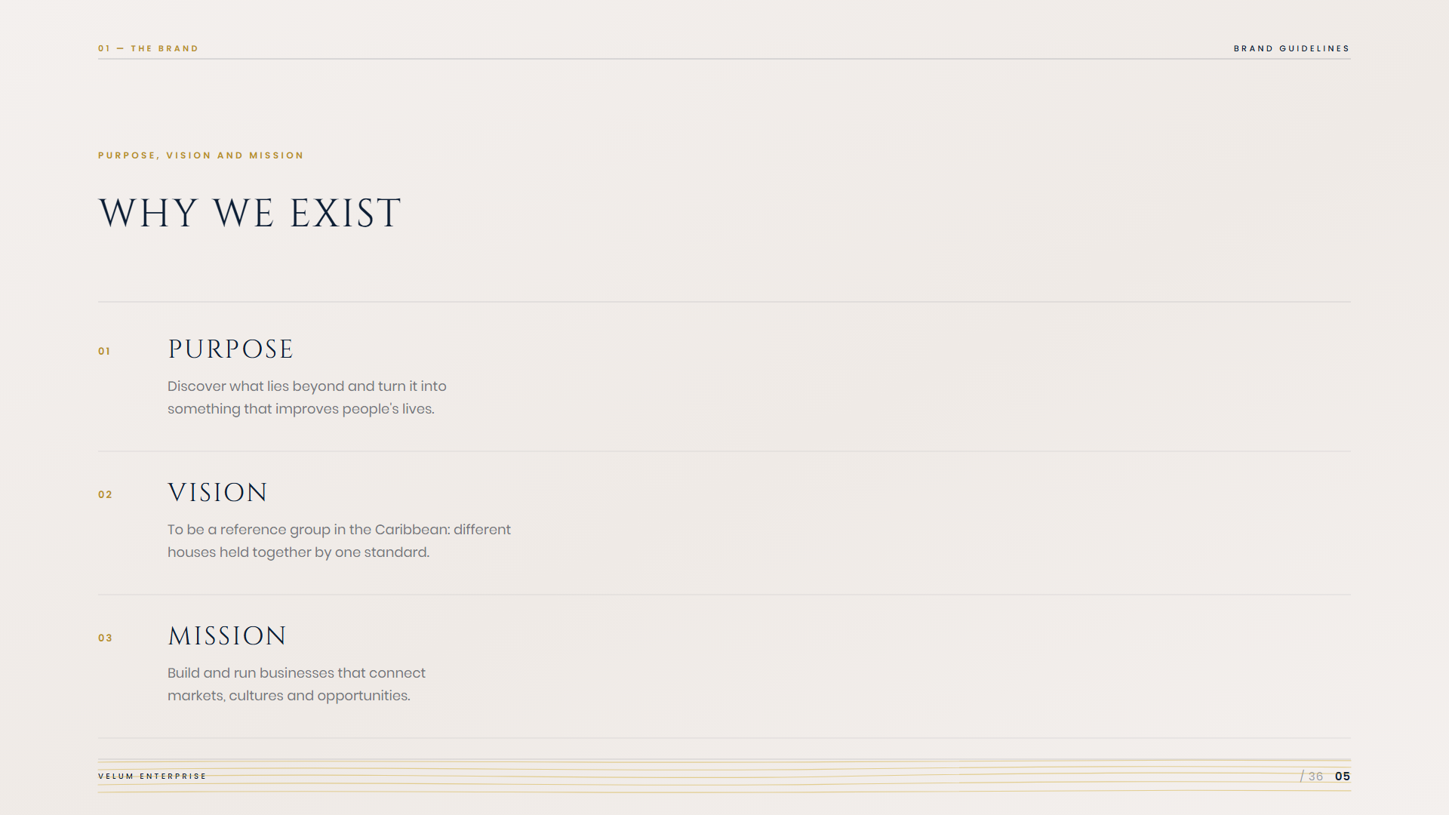
Notes:
05 — Purpose, vision, mission

Slide 6
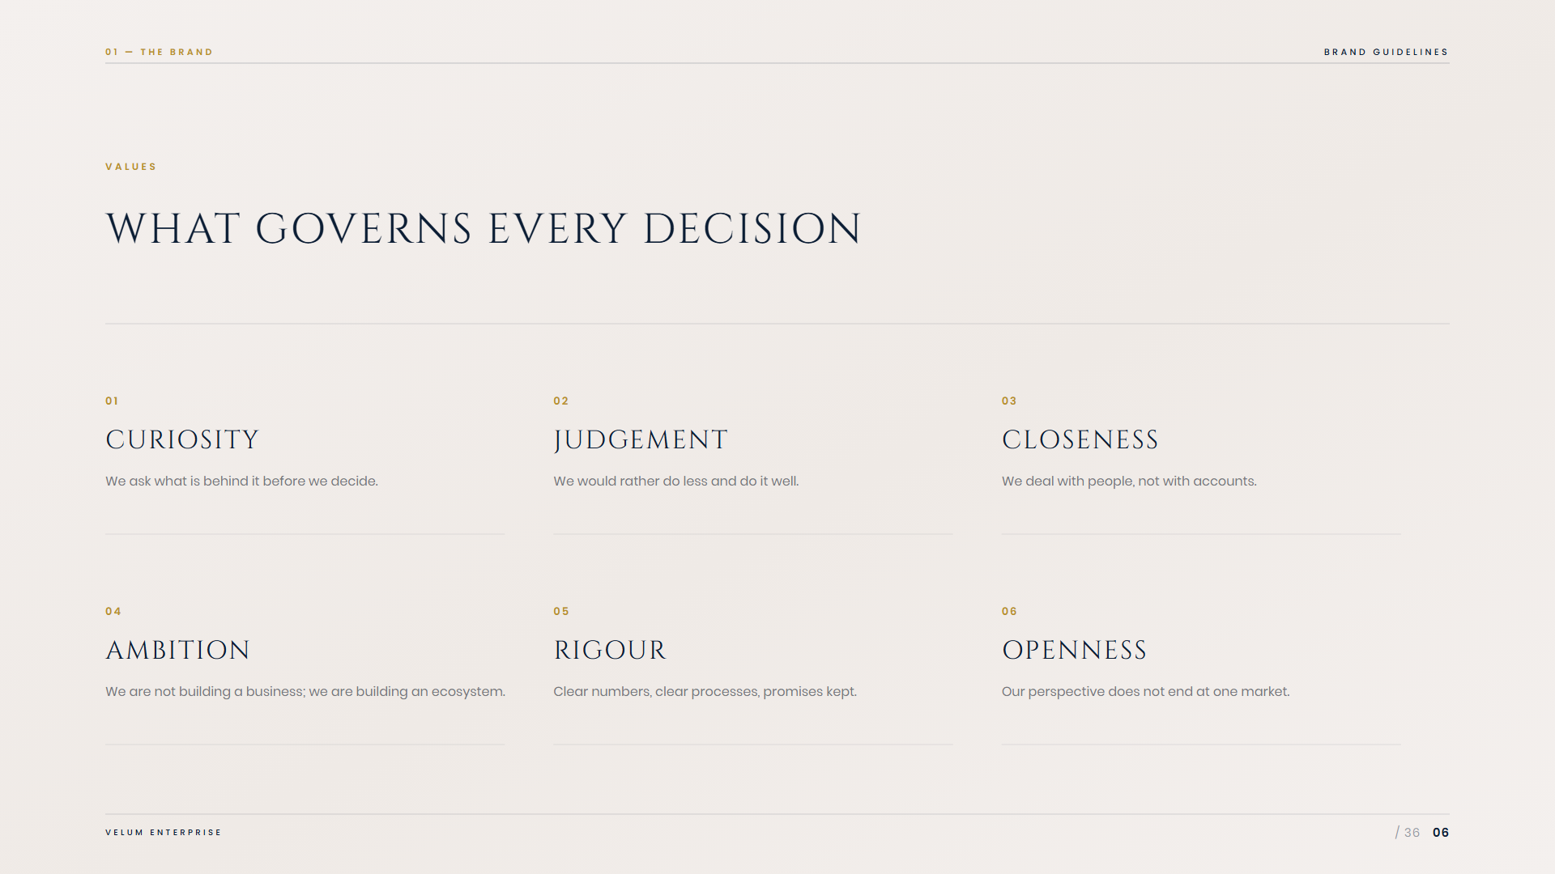
Notes:
06 — Values

Slide 7
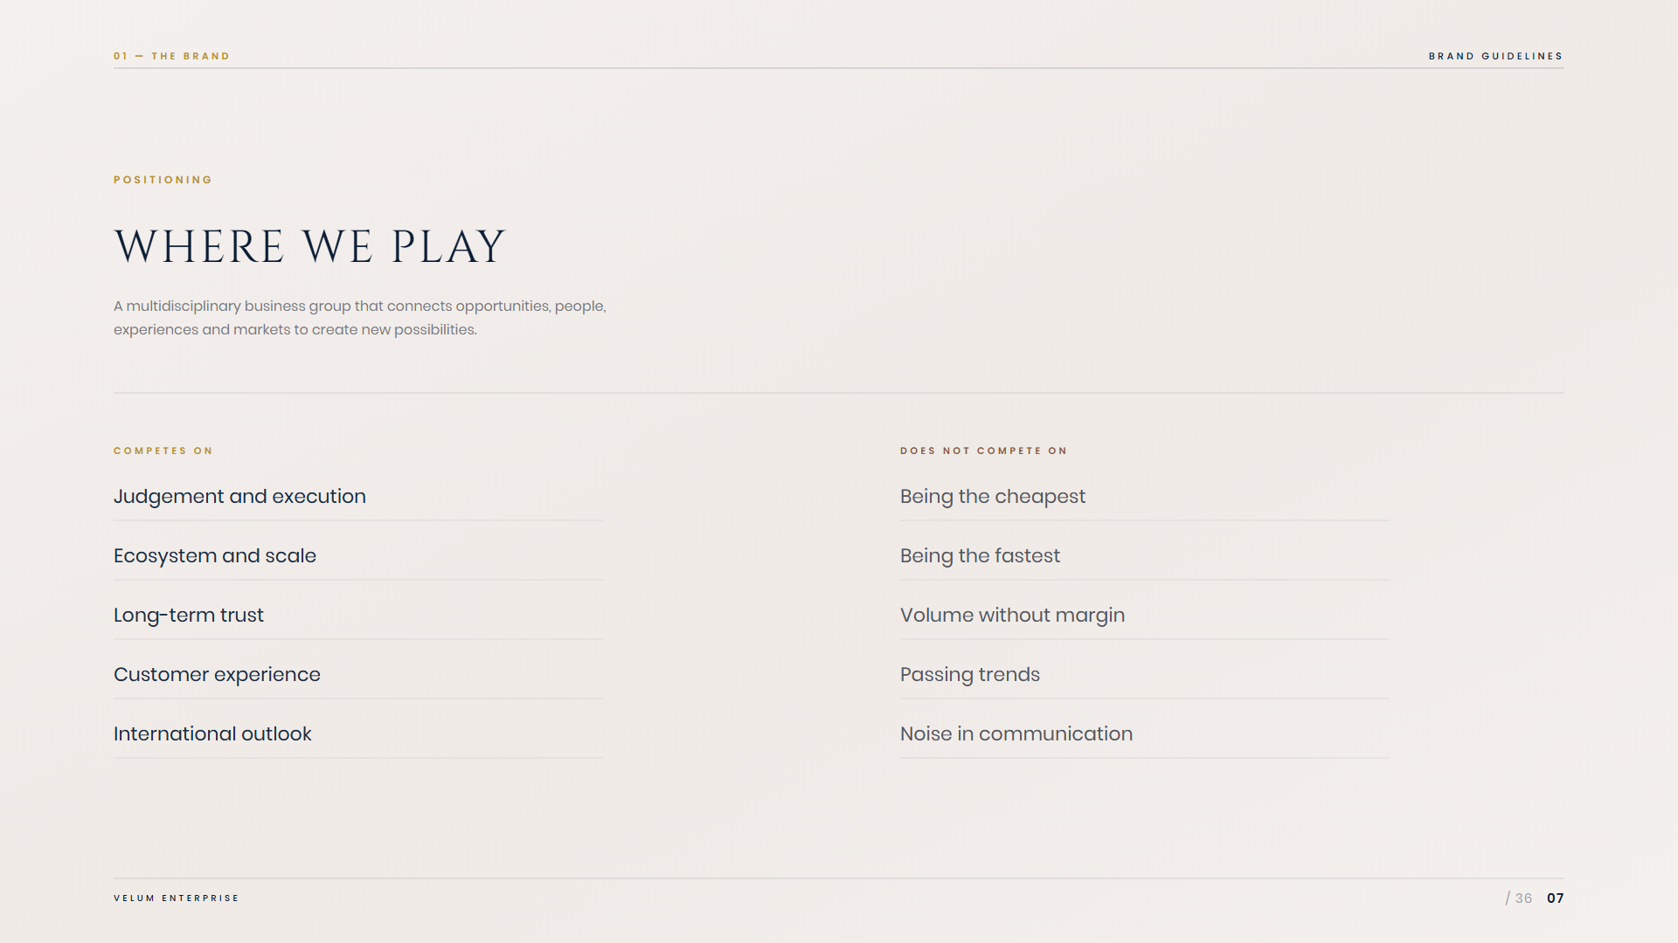
Notes:
07 — Positioning

Slide 8
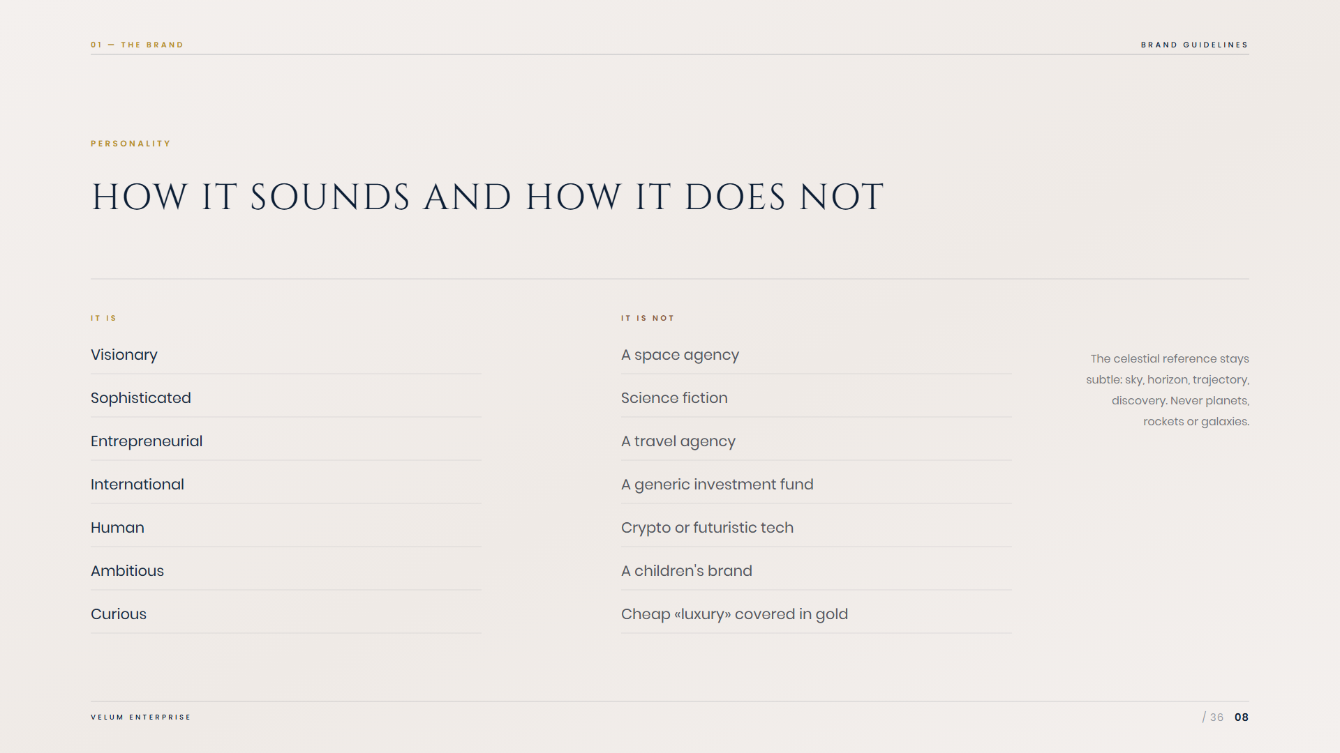
Notes:
08 — Personality

Slide 9
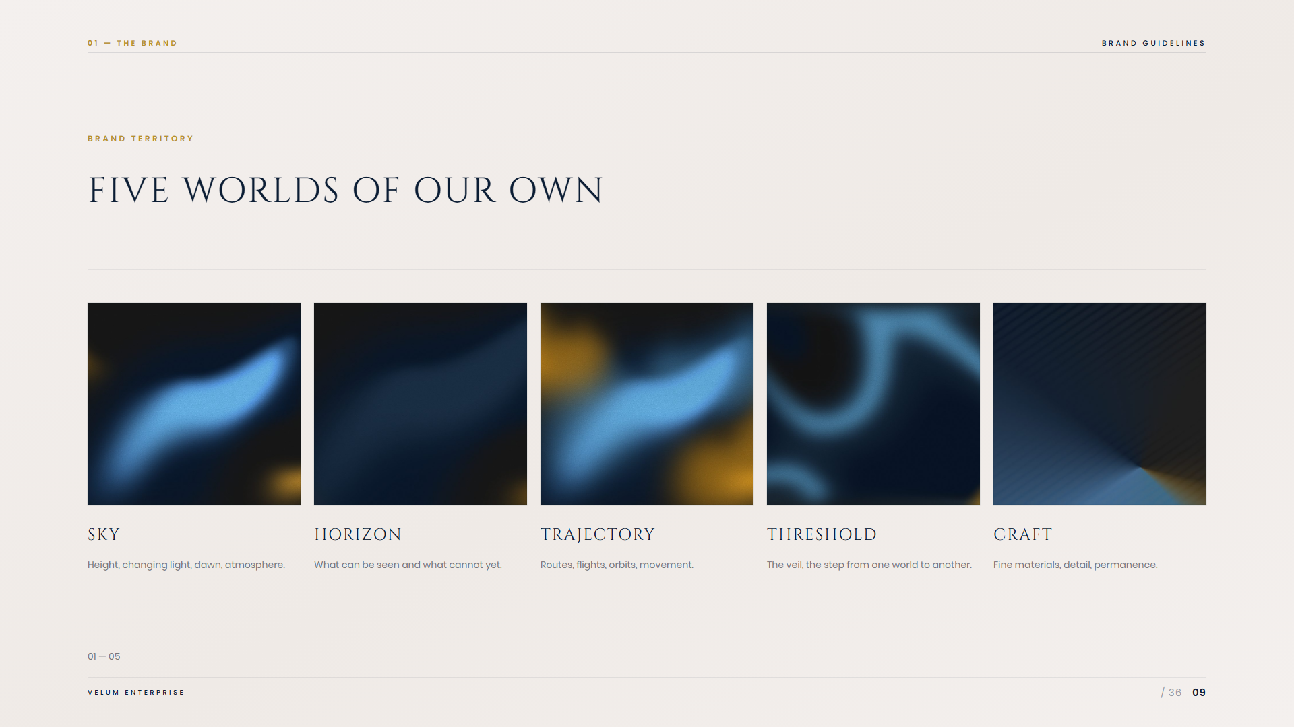
Notes:
09 — Brand territory

Slide 10

Notes:
10 — Manifesto

Slide 11
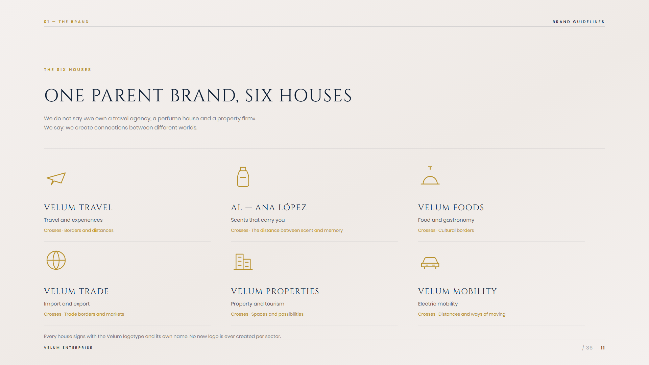
Notes:
11 — The six houses

Slide 12
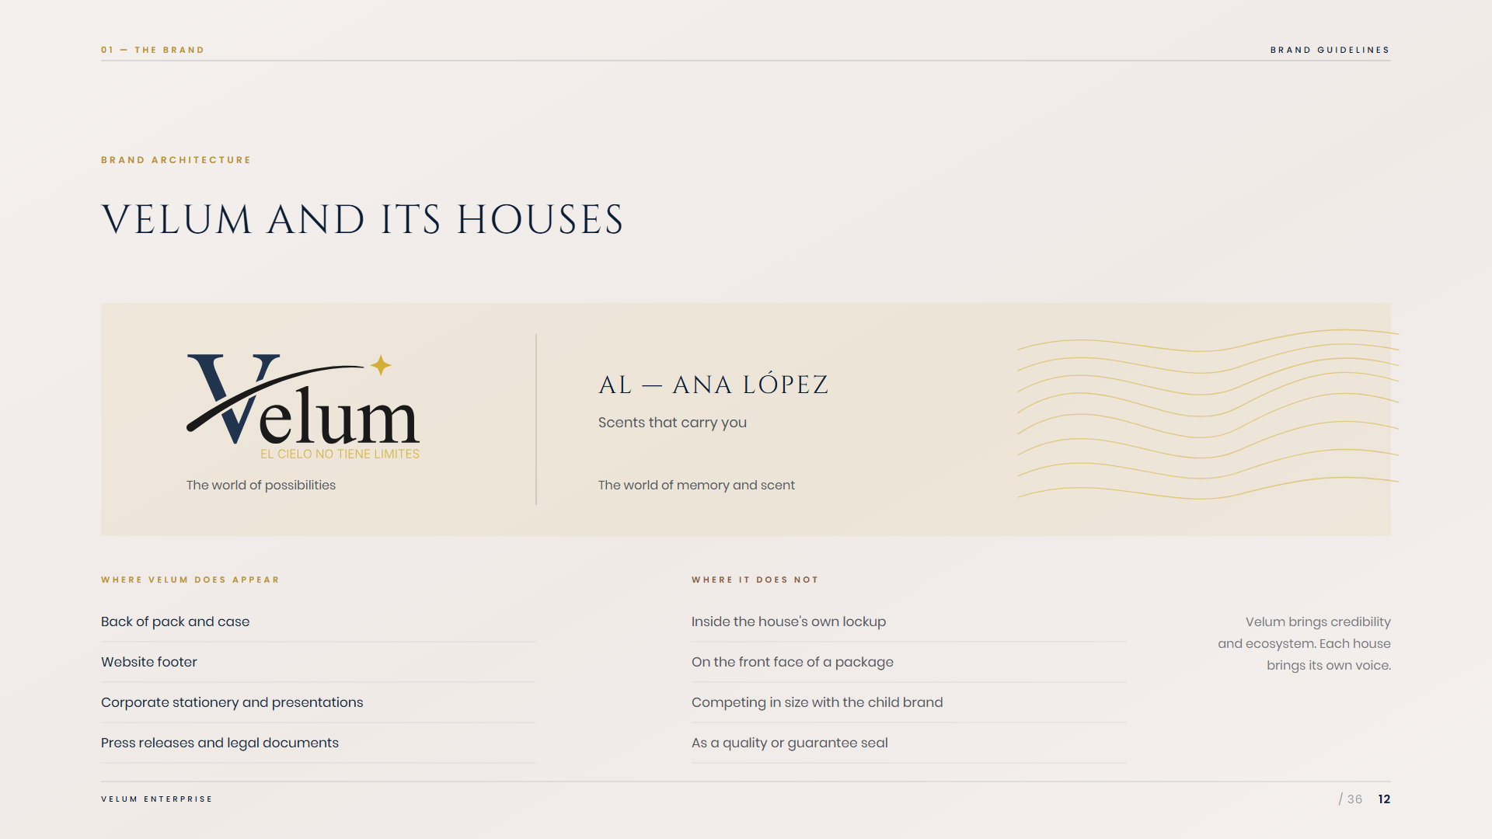
Notes:
12 — Brand architecture

Slide 13
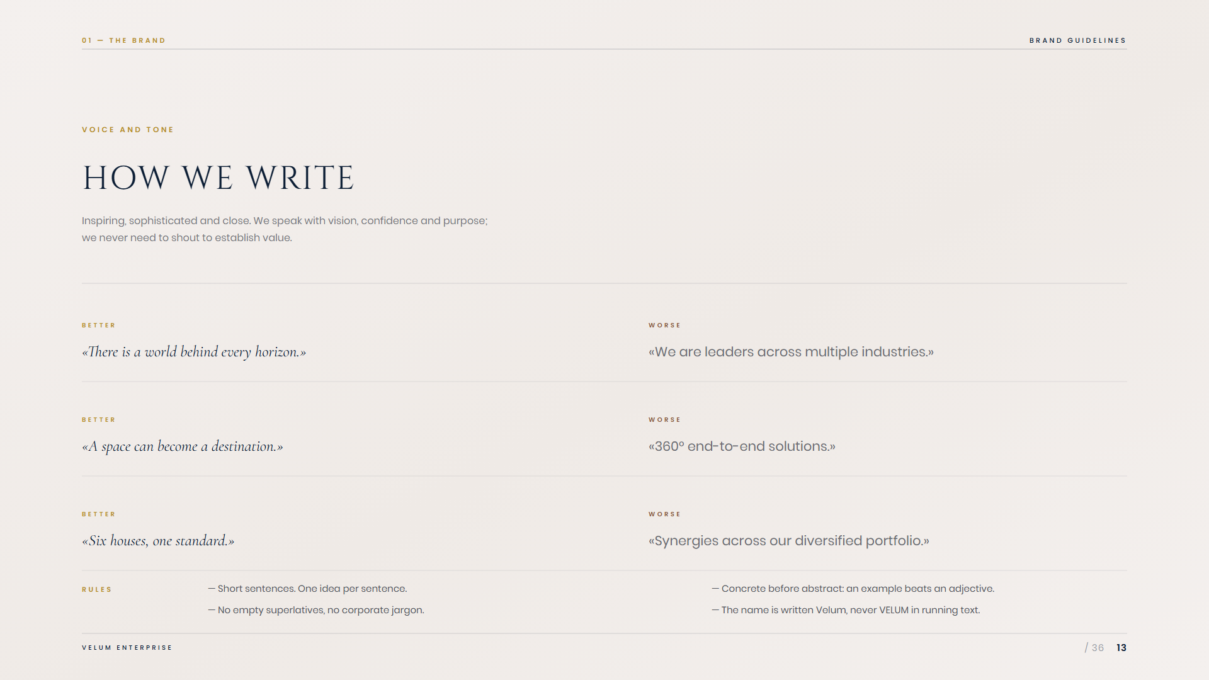
Notes:
13 — Voice and tone

Slide 14

Notes:
14 — 02 · Identity

Slide 15
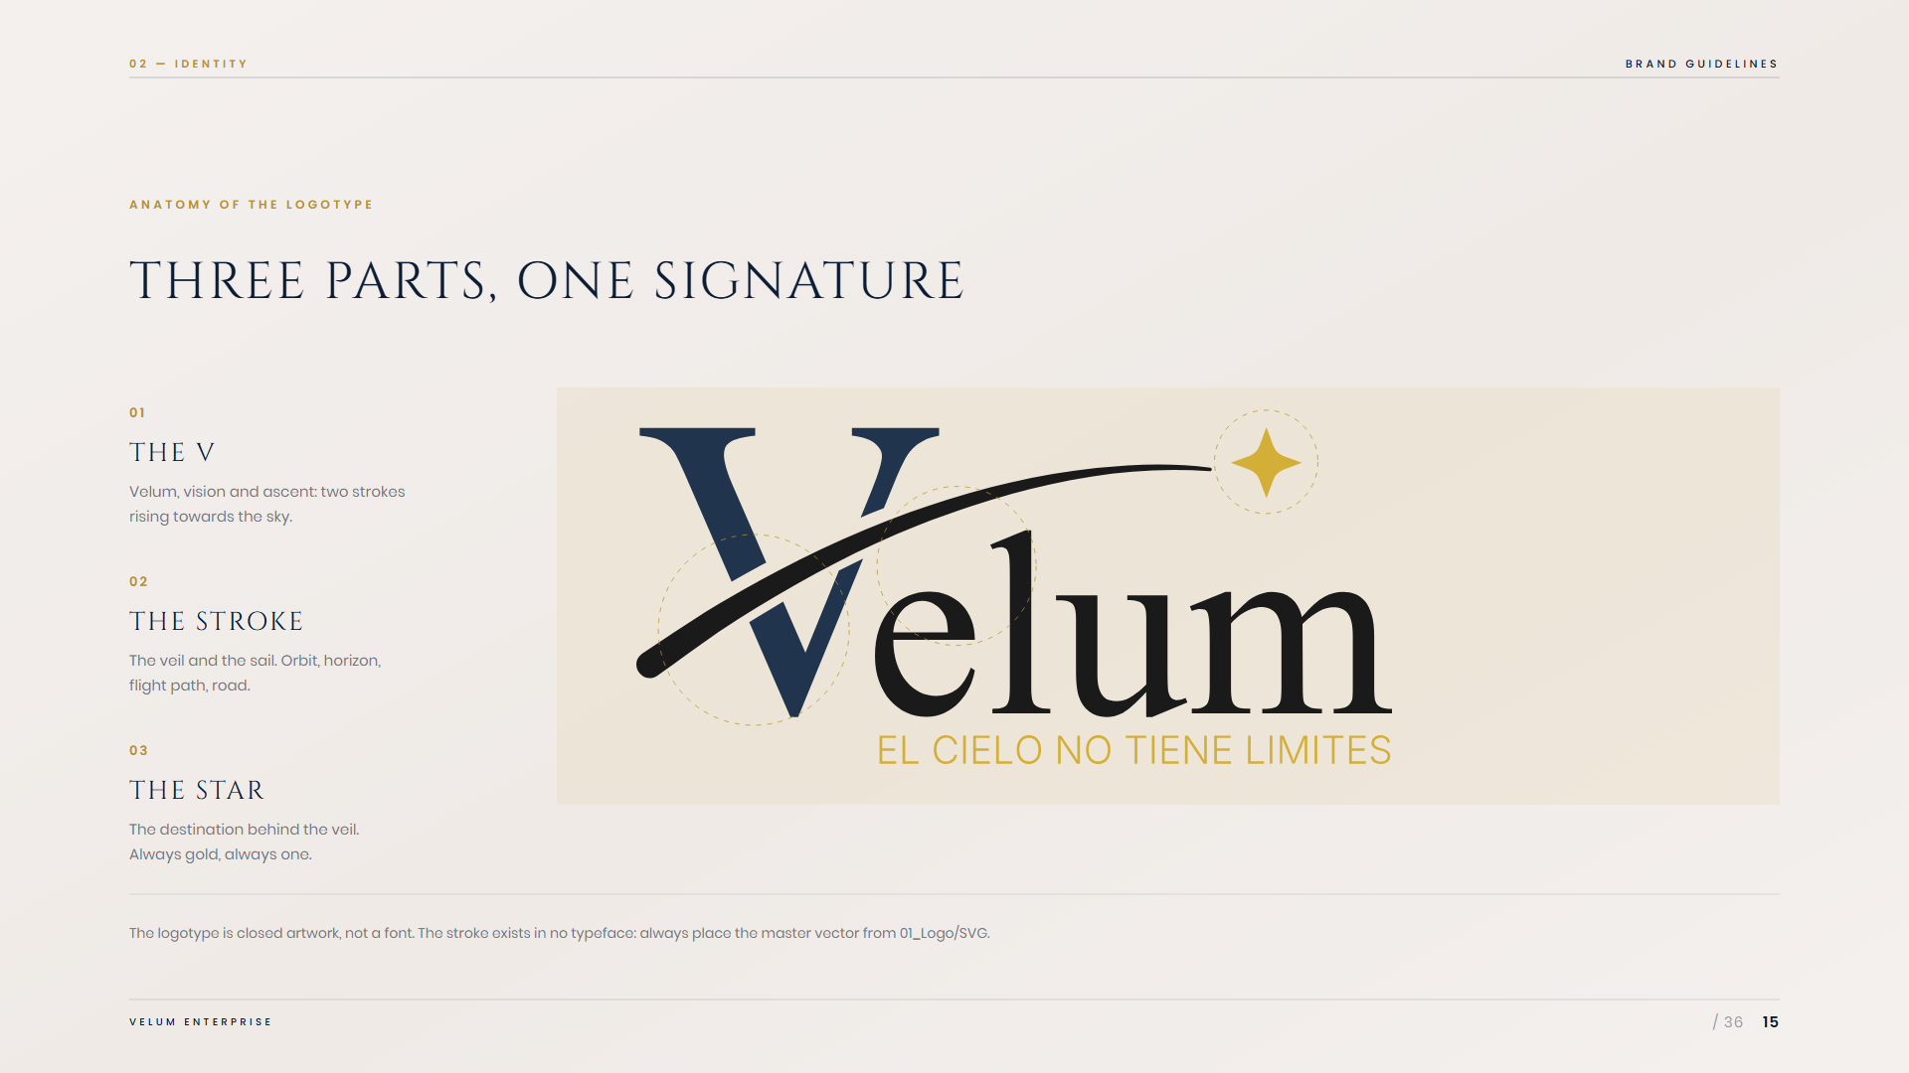
Notes:
15 — Anatomy of the logotype

Slide 16
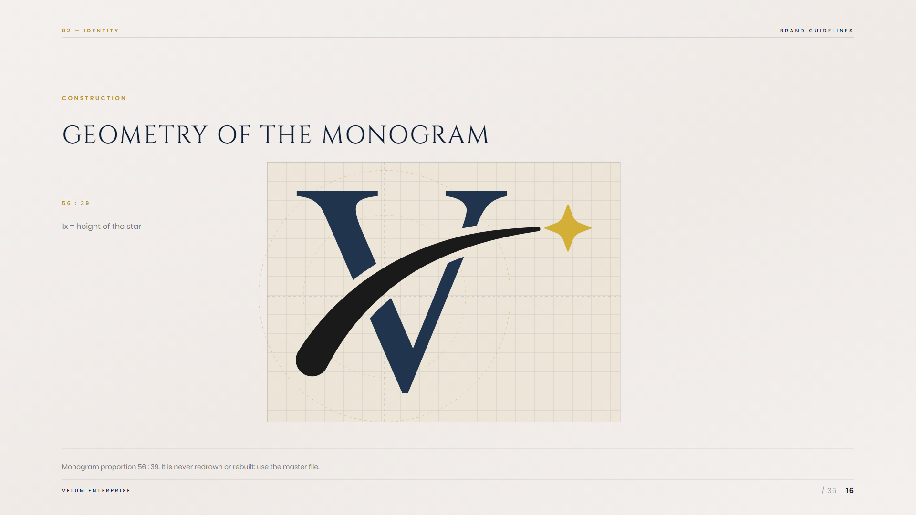
Notes:
16 — Construction

Slide 17
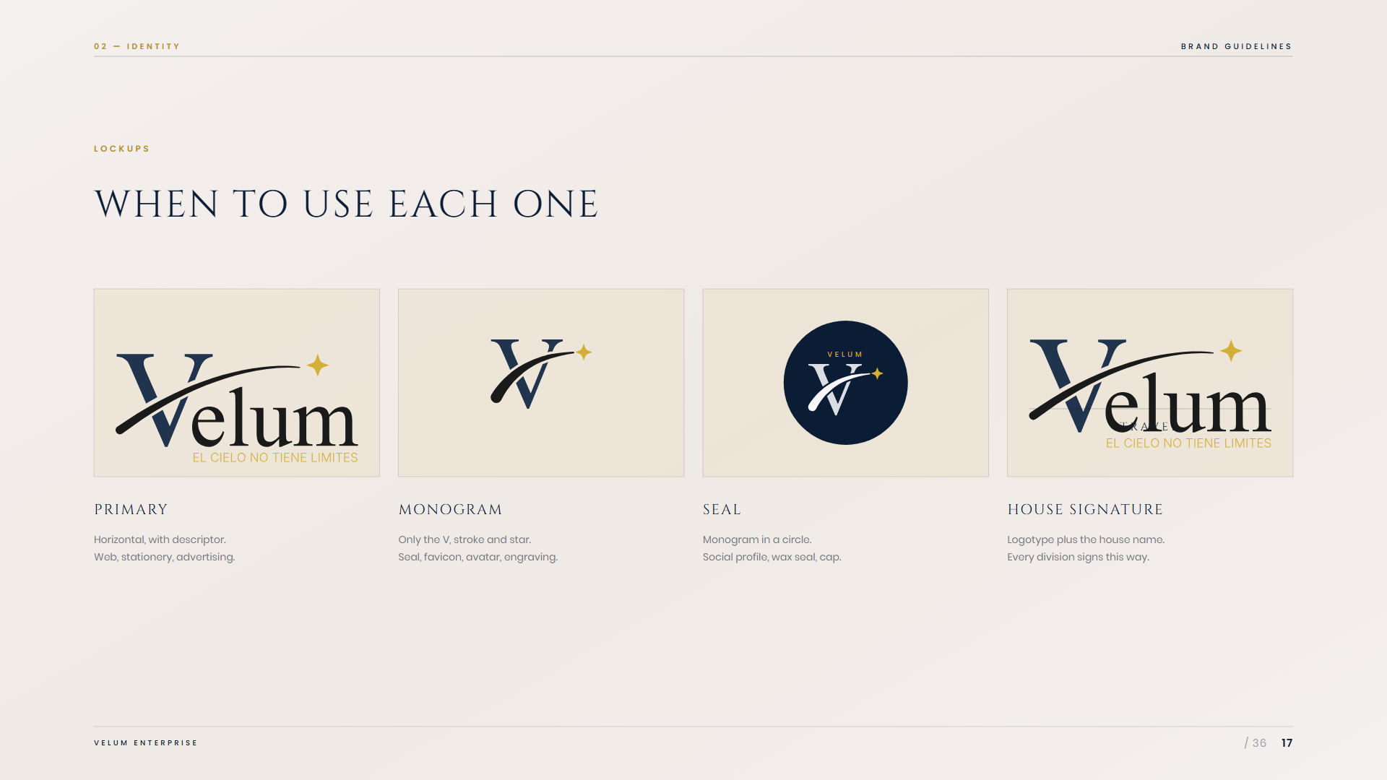
Notes:
17 — Lockups

Slide 18
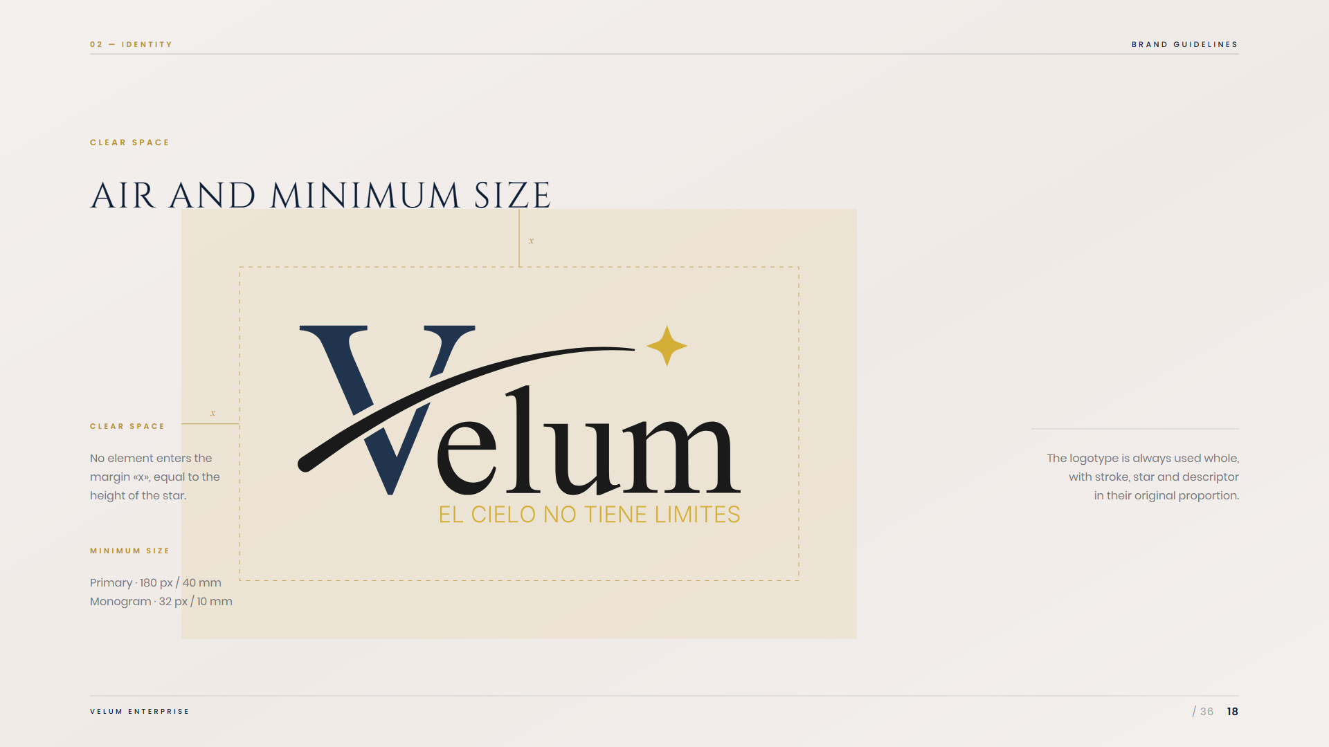
Notes:
18 — Clear space

Slide 19
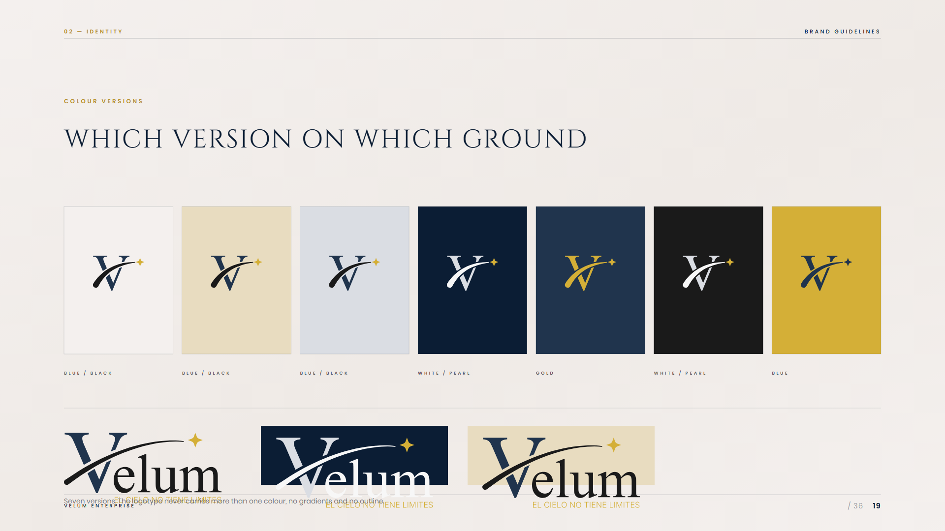
Notes:
19 — Colour versions

Slide 20
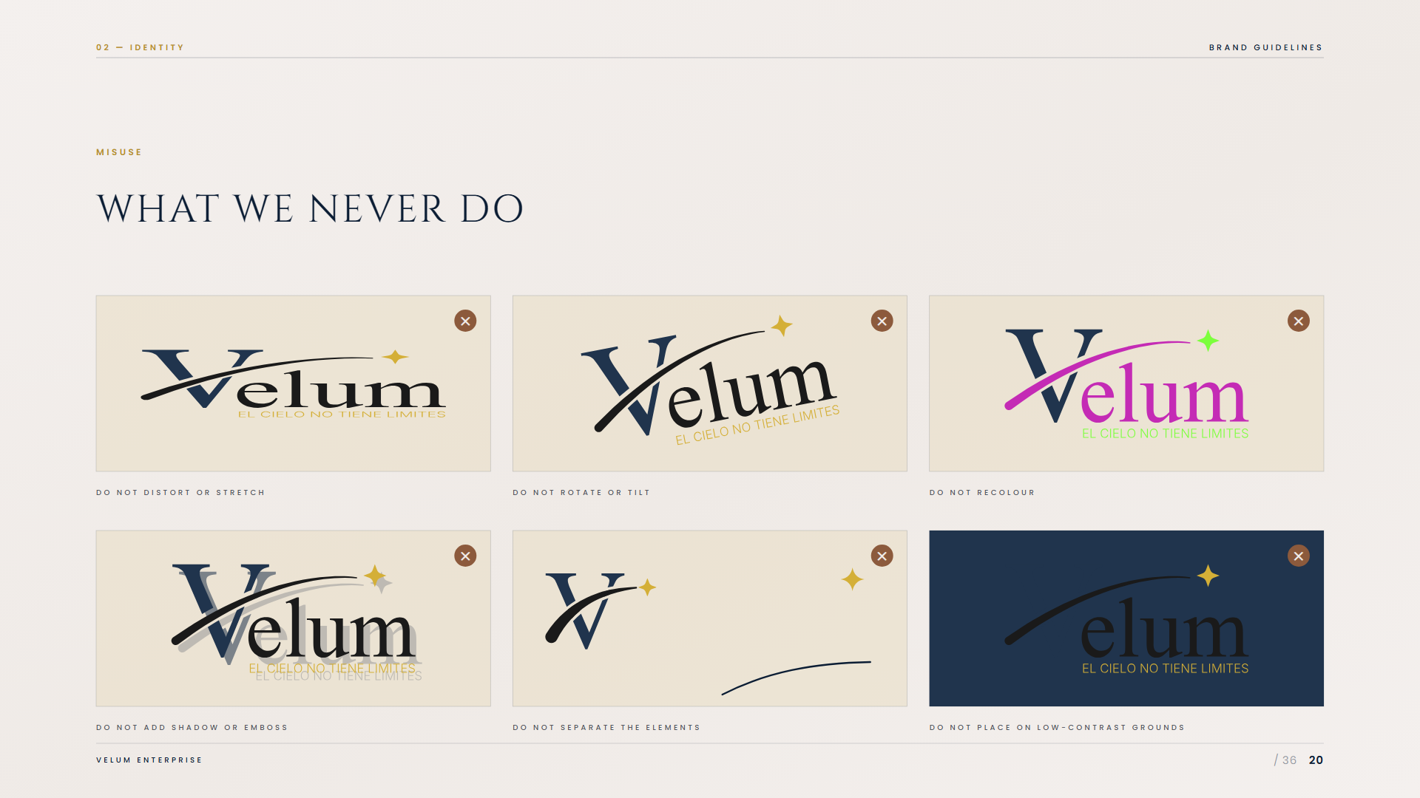
Notes:
20 — Misuse

Slide 21
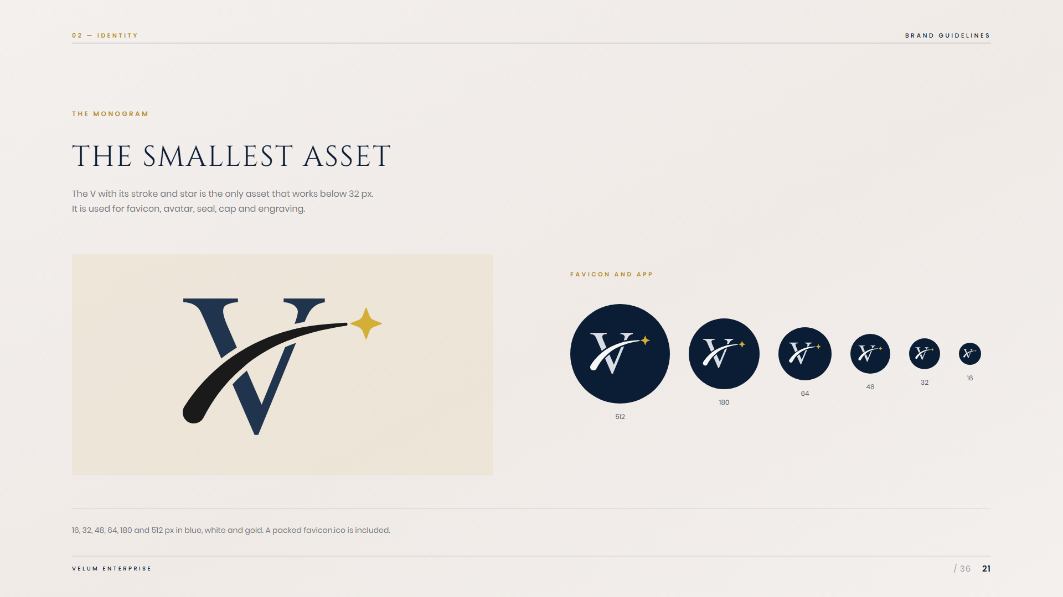
Notes:
21 — The monogram

Slide 22

Notes:
22 — 03 · Colour

Slide 23
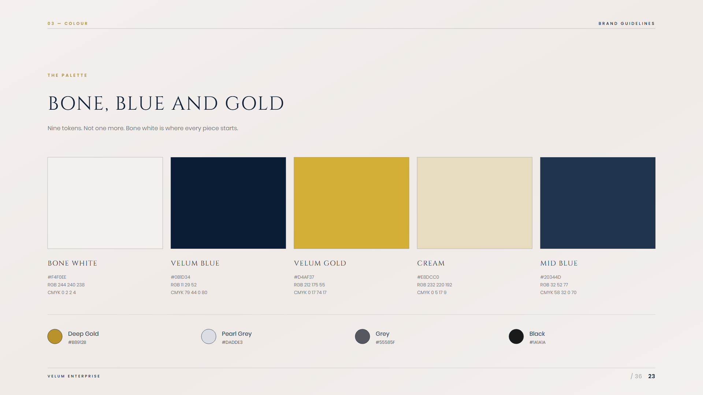
Notes:
23 — The palette

Slide 24
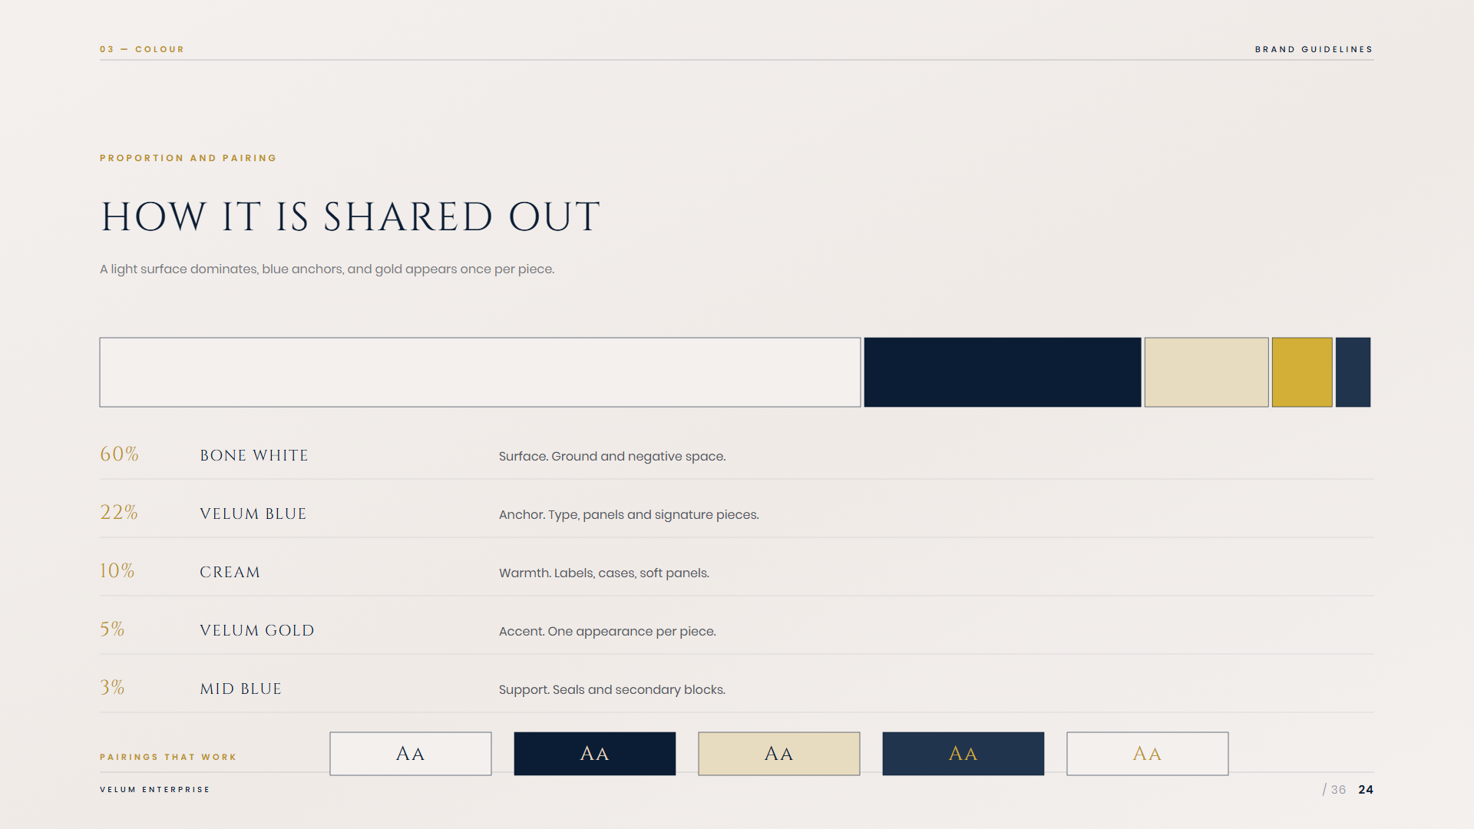
Notes:
24 — Proportion

Slide 25
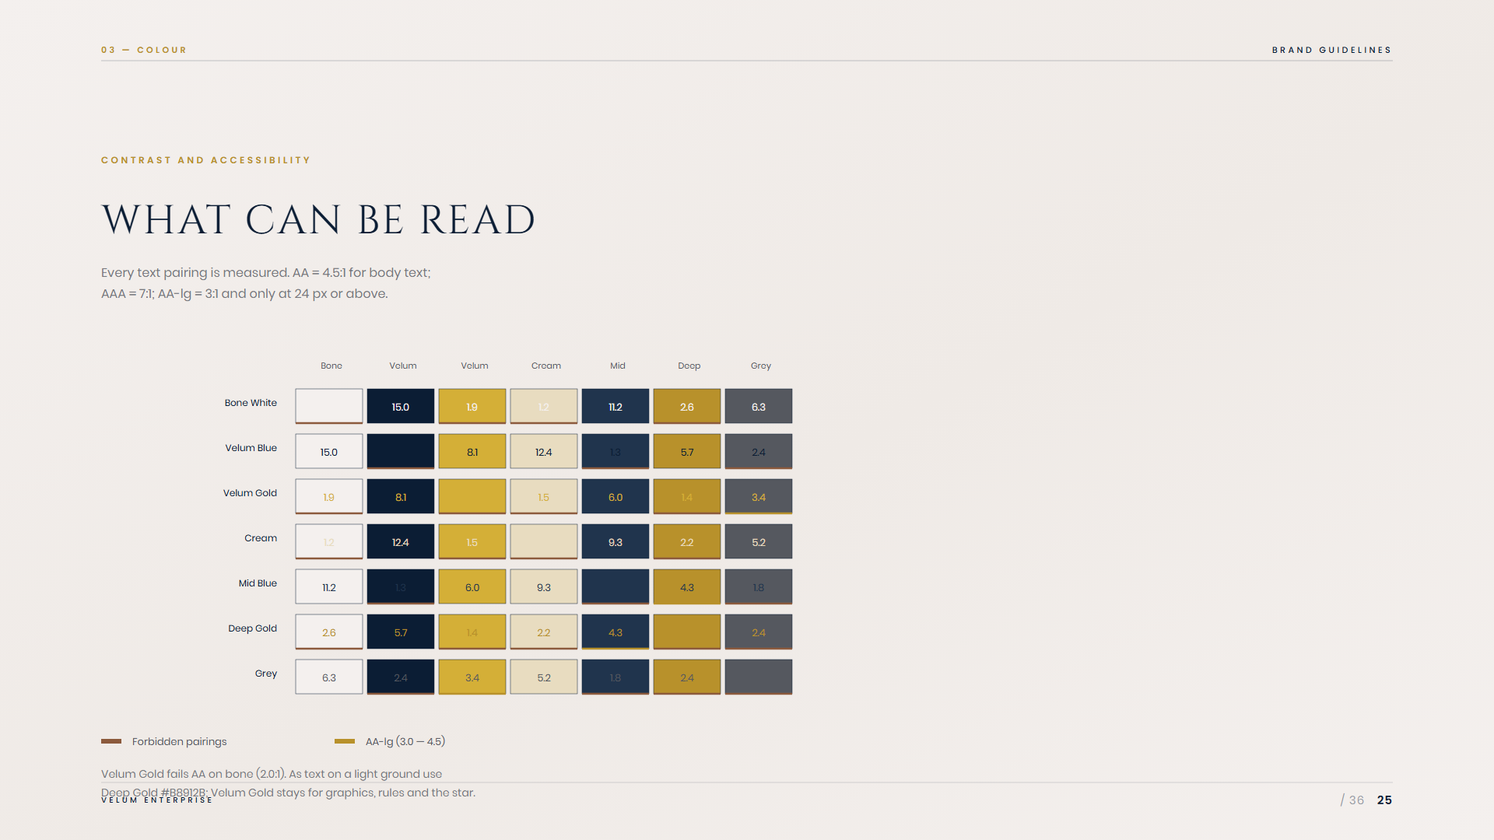
Notes:
25 — Contrast and accessibility

Slide 26

Notes:
26 — 04 · Typography

Slide 27
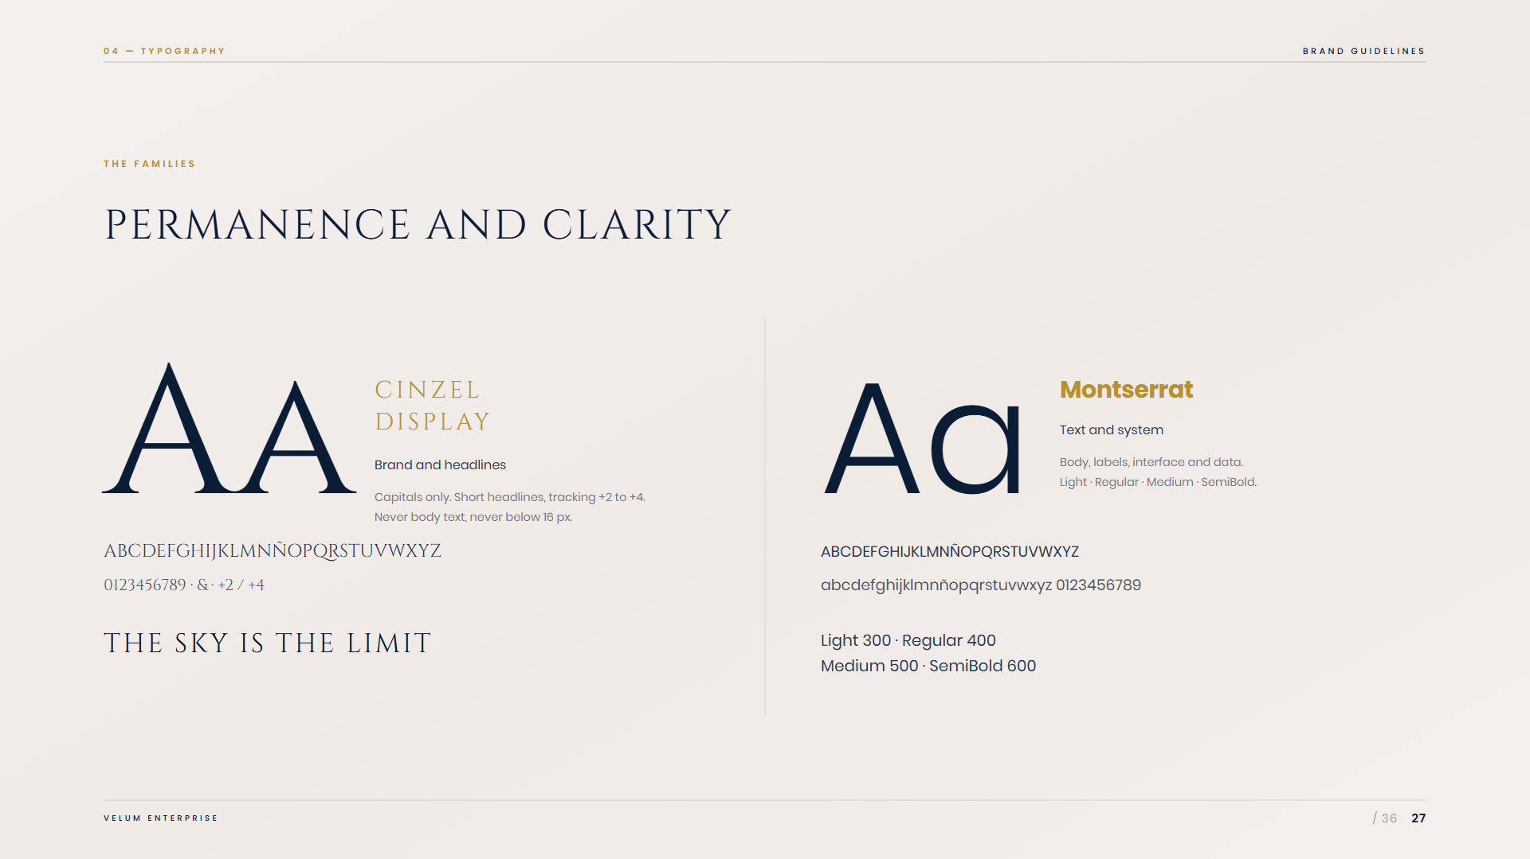
Notes:
27 — The families

Slide 28
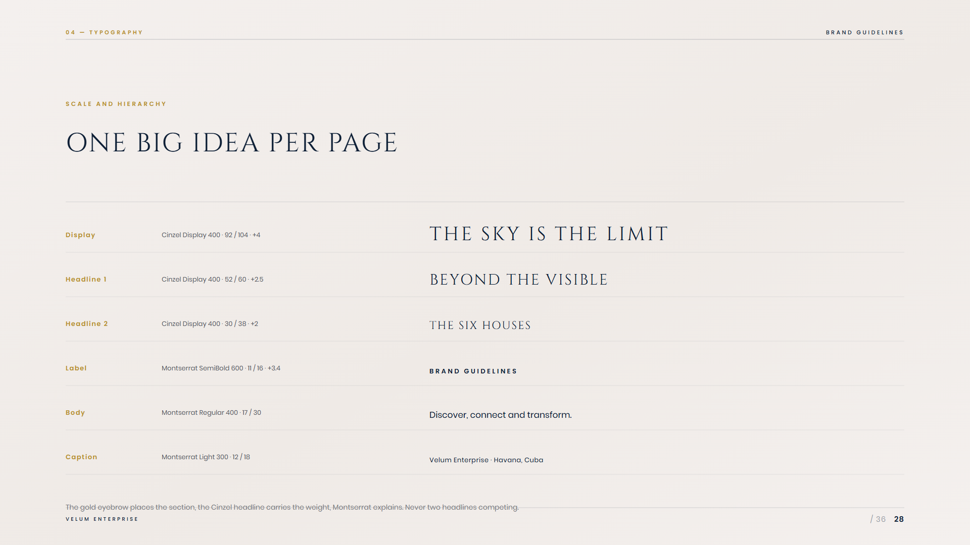
Notes:
28 — Scale and hierarchy

Slide 29

Notes:
29 — 05 · The veil

Slide 30
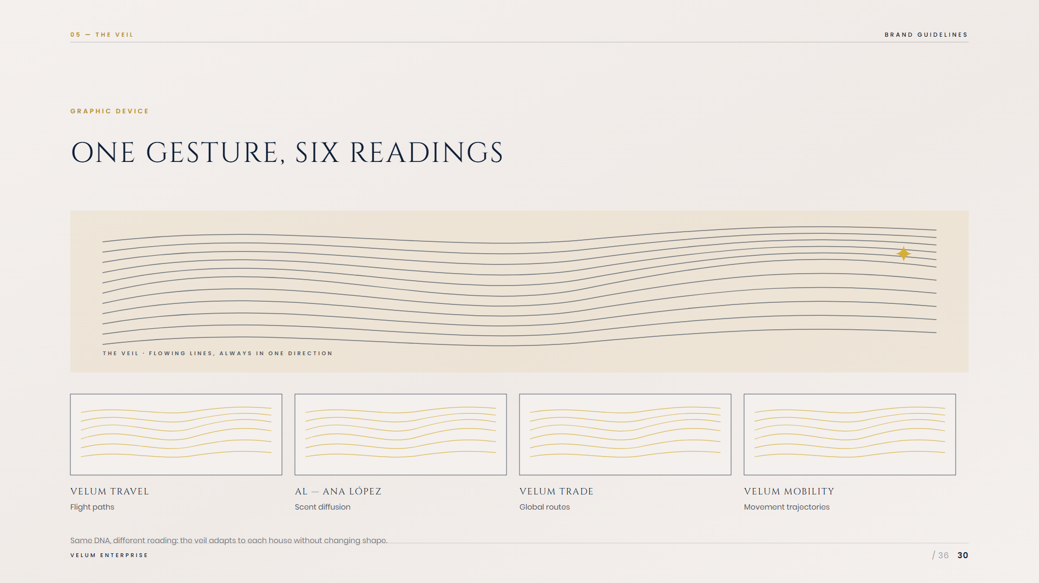
Notes:
30 — The veil

Slide 31
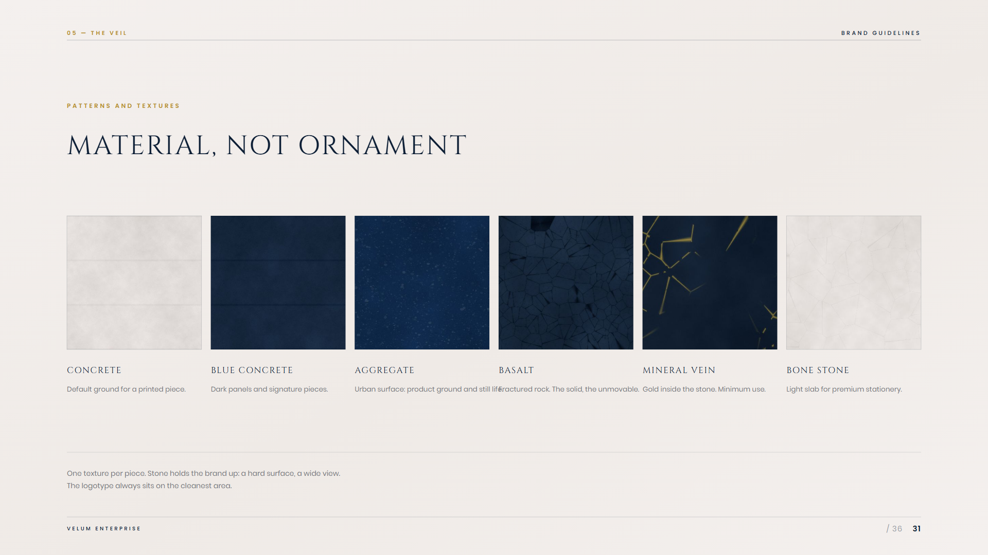
Notes:
31 — Patterns and textures

Slide 32
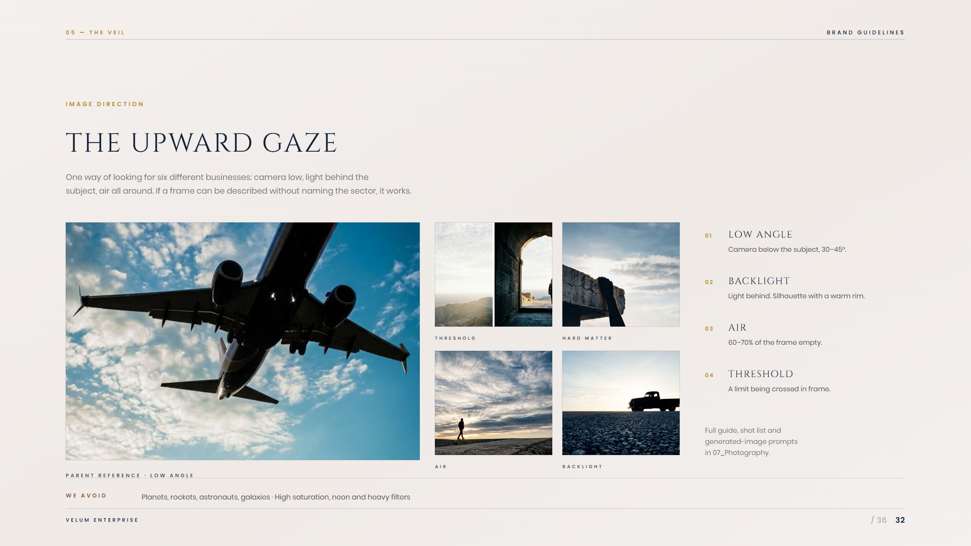
Notes:
32 — Image direction

Slide 33

Notes:
33 — 06 · Applications

Slide 34
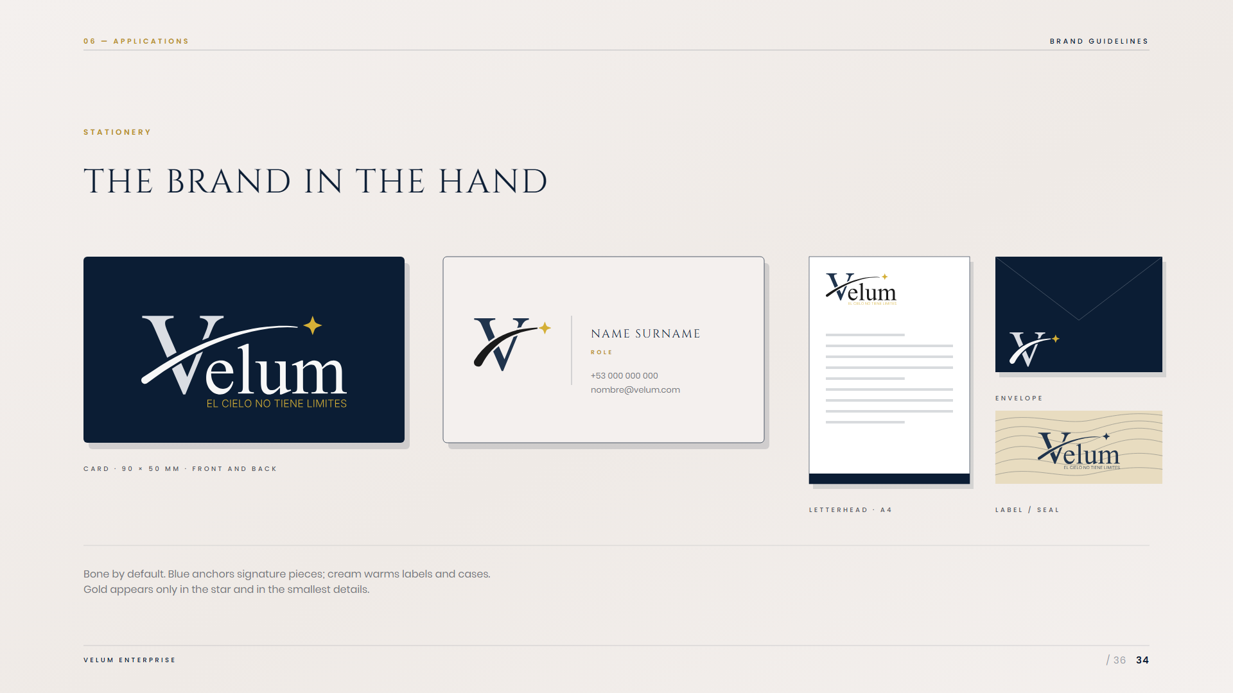
Notes:
34 — Stationery

Slide 35
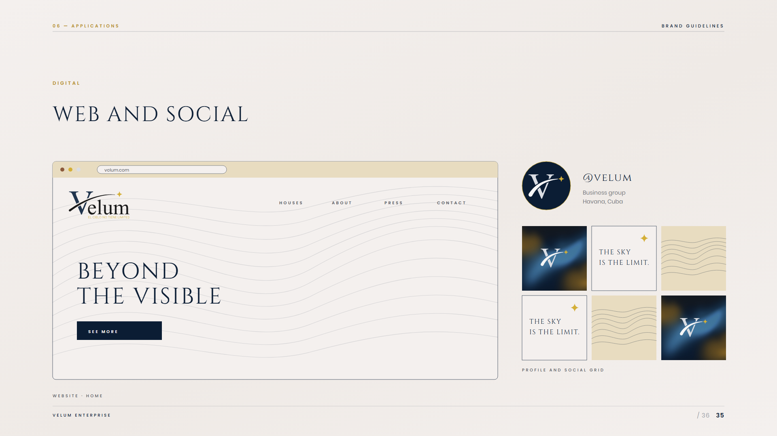
Notes:
35 — Digital

Slide 36
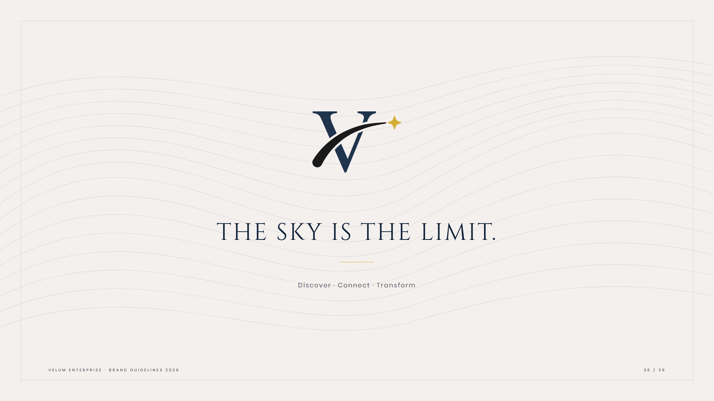
Notes:
36 — Closing

