Slide 1

Bee Hive Analysis
Identifying variables that affect bee activity and production

Slide 2

Why are bees important to us?
More than three quarters of global food crops rely on animal pollination for yield and/or quality.
They promote biodiversity in plants which are a resources for a wide range of other species.
A source for other benefits such as contributing to medicines, biofuels, fibers and timbers.
S.G. Potts, e. a. (2014–2018 ). Summary for policymakers of the assessment report of the
Intergovernmental Science-Policy Platform on Biodiversity and Ecosystem Services on
pollinators, pollination and food production. Intergovernmental Science-Policy Platform on
Biodiversity and Ecosystem.

Slide 3

…
What is happening to the World’s Bees?
An increase in land use, pesticide use, environmental pollution, invasive alien species, pathogens and climate change have caused a decline in the abundance, diversity and health of pollinators.
Why is this so concerning?
The volume of production of pollinator-dependent crops has increased by 300% over the last five decades, making livelihoods increasingly dependent on pollination.
Pollinator-dependent crops have experienced lower growth and lower stability of yield than pollinator-independent crops.
S.G. Potts, e. a. (2014–2018 ). Summary for policymakers of the assessment report of the
Intergovernmental Science-Policy Platform on Biodiversity and Ecosystem Services on
pollinators, pollination and food production. Intergovernmental Science-Policy Platform on
Biodiversity and Ecosystem.

Slide 4

How can we help?
Bee culture (beekeeping) and metric capture.
- Beekeeping is a great way to help boost population and increase species’ genetic variability, increasing their gene pool.
- Studying colonies and capturing important data metrics for analysis can help us better understand what factors affect colony survival and to what degree.

Slide 5
The Data: What, Where and How
Beehive metric data
- Source: HOneybee Online Studies https://www.hobos.de via Kaggle.com
- Data: 4 archives (CSV files) with data from year 2017 to 2019 for colony (locations: Wurzburg and Schwartau, Germany))
flow: For a date it contains the number of departures and arrivals from/to the beehive. A positive number indicates the number of arrivals and a negative number of departures.
humidity: Level of relative humidity through time of the beehive expressed in %
temperature : Temperature of the beehive through time of the beehive in Cº
weight: Weight of the beehive through time in Kg.
Weather metric data for Wurzburg and Schwartau
- Source: Reliable Prognosis https://rp5.ru
- Data: Temperature and relative humidity readings every hour from 12/31/2016 to 05/31/2019 (CSV file).

Slide 6
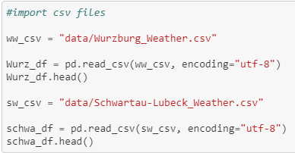
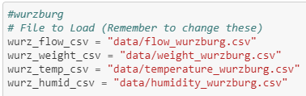
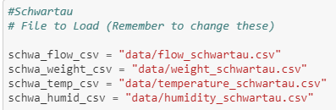
10 CSV files

Slide 7
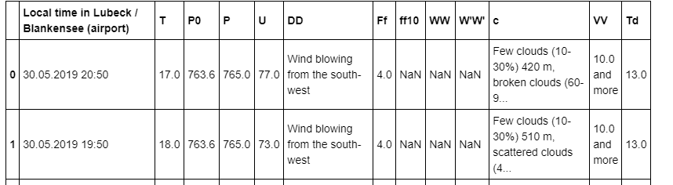
Too much info!

Slide 8
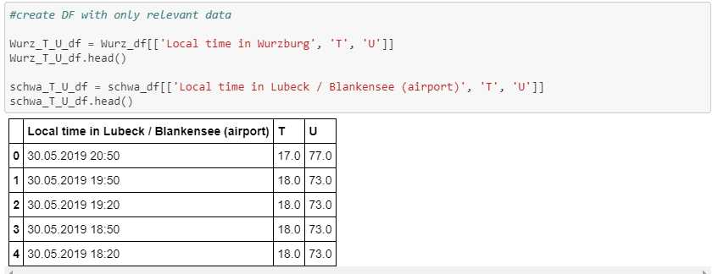
Only used relevant info

Slide 9
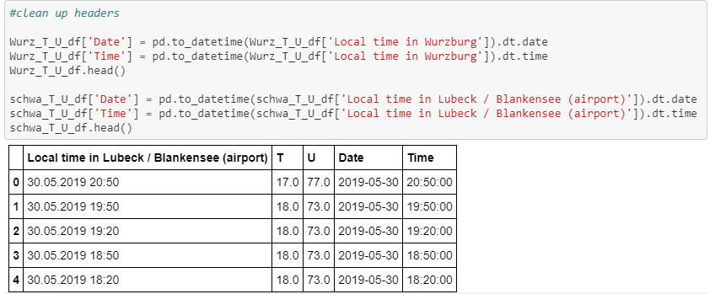
Split the Timestamp to separate Date Time columns

Slide 10
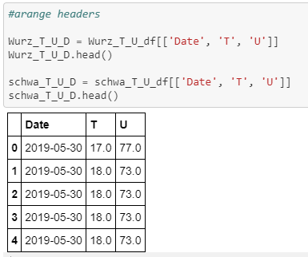
Less is more!

Slide 11
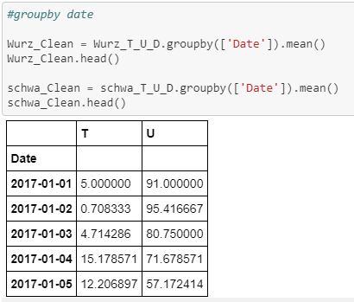
Average values for each day

Slide 12

Converted strings to timestamp

Slide 13
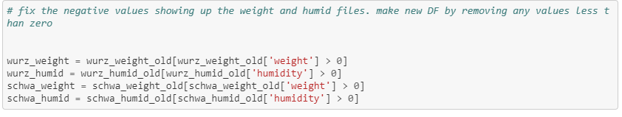
Eliminated bad data

Slide 14
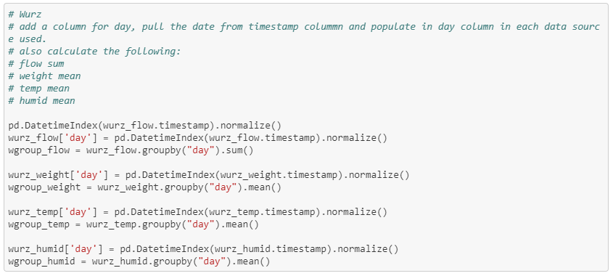
Daily averages of weight, temperature and humidity, as well as the sum of the flow

Slide 15
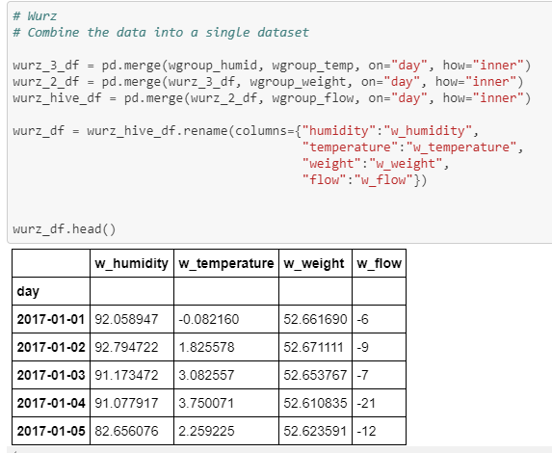
Start merging!

Slide 16

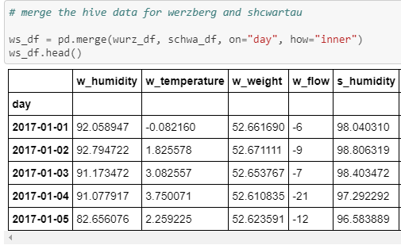
Wait, did you notice the index?

Slide 17
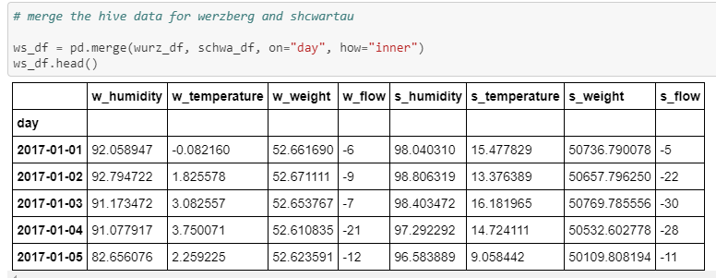
Omg more merging!?

Slide 18
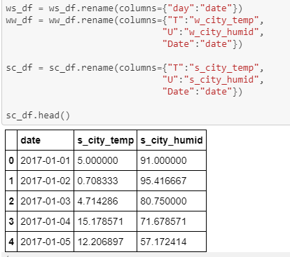
Prepare the city weather for…

Slide 19
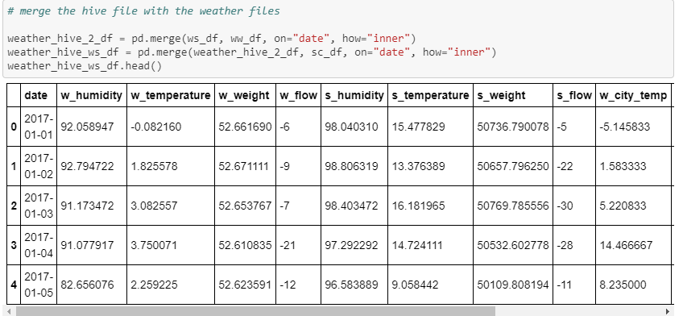
…. That’s right, more merging!

Slide 20
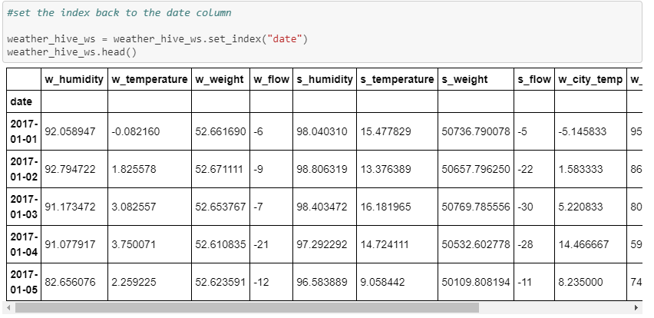
Funny thing about that index

Slide 21
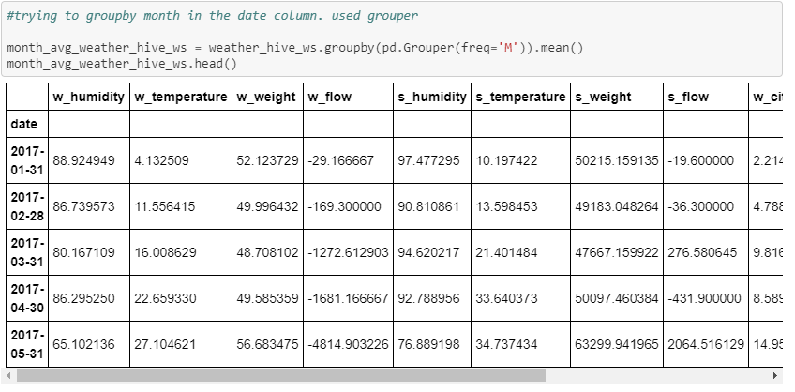
It’s not the fish of the month, it’s groupby Grouper

Slide 22
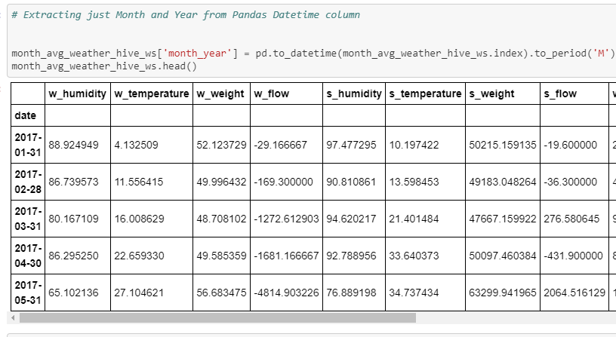
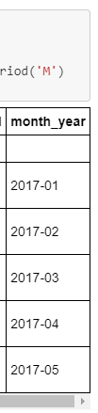
Fix the date column

Slide 23
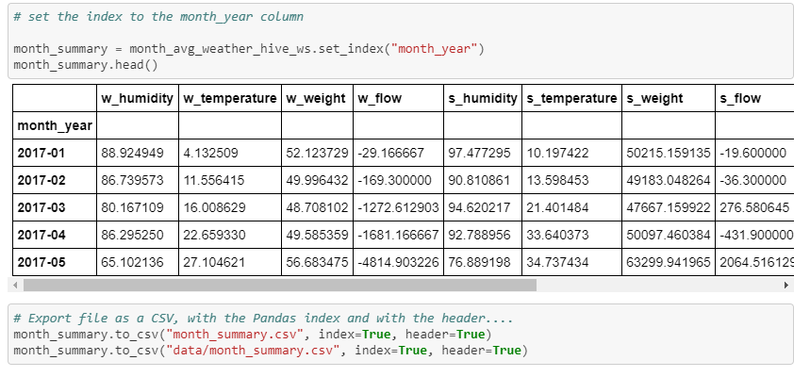
Reset the Index and output CSV

Slide 24
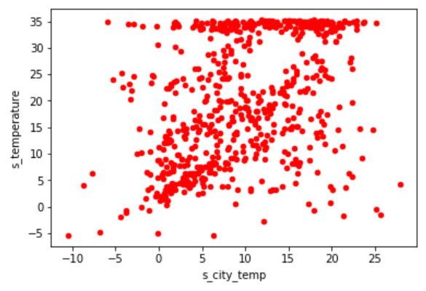
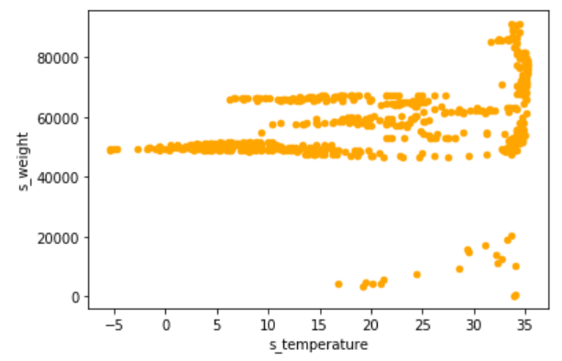
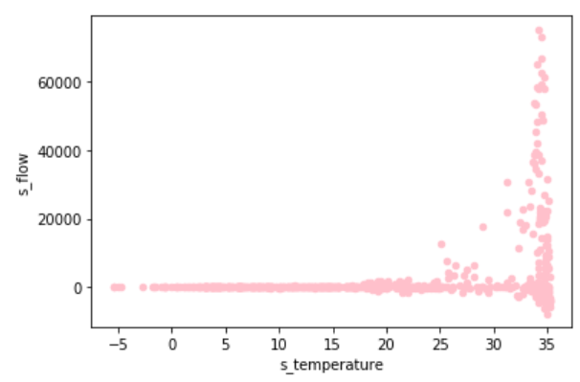
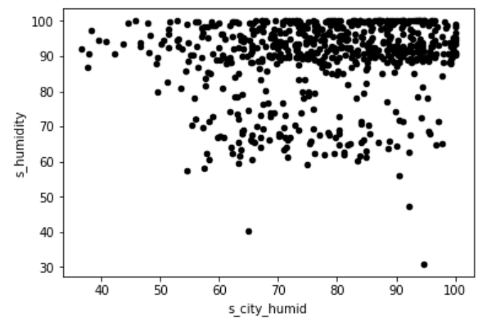
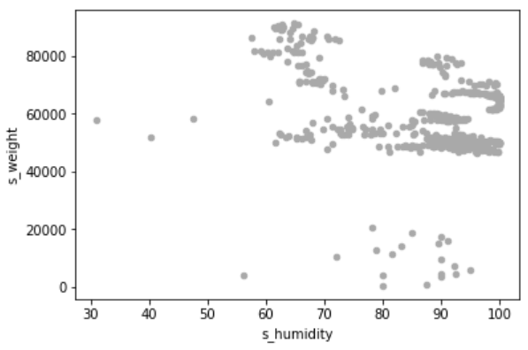
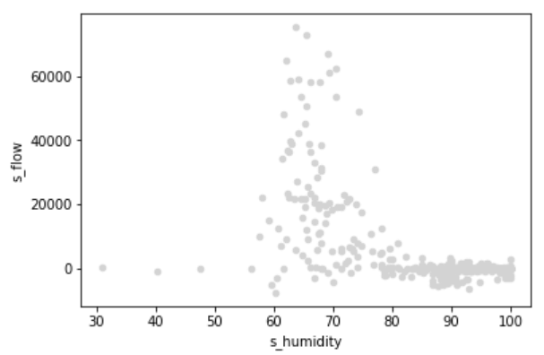
Analysis Process: Schwartau
Key Questions:
Temp inside hive is not influenced by city temperature?
When hive temp rises above ~32ºC, hive weight increases by ~30000 kgs?
When hive temp rises above ~32ºC, net bees flow per day is into the hive?
Hive humidity seems to be independent of city humidity, and is close to 90-100%?
When hive humidity is between~ 60-70%, hive weight increases the most?
When hive humidity is between~ 60-70%, net bee flow per day is into the hive? When humidity is between 80-100%, net bee flow per day is close to 0?

Slide 25
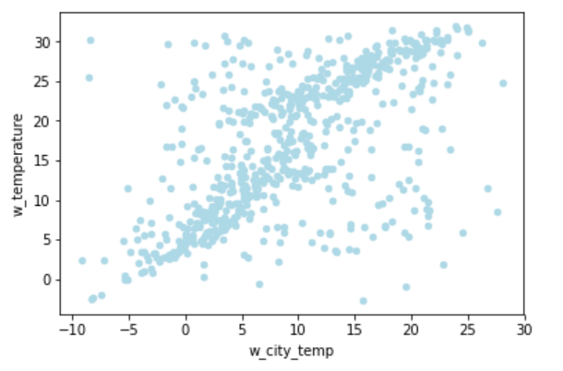
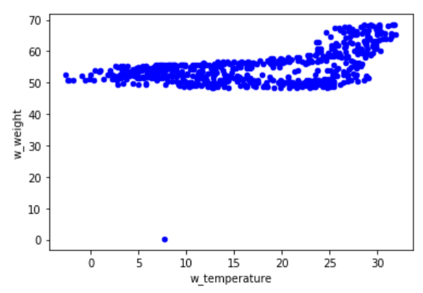
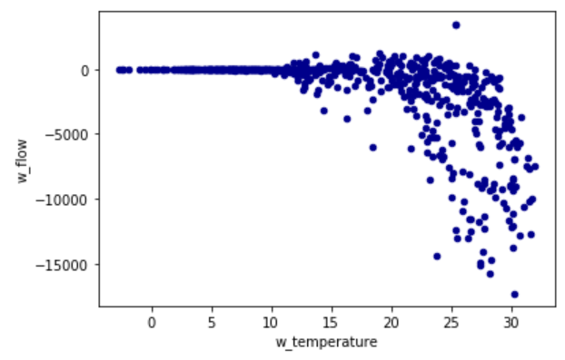
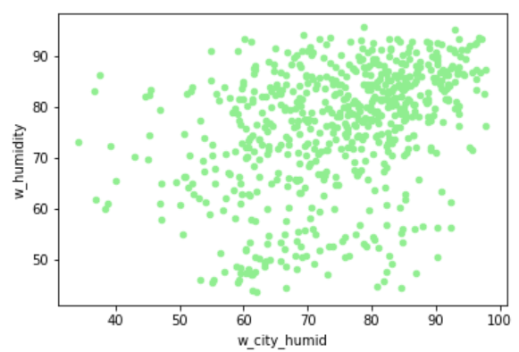
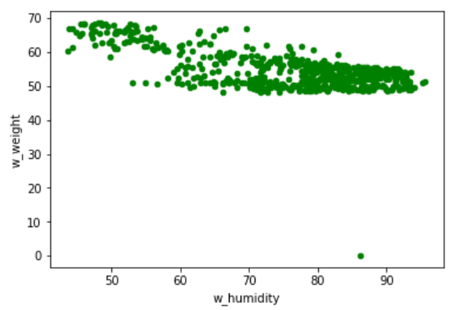
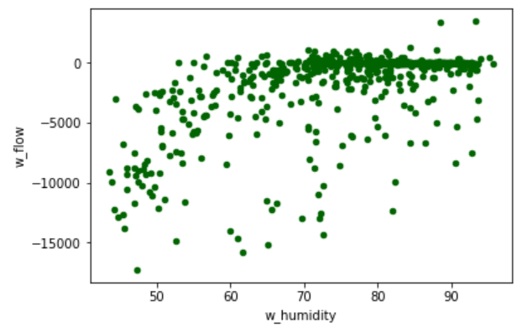
Analysis Process: Wurzburg
Key Questions:
Temp inside hive is influenced by city temperature?
When hive temp rises above ~25ºC, hive weight increases by ~20 kgs?
When hive temp rises above ~20ºC, net bees flow per day is out of the hive?
Hive humidity seems to be independent of city humidity?
When hive humidity is below ~ 60%, hive weight increases by ~20 kgs?
When hive humidity is below ~60%, net bee flow per day is out of the hive?

Slide 26
Analysis Process

Slide 27
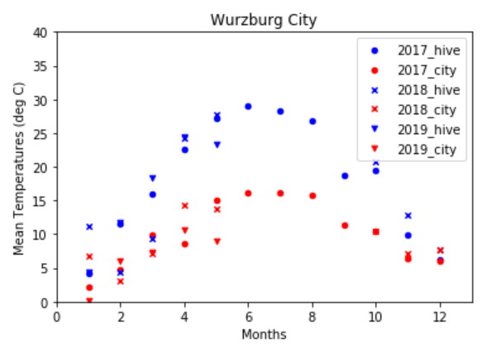
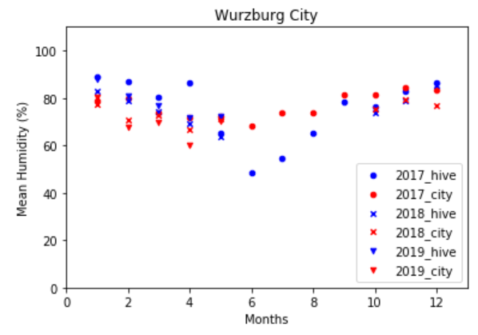
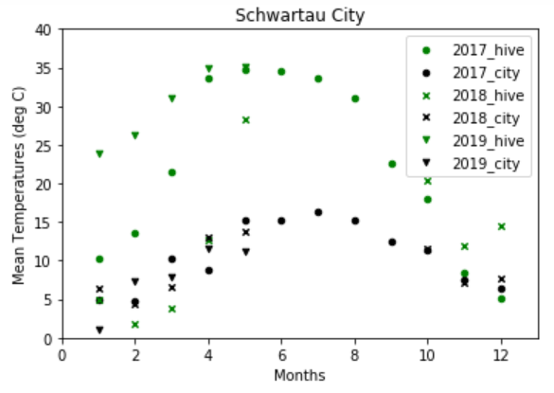
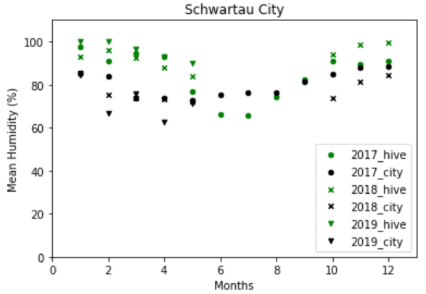
Temperature And Humidity Variation Inside The Hive And The Cities Of Wurzburg And Schwartau
Conclusion: bees regulate the temperature and humidity inside the hive irrespective of the temperature and humidity outside.
Hypothesis: The median temperature in the city and in the hive are the same.
Wurzburg:
P-value = 2.8 x 10⁻⁶
Schwartau:
P-value = 1.77 x 10⁻⁵
Hypothesis: The median humidity in the city and in the hive are the same
Wurzburg:
P-value = 0.035
Schwartau:
P-value = 2.36 x 10⁻⁵

Slide 28
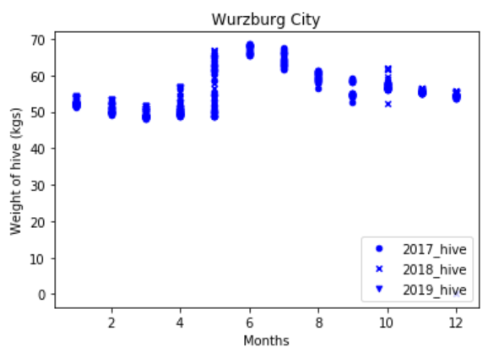
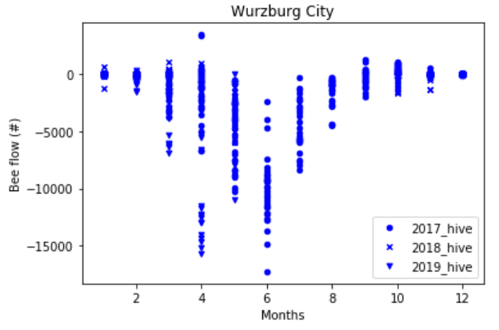
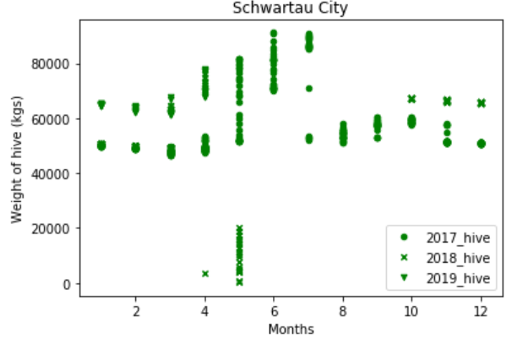
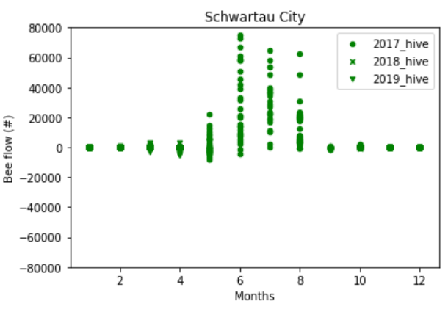
Hive Weight And Bee-flow Distribution Throughout The Year In Cities Of Wurzburg And Schwartau
Key observation: Wurzburg: Bee activity peaks in the months of April, May, June, where bees flew out of hive Schwartau: Bee activity peaks in the months of June, July, August, where bees flew into the hive with nectar increasing hive weight.
Conclusion: need to add!
Hypothesis: Weight of the hive is influenced by the flow of the bees
Wurzburg:
P-value =
Schwartau:
P-value =
Hypothesis: Weight of the hive and flow of bees is influenced by time of the year
Wurzburg:
P-value =
Schwartau:
P-value =

Slide 29
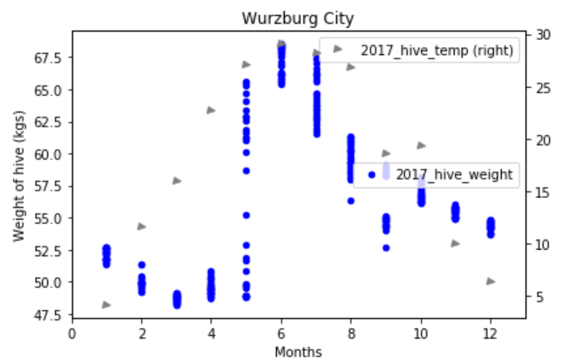
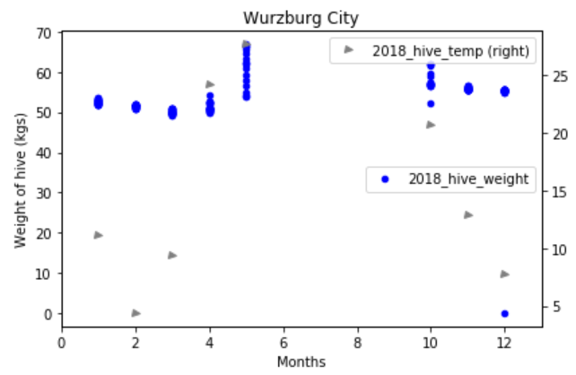
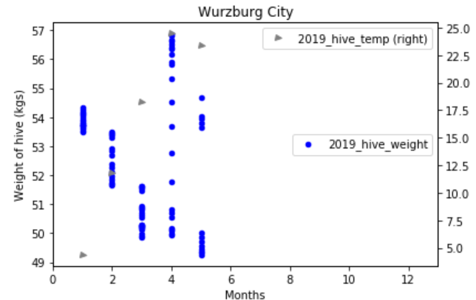
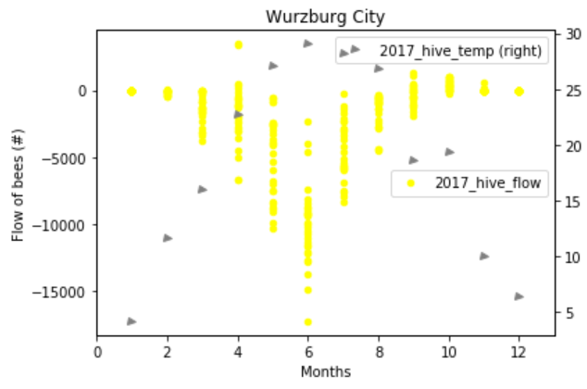
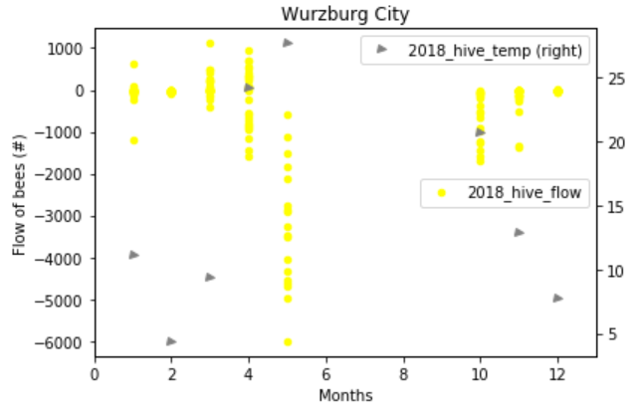
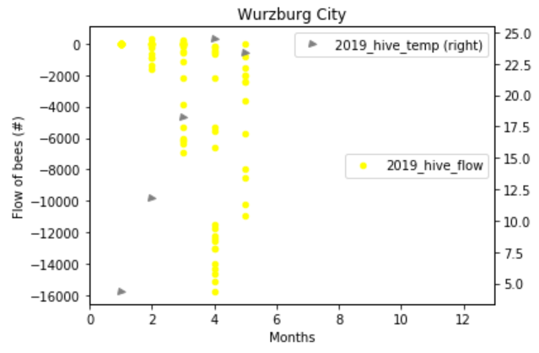
Wurzburg: Weight, Flow, Temperature distribution throughout the year
Key observations:
2017: when temp of hive was between 25-30ºC in the months of May, June, July, max. bees flew out of the hive.
2018: even though hive temp was between 25-30ºC in the month of May, bees were flying out of the hive.
2019: even though the temp were above 20ºC in April, May, bees continue to flow out of the hive.
Conclusion: need to add!
Hypothesis: Need to add!
Wurzburg:
P-value =
Schwartau:
P-value =
Hypothesis: Need to add!
Wurzburg:
P-value =
Schwartau:
P-value =

Slide 30
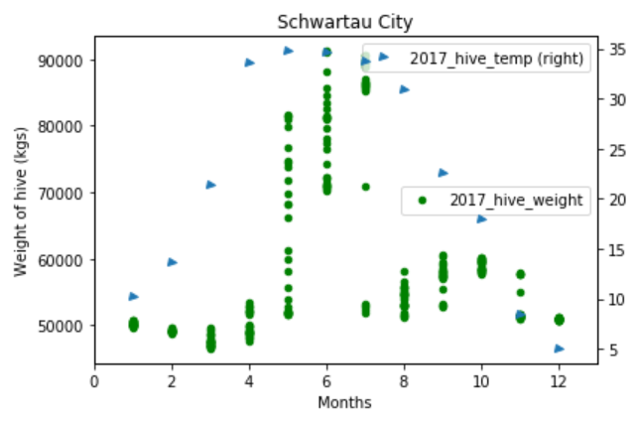
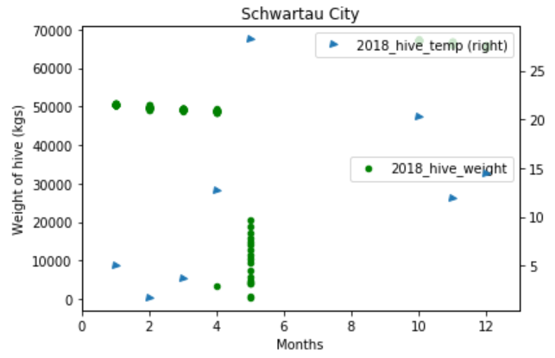
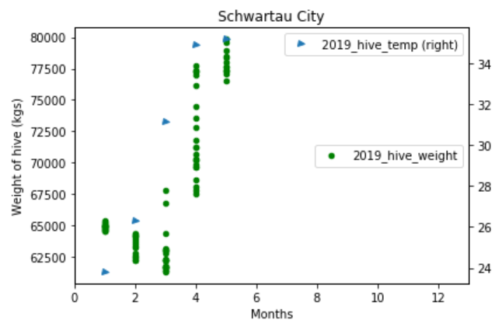
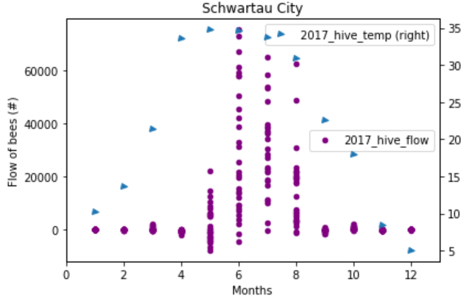


Schwartau: weight, Flow, Temperature distribution throughout the year
Key observations:
2017: when temp of hive was around 35ºC in the months of June, July, Aug, max. bees flew into the hive and weight of hive increased to max.
2018: even though hive temp was around 30ºC in the month of May, bees flew out of the hive, and weight of the hive dropped. Bees died or hive was infected?
2019: even though in the winter season (Jan-Mar), the temp were always above 20ºC in the hive, and weight of the hive was recovered, bees continue to flow out of the hive
Hive infected? Or queen bee died?
Conclusion: need to add!
Hypothesis: Need to add!
Wurzburg:
P-value =
Schwartau:
P-value =
Hypothesis: Need to add!
Wurzburg:
P-value =
Schwartau:
P-value =

Slide 31
Conclusions

