Slide 1

Bee Hive Analysis
Identify variables affecting bee activity and production

Slide 2

Why are bees important to us?
More than three quarters of global food crops rely on animal pollination for yield and/or quality.
They promote biodiversity in plants which are a resources for a wide range of other species.
A source for other benefits such as contributing to medicines, biofuels, fibers and timbers.
S.G. Potts, e. a. (2014–2018 ). Summary for policymakers of the assessment report of the
Intergovernmental Science-Policy Platform on Biodiversity and Ecosystem Services on
pollinators, pollination and food production. Intergovernmental Science-Policy Platform on
Biodiversity and Ecosystem.

Slide 3

…
What is happening to the World’s Bees?
An increase in land use, pesticide use, environmental pollution, invasive alien species, pathogens and climate change have caused a decline in the abundance, diversity and health of pollinators.
Why is this so concerning?
The volume of production of pollinator-dependent crops has increased by 300% over the last five decades, making livelihoods increasingly dependent on pollination.
Pollinator-dependent crops have experienced lower growth and lower stability of yield than pollinator-independent crops.
S.G. Potts, e. a. (2014–2018 ). Summary for policymakers of the assessment report of the
Intergovernmental Science-Policy Platform on Biodiversity and Ecosystem Services on
pollinators, pollination and food production. Intergovernmental Science-Policy Platform on
Biodiversity and Ecosystem.

Slide 4

How can we help?
Bee culture (beekeeping) and metric capture.
- Beekeeping is a great way to help boost population and increase species’ genetic variability, increasing their gene pool.
- Studying colonies and capturing important data metrics for analysis can help us better understand what factors affect colony survival and to what degree.

Slide 5
The Data: What, Where and How
Beehive metric data
- Source: HOneybee Online Studies https://www.hobos.de via Kaggle.com
- Data: 4 archives (CSV files) with data from year 2017 to 2019 for colony (locations: Wurzburg and Schwartau, Germany))
flow: For a date it contains the number of departures and arrivals from/to the beehive. A positive number indicates the number of arrivals and a negative number of departures.
humidity: Level of relative humidity through time of the beehive expressed in %
temperature : Temperature of the beehive through time of the beehive in Cº
weight: Weight of the beehive through time in Kg.
Weather metric data for Wurzburg and Schwartau
- Source: Reliable Prognosis https://rp5.ru
- Data: Temperature and relative humidity readings every hour from 12/31/2016 to 05/31/2019 (CSV file).

Slide 6
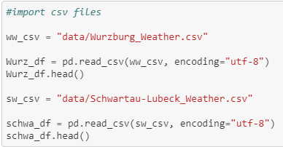
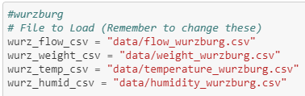
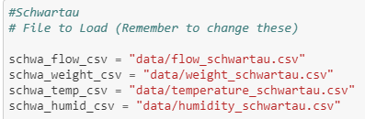
10 CSV files

Slide 7
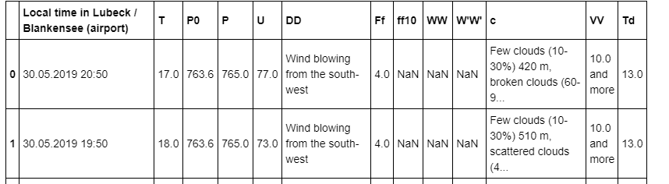
Too much info!

Slide 8
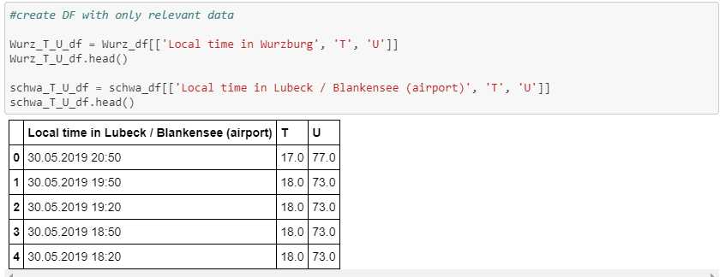
Only used relevant info

Slide 9
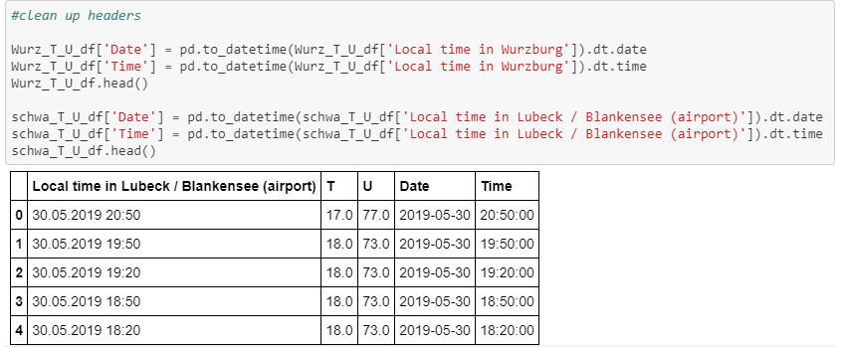
Split the Timestamp to separate Date Time columns

Slide 10
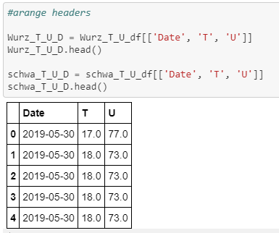
Less is more!

Slide 11
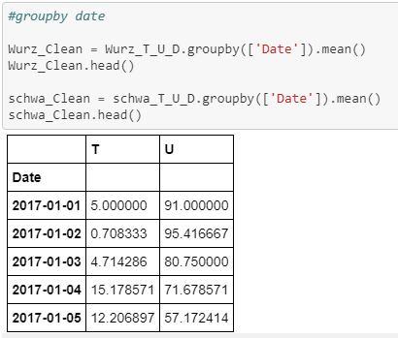
Average values for each day

Slide 12

Converted strings to timestamp

Slide 13
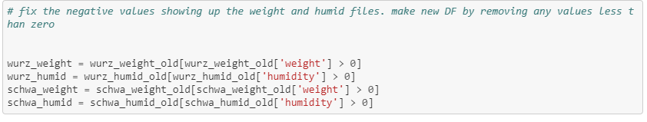
Eliminated bad data

Slide 14
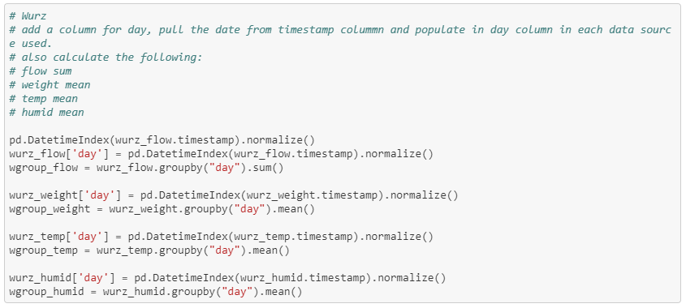
Daily averages of weight, temperature and humidity, as well as the sum of the flow

Slide 15
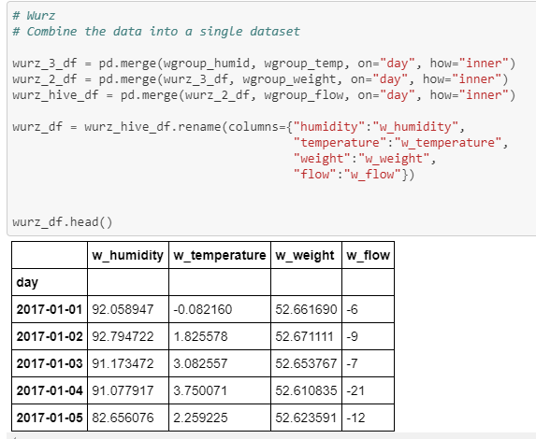
Start merging!

Slide 16

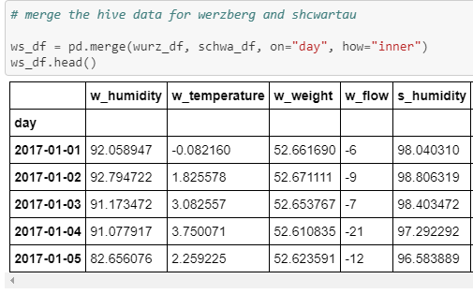
Wait, did you notice the index?

Slide 17
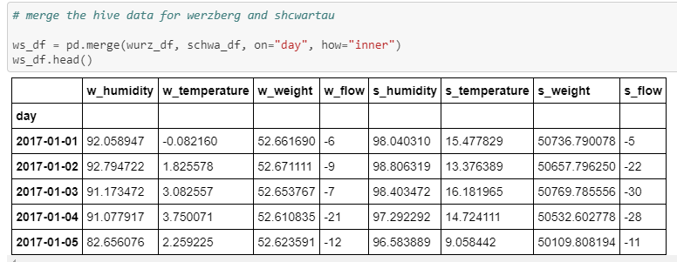
Omg more merging!?

Slide 18
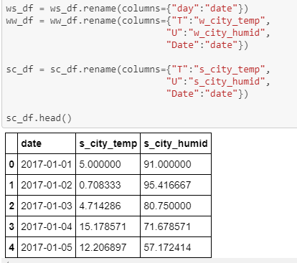
Prepare the city weather for…

Slide 19
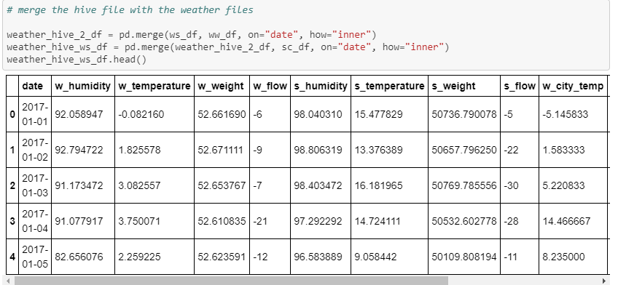
…. That’s right, more merging!

Slide 20
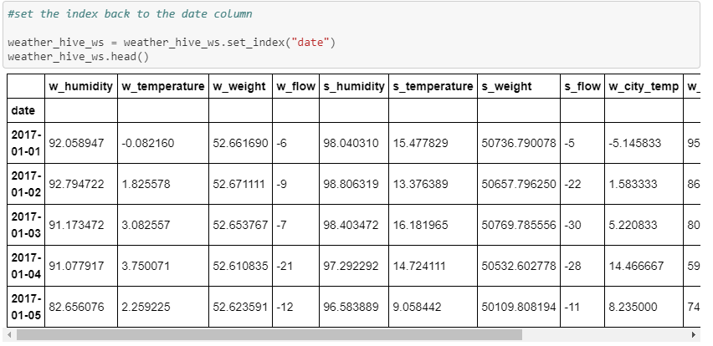
Funny thing about that index

Slide 21
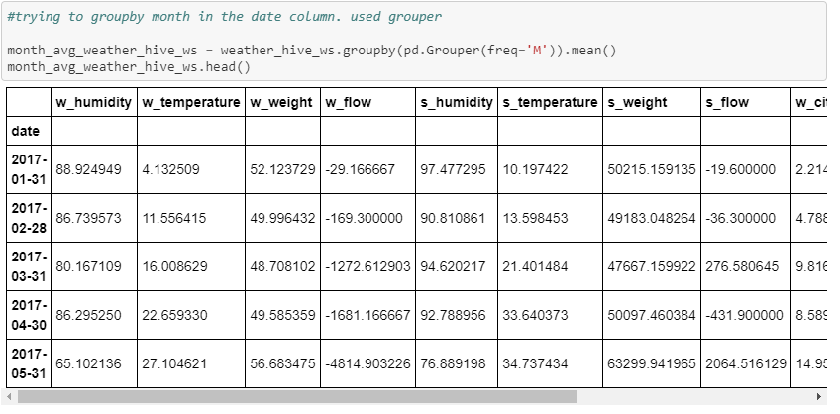
It’s not the fish of the month, it’s groupby Grouper

Slide 22
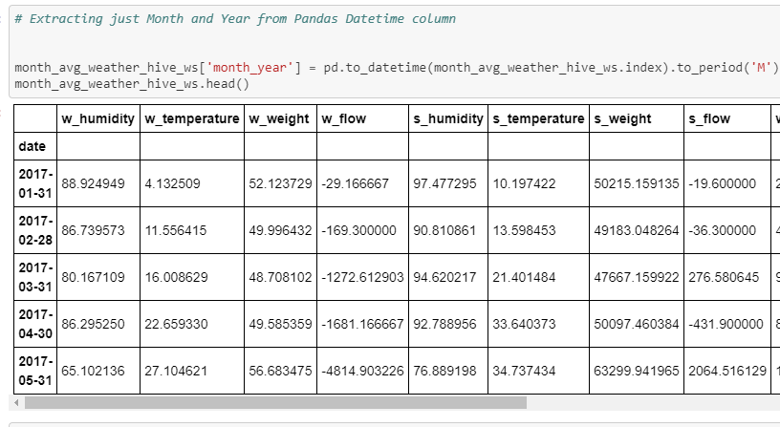
Fix the date column

Slide 23
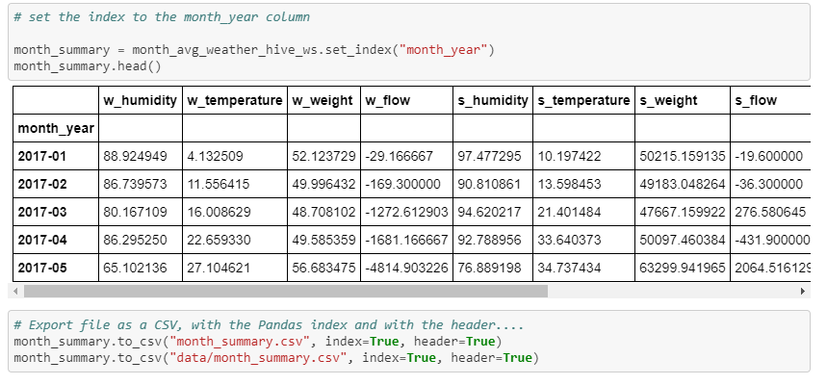
Reset the Index and output CSV

Slide 24
Statistical Methods
Steps
Statistical Method
Test for normal data distribution
Shapiro-Wilk method
Paired difference test between continuous variables with non-normal distribution
Wilcoxon method
Correlation between variables with unknown distribution
Spearman rank correlation method
Transform non-normal variables to normal variables
Boxcox transformation
Compare differences between two normal-like distributed variables with unequal sample sizes
Welch’s t-test
Notes:
Shapiro – reliable statistical method to determine whether a sample set has a Gaussian distribution

Slide 25
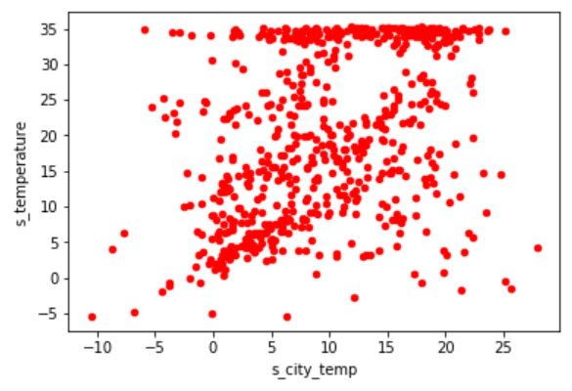
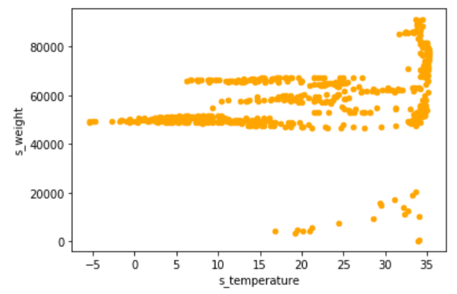
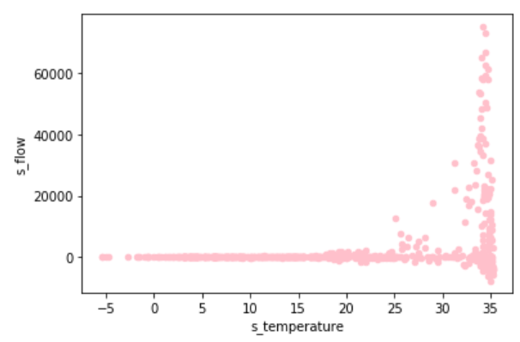
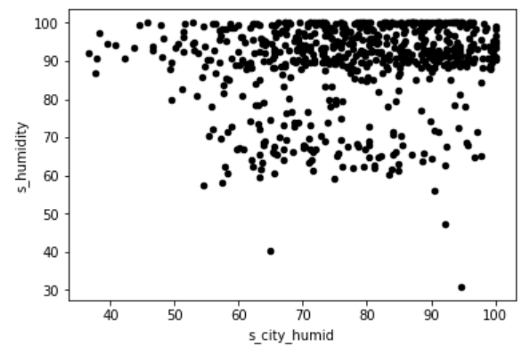
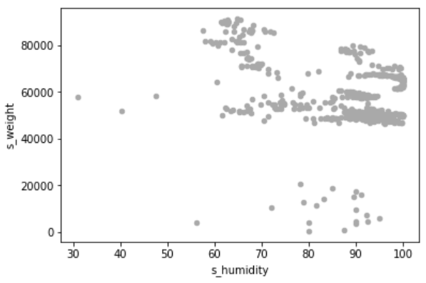
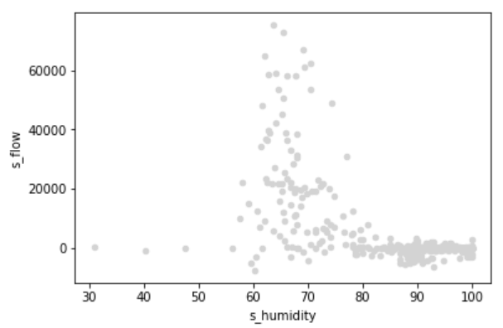
Analysis Process: Schwartau
Key Observations:
Hive temp influenced by city temperature. Bees doing their job
Hive temp moderately influences hive weight. More traditional
Hive temp influences bee flow, in the right direction. Net bees flowing into the hive
Hive temp increase lead to hive humidity decrease and vice-versa. (r_{s} = -0.36, graph not shown)
Hive humidity independent of city humidity.
Hive humidity did not influence hive-weight.
Hive humidity did not influence bee flow.
Conclusion: Hive temperature better indicator of bees performance
r_{s} = 0.04 (very weak)
r_{s} = 0.43 (moderate)
r_{s} = 0.5 (moderate)
r_{s} = -0.23 (weak)
r_{s} = 0.12 (very weak)
r_{s} = -0.09 (very weak)

Slide 26
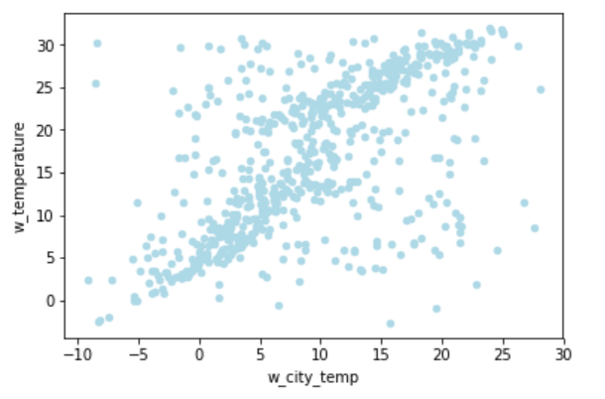
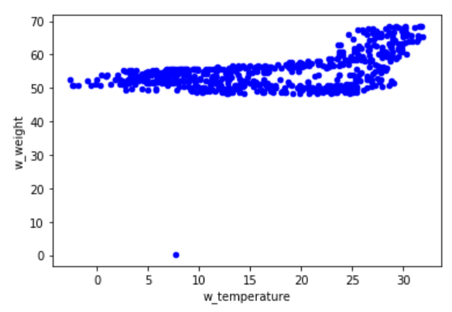
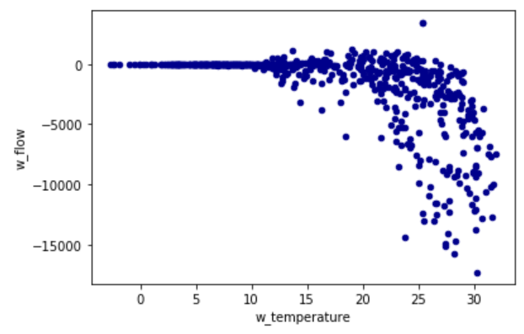
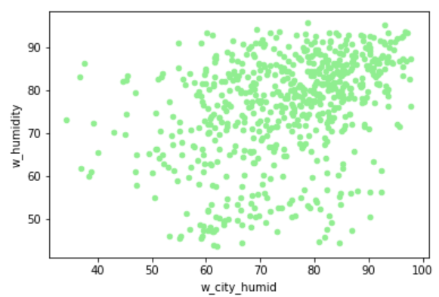
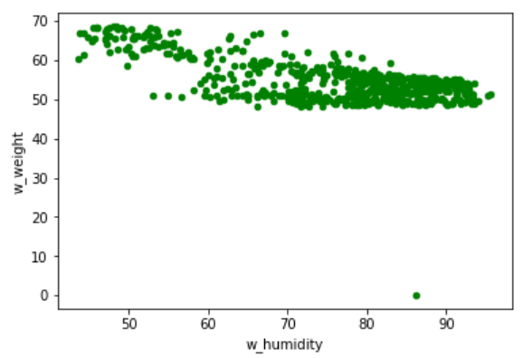
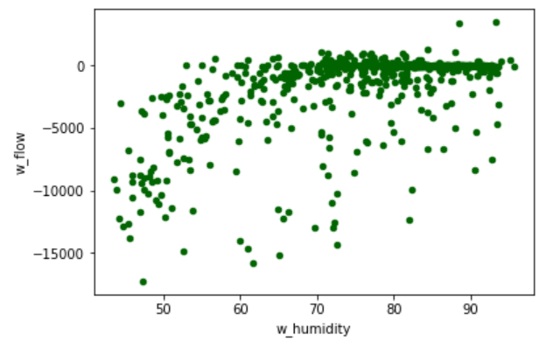
Analysis Process: Wurzburg
Key Observations:
Hive temp influenced by city temperature. Bees not doing their job
Hive temp does not influence hive weight. Untraditional
Hive temp influences bee flow, although in the wrong direction. Bees bailing out
Inverse correlation observed between hive temperature and hive humidity (r_{s} = -0.68, graph not shown)
Hive humidity independent of city humidity.
Hive humidity moderately influences hive-weight.
Hive humidity moderately influences bee flow
Conclusion: Hive temperature better indicator of bees performance
r_{s} = 0.61 (strong)
r_{s} = 0.39 (weak)
r_{s} = 0.66 (strong)
r_{s} = 0.39 (weak)
r_{s} = 0.48 (moderate)
r_{s} = 0.45 (moderate)

Slide 27
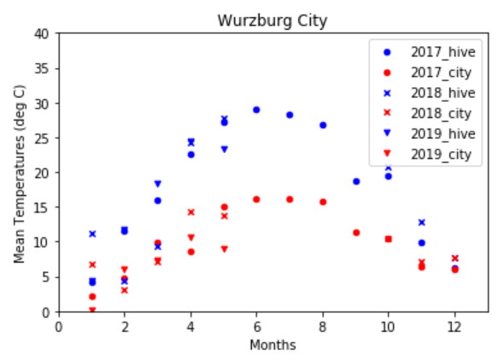
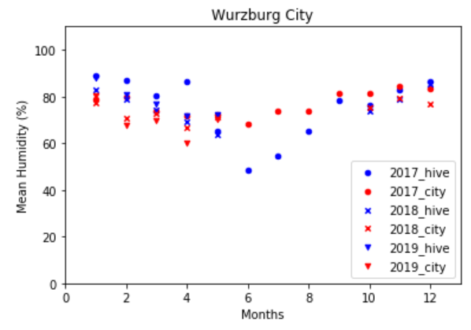
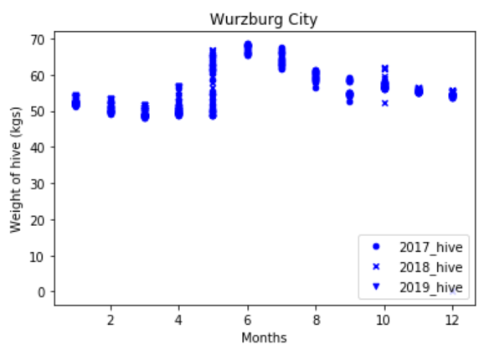
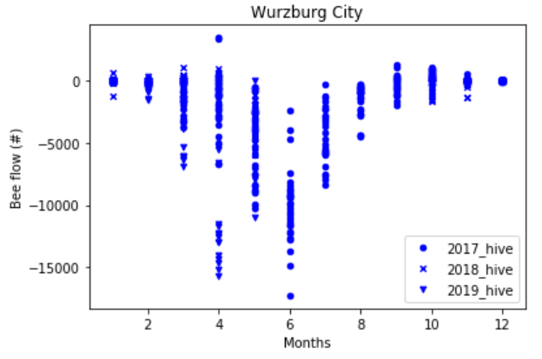
Wurzburg: Temperature And Humidity Variation Through the Year Inside the Hive
Conclusions:
There were very few times in the year when the temperature inside the hive was optimal
Hive was dying, and most of the bees were flowing out when temperatures were optimal
Hypothesis: Hive temperature greater than 30ºC is optimal for bee flow:
Temp >30 | Temp <30
n = 25 | 626
Mean = -8807 | -1372
SD = 3221 | 2905
p = 1.7 x 10⁻¹¹
Hypothesis: Hive temperature greater than 30ºC is optimal for hive weight:
Temp >30 | Temp <30
n = 25 | 626
Mean = 65.9 | 54.2
SD = 2.1 | 5.04
p = 1.1 x 10⁻²⁴
Note: Welch’s t-test

Slide 28
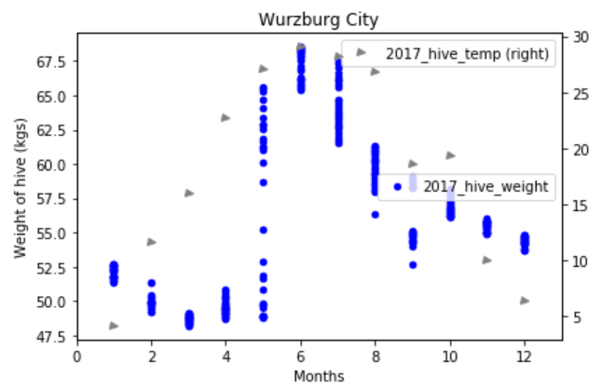
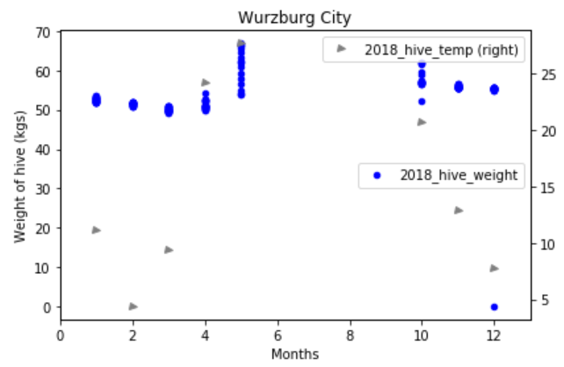
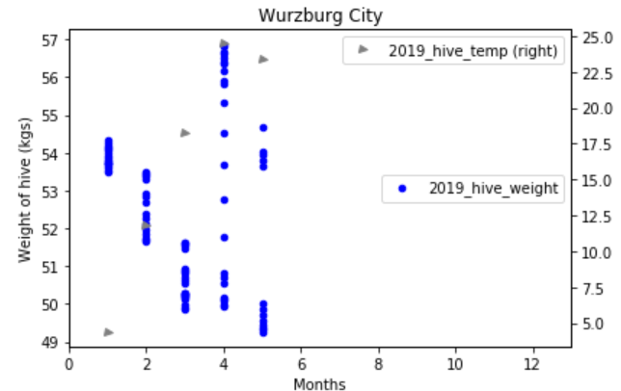
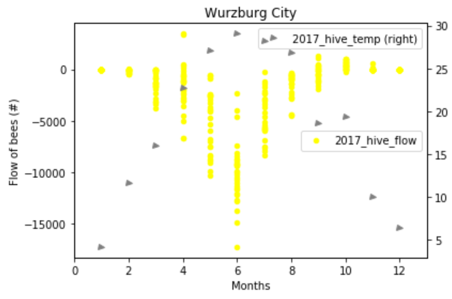
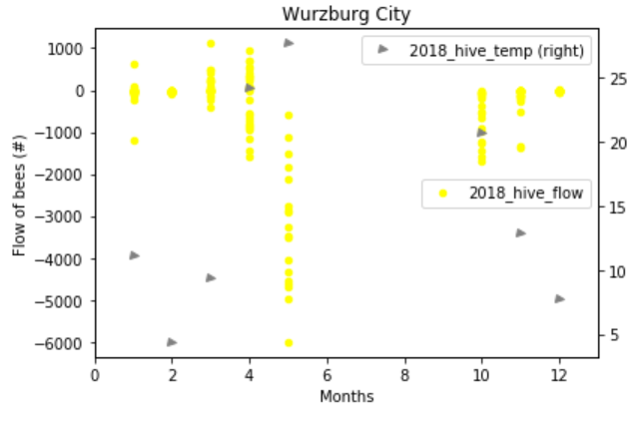
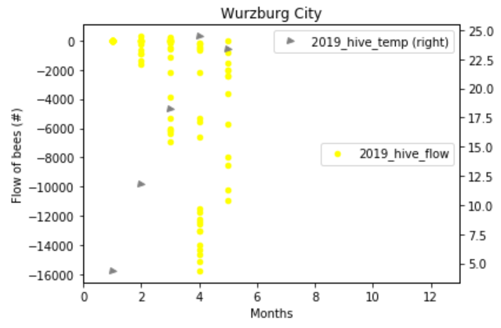
Wurzburg: Weight, Flow, Temperature distribution in 2017, 2018, 2019
Key observations:
2017: when temp of hive was between 25-30ºC in the months of May, June, July, max. bees flew out of the hive.
2018: even though hive temp was between 25-30ºC in the month of May, bees were flying out of the hive.
2019: even though the temp were above 20ºC in April, May, bees continue to flow out of the hive.

Slide 29
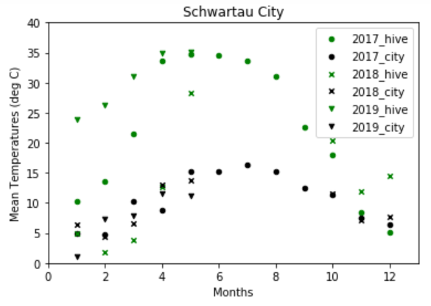
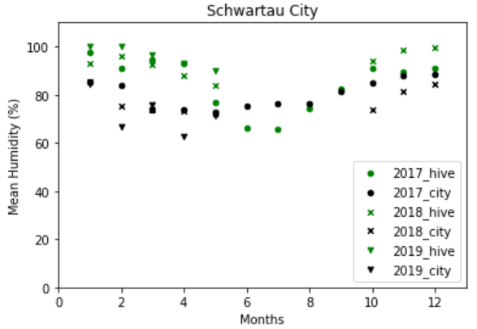
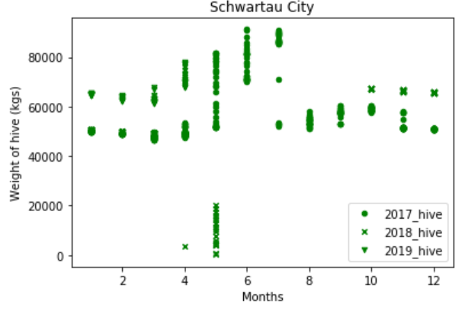
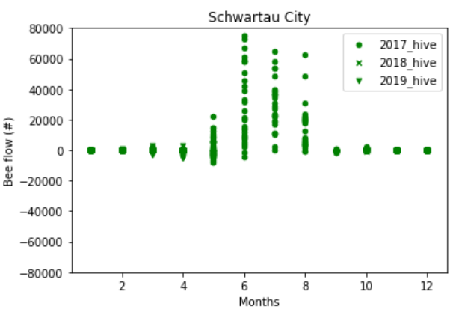
Schwartau: Hive Weight And Bee-flow Distribution Throughout The Year
Key Observations:
Better performing hive than Wurzburg, where we found more instances of optimal temperature
Hive weight was significantly higher than Wurzburg at temp above 30ºC and below 30ºC(p=1.4 x 10⁻¹³)
Bees flow into the hive was significantly higher than Wurzburg at temp above 30ºC and below 30ºC (p=1.3 x 10⁻¹²)
Hypothesis: Hive temperature greater than 30ºC is optimal for bee flow:
Temp >30 | Temp <30
n = 206 | 445
Mean = 9810 | 186
SD = 18239 | 1290
p = 1.3 x 10⁻¹²
Hypothesis: Hive temperature greater than 30ºC is optimal for hive weight:
Temp >30 | Temp <30
n = 206 | 445
Mean = 64285.4 | 54175.8
SD = 17343.8 | 9898.9
p = 1.4 x 10⁻¹³

Slide 30
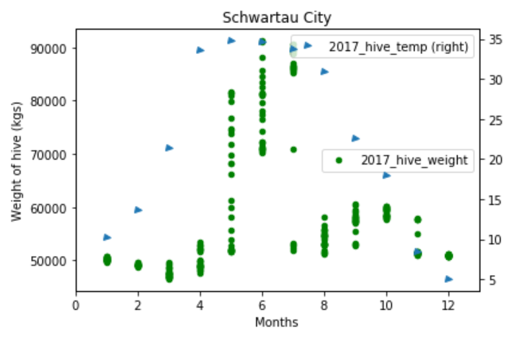
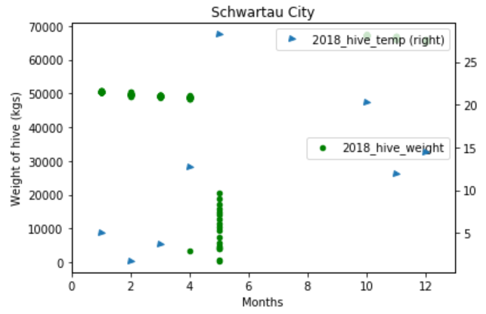
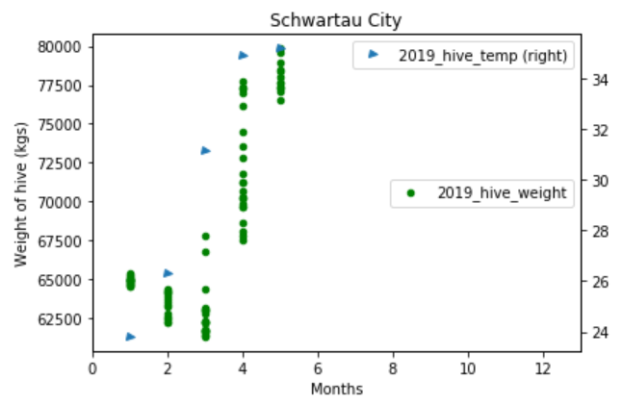
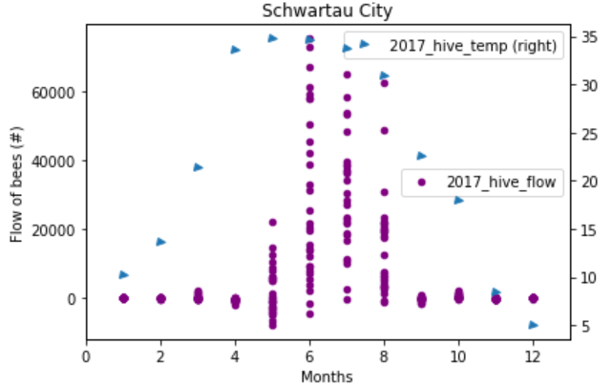
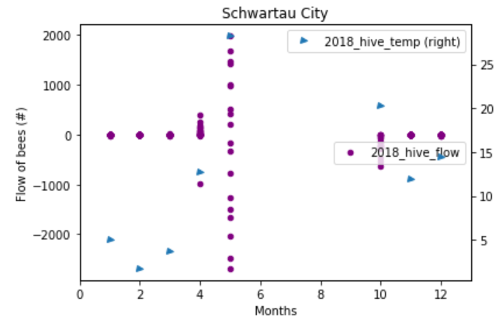

Schwartau: weight, Flow, Temperature distribution throughout the year
Key observations:
2017: when temp of hive was around 35ºC in the months of June, July, Aug, max. bees flew into the hive and weight of hive increased to max.
2018: even though hive temp was around 30ºC in the month of May, bees flew out of the hive, and weight of the hive dropped. Bees died or hive was infected?
2019: even though in the winter season (Jan-Mar), the temp were always above 20ºC in the hive, and weight of the hive was recovered, bees continue to flow out of the hive
Hive infected at end of 2017? Or queen bee died at end of 2017?

Slide 31

Conclusions
Hive temperature better indicator of bees performance
Bees in Wurzburg hive was already in the process of bailing starting 2017
Temperature rarely reached 30ºC
Net bee flow was out of the hive
Bees in Schwartau hive were doing well in 2017. However during the winter season of the 2017, due to unknown incidence (queen bee death, infestation by mite, change in internal environment):
Net bee flow in 2018 and 2019 was out of hive (similar to Wurzburg) despite healthy temperatures in 2019
BEE VIGILANT and SAVE BEES

