Slide 1


Take your first step into the cognitive era with the variety of smart services.
IBM Watson Services
Rome – Tor Vergata June 14th, 2017
Crescenzo Migliaccio Valerio Bontempi Roberto Basili Giuseppe Calavaro
DSET Manager - Fabrizio Isidori

Slide 2
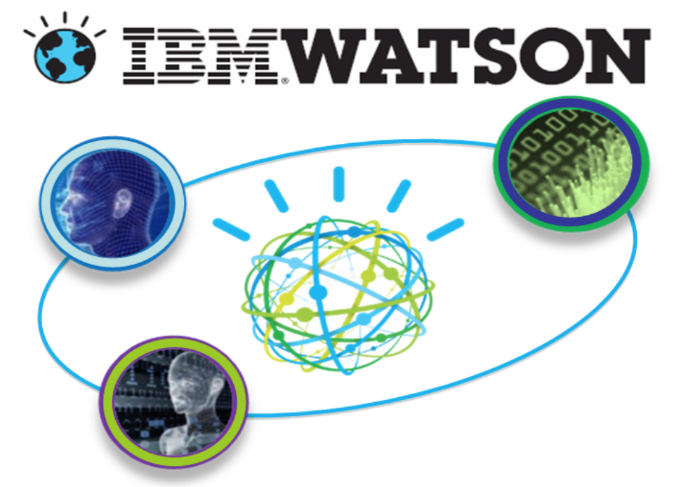
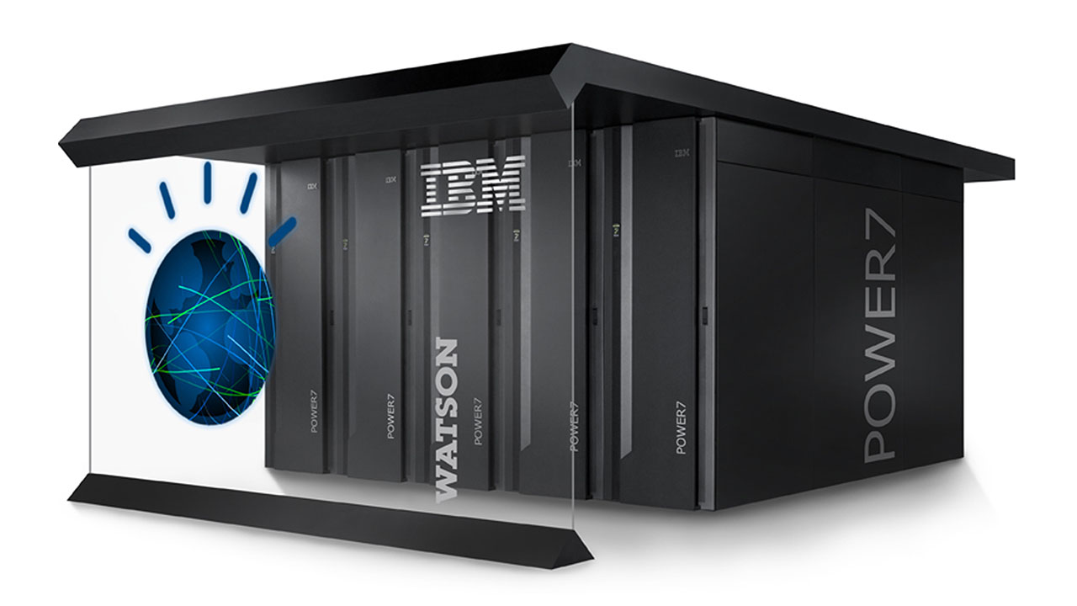

What is Watson - Introduction
Is a question answering computer system capable of answering questions posed in natural language developed by IBM.
Watson was named after IBM's first CEO, Thomas J. Watson.
Software: more than 100 different techniques are used to analyze:
natural language
identify sources
find and generate hypotheses
find and score evidence
merge and rank hypotheses.
Hardware:
cluster of ninety IBM servers
each of which uses a 3.5 GHz POWER7 8-core processor, with 4 threads per core.
In total, the system has 2,880 POWER7 processor threads and 16 terabytes of RAM.
Definitely: Watson is a supercomputer with cognitive technologies
Notes:
Il calcolo cognitivo è la simulazione dei processi di pensiero umano in un modello computerizzato. Il calcolo cognitivo prevede sistemi di autoapprendimento che utilizzano l'estrazione dei dati, il riconoscimento dei pattern e l'elaborazione della lingua naturale per simulare il funzionamento del cervello umano.

Slide 3
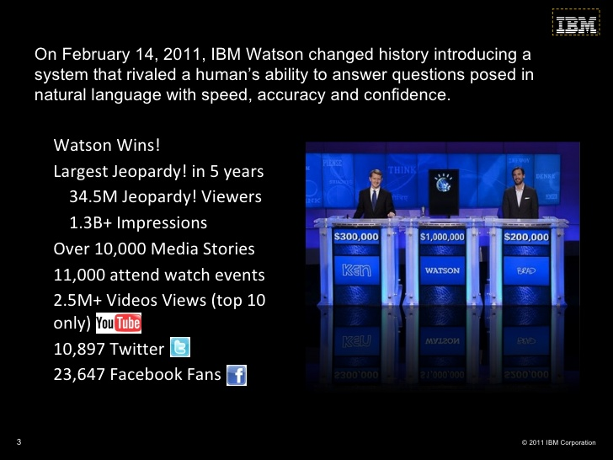
What is Watson – Jeopardy challenge
Watson Jeopardy game Video:
https://youtu.be/lI-M7O_bRNg

Slide 4
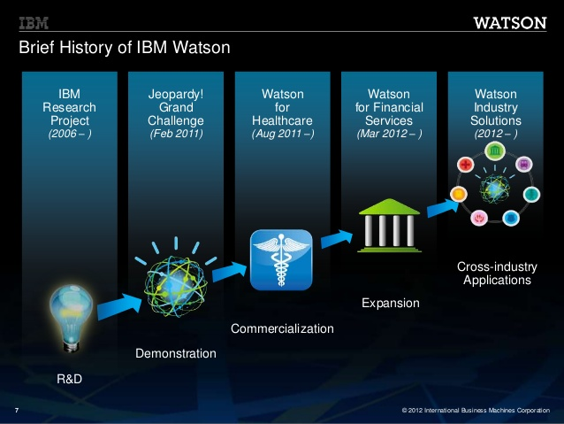
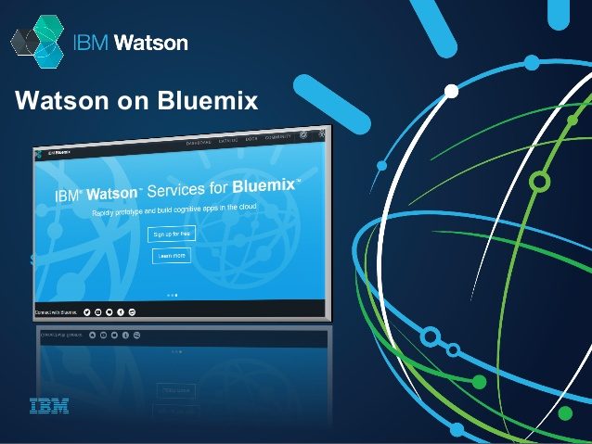
Watson – From Research to Cloud Services
… and Now(2017-): IBM Watson on Bluemix
Accessible by anyone with a Bluemix Account
A lot of services in Bluemix Catalog
Documentation for each services
Notes:
Sviluppo classico
1 – Va individuata la tecnologia da utilizzare, come codice applicativo, ambiente di esecuzione (server & sistema operativo), servizi associati (database ad esempio)
2 – IDE di sviluppo
3 – installazione e configurazione sistema operativo, server, servizi, tecnologie, framework, etc etc…
4 – lo sviluppo vero e proprio in locale, sistemi di rilascio con gli ambienti di test e produzione, test automatizzati e CI
6 – l’ambiente va aggiornato? È sicuro? È attaccato? È sufficientemente configurato?
7 – il mio codice va salvato, dove lo salvo? Come lo condivido con gli altri se necessario?
8 – devo aggiornare il mio ambiente e/o, come faccio a ridurre il downtime? E se volessi azzerarlo?

Slide 5
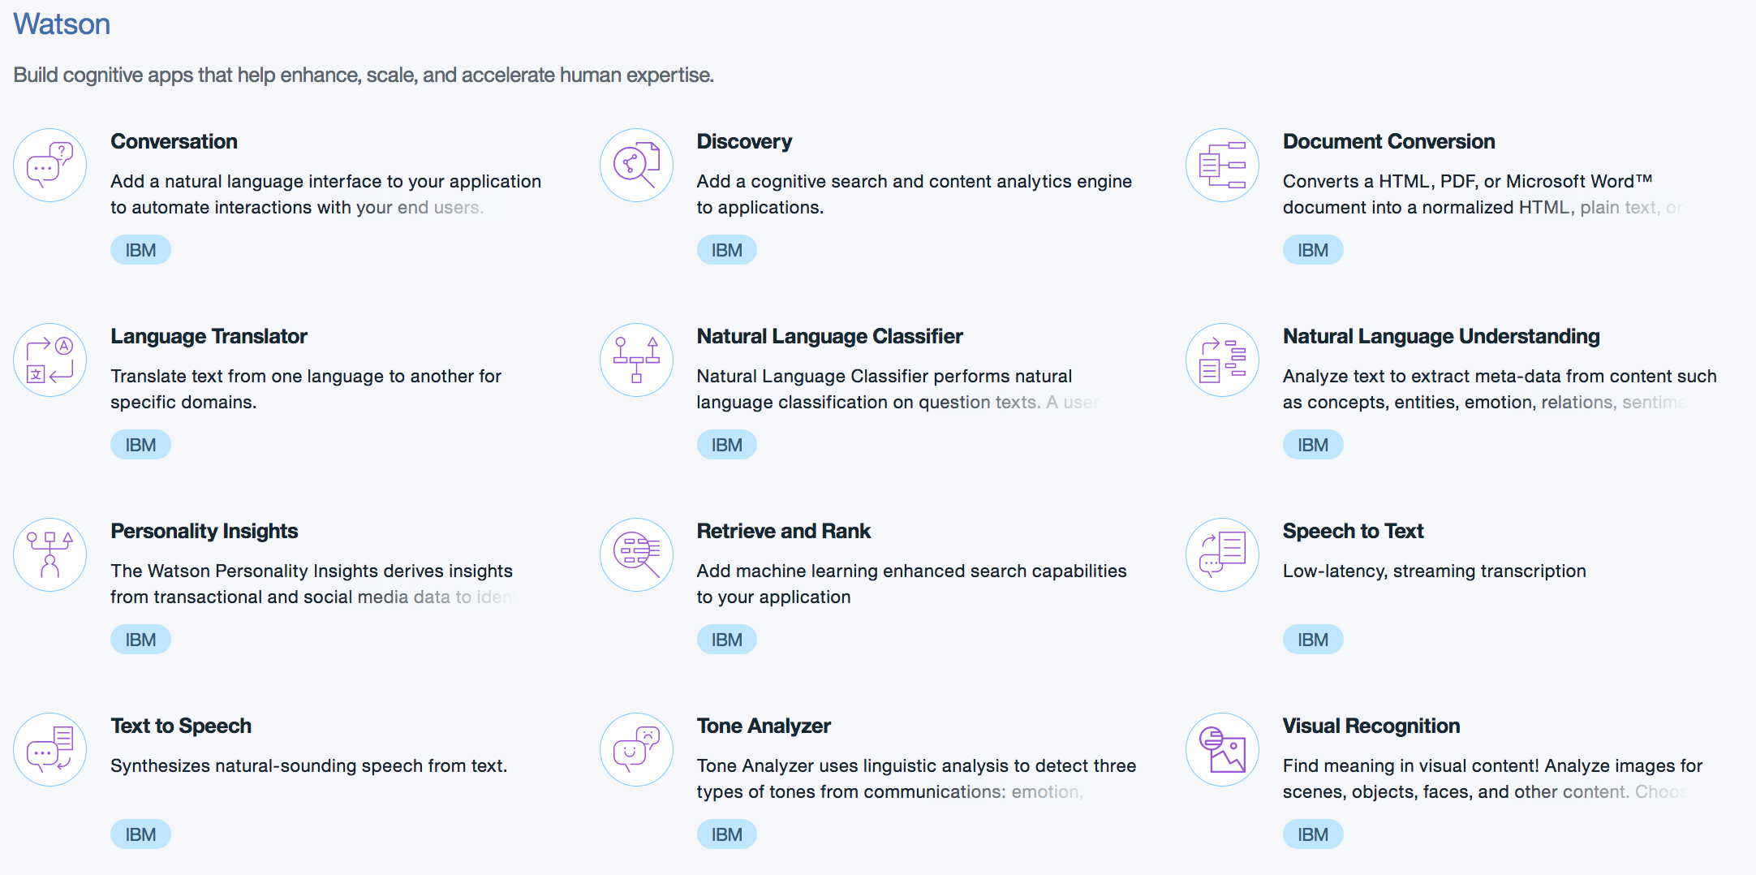
Bluemix Watson Services Catalog
Widest range of cognitive technologies available today to quickly and securely build smart applications.

Slide 6
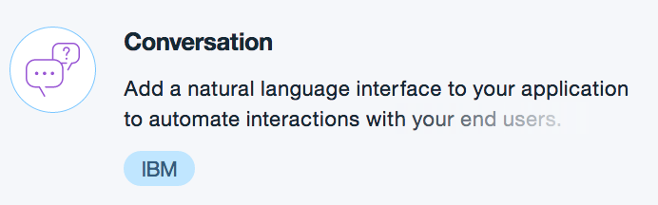
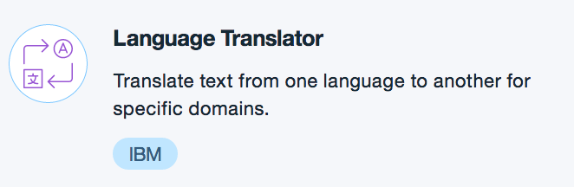
Bluemix Watson Services Catalog
Watson Conversation allows you to quickly build, test and deploy a bot or virtual agent across mobile devices, messaging platforms like Slack or even on a physical robot. Conversation has a visual dialog builder to help you create natural conversations between your apps and users, without any coding experience required.
Demo: https://conversation-demo.mybluemix.net/ Git Project full ( With UI): https://github.com/watson-developer-cloud/car-dashboard Git Project simple (simple chat): https://github.com/watson-developer-cloud/conversation-simple
Doc: https://www.ibm.com/watson/developercloud/discovery.html
Language Translator translates text from one language to another. The service offers multiple domain-specific models that you can customize based on your unique terminology and language. Use Language Translator to take news from across the globe and present it in your language, communicate with your customers in their own language, and more.
Demo: https://language-translator-demo.mybluemix.net/
Git Project: https://github.com/watson-developer-cloud/language-translator-nodejs
Doc: https://www.ibm.com/watson/developercloud/language-translator.html

Slide 7
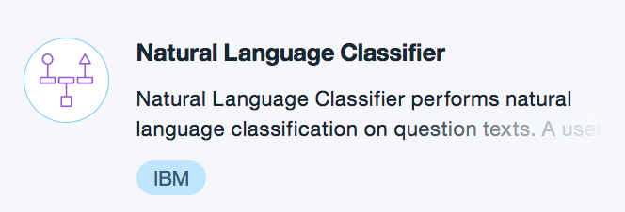
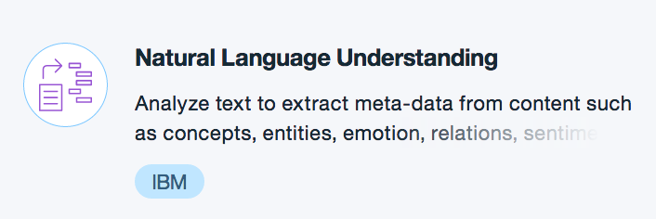
Bluemix Watson Services Catalog
Watson Conversation allows you to quickly build, test and deploy a bot or virtual agent across mobile devices, messaging platforms like Slack or even on a physical robot. Conversation has a visual dialog builder to help you create natural conversations between your apps and users, without any coding experience required.
Demo: https://natural-language-classifier-demo.mybluemix.net/
Training set\Data: https://github.com/watson-developer-cloud/natural-language-classifier-nodejs/blob/master/training/weather_data_train.csv
Git Project: https://github.com/watson-developer-cloud/natural-language-classifier-nodejs
Doc: https://console.bluemix.net/docs/services/natural-language-classifier/getting-started.html#natural-language-classifier
Analyze text to extract meta-data from content such as concepts, entities, keywords, categories, sentiment, emotion, relations, semantic roles, using natural language understanding.
Demo: https://natural-language-understanding-demo.mybluemix.net/ Git Project: https://github.com/watson-developer-cloud/natural-language-understanding-nodejs Doc: https://www.ibm.com/watson/developercloud/doc/natural-language-understanding/

Slide 8
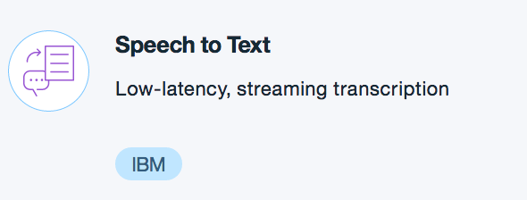
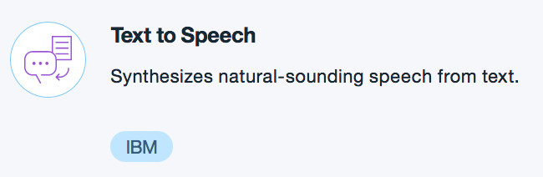
Bluemix Watson Services Catalog
The Speech to Text service converts the human voice into the written word. It can be used anywhere there is a need to bridge the gap between the spoken word and their written form, including voice control of embedded systems, transcription of meetings and conference calls, and dictation of email and notes. This easy-to-use service uses machine intelligence to combine information about grammar and language structure with knowledge of the composition of the audio signal to generate an accurate transcription.
Demo: https://speech-to-text-demo.mybluemix.net/ Git Project: https://github.com/watson-developer-cloud/speech-to-text-nodejs Doc: https://www.ibm.com/watson/developercloud/speech-to-text.html
The Text to Speech service processes text and natural language to generate synthesized audio output complete with appropriate cadence and intonation. It is available in several voices:
Demo: https://www.ibm.com/watson/developercloud/text-to-speech.html Git Project: https://github.com/watson-developer-cloud/text-to-speech-nodejs Doc: https://www.ibm.com/watson/developercloud/text-to-speech.html

Slide 9
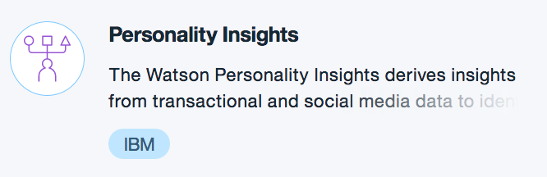
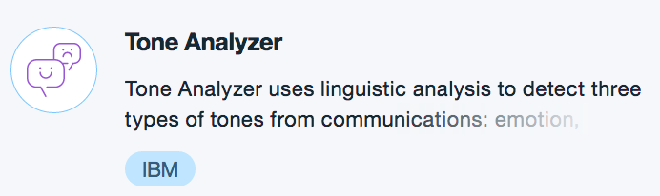
Bluemix Watson Services Catalog
Personality Insights extracts personality characteristics based on how a person writes. You can use the service to match individuals to other individuals, opportunities, and products, or tailor their experience with personalized messaging and recommendations. Characteristics include the Big 5 Personality Traits, Values, and Needs. At least 1200 words of input text are recommended when using this service.
Demo: https://personality-insights-livedemo.mybluemix.net/ Git Project: https://github.com/watson-developer-cloud/personality-insights-nodejs Doc: https://www.ibm.com/watson/developercloud/personality-insights.html
the Big 5 Personality, Values and Needs are described here: https://www.ibm.com/watson/developercloud/doc/personality-insights/user-overview.html
The IBM Watson Tone Analyzer service uses linguistic analysis to detect communication tones in written text. Use the Tone Analyzer service to understand conversations and communications, and then respond to customers appropriately at scale.
Doc: https://www.ibm.com/watson/developercloud/tone-analyzer.html Demo 1: https://tone-analyzer-demo.mybluemix.net/
Git Project 1: https://github.com/watson-developer-cloud/tone-analyzer-nodejs
Demo 2: https://customer-engagement-demo.mybluemix.net/
Git Project 2: https://github.com/watson-developer-cloud/customer-engagement-nodejs

Slide 10
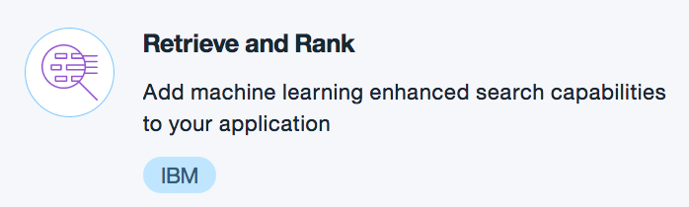
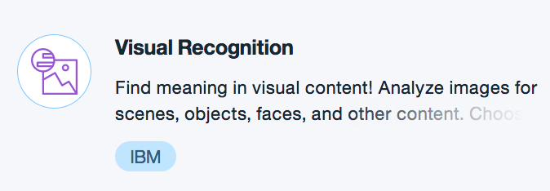
Bluemix Watson Services Catalog
The IBM Watson Retrieve and Rank service helps users find the most relevant information for their query by using a combination of search and machine learning algorithms to detect "signals" in the data. Built on top of Apache Solr, developers load their data into the service, train a machine learning model based on known relevant results, then leverage this model to provide improved results to their end users based on their question or query.
Demo: http://retrieve-and-rank-demo.mybluemix.net/
Git Project: https://github.com/watson-developer-cloud/retrieve-and-rank-java
Doc: https://www.ibm.com/watson/developercloud/retrieve-rank.html
Visual Recognition understands the contents of images - visual concepts tag the image, recognize food, find human faces, approximate age and gender, and find similar images in a collection. You can also train the service by creating your own custom concepts. Use Visual Recognition to detect a dress type in retail, identify spoiled fruit in inventory, and more.
Demo 1: https://visual-recognition-demo.mybluemix.net/
Git Project 1: https://github.com/watson-developer-cloud/visual-recognition-nodejs
Demo 2: https://visual-recognition-demo.mybluemix.net/train
Git Project 2: https://github.com/watson-developer-cloud/visual-recognition-nodejs
Demo 3: https://similarity-search-demo.mybluemix.net/
Git Project 3: https://github.com/watson-developer-cloud/similarity-search-nodejs
Doc: https://www.ibm.com/watson/developercloud/visual-recognition.html

Slide 11

Interact with Watson Services – Diagram
Application Component
Service
Configure Parameters, including Basic Auth using the user id and password for Watson Service;
POST question
Receive question, obtain response JSON
Receive response from Watson service
Return JSON response
Send response to user or further processing
Notes:
Il calcolo cognitivo è la simulazione dei processi di pensiero umano in un modello computerizzato. Il calcolo cognitivo prevede sistemi di autoapprendimento che utilizzano l'estrazione dei dati, il riconoscimento dei pattern e l'elaborazione della lingua naturale per simulare il funzionamento del cervello umano.

Slide 12
Text here
Text here

