Slide 1


MQTT & Bluemix IOT service
Rome – Lab May 22, 2017
Crescenzo Migliaccio Valerio Bontempi
DSET TEAM – Fabrizio Isidori

Slide 2


Internet Of Things – what is …
“it is a network of physical objects like devices, vehicles, buildings and other items, all fully integrated with electronic components, sensors, software and connectivity the network that enables exchange and collection of data“
Important concepts:
physical objects with connectivity that can send and receive information.
This is the world of sensors (temperature, humidity…)
objects ("things") will make it recognizable and acquire intelligence thanks to being able to communicate information about themselves and access information aggregated from other.
Protocol communication: MQTT

Slide 3
MQTT & IBM IOT Platform service
What is the Target:
Create an application that read data from sensors (such as: Temperature, Humidity, Pressure, Luminosity) – we will call this application “Device Side Program”
Create an application Node-Red that receive data (like a metering station) and show received data – we will call this application “Application Side Program”
The communication goes through Bluemix IOT Platform service (MQTT broker) that receive and send data to appropriate station (in our case the station is a Node-red application)
In this workshop we will show only one receiver application with a dashboard that show data.
We will simulate sensors generating random data in order to test the Bluemix IOT Platform service without real boards (such as Arduino, Raspberry PI)
First of all: Introducing to MQTT Protocol

Slide 4
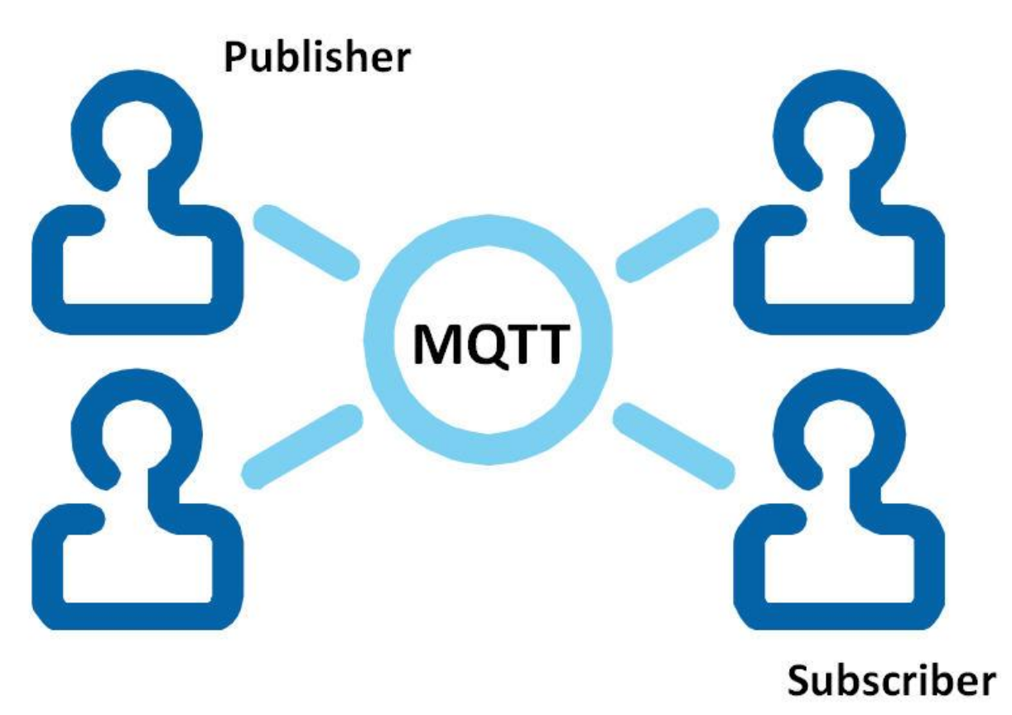
MQTT – What is
MQTT is a publish/subscribe messaging protocol
Characteristics:
Open: created by Dr Andy Stanford-Clark of IBM and Eurotech in 1999 and donated to Eclipse “Paho” M2M project (defining the OASIS standard in 2014)
Lightweight: small packet size
Reliable: 3 QoS level to avoid packet loss on client disconnection
Simple : only 5 verbs\commands:
Connect
Disconnect
Publish
Subscribe
UnSubscribe

Slide 5
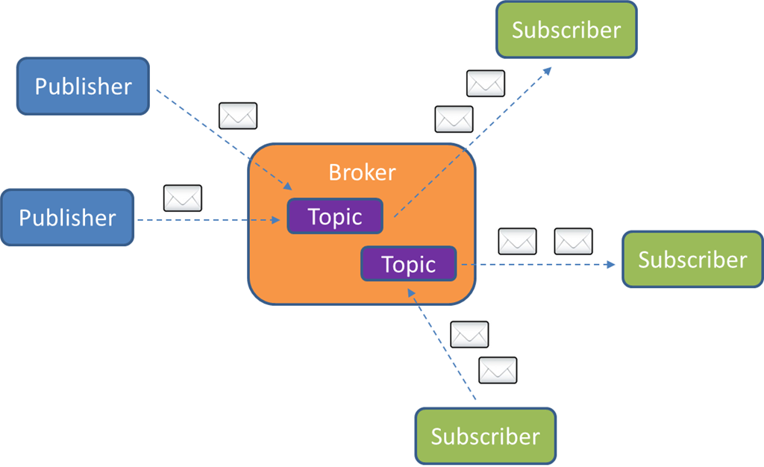
MQTT – How it works
Publish/Subscribe, topics, MQTT Broker concepts
Topics: are somewhat like message subjects(for example: temperature, status… ) - technically it is a message queue
Publisher: publish/send a message on a specific topic (ex: publish a message on the topic ‘temperature’)
Subscriber: subscribed to a specific topic in order to listen and receive all messages that are sent to the subscribed topic
MQTT Broker: have to manage all subscriptions to the queues (topics) and it have to relay messages from clients publishing messages to a certain topic to those who are subscribed to it.
Notes:
MQTT allows devices to send (publish) information about a given topic to a server that functions as an MQTT message broker. The broker then pushes the information out to those clients that have previously subscribed to the client's topic.Automation, the foundation for many DevOps practices, helps you move faster without sacrificing stability or security. Now is the time to take advantage of automation and proven DevOps practices to drive your team and your deployments forward. Puppet Enterprise lets you deliver technology changes faster, release better software, and do it all more frequently with confidence.
---
MQTT protocol is based on “Publish/Subscribe” pattern and “topic” concept. A client can be a publisher, a subscriber or both. If it is a publisher, it publishes a message on a topic; if it is a subscriber, it subscribes to a specific topic so that it can receive all the messages published on that topic. The topic is the mechanism by which clients exchange messages and technically it is a message queue; the broker have to manage all subscriptions to the queues (topics) and it have to relay messages from clients publishing messages to a certain topic to those who are subscribed to it. This pattern is also known as “Observer” because a client can observe a topic for which it is interested in receiving published messages. This model allows one-to-one and one-to-many distribution and the publisher don’t need to know anything about the subscribers; all these features guarantee clients decoupling and asynchronous communication.

Slide 6
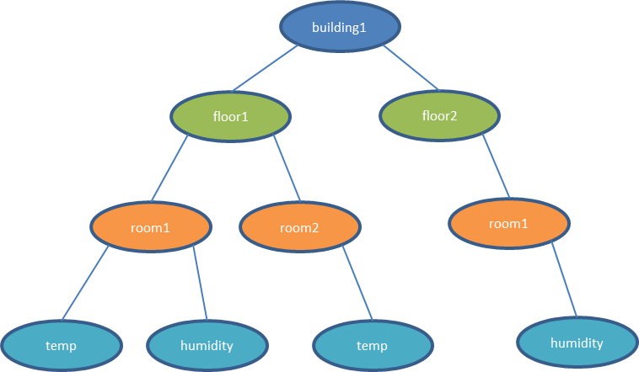
MQTT – Topic Format
The topic is represented by a string
Hierarchical structure - each layer (subtopic) is separated by “/” character (ex: building1/floor1/room1/temp)
A publisher can publish only to an absolute topic. A subscriber can subscribe to an absolute topic or can use wildcards so that it can receives messages published on more topics.
Single-level wildcard “+”: represents any subtopic to a specific level of the hierarchy
Multi-level wildcard “#”: appears only at the end of the string and it represents one or more levels of the hierarchy
Wildcards Example:
building1/floor1/+/temperature
building2/floor2/room3/#
Notes:
A publisher can publish only to an absolute topic but a subscriber can subscribe to an absolute topic or can use wildcards so that it can receives messages published on more topics. There are two types of wildcards: Single-level wildcard “+” that represents any subtopic to a specific level of the hierarchy Multi-level wildcard “#” that appears only at the end of the string and it represents one or more levels of the hierarchyIf we consider the above examples, we could be interested in all temperature values for all rooms on floor1 in the building1. In this case, we can use the wildcard “+” to collapse the room level inside our topic hierarchy in the following way :building1/floor1/+/temperatureIn the same manner, if we are interested in all data sensors (temperature, humidity, …) in room3 on floor2 in the building2, we can use the wildcard ”#” to collapse the last level of the topic hierarchy in the following way :
----
Wildcards
When a client subscribes to a topic it can use the exact topic the message was published to or it can subscribe to more topics at once by using wildcards. A wildcard can only be used when subscribing to topics and is not permitted when publishing a message. In the following we will look at the two different kinds one by one: single level and multi level wildcards.
Single Level: +
As the name already suggests, a single level wildcard is a substitute for one topic level. The plus symbol represents a single level wildcard in the topic.
Any topic matches to a topic including the single level wildcard if it contains an arbitrary string instead of the wildcard. For example a subscription to myhome/groundfloor/+/temperature would match or not match the following topics:
Multi Level: #
While the single level wildcard only covers one topic level, the multi level wildcard covers an arbitrary number of topic levels. In order to determine the matching topics it is required that the multi level wildcard is always the last character in the topic and it is preceded by a forward slash.
A client subscribing to a topic with a multi level wildcard is receiving all messages, which start with the pattern before the wildcard character, no matter how long or deep the topics will get. If you only specify the multilevel wildcard as a topic (#), it means that you will get every message sent over the MQTT broker. If you expect high throughput this is an anti pattern, see the best practices below.
Reference:
* http://www.hivemq.com/blog/mqtt-essentials-part-5-mqtt-topics-best-practices
* http://www.embedded101.com/Develop-M2M-IoT-Devices-Ebook/DevelopM2MIoTDevicesContent/ArticleId/221/3-4-Topic-Format

Slide 7
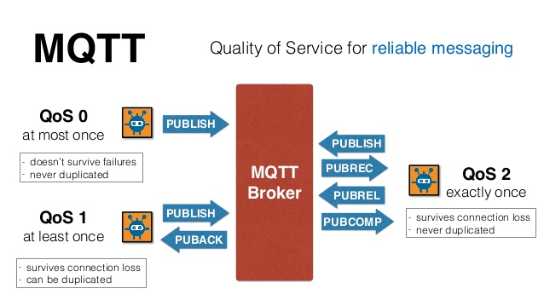
MQTT – QoS Level
The Quality of Service (QoS) level is an agreement between sender and receiver of a message regarding the guarantees of delivering a message. There are 3 QoS levels in MQTT:
(0) QoS: At Most Once (fire and forget) – used when the data is not that important or will be send at short intervals
(1) QoS: At least Once – used when the data have to be received at least once tolerating duplicates.
(2) QoS: Exactly once. Critical application when the data have to be received without duplicates.
Notes:
What is Quality of Service?
The Quality of Service (QoS) level is an agreement between sender and receiver of a message regarding the guarantees of delivering a message. There are 3 QoS levels in MQTT:
At most once (0)
At least once (1)
Exactly once (2).
When talking about QoS there are always two different parts of delivering a message: publishing client to broker and broker to subscribing client. We need to look at them separately since there are subtle differences. The QoS level for publishing client to broker is depending on the QoS level the client sets for the particular message. When the broker transfers a message to a subscribing client it uses the QoS of the subscription made by the client earlier. That means, QoS guarantees can get downgraded for a particular receiving client if subscribed with a lower QoS.
Why is Quality of Service important?
QoS is a major feature of MQTT, it makes communication in unreliable networks a lot easier because the protocol handles retransmission and guarantees the delivery of the message, regardless how unreliable the underlying transport is. Also it empowers a client to choose the QoS level depending on its network reliability and application logic.
How does it work?
So how is the quality of service implemented in the MQTT protocol ? We will look at each level one by one and explain the functionality.
QoS 0 – at most once
The minimal level is zero and it guarantees a best effort delivery. A message won’t be acknowledged by the receiver or stored and redelivered by the sender. This is often called “fire and forget” and provides the same guarantee as the underlying TCP protocol.
QoS 1 – at least once
When using QoS level 1, it is guaranteed that a message will be delivered at least once to the receiver. But the message can also be delivered more than once.
The sender will store the message until it gets an acknowledgement in form of a PUBACK command message from the receiver.
The association of PUBLISH and PUBACK is done by comparing the packet identifier in each packet. If the PUBACK isn’t received in a reasonable amount of time the sender will resend the PUBLISH message. If a receiver gets a message with QoS 1, it can process it immediately, for example sending it to all subscribing clients in case of a broker and then replying with the PUBACK. The duplicate (DUP) flag, which is set in the case a PUBLISH is redelivered, is only for internal purposes and won’t be processed by broker or client in the case of QoS 1. The receiver will send a PUBACK regardless of the DUP flag.
QoS 2
The highest QoS is 2, it guarantees that each message is received only once by the counterpart. It is the safest and also the slowest quality of service level. The guarantee is provided by two flows there and back between sender and receiver.
If a receiver gets a QoS 2 PUBLISH it will process the publish message accordingly and acknowledge it to the sender with a PUBREC message.
The receiver will store a reference to the packet identifier until it has send the PUBCOMP. This is important for avoid processing the message a second time. When the sender receives the PUBREC it can safely discard the initial publish, because it knows that the counter part has successfully received the message. It will store the PUBREC and respond with a PUBREL.
After the receiver gets the PUBREL it can discard every stored state and answer with a PUBCOMP. The same is true when the sender receives the PUBCOMP.
When the flow is completed both parties can be sure that the message has been delivered and the sender also knows about it.
Whenever a packet gets lost on the way, the sender is responsible for resending the last message after a reasonable amount of time. This is true when the sender is a MQTT client and also when a MQTT broker sends a message. The receiver has the responsibility to respond to each command message accordingly.
Good to know
There are a few things you should have in mind when using QoS. These are not obvious or clear on first sight.
Use QoS 0 when …
You have a complete or almost stable connection between sender and receiver. A classic use case is when connecting a test client or a front end application to a MQTT broker over a wired connection.
You don’t care if one or more messages are lost once a while. That is sometimes the case if the data is not that important or will be send at short intervals, where it is okay that messages might get lost.
You don’t need any message queuing. Messages are only queued for disconnected clients if they have QoS 1 or 2 and a persistent session.
Use QoS 1 when …
You need to get every message and your use case can handle duplicates. The most often used QoS is level 1, because it guarantees the message arrives at least once. Of course your application must be tolerating duplicates and process them accordingly.
You can’t bear the overhead of QoS 2. Of course QoS 1 is a lot fast in delivering messages without the guarantee of level 2.
Use QoS 2 when …
It is critical to your application to receive all messages exactly once. This is often the case if a duplicate delivery would do harm to application users or subscribing clients. You should be aware of the overhead and that it takes a bit longer to complete the QoS 2 flow.

Slide 8
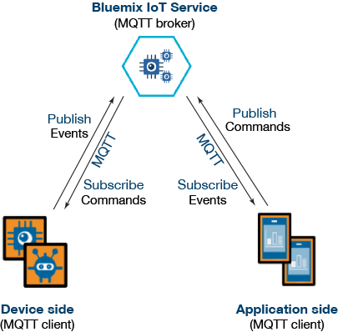
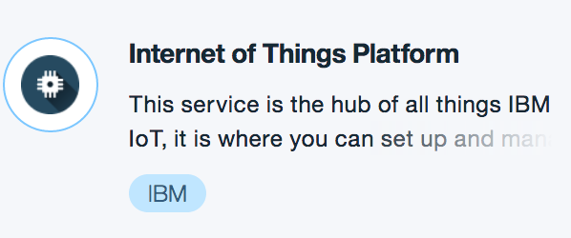
IBM IoT Bluemix Service
IBM Internet Of Things Platform service represents the MQTT broker
… from Bluemix Catalog
The access point for the IoT service (MQTT broker) is: <orgid>.messaging.internetofthings.ibmcloud.com
<orgid> is created automatically when the IoT service is configured.
Notes:
In general terms, the Bluemix IoT service acts as the MQTT broker, and is thus responsible for distributing messages to connected clients (devices and applications). Devices include machines that publish information they detect, and applications are the programs that consume the information received from those devices. Devices and applications communicate with the MQTT broker using the MQTT protocol.

Slide 9
IBM IoT Bluemix Service
An app using the Bluemix IoT service usually consists of three parts:
Bluemix IoT service configuration (device and application registration) = MQTT broker configuration
Device-side programming
Application-side programming
Notes:
In general terms, the Bluemix IoT service acts as the MQTT broker, and is thus responsible for distributing messages to connected clients (devices and applications). Devices include machines that publish information they detect, and applications are the programs that consume the information received from those devices. Devices and applications communicate with the MQTT broker using the MQTT protocol.

Slide 10
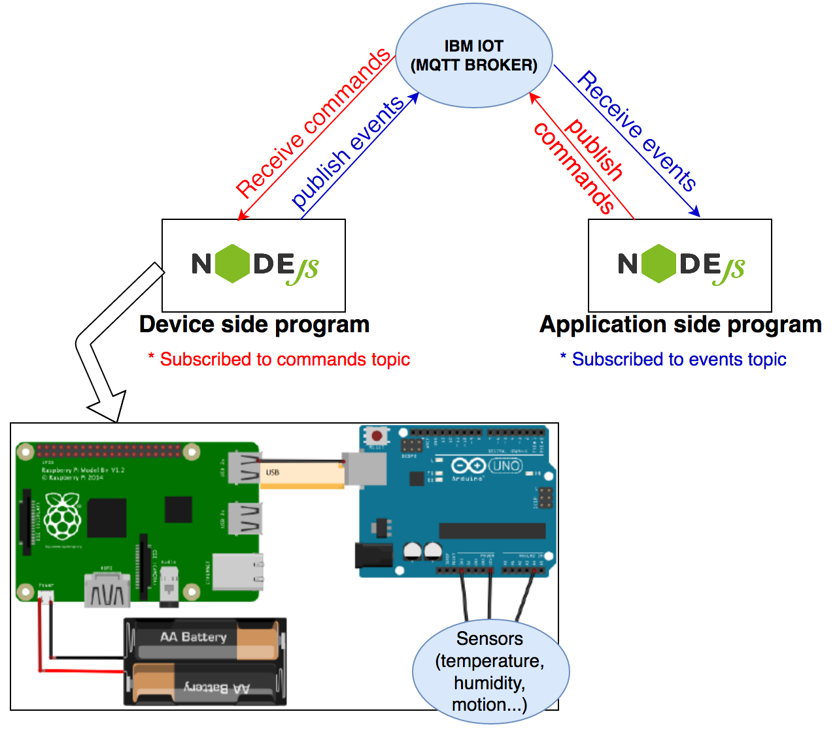

IBM IoT Bluemix Service - Practice
Execution Flow:
Arduino read the sensors data
Arduino send the data to Raspberry PI
on Raspberry PI there is a NodeJS application (DeviceSide program) that read the data sensor and publish the data (publish event) to IBM IOT service (MQTT Broker)
the application side program receive the sensors data. We could create an User Interface that show data sensors in diagram chart
In order to send a command to Device, the flow, instead, is:
Application side -> MQTT broker -> Device side program -> RaspberryPI -> Arduino
Notes:
In general terms, the Bluemix IoT service acts as the MQTT broker, and is thus responsible for distributing messages to connected clients (devices and applications). Devices include machines that publish information they detect, and applications are the programs that consume the information received from those devices. Devices and applications communicate with the MQTT broker using the MQTT protocol.

Slide 11
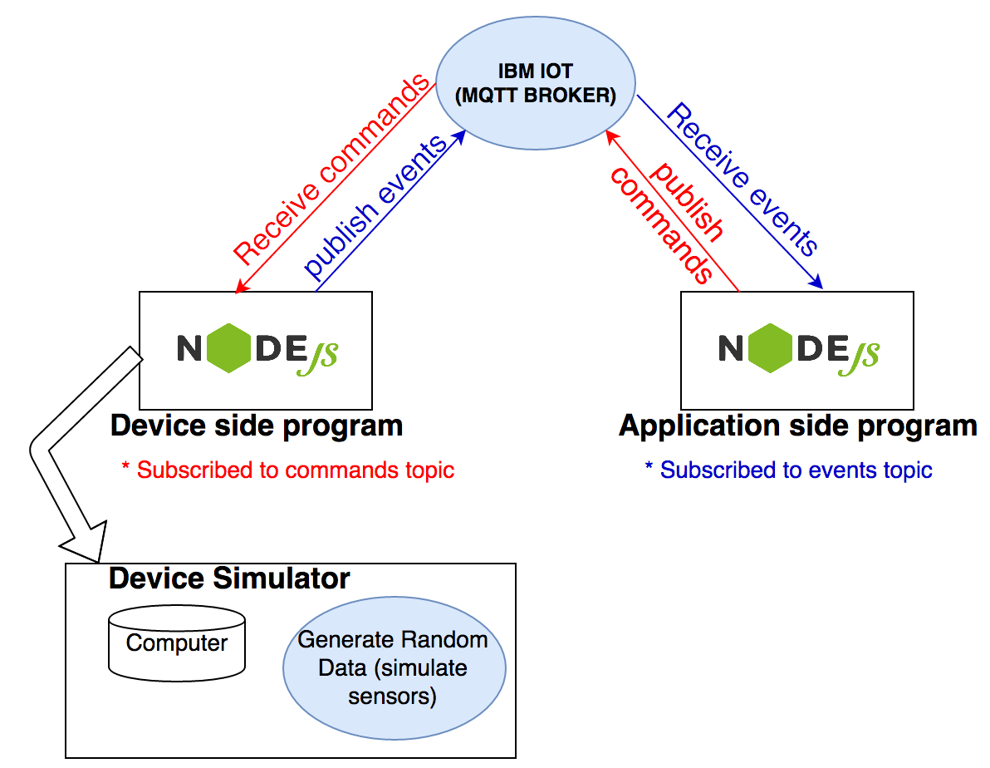
IBM IoT Bluemix Service - Practice
Execution Flow:
NodeJS device side program run on a computer and generate random data. In this way we can simulate sensors data (ex: temperature, humidity…)
the application side program receive the sensors data. We could create an User Interface that show data sensors in diagram chart
In order to send a command to Device, the flow, instead, is:
Application side -> MQTT broker -> Device side program
If we don’t have Devices boards (Raspberry, Arduino) …
Notes:
In general terms, the Bluemix IoT service acts as the MQTT broker, and is thus responsible for distributing messages to connected clients (devices and applications). Devices include machines that publish information they detect, and applications are the programs that consume the information received from those devices. Devices and applications communicate with the MQTT broker using the MQTT protocol.

Slide 12
IBM IoT Bluemix Service - Practice
Step 1. Set up the Bluemix IoT service
Add the IoT service to your Bluemix Organization
Launch the IoT service console
Register the Device (each devices is identified with Device Type, Device ID and Authorization Token)
Register the Application (each application is identified with API key and API token)
Step 2. Create a device-side program.
Github url: https://github.com/crescmig/iotdeviceside
It consists of three parts:
Connecting to the IoT service (MQTT broker)
Publishing events to applications
Subscribing commands from applications
Step 3. Create an application-side program - Node-red Application:
It consists of three parts:
Connecting to the IoT service (MQTT broker)
Subscribing events from devices or from the MQTT broker
Publishing commands to devices
Notes:
In general terms, the Bluemix IoT service acts as the MQTT broker, and is thus responsible for distributing messages to connected clients (devices and applications). Devices include machines that publish information they detect, and applications are the programs that consume the information received from those devices. Devices and applications communicate with the MQTT broker using the MQTT protocol.
Step 1. Set up the Bluemix IoT service
Add the IoT service to your Bluemix Organization
Launch the IoT service console
Register the Device (each devices is identified with Device Type, Device ID and Authorization Token)
Register the Application (each application is identified with API key and API token)
Step 2. Create a device-side program. It consists of three parts:
Connecting to the IoT service (MQTT broker)
Publishing events to applications
Event topics should be published in this form: iot-2/evt/<event-id>/fmt/json
The convention of the event topic is established by IBM IoT Service (MQTT broker).
The <event-id> is set to categorize different event types; you may choose your own value.
Subscribing commands from applications
The topic of subscribing commands should be in the form: iot-2/cmd/<cmd-type>/fmt/json
The convention of the command topic is established by IBM IoT Service (MQTT broker).
The <cmd-type> is set to categorize different event types; you may choose your own value.
Step 3. Create an application-side program. It consists of three parts:
Connecting to the IoT service (MQTT broker)
Subscribing events from devices or from the MQTT broker
Publishing commands to devices

Slide 13
IBM IoT Bluemix Service – Practice
IBM IOT Platform library for NodeJS (ibmiotf: https://www.npmjs.com/package/ibmiotf)
The ibmiotf library is used for simplifying the interaction with the IBM Watson Internet of Things Platform.
It provides a set of functions to publish events, subscribe to events, send(publish) commands and receive commands
var Iotf = require("ibmiotf");
var iotfClient = new Iotf.IotfDevice(iotfConfig);
Device Side Function:
Connect to IBM IOT service (MQTT broker): iotfClient.connect();
Publish events on a topic: iotfClient.publish(topic, format, data, QoS)
Subscribe to commands: iotfClient.on("command", function (commandName, format, data, topic) { }
Note: topic is also called eventType
Notes:
Publish event example: Iotf.publish("status","json",'{"d" : { "cpu" : 60, "mem" : 50 }}', myQosLevel);
When an event is received by the IOT Platform the credentials of the connection on which the event was received are used to determine from which device the event was sent. With this architecture it is impossible for a device to impersonate another device.
Events can be published at any of the three quality of service levels defined by the MQTT protocol. By default events will be published as qos level 0.

Slide 14
Reference
http://ibm.github.io/
https://bluemix.net
https://console.ng.bluemix.net/catalog/services/internet-of-things-platform/
https://console.ng.bluemix.net/registration/
https://github.com/cloudfoundry/cli
https://developer.ibm.com/iotfoundation/recipes/api-documentation/
https://www.ng.bluemix.net/docs/services/IoT/index.html#iot170
https://docs.internetofthings.ibmcloud.com/devices/mqtt.html

