Slide 1
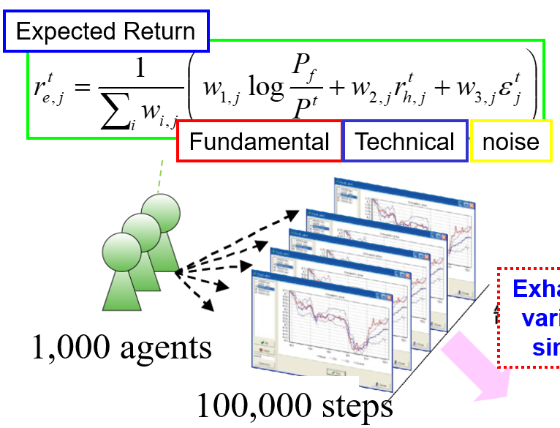
1. Simulation
2. Real-data analysis
3. Regulation design
The simulation result was reflected in the plan of selection of the target stocks in the tick size reduction of Tokyo Stock Exchange in 2014.

