Slide 1
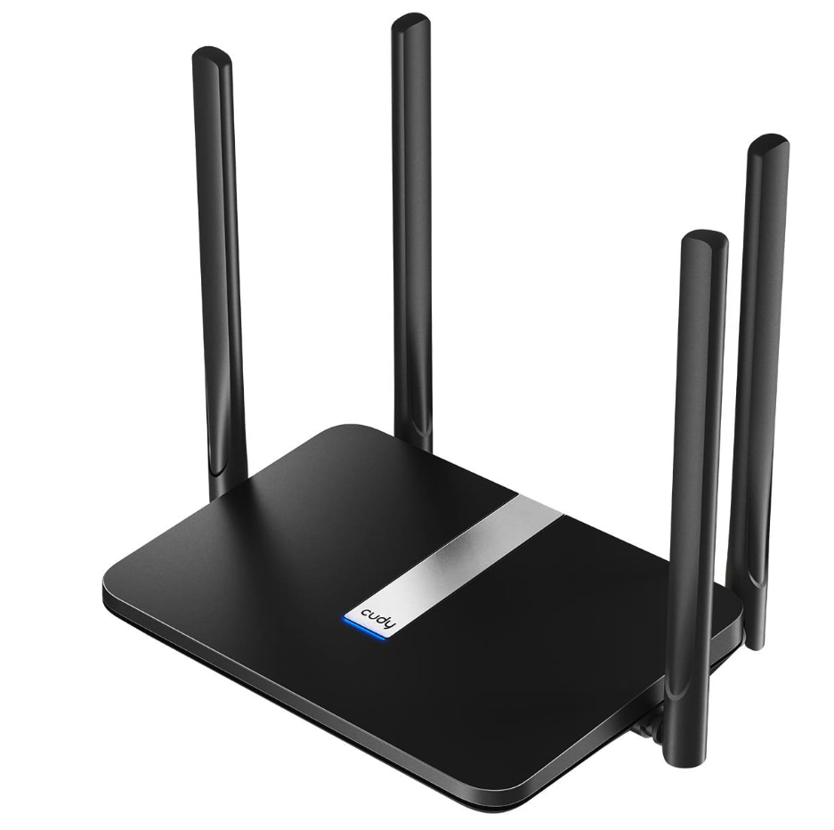
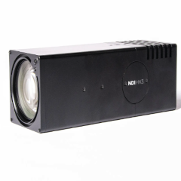
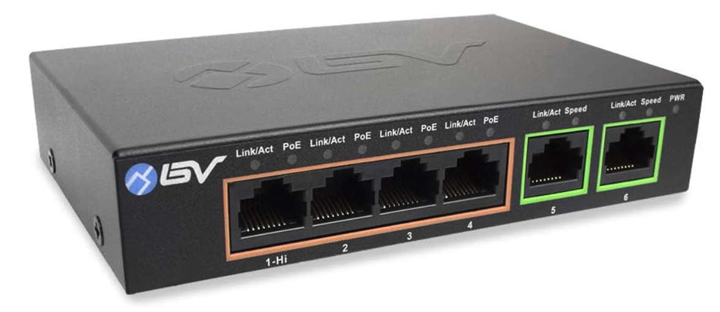


CrewTimer
Video Recording and
Video Review
PoE Streaming Video Camera
PoE Switch
LTE Internet Router
Recording and Review
Either LTE Internet,
Wired Facility Internet,
Or Internet connection sharing from laptop
Wired Internet
Internet access is required for precision time synchronization, reporting of timestamps, and integration with CrewTimer cloud services.

