Slide 1


Slide 2
Introduction : Team
Dean Leeks
  Project Leader
  2D Artist
Roger Creyke
  Lead Programmer
  2D Artist
Ryan Avent
  Lead Artist
  Ideas Man
George Daters
  Programmer
  Audio Engineer
Dean

Slide 3

Introduction : Game
Q. Is it a Casual, Hardcore or NEW category of Game?
Freestyle Arcade
Q. What GENRE is it?
A. Top Down Platformer
Dean

Slide 4
Introduction : Game
Q. What’s the HIGH Concept?
A. <ANSWER>
Dean

Slide 5
Concept : Gameplay
What is the basic gameplay in your project?
Our game will be for the for the Nintendo DS.
It will consist of using the stylus to slingshot arctic animals (i.e.: Polar Bears & Penguins) between blocks of ice floating on the arctic waters. So therefore it will be a top down platformer.
The object of the game will be to reach the goal by jumping between blocks of ice.
Ryan

Slide 6
Concept : Game Flow
What does the player do?
Second by second
  Jump between ice platforms
Minute by Minute
  Try to complete the levels with a high score
Hour by hour
  Get maximum scores on all the levels
Ryan

Slide 7
Concept : Narrative
Not sure if we’ll have a narrative but if we do it’ll consist of:
Humans are destroying the planet (global warming) so the arctic animals have to do more jumping between blocks of ice in order to find food.
Ryan

Slide 8
Concept : Art
Provide examples of expected art style, including:
Game screen concepts
Interface concepts
Characters sketches if relevant.
Ryan

Slide 9
Concept : Commercial
What is the Game’s MAIN Market potential?
Arcade style game that should be easy to pick up and play for players of all ages.
Will suit casual gamers.
Cute, fluffy arctic animals should appeal to girls.
High scores and difficulty levels should appeal to boys.
Fun and addictive game play should appeal to everyone.
George

Slide 10
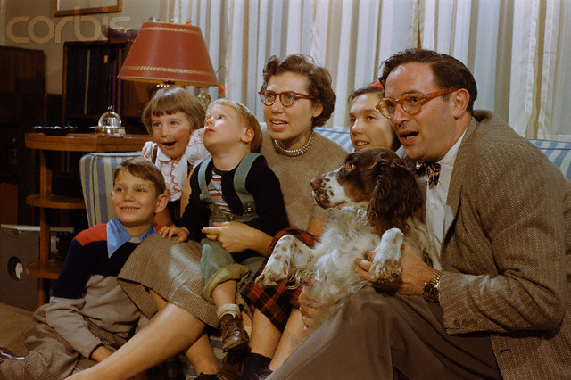
Concept : Commercial
Who is the game aimed at?
George

Slide 11
Concept : Commercial
Why will the target audience notice our game?
Pick-up-and-play arcade style game play.
Slick and attractive graphics.
Varying levels of difficulty.
Replay Value – High Scores, get round the levels quicker.
Originality of concept.
George

Slide 12
Concept : Risks
Key Risks
Lack of communication between group members.
Team members’ workload.
Little experience developing on the target platform.
Laptops blowing up due to over use.
Creating / rendering out characters is time-consuming.
George

Slide 13
Concept : Risks
Risk Mitigation
Pro-active communication between group members using any available tools.
Superhuman efforts to learn everything necessary to develop the game.
Effective project planning and management.
George

Slide 14


Slide 15
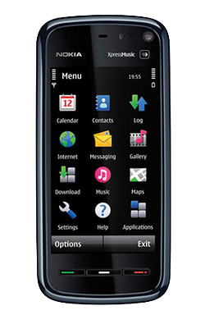

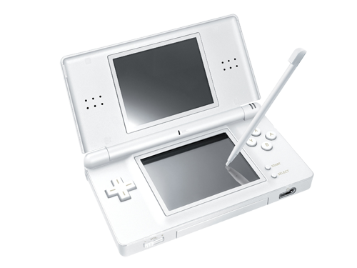
Platform : Choices
Objective C | JavaME | C++
Roger

Slide 16


Platform : Middleware
Professional Developer
Homebrew Developer
Nintendo Dev Program
Nitro SDK
DS Card
libnds / PALib
Homebrew GBCard e.g. R4
Roger

Slide 17
Platform : Engine Features
PALib
  Stylus based input
  Sprite and text tiling and transformation
Custom Library
  Projectile motion physics
  Radial, per-pixel and tri-point collision
  2D vector rasterizer
  State management
Roger

Slide 18
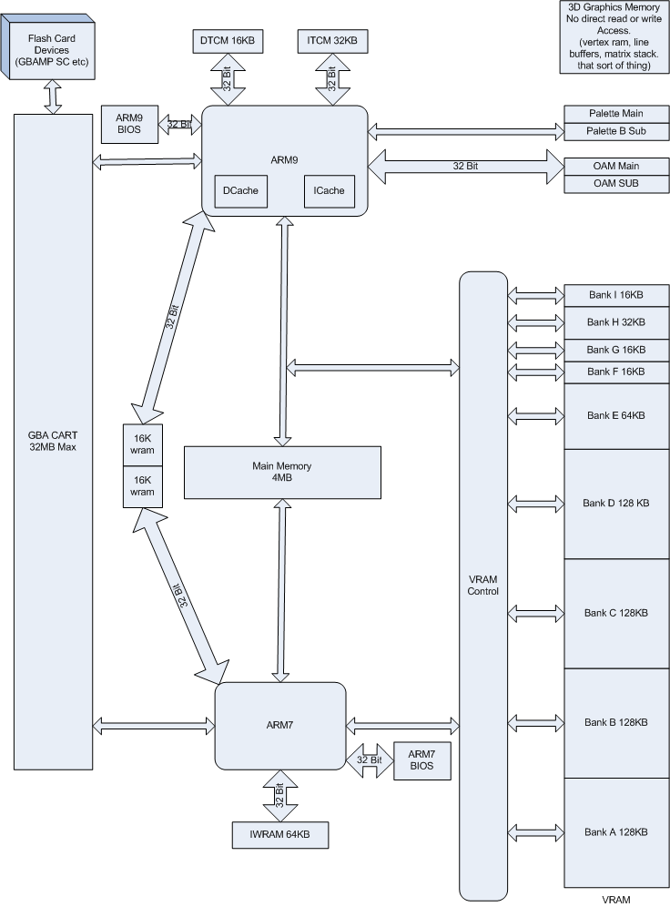
Platform : Limitations
Complex memory architecture
Roger
http://www.dev-scene.com/NDS/Tutorials_Day_2

Slide 19
Platform : Limitations
Complex memory architecture
  Optimisation will be fun
Memory
  Can’t just load all textures into memory
Storage space
  GBA Cart 32mb max
Debugging
Team Experience
Roger

Slide 20
Demo
Insert video of demo here
Roger

Slide 22
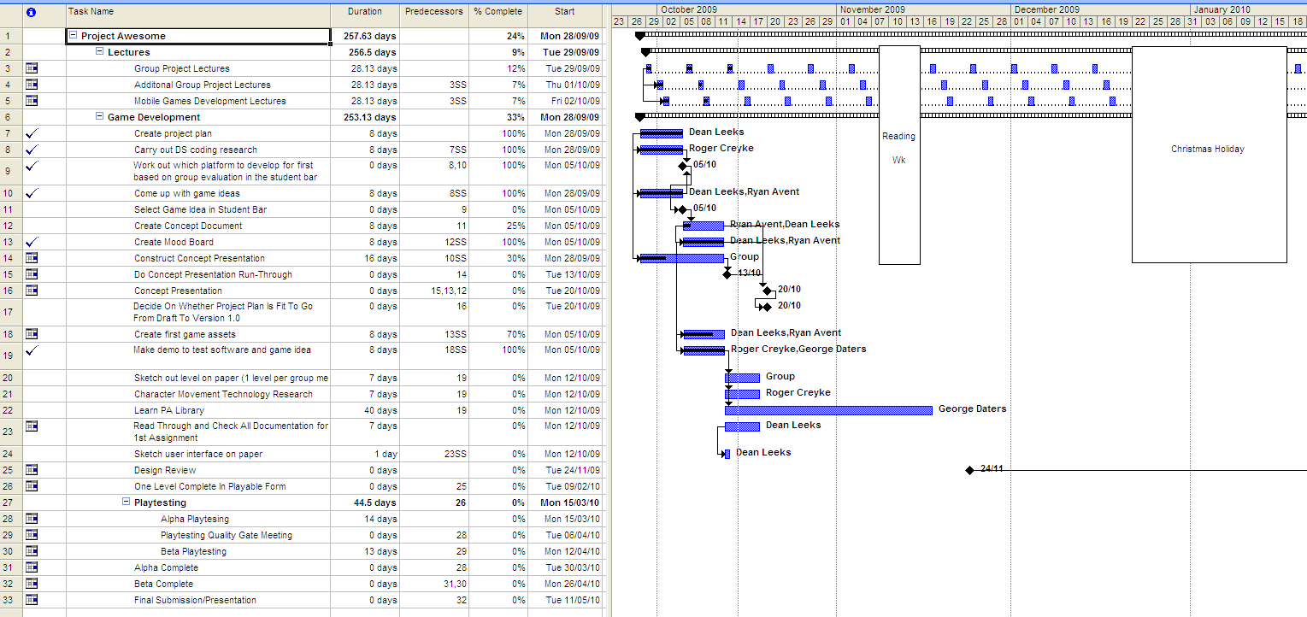
Project Plan
Dean

Slide 23
Conclusion
To keep up constant communication between group members so we all know we’re working in the right areas. This will mean we continue to stay on track deadline wise.
To stick to and keep project plan up-to-date.
Have more group meetings in the bar. Alcohol induced ideas rock.
Get game mechanics sorted and finish a tech demo to make sure game idea has good potential and has no technical flaws. Then playtest demo.
Have one playable level in complete form by the 24th November
Roger

Slide 24
Thanks for listening
…any questions?
Dean

