Slide 1
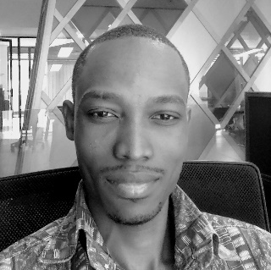









RB
BUHENDWA BABONE RANDY
+243 822 561 854
creytas@gmail.com
Hello World !!!
I’m Randy BUHENDWA
and
I’m a Front-end Web Developper
About Me
Skills
Projects
© Imagin’Soft 2021

Slide 2
RB
ABOUT ME
BUHENDWA BABONE RANDY
+243 822 561 854
creytas@gmail.com
About Me
Skills
Projects
© Imagin’Soft 2021

Slide 3
RB
SKILLS
BUHENDWA BABONE RANDY
+243 822 561 854
creytas@gmail.com
About Me
Skills
Skills
Projects
© Imagin’Soft 2021

Slide 4
RB
PROJECTS
BUHENDWA BABONE RANDY
+243 822 561 854
creytas@gmail.com
About Me
Skills
Projects
Projects
© Imagin’Soft 2021

