Slide 1
Software Process in Software Engineering
By Yino Alva

Slide 2
Part 1: What is Software Process?
Definition of Software Process : A software process is a structured set of activities required to plan, design, develop, test, and maintain a software system. Rather than writing code in an ad-hoc manner, a software process provides a systematic framework that ensures predictability, quality, and maintainability throughout the system's life cycle.

Slide 3
2. Why Software Development Requires an Organized Process :
Software engineering is fundamentally different from simple programming. While ad-hoc programming works for small, single-developer projects ("toy applications"), large-scale software systems are built by multi-disciplinary teams, must handle complex user requirements, and must evolve over many years. An organized software process is necessary because:
Complexity & Scale: Modern software involves millions of lines of code and numerous interacting components.
Team Coordination: Clear structures define who does what, when, and how, preventing duplicated work or conflicting architectural decisions.
Cost & Schedule Control: Structured processes enable project estimation, resource planning, and progress tracking to avoid severe cost and time overruns.
Quality Assurance: Systematic testing and validation ensure the software is reliable, secure, and meets stakeholder requirements before release.

Slide 4
3. Four Fundamental Software Process Activities
Regardless of the methodology used (Waterfall, Agile, or Hybrid), all software processes comprise four core activities:
Software Specification (Requirements Engineering): Defining what the system should do, its operational constraints, and the needs of software users and stakeholders.
Software Design and Implementation: Engineering the architecture, data structures, and code logic to produce an executable software system according to specification.
Software Validation: Verifying and testing the software to ensure that it operates correctly and conforms to customer expectations.
Software Evolution: Modifying, updating, and extending the software over time to adapt to changing user requirements, market conditions, and technology environments.

Slide 5
4. Practical Example
Consider developing a Mobile Banking Application:
Specification: Engineers gather requirements from bank regulators and customers (e.g., login security, account balance display, wire transfers).
Design & Implementation: Software architects design secure database schemas and REST APIs while mobile developers write code in Swift/Kotlin.
Validation: Quality assurance (QA) teams run automated security checks, unit tests, and user-acceptance testing (UAT) to confirm transfers occur accurately.
Evolution: Post-launch, the development team releases updates to support biometric authentication (Face ID) or new tax reporting laws.

Slide 6
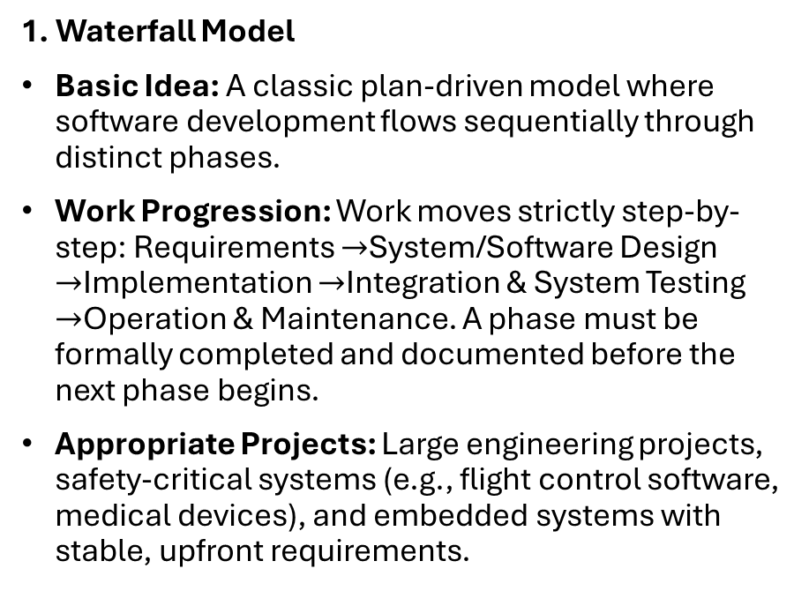
Part 2 : Software Process Models
1. Waterfall Model
Basic Idea: A classic plan-driven model where software development flows sequentially through distinct phases.
Work Progression: Work moves strictly step-by-step: Requirements $→$System/Software Design $→$Implementation $→$Integration & System Testing $→$Operation & Maintenance. A phase must be formally completed and documented before the next phase begins.
Appropriate Projects: Large engineering projects, safety-critical systems (e.g., flight control software, medical devices), and embedded systems with stable, upfront requirements.

Slide 7
2. Incremental Development
Basic Idea: The software is developed as a series of versions (increments), with each increment adding functional features to the previous version.
Work Progression: Specification, design, implementation, and validation activities are interleaved rather than sequential. Early increments deliver core functionality; subsequent increments expand capability based on feedback.
Appropriate Projects: Business software, consumer web/mobile applications, and fast-moving startup products where requirements evolve rapidly.

Slide 8
3. Integration and Configuration (Component-Based Reuse)
Basic Idea: Development focuses on assembling and configuring pre-existing software components, commercial off-the-shelf (COTS) software, cloud microservices, or frameworks rather than building from scratch.
Work Progression: Starts with identifying available software components, refining requirements to match component capabilities, configuring the parameters, and integrating them into the system architecture.
Appropriate Projects: Enterprise resource planning (ERP) systems, e-commerce stores, and web services that leverage standardized third-party APIs.

Slide 9
4. Plan-Driven Development
Basic Idea: An approach where all process activities are planned, and progress is measured against this explicit, detailed plan.
Work Progression: Extensive upfront planning, detailed architectural design, formal milestone reviews, and strict change-management boards govern progression.
Appropriate Projects: Government contracts, defense systems, and highly regulated industries where compliance, safety, and traceability are mandatory.

Slide 10
4. Plan-Driven Development
Basic Idea: An approach where all process activities are planned, and progress is measured against this explicit, detailed plan.
Work Progression: Extensive upfront planning, detailed architectural design, formal milestone reviews, and strict change-management boards govern progression.
Appropriate Projects: Government contracts, defense systems, and highly regulated industries where compliance, safety, and traceability are mandatory.

Slide 11
5. Agile Development
Basic Idea: An iterative and adaptive approach emphasizing rapid release cycles, customer collaboration, and the ability to respond flexibly to change over sticking to a rigid plan.
Work Progression: Development occurs in short iterations (sprints, typically 1–4 weeks). Cross-functional teams work on prioritized backlog tasks, releasing functioning software updates frequently.
Appropriate Projects: Consumer applications, SaaS products, startups, and projects operating in volatile market environments.

