Slide 1
Software Process in Software Engineering
By Yino Alva

Slide 2
Part 1: What is Software Process?
Definition of Software Process : A software process is a structured set of activities required to plan, design, develop, test, and maintain a software system. Rather than writing code in an ad-hoc manner, a software process provides a systematic framework that ensures predictability, quality, and maintainability throughout the system's life cycle.

Slide 3
2. Why Software Development Requires an Organized Process :
Software engineering is fundamentally different from simple programming. While ad-hoc programming works for small, single-developer projects ("toy applications"), large-scale software systems are built by multi-disciplinary teams, must handle complex user requirements, and must evolve over many years. An organized software process is necessary because:
Complexity & Scale: Modern software involves millions of lines of code and numerous interacting components.
Team Coordination: Clear structures define who does what, when, and how, preventing duplicated work or conflicting architectural decisions.
Cost & Schedule Control: Structured processes enable project estimation, resource planning, and progress tracking to avoid severe cost and time overruns.
Quality Assurance: Systematic testing and validation ensure the software is reliable, secure, and meets stakeholder requirements before release.

Slide 4
3. Four Fundamental Software Process Activities
Regardless of the methodology used (Waterfall, Agile, or Hybrid), all software processes comprise four core activities:
Software Specification (Requirements Engineering): Defining what the system should do, its operational constraints, and the needs of software users and stakeholders.
Software Design and Implementation: Engineering the architecture, data structures, and code logic to produce an executable software system according to specification.
Software Validation: Verifying and testing the software to ensure that it operates correctly and conforms to customer expectations.
Software Evolution: Modifying, updating, and extending the software over time to adapt to changing user requirements, market conditions, and technology environments.

Slide 5
4. Practical Example
Consider developing a Mobile Banking Application:
Specification: Engineers gather requirements from bank regulators and customers (e.g., login security, account balance display, wire transfers).
Design & Implementation: Software architects design secure database schemas and REST APIs while mobile developers write code in Swift/Kotlin.
Validation: Quality assurance (QA) teams run automated security checks, unit tests, and user-acceptance testing (UAT) to confirm transfers occur accurately.
Evolution: Post-launch, the development team releases updates to support biometric authentication (Face ID) or new tax reporting laws.

Slide 6
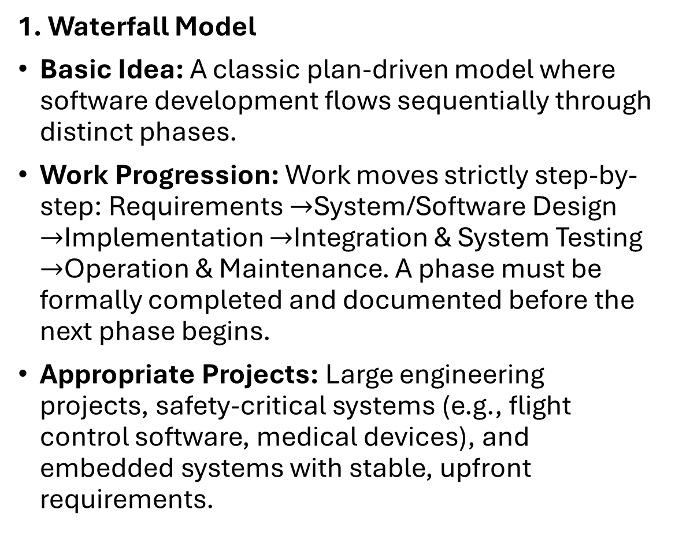
Part 2 : Software Process Models
1. Waterfall Model
Basic Idea: A classic plan-driven model where software development flows sequentially through distinct phases.
Work Progression: Work moves strictly step-by-step: Requirements $→$System/Software Design $→$Implementation $→$Integration & System Testing $→$Operation & Maintenance. A phase must be formally completed and documented before the next phase begins.
Appropriate Projects: Large engineering projects, safety-critical systems (e.g., flight control software, medical devices), and embedded systems with stable, upfront requirements.

Slide 7
2. Incremental Development
Basic Idea: The software is developed as a series of versions (increments), with each increment adding functional features to the previous version.
Work Progression: Specification, design, implementation, and validation activities are interleaved rather than sequential. Early increments deliver core functionality; subsequent increments expand capability based on feedback.
Appropriate Projects: Business software, consumer web/mobile applications, and fast-moving startup products where requirements evolve rapidly.

Slide 8
3. Integration and Configuration (Component-Based Reuse)
Basic Idea: Development focuses on assembling and configuring pre-existing software components, commercial off-the-shelf (COTS) software, cloud microservices, or frameworks rather than building from scratch.
Work Progression: Starts with identifying available software components, refining requirements to match component capabilities, configuring the parameters, and integrating them into the system architecture.
Appropriate Projects: Enterprise resource planning (ERP) systems, e-commerce stores, and web services that leverage standardized third-party APIs.

Slide 9
4. Plan-Driven Development
Basic Idea: An approach where all process activities are planned, and progress is measured against this explicit, detailed plan.
Work Progression: Extensive upfront planning, detailed architectural design, formal milestone reviews, and strict change-management boards govern progression.
Appropriate Projects: Government contracts, defense systems, and highly regulated industries where compliance, safety, and traceability are mandatory.

Slide 10
5. Agile Development
Basic Idea: An iterative and adaptive approach emphasizing rapid release cycles, customer collaboration, and the ability to respond flexibly to change over sticking to a rigid plan.
Work Progression: Development occurs in short iterations (sprints, typically 1–4 weeks). Cross-functional teams work on prioritized backlog tasks, releasing functioning software updates frequently.
Appropriate Projects: Consumer applications, SaaS products, startups, and projects operating in volatile market environments.

Slide 11
Part 3: The Waterfall Model
1. Major Phases of the Waterfall Model
Requirements Definition: Consultations with system stakeholders establish the system's goals, services, and constraints, which are then documented in detail.
System and Software Design: Establishes an overall system architecture and defines basic software abstractions and relationships.
Implementation and Unit Testing: Software design is realized as a set of programs or program units, and individual modules are verified against specifications.
Integration and System Testing: Individual program units are integrated and tested as a complete system to ensure software requirements are met.
Operation and Maintenance: The system is installed and put into practical use. Maintenance involves correcting errors, improving units, and enhancing system services as new requirements surface.

Slide 12
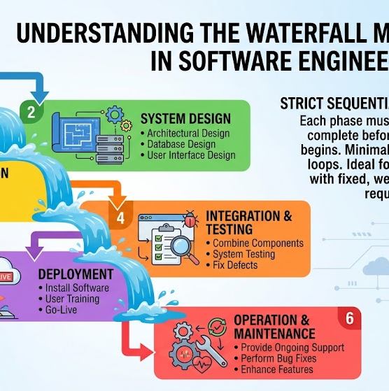
Waterfall Diagram

Slide 13
2. Why Waterfall is "Plan-Driven"
Waterfall is categorized as plan-driven because all process activities—budget, schedule, software architecture, and system requirements—are explicitly planned before software development begins. Progress is tracked directly against documented project plans and milestones.

Slide 14
3. Importance of Documentation and Phase Completion
Because teams often transition between distinct phases or groups (e.g., systems analyst team to software development team), comprehensive documentation serves as the primary communication bridge. Sign-offs and completed phase deliverables ensure that requirements and architectural specifications are fully validated before committing financial and technical resources to subsequent stages.

Slide 15
4. Impact of Requirements Change Mid-Development
When requirements change after development has progressed, Waterfall requires going back through previous stages (e.g., redesigning architecture, re-specifying requirements, re-writing code, and re-executing unit tests). This rework is extraordinarily expensive, disruptive to schedules, and can result in severe budget overruns.

Slide 16
Part 4: Incremental Development
1. Concept of Incremental Development
Incremental development breaks the software system into manageable chunks (increments), where each increment delivers a specific subset of functionality.
2. Interleaving of Process Activities
Unlike Waterfall's distinct linear phases, specification, design, coding, and testing activities are conducted concurrently during each increment. Requirements for upcoming increments are refined while current increments are actively being coded and validated.

Slide 17
3. Role of Customer Feedback
Customers receive early releases of working software. They provide real-world feedback based on actual hands-on usage rather than static spec documents. This feedback directly informs the priorities and requirements for subsequent increments.
4. Reducing the Cost of Accommodating Change
Because increments are small and modular, changes in customer requirements affect only current or future increments, minimizing software rework. The amount of code that needs to be rewritten is vastly smaller compared to modifying a fully built Waterfall system.

Slide 18
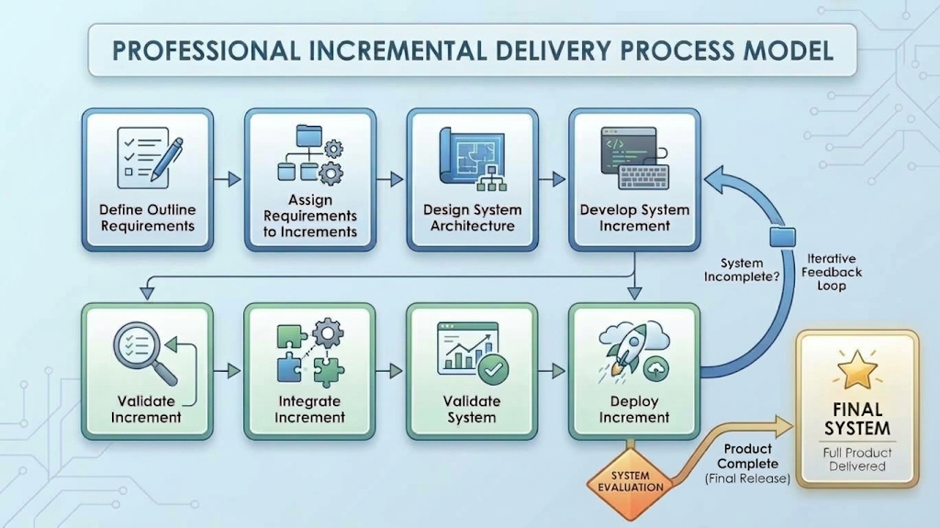
Incremental Development Model

Slide 19
Part 5 : Integration and Configuration
1. Reuse-Based Software Development
Modern software development heavily relies on reusing pre-built software components, off-the-shelf packages, cloud microservices, and framework APIs rather than writing every component from scratch.

Slide 20
2. Process Stages in Component Reuse
Requirements Specification: Initial requirements are established to guide component search.
Software Discovery & Evaluation: Developers search repositories and commercial markets to discover components that match requirements.
Requirements Refinement: Original requirements are modified to align with the capabilities and limitations of existing reusable components.
Configuration / Adaptation: Reusable components are configured, parameterized, and adapted to fit the specific operational context.
Integration: Components, frameworks, and custom glue code are integrated to form the unified software system.

Slide 21
3. Advantages and Limitations
Advantage: Rapid deployment to market and reduced development cost/effort. Reusing proven, pre-tested components also enhances software reliability.
Limitation: Loss of control over system evolution. If a third-party component vendor updates, deprecates, or discontinues an API or package, the software owner must adapt, often risking compatibility issues.

Slide 22
Part 6 : Software Process Activities
1. Software Specification / Requirements Engineering
Role: Establishes the boundary conditions, capabilities, and system constraints.
Contribution: Prevents teams from building the wrong system by aligning technical output with stakeholder needs.

Slide 23
2. Software Design and Implementation
Role: Transforms system specifications into an operational software executable.
Contribution: Software design structures the internal system architecture, database models, and interface definitions, while implementation writes clean, maintainable code.
3. Software Validation
Role: Evaluates software via unit testing, integration testing, system testing, and user-acceptance testing (UAT).
Contribution: Ensures that the software operates accurately, satisfies security requirements, and meets specified expectations before deployment.
4. Software Evolution
Role: Updates, patches, and refactors software in response to changing environments, bug discoveries, and user requests.
Contribution: Software is dynamic; evolution ensures that software remains useful, secure, and operational over its commercial lifecycle.

Slide 24
Part 7 : Coping with Change
1. Inevitability of Change in Software Projects
Software operates within dynamic business, technical, and human environments. Changes arise from shifting market demands, evolving consumer preferences, corporate restructuring, regulatory updates, hardware changes, and newly discovered security vulnerabilities.

Slide 25
2. Software Prototyping
A prototype is an initial version of a software system used to demonstrate concepts, evaluate design options, and discover requirements.
Clarifying Requirements: Users test prototypes to discover missing features or clarify ambiguous specifications early in development.
Evaluating Design Decisions: Architects use prototypes to test performance bottleneck issues or evaluate different UI/UX layouts.

Slide 26
3. Incremental Delivery
Incremental delivery supplies working software functionality directly to end-users in successive releases.
Early Customer Value: Customers receive functional software sooner, allowing them to gain business value early rather than waiting years for a full release.
Impact of Change: Managing change iteratively isolates cost, schedule, testing, and documentation impacts to specific increments rather than destabilizing the entire software platform.

Slide 27
Part 8 : Application 1: E-Commerce Platform (Shopify)
Company & System: Shopify Inc. — Global E-Commerce Merchant Platform
System Function: Powers 2M+ online merchant storefronts, handling product catalog navigation, checkout, payment gateways, and inventory tracking.
Development Approach: Agile / DevOps / Continuous Delivery / Component Reuse
4 Core Process Activities:
  Specification: Dynamic backlog prioritized via merchant feedback, A/B testing, and market trends.
  Design & Implementation: API-first microservices architecture; integrates pre-built third-party components (Stripe, PayPal, carrier shipping APIs).
  Validation: Automated CI/CD pipelines, unit/integration testing suites, and canary deployments to ensure zero downtime.
  Evolution: Continuous daily releases to production without interrupting active storefront sales.
Process Flow: Merchant Feedback → Agile Backlog → Microservice/API Coding → Automated CI/CD Testing → Continuous Deployment → Live Telemetry

Slide 28
Application 2: Healthcare Software (Epic Systems)
Company & System: Epic Systems Corporation — EpicCare Electronic Health Record (EHR)
System Function: Manages electronic patient medical records, physician notes, prescription orders, and clinical workflows across hospital networks.
Development Approach: Plan-Driven / Safety-Critical Waterfall Hybrid
4 Core Process Activities:
  Specification: Exhaustive upfront specifications driven by regulatory standards (HIPAA, FDA) and clinical safety protocols.
  Design & Implementation: Modular clinical architecture with strict access control security models and data integrity baselines.
  Validation: Months of multi-tier clinical simulation, security audits, and formal verification before code freeze.
  Evolution: Scheduled quarterly/annual institutional releases managed by hospital Change Control Boards (CCB) to protect patient safety.
Process Flow: Regulatory/Safety Specs → Formal Architecture → Secure Module Coding → Clinical Simulation & Audits → Scheduled Institutional Rollout

Slide 29
Part 9 : Comparison: E-Commerce vs. Healthcare
Category | Application 1 (Shopify) | Application 2 (Epic Systems)
Company/Organization | Shopify Inc. | Epic Systems Corporation
Software/Application | Shopify E-Commerce Storefront Infrastructure | EpicCare Electronic Health Record (EHR) System
Primary Users | Online merchants, store managers, and global shoppers | Doctors, nurses, pharmacists, and medical staff
Development Approach | Agile / DevOps / Microservices Architecture | Plan-Driven / Safety-Critical Waterfall Hybrid
Requirements Process | Dynamic product backlog driven by merchant usage analytics & A/B testing | Formal upfront specifications based on HIPAA rules & FDA regulations
Development | API-first microservices & pre-built third-party component integration | Modular clinical data engine with strict role-based access control
Testing/Validation | Automated CI/CD pipelines, unit suites, and canary deployments | Multi-tier clinical simulation, data integrity testing & HIPAA audits

Slide 30
Part 9 : Comparison: E-Commerce vs. Healthcare
Category | Application 1 (Shopify) | Application 2 (Epic Systems)
Deployment | Continuous deployment (multiple updates pushed live per day) | Scheduled institutional release cycles (quarterly or annual updates)
Maintenance/Updates | Real-time cloud background updates without storefront downtime | Institutional patches governed by Change Control Board (CCB) oversight
Customer Feedback | Real-time site telemetry, merchant analytics, and live experimentation | Clinical advisory boards, hospital system feedback, and audit reports
Waterfall Characteristics | Core payment security baselines & financial data compliance rules | Sequential phase gates, exhaustive documentation, and signed-off specs
Agile/Incremental Characteristics | Rapid storefront feature updates and short sprint releases | Internal iterative engineering sprints prior to formal release freezes
Major Advantage of Approach | Rapid time-to-market and continuous scaling for merchants | Uncompromising patient safety, zero fault tolerance & regulatory compliance
Major Challenge | Handling massive real-time traffic spikes (e.g., Black Friday sales) | High cost, extreme complexity, and risk of modifying baseline core code

Slide 31
Part 10 : Advantages, Disadvantages & Appropriate Use
Waterfall Model:
  Advantages: Clear project milestones, detailed design documentation, predictable planning.
  Disadvantages: Inflexible to mid-project changes; working software delivered late in the process.
  Best Used For: Safety-critical, heavily regulated software (Healthcare EHRs, aerospace flight controls).

Slide 32
Incremental / Agile Models:
  Advantages: Fast time-to-market, flexible to changing requirements, early user value.
  Disadvantages: Less predictable long-term schedules; requires continuous team coordination.
  Best Used For: Dynamic commercial applications (E-commerce storefronts, consumer web/mobile apps).
Why Use Hybrid Models?
  Allows companies to keep core engines plan-driven for safety/compliance while using agile iterations for user interfaces.

Slide 33
Part 11 : Key Learnings & Summary
No "One-Size-Fits-All" Process: Software engineering processes must be tailored to the system's specific domain, risk profile, and target audience.
Safety & Regulation Drive Plan-Driven Processes: Systems where errors risk patient safety or legal non-compliance rely on structured, documented phases.
Market Competition Drives Agile Processes: Systems where customer expectations change quickly rely on iterative updates and continuous feedback.

Slide 34
References:
Govindaswamy, V. Software Engineering Lecture 1: Basics of Software Engineering Parts 1–3. Course Presentation Slides. 2.
Govindaswamy, V. Software Engineering Lecture 2: Software Processes Parts 1–2. Course Presentation Slides.
Shopify Engineering. How Shopify Delivers Software at Scale: Continuous Delivery & Microservices. Shopify Tech Blog. https://engineering.shopify.com
Epic Systems Corporation. Safety-Critical System Validation and Healthcare Compliance Standards. Epic Technical Documentation. https://www.epic.com

Slide 35
References
Shopify Engineering. Continuous Modernization & Infrastructure Scale for Enterprise Commerce. Shopify Tech Blog, 2026. Available at: [https://www.shopify.com/enterprise/blog/continuous-modernization](https://www.shopify.com/enterprise/blog/continuous-modernization)
Shopify Engineering. IT Transformation & Continuous Feature Delivery Benchmarks. Shopify Tech Blog, 2026. Available at: [https://www.shopify.com/enterprise/blog/it-transformation](https://www.shopify.com/enterprise/blog/it-transformation)

Slide 36
References
Epic Systems Corporation. Epic EHR Security Features & Healthcare Regulatory Compliance Standards. Digital Health Engineering, 2026. Available at: [https://digitalhealth.folio3.com/blog/epic-ehr-security-features/](https://digitalhealth.folio3.com/blog/epic-ehr-security-features/)
Accountable HQ. Epic HIPAA Compliance: Administrative, Technical Controls, and Change Oversight. Security & Compliance Guide, 2026. Available at: [https://www.accountablehq.com/post/epic-hipaa-compliance-requirements-security-features-and-best-practices](https://www.accountablehq.com/post/epic-hipaa-compliance-requirements-security-features-and-best-practices)

