Slide 1
Amazon Managed Streaming, Apache Flink & Amazon MSK
Presented by : Praveen
Faculty Advisor : Dr. Victor Govindaswamy

Slide 2
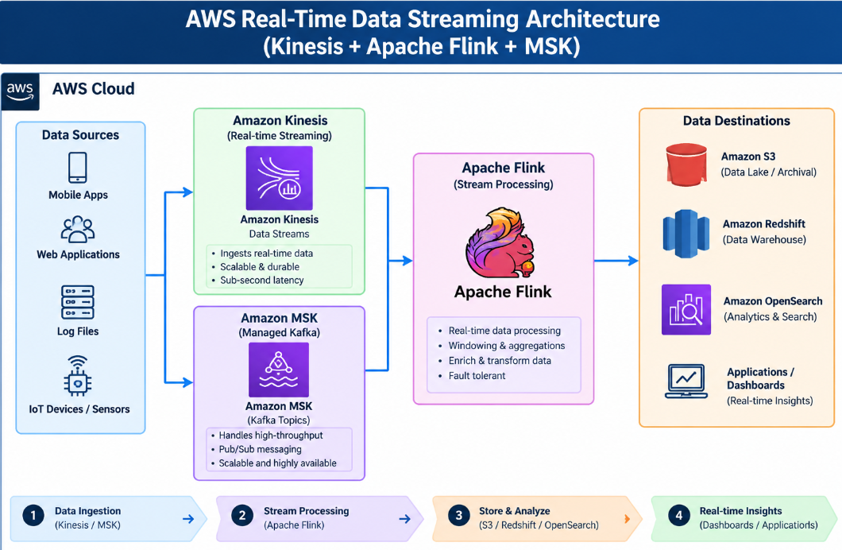
Amazon Managed Streaming, Apache Flink & Amazon MSK
Main Course Topics Covered
Amazon Managed Service for Apache Flink
Apache Flink Hands-On
Kinesis Analytics
Amazon MSK
MSK Connect
MSK Serverless
Kinesis vs. MSK
This presentation introduces AWS streaming technologies used for processing and analyzing real-time data. It covers Amazon Managed Service for Apache Flink and Amazon MSK, including MSK Connect, MSK Serverless, and the differences between Amazon Kinesis and Amazon MSK.

Slide 3
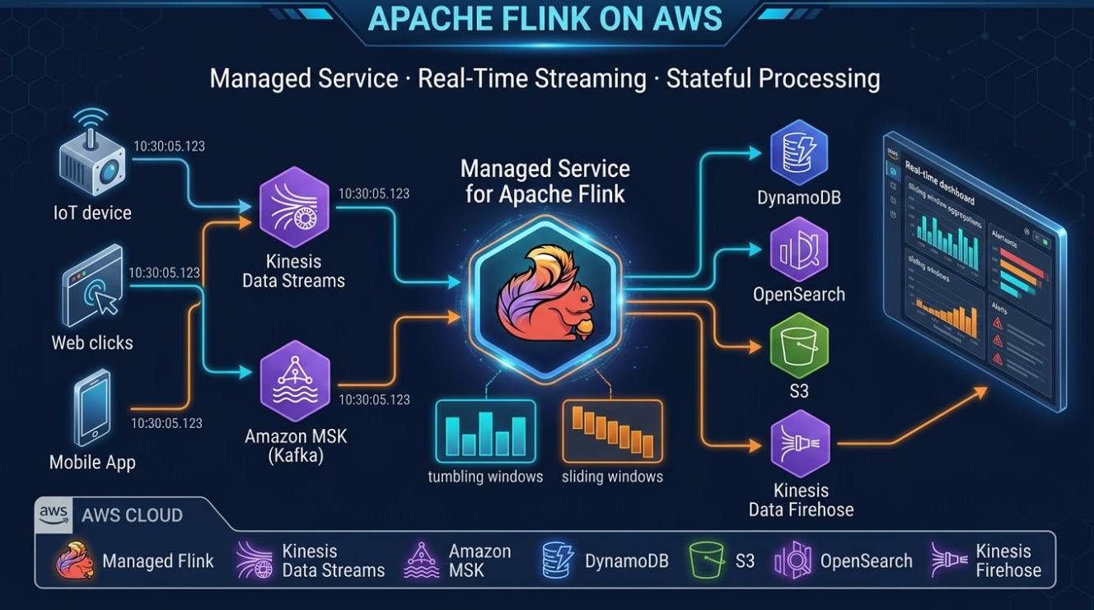
Amazon Managed Service for Apache Flink
Main Features
Managed Apache Flink service
Real-time data processing
Stream analytics
Continuous data processing
AWS managed infrastructure
Description
Amazon Managed Service for Apache Flink allows applications to process and analyze streaming data in real time using Apache Flink. The managed service helps developers work with streaming applications without managing the underlying infrastructure themselves.

Slide 4
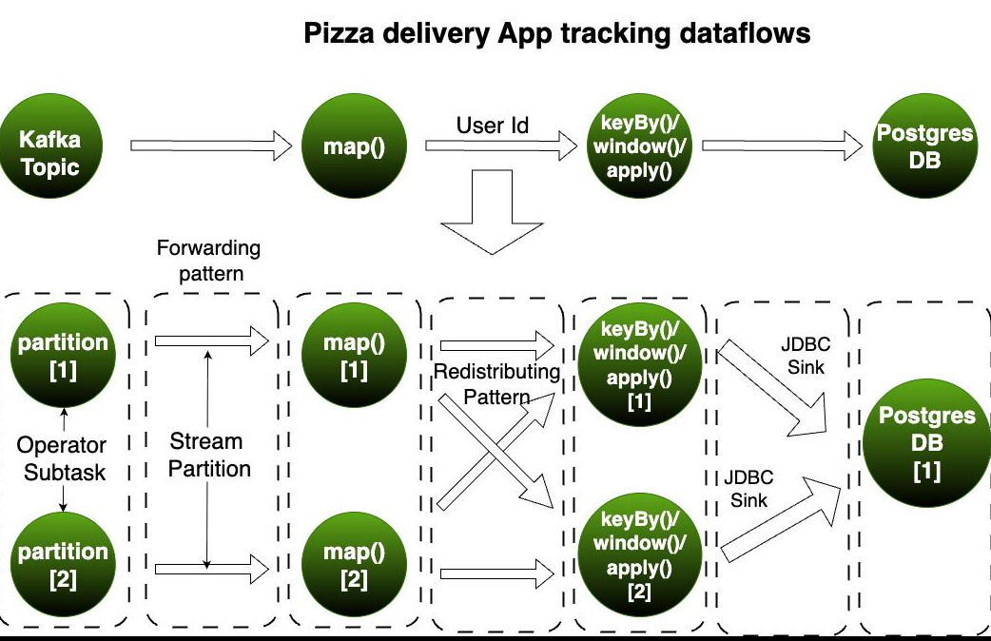
Apache Flink for Stream Processing
Core Components
Real-time processing
Streaming analytics
Continuous computation
Event processing
Data streams
Description
Apache Flink is a stream-processing technology designed to process continuously generated data. It can analyze incoming events and perform computations as data is received, making it useful for real-time analytics applications.

Slide 5
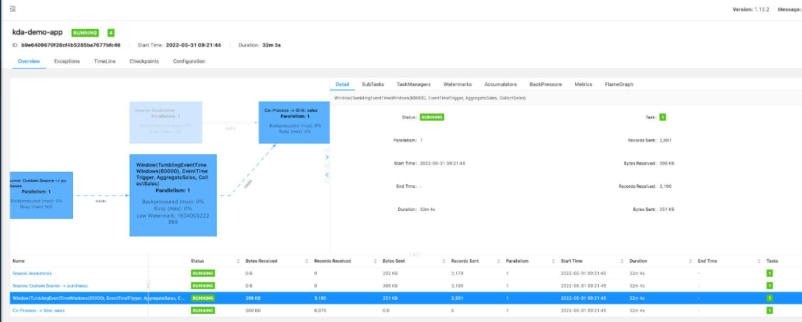
Managed Service for Apache Flink – Hands-On
Important Features
Hands-on experience
Streaming application
Real-time processing
Flink configuration
Data analysis
Description
The hands-on lesson provides practical experience with Amazon Managed Service for Apache Flink. It demonstrates how streaming data can be processed and analyzed using a managed AWS environment.

Slide 6
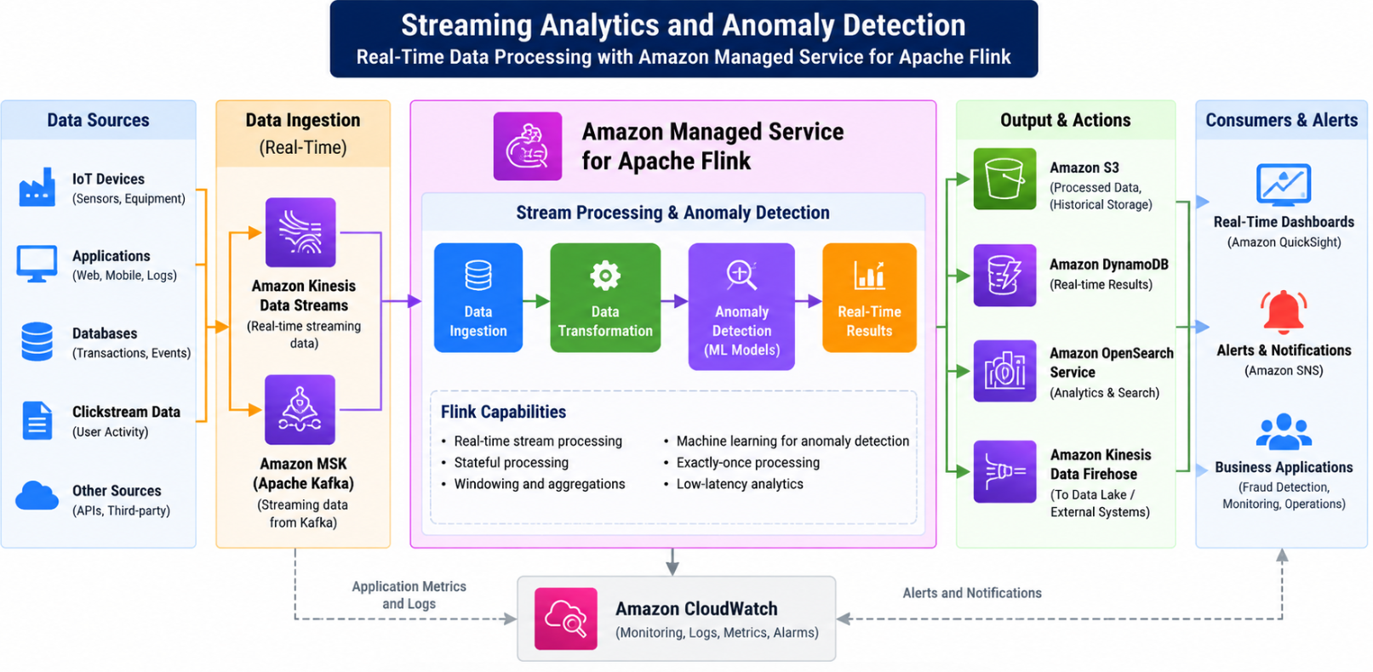
Kinesis Analytics Costs and RANDOM_CUT_FOREST
AWS AI Services
Kinesis Analytics costs
Streaming analytics
RANDOM_CUT_FOREST
Real-time analysis
Anomaly detection concept
Description
This topic introduces considerations related to Kinesis Analytics costs and the RANDOM_CUT_FOREST algorithm. RANDOM_CUT_FOREST can be used for analyzing streaming data and identifying unusual patterns within data streams.

Slide 7
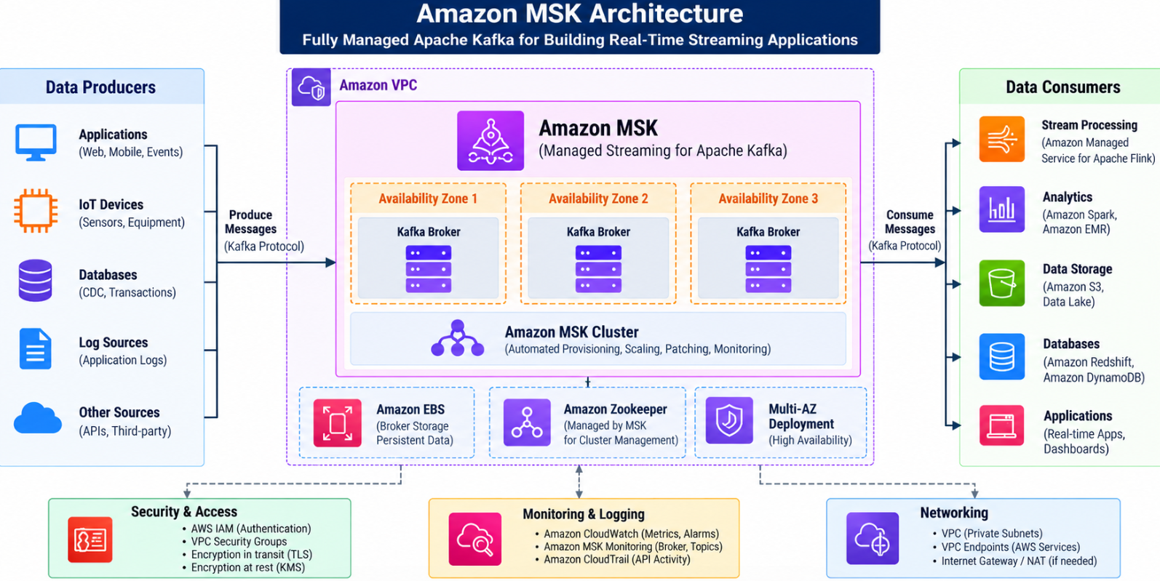
Amazon MSK
Learning Activities
Amazon Managed Streaming for Apache Kafka
Apache Kafka
Real-time data
Event streaming
Managed Kafka infrastructure
Description
Amazon MSK, or Amazon Managed Streaming for Apache Kafka, provides a managed environment for running Apache Kafka. It can be used to build applications that collect, process, and transmit real-time streaming data.

Slide 8
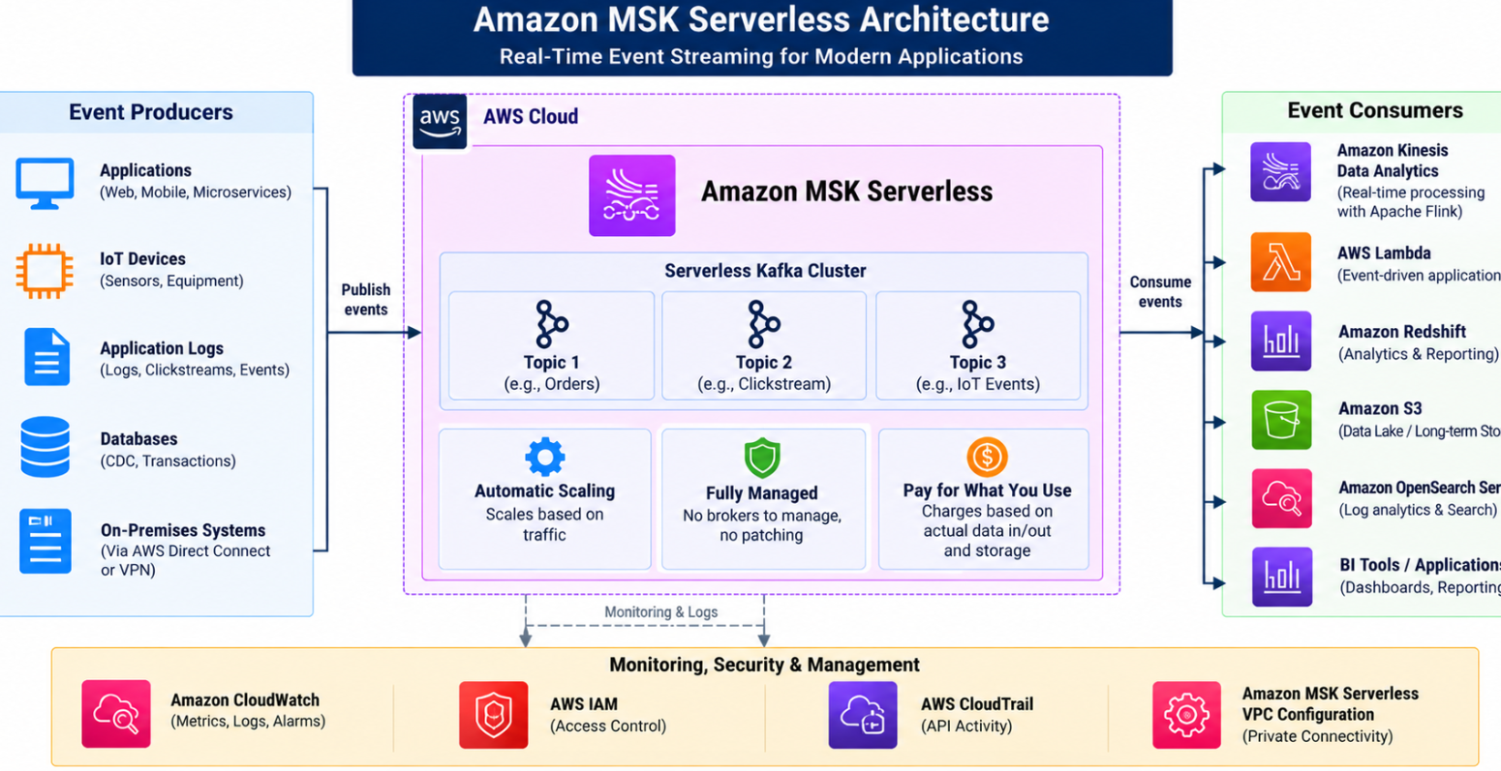
Amazon MSK – Serverless
Main Features
MSK Serverless
Serverless Kafka
Automatic resource management
Streaming applications
Scalable infrastructure
Description
Amazon MSK Serverless provides a serverless approach to Apache Kafka. It allows applications to use Kafka without requiring users to manage Kafka cluster capacity directly.

