Slide 1
Feature Engineering, Data Preparation & Data Quality
Presented by : Praveen
Faculty Advisor : Dr. Victor Govindaswamy

Slide 2
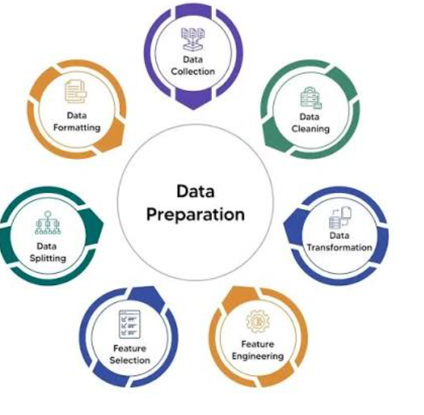
Feature Engineering, Data Preparation & Data Quality
Security Services
Feature engineering
TF-IDF
Spark
EMR Studio
Missing data
Unbalanced data
Description
This presentation focuses on preparing datasets for machine learning. It covers practical data preparation using Spark and EMR Studio, TF-IDF preparation, missing data, and unbalanced data.

Slide 3

Feature Engineering
Main Features
Feature creation
Data preparation
Machine learning
Feature transformation
Model inputs
Description
Feature engineering prepares useful information from raw datasets so that it can be used by machine learning algorithms. It is an important step between raw data and model development.

Slide 4
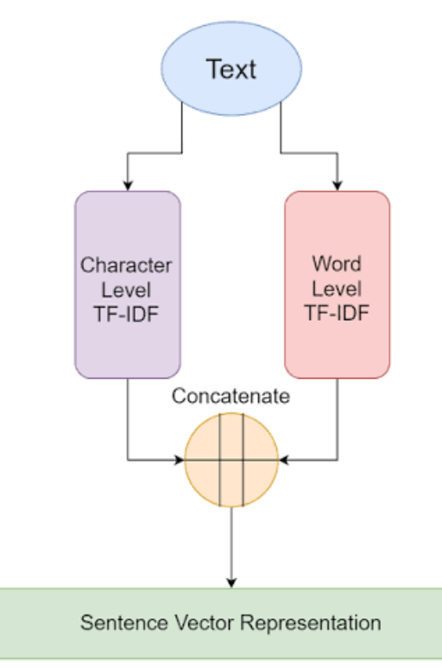
Curse of Dimensionality
Main Features
Many features
High dimensionality
Computational complexity
Feature selection
Data representation
Description
The curse of dimensionality describes challenges associated with datasets containing many features. Increasing the number of dimensions can make data processing and machine learning more difficult.

Slide 5
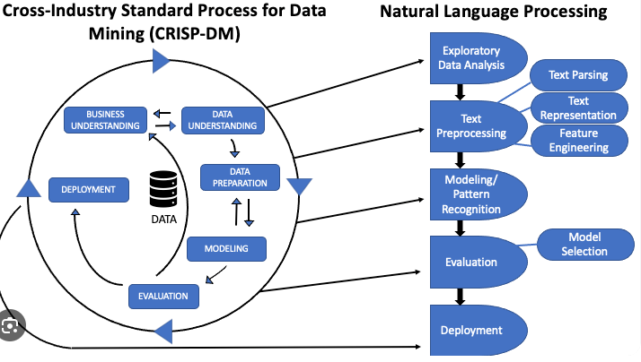
Preparing Data for TF-IDF
Main Features
TF-IDF
Text data
Feature extraction
Spark
EMR Studio
Description
TF-IDF is a technique used to represent text data numerically. The course includes practical labs for preparing data for TF-IDF using Spark and EMR Studio.

Slide 6
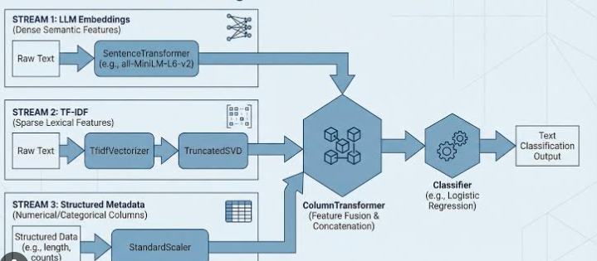
TF-IDF with Spark
Main Features
Text processing
Spark
TF-IDF
Feature vectors
Distributed processing
Description
Spark can be used to process large amounts of text data and prepare features using techniques such as TF-IDF. This allows textual information to be transformed into numerical representations for machine learning workflows.

Slide 7
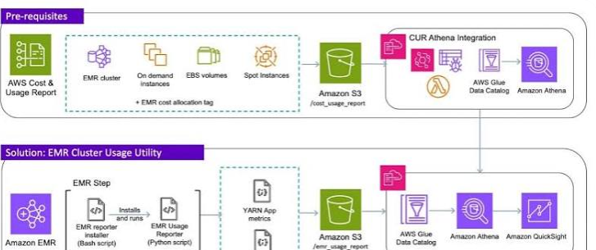
Lab – Preparing Data for TF-IDF Part 1
Main Features
Data preparation
Spark
EMR Studio
Text data
TF-IDF preparation
Description
The first hands-on lab focuses on preparing data for TF-IDF using Spark and EMR Studio. It provides practical experience with the initial stages of text-data preparation.

Slide 8
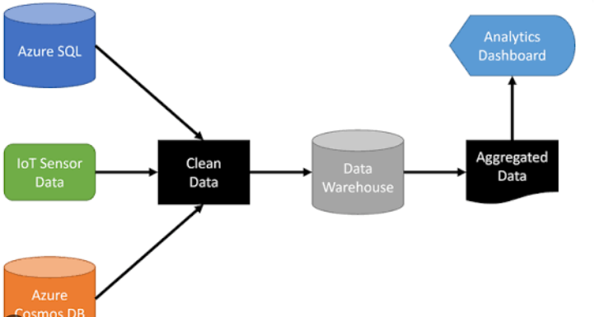
Lab – Preparing Data for TF-IDF Part 2
Main Features
Continued data preparation
Spark
EMR Studio
TF-IDF
Feature generation
Description
The second lab continues the process of preparing data for TF-IDF. It provides additional practical experience with processing text data and preparing features using Spark and EMR Studio.

Slide 9
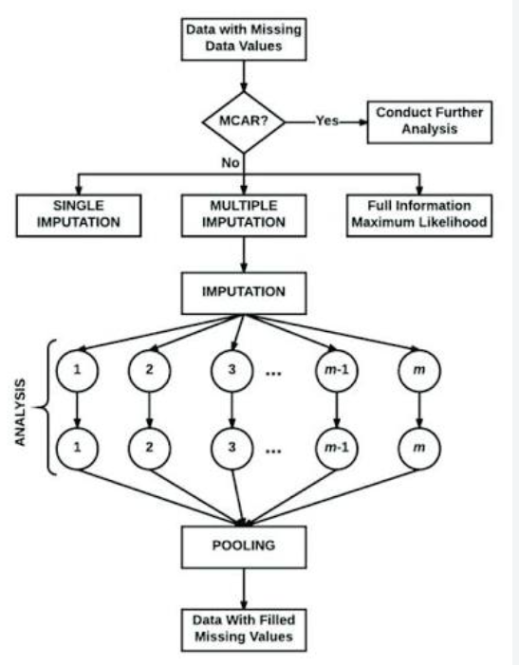
Imputing Missing Data
Main Features
Missing values
Data cleaning
Imputation
Dataset quality
Data preparation
Description
Missing data is a common issue in datasets. Imputation is a data-preparation technique used to handle missing values so that datasets can be processed more effectively.

