Slide 1
Data Transformation, EMR, Hadoop & Apache Spark
Presented by : Praveen
Faculty Advisor : Dr. Victor Govindaswamy

Slide 2
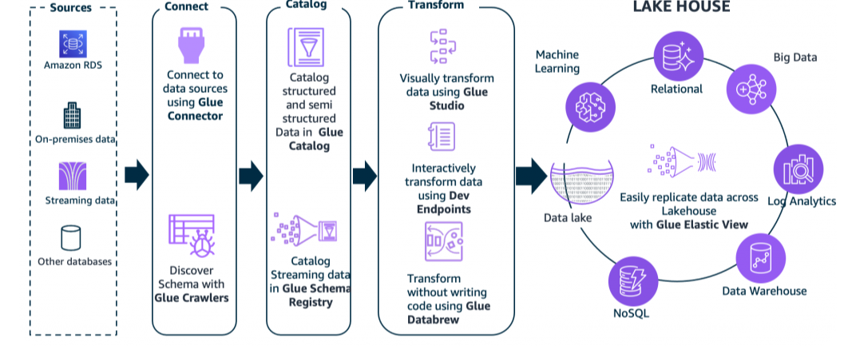
Data Transformation, EMR, Hadoop & Apache Spark
Key Functions
Data transformation
Data integrity
Feature engineering
Amazon EMR
Hadoop
EMR Serverless
Apache Spark
Description
This presentation focuses on transforming and processing data using AWS services and distributed data-processing technologies. It covers Amazon EMR, Hadoop, EMR Serverless, and Apache Spark.

Slide 3
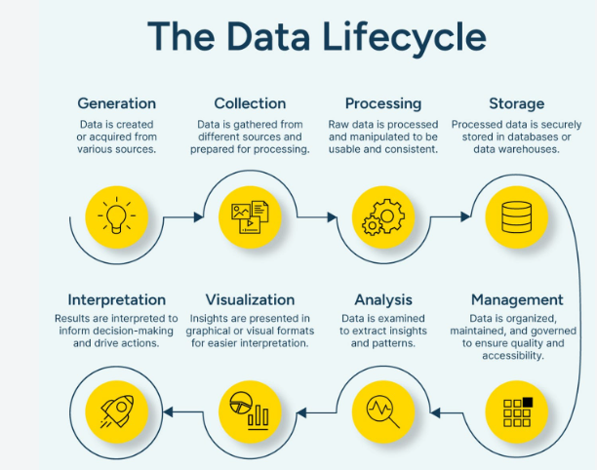
Introduction to Data Transformation
Main Features
Data transformation
Raw data
Structured data
Data processing
Preparing data for analysis
Description
Data transformation involves converting raw data into a format that can be used effectively for analysis and machine learning. Transformation is an important part of preparing data for downstream processing.

Slide 4
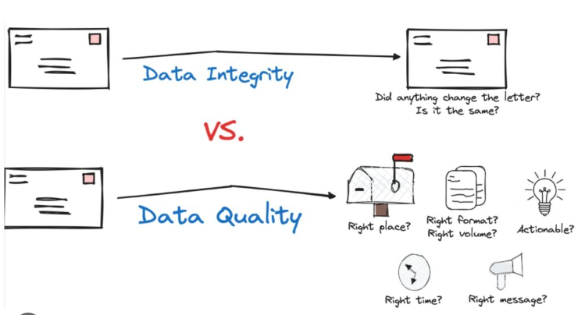
Data Integrity
Main Features
Data quality
Consistency
Accuracy
Reliable datasets
Data validation
Description
Data integrity focuses on maintaining reliable and consistent data throughout the data-processing workflow. Ensuring data integrity is important because incorrect or inconsistent data can affect analysis and machine learning results.

Slide 5
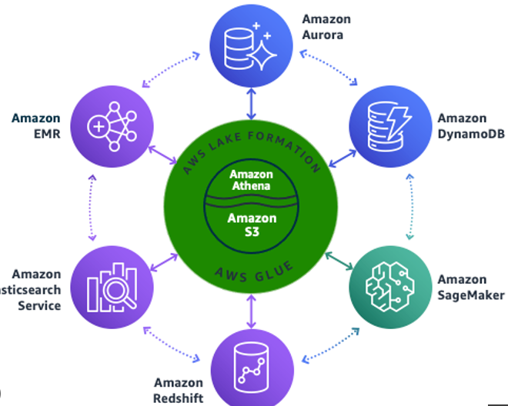
Amazon EMR
Main Features
Amazon EMR
Big data processing
Distributed computing
Hadoop ecosystem
Large-scale datasets
Description
Amazon EMR is an AWS service for processing large amounts of data using distributed data-processing frameworks. It supports technologies such as Hadoop and Apache Spark.

Slide 6
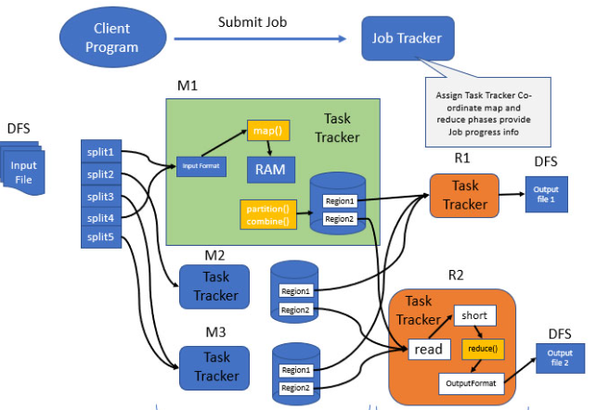
Elastic MapReduce and Hadoop Overview
Main Features
Elastic MapReduce
Hadoop
Distributed processing
MapReduce
Big data
Description
Elastic MapReduce, commonly known as EMR, provides a managed environment for big-data processing. Hadoop is a distributed processing ecosystem designed to work with large datasets across multiple computing resources.

Slide 7
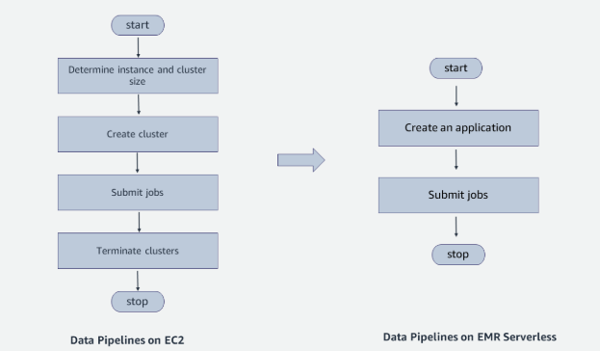
EMR Serverless
Main Features
Serverless data processing
Amazon EMR
Automatic resource management
Data-processing applications
Scalability
Description
EMR Serverless provides a way to run data-processing applications without managing clusters manually. It can automatically provide the resources required for processing workloads.

Slide 8
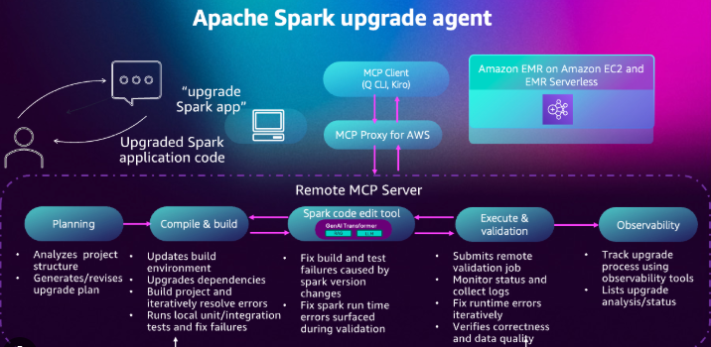
Apache Spark on EMR
Main Features
Apache Spark
Distributed processing
Data transformation
Analytics
Amazon EMR
Description
Apache Spark is a distributed data-processing framework that can be used with Amazon EMR. Spark can process large datasets and support data transformation, analytics, and machine learning workflows.

Slide 9
Spark Data Processing Workflow
Main Features
Input data
Spark processing
Transformation
Analysis
Output data
Description
A Spark workflow can receive input data, perform transformations and computations, and produce processed output. This workflow allows large datasets to be processed using distributed computing.

Slide 10
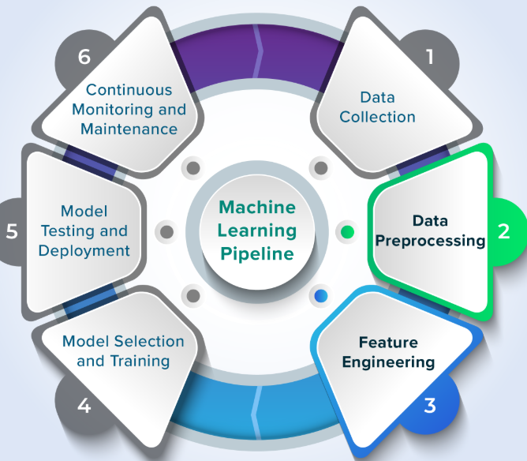
Feature Engineering
Main Features
Feature engineering
Machine learning data
Feature creation
Data preparation
Model inputs
Description
Feature engineering involves preparing and creating useful features from existing data. These features can be used as inputs for machine learning models and can influence the quality of model training.

