Slide 1
STACK
Presented by : NagaJayaMadhuPraveen
Faculty Advisor : Dr. Victor Govindaswamy

Slide 2
Stack – Introduction
Main Points
A stack is a linear data structure used to store a collection of items.
A stack follows the LIFO principle.
LIFO = Last In, First Out
The item added most recently is the first item removed.
We can think of a stack like a stack of plates.
We can add and remove plates only from the top.
TOP
↓
┌───────────┐
│ Plate 3│ ← Last added
├───────────┤
│ Plate 2 │
├───────────┤
│ Plate 1 │
└───────────┘
↑
BOTTOM
Key Idea
Last plate added → First plate removed
Example:
If we add 10 → 20 → 30, then 30 will be removed first.

Slide 3
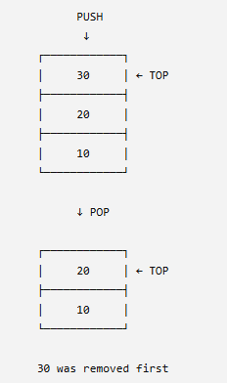
STACK OPERATIONS
Main Stack Operations
1. push()
Adds a new element to the top of the stack.
2. pop()
Removes the element from the top of the stack.
3. peek() / top()
Looks at the top element without removing it.
4. isEmpty()
Checks whether the stack contains no elements.
5. isFull()
Checks whether the stack has reached its maximum capacity.
6. displayAll()
Displays all elements currently stored in the stack.
Important Point
All insertion and deletion happens at the TOP of the stack.

Slide 4
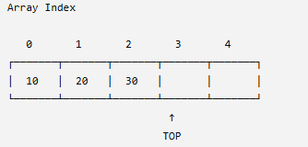
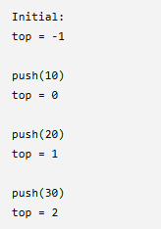

STACK USING A STATIC ARRAY
Array-Based Stack
A stack can be implemented using a static array.
For example, if the maximum size is 5:
How it works
The array has a fixed size.
A variable such as top keeps track of the top element.
When we perform push(), top moves upward.
When we perform pop(), top moves downward.
Initially, top = -1, meaning the stack is empty.
Example: The Stack becomes

Slide 5
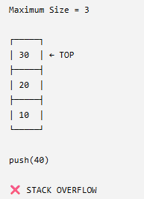
OVERFLOW, UNDERFLOW & LIMITATIONS
Stack Overflow
Overflow happens when we try to push() an element into a stack that is already full.

Slide 6
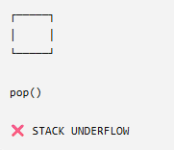
OVERFLOW, UNDERFLOW & LIMITATIONS
Stack Underflow
Underflow happens when we try to pop() from an empty stack.
Advantages
Simple to implement.
Fast push() and pop() operations.
Easy to understand.
Array access is efficient.
Limitations
A static array has a fixed capacity.
Extra space may be unused.
Stack overflow can occur when the array is full.

Slide 7
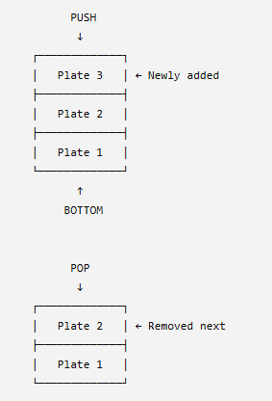
REAL-LIFE EXAMPLE: STACK OF PLATES
Stack of Plates
A stack of plates is an easy real-life example of a stack.
Why is it LIFO?
When a new plate is placed on top, it blocks the plates underneath it.
Therefore:
Plate 3 was added last → Plate 3 is removed first.
This is exactly how a computer stack works.

