Slide 1
Amazon Bedrock Playground, Converse API & Model Fine-Tuning
Presented by : NagaJayaMadhuPraveen
Faculty Advisor : Dr. Victor Govindaswamy

Slide 2
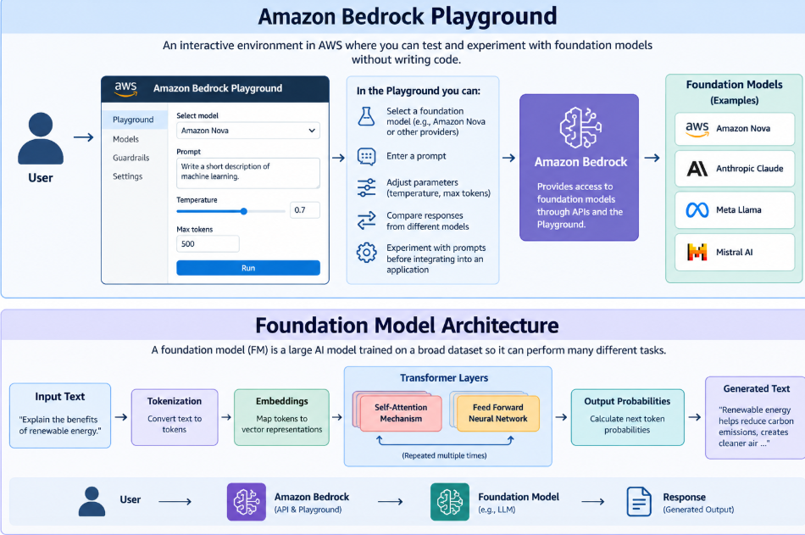
Amazon Bedrock Playground, Converse API & Model Fine-Tuning
Main Course Topics Covered
Amazon Bedrock
Bedrock Playground
Converse API
Foundation Models
Model Fine-Tuning
This presentation explores Amazon Bedrock tools and capabilities for experimenting with Generative AI models. It covers the Bedrock Playground, Converse API, foundation model fine-tuning, and Low-Rank Adaptation (LoRA) for customizing AI models.

Slide 3
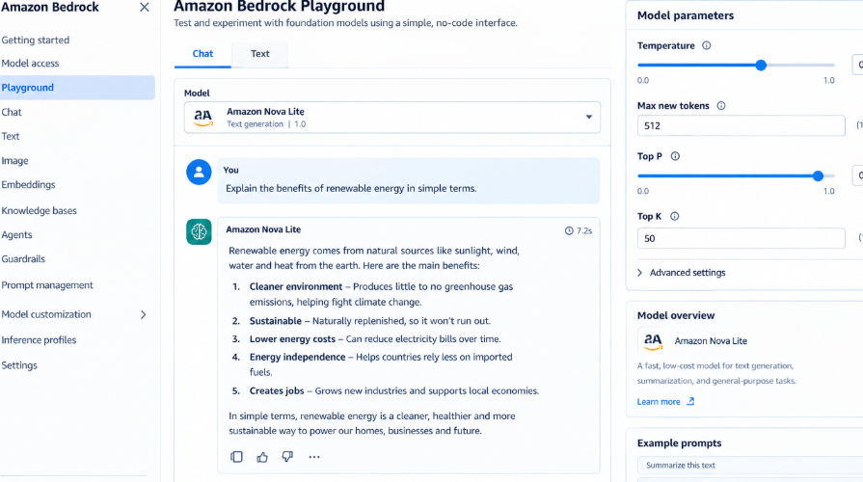
Hands-On with the Bedrock Playground
Main Features
Model Experimentation
Prompt Testing
AI Responses
Generative AI
Description
The Amazon Bedrock Playground provides an interactive environment for experimenting with foundation models. Users can enter prompts, test model responses, and explore Generative AI capabilities before integrating models into applications.

Slide 4
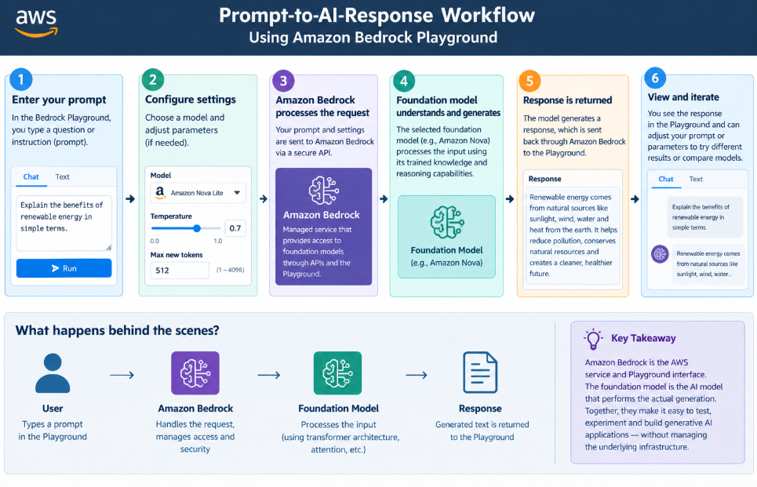
Prompt Experimentation in Amazon Bedrock
Core Components
Prompt Engineering
Model Testing
Response Evaluation
AI Experimentation
Description
Prompt experimentation helps developers understand how foundation models respond to different instructions. Testing different prompts provides practical experience with model behavior and response quality.

Slide 5
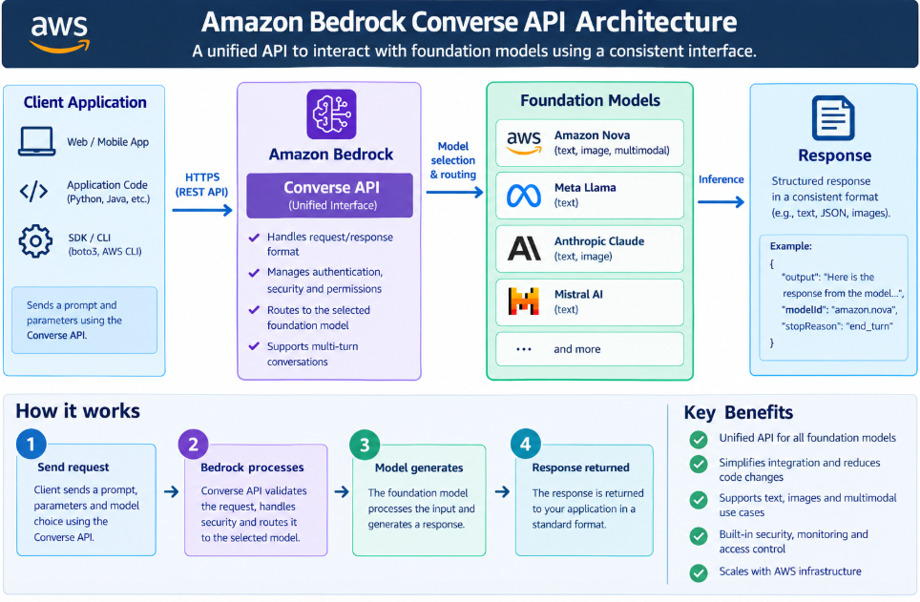
Amazon Bedrock Converse API
Important Features
Conversational AI
API Integration
Foundation Models
Application Development
Description
The Amazon Bedrock Converse API provides a consistent interface for interacting with supported foundation models. It can be used to build conversational AI applications while simplifying communication with different models.

Slide 6
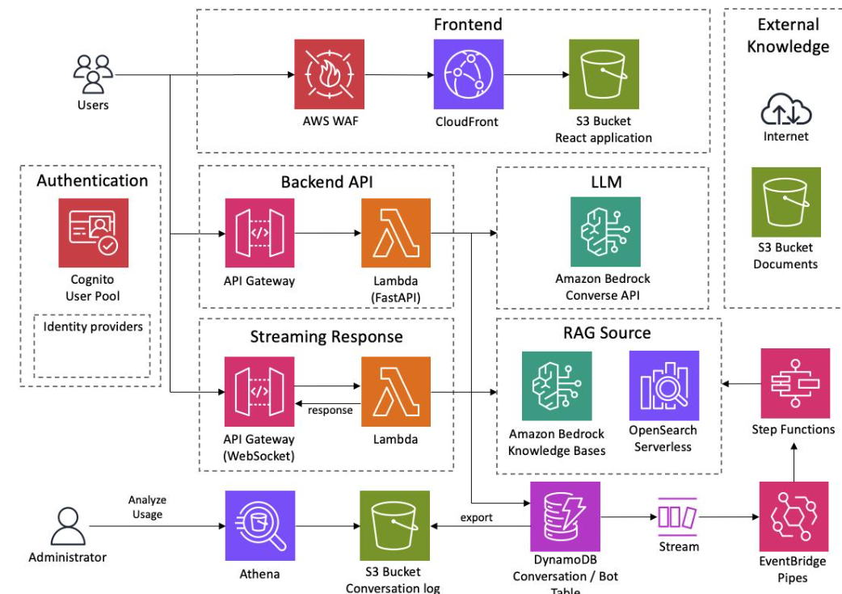
Benefits of the Converse API
AWS AI Services
Consistent Interface
Multi-Model Support
Conversational Applications
API-Based Access
Description
The Converse API helps developers interact with supported foundation models through a common interface. This simplifies application development and supports conversational AI use cases.

Slide 7
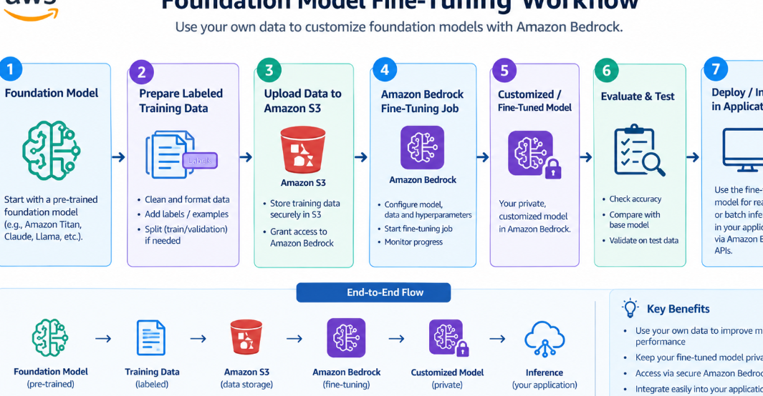
Foundation Model Fine-Tuning
Learning Activities
Model Customization
Training Data
Domain Knowledge
Improved Responses
Description
Fine-tuning allows a foundation model to be adapted using additional training data for specific requirements. It can help customize model behavior for particular domains, tasks, and application needs.

Slide 8
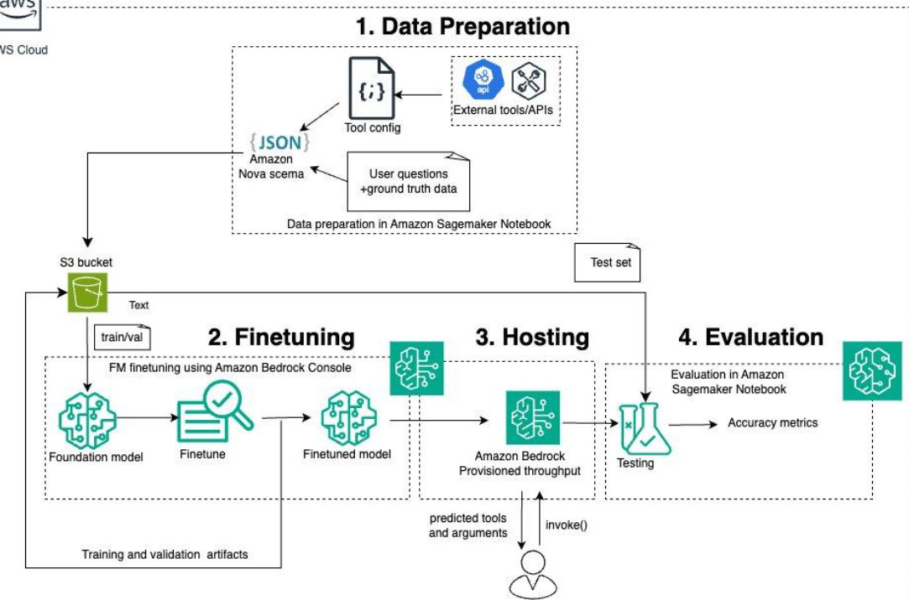
Fine-Tuning Process
Main Features
Prepare Training Data
Select Foundation Model
Fine-Tune Model
Evaluate Results
Description
The fine-tuning process involves preparing suitable training data, selecting a foundation model, performing additional training, and evaluating the resulting model for the intended application.

