Slide 1
OpenSearch, Chunking Strategies & Vector Store Optimization
Presented by : Praveen
Faculty Advisor : Dr. Victor Govindaswamy

Slide 2
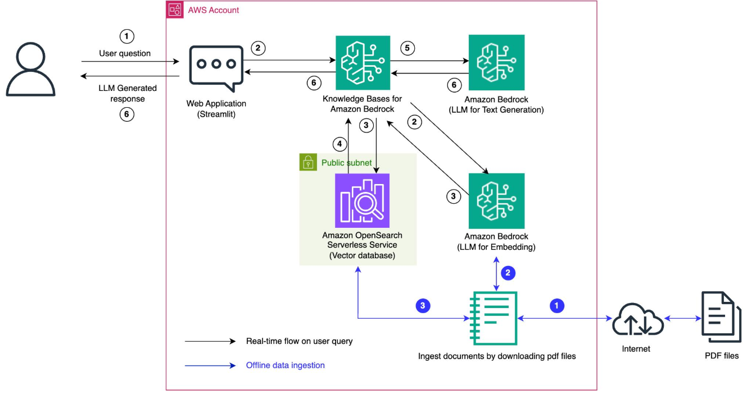
OpenSearch, Chunking Strategies & Vector Store Optimization
Security Services
Amazon OpenSearch
Chunking Strategies
Vector Stores
Embeddings
RAG Optimization
Description
This presentation focuses on important optimization techniques for RAG and Knowledge Base applications. It covers Amazon OpenSearch, pre-retrieval processing, chunking strategies, chunk management, vector store optimization, and embeddings.

Slide 3
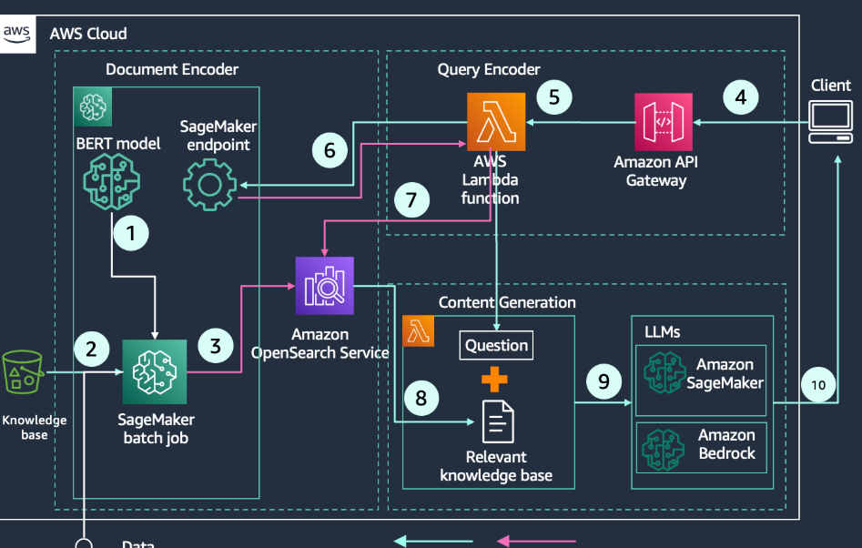
Amazon OpenSearch in Generative AI
Main Features
Search Engine
Vector Search
Data Retrieval
RAG Applications
Description
Amazon OpenSearch can support search and retrieval workloads in Generative AI applications. Vector search capabilities can help retrieve information based on semantic similarity for RAG-based solutions.

Slide 4
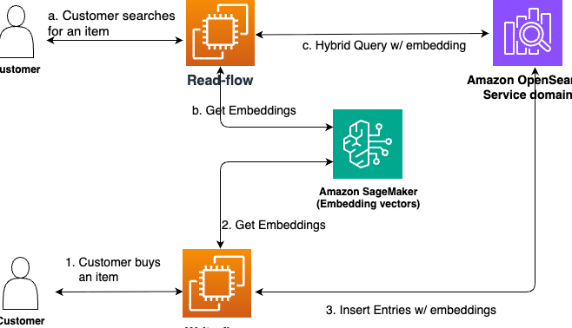
Importance of OpenSearch
Main Features
Fast Search
Vector Retrieval
Scalable Storage
Knowledge Retrieval
Description
OpenSearch can provide scalable search and retrieval capabilities for applications that need to work with large amounts of information. It can be integrated into architectures that use embeddings and semantic search.

Slide 5
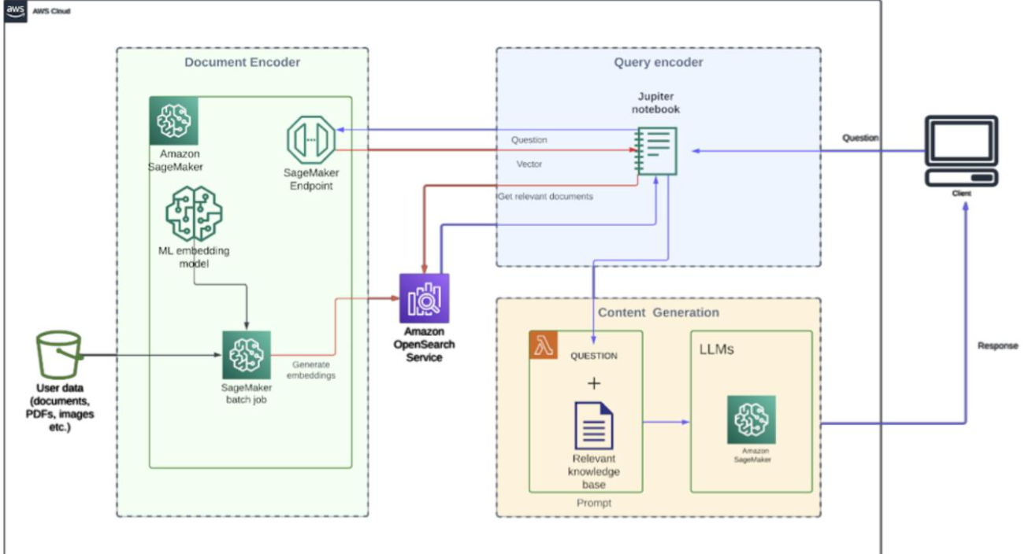
Pre-Retrieval Strategies
Main Features
Query Preparation
Data Preparation
Search Optimization
Retrieval Quality
Description
Pre-retrieval strategies prepare information before the retrieval process. Proper preparation of queries and stored content can improve the relevance of information returned to Generative AI applications.

Slide 6
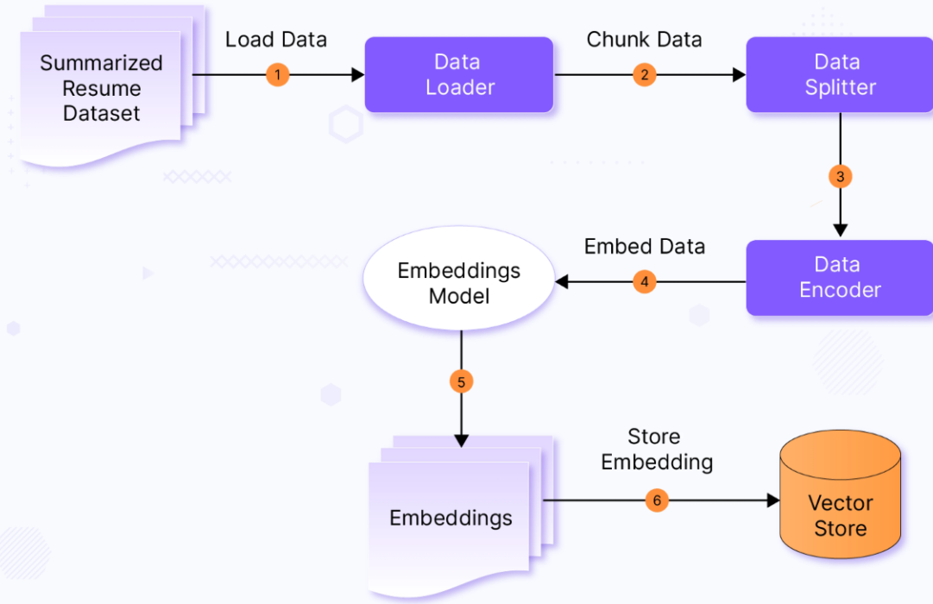
Chunking Strategies
Main Features
Document Splitting
Smaller Text Sections
Context Preservation
Retrieval Efficiency
Description
Chunking divides large documents into smaller sections that can be processed and retrieved efficiently. Choosing an appropriate chunking strategy helps maintain useful context while improving retrieval performance.

Slide 7
Types of Chunking Approaches
Main Features
Fixed-Size Chunks
Semantic Chunks
Overlapping Chunks
Context Preservation
Description
Different chunking approaches can be used depending on the structure and purpose of the source documents. The goal is to create useful information segments while preserving enough context for accurate retrieval.

Slide 8
Managing Chunking Strategies with Bedrock
Main Features
Bedrock Knowledge Bases
Data Processing
Chunk Configuration
Retrieval Quality
Description
Amazon Bedrock Knowledge Bases provide options for managing how source information is processed and divided for retrieval. Proper chunking configuration can help improve the quality and relevance of retrieved information.

Slide 9
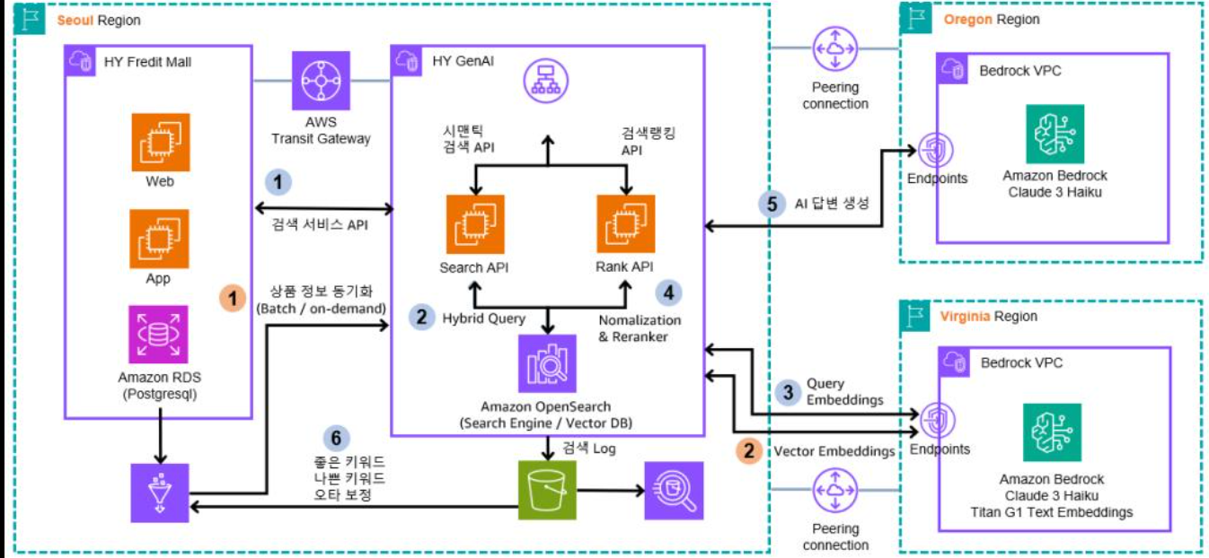
Optimizing Vector Stores
Main Features
Vector Storage
Search Performance
Index Optimization
Retrieval Efficiency
Description
Optimizing a vector store involves considering how embeddings are stored, indexed, and retrieved. Efficient vector storage and search can improve the performance of applications that depend on semantic retrieval.

