Slide 1
Retrieval-Augmented Generation, Vector Stores & Knowledge Bases
Presented by : NagaJayaMadhuPraveen
Faculty Advisor : Dr. Victor Govindaswamy

Slide 2
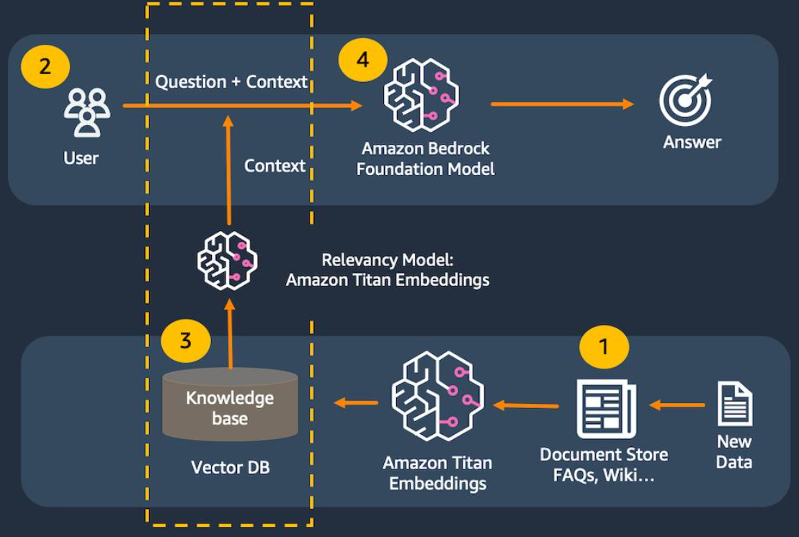
Retrieval-Augmented Generation, Vector Stores & Knowledge Bases
Key Functions
Retrieval-Augmented Generation
Vector Stores
Semantic Search
Amazon Bedrock Knowledge Bases
Generative AI
Description
This presentation explores Retrieval-Augmented Generation (RAG), vector stores, semantic search, and Amazon Bedrock Knowledge Bases. These technologies help Generative AI applications retrieve relevant information and generate responses based on external knowledge.

Slide 3
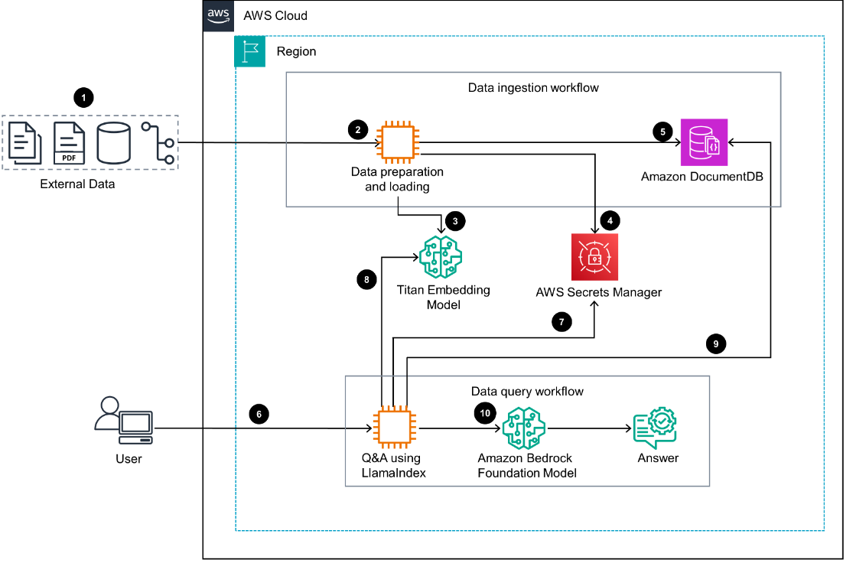
Introduction to Retrieval-Augmented Generation
Main Features
RAG
Knowledge Retrieval
Foundation Models
Contextual Responses
Description
Retrieval-Augmented Generation combines information retrieval with Generative AI. Relevant information is retrieved from a knowledge source and provided to the model as context for generating responses.

Slide 4
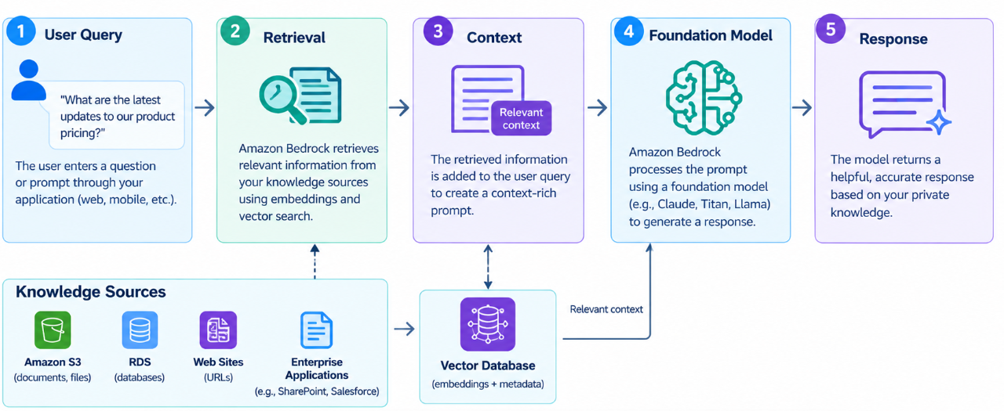
How RAG Works
Main Features
User Query
Information Retrieval
Context
AI Response
Description
A RAG system receives a user query, searches a connected knowledge source for relevant information, provides the retrieved content to the foundation model, and generates a response using that context.

Slide 5
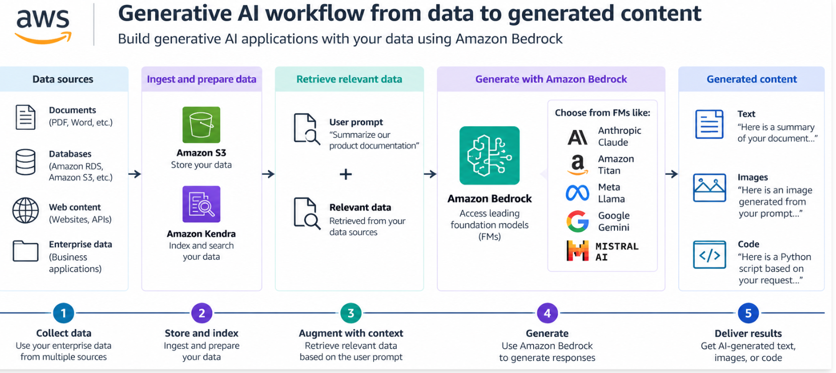
Benefits of RAG
Main Features
External Knowledge
Relevant Responses
Updated Information
Reduced Hallucination Risk
Description
RAG allows applications to use information stored outside the foundation model. Retrieving relevant context can help applications provide responses that are grounded in the available knowledge source.

Slide 6
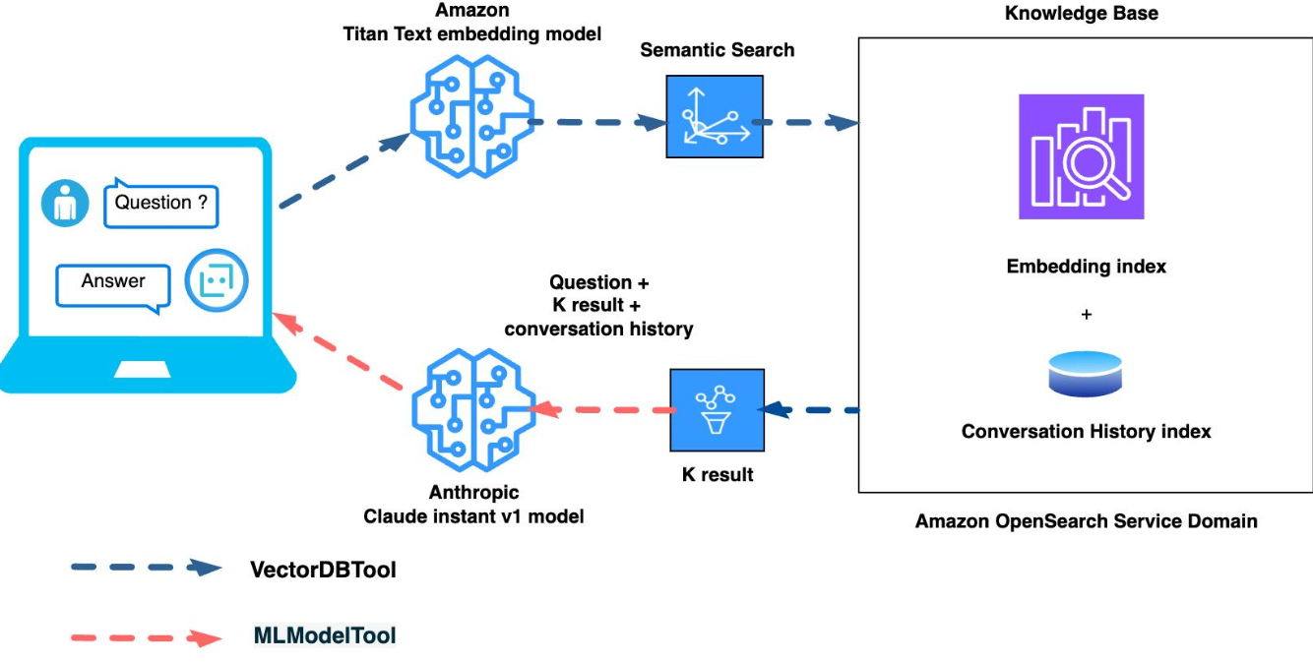
Vector Stores
Main Features
Vector Embeddings
Data Representation
Similarity Search
Information Retrieval
Description
Vector stores are used to store numerical representations called embeddings. These representations allow systems to search for information based on semantic similarity rather than relying only on exact keyword matches.

Slide 7
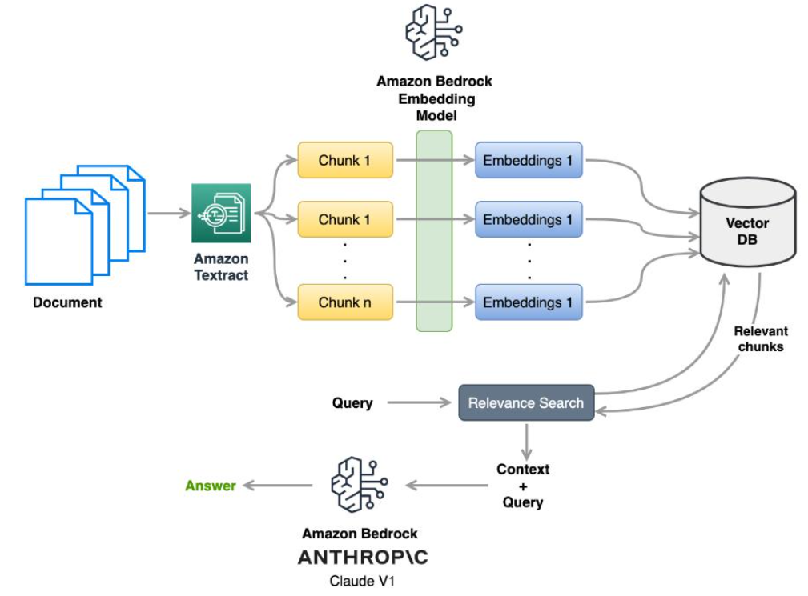
Semantic Search
Main Features
Search by Meaning
Embeddings
Similarity
Relevant Results
Description
Semantic search uses embeddings to identify information that is conceptually related to a user's query. This allows search systems to retrieve relevant content even when the exact words in the query and documents are different.

Slide 8
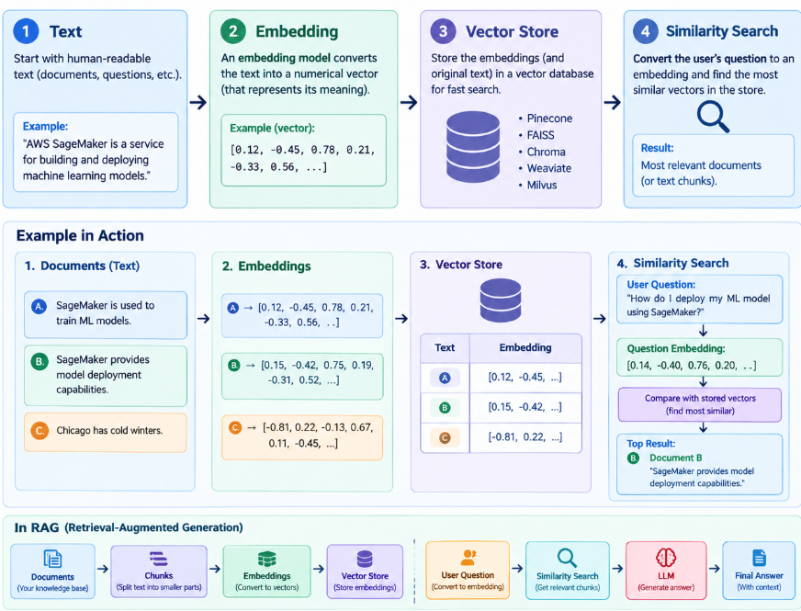
Embeddings in RAG
Main Features
Text Embeddings
Numerical Vectors
Similarity Matching
Information Retrieval
Description
Embeddings convert text and other information into numerical vector representations. RAG systems use these vectors to compare queries with stored information and retrieve relevant content.

Slide 9
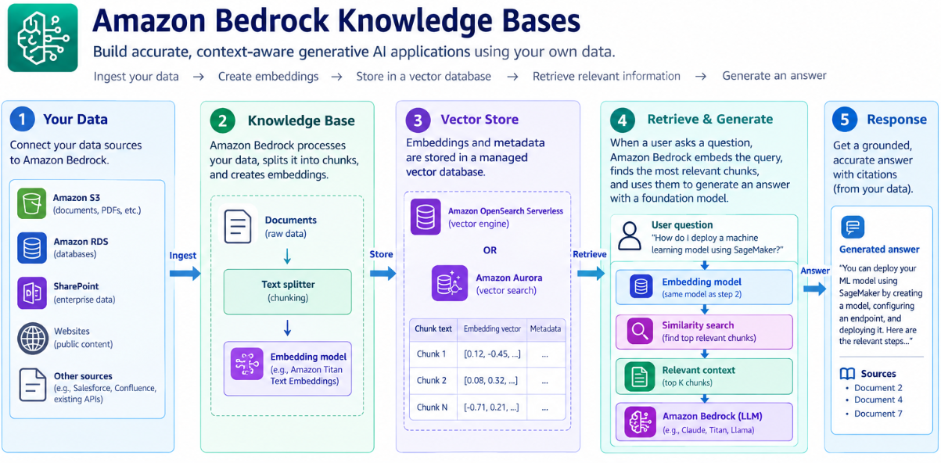
Amazon Bedrock Knowledge Bases
Main Features
Knowledge Sources
Data Retrieval
Foundation Models
RAG Applications
Description
Amazon Bedrock Knowledge Bases help developers connect Generative AI applications with organizational information. They support retrieval of relevant information that can be used to provide context to foundation models.

Slide 10
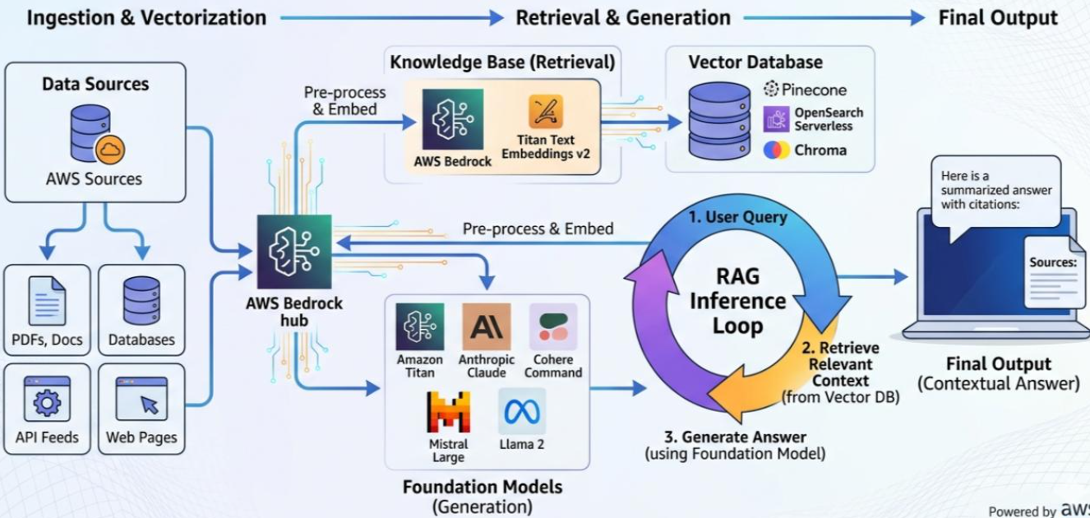
Knowledge Base Workflow
Main Features
Data Sources
Data Processing
Vector Embeddings
Retrieval
Description
A Knowledge Base workflow involves connecting data sources, processing information, creating embeddings, storing vectors, and retrieving relevant content when users submit questions or requests.

